Slide 1


Can Social Media Data Predict Winery Sales?

Slide 2
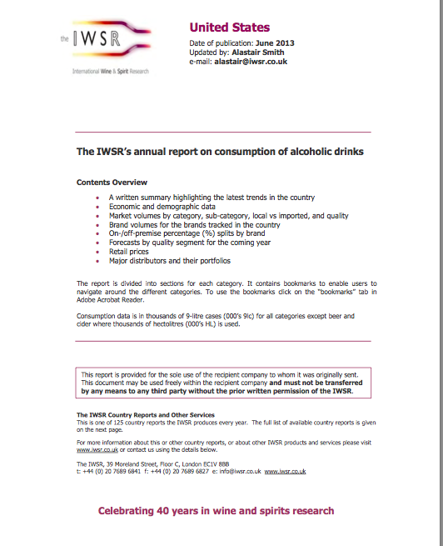

Slide 3
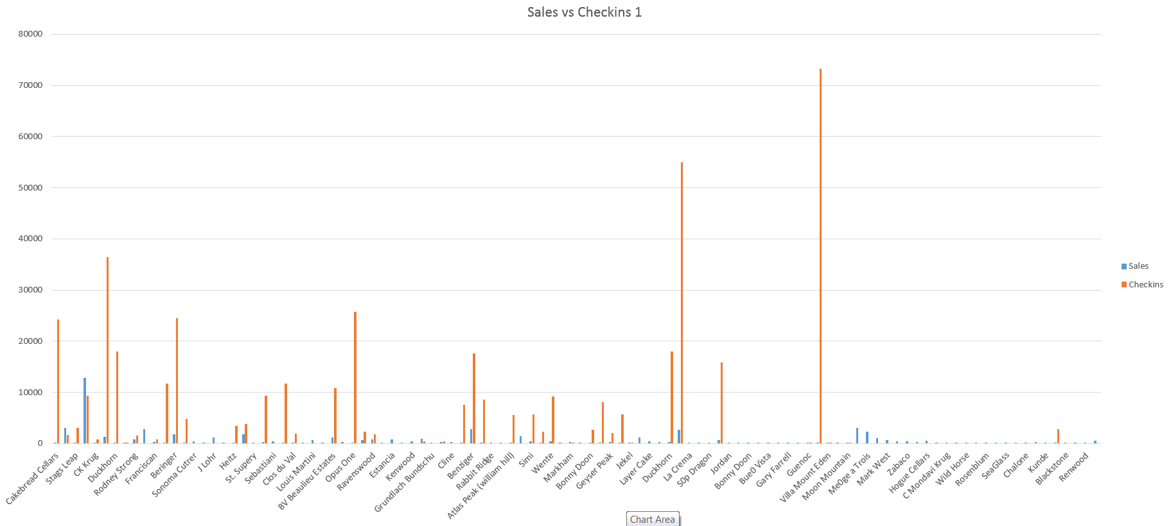
Sales vs. Facebook Checkins - Part 1

Slide 4
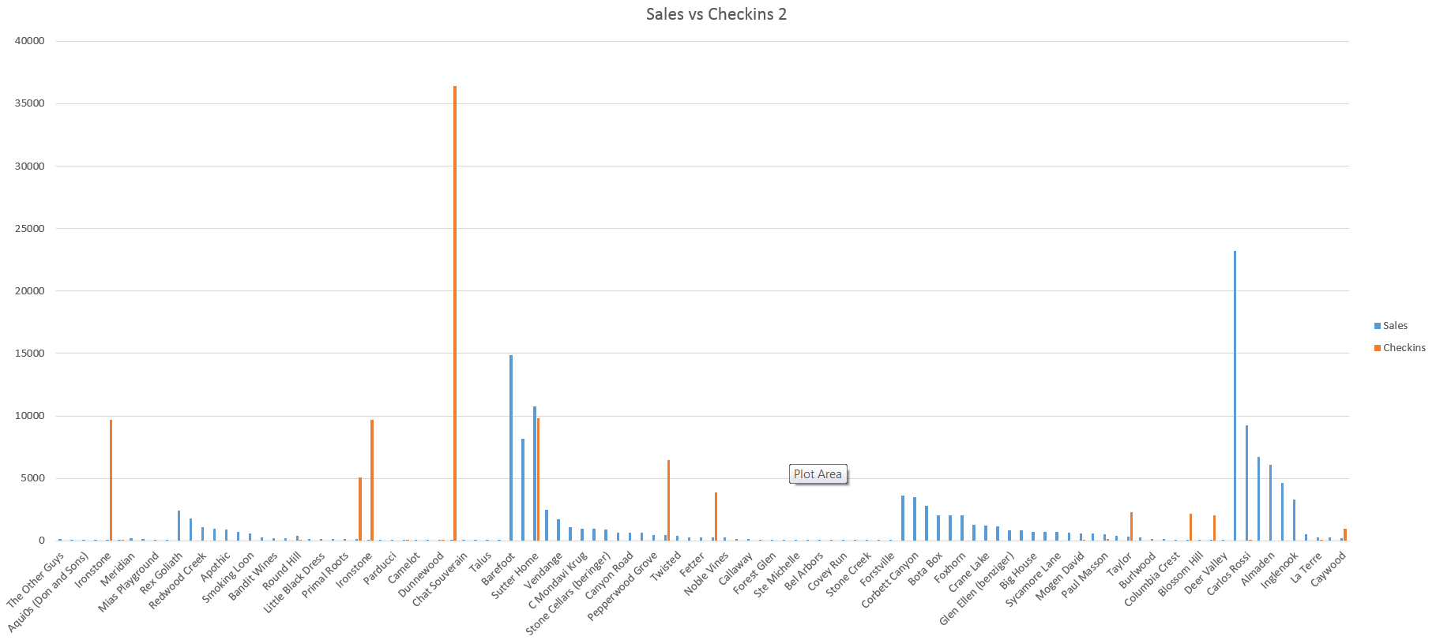
Sales Vs. Facebook Checkins - Part 2

Slide 5
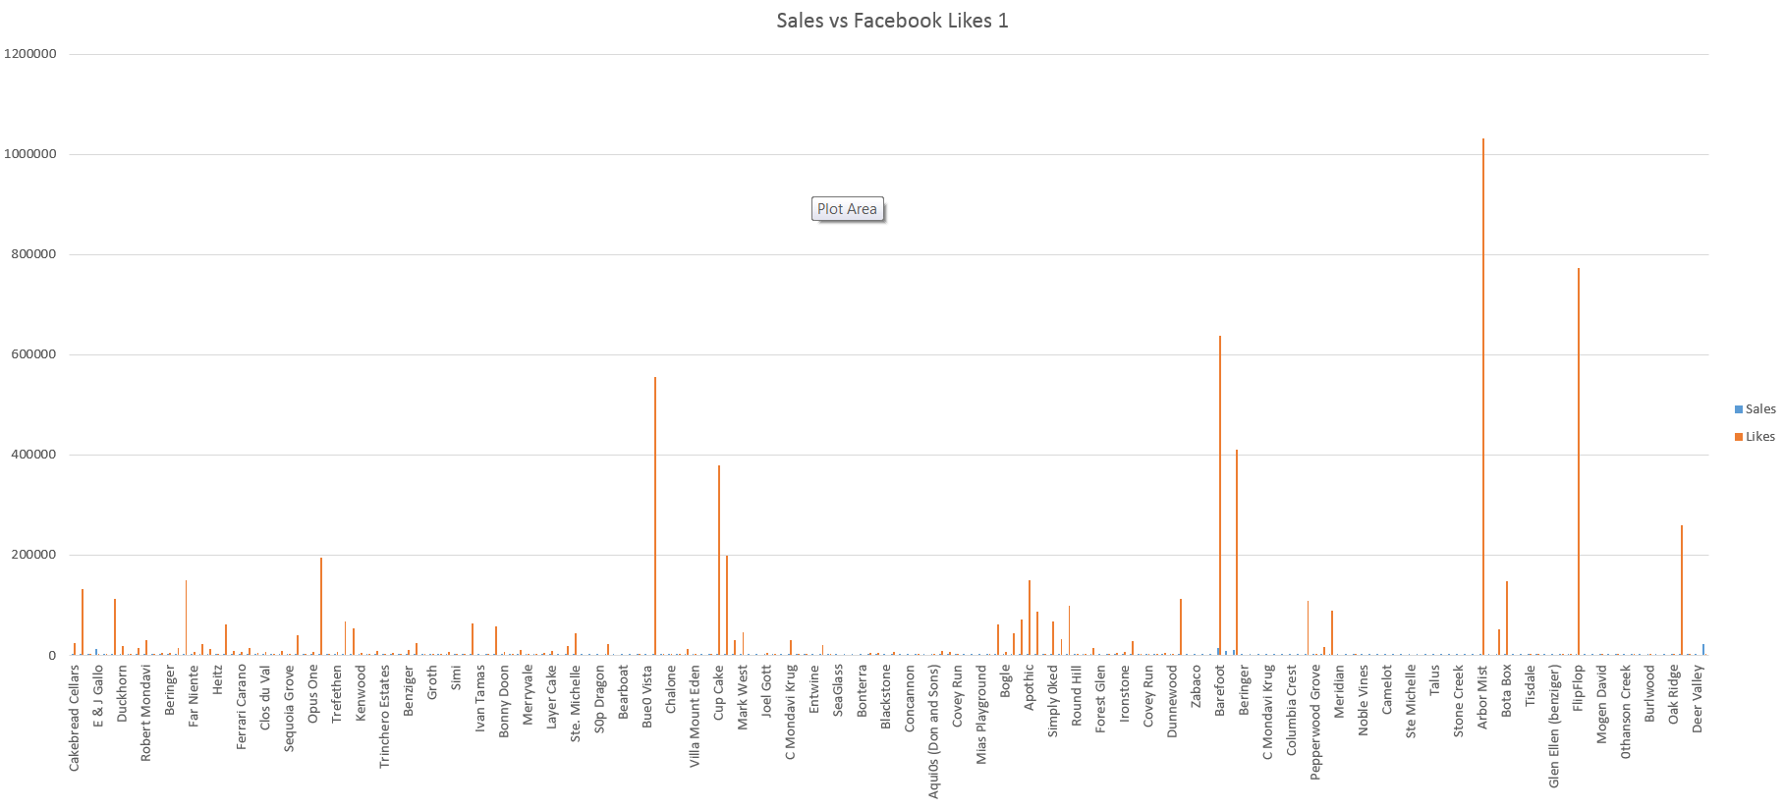
Sales vs. Facebook Likes – Part 1

Slide 6
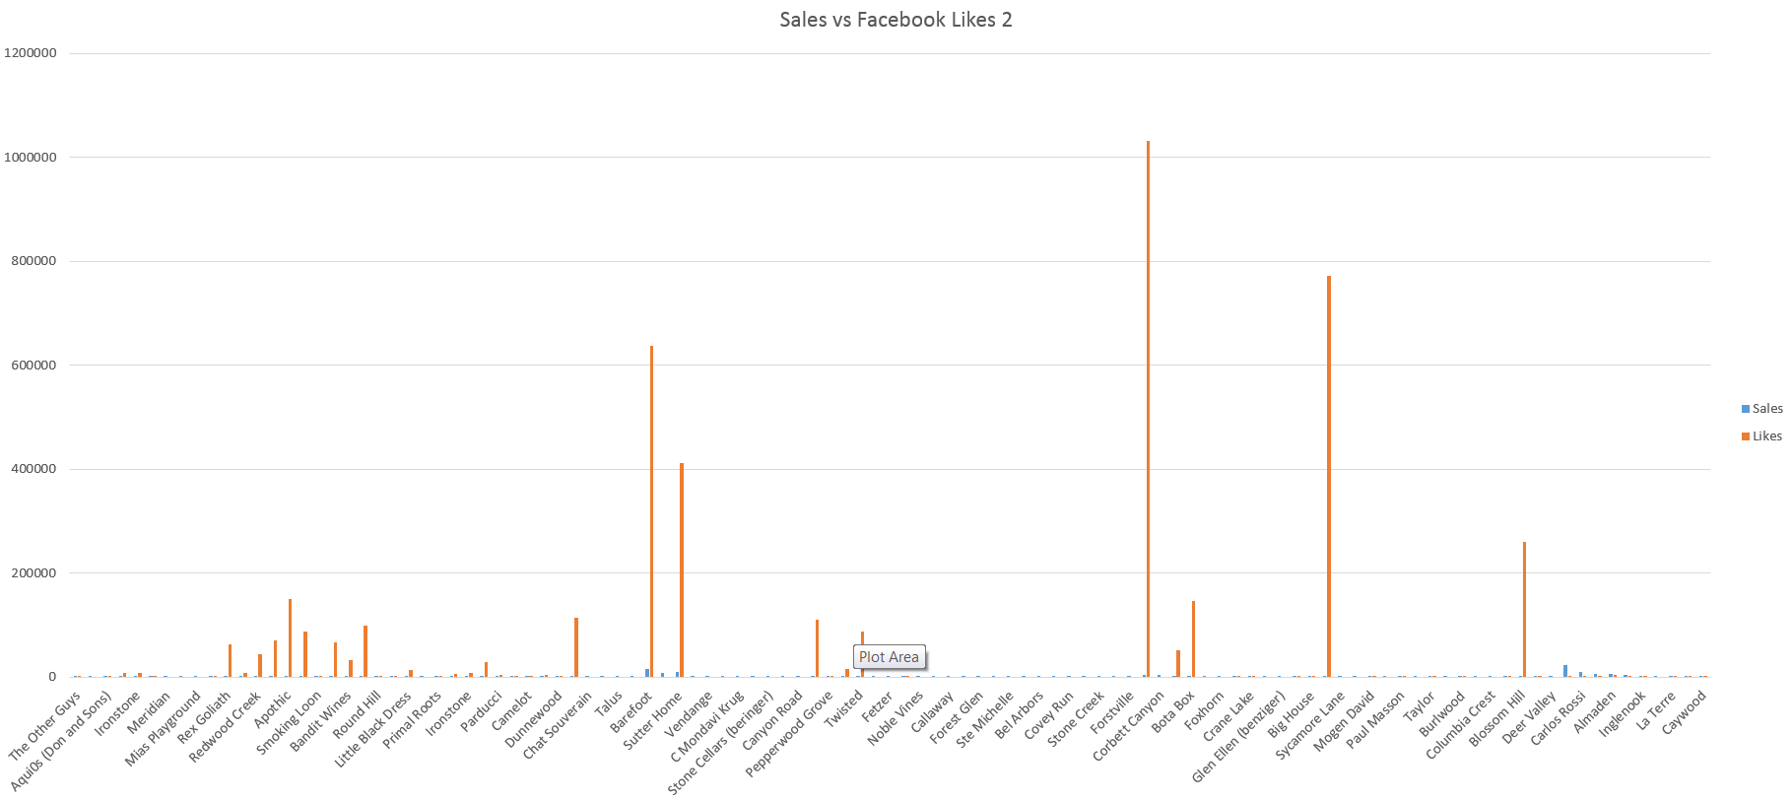
Sales vs. Facebook Likes – Part 2

Slide 7
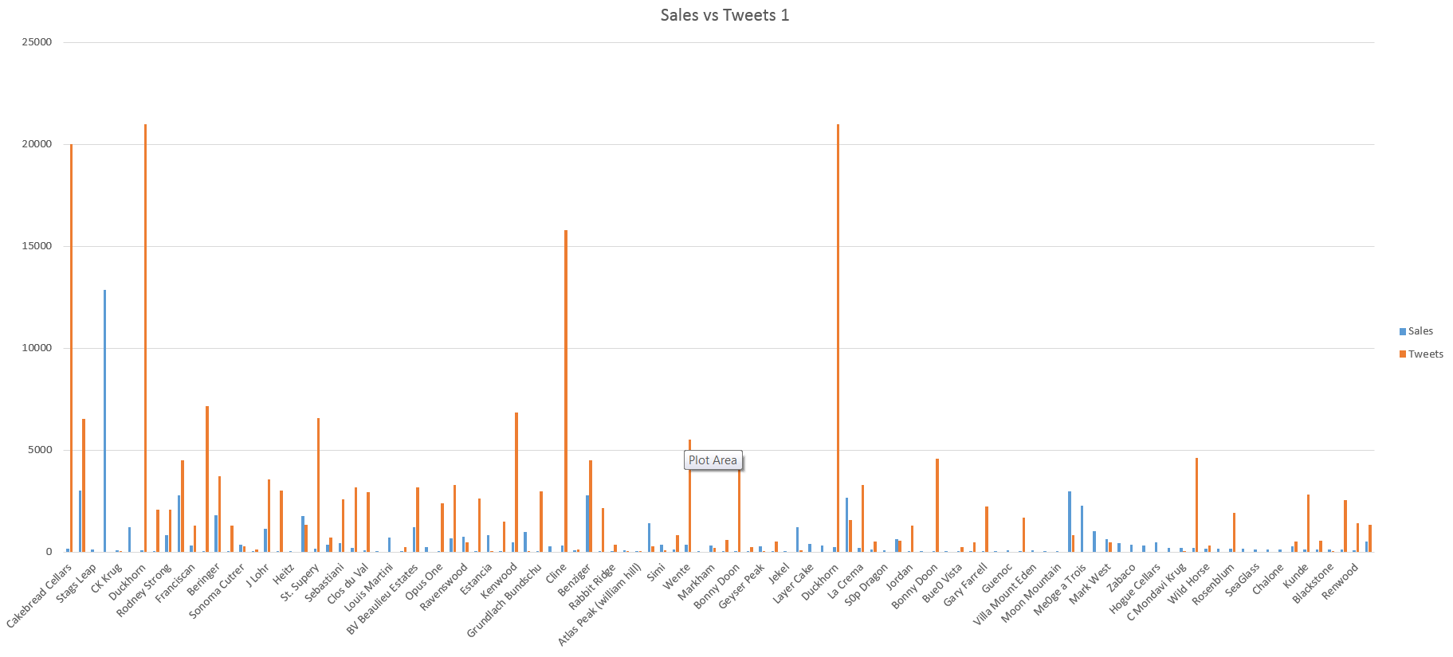
Sales vs. Number of Tweets – Part 1

Slide 8
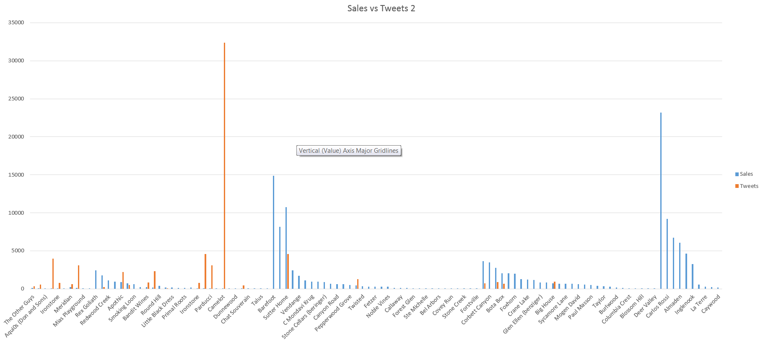
Sales vs. Number of Tweets – Part 2

Slide 9
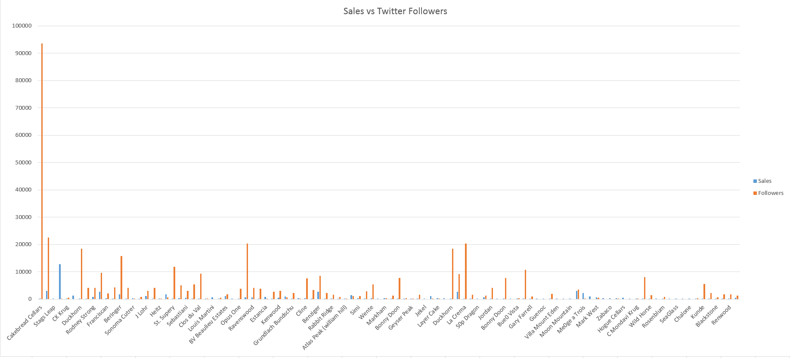
Sales vs. Twitter Followers – Part 1

Slide 10
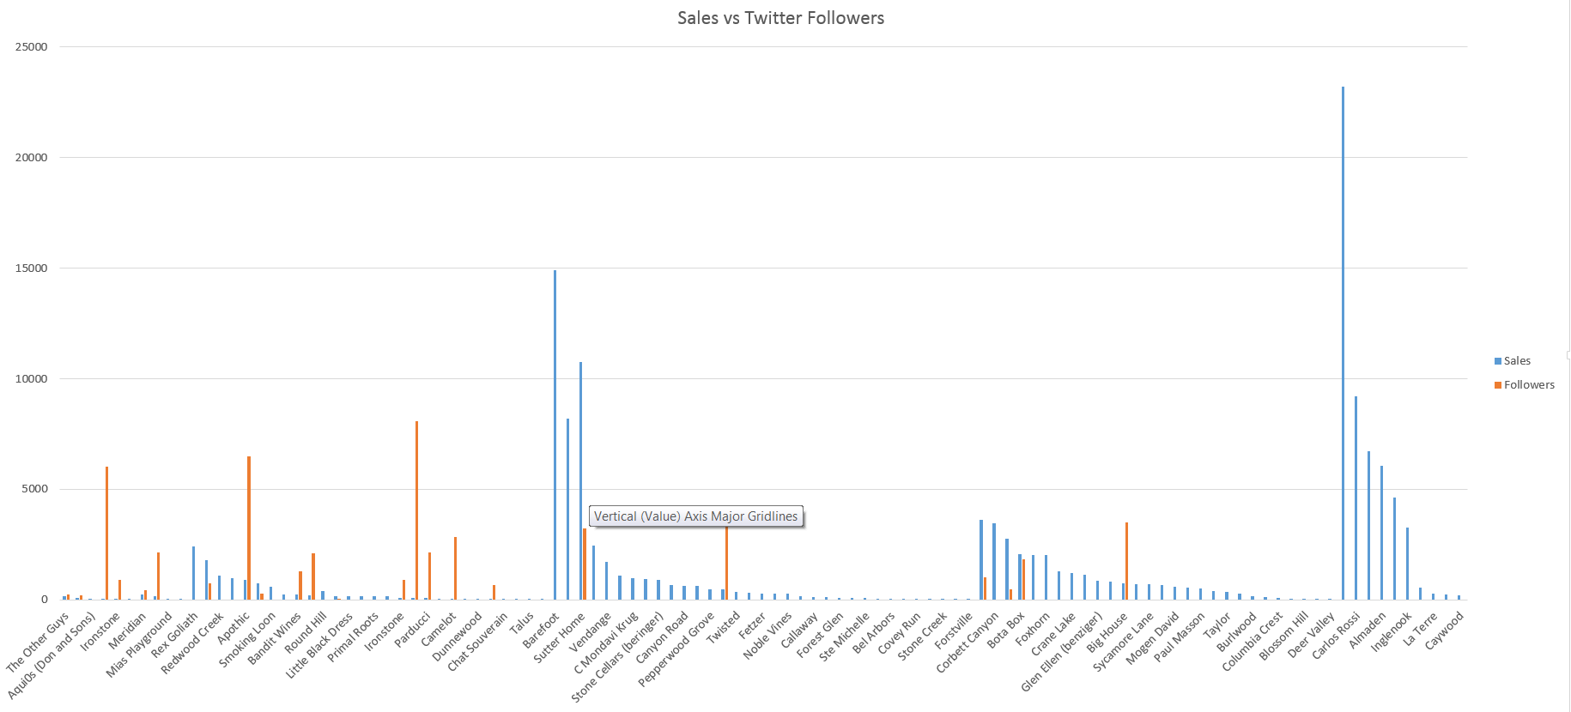
Sales vs. Twitter Followers – Part 2

Slide 11
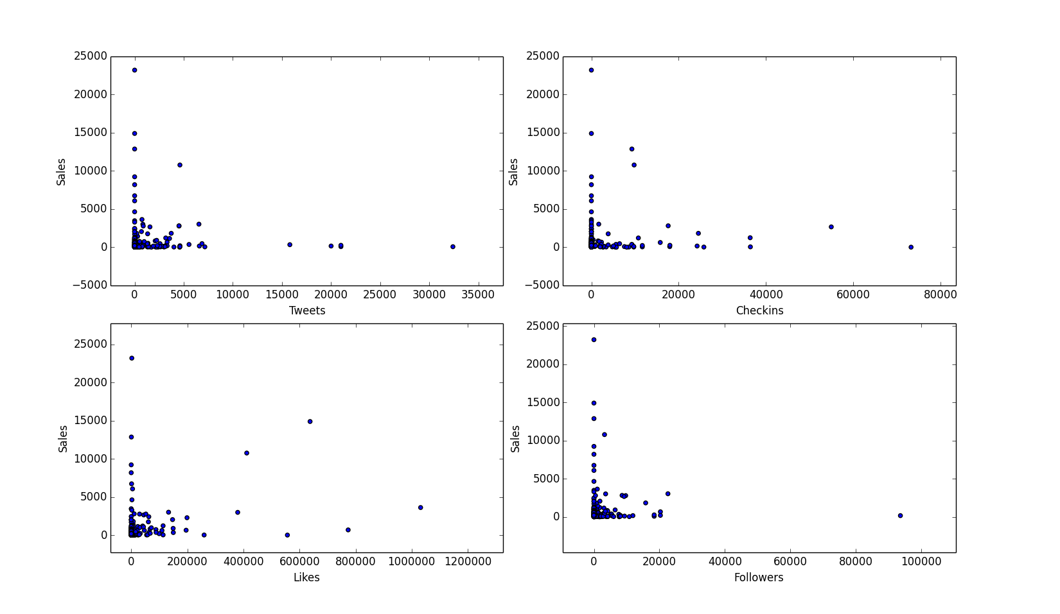
Raw Data Plot Using Pylab

Slide 27
In order to run SVM classification and Logistic regression, we need to have different classes for each training set.
so, i classified them using some observations:-
our main problem is to predict whether future sales are dependent on social media or not.
so in order for the above statement to be true, sales must be directly proportional to social media growth
so if sales are high social media numbers should also be high and the same applies for the inverse also.
What I did was calculate average sales(St) and average social presence(At),now
for each tuple in wineries data
if sales > St and Total Social media > At then classify it as "1"
if sales < St and Total Social media < At then classify it as "1"
if sales > St and Total Social media < At then classify it as "0"
if sales < St and Total Social media > At then classify it as "0”
Total social media = (fb likes+fb checkins + tweets + followers)/4
so now we have binary classifier(1 or 0) which tells us whether their social media presence will affect sales or not.

Slide 28
So,After classifying the data, i applied SVM classification and logistic regression on this data to get RMSE for every fold during cross validation.
RESULTS:-
Because of less data and high outliers in data tuples, results are not that appreciable. The only way these classifiers can perform well is if we have much more data and if they are already classified, then we will get very good results.

Slide 29
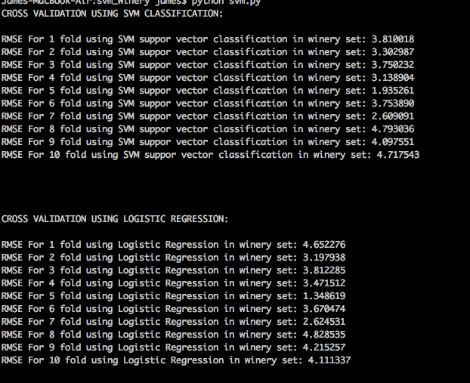

Slide 30
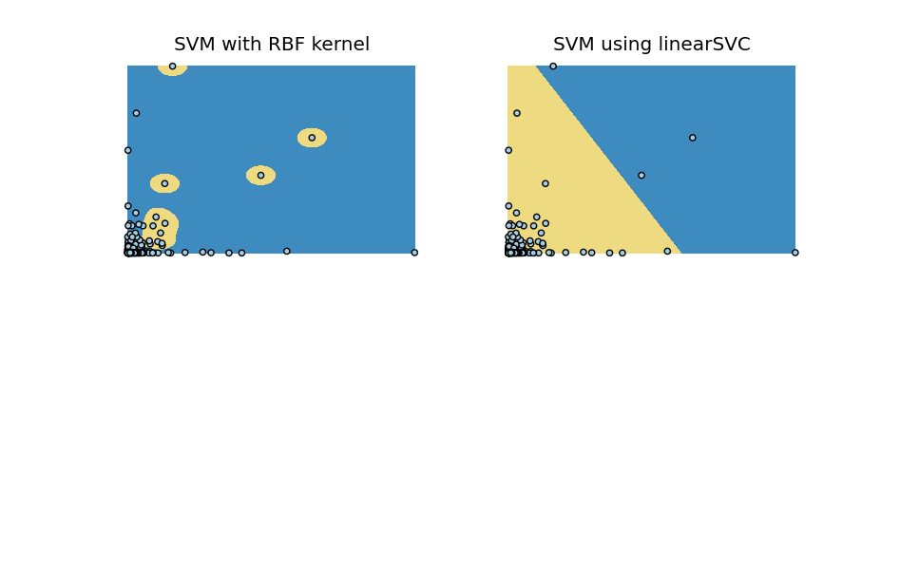

Slide 31
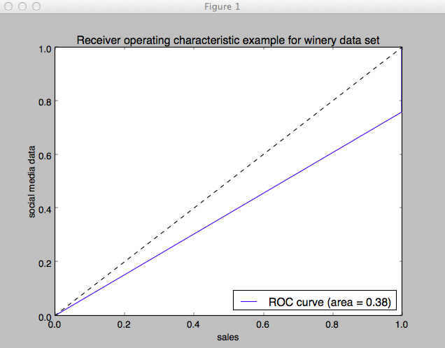

Slide 32
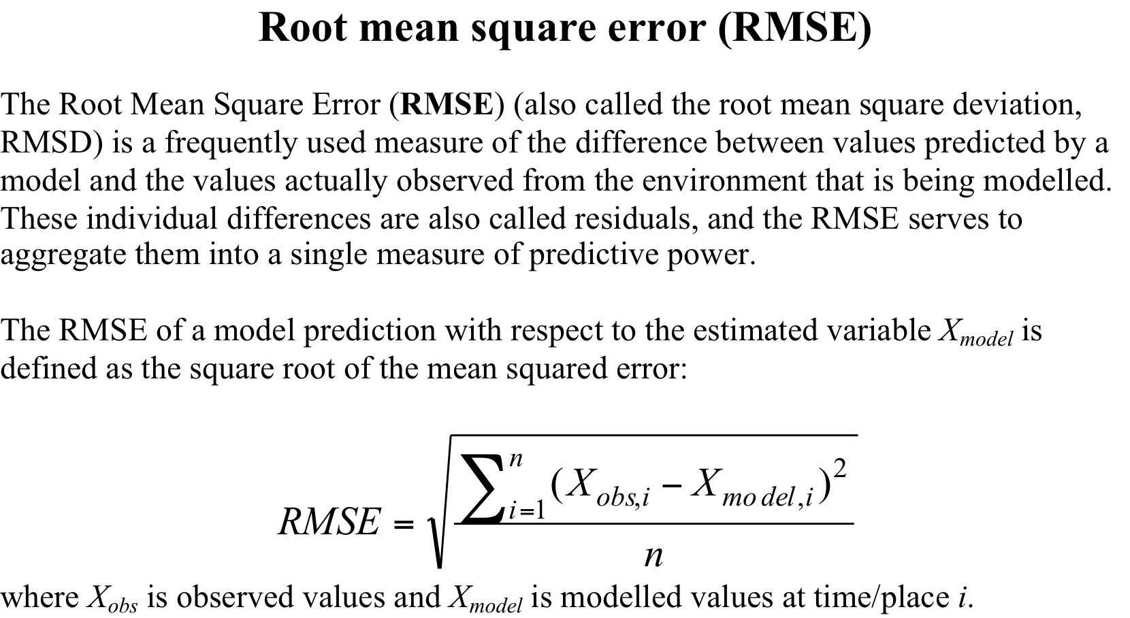
Support Vector Regression
sklearn.svm.svr

Slide 33
sklearn.preprocessing.StandardScaler
Many elements used in the objective function of a learning algorithm (such as the RBF kernel of Support Vector Machines or the l1 and l2 regularizers of linear models) assume that all features are centered around zero and have variance in the same order. If a feature has a variance that is orders of magnitude larger that others, it might dominate the objective function and make the estimator unable to learn from other features correctly as expected.

Slide 34
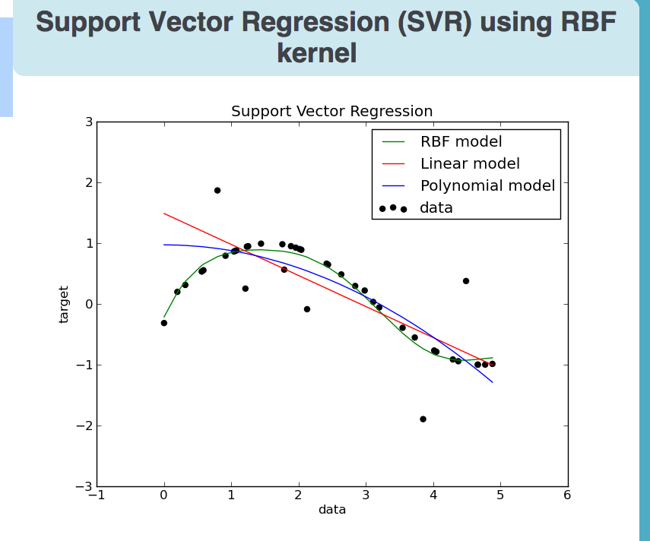

Slide 35
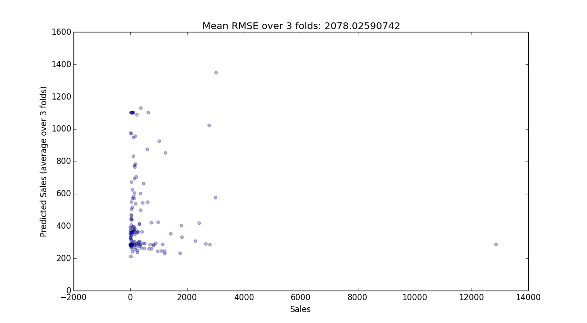

Slide 36
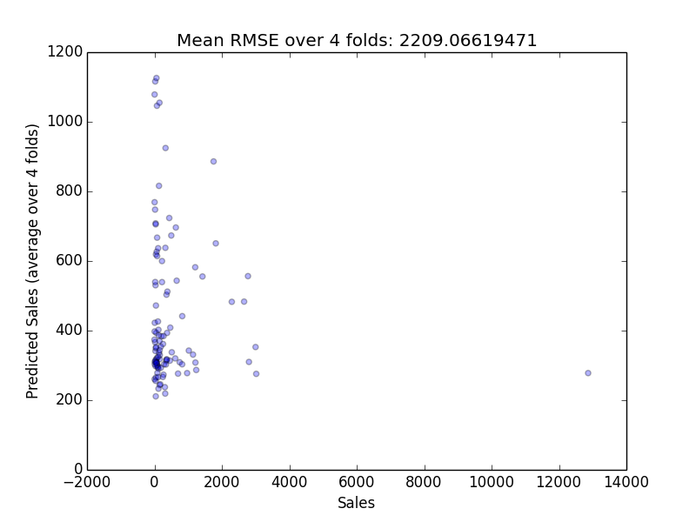

Slide 37
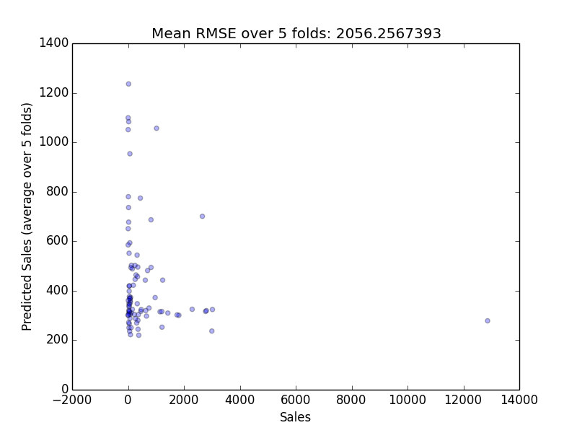

Slide 38
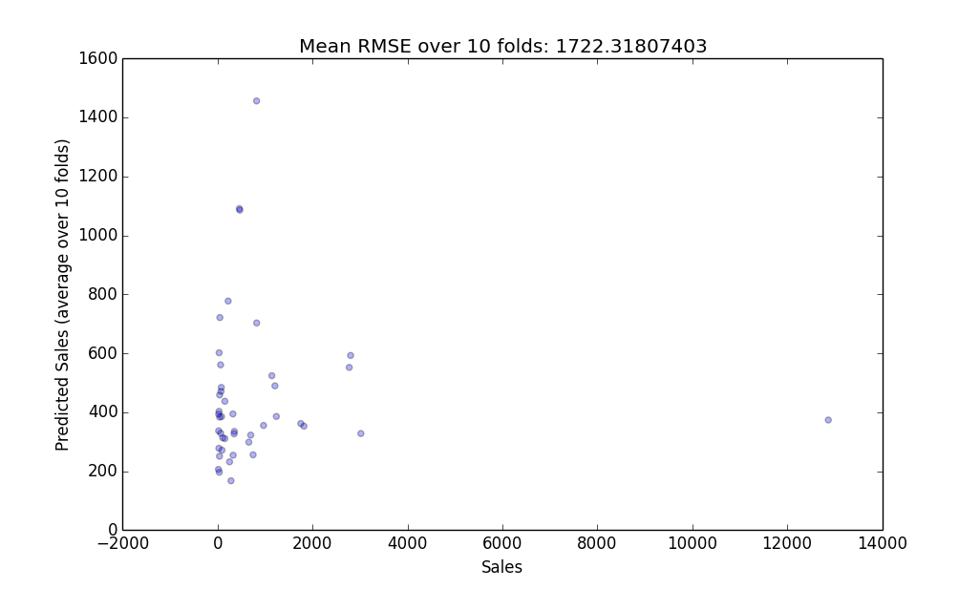

Slide 39
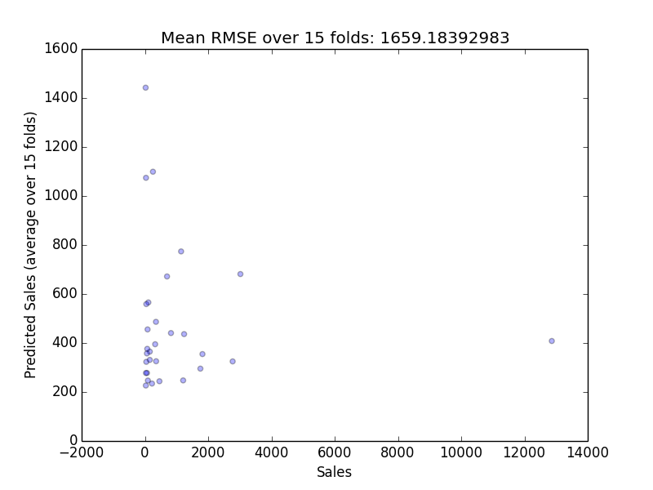

Slide 40
Conclusion
Forecasting sales based on social media data is probably not a good idea.

Slide 41
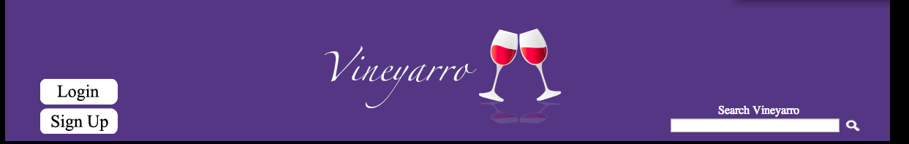
James@vineyarro.com

