Slide 1
F# for Data Science
Tomas Petricek, @tomaspetricek
PhD student @ University of Cambridge

Slide 2
software stacks trainings teaching F# user groups snippets mac and linux cross-platform tutorials
F# Software Foundation
F# community open-source MonoDevelop
http://www.fsharp.org
contributions research support consultancy mailing list

Slide 3
data acquisition statistics data cleaning machine learning data transformation visualization type providers
F# Data Science Working Group
kaggle vega grammar data sources presentation
R provider visualization
www.fslab.org
time-series data aggregation

Slide 4

www.fslab.org

Slide 5


F# Data type providers
First-class data
CSV, REST, WorldBank…
R Type provider
Statistics & visualization
5000 tested packages
www.fslab.org

Slide 6


Deedle data frame
Data exploration
Indexing and aggregation
F# Charting library
Simple & composable
Interactive style
www.fslab.org

Slide 7
F# Data
http://fsharp.github.io/FSharp.Data/

Slide 8
Accessing data in F#
Dynamic operator
Code generation (F# 2.0)
Standard providers (F# 3.0)
Custom type providers

Slide 9
The confusion of languages

Slide 10
Bridging the mismatch
Dynamic operator and generics
Specifies expected structure locally
Domain model using F# or C#
Define structure using types (auto generated)
Load data into the structure
Type providers in F# 3.0
Generate types representing the data (on demand)

Slide 11
Simple database access in F#
Operation resolved at compile-time
Result type inferred by F# compiler
let getCategories() : seq<int * string> =
[ for row in db.Query?GetProducts() ->
row?ID, row?Name ]
let (?) (x:Row) (name:string) : 'R =
x.Reader.[name] :?> 'R

Slide 12

The confusion of languages

Slide 13
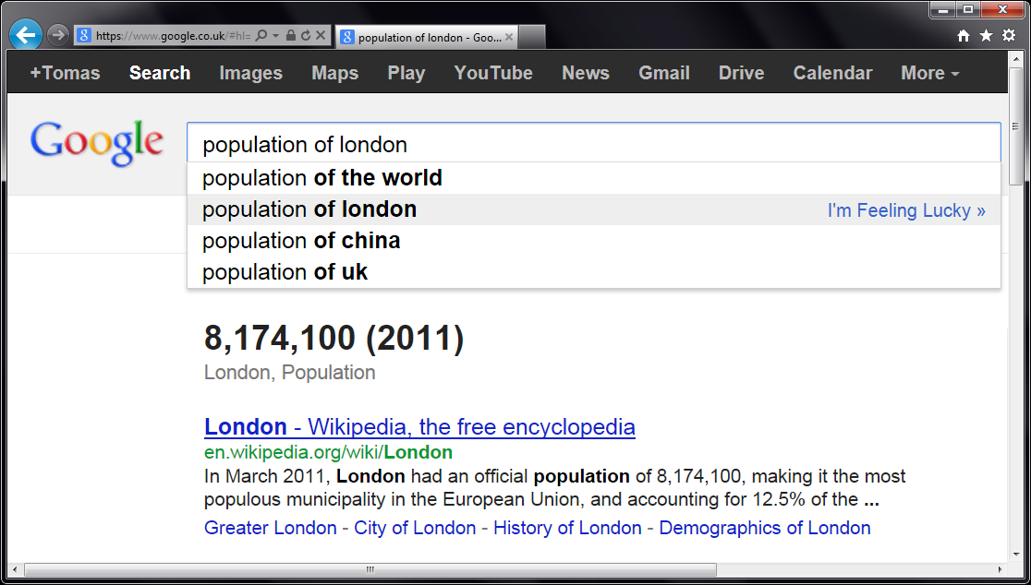


Slide 14
let wb = WorldBank() wb.

Slide 15
DEMO WorldBank type provider

Slide 16
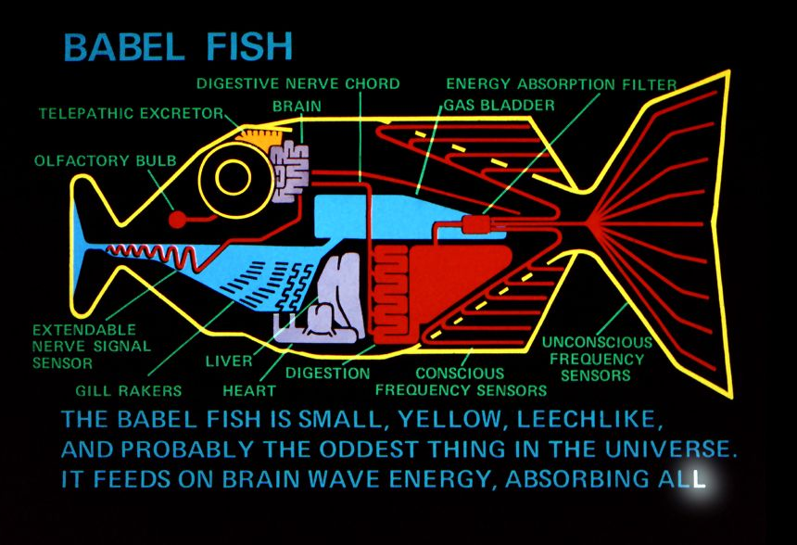
What is a Type Provider?

Slide 17
How are Type Providers used?
Compiler
Type-Check Imported Types
Compile using Type Provider
Type provider
IDE
IntelliSense for Generated Types

Slide 18
Type Providers for .NET
Hiding code generation
Web Services (WSDL)
SQL databases (LINQ to Entities)
Erasing provided types
REST services (World Bank)
Schematized web (Freebase)

Slide 19
Queries in F#
Can be turned to quotations
Extensible query language
query { for movie in netflix.Titles do
where (movie.Name.Contains(search))
select movie }
query { for index in Numbers do
reverse
takeWhile index > 10 }

Slide 20
Implementing Type Providers
public interface ITypeProvider
{
Type[] GetTypes();
Expression GetInvokerExpression
( MethodBase method,
ParameterExpression[] params );
event EventHandler Invalidate;
}

Slide 21
Design Considerations
Choosing the right view
Provide the right projection
Inferring structure from data
Schema structure
Refreshing the schema
Caching of online schema

Slide 22
Compile-Time vs. Run-time

Slide 23
Compile-Time vs. Run-time

Slide 24
Structure of a Simple Provider
[<TypeProvider>]
type SampleTypeProvider(config: TypeProviderConfig) =
inherit TypeProviderForNamespaces()
// Define new type Samples.GeneratedType
let thisAssembly = Assembly.GetExecutingAssembly()
let providedType = ProvidedTypeDefinition( ... )
do
// Add property 'Hello' that just returns a string
ProvidedProperty
( "Hello", typeof<string>, IsStatic = true,
GetterCode = fun args -> <@@ Runtime.lookup "Hello" @@>)
|> providedType.AddMember
// Register the type with the compiler
this.AddNamespace(namespaceName, [ providedType ])

Slide 25
DEMO Creating a type provider

Slide 26

Deedle
http://bluemountaincapital.github.io/Deedle/

Slide 27
Deedle is for…
(Exploratory) Data Analysis
Time-Series Analysis
Data Processing / Transformation
Data Cleaning
Statistics and Visualization, via other packages

Slide 28
Deedle is…
Our third iteration
Easy-to-use from C# and F#
Well documented
Open Source
Ready for you to contribute

Slide 29
Deedle Concepts
Series
Key->Value mapping
Key is often date/time
Immutable
Supports missing values
LINQ-friendly

Slide 30
Deedle Concepts
Frame
(RowKey, ColKey)->Value
RowKey is often date/time
ColKey is often string
Heterogeneous Values
Column-wise mutable
Data alignment
Hierarchical indexing

Slide 31
DEMO Financial calculations

Slide 32
F# Charting
http://fsharp.github.io/FSharp.Charting/

Slide 33
F# Charting
Charting Composable Simple Interactive

Slide 34

F# RProvider
http://bluemountaincapital.github.io/FSharpRProvider/

Slide 35
R Type provider
RProvider Language integration Not just about data Access non-.NET ggplot2, zoo, … Also interesting Matlab, Python

Slide 36
FsLab: Putting things together Understanding US debt

Slide 37
FsLab needs you & you need FsLab
Ready to use
Used & well tested
Created by experts
Contribute
Try it out & send feedback
Fig bugs & add features
Integrate with other packages
http://www.fslab.org

