Slide 1
Fast Track to F#
Data processing

Slide 2
Accessing data in F#
Dynamic operator
Code generation (F# 2.0)
Standard providers (F# 3.0)
Custom type providers

Slide 3
How to write calculations in F#
Standard F# tools
F# language and core libraries
F# Charting & F# PowerPack
Third-party math libraries
Math.NET Numerics (open-source)
StatFactory FCore, etc. (commercial)
Machine-learning packages
Accord.NET, k-means, random forests

Slide 4
Data processing: Modeling options

Slide 5
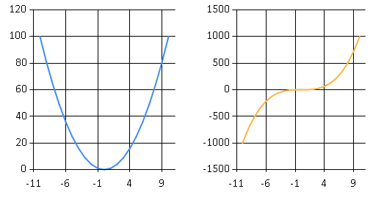
F# charting and sequence expressions
Generating lists of XY pairs
Creating line charts
let x2 = [ for x in -10.0 .. 10.0 -> x, pown x 2 ]
let x3 = [ for x in -10.0 .. 10.0 -> x, pown x 3 ]
Chart.Line(x2)
Chart.Columns
[ Chart.Line(x2)
Chart.Line(x3) ]

Slide 6
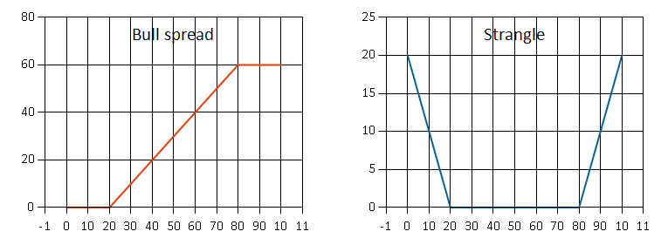
DEMO: Options and payoff diagrams

Slide 7
Modeling Euro options
What is the language?
Primitive values
Composition operations
How do we use the model?
Drawing a pay-off diagram
Calculating option price
Checking for execution

Slide 8
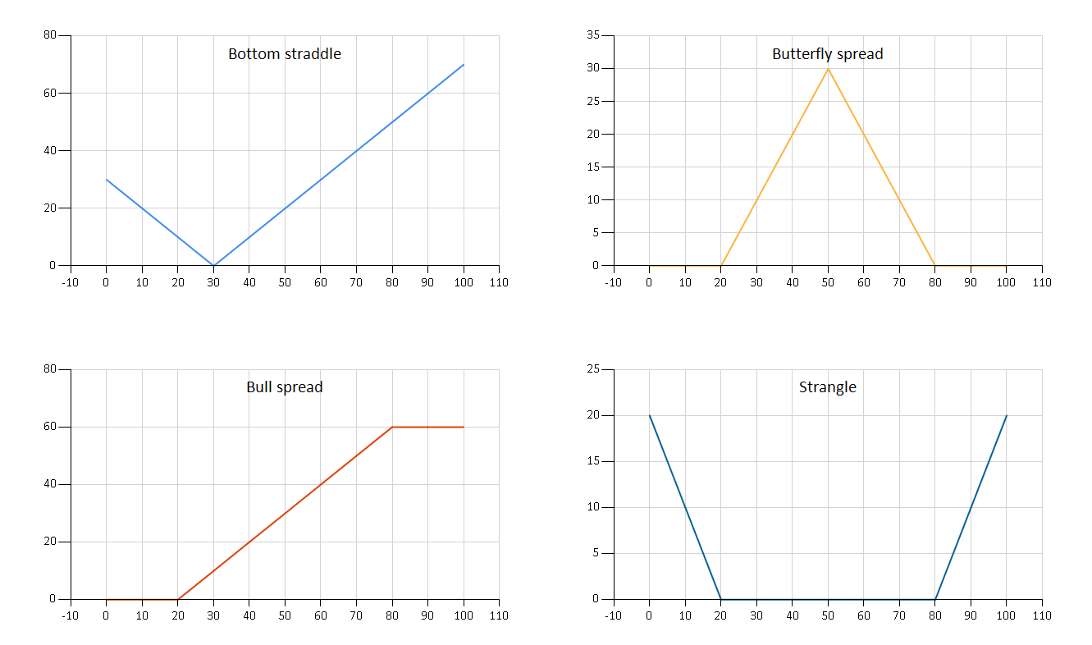
Composed options

Slide 9
Building the model
Primitives of the language
Composition combinators
type OptionKind = Call | Put
type Option =
| European of OptionKind * float
| Combine of Option * Option
| Times of float * Option

Slide 10
Building & using the DSL
Make it more convenient
Custom operators
Derived primitives
Use it for its purpose
Drawing pay-off diagrams
Evaluating option price

Slide 11
Domain-specific languages
Advantages
Disadvantages
Readability
Greater for External DSL
Maintainability
Hides implementation
Internals can be changed
Domain Focus
Non-experts can read it
Additional abstraction
Smaller for Internal DSL
Time to implement
Easier for Internal DSL
Time to learn
Avoid crazy operators
Make it familiar
Notes:
Prefer internal DSLs

Slide 12
Data processing: Type Providers

Slide 13
Languages and Data
Mismatch between two worlds!
Structure in the language
Classes with properties (C#)
Functional data types or classes (F#)
Structure in the data source
Database, XML, OData, Web services (explicit)
REST service or JSON file (implicit)

Slide 14
Bridging the mismatch
Dynamic operator and generics
Specifies expected structure locally
Domain model using F# or C#
Define structure using types (auto generated)
Load data into the structure
Type providers in F# 3.0
Generate types representing the data (on demand)

Slide 15
Simple database access in F#
Operation resolved at compile-time
Result type inferred by F# compiler
let getCategories() : seq<int * string> =
[ for row in db.Query?GetProducts() ->
row?ID, row?Name ]
let (?) (x:Row) (name:string) : 'R =
x.Reader.[name] :?> 'R

Slide 16
Demo: Using the dynamic operator

Slide 17
What type providers do?
Compiler
Type-Check Imported Types
Compile using Type Provider
Type provider
IDE
IntelliSense for Generated Types

Slide 18
F# Type providers
Assembly with special attribute
Compiler plugin that generates types
Parameterized (i.e. by connection string)
#r "FSharp.Data.TypeProviders.dll"
open Microsoft.FSharp.Data
[<Literal>]
type cs = "data source=.; initial catalog=Sample"
type Northwind = TypeProviders.SqlDataConnection<cs>
let ctx = Northwind.GetDataContext()
ctx.Student |> Seq.length

Slide 19
Type providers
Standard type providers
Web services, LINQ to SQL, Entities, Azure Data Market, OData
Sample type providers
WMI, FreeBase data, Hadoop, Microsoft Dynamics
Community type providers
XML, JSON, CSV, WorldBank, Excel, R interoperability

Slide 20
Demo: Accessing stock prices

Slide 21
Translating LINQ to F#
Declarative data processing language in C#
Using function composition
We’re not limited to built-in keywords
Functional design allows declarative style
from stock in StockData.MSFT
where stock.Close - stock.Open > 7.0
select stock.Date
StockData.MSFT
|> Seq.filter (fun s -> s.Close - s.Open > 7.0)
|> Seq.map (fun s -> s.Date)

Slide 22
Sequence expressions in F#
Exploring data using imperative loops
Can be turned into a sequence expression…
[ … ] for lists, [| … |] for arrays, seq { … } for sequences
for year, value in yearlyAverages do
if value < 25.0 then
printfn "%d (only %f)" year value
let badYears =
[ for year, value in yearlyAverages do
if value < 25.0 then
yield year, value ]

Slide 23
Useful library functions
Basic functions
Seq.filter – filter elements using predicate (Where)
Seq.map – turn values into different (Select)
Aggregating all elements of a sequence
Seq.max, Seq.min, Seq.average – the obvious
Seq.fold – general aggregation
Grouping elements of a sequence
Seq.groupBy – group using key
Seq.pairwise – adjacent pairs
Seq.windowed – sliding window

Slide 24
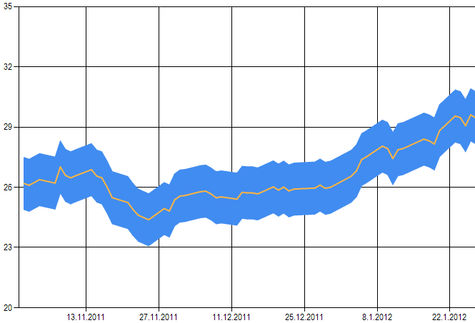
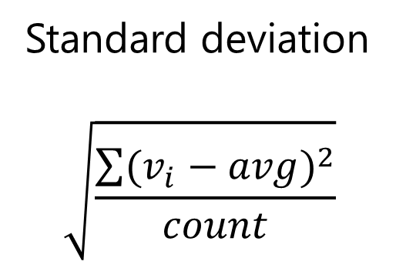

Demo: Working with stock data
Standard deviation
$$\sqrt{\frac{\sum{{(v_{i}−avg)}^{2}}}{count}}$$
Chart price $+/−$ sdv.

Slide 25
Data processing: LINQ and queries

Slide 26
Queryable data sources
In-memory data
SQL Databases
Azure cloud storage
OData type provider

Slide 27
F# 3.0 Queries
Limiting using skip, take and related
Aggregation using sum, count, min, max, etc.
Grouping using groupBy and related
query { for n in numbers do
skipWhile (n % 3 <> 0) }
query { for n in numbers do
maxBy n }
query { for p in ctx.Products do
groupBy p.CategoryID into g
select (g.Key, g.Count()) }

Slide 28
OData Type provider
Protocol for querying data over the web
Limited querying capabilities (filtering etc.)
Sources available from Azure data market
[<Literal>]
let url = "http://odata.netflix.com/Catalog/"
type Netflix = ODataService<url>
let client = Netflix.GetDataContext()
query { for title in client.Titles do
where (title.Name.Contains "Star") }
No “select” needed!

Slide 29
Demo: Writing queries in F#

Slide 30
Demo: Writing a type provider

Slide 31
Data processing: Computations

Slide 32
Components of Math.NET
Probability and statistics
Random distributions
Descriptive statistics
Linear algebra
Dense and sparse matrices
Wrappers for BLASS and LAPACK
Other features
Number theory, functions, FFT

Slide 33
Probability & statistics in Math.NET
Generating samples from distributions
Descriptive statistics
open MathNet.Numerics.Distributions
let normal = new Normal(1.0, 4.0)
normal.Samples() |> Seq.take 10 |> Seq.toList
open MathNet.Numerics.Statistics
let stats = new DescriptiveStatistics(data)
stats.Mean, stats.StandardDeviation

Slide 34
Demo: Using Math.NET

Slide 35
Efficient generic math in F#
Enabled by two language features
Inline function annotation
Static member constraints
Calculating list average
Goes beyond the .NET type system
val inline average : list: ^a list -> ^a
when ^a : (static member ( + ) : ^a * ^a -> ^a)
and ^a : (static member DivideByInt : ^a * int -> ^a)
and ^a : (static member get_Zero : -> ^a)

Slide 36
Writing inline math functions
How does it work?
Function is inlined at the call side
All generics are resolved & specialized
When & how to use it?
Always inline generic comparison
You can use generic numeric operators
You can use LanguagePrimitives functions

Slide 37
Choose the right data structure!
Collections
Sequence – allows lazy evaluation, most general
Array – efficient for storage, large data processing
List – efficient for small data, cons-style processing
Maps or dictionaries
Map (F#) – cannot do better than O(log n)
Dictionary (.NET) – O(1) lookup, but mutable

Slide 38
More high performance libraries
Native BLAS, LAPACK, FFT and more
Using .NET interoperability
F# PowerPack & F# MathProvider
Intel MKL (Math Kernel Library)
Microsoft SHO, Math.NET Numerics
NVidia CUDA (GPU)
Commercial libraries (StatFactory FCore, …)

Slide 39
Data processing: R type provider

Slide 40
R Type Provider
The R project
Statistical computing software
Loads of open-source libraries
Statistics, Finance (time series), Plotting (ggplot2)
Calling R from F#
Imports available functions
Serializes data frames between R and F#

Slide 41
Demo: Accessing world bank data

