Slide 1

F# Type Providers in Depth
Tomas Petricek
@tomaspetricek | http://tomasp.net

Slide 2


Slide 3

F# 3.0 in Visual Studio 11

Slide 4
The Problem
Meta-data information
≠
F# type declaration
<s:complexType name="Session">
<s:sequence>
<s:element minOccurs="0" maxOccurs="1"
name="CustomerID" type="s:string" />
<s:element minOccurs="0" maxOccurs="1"
name="CustomerName" type="s:string" />
<s:element minOccurs="0" maxOccurs="1"
name="BranchNumber" type="s:string" />
<s:element minOccurs="0" maxOccurs="1"
name="SessionKey" type="s:string" />
<s:element minOccurs="0" maxOccurs="1"
name="ChosenDeliverySlotInfo"
type="s:string" />
<s:element minOccurs="0" maxOccurs="1"
name="CustomerMessageOfTheDay"
type="s:string" />
<s:element minOccurs="0" maxOccurs="1"
name="CustomerForename"
type="s:string" />
</s:sequence>
</s:complexType>
type Session =
{ CustomerID : int
CustomerName : string
BranchNumber : int
SessionKey : string
ChosenDeliverySlotInfo : string
CustomerMessageOfTheDay : string
CustomerForName : string }

Slide 5

The Problem

Slide 6
Levels of Data Access
Expression Scale
Dynamic typing
Program Scale
Code generation
Internet Scale
Type providers

Slide 7
Type providers change how you think about programming!

Slide 8


Slide 9
Demo: World bank

Slide 10
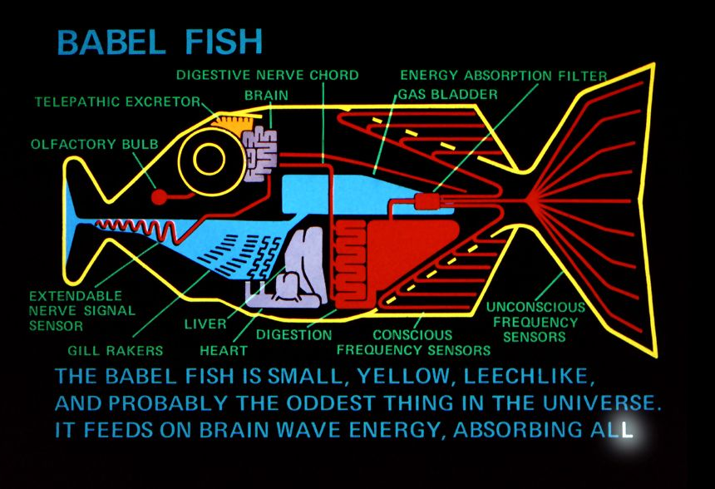
What is a Type Provider?

Slide 11
How are Type Providers used?
Compiler
Type-Check Imported Types
Compile using Type Provider
Type provider
IDE
IntelliSense for Generated Types

Slide 12
Demo: WSDL, SQL, OData

Slide 13
Type Providers for .NET
Hiding code generation
Web Services (WSDL)
SQL databases (LINQ to Entities)
Erasing provided types
REST services (World Bank)
Schematized web (Freebase)

Slide 14
Queries in F#
Can be turned to quotations
Extensible query language
query { for movie in netflix.Titles do
where (movie.Name.Contains(search))
select movie }
query { for index in Numbers do
reverse
takeWhile index > 10 }

Slide 15
Implementing Type Providers
public interface ITypeProvider
{
Type[] GetTypes();
Expression GetInvokerExpression
( MethodBase method,
ParameterExpression[] params );
event EventHandler Invalidate;
}

Slide 16
Design Considerations
Choosing the right view
Provide the right projection
Inferring structure from data
Schema structure
Refreshing the schema
Caching of online schema

Slide 17
Demo: XML type provider

Slide 18
Summary
The ease of dynamic languages
Generate types from schema
No actual types are needed
With the static typing benefits
Checked at compile-time
Full IntelliSense support

Slide 19
Compile-Time vs. Run-time

Slide 20
Compile-Time vs. Run-time

Slide 21
Structure of a Simple Provider
[<TypeProvider>]
type SampleTypeProvider(config: TypeProviderConfig) =
inherit TypeProviderForNamespaces()
// Define new type Samples.GeneratedType
let thisAssembly = Assembly.GetExecutingAssembly()
let providedType = ProvidedTypeDefinition( ... )
do
// Add property 'Hello' that just returns a string
ProvidedProperty
( "Hello", typeof<string>, IsStatic = true,
GetterCode = fun args -> <@@ Runtime.lookup "Hello" @@>)
|> providedType.AddMember
// Register the type with the compiler
this.AddNamespace(namespaceName, [ providedType ])

