Slide 1
Information-rich programming in F#
Tomas Petricek, University of Cambridge
with the Try F# team and the F# community
Rensselaer Polytechnic Institute (Rensselaer, 15 February, 2013)

Slide 2
software stacks trainings teaching F# user groups snippets mac and linux cross-platform books and tutorials
F# Software Foundation
F# community open-source MonoDevelop
http://www.fsharp.org
contributions research support consultancy mailing list

Slide 3
The confusion of languages

Slide 4

The confusion of languages

Slide 5
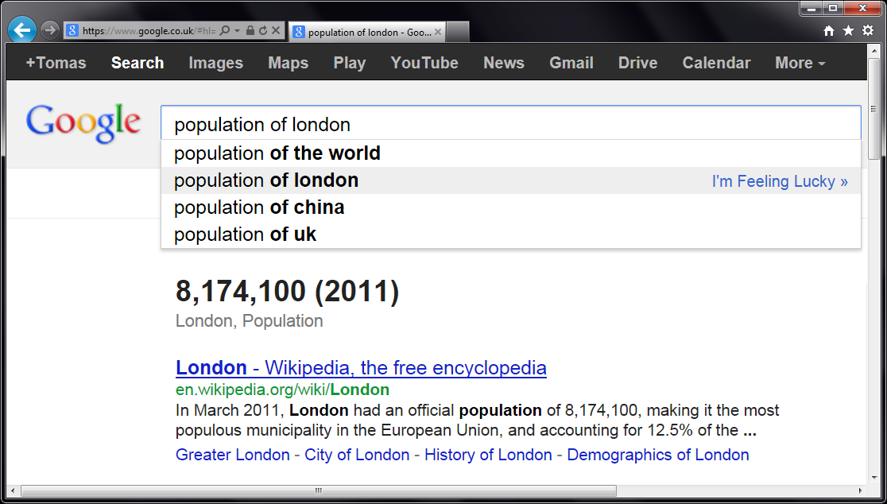


Slide 6
let wb = WorldBank()
w
b
.

Slide 7
DEMO: Try F#
Comparing university enrollment rate in Czech Republic and OECD countries

Slide 8
F# to JavaScript
Writing plain web sites in F#
Access type providers as usual
Compile and run as JavaScript
Libraries & frameworks
Open source: FunScript (https://github.com/ZachBray/FunScript)
Commercial: IntelliFactory WebSharper (http://www.websharper.com)

Slide 9
DEMO: FunScript
Accessing World Bank in F#, running as plain JavaScript

Slide 10
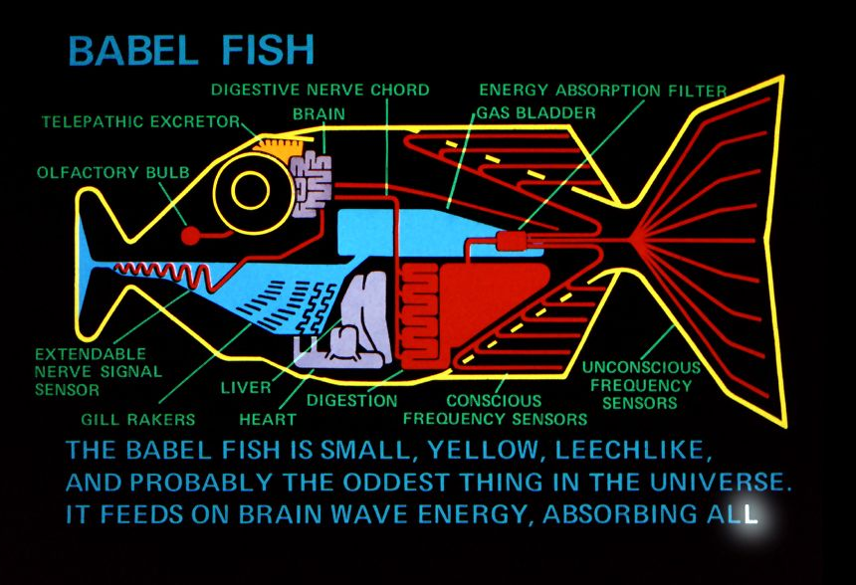
What is a type provider?

Slide 11
Problems with data access
Data is not types with members
Use dynamic languages?
Need to know names of properties
Use code generation and static languages?
Enormous scale of data sources
Types need to be generated “on demand”

Slide 12
Components of a type provider
Compiler
Type-Check Provided Types
Compile using Type Provider
Type provider
IDE
IntelliSense for Provided Types

Slide 13
Research problems (1.)
Types are provided on demand
Cannot generate all indicator types at once!
Scales to millions of data sets
Mapping data sources to types
What is a type? What is a value?
What view does the user need?

Slide 14
Mapping data source to types
Country
Indicator
Year

Slide 15
Research problems (2.)
How to access unstructured data
Infer structure from samples?
Specify schema explicitly?
Adapting to schema change
Will my program still compile?
Will my program still work?

Slide 16
DEMO: XML and JSON Providers
Working with structured data and adapting to schema change

Slide 17
Queries in F#
Can be turned to quotations
Extensible query language
query { for movie in netflix.Titles do
where (movie.Name.Contains(search))
select movie }
query { for index in Numbers do
reverse
takeWhile index > 10 }

Slide 18
Summary
Mismatch between data and programs
Type providers bridge the gap
Development-time, compile-time & run-time
Interesting future questions
Providers for semantic web?
Capturing meta-data with types

Slide 19
Research problems (3.)
Representing meta-data as types
Inheritance between entities
Physical units of measure
Future work on the F# language
Capturing provenance, security
Validity of data and guarantees

Slide 20
DEMO: FreeBase Type Provider
Working with chemistry data and units of measure

Slide 21
Structure of a Simple Provider
[<TypeProvider>]
type SampleTypeProvider(config: TypeProviderConfig) =
inherit TypeProviderForNamespaces()
// Define new type Samples.GeneratedType
let thisAssembly = Assembly.GetExecutingAssembly()
let providedType = ProvidedTypeDefinition( ... )
do
// Add property 'Hello' that just returns a string
ProvidedProperty
( "Hello", typeof<string>, IsStatic = true,
GetterCode = fun args -> <@@ Runtime.lookup "Hello" @@>)
|> providedType.AddMember
// Register the type with the compiler
this.AddNamespace(namespaceName, [ providedType ])

Slide 22
Compile-Time vs. Run-time

Slide 23
Compile-Time vs. Run-time

