Slide 1
F# for Data Science
Slides borrowed from Tomas Petricek’s
talk from 2013

Slide 2


F# Data type providers
First-class data
CSV, REST, WorldBank…
R Type provider
Statistics & visualization
5000 tested packages
www.fslab.org

Slide 3


Deedle data frame
Data exploration
Indexing and aggregation
F# Charting library
Simple & composable
Interactive style
www.fslab.org

Slide 4
F# Data
http://fsharp.github.io/FSharp.Data/

Slide 5
Accessing data in F#
Dynamic operator
Code generation (F# 2.0)
Standard providers (F# 3.0)
Custom type providers

Slide 6
The confusion of languages

Slide 7
Bridging the mismatch
Dynamic operator and generics
Specifies expected structure locally
Domain model using F# or C#
Define structure using types (auto generated)
Load data into the structure
Type providers in F# 3.0
Generate types representing the data (on demand)

Slide 8
Simple database access in F#
Operation resolved at compile-time
Result type inferred by F# compiler
let getCategories() : seq<int * string> =
[ for row in db.Query?GetProducts() ->
row?ID, row?Name ]
let (?) (x:Row) (name:string) : 'R =
x.Reader.[name] :?> 'R

Slide 9
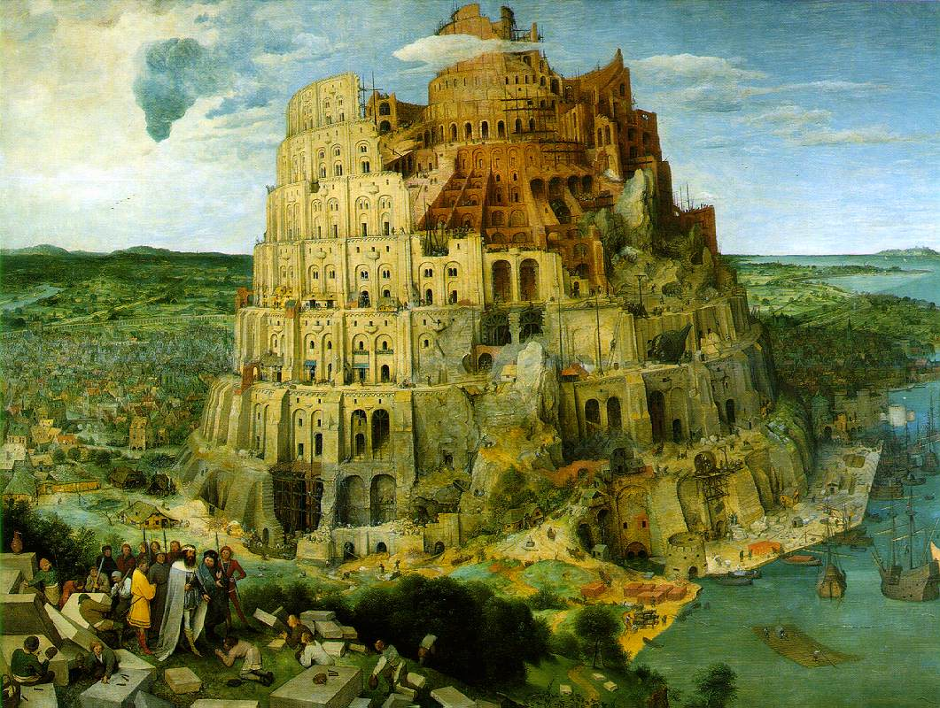
The confusion of languages

Slide 10
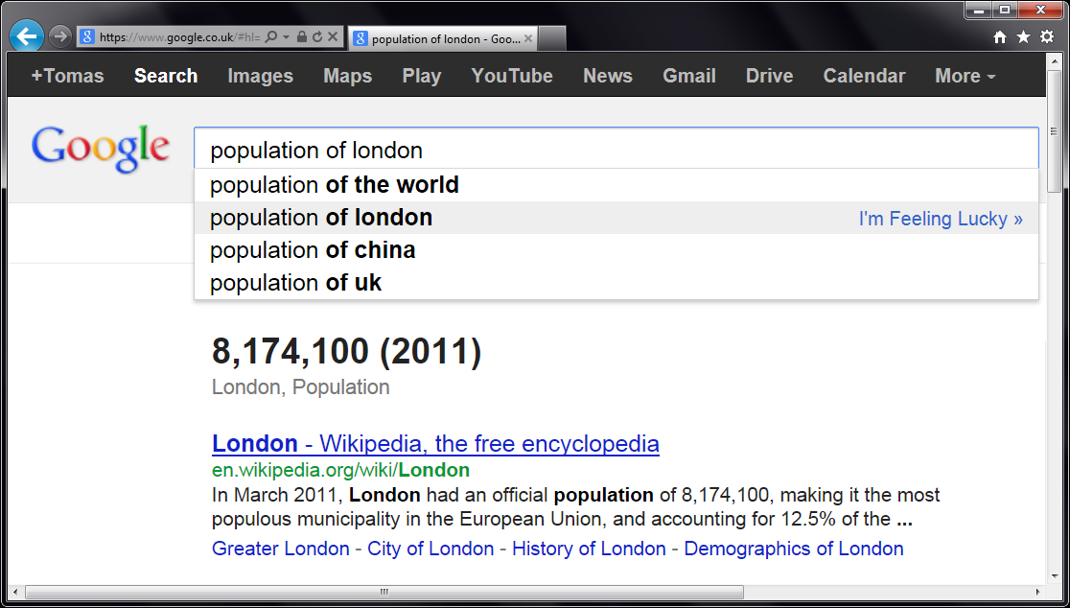


Slide 11
let wb = WorldBank() wb.

Slide 12
DEMO WorldBank type provider

Slide 13
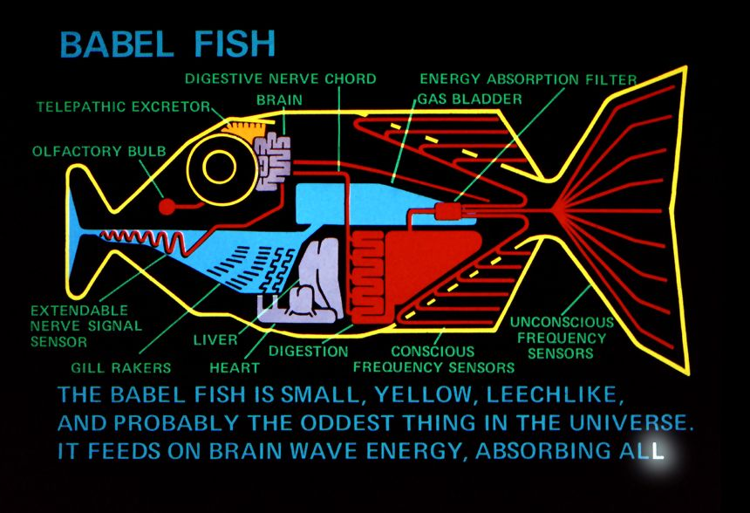
What is a Type Provider?

Slide 14
How are Type Providers used?
Compiler
Type-Check Imported Types
Compile using Type Provider
Type provider
IDE
IntelliSense for Generated Types

Slide 15
Type Providers for .NET
Hiding code generation
Web Services (WSDL)
SQL databases (LINQ to Entities)
Erasing provided types
REST services (World Bank)
Schematized web (Freebase)

Slide 16
Queries in F#
Can be turned to quotations
Extensible query language
query { for movie in netflix.Titles do
where (movie.Name.Contains(search))
select movie }
query { for index in Numbers do
reverse
takeWhile index > 10 }

Slide 17
Implementing Type Providers
public interface ITypeProvider
{
Type[] GetTypes();
Expression GetInvokerExpression
( MethodBase method,
ParameterExpression[] params );
event EventHandler Invalidate;
}

Slide 18
Design Considerations
Choosing the right view
Provide the right projection
Inferring structure from data
Schema structure
Refreshing the schema
Caching of online schema

Slide 19
Compile-Time vs. Run-time

Slide 20
Compile-Time vs. Run-time

Slide 21
Structure of a Simple Provider
[<TypeProvider>]
type SampleTypeProvider(config: TypeProviderConfig) =
inherit TypeProviderForNamespaces()
// Define new type Samples.GeneratedType
let thisAssembly = Assembly.GetExecutingAssembly()
let providedType = ProvidedTypeDefinition( ... )
do
// Add property 'Hello' that just returns a string
ProvidedProperty
( "Hello", typeof<string>, IsStatic = true,
GetterCode = fun args -> <@@ Runtime.lookup "Hello" @@>)
|> providedType.AddMember
// Register the type with the compiler
this.AddNamespace(namespaceName, [ providedType ])

Slide 22
DEMO Creating a type provider

Slide 23

Deedle
http://bluemountaincapital.github.io/Deedle/

Slide 24
Deedle is for…
(Exploratory) Data Analysis
Time-Series Analysis
Data Processing / Transformation
Data Cleaning
Statistics and Visualization, via other packages

Slide 25
Deedle is…
Our third iteration
Easy-to-use from C# and F#
Well documented
Open Source
Ready for you to contribute

Slide 26
Deedle Concepts
Series
Key->Value mapping
Key is often date/time
Immutable
Supports missing values
LINQ-friendly

Slide 27
Deedle Concepts
Frame
(RowKey, ColKey)->Value
RowKey is often date/time
ColKey is often string
Heterogeneous Values
Column-wise mutable
Data alignment
Hierarchical indexing

Slide 28
DEMO Financial calculations

Slide 29
F# Charting
http://fsharp.github.io/FSharp.Charting/

Slide 30
F# Charting
Charting Composable Simple Interactive

Slide 31

F# RProvider
http://bluemountaincapital.github.io/FSharpRProvider/

Slide 32
R Type provider
RProvider Language integration Not just about data Access non-.NET ggplot2, zoo, … Also interesting Matlab, Python

Slide 33
FsLab: Putting things together Understanding US debt

Slide 34
FsLab needs you & you need FsLab
Ready to use
Used & well tested
Created by experts
Contribute
Try it out & send feedback
Fig bugs & add features
Integrate with other packages
http://www.fslab.org

