Slide 1
“Smart Attendance Application”
Presented By
Jigar Chavda

Slide 2


Outline
Introduction / Motivation
    Objectives
    Literature Review
    System Design and Methodology
    Implementation ( Technology Used )
    Technical Challenges and Solutions
    Testing & Results
    Conclusion
    references
<Smart Attendance Application>

Slide 3
Introduction / Motivation
The Problem: Traditional attendance is slow, prone to errors, and lacks real-time reporting. Managing faculty, subjects, and student data manually is a significant administrative burden.
The Solution: A centralized Android application that bridges the gap between administrative management (Subjects/Faculty) and classroom execution (Live Face Recognition).
<Smart Attendance Application>

Slide 4
Objectives
To provide a multi-role system (Admin, Faculty, Student) for academic governance.
To implement a high-speed, local Face Recognition engine for attendance.
To enable bulk data handling via CSV for scaling to large institutions.
To maintain real-time synchronization of attendance records.
<Smart Attendance Application>

Slide 5
Literature Review
MobileFaceNet: Chosen for its small footprint (approx. 4MB) and high accuracy on ARM-based mobile processors compared to standard FaceNet.
SQLite for Local ERP: Utilizing a local relational database to ensure the app works offline in areas with poor campus Wi-Fi.
CameraX API: Used for lifecycle-aware camera handling, reducing memory leaks during long scanning sessions.
<Smart Attendance Application>

Slide 6
System Design and Methodology
Database Schema: Explain the relationships between Faculty, Subject, Class, and Attendance_Records.
Algorithm: Explain L2 Distance (Euclidean distance) used to compare the live face vector against the database vector.
Optimization: Mention disabling XNNPACK to ensure model stability across different Android versions.
<Smart Attendance Application>

Slide 7
Implementation ( Technology Used )
Frontend: XML (Material Design), Activity & Fragment lifecycle.
Backend Logic: Java 8.
AI Engine: TensorFlow Lite, Google ML Kit.
Database: SQLite (OpenHelper).
Permissions: Runtime Camera and Storage permissions handling.
Utilities: OpenCSV for file processing.
<Smart Attendance Application>

Slide 8
Implementation ( Technology Used )
1. Development Environment
IDE: Android Studio
Language: Java (JDK 11)
Build System: Gradle (Android Gradle Plugin: 8.13.2)
Minimum SDK: API 24 (Android 7.0)
Target SDK: API 35 (Android 15)
Compile SDK: API 36
2. Artificial Intelligence & Machine Learning
Face Detection: Google ML Kit Face Detection (v16.1.7)
Deep Learning Engine: TensorFlow Lite (v2.16.1)
TFLite Support Library: TensorFlow Lite Support (v0.4.4)
Face Recognition Model: MobileFaceNet (Quantized TFLite)
<Smart Attendance Application>

Slide 9
Implementation ( Technology Used )
3. Camera & Image Processing
    Camera Framework: Android CameraX (v1.4.1)
camera-core
camera-camera2
camera-lifecycle
camera-view
Image Handling: Bitmap manipulation with Android Graphics API
4. UI & Core Android Components
Material Design: Google Material Components (v1.12.0)
App Compat: AndroidX AppCompat (v1.7.0)
Activity: AndroidX Activity (v1.9.3)
Constraint Layout: AndroidX ConstraintLayout (v2.2.0)
Recycler View: AndroidX RecyclerView (v1.3.2)
<Smart Attendance Application>

Slide 10
Implementation ( Technology Used )
5. Database & Utilities
Local Database: SQLite (via SQLiteOpenHelper)
CSV Processing: OpenCSV (used for bulk student/faculty imports)
Notifications: Android NotificationManager API
6. Testing Tools
Unit Testing: JUnit (v4.13.2)
Android Testing: AndroidX JUnit Extension (v1.2.1)
UI Testing: Espresso Core (v3.6.1)
<Smart Attendance Application>

Slide 11
Technical Challenges & Solutions
Tensor Allocation Error: Fixed a "Shape Mismatch" (192 != 384) by disabling the XNNPACK delegate and explicitly managing batch sizes in the TFLite Interpreter.
Recognition Accuracy: Improved accuracy by:
Applying L2 Normalization on embeddings.
Rotating camera frames to match training data.
Optimizing the Distance Threshold (1.0 - 1.2) to distinguish between similar faces.
<Smart Attendance Application>

Slide 12
Admin Login
Subject management
Add Subject
View / Edit Subject
Faculty Management
Class Management
Student Management
Add Faculty
View / Edit Faculty
Add Class
View / Edit Class
Select Class
Add Students
View Students
Upload Faces Data
View / DeleteFaces Data
Profile
Notification
Delete Records
Edit
Logout
System Workflow ( Admin )
<Smart Attendance Application>

Slide 13
System Workflow ( Faculty )
Faculty Login
Selects Class
Take Attendance
Show Less Than 75% Attendance Students
Enter Date
Enter Lecture No.
Take Attendance and Save
Live Attendance
Show Attendance Records
All Absent or Present
Edit / Delete Attendance Records
Notify Custom / Default Message
Profile
Edit
Logout
<Smart Attendance Application>

Slide 14
System Workflow ( Student )
Student Login
Show Subjects
Show Date and Lecture Number wise Records
Profile
Edit
Logout
Notifications
Present / Absent
<Smart Attendance Application>

Slide 15
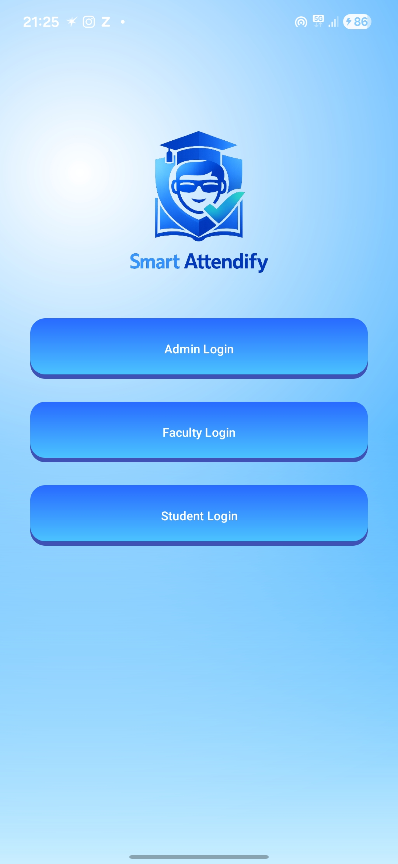
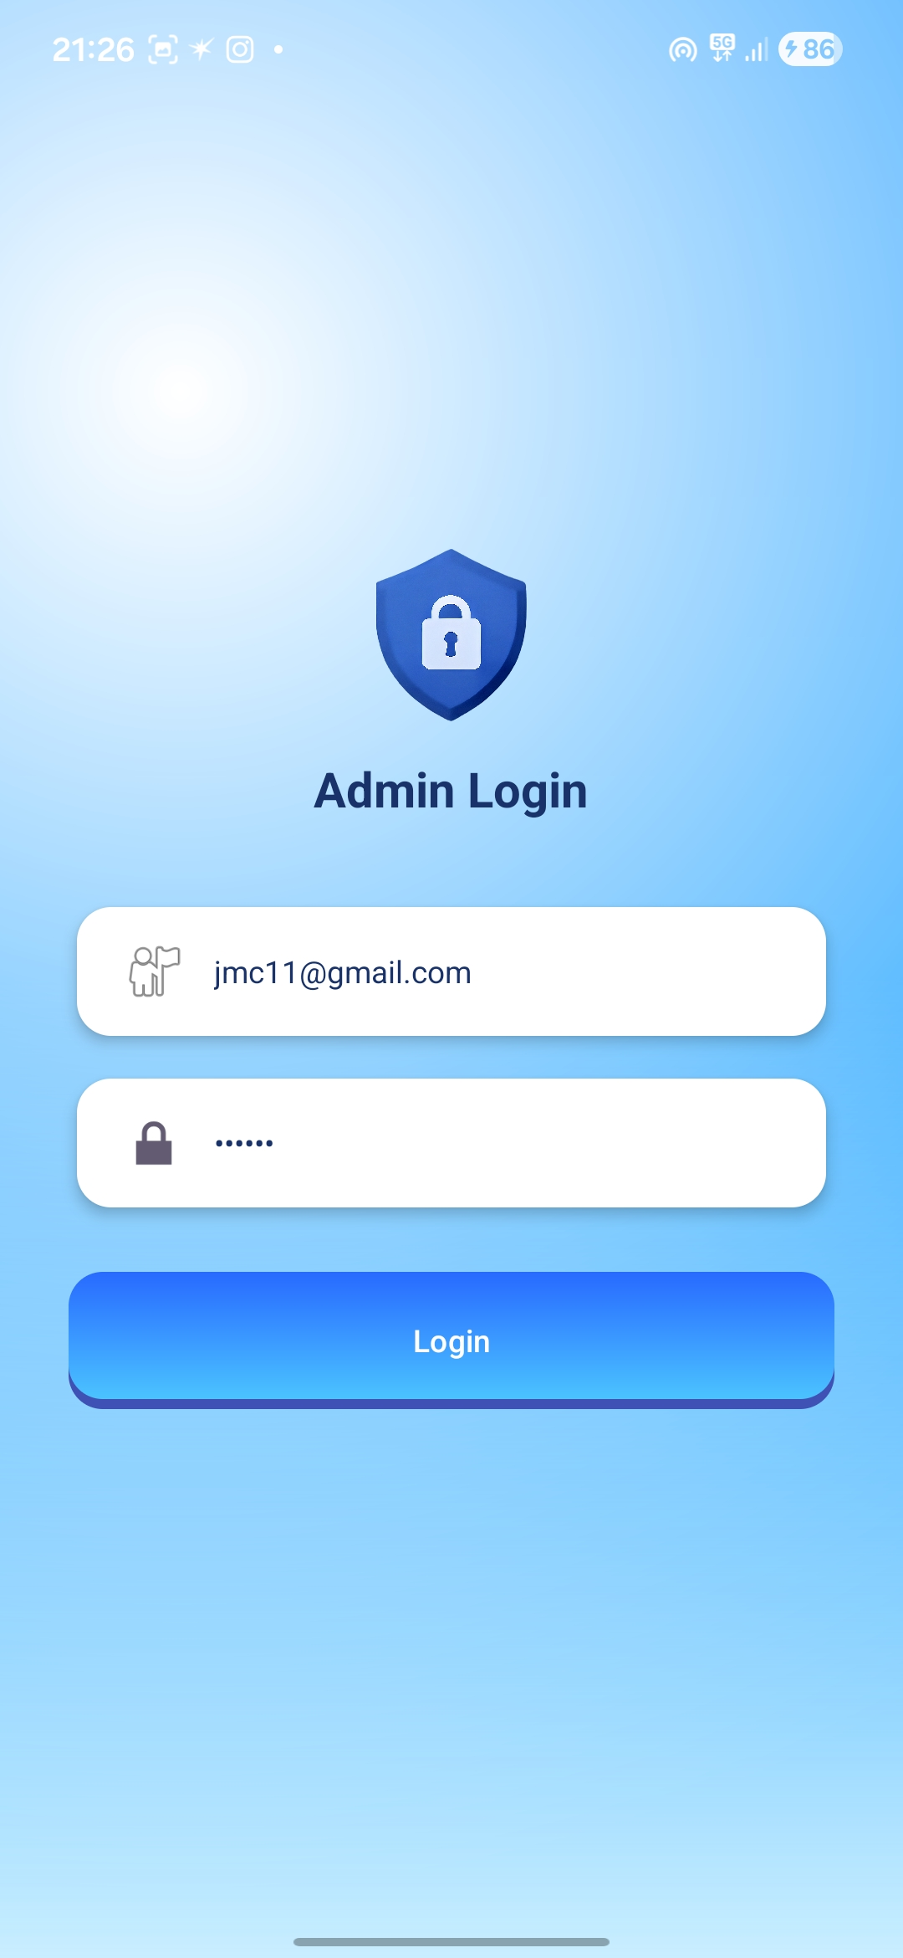
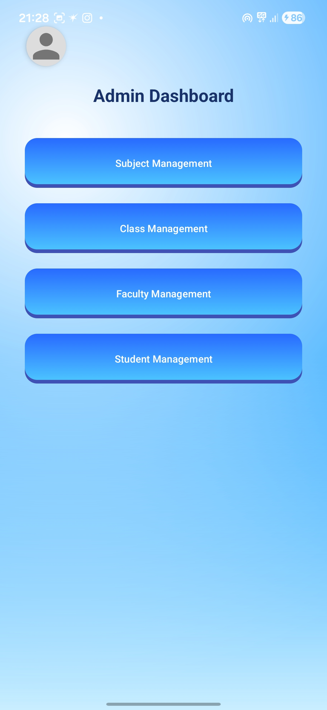
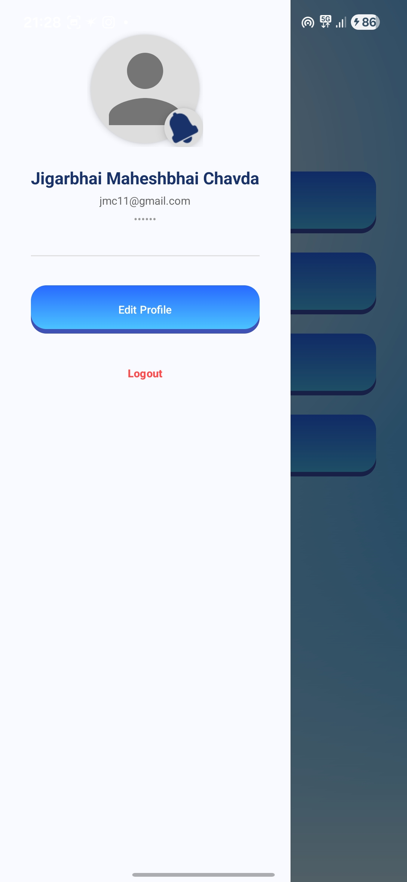
Implementation Demo ( Screenshots )
<Smart Attendance Application>

Slide 16
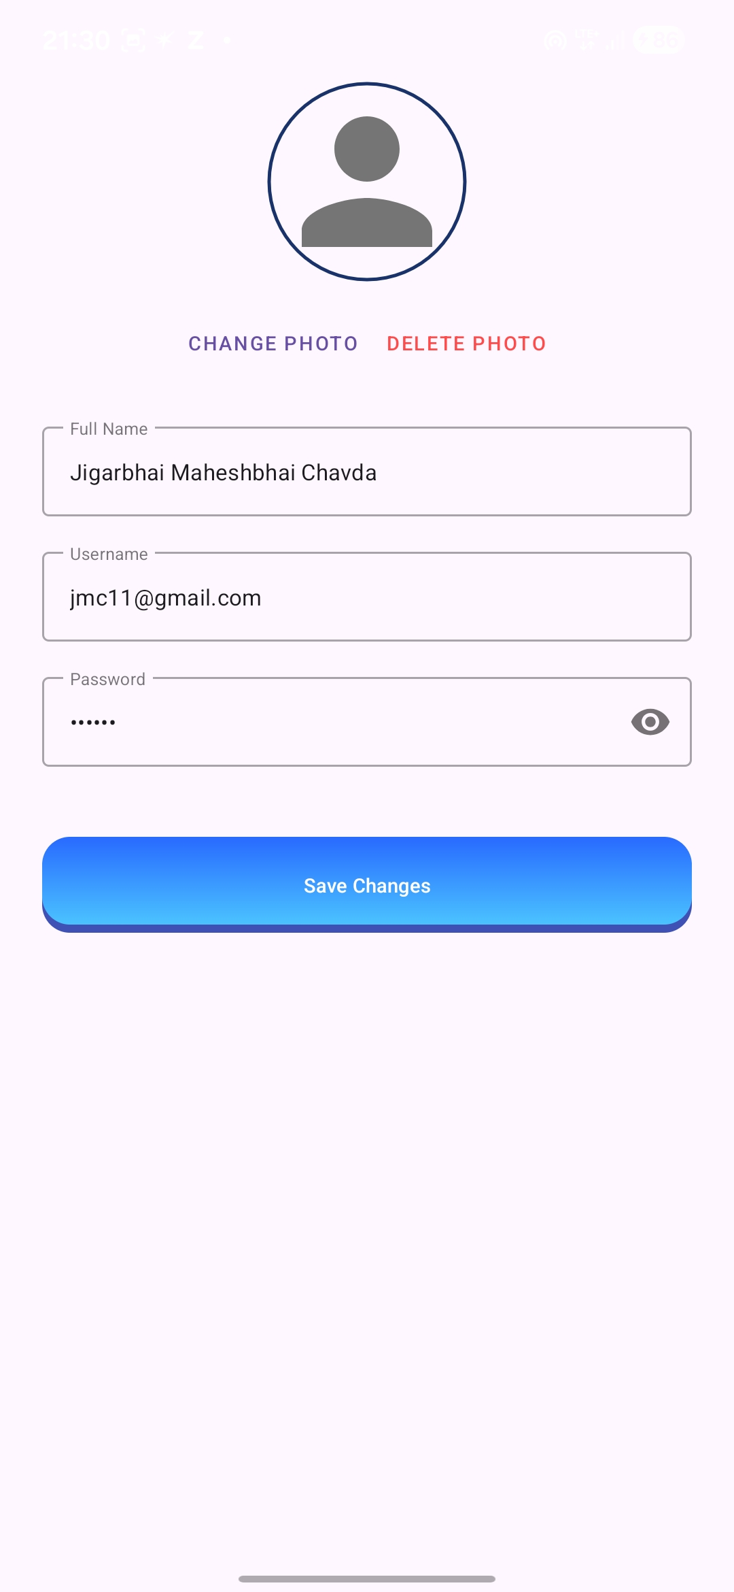
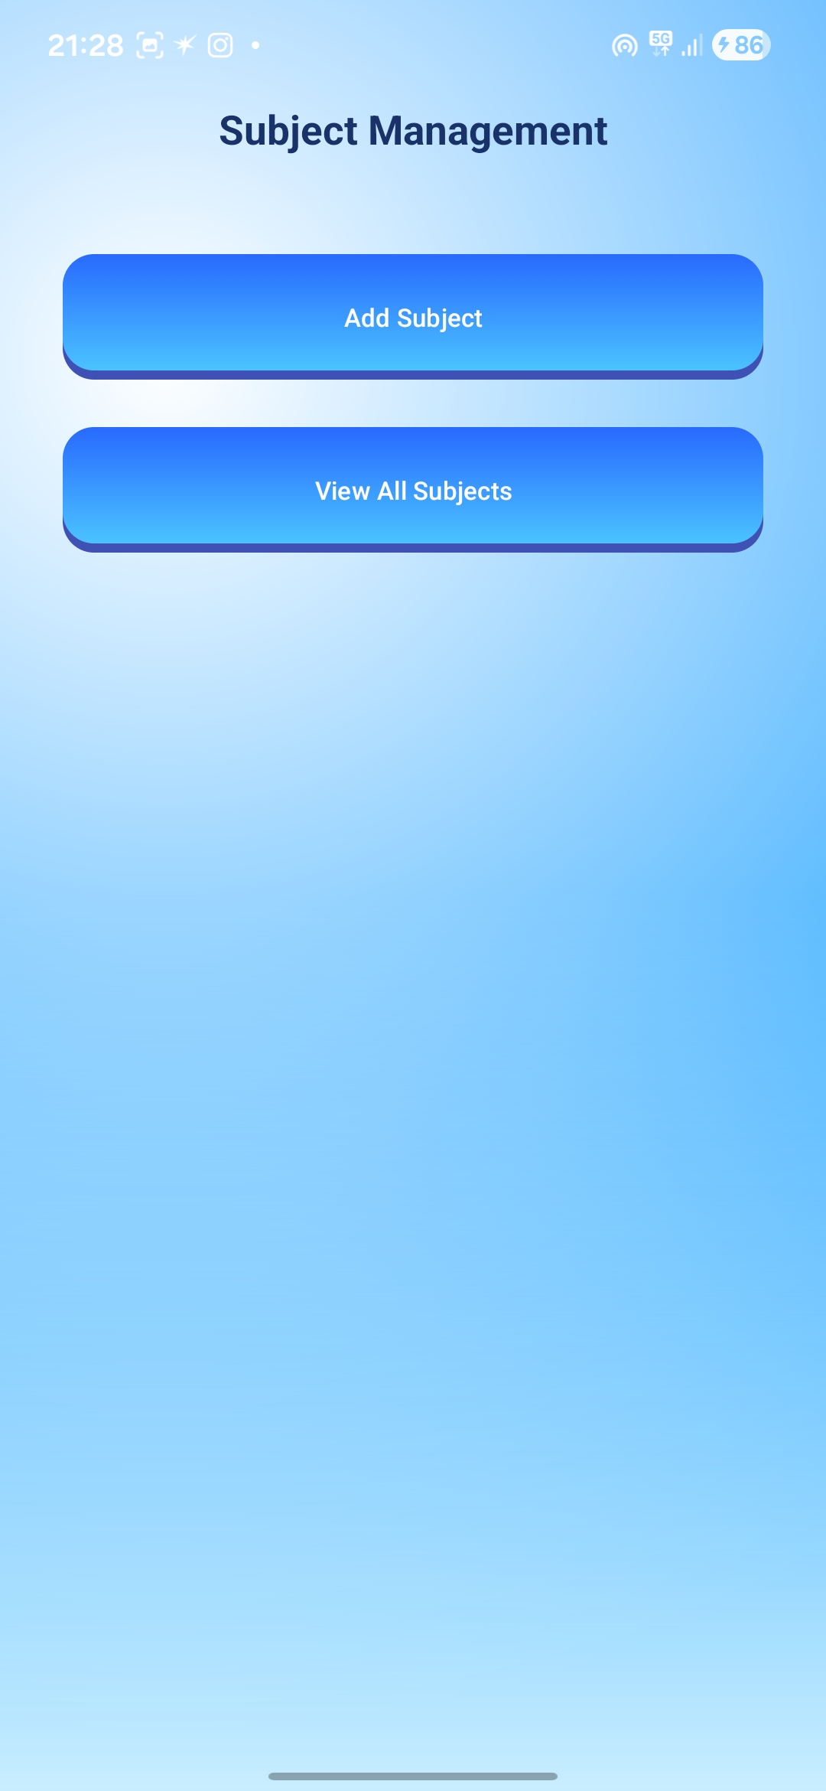
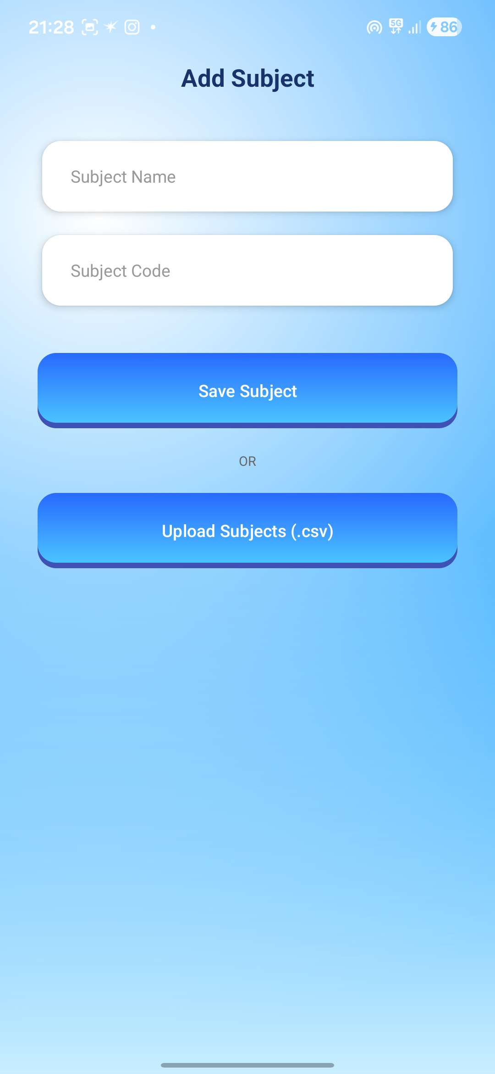
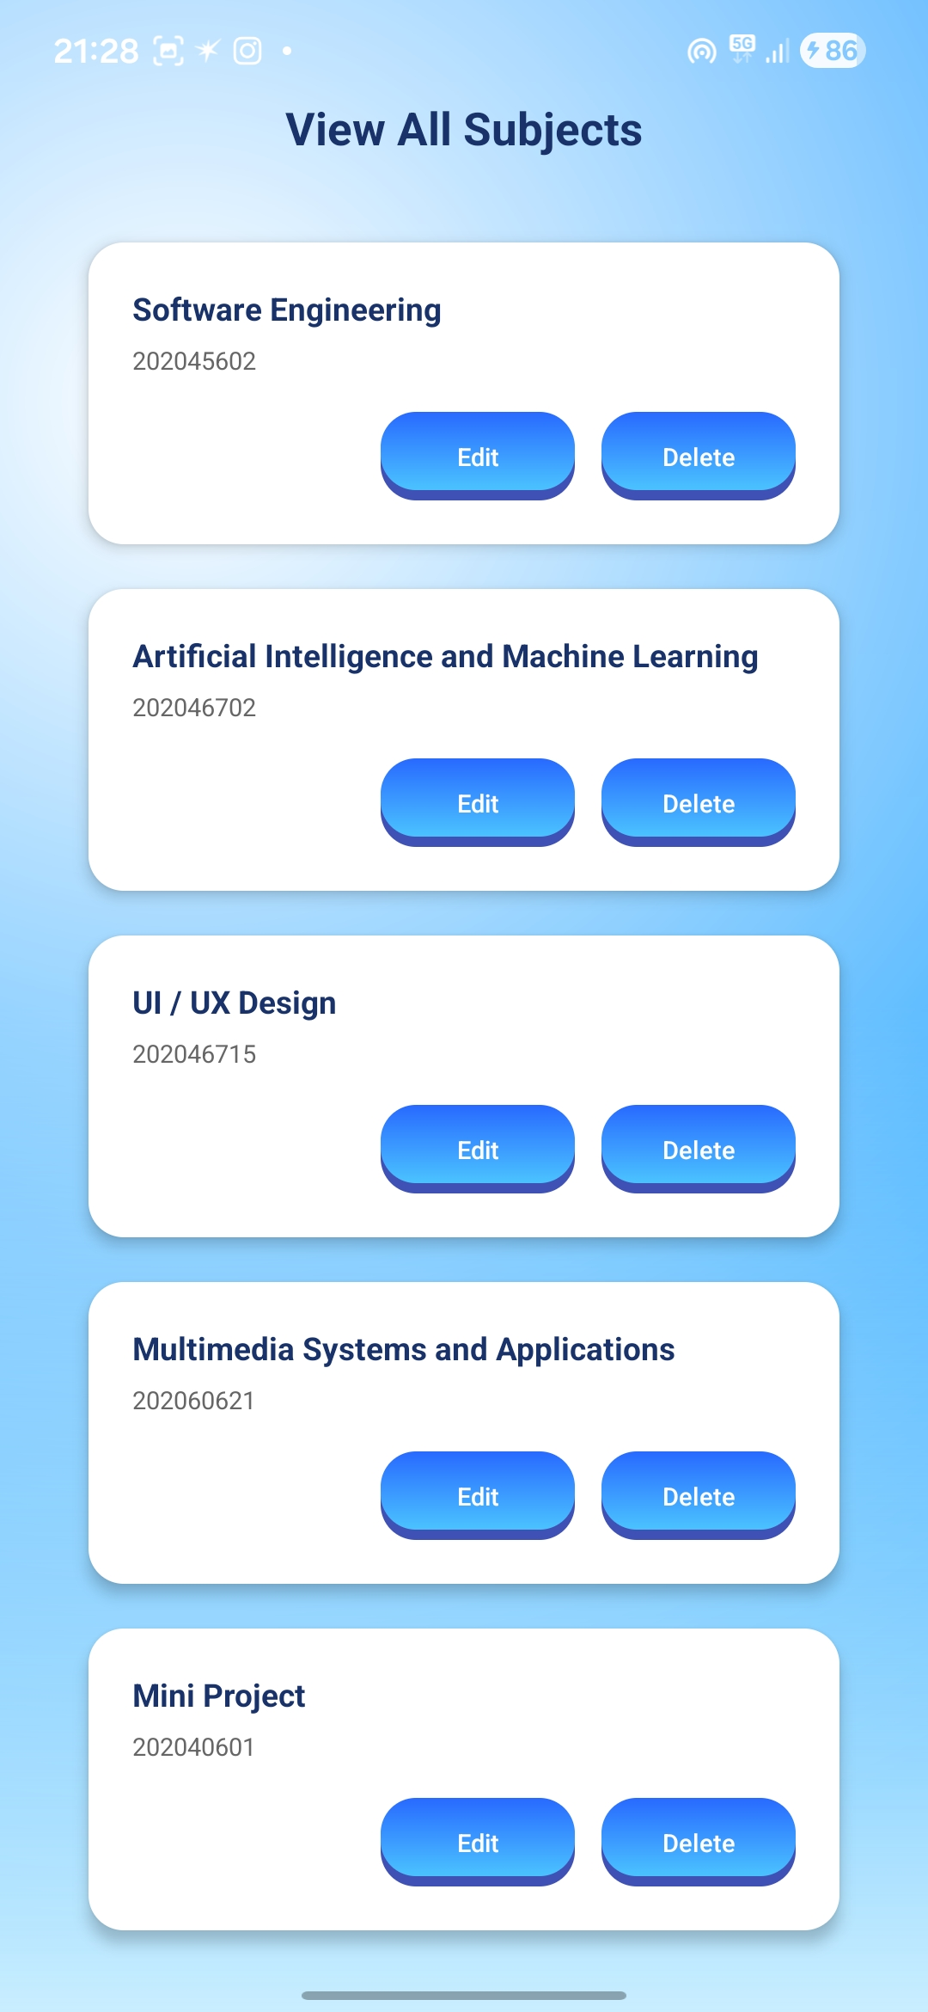
Implementation Demo ( Screenshots )
<Smart Attendance Application>

Slide 17

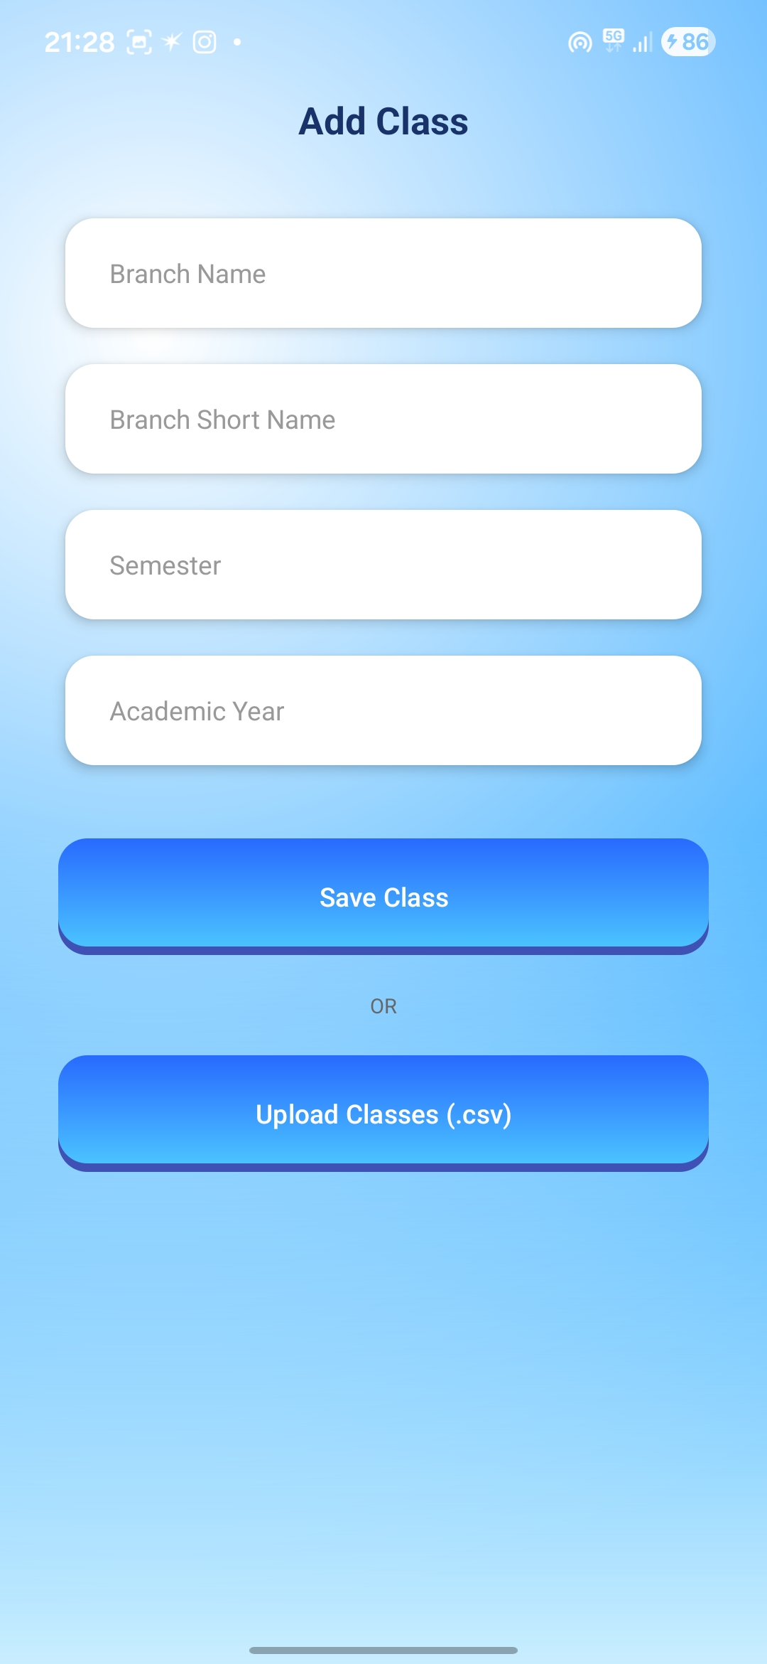
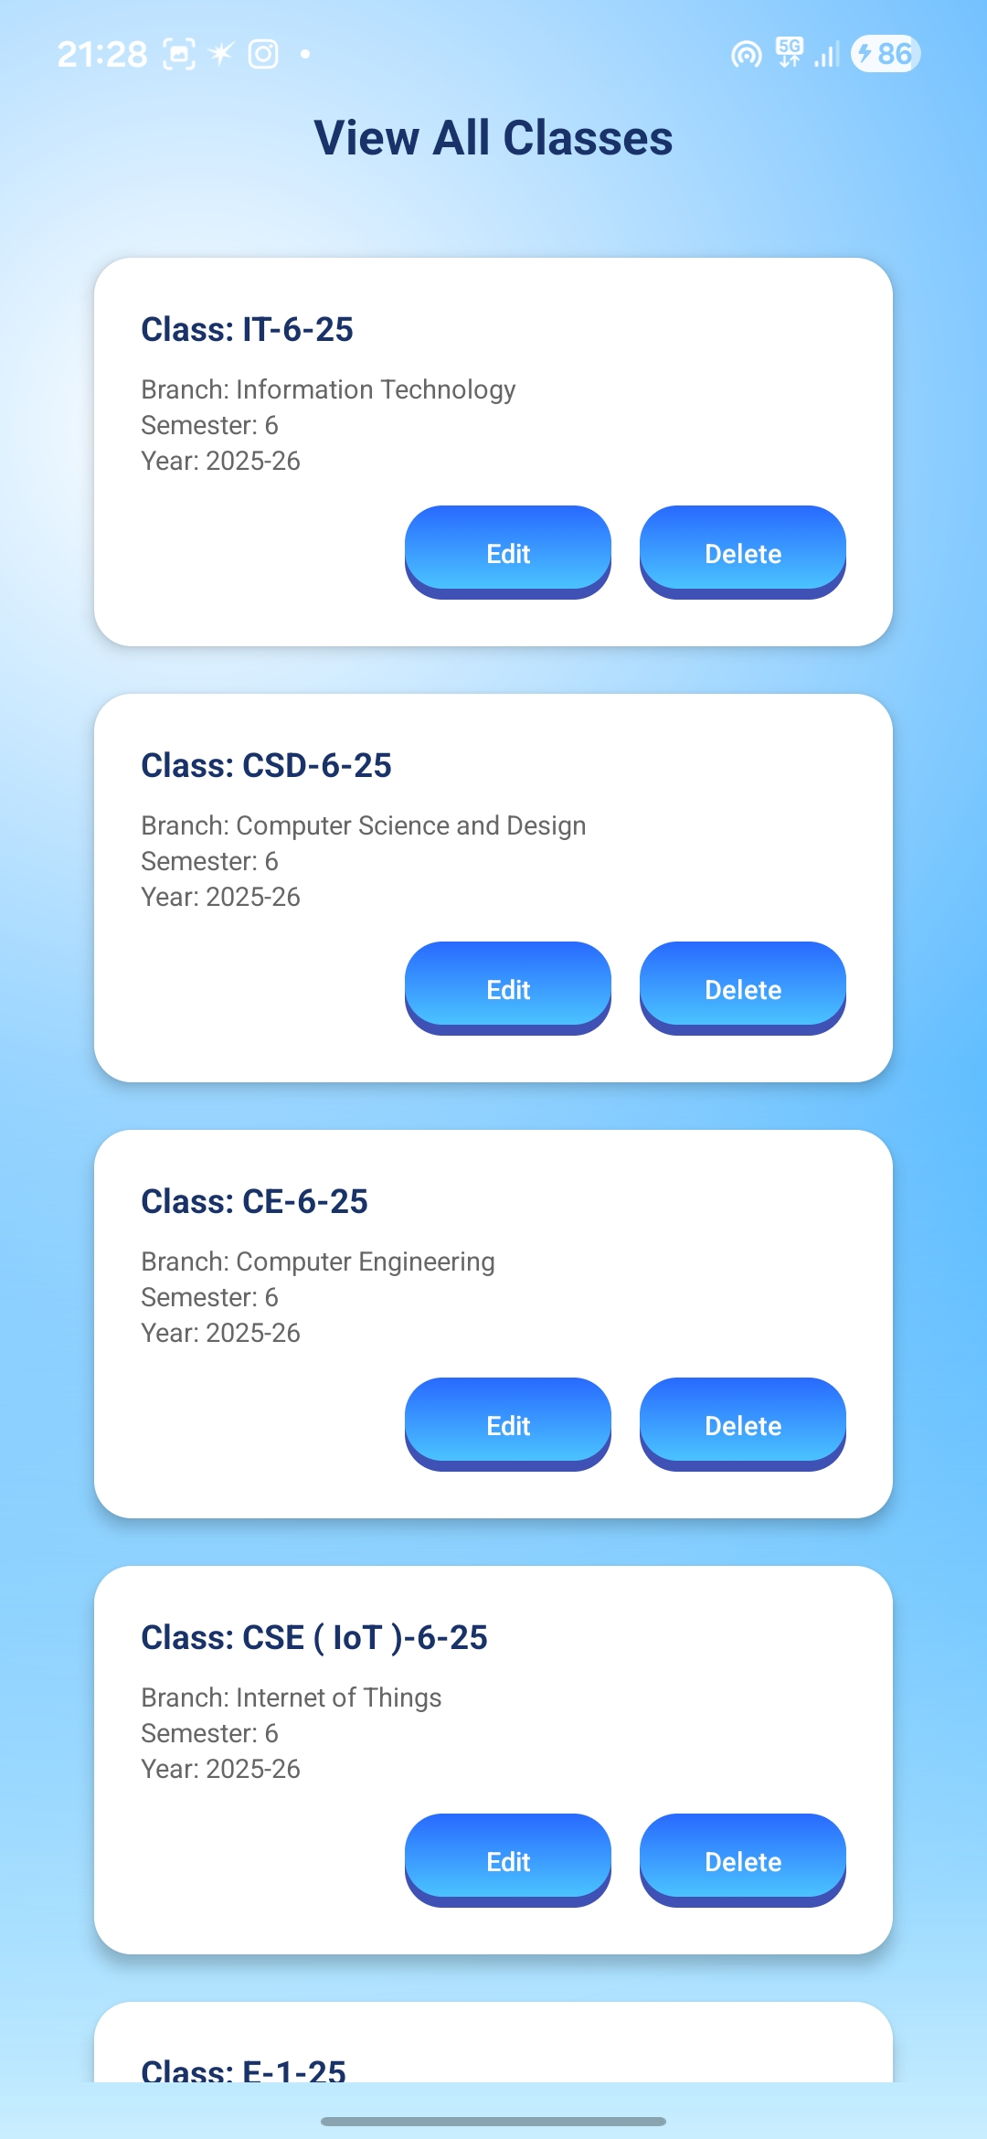

Implementation Demo ( Screenshots )
<Smart Attendance Application>

Slide 18
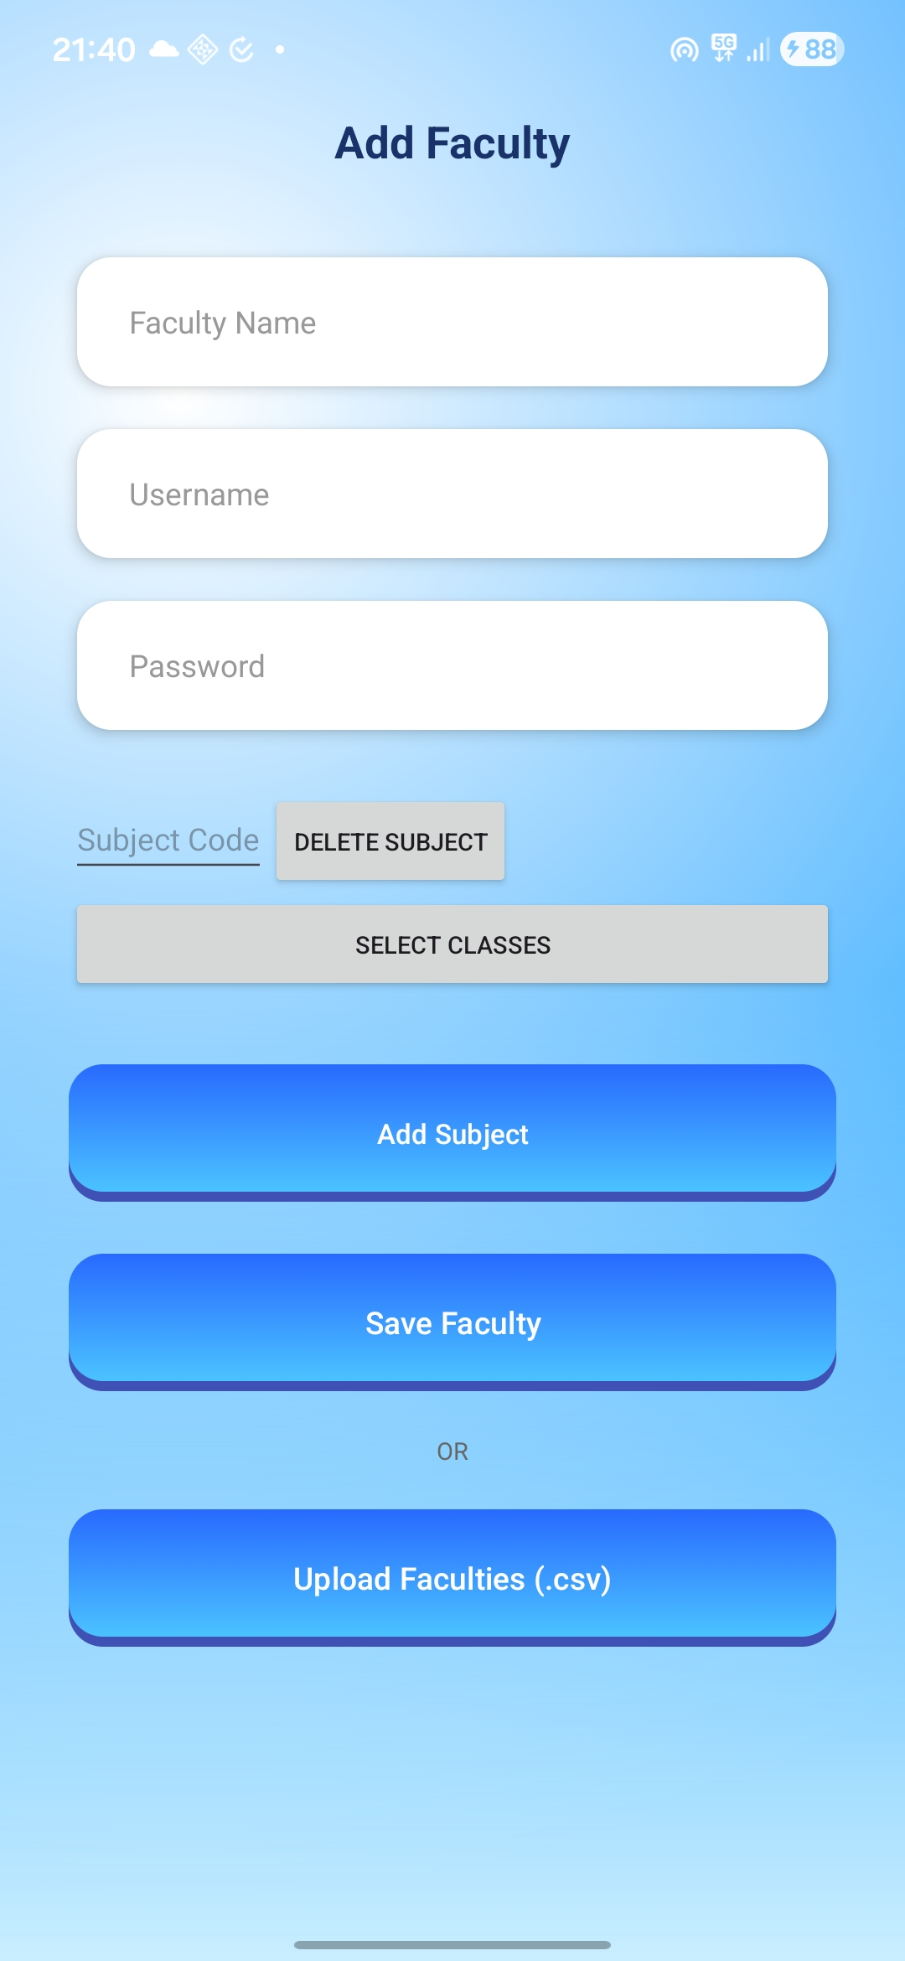
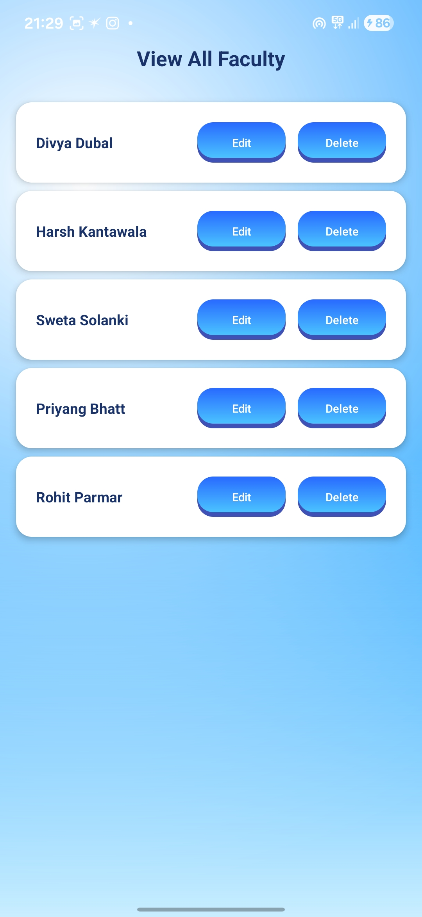
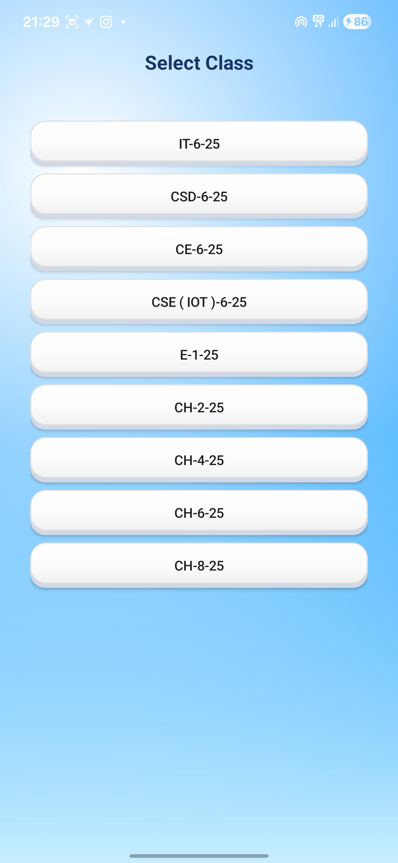
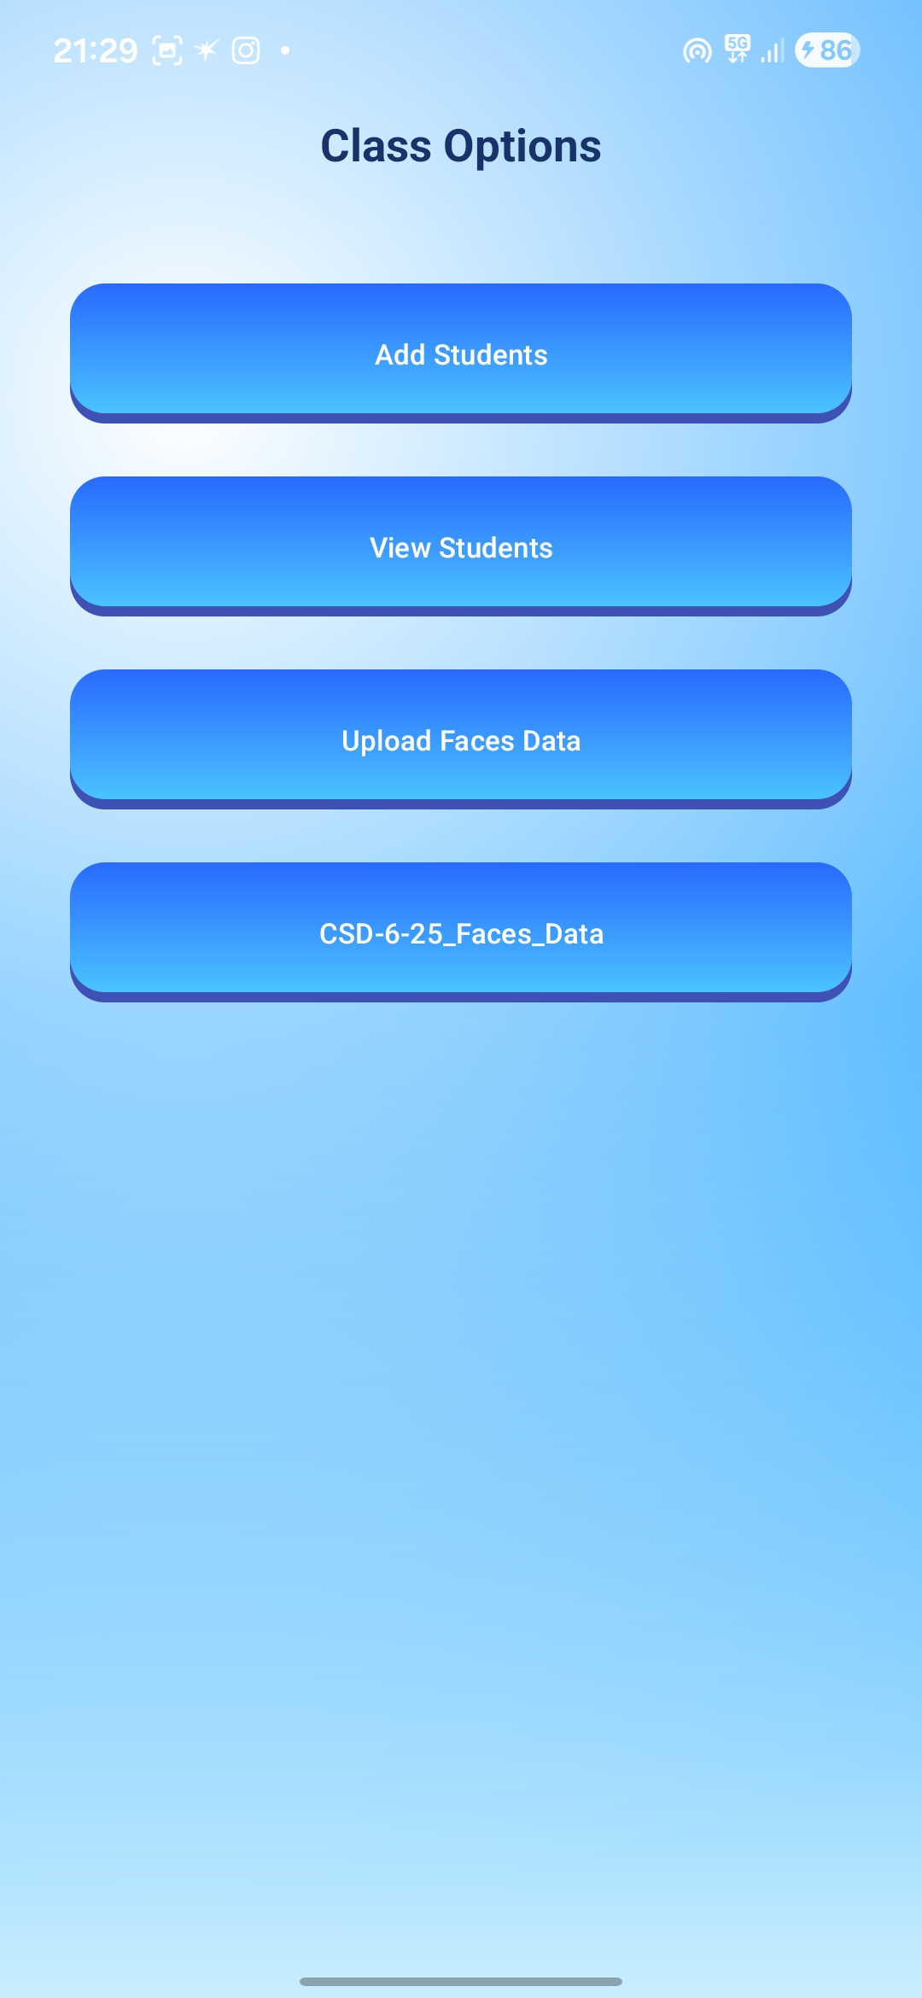
Implementation Demo ( Screenshots )
<Smart Attendance Application>

Slide 19
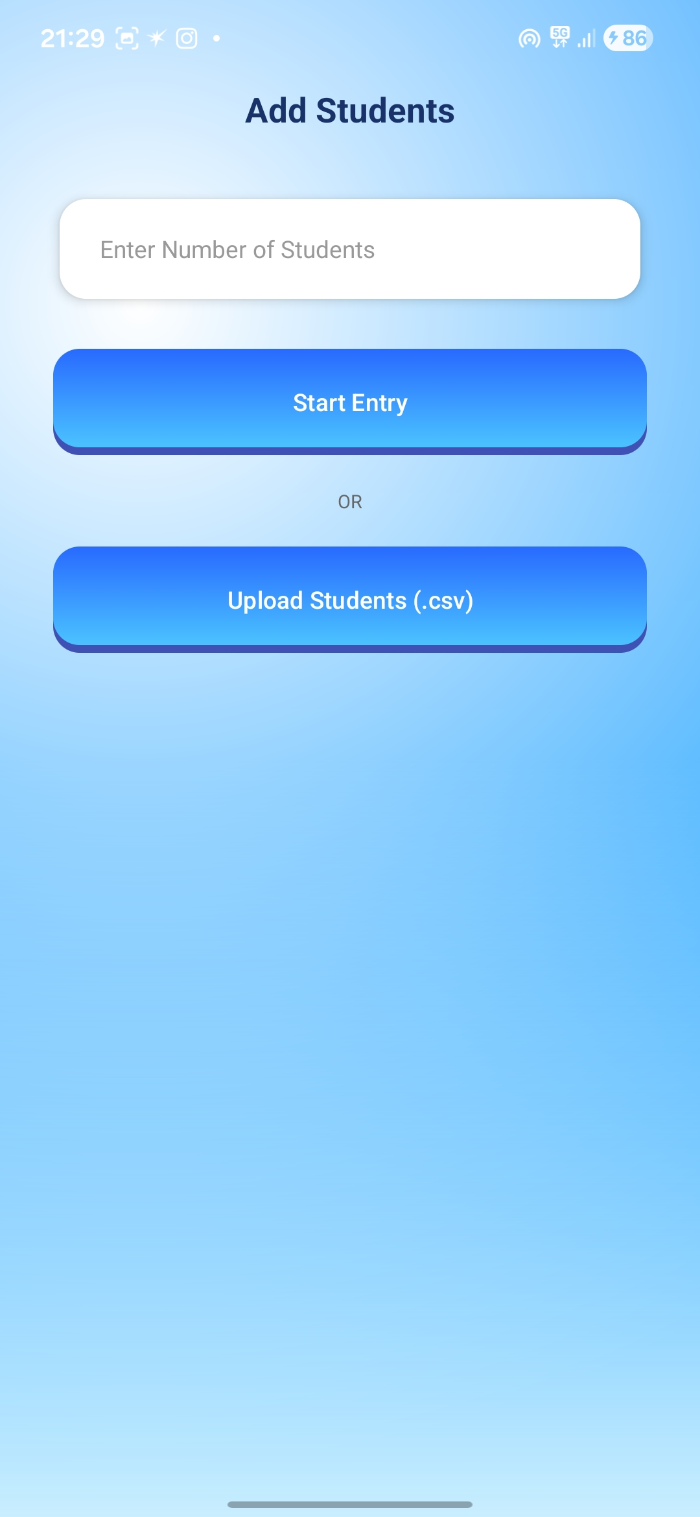
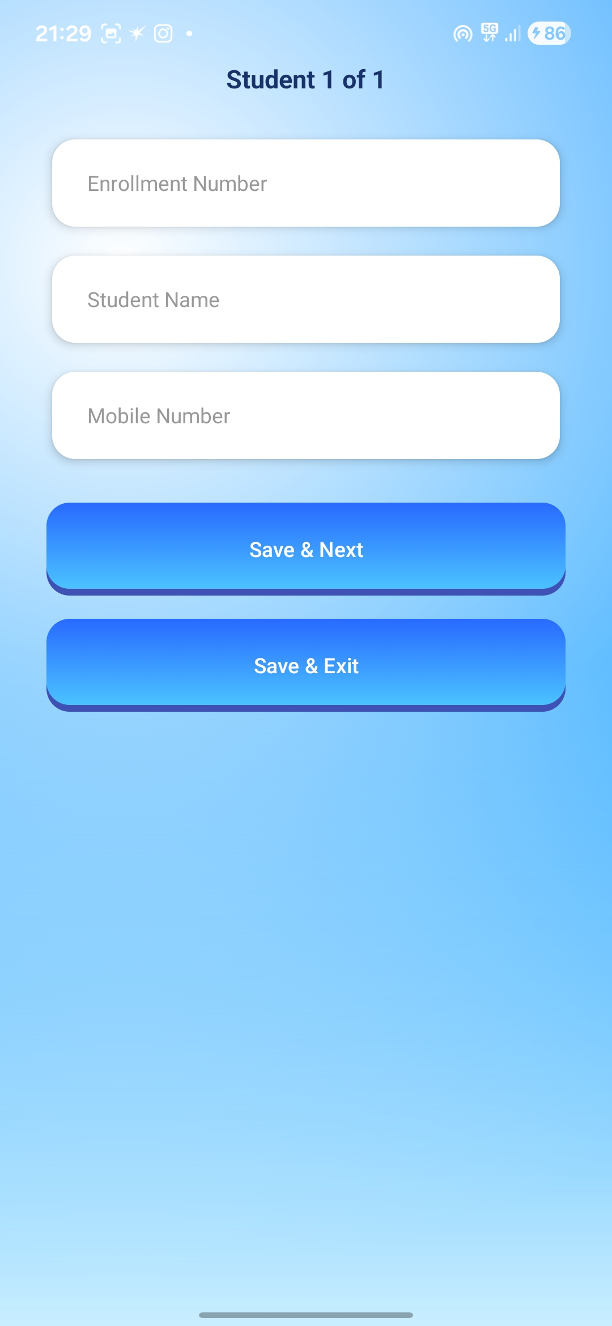
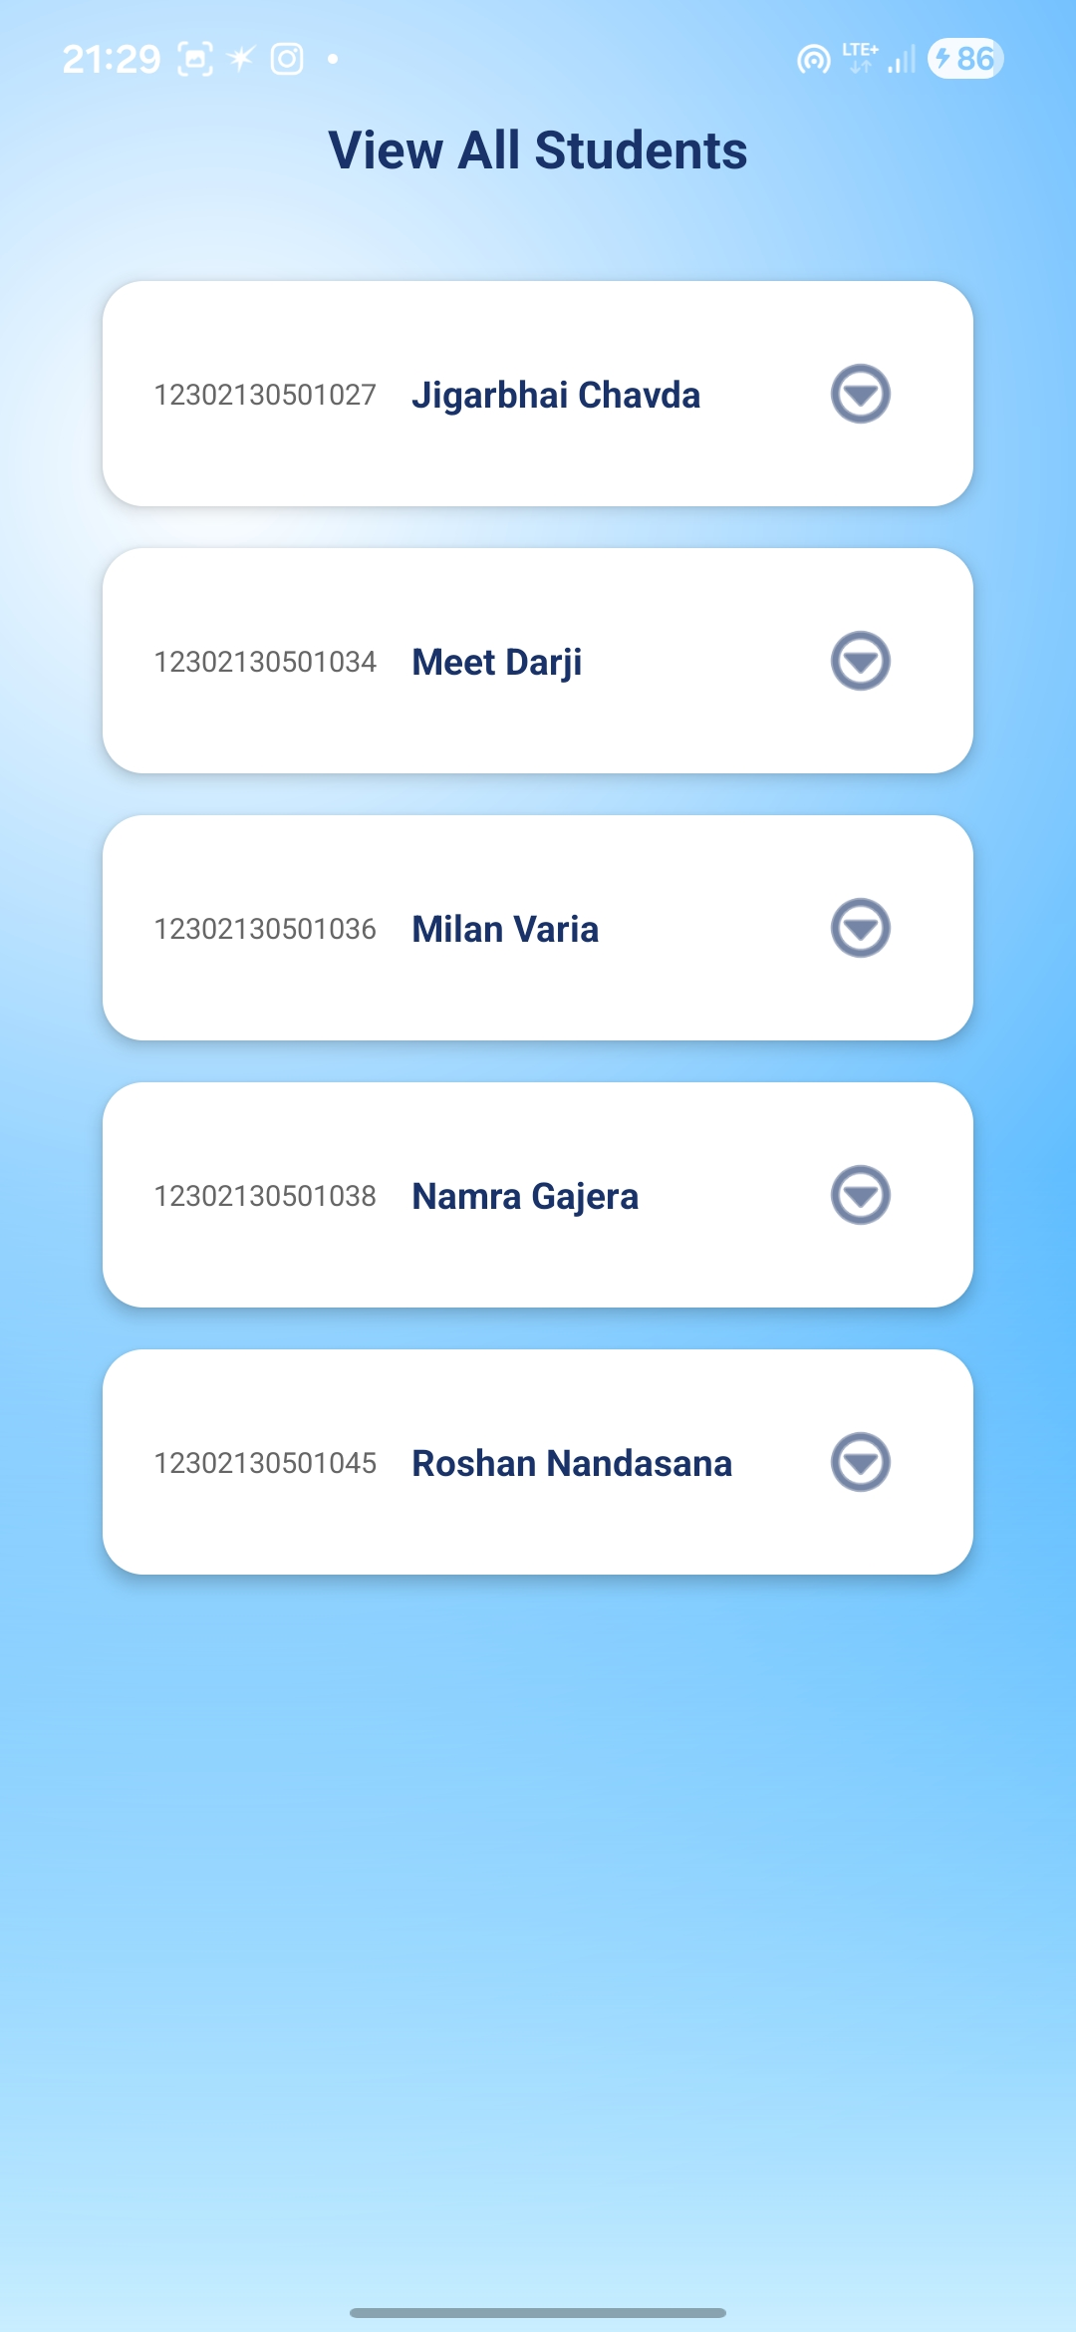
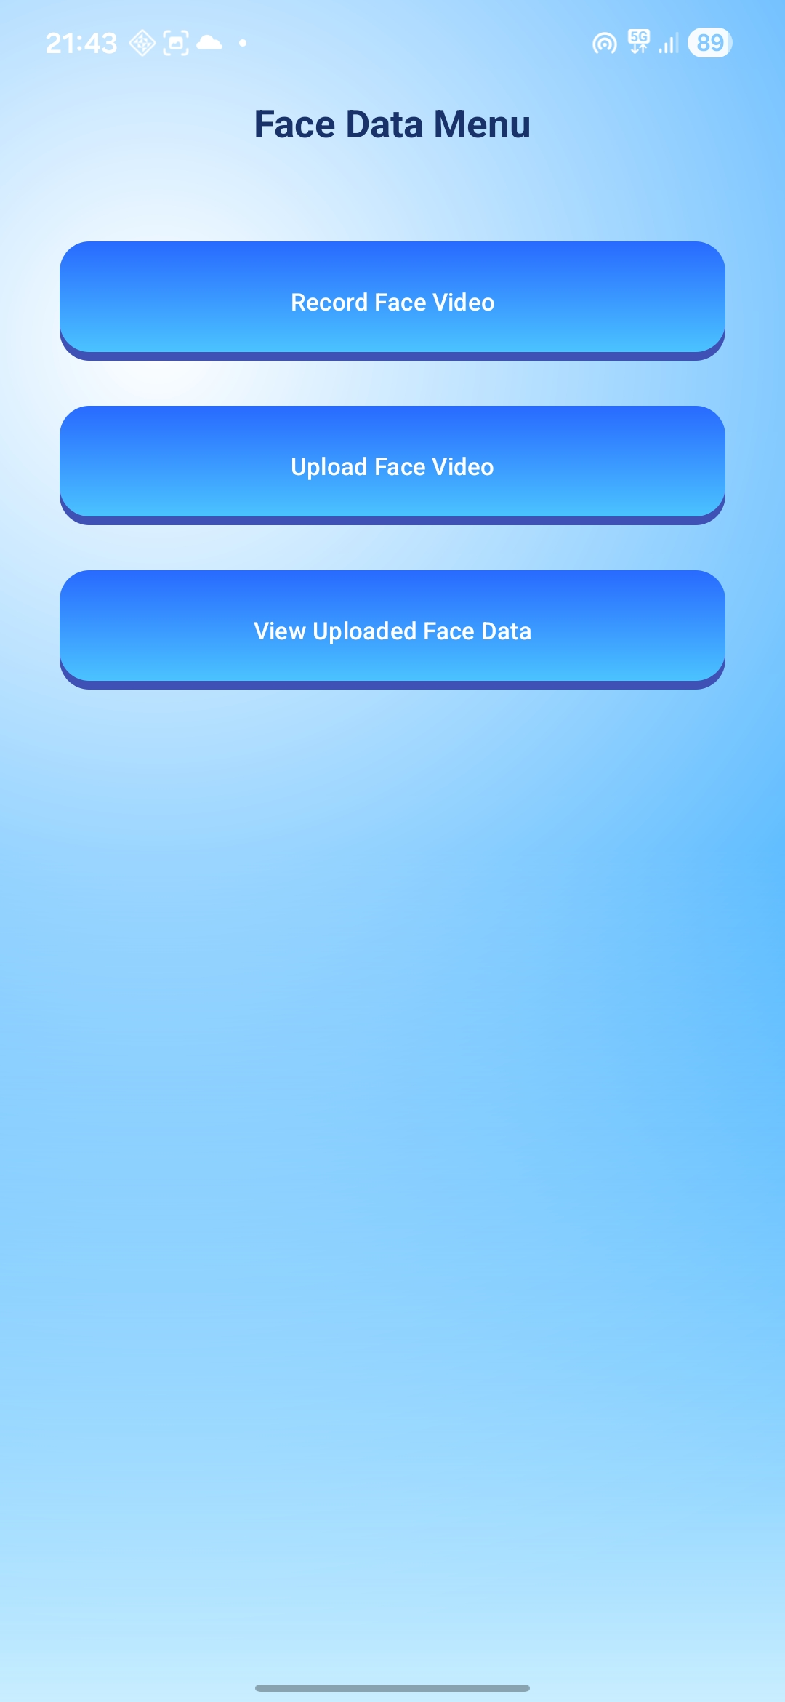
Implementation Demo ( Screenshots )
<Smart Attendance Application>

Slide 20
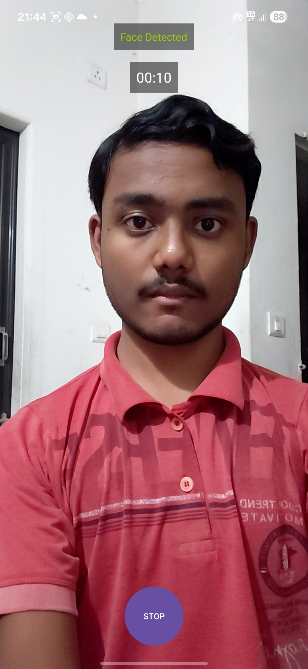
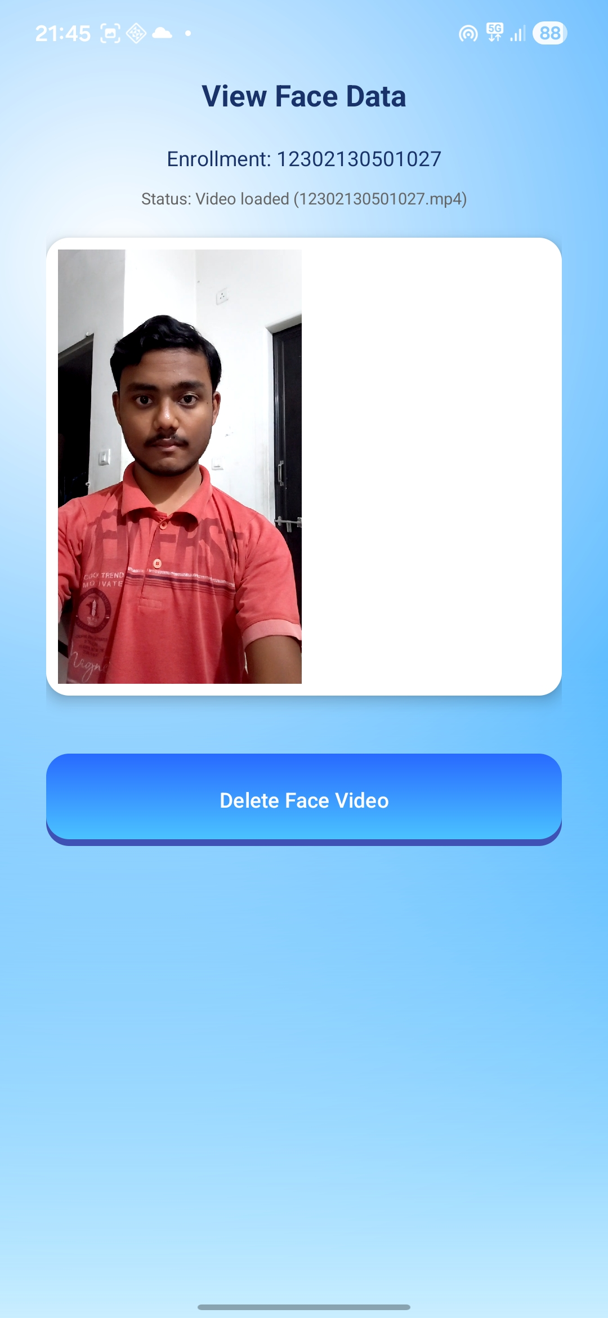
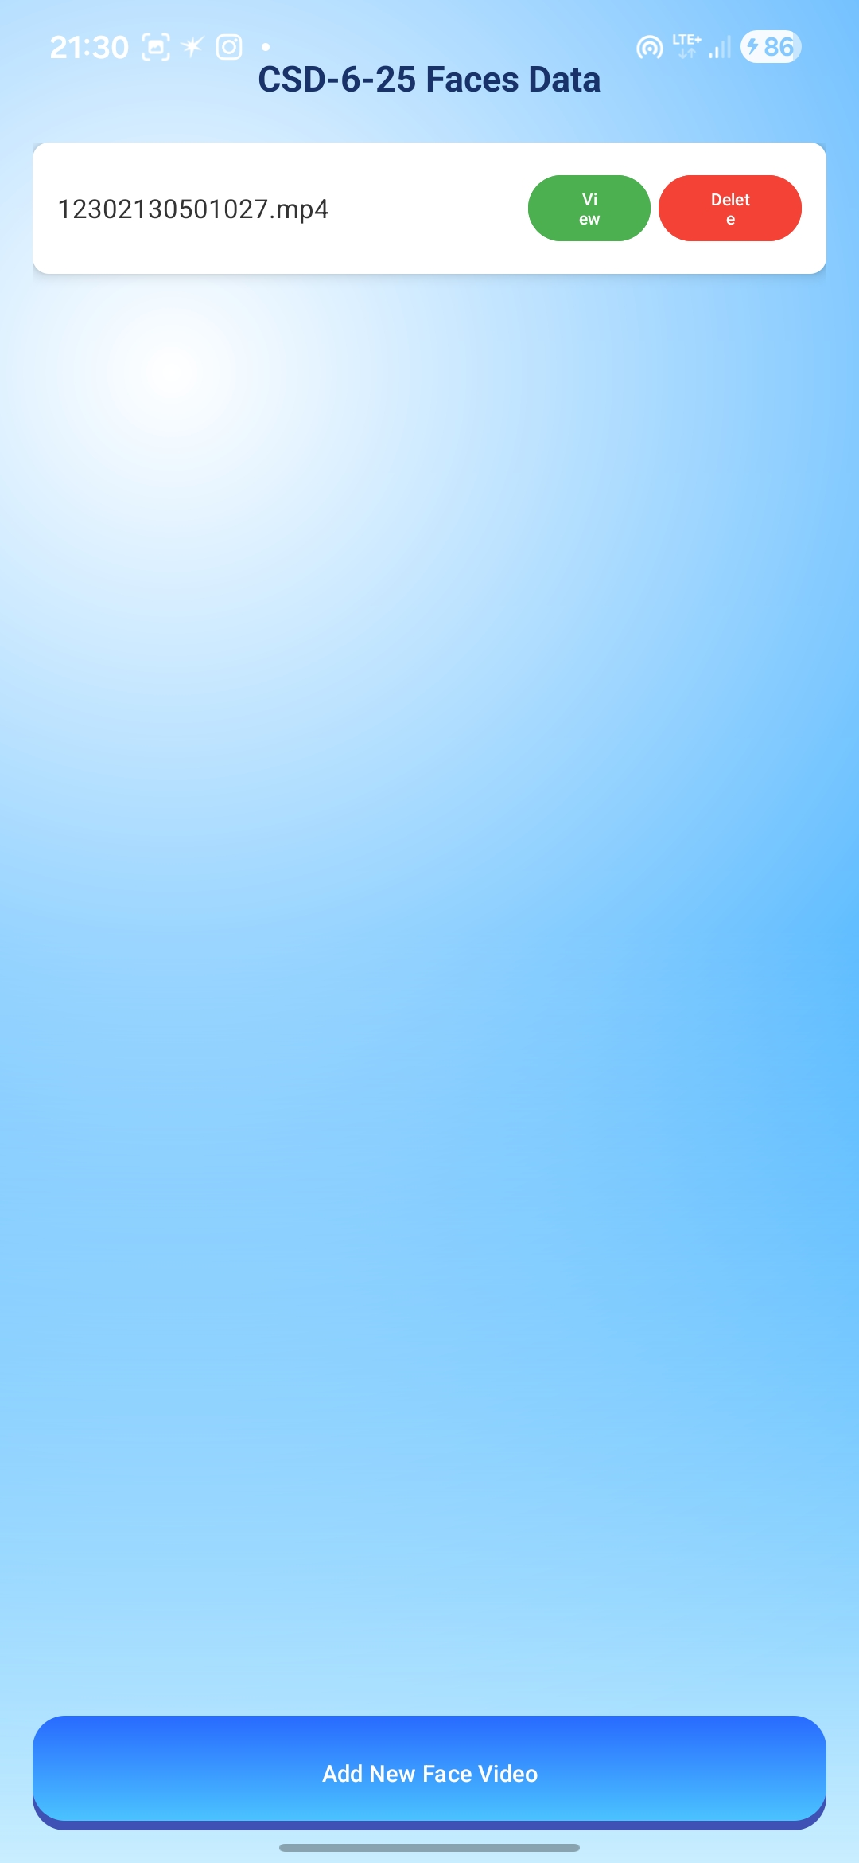
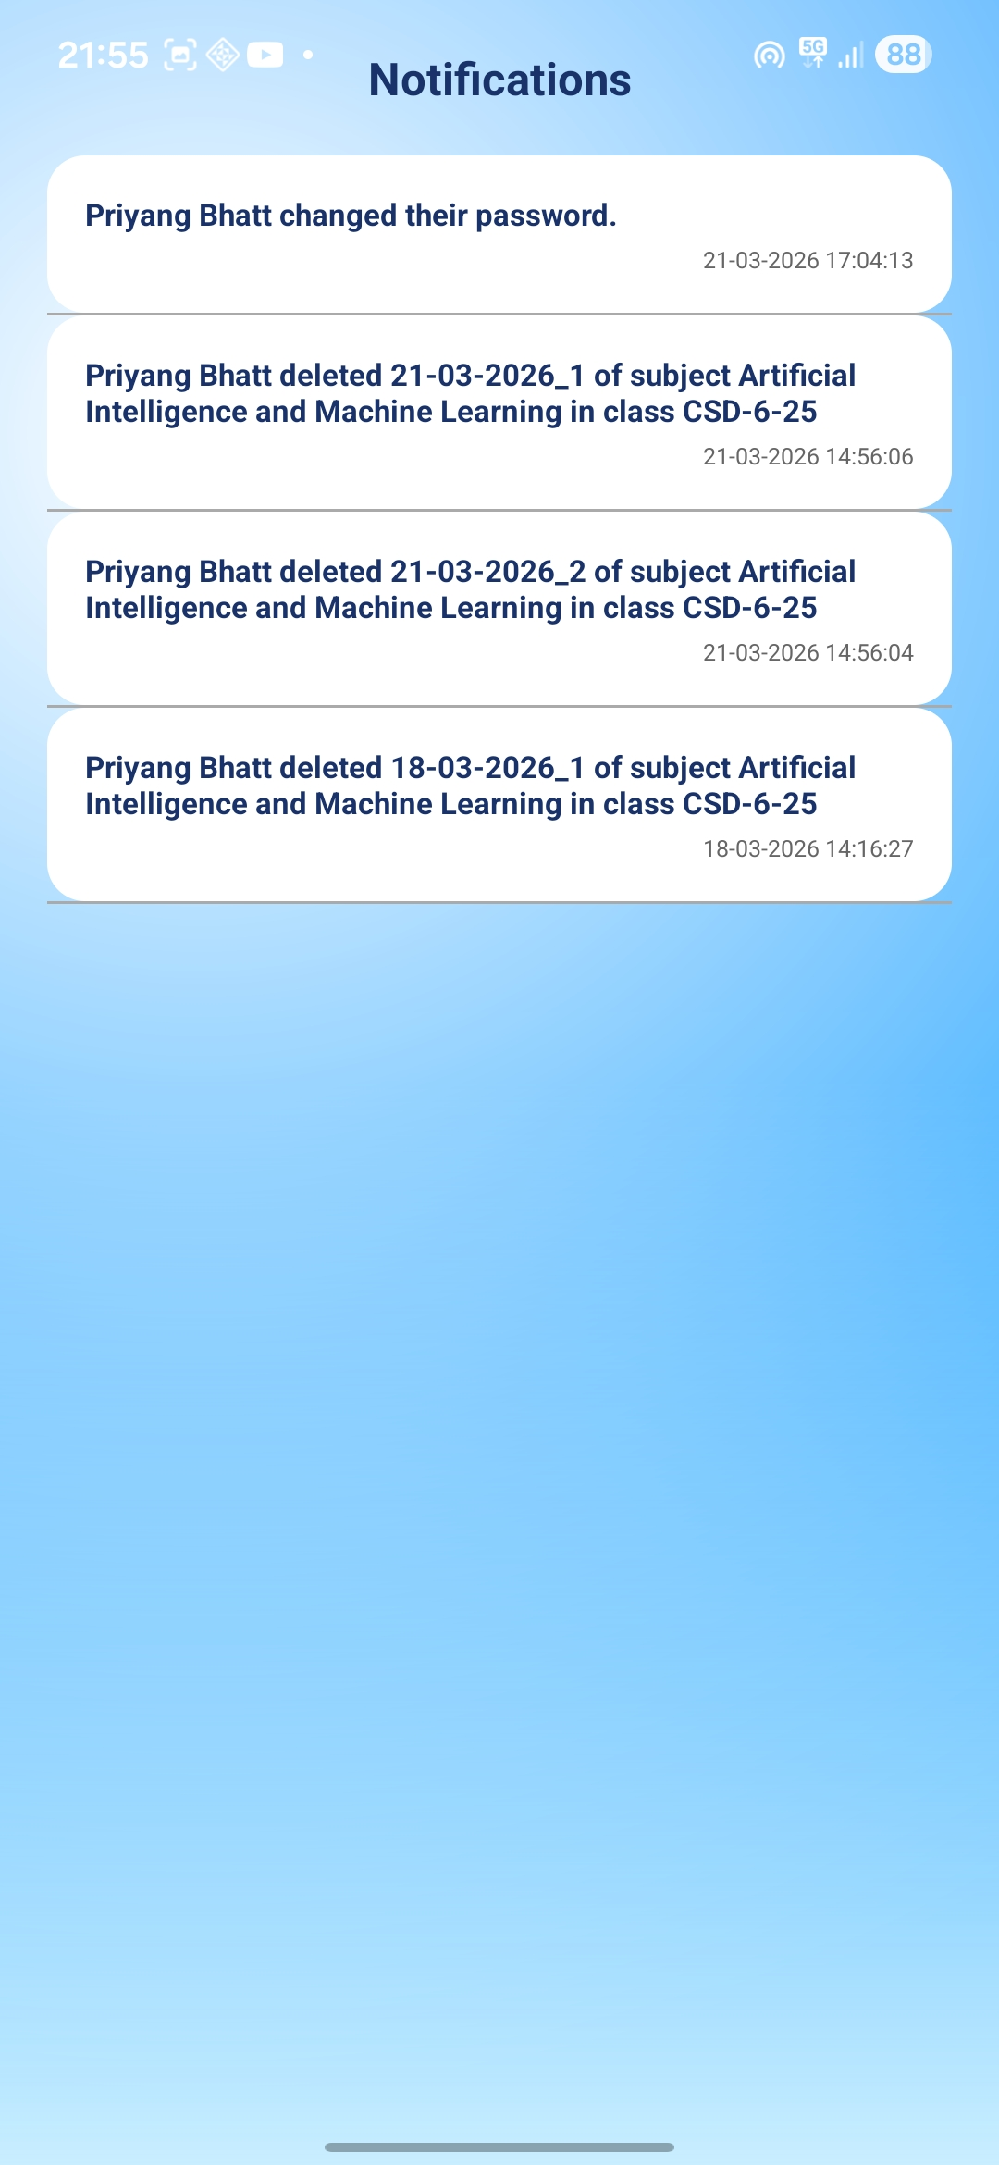
Implementation Demo ( Screenshots )
<Smart Attendance Application>

Slide 21

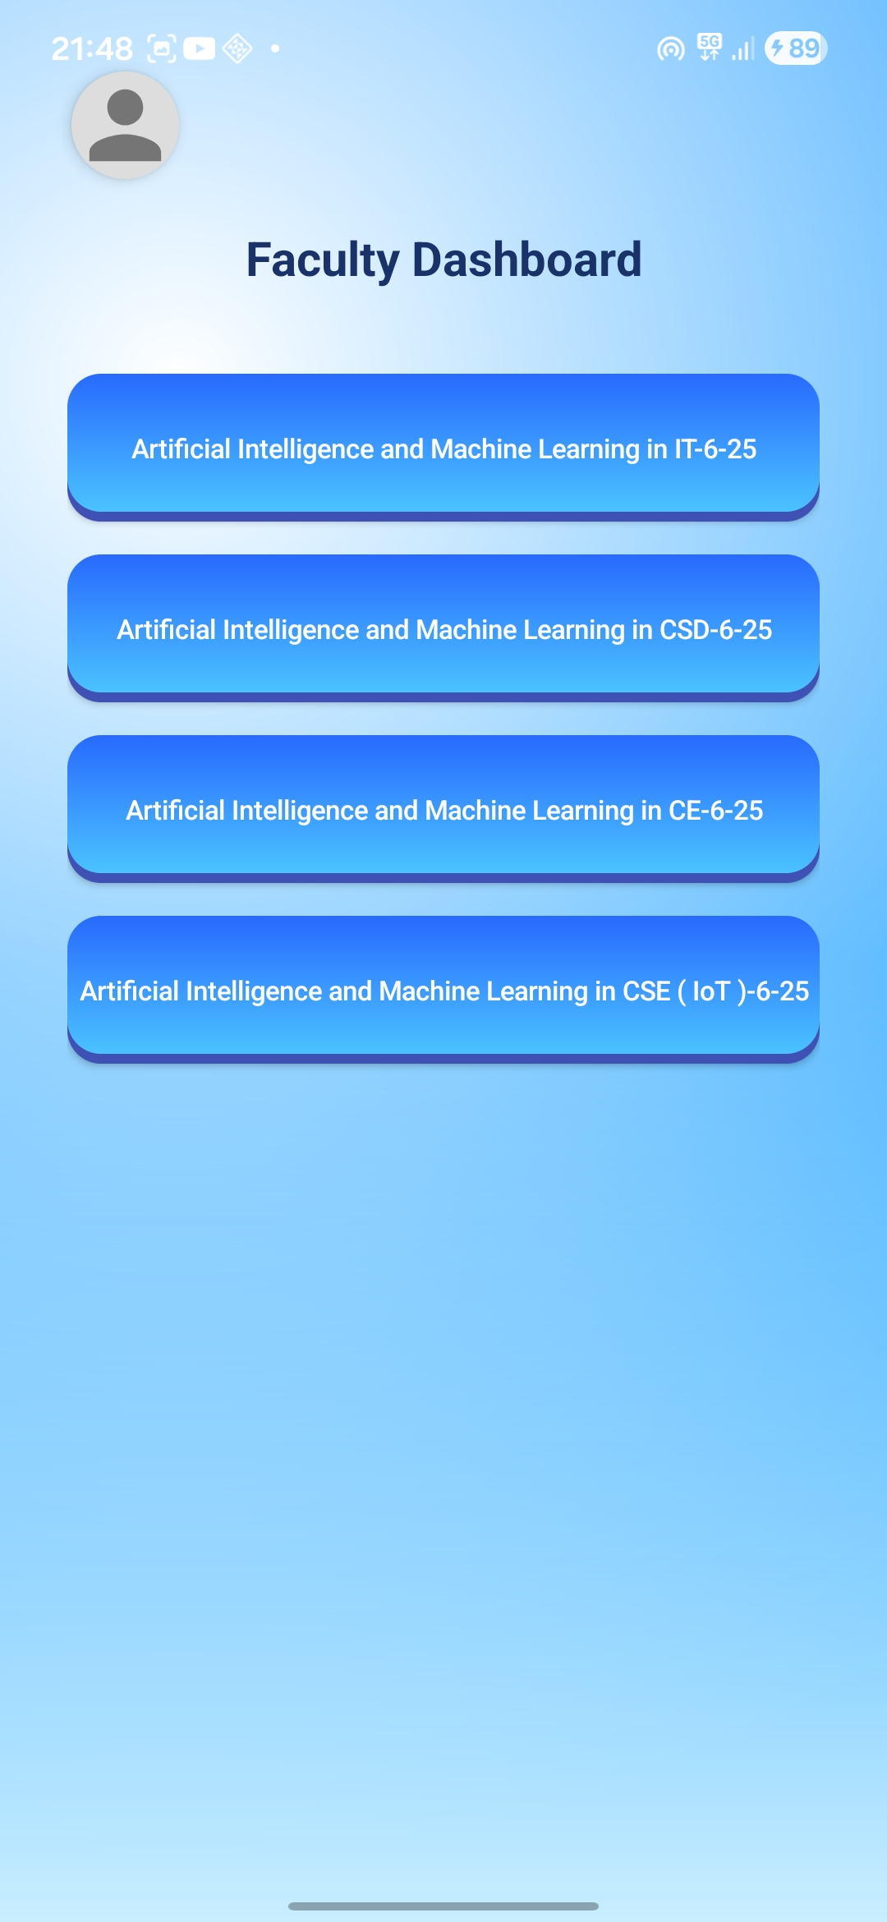
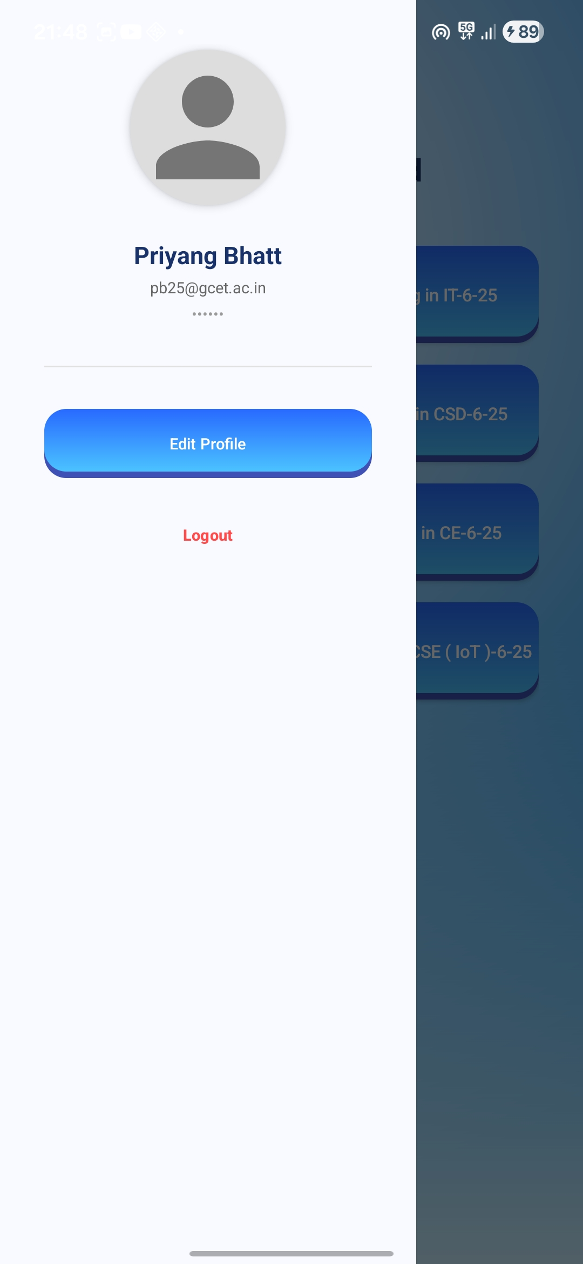
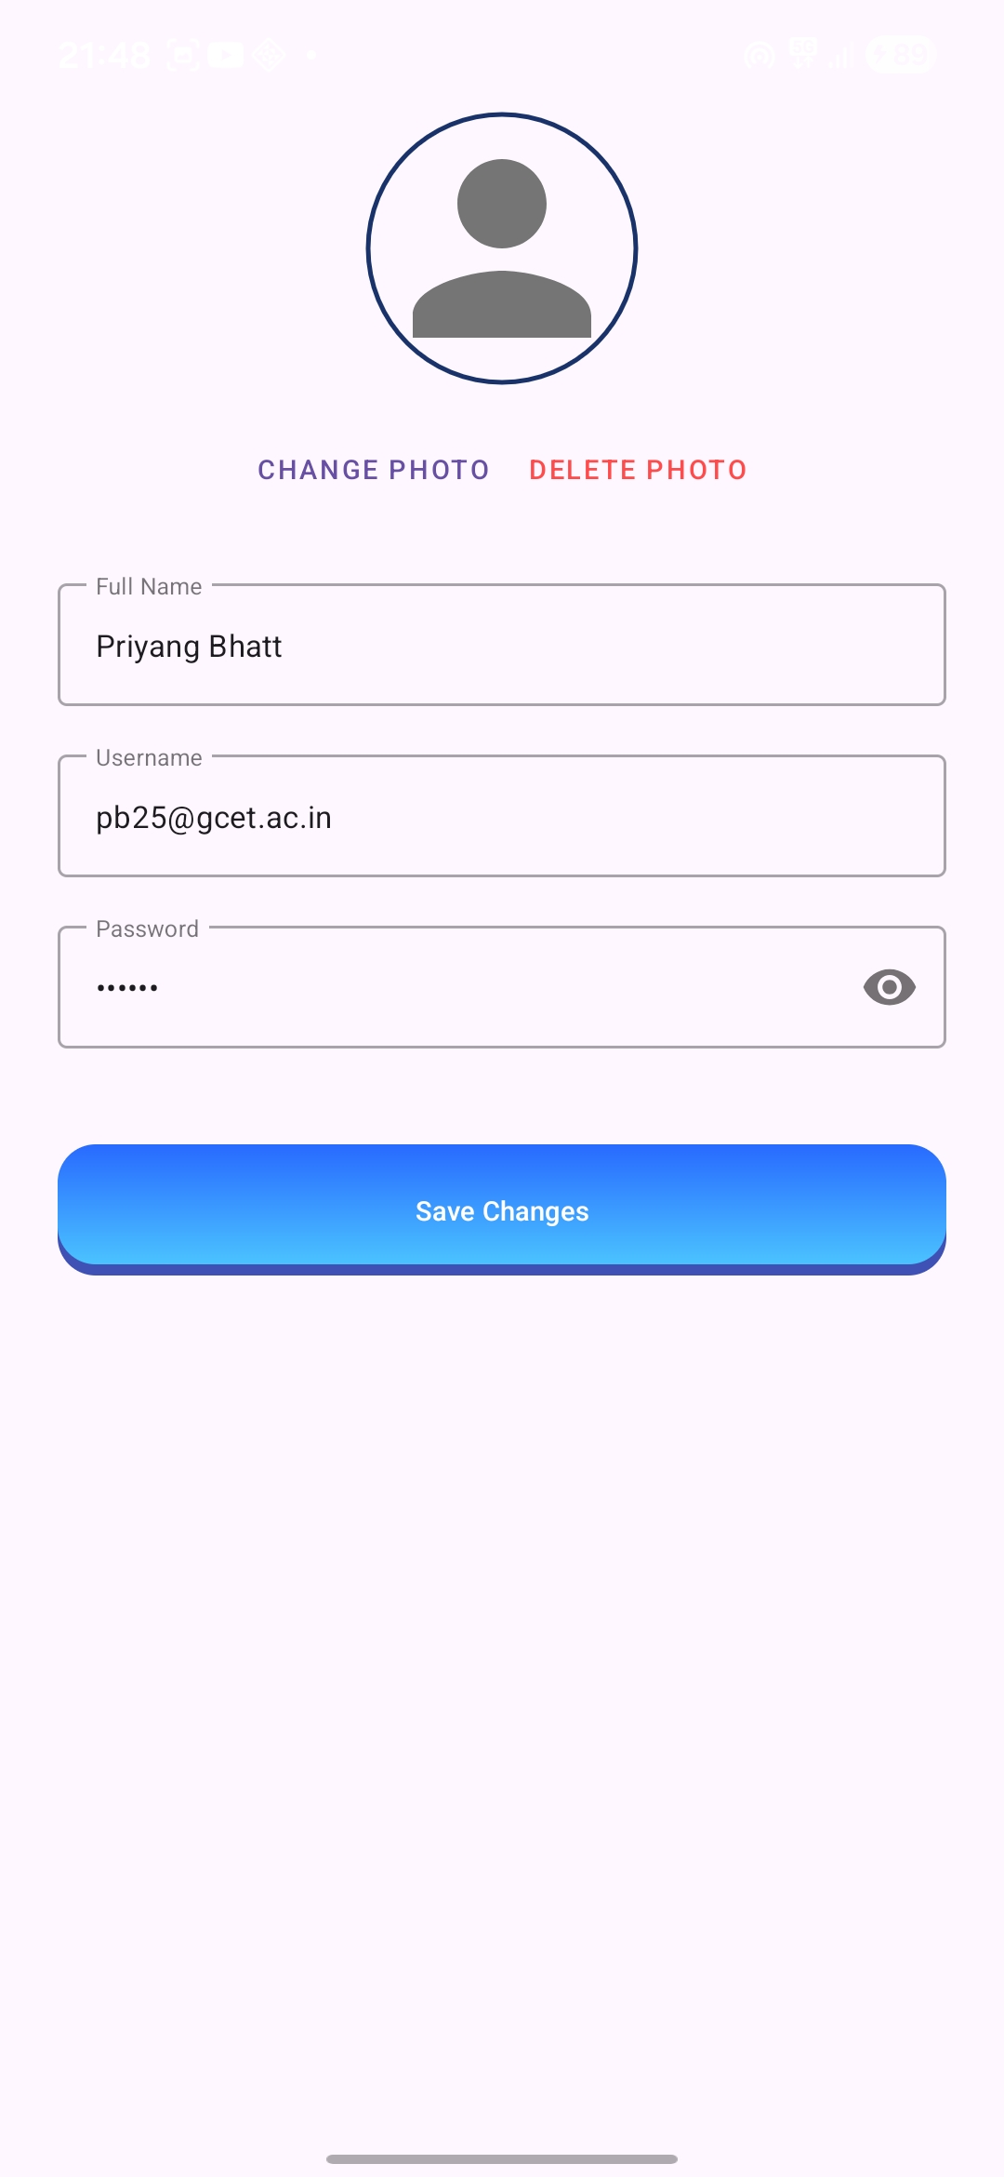
Implementation Demo ( Screenshots )
<Smart Attendance Application>

Slide 22
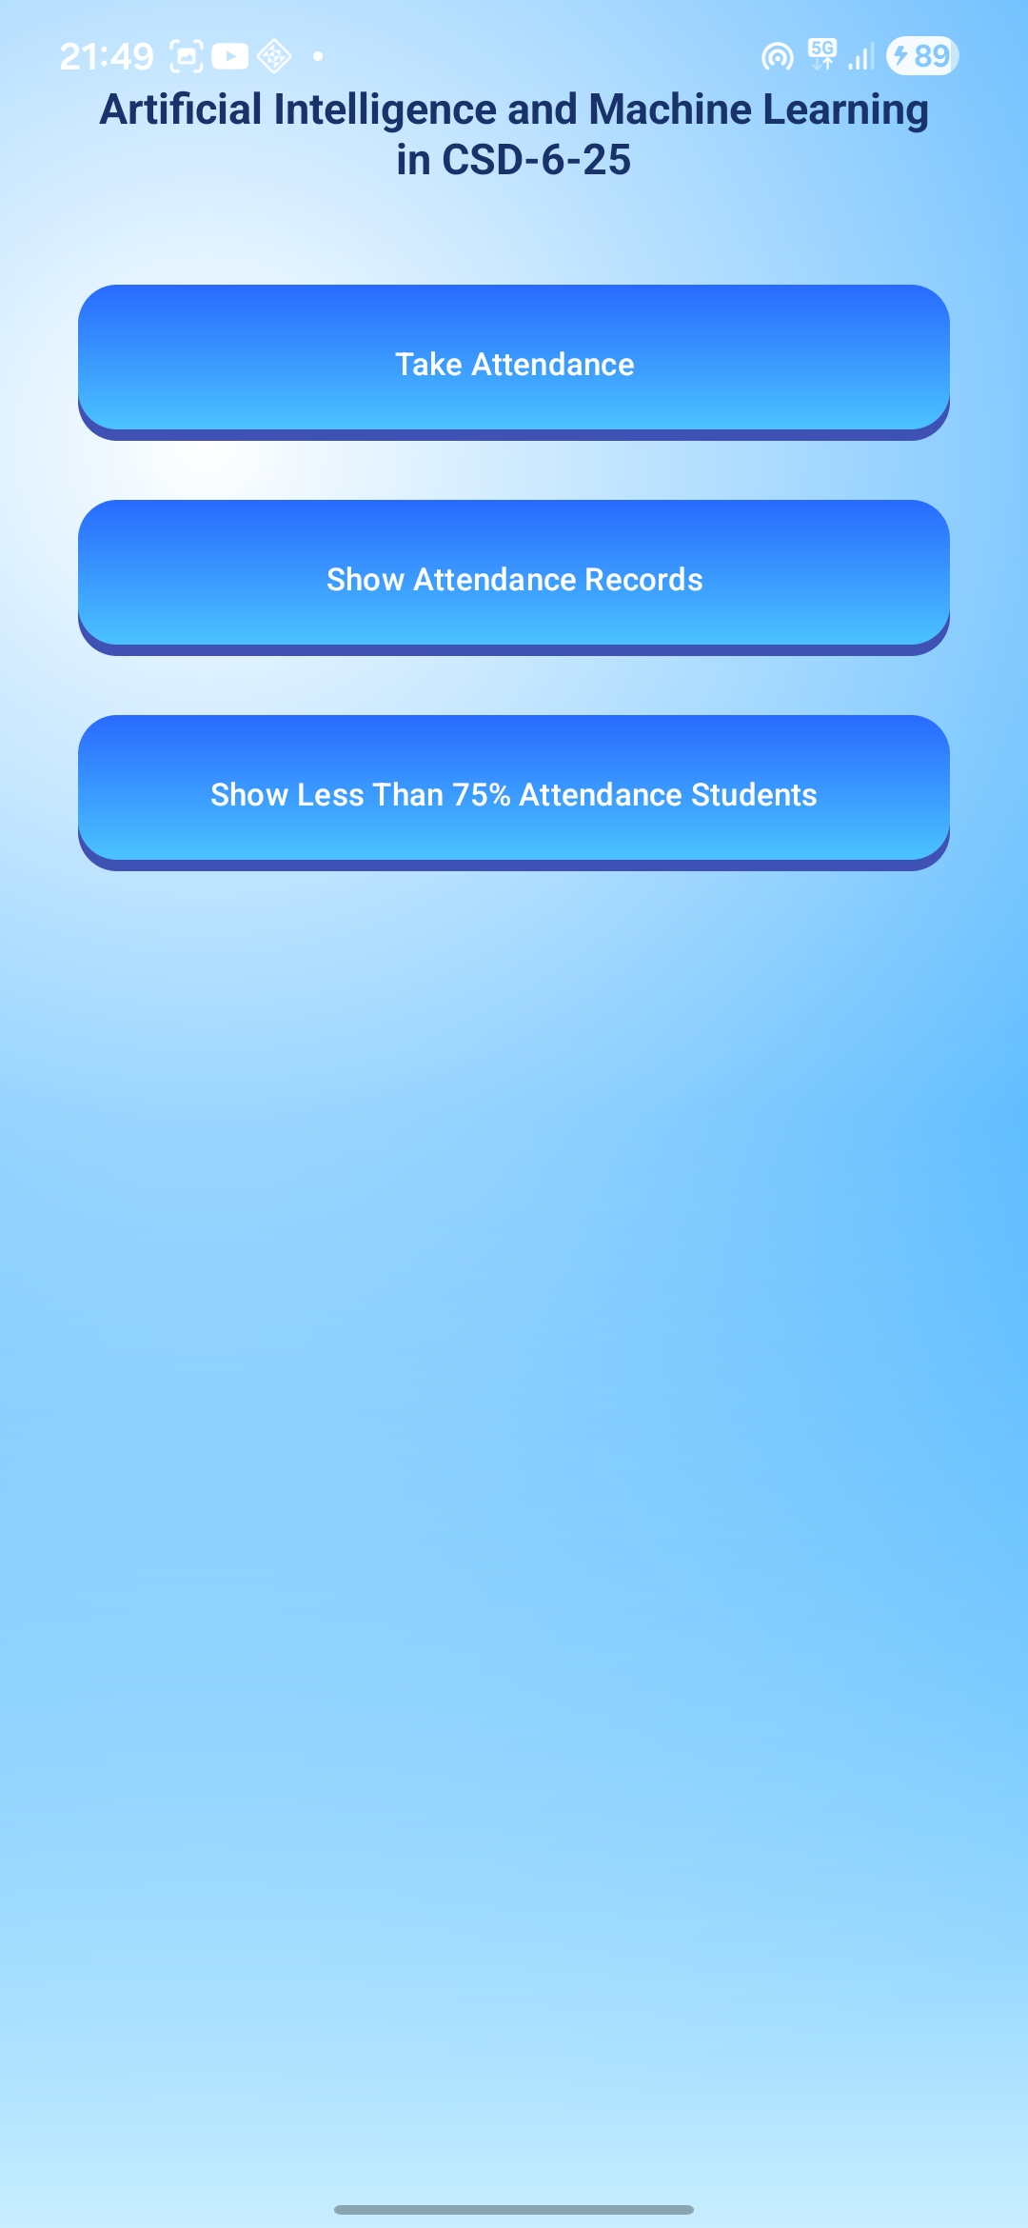
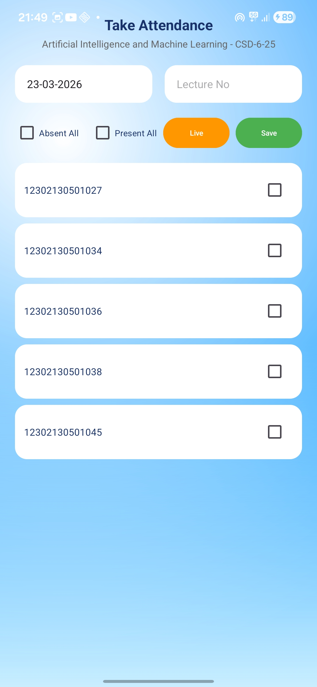
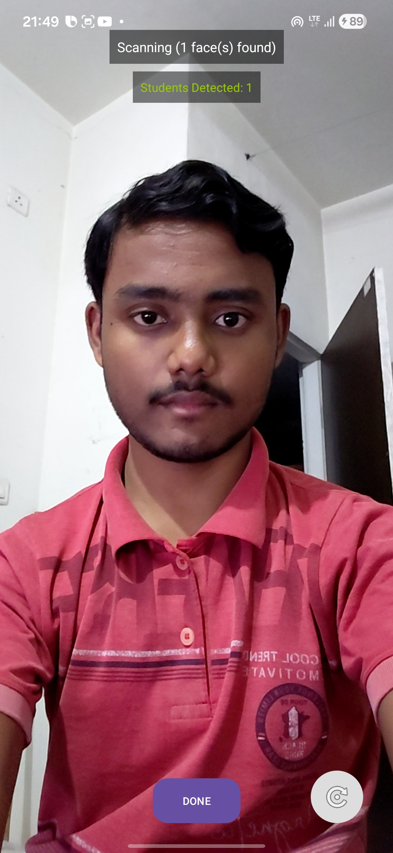
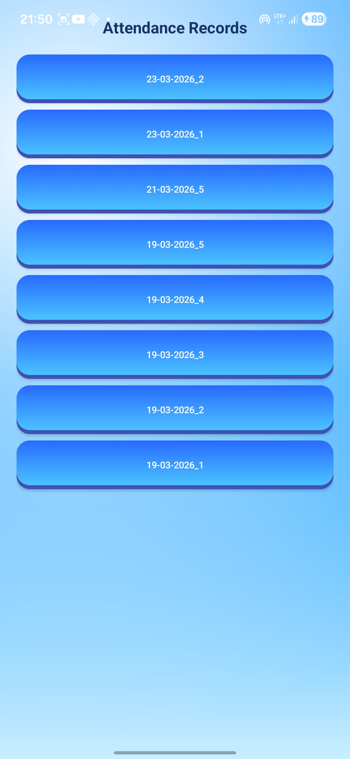
Implementation Demo ( Screenshots )
<Smart Attendance Application>

Slide 23
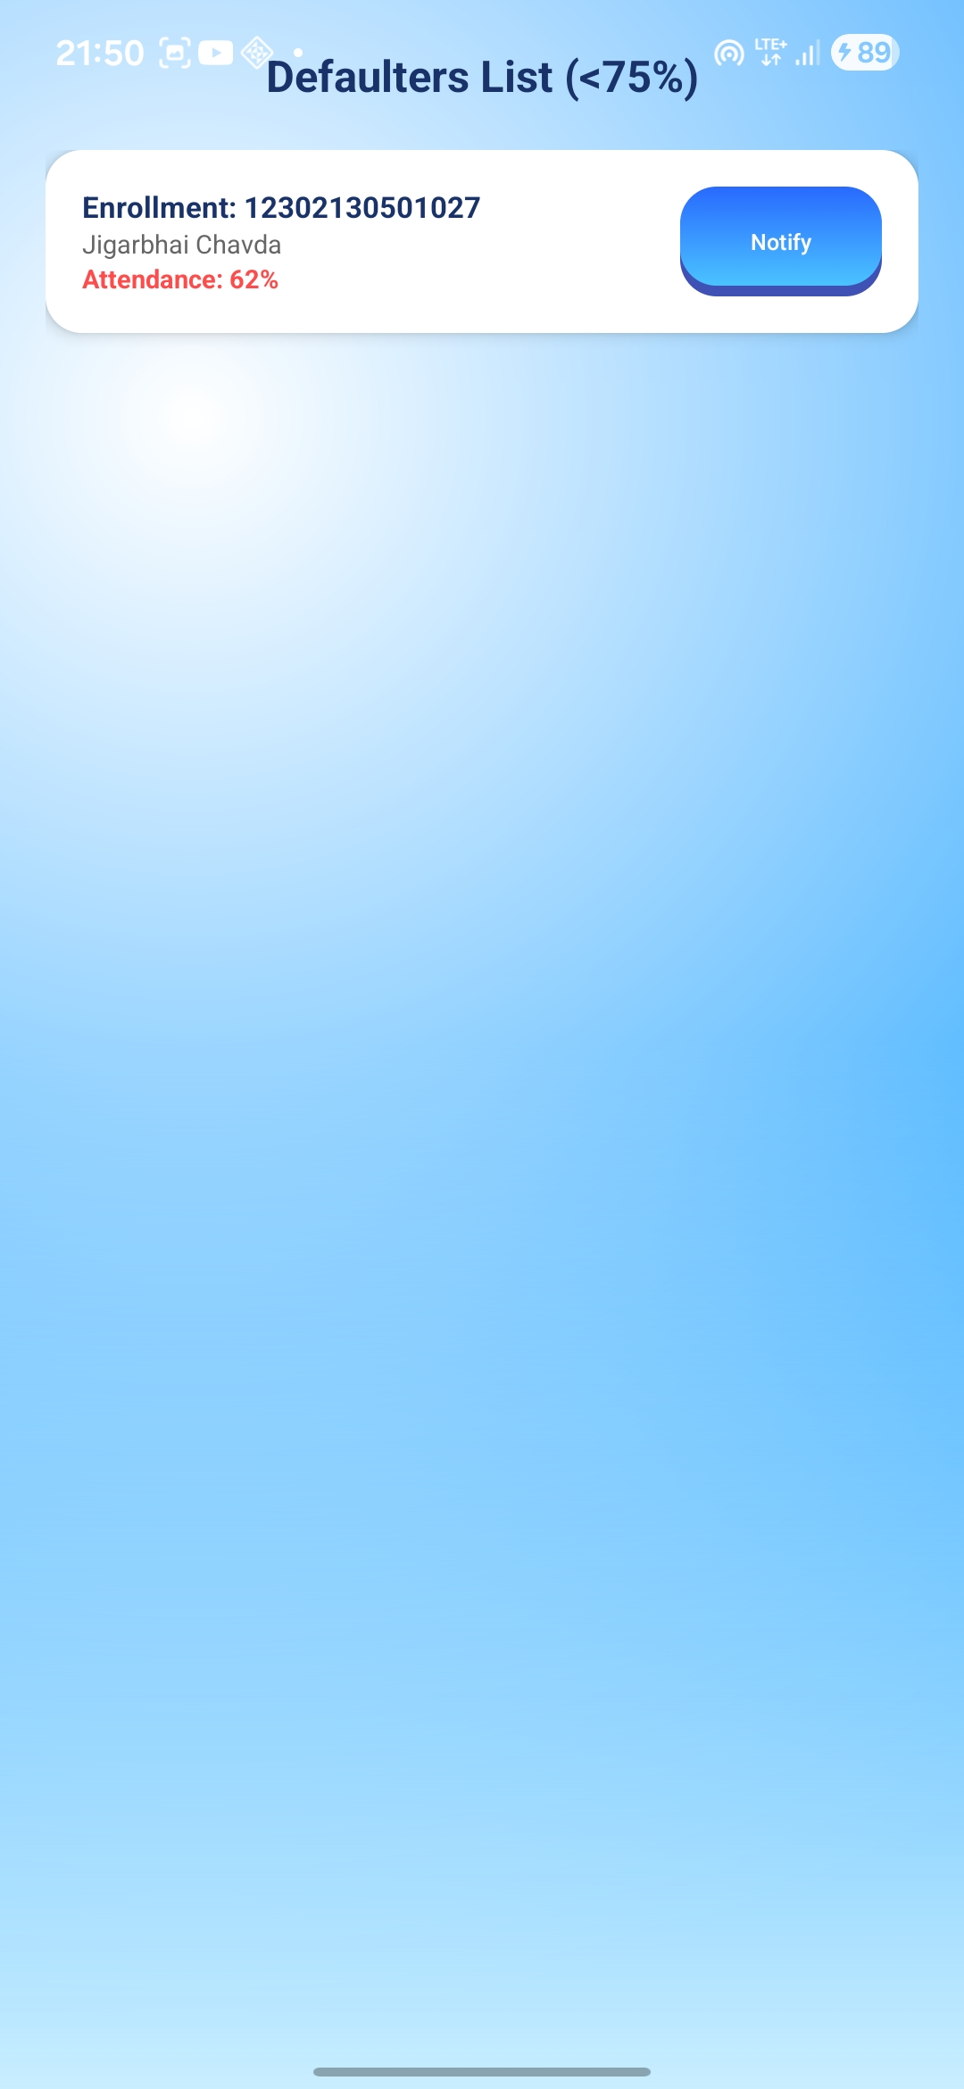
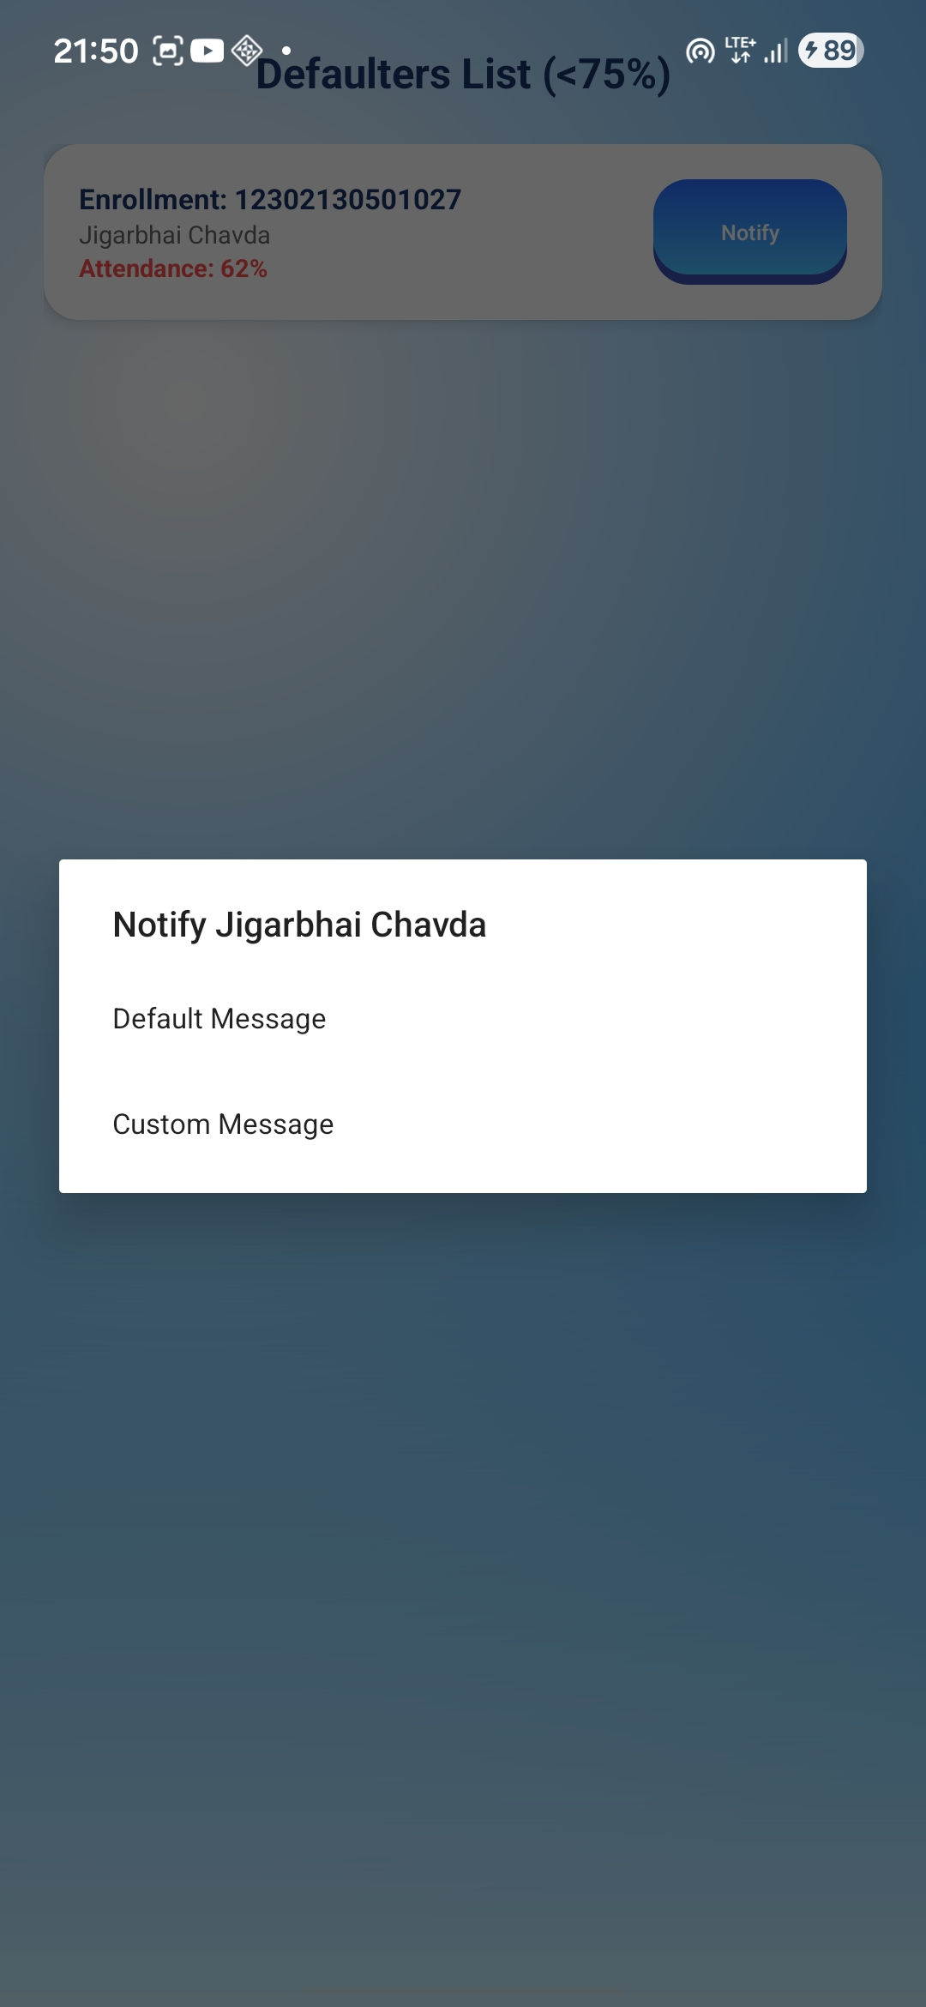
Implementation Demo ( Screenshots )
<Smart Attendance Application>

Slide 24
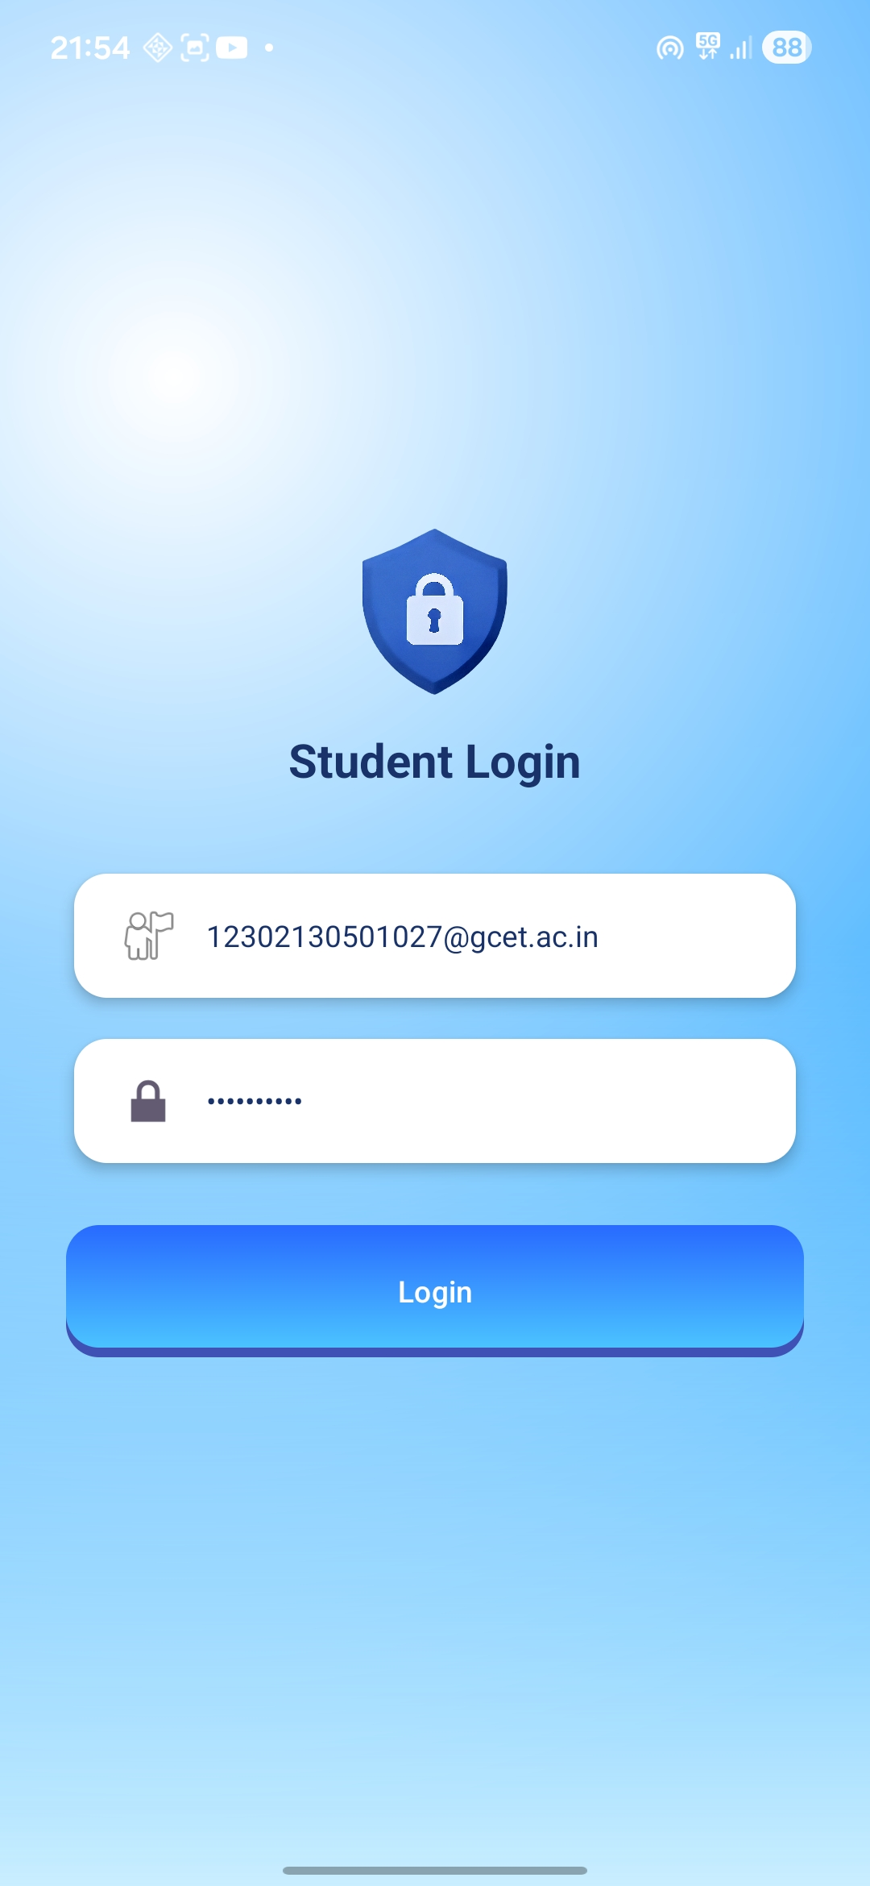
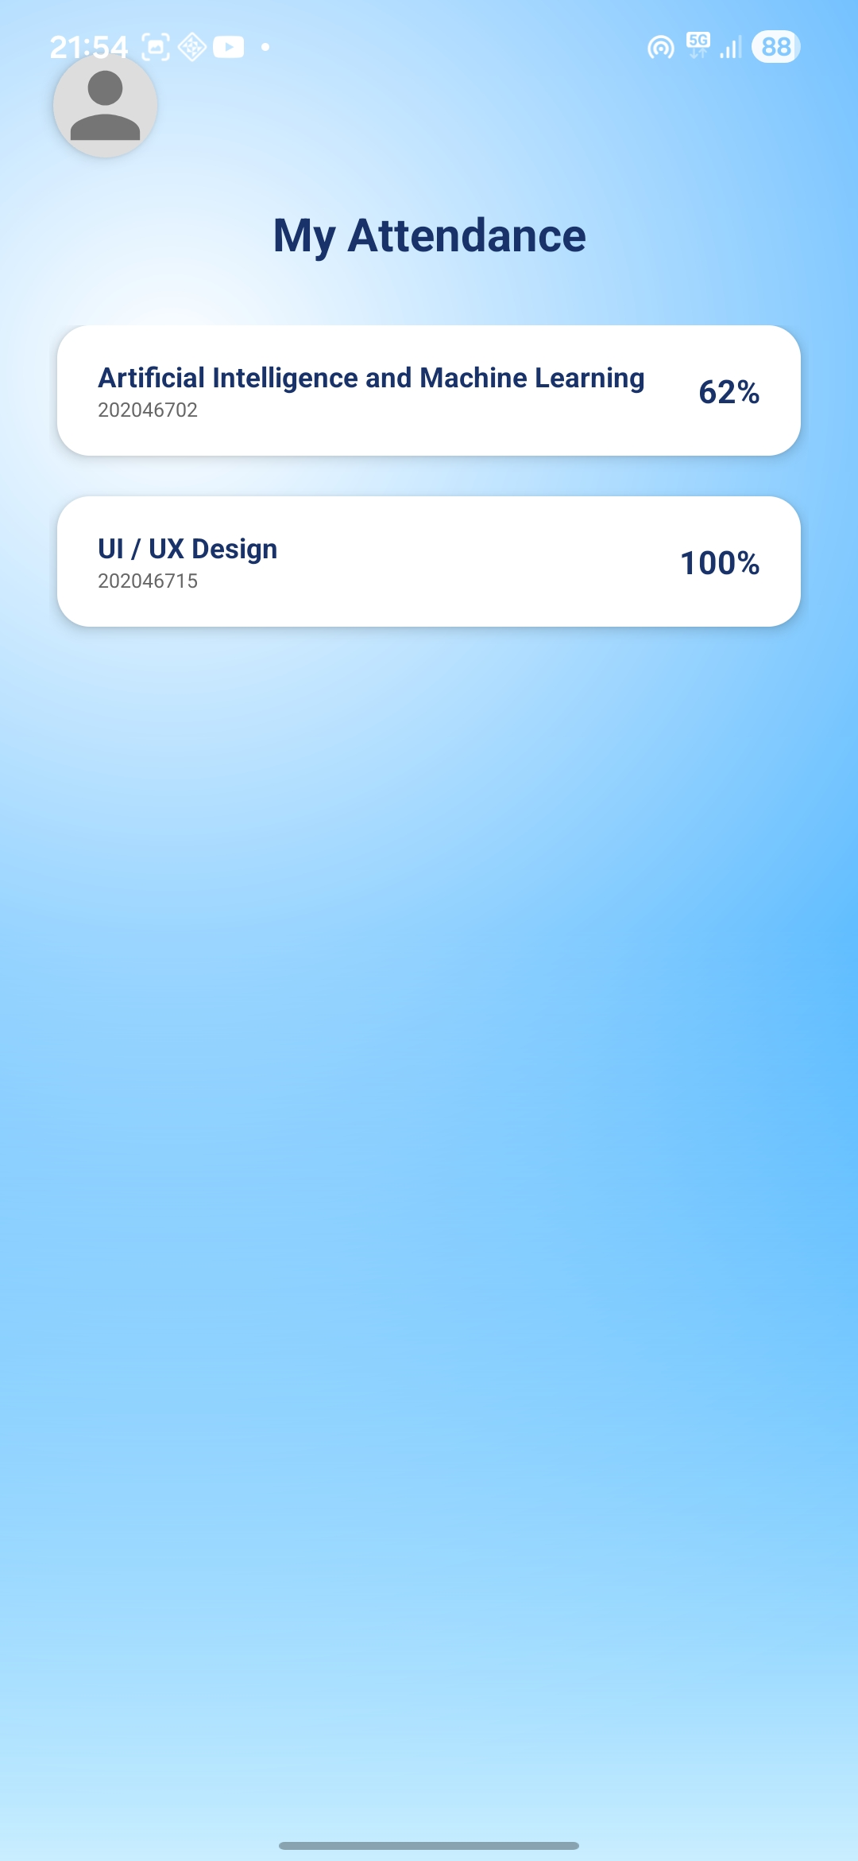
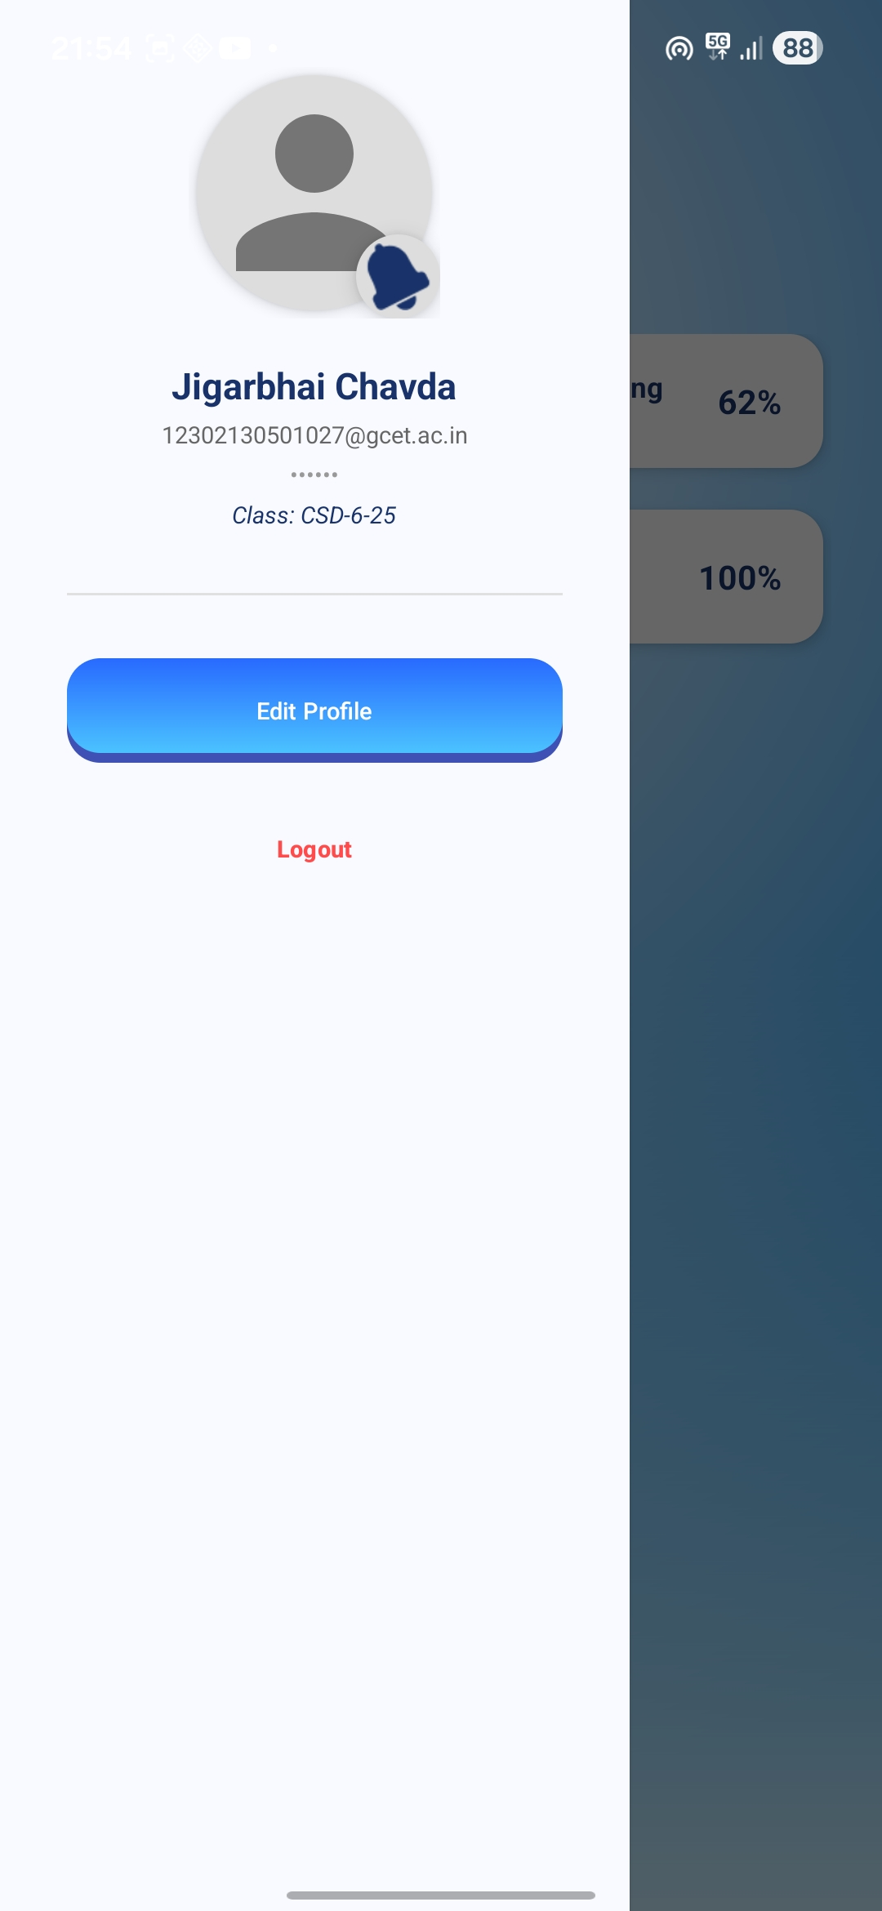
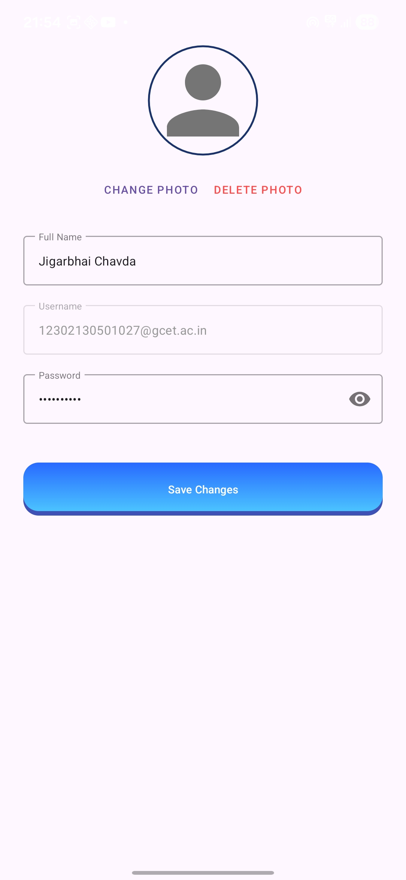
Implementation Demo ( Screenshots )
<Smart Attendance Application>

Slide 25
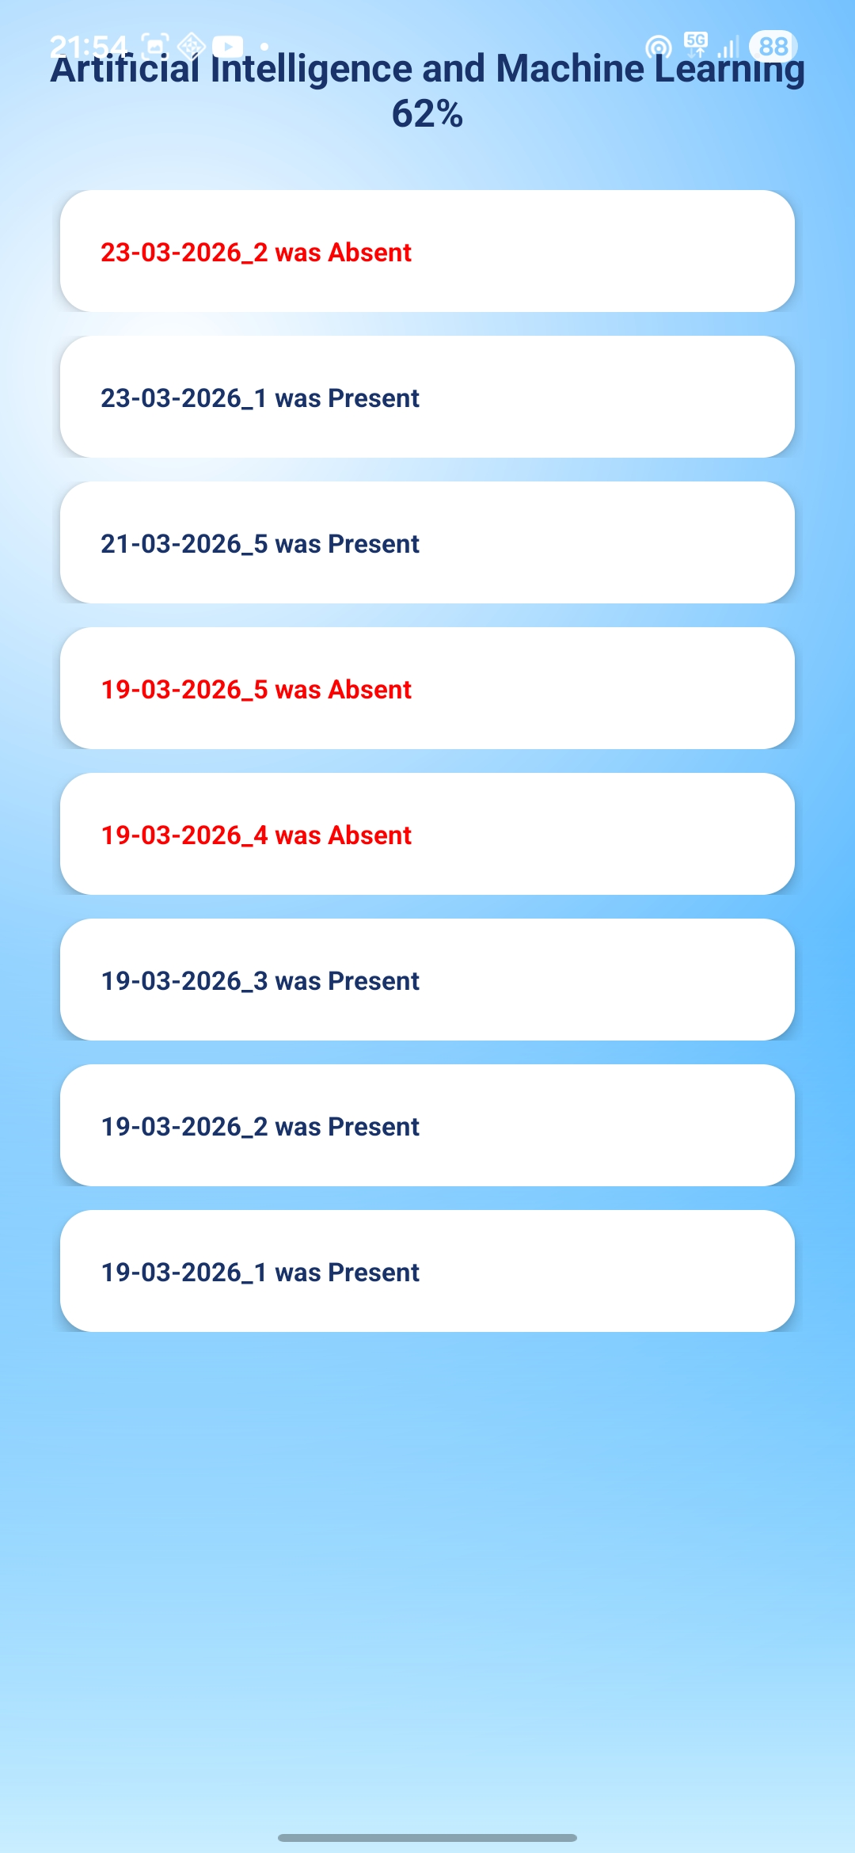
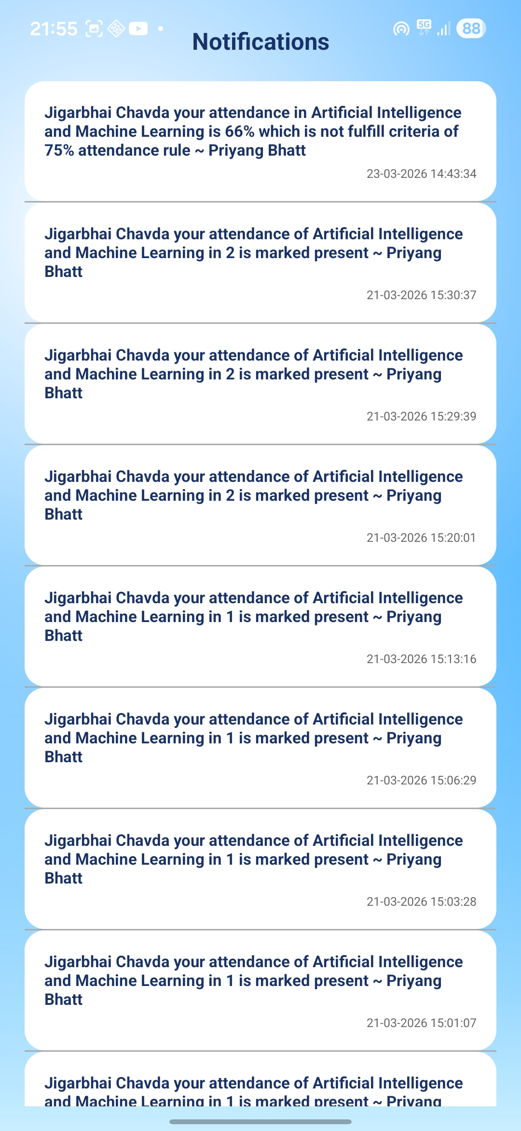
Implementation Demo ( Screenshots )
<Smart Attendance Application>

Slide 26
Conclusion
Conclusion: The system successfully automates the attendance process with a high degree of accuracy and minimal manual intervention.
Future Work :
Integration with a Cloud Backend (Firebase) for cross-device syncing.
Multi-face recognition (detecting multiple students in one frame).
Exporting attendance reports to Excel/PDF formats.
Anti-spoofing (Liveness detection) to prevent recognition via photos.
<Smart Attendance Application>

Slide 27
References
Research paper 2024 : SMART ATTENDANCE MANAGEMENT SYSTEM (SAMS): ATTENDANCE TRACKING PROCESS IN EDUCATIONAL INSTITUTION
  https://www.irjet.net/archives/V11/i4/IRJET-V11I4235.pdf
Research paper 2025 : AI BASED SMART ATTENDANCE MANAGEMENT SYSTEM
https://www.ijisrt.com/assets/upload/files/IJISRT25APR723.pdf
<Smart Attendance Application>

Slide 28
Thank You…
<Smart Attendance Application>

