Slide 1
GAMSA
A Graphical Application for Microarray Statistical Analysis

Slide 2
What you should leave with
Overview of some commonly used microarray normalization and statistical analysis methods
Overview of GAMSA, the program that I developed as my summer project

Slide 3
Microarray Basics ( 1 / 4 )
A slide or array refers to the physical medium that contains up to thousands of cDNA or oligonucleotides probes
Each of these probes is referred to as a spot and codes for a known or suspected gene

Slide 4
Microarray Basics ( 2 / 4 )
Two color microarrays measure relative gene expression levels between two cell populations
mRNA from samples is converted to cDNA or cRNA
One sample labeled as “red”, and the other as “green”
  Radioactivity or Florescence

Slide 5
Microarray Basics ( 3 / 4 )
Labeled samples are then applied to a array
The amount of hybridization to the probes that occur, indicates the amount of mRNA activity for that gene
Spot intensity detection preformed producing numerical data

Slide 6
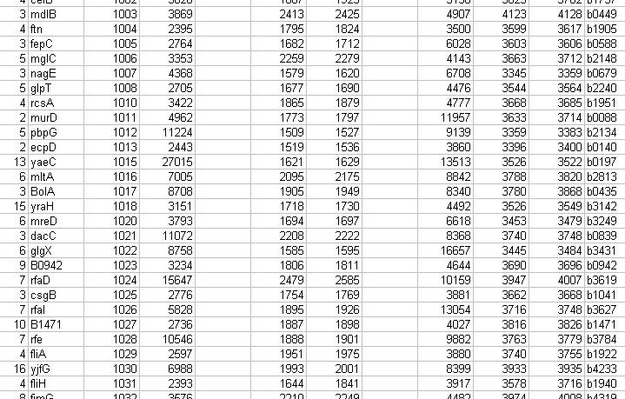
Microarray Basics ( 4 / 4 )

Slide 7
Why normalize?
Systematic biases and variations may exist in microarray data resulting from the experimental setup
Normalizing data attempts to correct for these biases, and allow for comparisons across genes, arrays, and experiments

Slide 8
Microarray Normalization – Necessary Background
Instead of using red and green intensities directly, log ratio (M) is frequently used
M_{ij} = log₂( R_{ij} / G_{ij} )
Intensity (A) is also frequently used
A_{ij} = [ log₂(R_{ij}) + log₂(G_{ij}) ] / 2

Slide 9
Dye Biases
Dye effects result when one of the dyes is “brighter” on average
Green intensities are frequently higher on average than red intensities
When this occurs, the mean of the log ratio values of an array will not be zero

Slide 10
Global Normalization
To correct for these dye effects, the mean log ratio value of the array is subtracted off of each M_{ij} value
Mean log ratio value of each array is set to zero

Slide 11
Intensity Dependant Biases
It is also undesirable for the log ratio (M) to depend on the intensity (A)
This indicates dye bias dependent on spot intensity

Slide 12
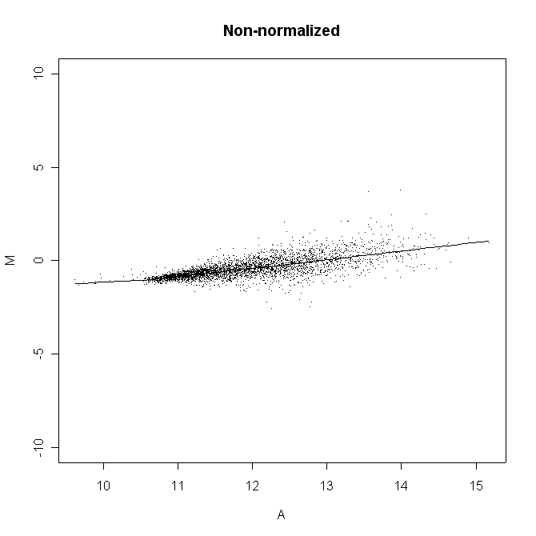

Slide 13
Lowess Normalization
Corrects for intensity dependent bias
Instead of subtracting off a constant, function on A, say c(A), is subtracted off of log ratio
c(A) is the lowess fit of the MVA scatter plot

Slide 14
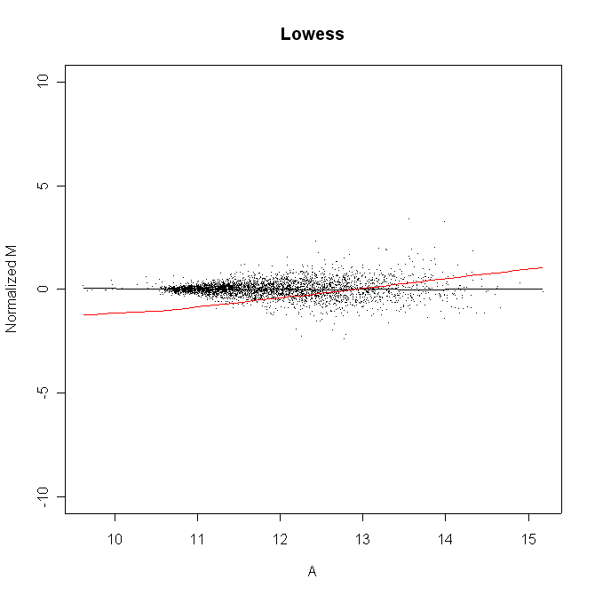

Slide 15
Print-tip Biases
Arrays can be broken into blocks or print-tip groups based on how the array was printed
Slight differences can exist between blocks

Slide 16
Print-tip Normalization
Simply perform Lowess normalization on each print-tip group individually

Slide 17
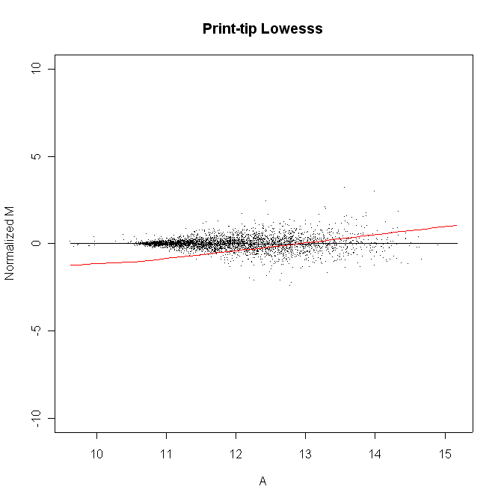

Slide 18
ANOVA Normalizations
Two additional normalizations implemented
  ANOVA
  ANOVA-Lowess
Based on fitting data to an ANOVA model
Implemented via R/Maanova Package

Slide 19
Test Statistics
Statistics based on the log ratios which evaluate how differentially expressed a particular gene is

Slide 20
The M Statistic
M_{i} is the value of the M statistic for the i^{th} gene
M_{i} is simply mean of the log ratio values for the i^{th} gene
Potential Problem: Genes with highly variable intensities are treated the same way as genes with more stable intensities

Slide 21
The t Statistic (1 / 2)
Takes into account expression intensity variability via estimated standard error (SE)
t_{i} = M_{i} / SE_{i}
If n arrays are used, and σ_{i}² is sample variance of the log ratio values for the i^{th} gene, then SE_{i} = √( σ_{i}² / n )

Slide 22
The t Statistic (2 / 2)
The problem: The number of genes could be tremendous, while the number of arrays used tends to be small in comparison
SE_{i} could be very small by chance for a few genes leading to huge t_{i} values

Slide 23
The S Statistic
Purposed by Tusher et al.
Add a constant to the t statistic denominator
S_{i} = M_{i} / ( SE_{i} + v_{o} )

Slide 24

The B Statistic
Good but complicated…
Implemented with SMA package

Slide 25
False Discovery Rate (1 / 2)
Given a list of genes predicted to be differentially expressed in a biologically significant way, the FDR of the list is the percentage of the genes that is falsely identified
Type II error rate

Slide 26
False Discovery Rate (2 / 2)
The FDR can be estimated via an algorithm described by Tusher et al.
This is implemented in GAMSA as a method of evaluating normalization methods and statistics
Smaller FDR is an indication of a better method of selecting genes

Slide 27
GAMSA
Developed in R, a programming environment for statistical analysis
  Many preexisting software packages for microarray analysis
  Freely available for many different operating systems
  Tcl/Tk support allowing for the development of a cross platform graphical user interface (GUI)

Slide 28
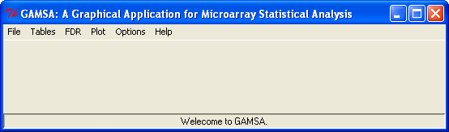

Slide 29
A GAMSA Approach
Many of the features GAMSA involve the evaluation of the various combinations of normalization methods and statistics on data set
  FDR Estimates
  Using genes believed to be expressed based on previous knowledge

Slide 30
The Data
From an experiment on Escherichia Coli response to UV irradiation
Two color cDNA microarrays representing 4101 open reading frames were used in this experiment

Slide 31
Top N Table
The most basic feature of GAMSA is the ability to generate top n tables
Includes top genes identified by selected methods

Slide 32
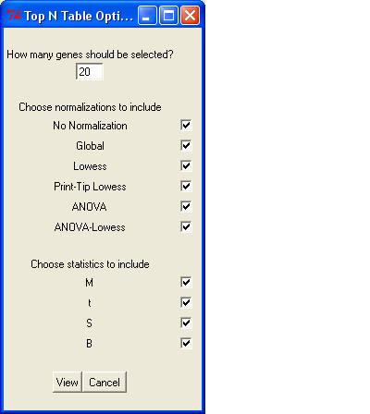

Slide 33
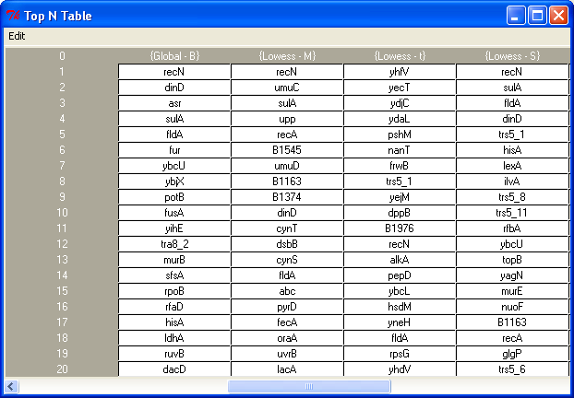

Slide 34
FDR Estimate Tables
Generates FDR estimates described earlier, again for all combinations of normalization methods and statistics chosen

Slide 35
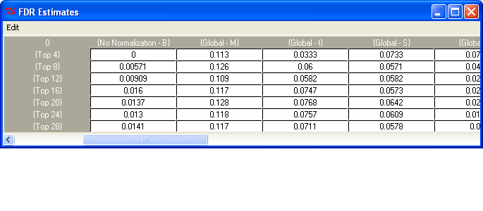

Slide 36
FDR Plots
False discovery rates can also be plotted
Can choose a statistic to plot for and then include any of the normalizations, or vice versa

Slide 37
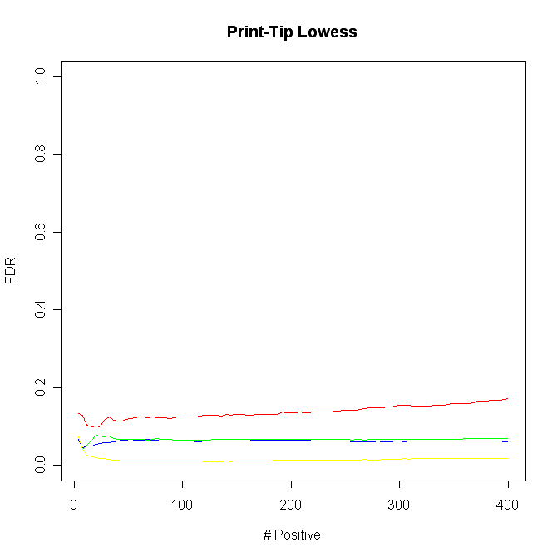

Slide 38
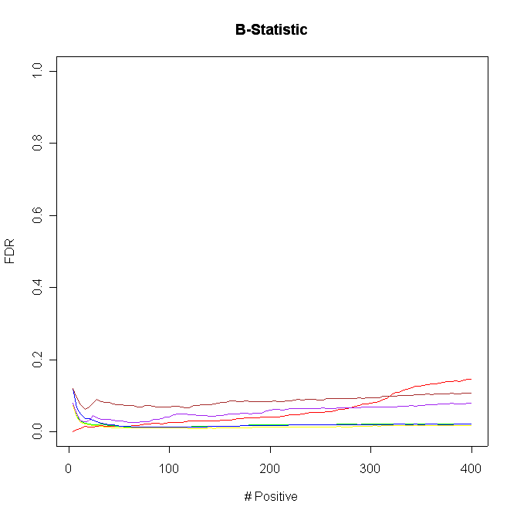

Slide 39
Suspected Genes Plots
Can plot number of suspected genes correctly predicted by various combinations of normalization methods and statistics
Like FDR plots, these can be plotted for any normalization method or statistic

Slide 40
Suspected Genes for this Data
Genes that have been experimentally verified to be up regulated in response to DNA damage caused by UV irradiation

Slide 41
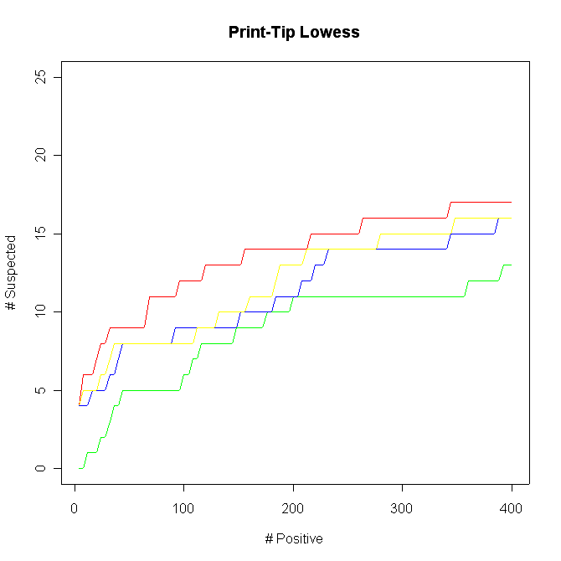

Slide 42
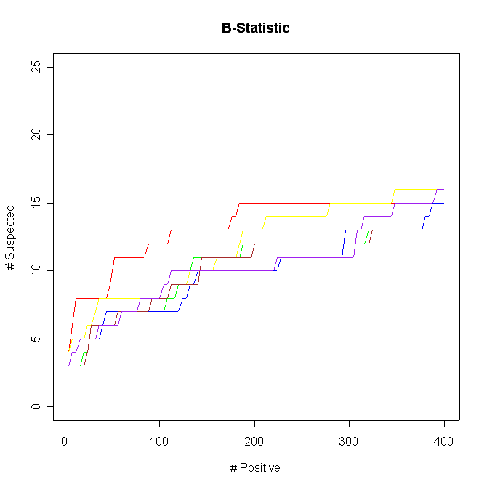

Slide 43
Top N Gene Frequency Tables
A novel approach of GAMSA
Combines various combinations of normalization methods and statistics
Key Assumption: The more different methods that identify a gene, the more likely it is to be biologically significant

Slide 44
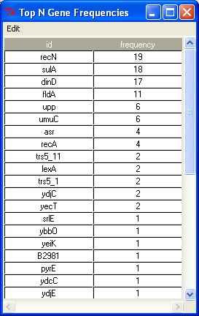

Slide 45
Suspected Gene Frequencies
Similar to top N gene frequencies table except frequencies of suspected genes, not genes appearing in a top n list, are displayed
Not necessarily useful for determining differentially expressed genes, but may be interesting

Slide 46
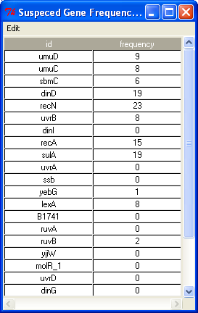

Slide 47
Other Features
Easy to use data import wizard
MVA plots
Array Viewer
Suspected Gene Ranks
Save/Load Workspace
Extensible

Slide 48


Slide 49
Where to go from here?
Touch up the program, work out the bugs, write a developers manual
Implement two class comparison methods
Connect to gene function database

Slide 50
Thank You…
Professor Khodursky
Yang Xie
Brian Hansen
Gary Churchill’s Statistical Genetics Group
Terry Speed’s Microarray Data Analysis Group
R Development Team
James Wettenhall

Slide 51
Questions

