Slide 1

SeaSplash
Higher Diploma in Computer Science
John McDonald
20006166

Slide 2

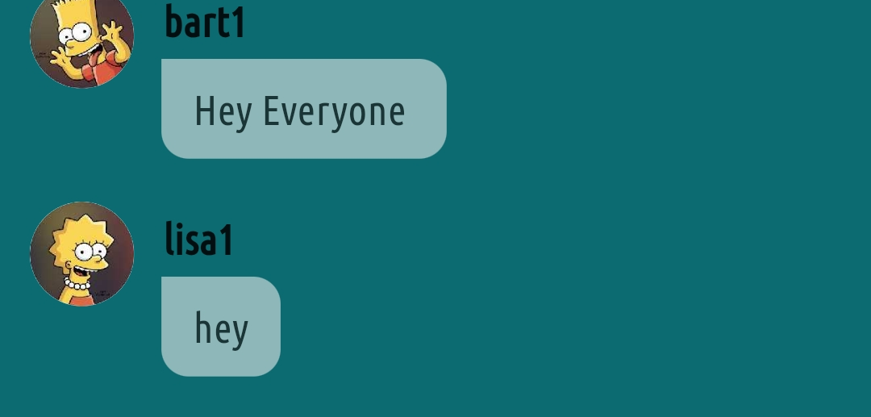
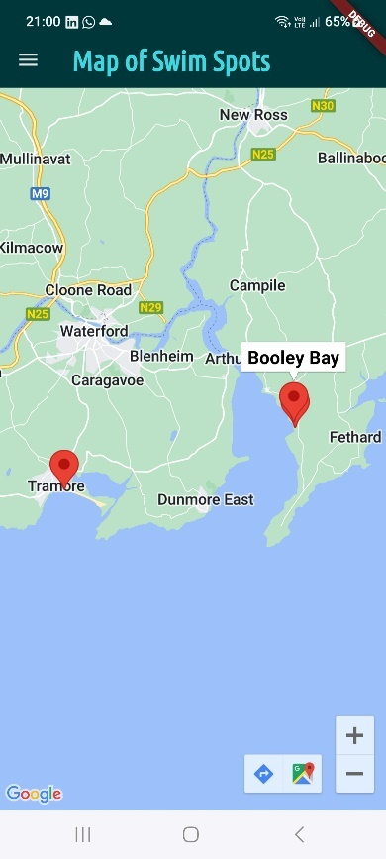
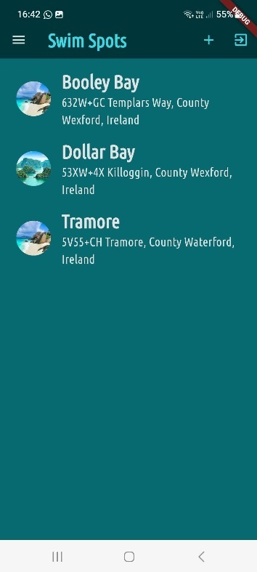
SeaSplash
Mobile App developed for sea swimmers
List Swim Locations
Map of Swim Spots
Upload Image + Location
Chat with Swim Community

Slide 3
Demo

Slide 4
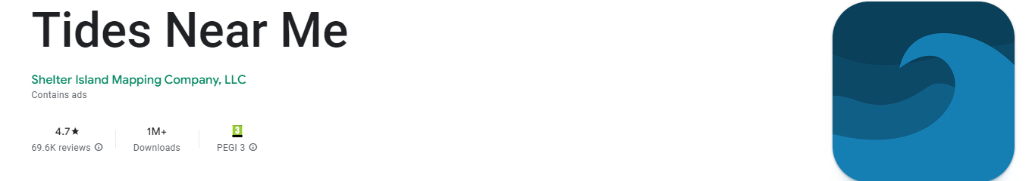
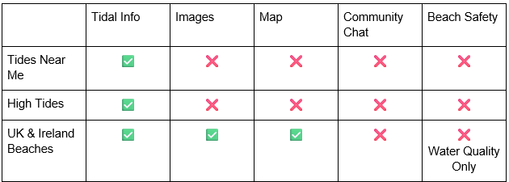
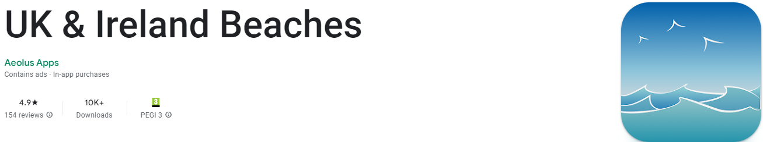
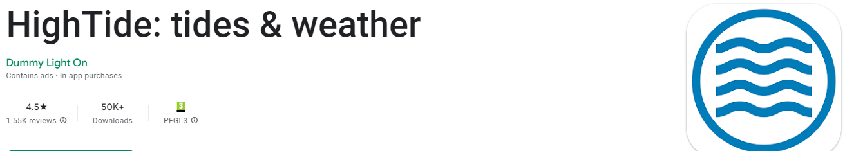
Analysis

Slide 5
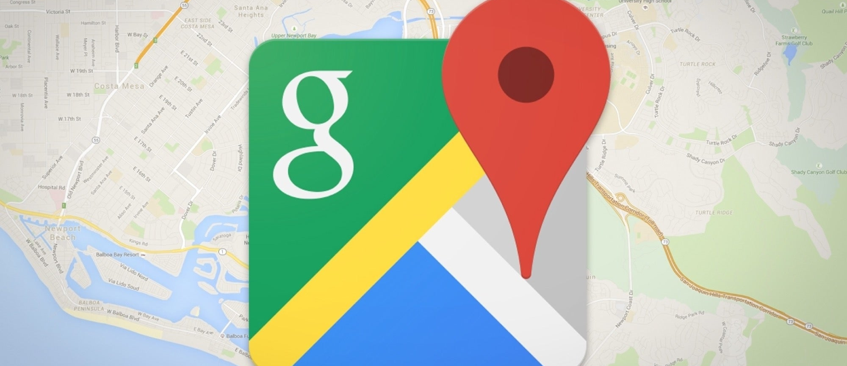
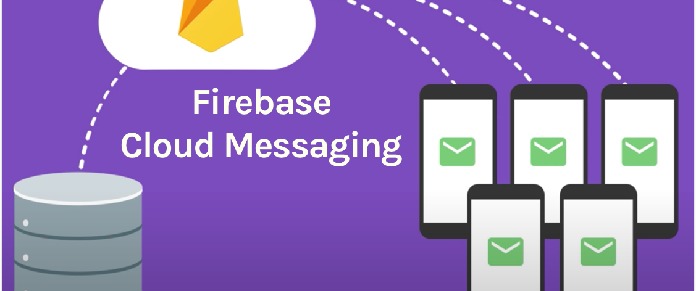


Technologies

Slide 6
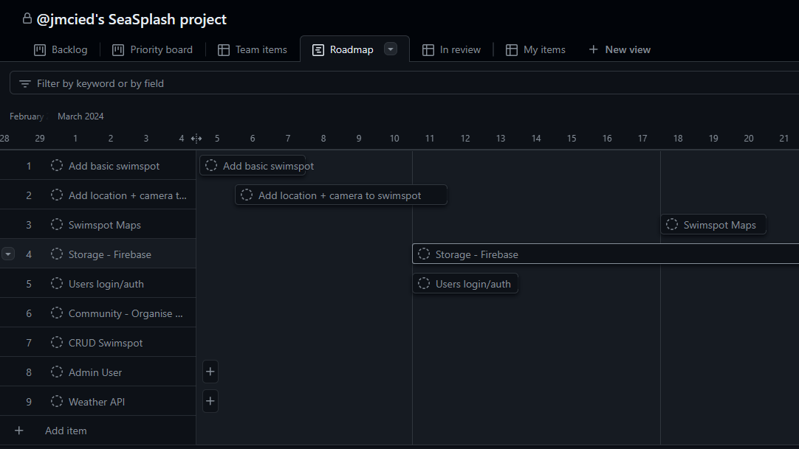
Project Tracking – GitHub Projects

Slide 7
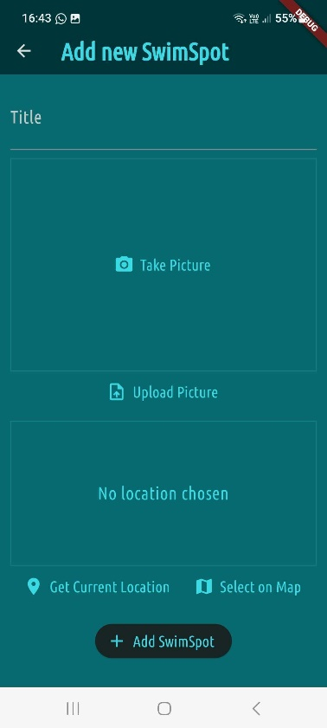
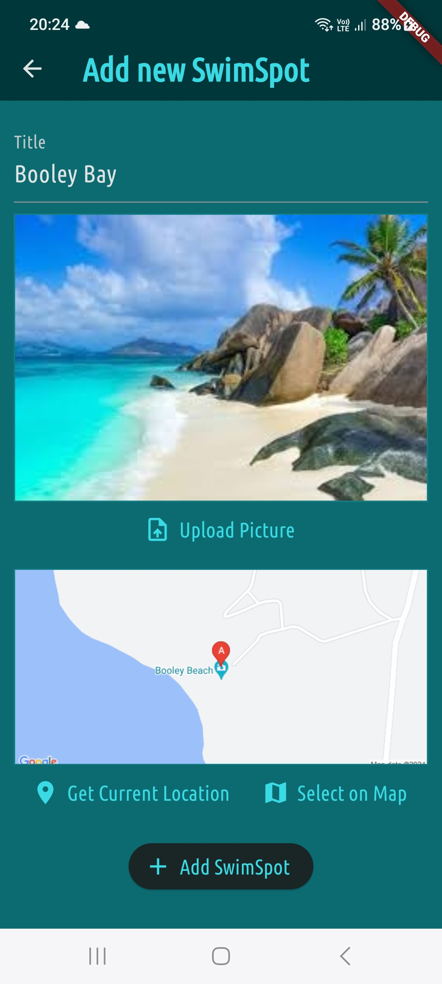
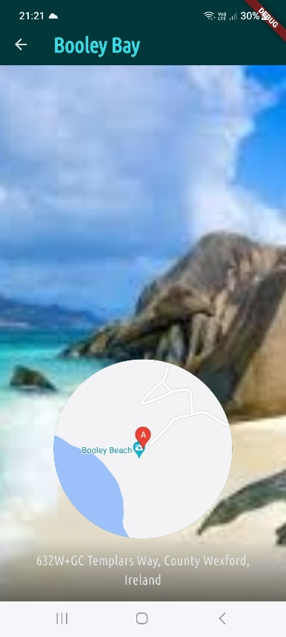
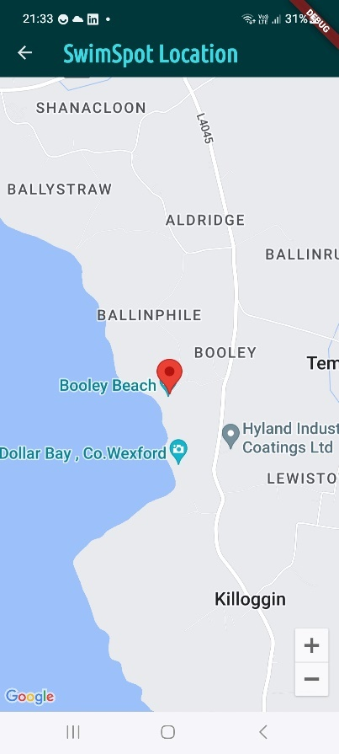
Implementation
Add Swim Spot
List
Swim Spot Details

Slide 8
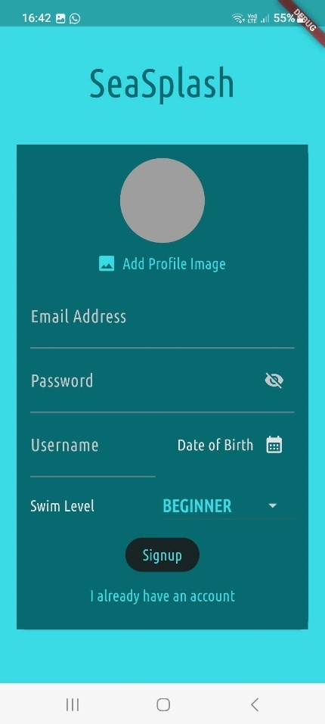
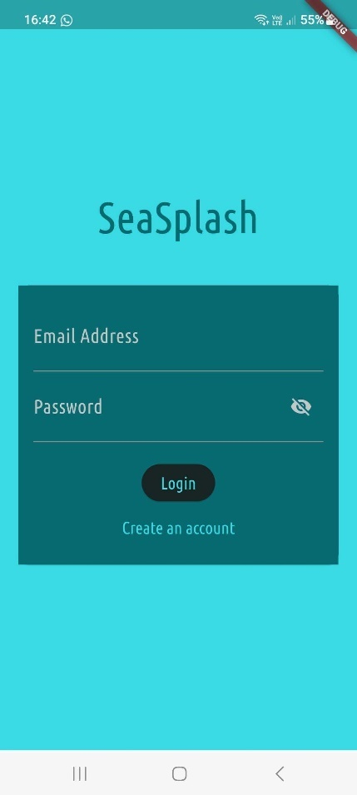
Implementation

Slide 9
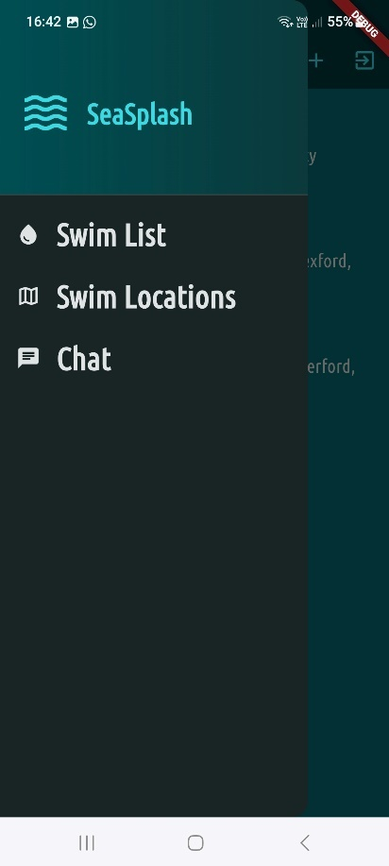
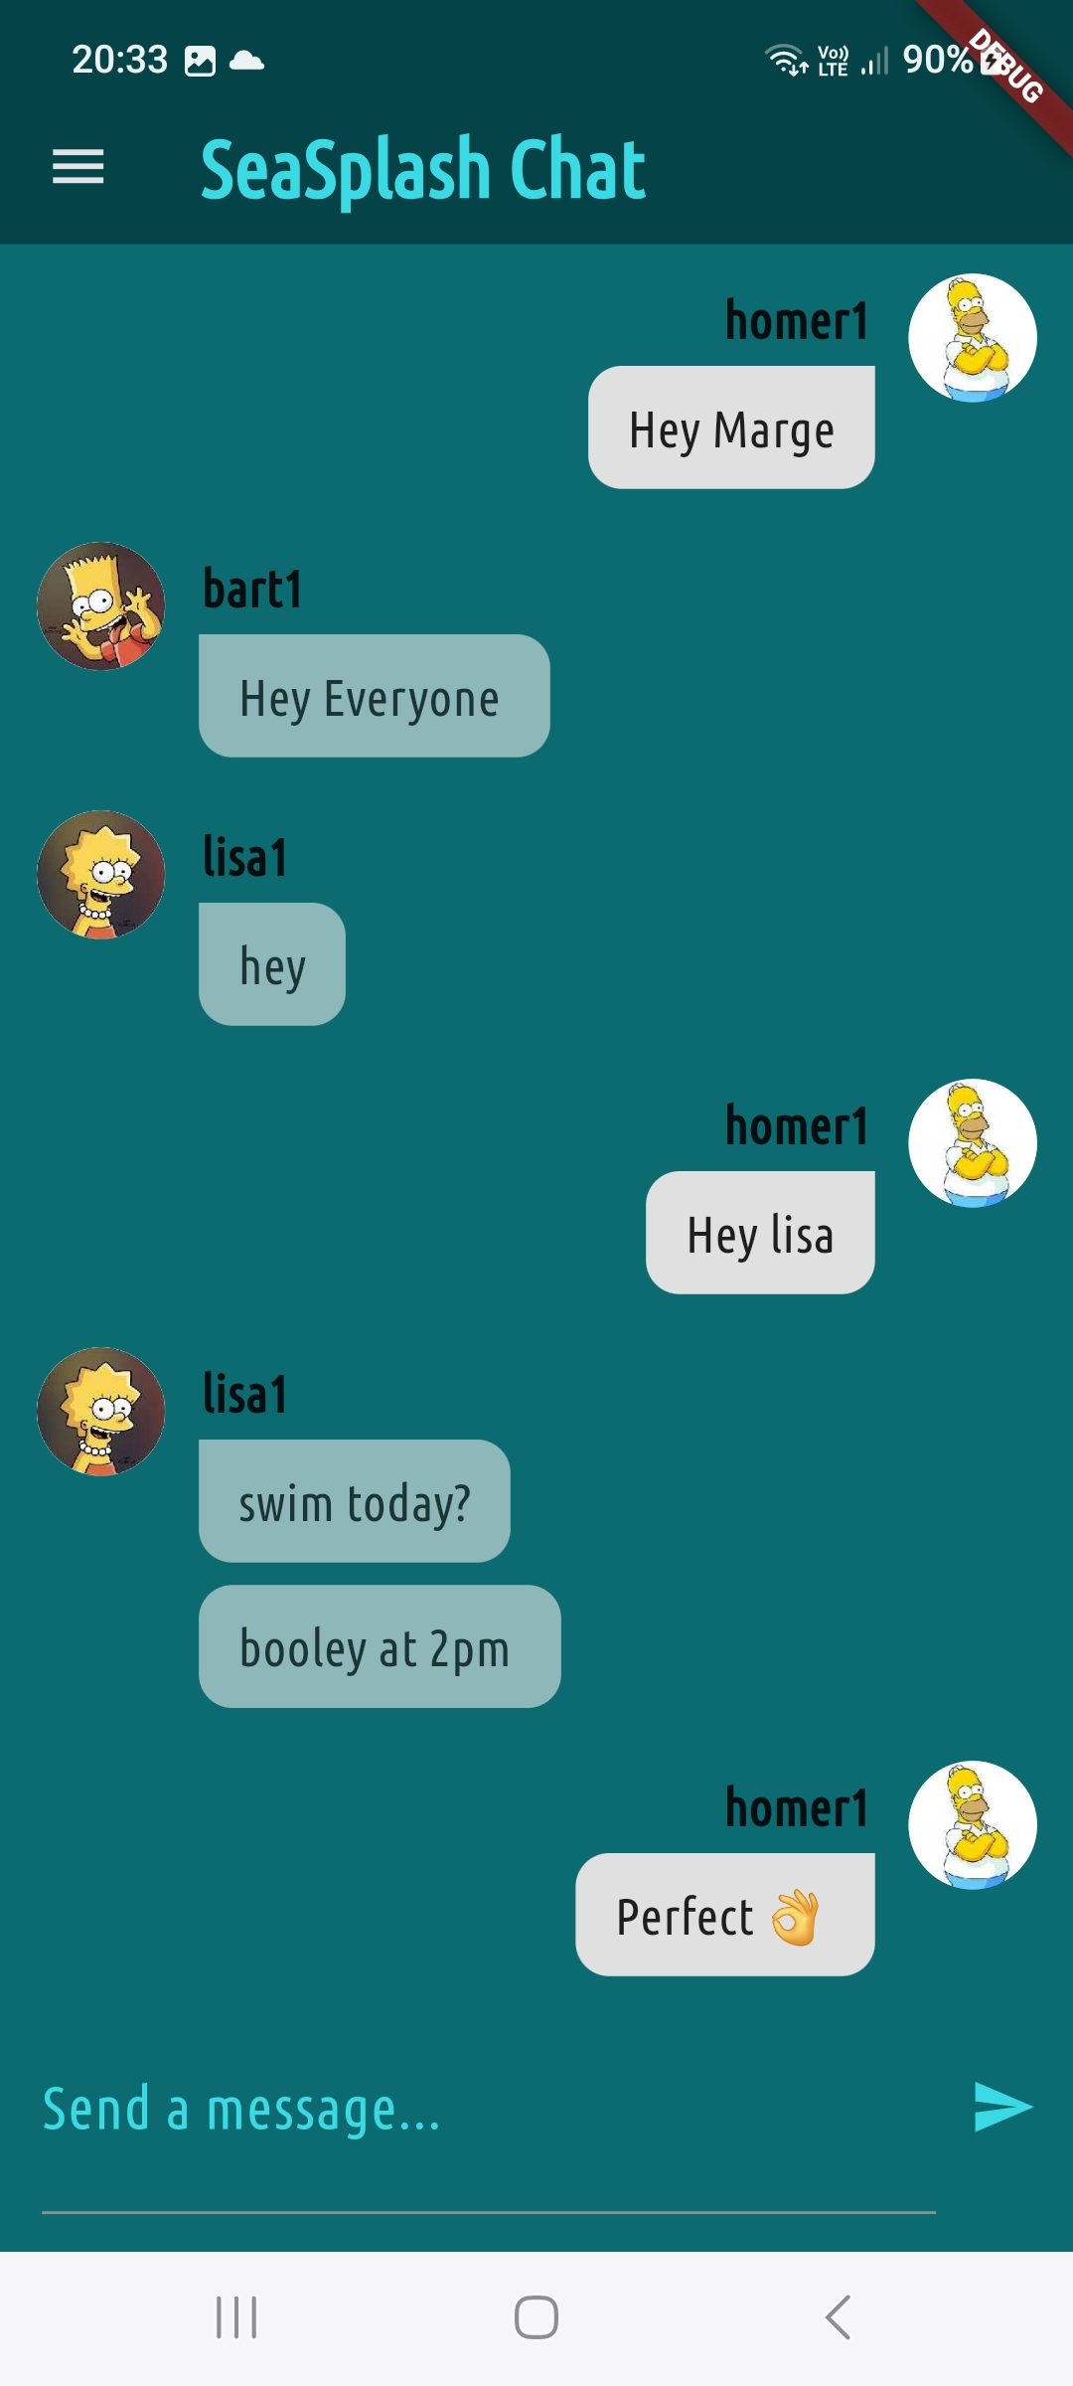
Implementation

Slide 10
Learning Outcomes
New Programming Language – Dart + Flutter
Firebase Cloud Messaging
Firebase Image storage/retrieval

Slide 11
Future Development
Live Weather Updates
Admin User
Additional Beach Information – Parking/Lifeguard on Duty/Water Quality

Slide 12
Use of AI
Limited to Debugging
Found Free Version ChatGPT 3.5 unreliable since release of paid version 4.0

Slide 13
Thank You
Questions??

