Slide 1
Foreman
Supervise everything your agents build — and prove it’s healthy.
The control plane for a portfolio of software built and maintained by coding agents: it schedules the recurring reviews, collects a verdict from every run, and surfaces what needs you. Schedules and reads — the prompts do the work.
M1–M8 shipped · 304 tests · ~86% coverage
receipts in git · green/amber/red verdicts · declared-vs-effective drift · cloud / local / session tiers · one board

Slide 2
The shift
“The bottleneck moved from writing code to supervising many autonomous streams of it.”
• Coding agents made it cheap to create and maintain far more software per person.
• One operator now runs 10–30 agent-maintained projects at once.
• Nothing exists to keep them all healthy without babysitting each one.

Slide 3
The problem
• Is each of 20 repos still documented? secure? prod-ready? on budget?
• CI only fires on commits — and only runs deterministic checks.
• The reviews that matter (architecture, UX, pen-test, prod-readiness) are open-ended judgment no linter can make.
• Doing it by hand, per repo, every week — doesn't scale.

Slide 4
What Foreman is
“A control plane: it schedules AI reviews across every project, reduces each to a durable green/amber/red verdict, and shows the fleet on one board — with a git-committed receipt behind every verdict.”
• A control repo, a contract, and a small index — not a daemon, not an agent runtime.
• Foreman never does the work; the cadence prompts do.

Slide 5
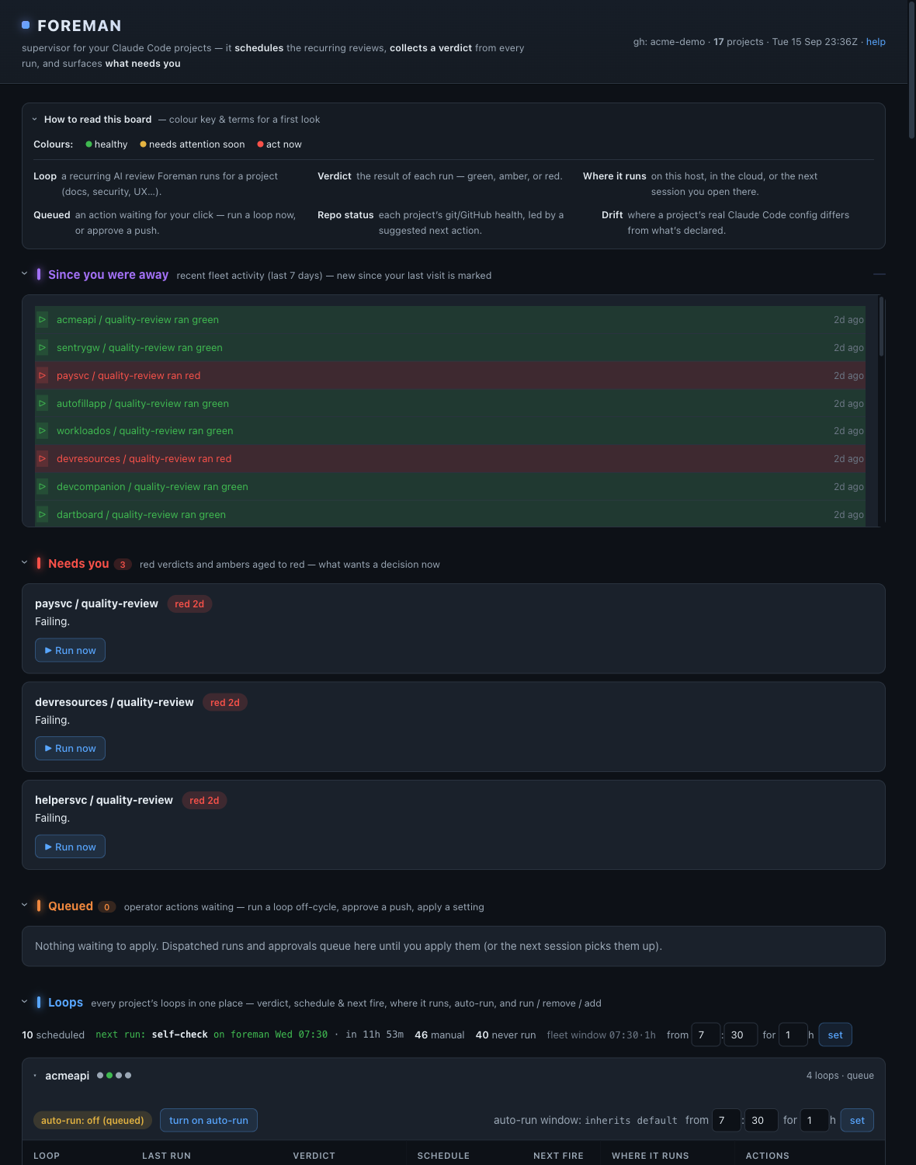
One glance: catch up on the whole fleet
Every section folds to a one-line peek and opens on signal, so the board is a scannable digest. “How to read this board” decodes the colour language · fleet catch-up (“Since you were away”) and triage (“Needs you” · “Queued” one-click actions) lead · “Recently worked on” is a searchable per-project prompt history.

Slide 6
How it works — every run leaves a receipt in git
a loop runs
(cloud / local / session)
writes a receipt
(one JSON shape)
committed to git
(state branch)
board reads it
→ verdict + trend
red → GitHub issue
green closes it
A run with no receipt is red by absence — silent scheduler failures become visible. The SQLite index is just a cache, fully rebuildable from the receipts.

Slide 7
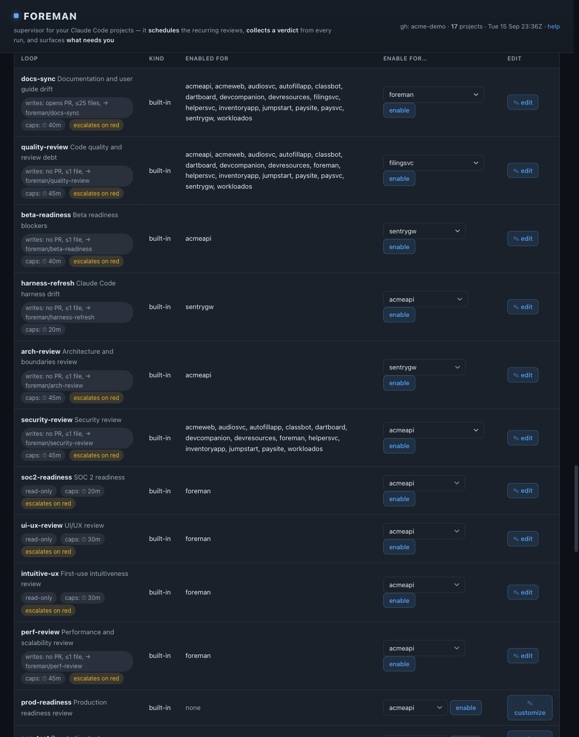
The loop library
docs · quality · security · soc2 · arch · perf · prod-readiness · pen-test · test · UI/UX — one-click per project, or customize a built-in / add your own.

Slide 8
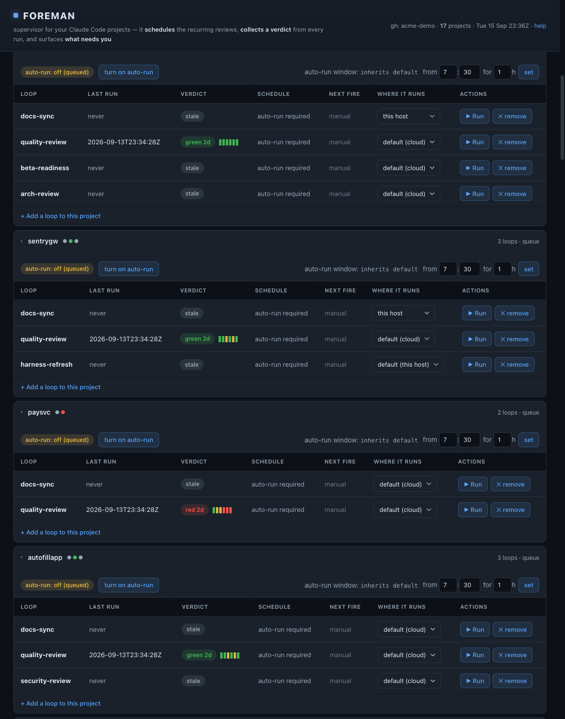
Every project’s loops, in one panel
verdict + trend sparkline · flexible schedule (“every N days”, weekdays, weekly…) & next run · where it runs · run / remove / add.

Slide 9
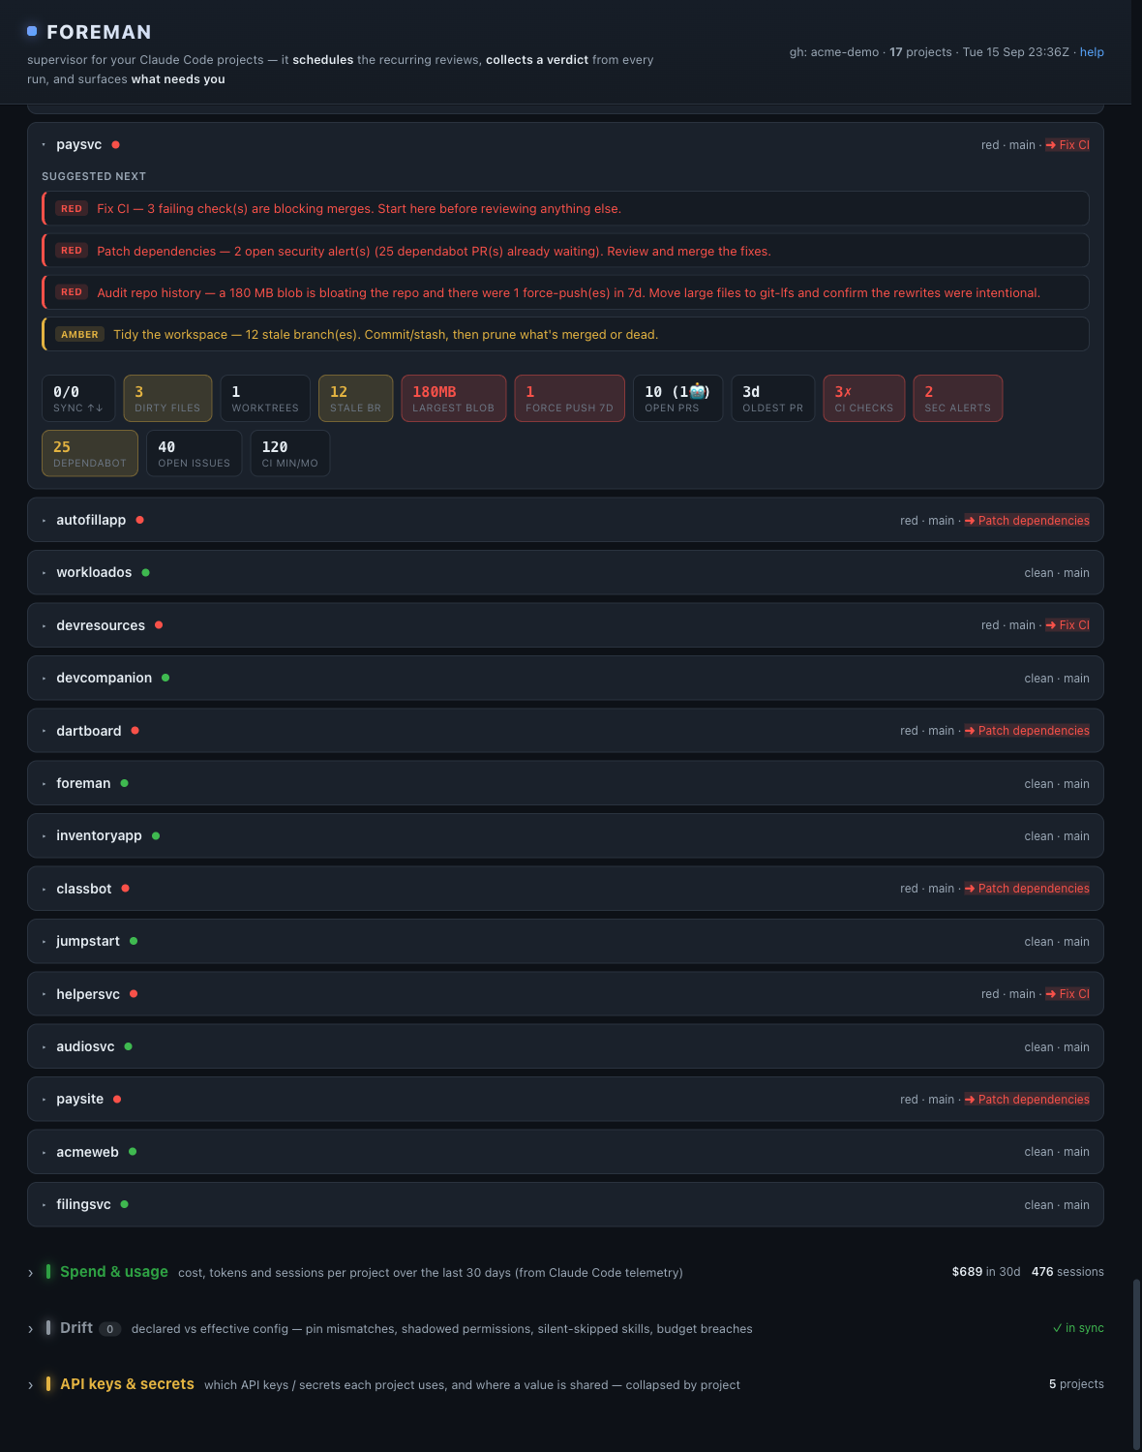
Fleet health — with a recommendation, not just numbers
Each repo leads with “Suggested next” — the raw git/GitHub stats synthesized into a short, prioritized list of what to act on (red → amber). Related signals fold into one action; the top one shows in the collapsed row. Vital-sign tiles and a cross-project roll-up sit below as detail.

Slide 10
The loop closes itself
“amber ages to red → red opens a GitHub issue → a green run closes it, linking the clearing receipt.”
• Every verdict is a schema-validated JSON receipt committed to git.
• A tamper-evident, versioned record of what was reviewed, when, and how it turned out.

Slide 11
Why it’s different — the moats
CONTRACT · Receipt-as-contract, index-as-cache
Every verdict is a git-committed JSON receipt; the database is a throwaway cache. Inspectable, versioned, portable — not a stateful black box.
DRIFT · Declared ≠ effective
Foreman probes what’s actually in effect (claude -p) and reports config drift — pins, shadowed permissions, silently-skipped skills. No comparable tool does this.
METERED · Portfolio + time, metered
Cloud/local/session tiers, per-run budgets, quota guard, spend by project — agent runs as a metered resource across a fleet.
SUPERVISOR · A supervisor, not a swarm
“Never does the work” keeps it composable and safe — it orchestrates when agents run and reads what they concluded.

Slide 12
The wedge: continuous assurance
“The security / soc2 / pen-test loops + the git-committed receipt history are, together, audit evidence that every project was reviewed on a schedule.”
• Every verdict and its clearing, versioned in git.
• Not a nice-to-have — audit evidence with a buyer and a budget.

Slide 13
Where it sits
• Not CI/CD — cadence-driven, not commit-driven; open-ended AI reviews, not scripts.
• Not a code-quality SaaS — LLM judgment (arch, UX, pen-test), portfolio-wide.
• Not a coding agent — the layer above; it never does the work.
• Not an agent-swarm framework — a standing supervisor across projects and time.
• Uniquely: the config-drift probe, and the rebuildable git-native receipt trail.

Slide 14
Who it’s for
• The operator — solo builder, studio, or platform team — running many agent-maintained projects.
• Who needs portfolio-level assurance: is every project still documented, secure, prod-ready, on budget — and can I prove it?

Slide 15
Status & honest limits
• Shipped: M1–M8 + secrets store + full operator surface. 304 tests, ~86% coverage.
• Live as a local dashboard + a token-gated read-only hosted board.
• Deeply wired to Claude Code today (the drift probe is the ecosystem-specific moat).
• Verdicts are LLM judgments — mitigated by an independent verifier pass.
• Single-operator today, not yet multi-tenant SaaS; cloud-tier ops partly host-bound.

Slide 16
The bottom line
“A supervisor you can trust and reconstruct — not an agent swarm.”
• README.md · docs/ONE-PAGER.md · docs/COMPARISON.md

