Slide 1


5
GROUP
I WATCH THEREFORE I AM: MOVIES RATINGS DATASET
Introduction to Data Science
Group 5 Project
JACK McMORROW
ADITYA KUMAR
ANTHONY C. OKOYE

Slide 2








“…movies mirror what we believe and help redefine the narrative on how we see others in the world”

Slide 3

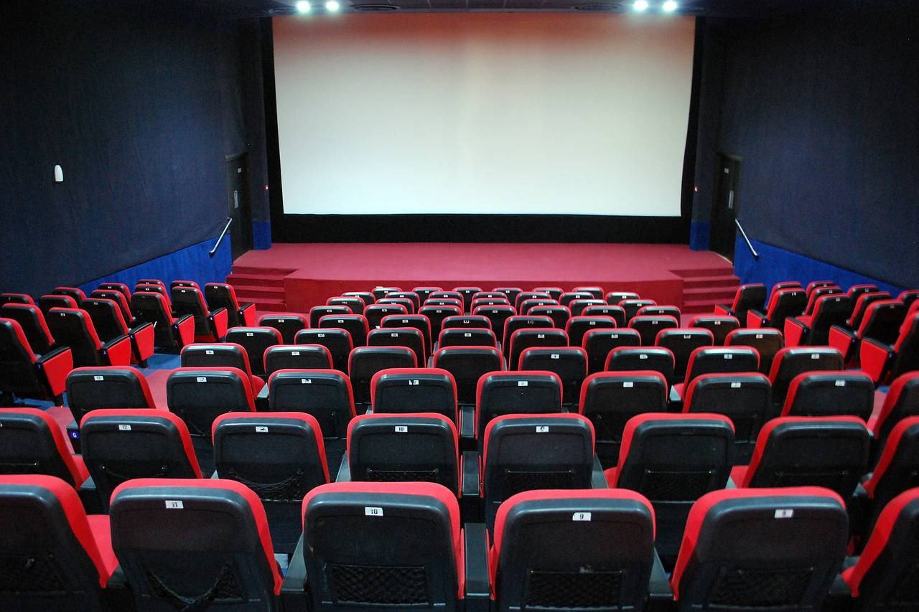
About the Data
What – 2 different datasets : Movies (movieId, genre, & title) and Ratings (UserId, movieId, rating)
How many – Movies (10,329 distinct & their genres) and Ratings (105,339 ratings)
When – Between March 1996 to September 2018
Who – 668 randomly selected Users and their ratings
Why – To produce some insights!
I WATCH THEREFORE I AM: MOVIES DATASET
Intro to Data Science Group 5 Project
– page 3
Notes:
Background:
For a long time, we’ve liked to engross ourselves in fables and stories for ranging purposes. Cinema has become the modern medium to achieve this. From documentaries to action thrillers, it has become an integral part of any community; movies mirror what we believe and help redefine the narrative on how we see others in the world. Whether they’re utilized as a medium to relax after work or school, address key issues to drive social change, or therapeutically to tackle mental health, movies drive and shape our societies.

Slide 4
Some assumptions about data
All movies had associated genres.
All movies had only one associated genre.
The number of user ratings were evenly spread out across movies, and hence genres.
Movies present were released only during the specified time range.
I WATCH THEREFORE I AM: MOVIES DATASET
Intro to Data Science Group 5 Project
– page 4
Notes:
Background:
For a long time, we’ve liked to engross ourselves in fables and stories for ranging purposes. Cinema has become the modern medium to achieve this. From documentaries to action thrillers, it has become an integral part of any community; movies mirror what we believe and help redefine the narrative on how we see others in the world. Whether they’re utilized as a medium to relax after work or school, address key issues to drive social change, or therapeutically to tackle mental health, movies drive and shape our societies.

Slide 5

SMART Questions
Which movie has the highest average rating across the user population between March 1996 and September 2018?
What is the average ratings of each genre using the movies in the sample, across the user population between March 1996 and September 2018?
Which genre is watched the greatest number of times by the user population between March 1996 and September 2018?
Which genre has the highest average rating using movies in the sample, across the user population between March 1996 and September 2018?
Which movie displays the maximum mixed reviews from the user population between March 1996 and September 2018?
Which genre displays the maximum mixed reviews, using the movies in the sample, from the user population between March 1996 and September 2018?
The aim of the analysis was to provide good insight to certain biases when it comes to rating movies, genres watched most by viewers, and how this could affect movie recommendation systems.
I WATCH THEREFORE I AM: MOVIES DATASET
Intro to Data Science Group 5 Project
– page 5
Notes:
Background:
For a long time, we’ve liked to engross ourselves in fables and stories for ranging purposes. Cinema has become the modern medium to achieve this. From documentaries to action thrillers, it has become an integral part of any community; movies mirror what we believe and help redefine the narrative on how we see others in the world. Whether they’re utilized as a medium to relax after work or school, address key issues to drive social change, or therapeutically to tackle mental health, movies drive and shape our societies.

Slide 6

Data pre-processing
Data exists in 2 separate files.
- A priori evaluation of number of genres per movie in movies.
- Initial Chi-Square motivation.
- Averaged rating per movie from Ratings – used in wide dataset.
Combined this data in unique ways for different insights:
1. Split and expanded the genres of each movie in movies.
2. Raw data table - Full Join b/w ‘Movies_expanded’ and ‘Ratings’.
3. Wide dataset – see feature engineering
4. Aggregated Tables:
Mean ratings by ‘genre’.
Mean ratings by ‘year’.
Mean rating by ‘movieId’.
Along with SD, User count etc.
I WATCH THEREFORE I AM: MOVIES DATASET
Intro to Data Science Group 5 Project
– page 6
Notes:
Background:
For a long time, we’ve liked to engross ourselves in fables and stories for ranging purposes. Cinema has become the modern medium to achieve this. From documentaries to action thrillers, it has become an integral part of any community; movies mirror what we believe and help redefine the narrative on how we see others in the world. Whether they’re utilized as a medium to relax after work or school, address key issues to drive social change, or therapeutically to tackle mental health, movies drive and shape our societies.

Slide 7
Feature Engineering
Created a wide dataset.
Engineered binary variables using all 20 genre for analysis - motivated by Chi-Square limitation.
Engineered the following additional variables:
Year: Extracted from movie title.
Averaged rating per movie across sample users – only in wide dataset.
Distinct user count – only in wide dataset.
I WATCH THEREFORE I AM: MOVIES DATASET
Intro to Data Science Group 5 Project
– page 7
Notes:
Background:
For a long time, we’ve liked to engross ourselves in fables and stories for ranging purposes. Cinema has become the modern medium to achieve this. From documentaries to action thrillers, it has become an integral part of any community; movies mirror what we believe and help redefine the narrative on how we see others in the world. Whether they’re utilized as a medium to relax after work or school, address key issues to drive social change, or therapeutically to tackle mental health, movies drive and shape our societies.

Slide 8

Exploratory Data Analysis – for our curiosity
Let's explore average Movie rating by year and find the Year with the highest average rating.
I WATCH THEREFORE I AM: MOVIES DATASET
Intro to Data Science Group 5 Project
– page 8
Notes:
Background:
For a long time, we’ve liked to engross ourselves in fables and stories for ranging purposes. Cinema has become the modern medium to achieve this. From documentaries to action thrillers, it has become an integral part of any community; movies mirror what we believe and help redefine the narrative on how we see others in the world. Whether they’re utilized as a medium to relax after work or school, address key issues to drive social change, or therapeutically to tackle mental health, movies drive and shape our societies.

Slide 9
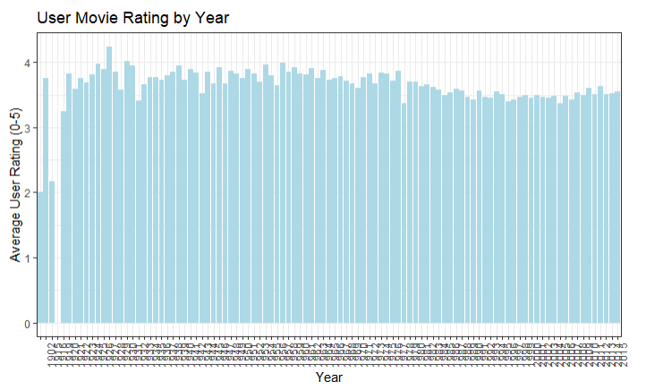

Movie rating by year
- Expecting only few years (according to sample data)
- Not a good indicator – Count varying
- 4.24 highest mean – for a movie in 1927
- More EDA to answer questions!!
I WATCH THEREFORE I AM: MOVIES DATASET
Intro to Data Science Group 5 Project
– page 9
Notes:
Background:
For a long time, we’ve liked to engross ourselves in fables and stories for ranging purposes. Cinema has become the modern medium to achieve this. From documentaries to action thrillers, it has become an integral part of any community; movies mirror what we believe and help redefine the narrative on how we see others in the world. Whether they’re utilized as a medium to relax after work or school, address key issues to drive social change, or therapeutically to tackle mental health, movies drive and shape our societies.

Slide 10
Answers to SMART questions
I WATCH THEREFORE I AM: MOVIES DATASET
Intro to Data Science Group 5 Project
– page 10
Notes:
Background:
For a long time, we’ve liked to engross ourselves in fables and stories for ranging purposes. Cinema has become the modern medium to achieve this. From documentaries to action thrillers, it has become an integral part of any community; movies mirror what we believe and help redefine the narrative on how we see others in the world. Whether they’re utilized as a medium to relax after work or school, address key issues to drive social change, or therapeutically to tackle mental health, movies drive and shape our societies.

Slide 11

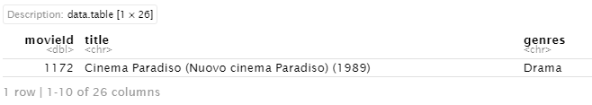
Answering questions
Q1: Which movie has the highest average rating across the user population between March 1996 and September 2018?
Limitation: For User Population ~ Confidence intervals for all 10,000+ movies???
The Alternate Approach – To get clear winner - Utilizing summary table on Movies/Wide dataset
The Result
Averaged Rating
4.46 / 5.00
Next Steps: T-Test on raw data subset
Conclusion: Average rating for this movie lies in [4.242887, 4.676032] for the entire User population with a confidence level of 95% for the period between March 1996 and September 2018.
I WATCH THEREFORE I AM: MOVIES DATASET
Intro to Data Science Group 5 Project
– page 11
Notes:
N should’ve been higher since the distribution is highly skewed. But we found that N>100, we were filtering out majority of the data.

Slide 12
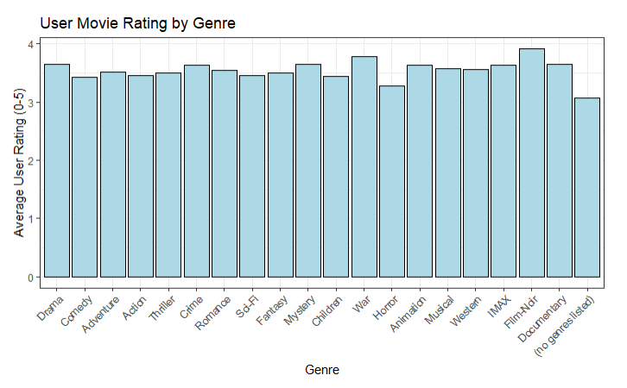

Answering questions
Q2: What is the average ratings of each genre using the movies in the sample, across the user population between March 1996 and September 2018?
Limitation – Plot based on Sample User Data Only!!
Approach – To calculate the confidence intervals (T-tests) of each genre for movie population using sample users : averaged ratings (Utilizing Wide dataset)
I WATCH THEREFORE I AM: MOVIES DATASET
Intro to Data Science Group 5 Project
– page 12
Notes:
Background:
For a long time, we’ve liked to engross ourselves in fables and stories for ranging purposes. Cinema has become the modern medium to achieve this. From documentaries to action thrillers, it has become an integral part of any community; movies mirror what we believe and help redefine the narrative on how we see others in the world. Whether they’re utilized as a medium to relax after work or school, address key issues to drive social change, or therapeutically to tackle mental health, movies drive and shape our societies.

Slide 13
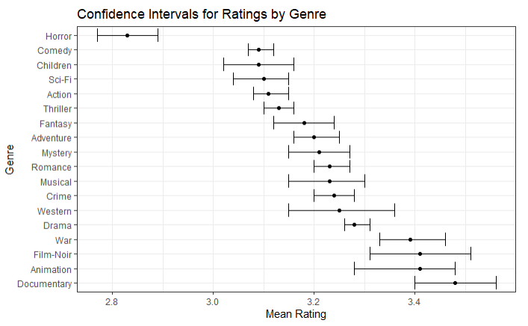

Answering questions
Conclusion:
Documentary has the higher confidence interval, which overlaps with War, Film-Noir, and Animation. One of these four is most likely the highest rating genre out of all the movies in each genre.
Horror is the lowest rating genre by far, with no overlap with any other genres.
I WATCH THEREFORE I AM: MOVIES DATASET
Intro to Data Science Group 5 Project
– page 13
Notes:
Background:
For a long time, we’ve liked to engross ourselves in fables and stories for ranging purposes. Cinema has become the modern medium to achieve this. From documentaries to action thrillers, it has become an integral part of any community; movies mirror what we believe and help redefine the narrative on how we see others in the world. Whether they’re utilized as a medium to relax after work or school, address key issues to drive social change, or therapeutically to tackle mental health, movies drive and shape our societies.

Slide 14
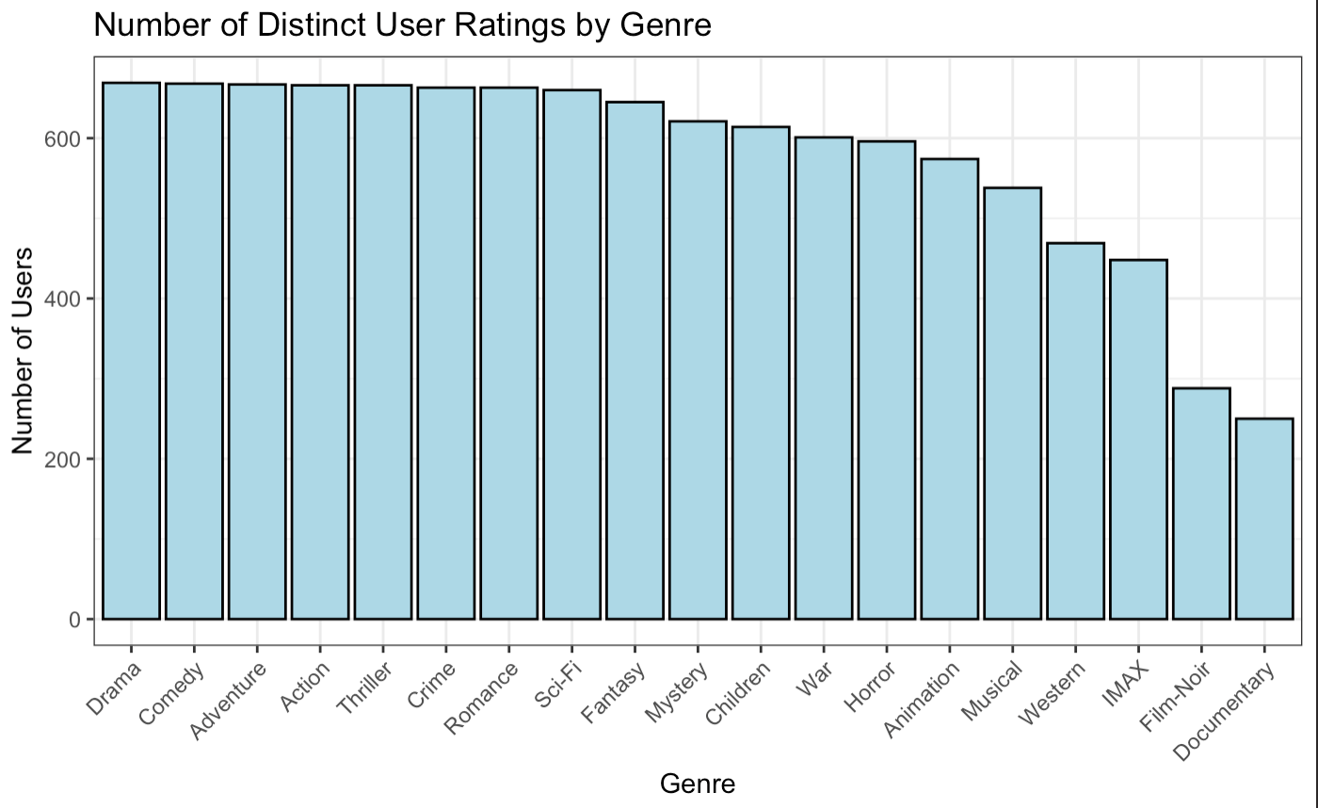

Answering questions
Q3: Which genre is watched the greatest number of times by the user population between March 1996 and September 2018?
Limitation: Scope of question reduced from User population to Sample Users.
Conclusion: Drama has the highest number of user ratings at 669.
I WATCH THEREFORE I AM: MOVIES DATASET
Intro to Data Science Group 5 Project
– page 14
Notes:
Background:
For a long time, we’ve liked to engross ourselves in fables and stories for ranging purposes. Cinema has become the modern medium to achieve this. From documentaries to action thrillers, it has become an integral part of any community; movies mirror what we believe and help redefine the narrative on how we see others in the world. Whether they’re utilized as a medium to relax after work or school, address key issues to drive social change, or therapeutically to tackle mental health, movies drive and shape our societies.

Slide 15

Answering Questions
Q4: Which genre has the highest average rating using movies in the sample, across the user population between March 1996 and September 2018?
Answering this proved to be a challenge, because genre was not mutually exclusive, so ANOVA was not possible.
Instead, we did a two-sample t-test for each genre.
The following had statistically higher ratings when compared to the rest of the sample:
Animation
Romance
Drama
Crime
War
Documentary
Film-Noir
The following had statistically lower ratings when compared to the rest of the sample:
Children
Comedy
Action
Thriller
Horror
Sci-Fi
I WATCH THEREFORE I AM: MOVIES DATASET
Intro to Data Science Group 5 Project
– page 15
Notes:
Background:
For a long time, we’ve liked to engross ourselves in fables and stories for ranging purposes. Cinema has become the modern medium to achieve this. From documentaries to action thrillers, it has become an integral part of any community; movies mirror what we believe and help redefine the narrative on how we see others in the world. Whether they’re utilized as a medium to relax after work or school, address key issues to drive social change, or therapeutically to tackle mental health, movies drive and shape our societies.

Slide 16
Answering questions
Conclusion:
Documentary has the higher confidence interval, which overlaps with War, Film-Noir, and Animation. One of these four is most likely the highest rating genre out of all the movies in each genre.
Horror is the lowest rating genre by far, with no overlap with any other genres.
I WATCH THEREFORE I AM: MOVIES DATASET
Intro to Data Science Group 5 Project
– page 16
Notes:
Background:
For a long time, we’ve liked to engross ourselves in fables and stories for ranging purposes. Cinema has become the modern medium to achieve this. From documentaries to action thrillers, it has become an integral part of any community; movies mirror what we believe and help redefine the narrative on how we see others in the world. Whether they’re utilized as a medium to relax after work or school, address key issues to drive social change, or therapeutically to tackle mental health, movies drive and shape our societies.

Slide 17
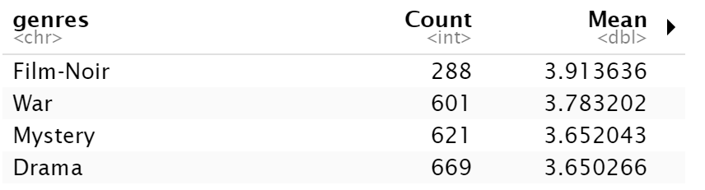
Answering questions
Q4: Which genre has the highest average rating using movies in the sample, across the user population between March 1996 and September 2018?
Limitation: No clear winner as there would be overlaps (Observed previously) during movie population.
Similar Approach as Movie – Utilizing summary table on Genre – rating by genre to get clear winner
The Result
Next Steps: T-Test on raw data subset
Conclusion: Average rating for this genre lies in [3.863753, 3.963520] for the entire User population with a confidence level of 95% for the period between March 1996 and September 2018.
I WATCH THEREFORE I AM: MOVIES DATASET
Intro to Data Science Group 5 Project
– page 17
Notes:
Background:
For a long time, we’ve liked to engross ourselves in fables and stories for ranging purposes. Cinema has become the modern medium to achieve this. From documentaries to action thrillers, it has become an integral part of any community; movies mirror what we believe and help redefine the narrative on how we see others in the world. Whether they’re utilized as a medium to relax after work or school, address key issues to drive social change, or therapeutically to tackle mental health, movies drive and shape our societies.

Slide 18

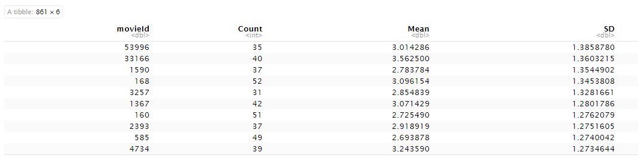
Answering questions
Q5: Which movie displays the maximum mixed reviews from the user population between March 1996 and September 2018?
Approach:
Initial thought to consider range. But not feasible. Why?
Methodology to consider Standard Deviation next.
User Count > 30
Utilizing Rating by movie summary table
The Result
Conclusion - MovieId = 53996, which is the movie titled = `Transformers (2007)` has maximum Standard Deviation and hence, maximum mixed reviews.
Limitation:
Sample Users data only
Law of large numbers – Unreliable result
To do a fair analysis – we’d need the same number of User ratings across all movies.
I WATCH THEREFORE I AM: MOVIES DATASET
Intro to Data Science Group 5 Project
– page 18
Notes:
Background:
For a long time, we’ve liked to engross ourselves in fables and stories for ranging purposes. Cinema has become the modern medium to achieve this. From documentaries to action thrillers, it has become an integral part of any community; movies mirror what we believe and help redefine the narrative on how we see others in the world. Whether they’re utilized as a medium to relax after work or school, address key issues to drive social change, or therapeutically to tackle mental health, movies drive and shape our societies.

Slide 19
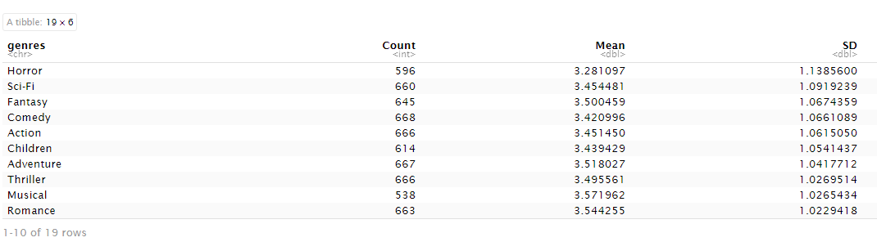

Answering questions
Q6: Which genre displays the maximum mixed reviews, using the movies in the sample, from the user population between March 1996 and September 2018?
Approach:
Similar approach as previous
Utilizing Rating by genre summary table
The Result
Conclusion – Horror genre has maximum Standard Deviation and hence, maximum mixed reviews.
Limitation:
Sample Users data only
Law of large numbers – Unreliable result
I WATCH THEREFORE I AM: MOVIES DATASET
Intro to Data Science Group 5 Project
– page 19
Notes:
Background:
For a long time, we’ve liked to engross ourselves in fables and stories for ranging purposes. Cinema has become the modern medium to achieve this. From documentaries to action thrillers, it has become an integral part of any community; movies mirror what we believe and help redefine the narrative on how we see others in the world. Whether they’re utilized as a medium to relax after work or school, address key issues to drive social change, or therapeutically to tackle mental health, movies drive and shape our societies.

Slide 20




Summary & Concluding Notes
Some genres like Film- Noir, War, Animation, and Documentary tend to have higher movie ratings.
Other films like Horror, Thriller and Action movies tend to have lower movie ratings.
Genre like Film - Noir have been watched by less people, but it is the best rated Genre. So less people watched it, but whoever did, loved it!
Challenges with the dataset prevented us from fulling answering some of our SMART questions.
Some SMART questions we developed were not answerable with statistical inference.
Available from $2.99 on
I WATCH THEREFORE I AM: MOVIES DATASET
Intro to Data Science Group 5 Project
– page 20
Notes:
Background:
For a long time, we’ve liked to engross ourselves in fables and stories for ranging purposes. Cinema has become the modern medium to achieve this. From documentaries to action thrillers, it has become an integral part of any community; movies mirror what we believe and help redefine the narrative on how we see others in the world. Whether they’re utilized as a medium to relax after work or school, address key issues to drive social change, or therapeutically to tackle mental health, movies drive and shape our societies.

Slide 21

Thank you for listening!
For more information
If you would like to learn more about our project, please reach out to any of the team members below
Aditya Kumar Jack McMorrow Anthony C. Okoye
aditya_kumar@gwu.edu jmcmorrow@gwmail.gwu.edu anthonycokoye@gwu.edu

