Slide 1
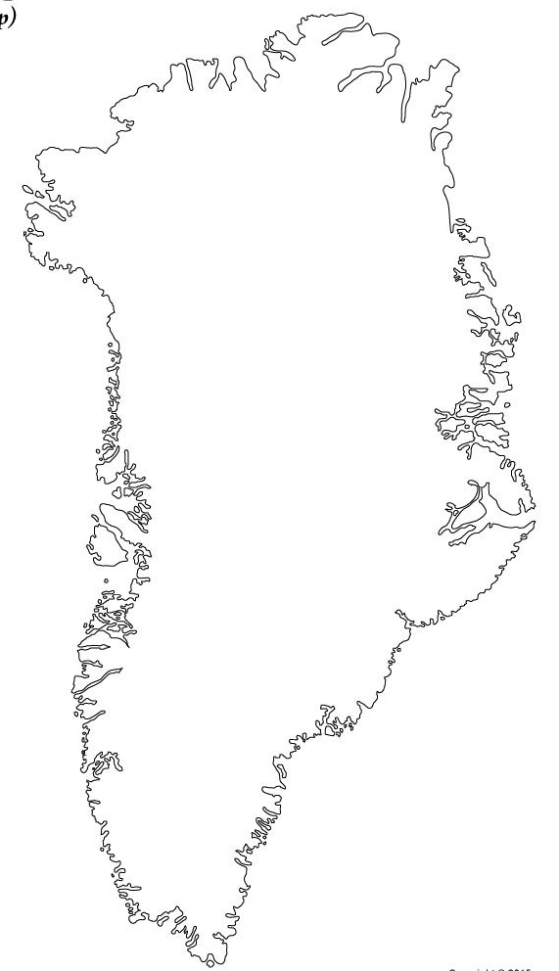
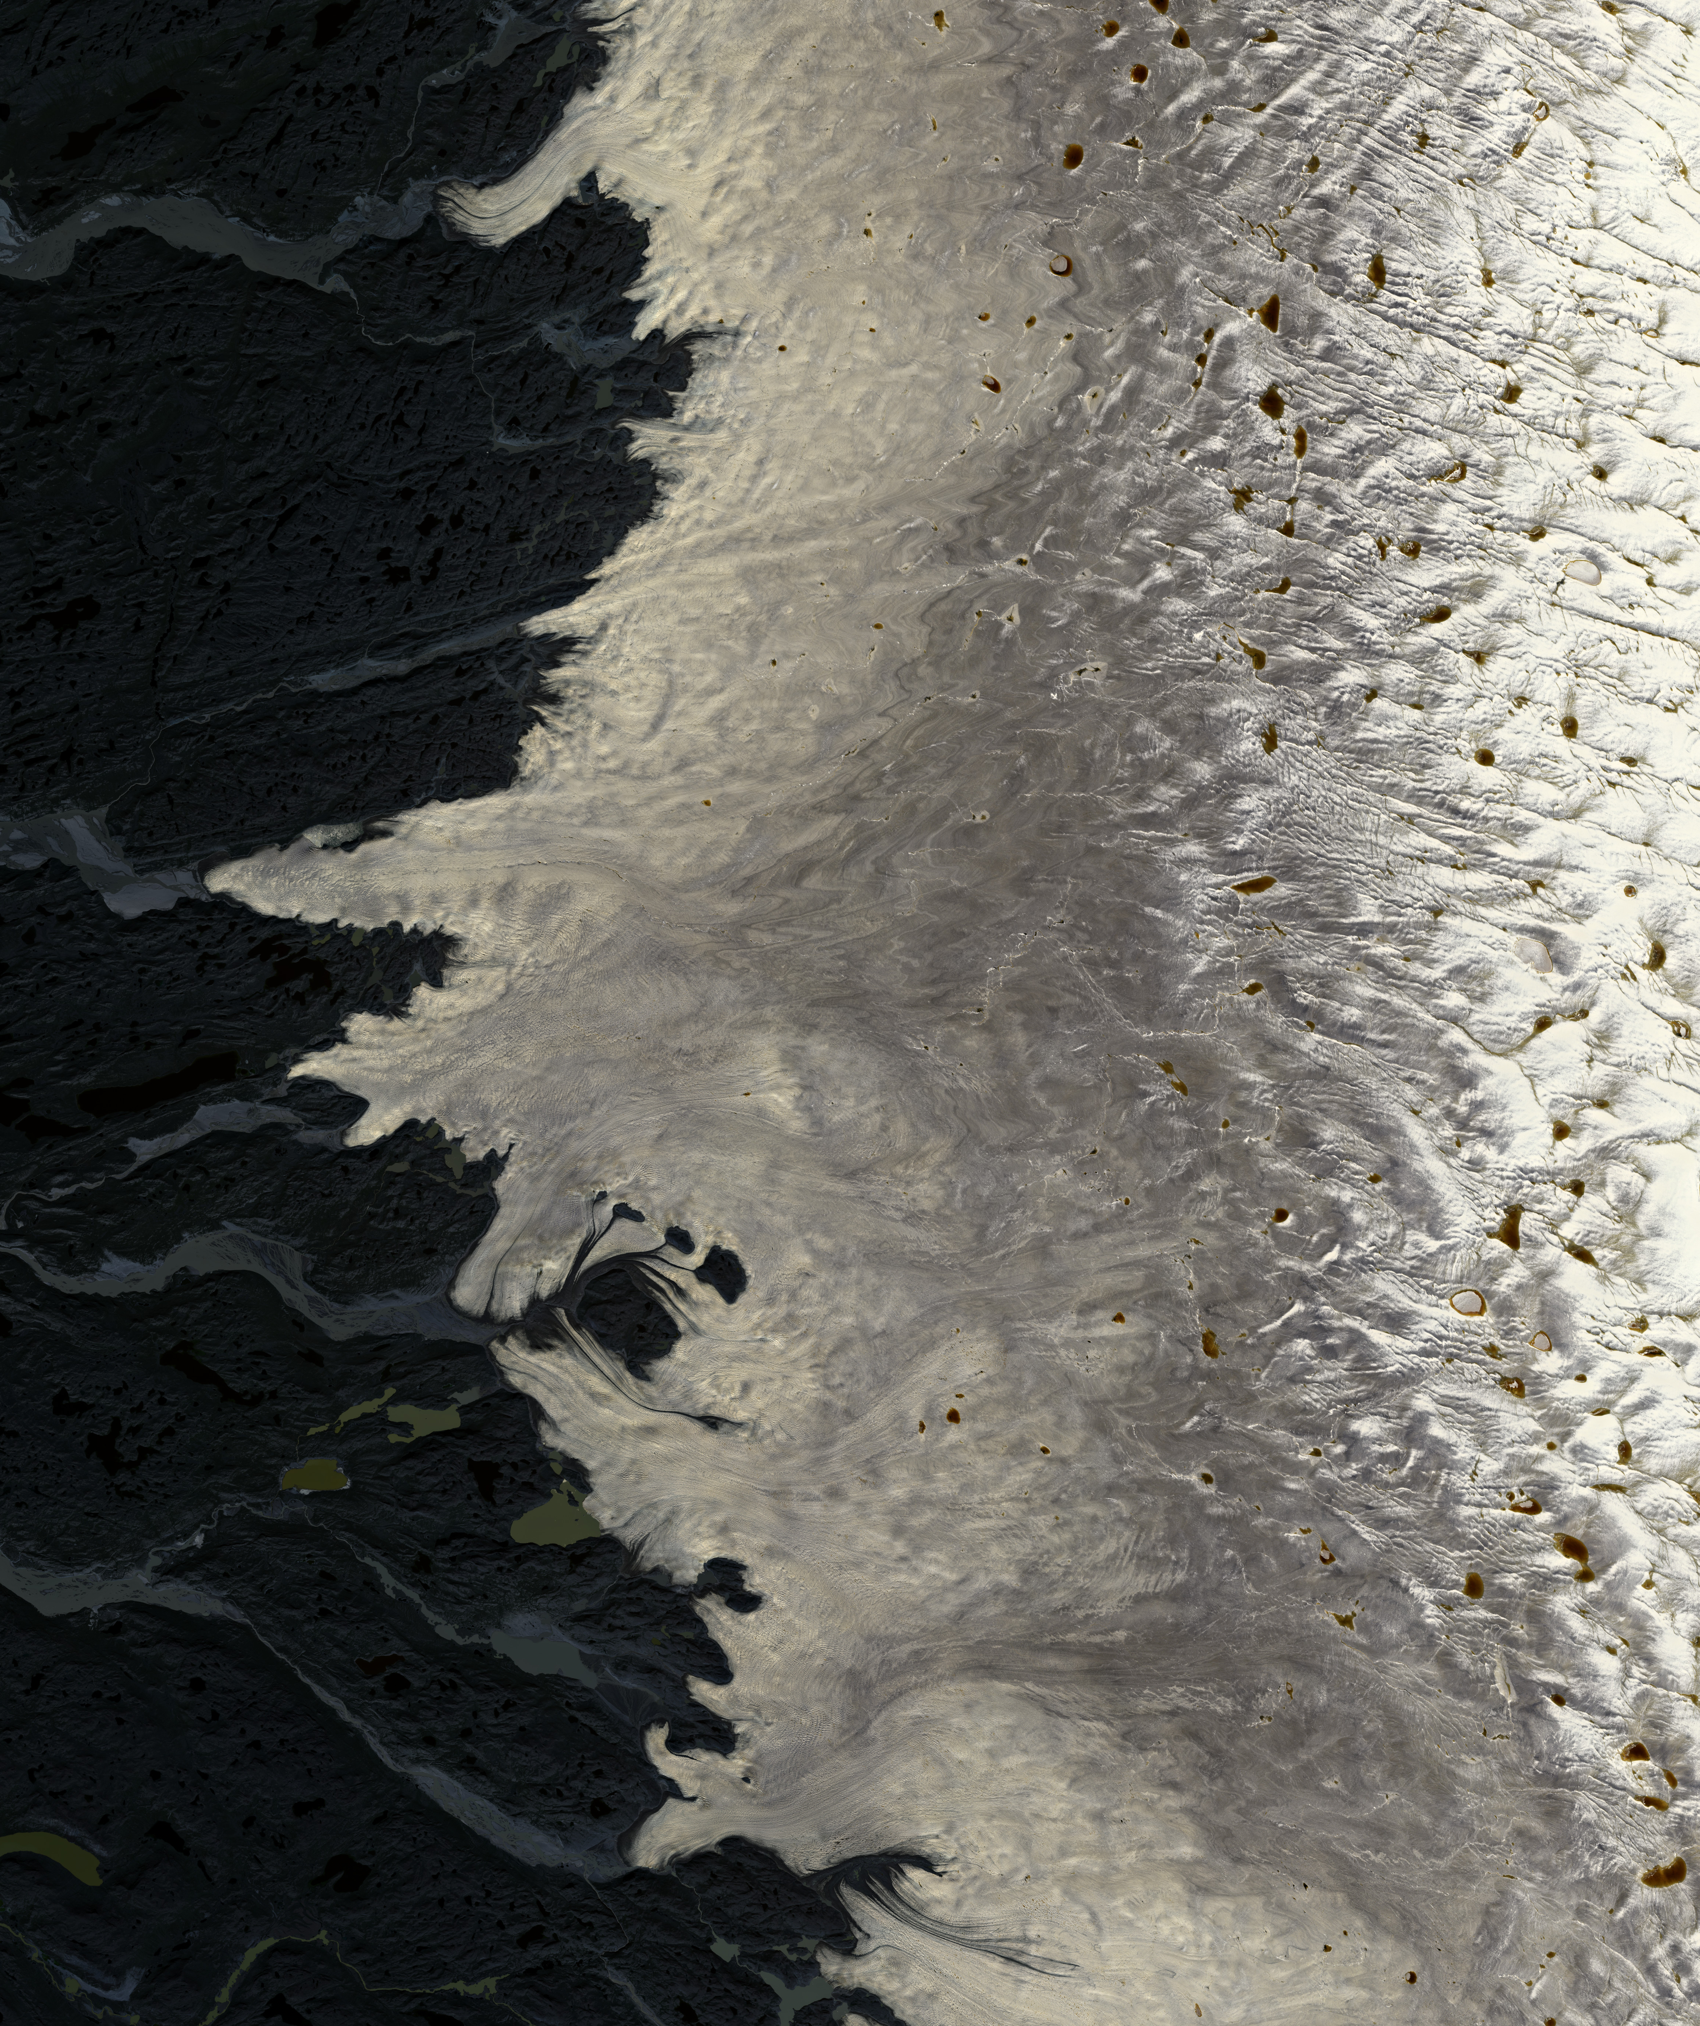
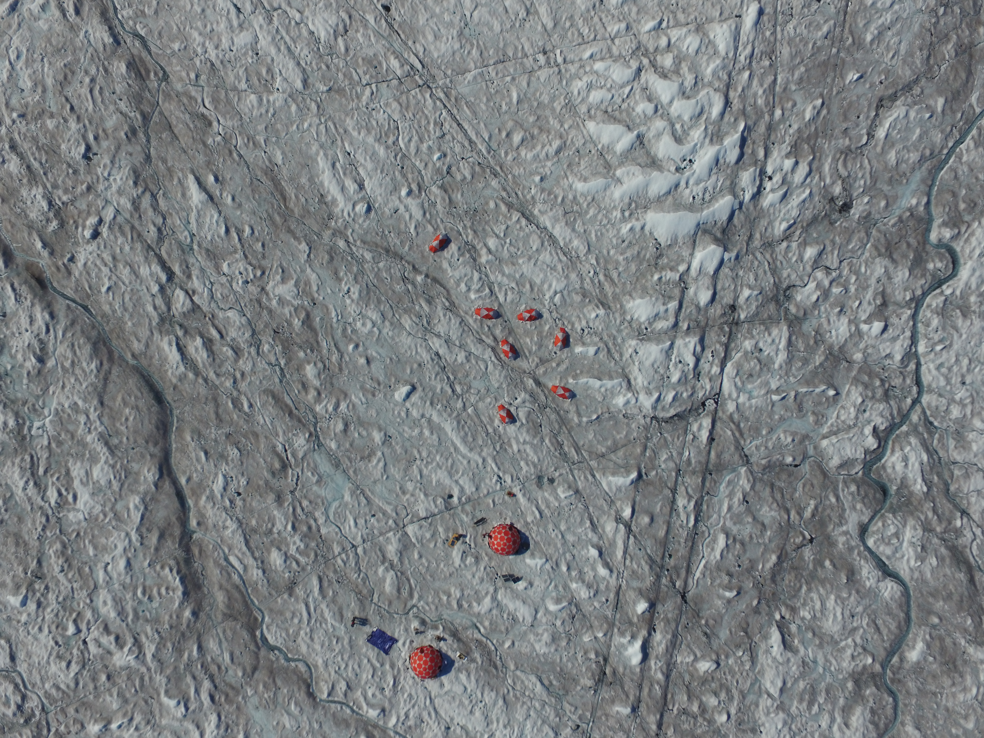
A
B
C
67.615
77.442
Latitude (decimal degrees)
Latitude (decimal degrees)
Field
Site
50 m
66.631
48.419
59.717
51.000
Longitude (decimal degrees)

Slide 2
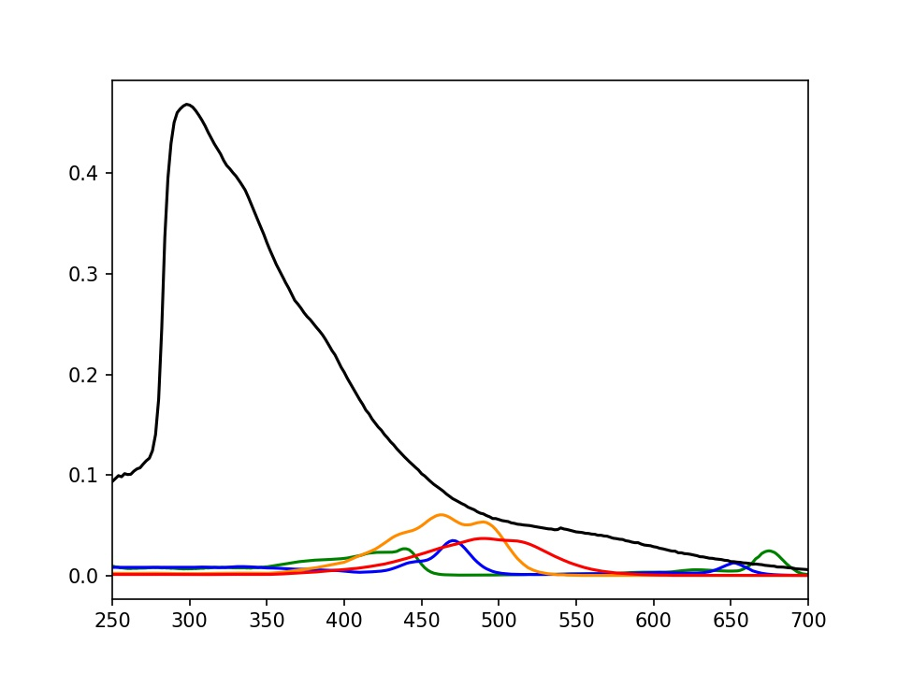
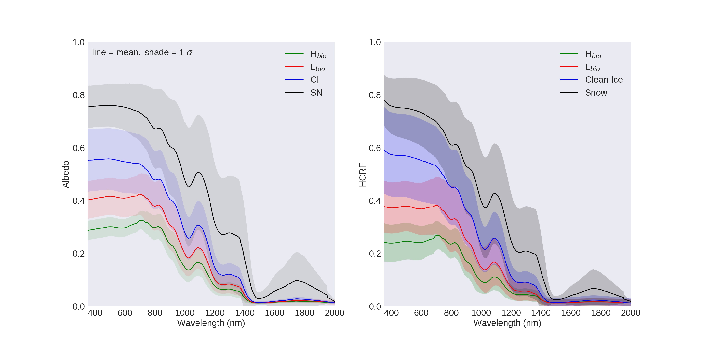
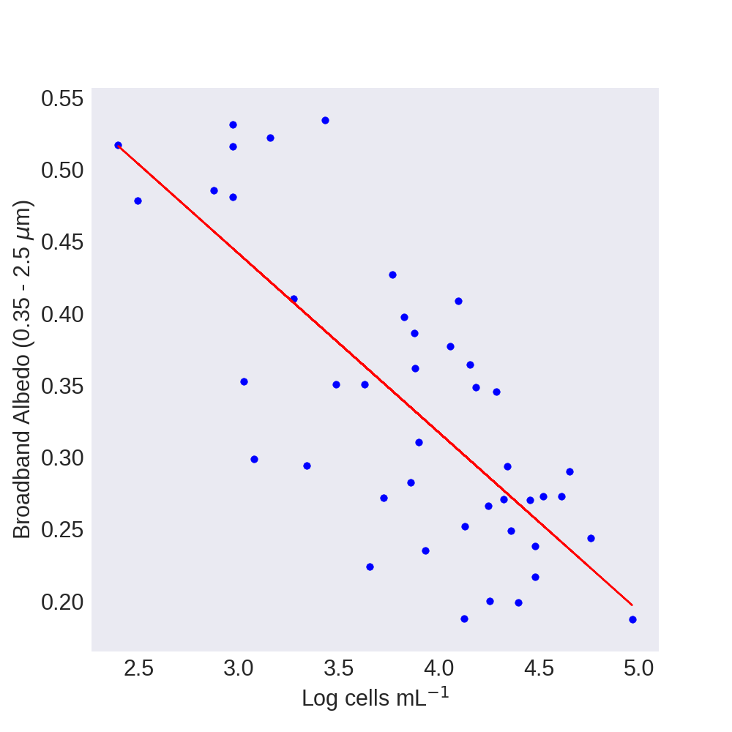
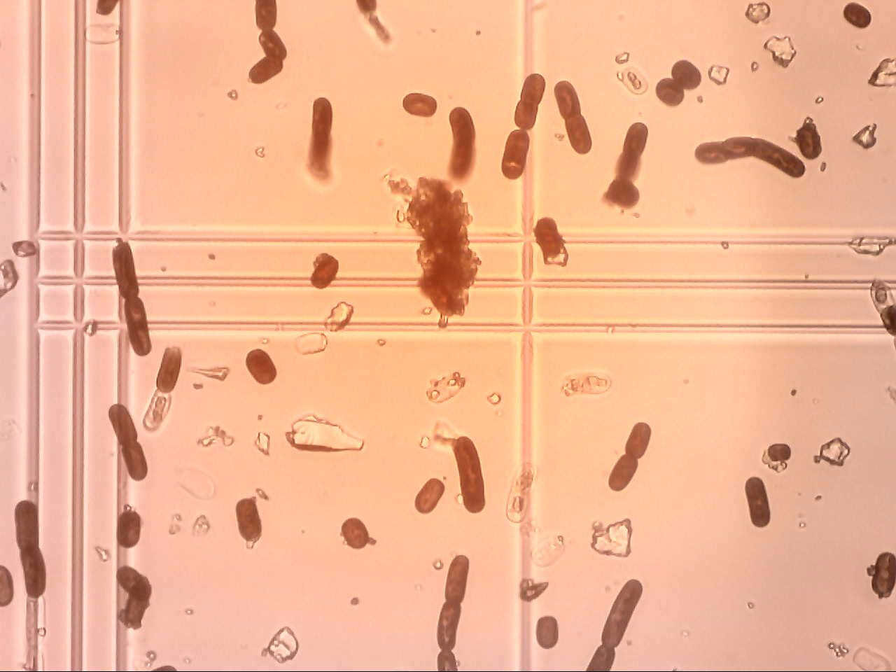
A
B
Phenol
0.4
Photoprotective carotenoids
Photosynthetic carotenoids
0.8
Chlorophyll-b
0.3
Chlorophyll-a
0.6
Albedo
Mass absorption coefficient m² mg⁻¹
0.2
0.4
0.1
0.2
0
0.7
0
2.0
0.3
0.4
0.5
0.6
0.4
0.6
0.8
1.0
1.2
1.4
1.6
1.8
Wavelength (µm)
Wavelength (µm)
C
r² = 0.57
D
0.5
Mesotaenium
berggrenii
H
0.4
Mineral
fragment
Broadband albedo (0.35 – 2.5 µm)
0.3
Ancylonema
nordenskioldii
0.2
50 µm
2.5
3.0
3.5
4.0
4.5
5.0
Log cells mL⁻¹

Slide 3
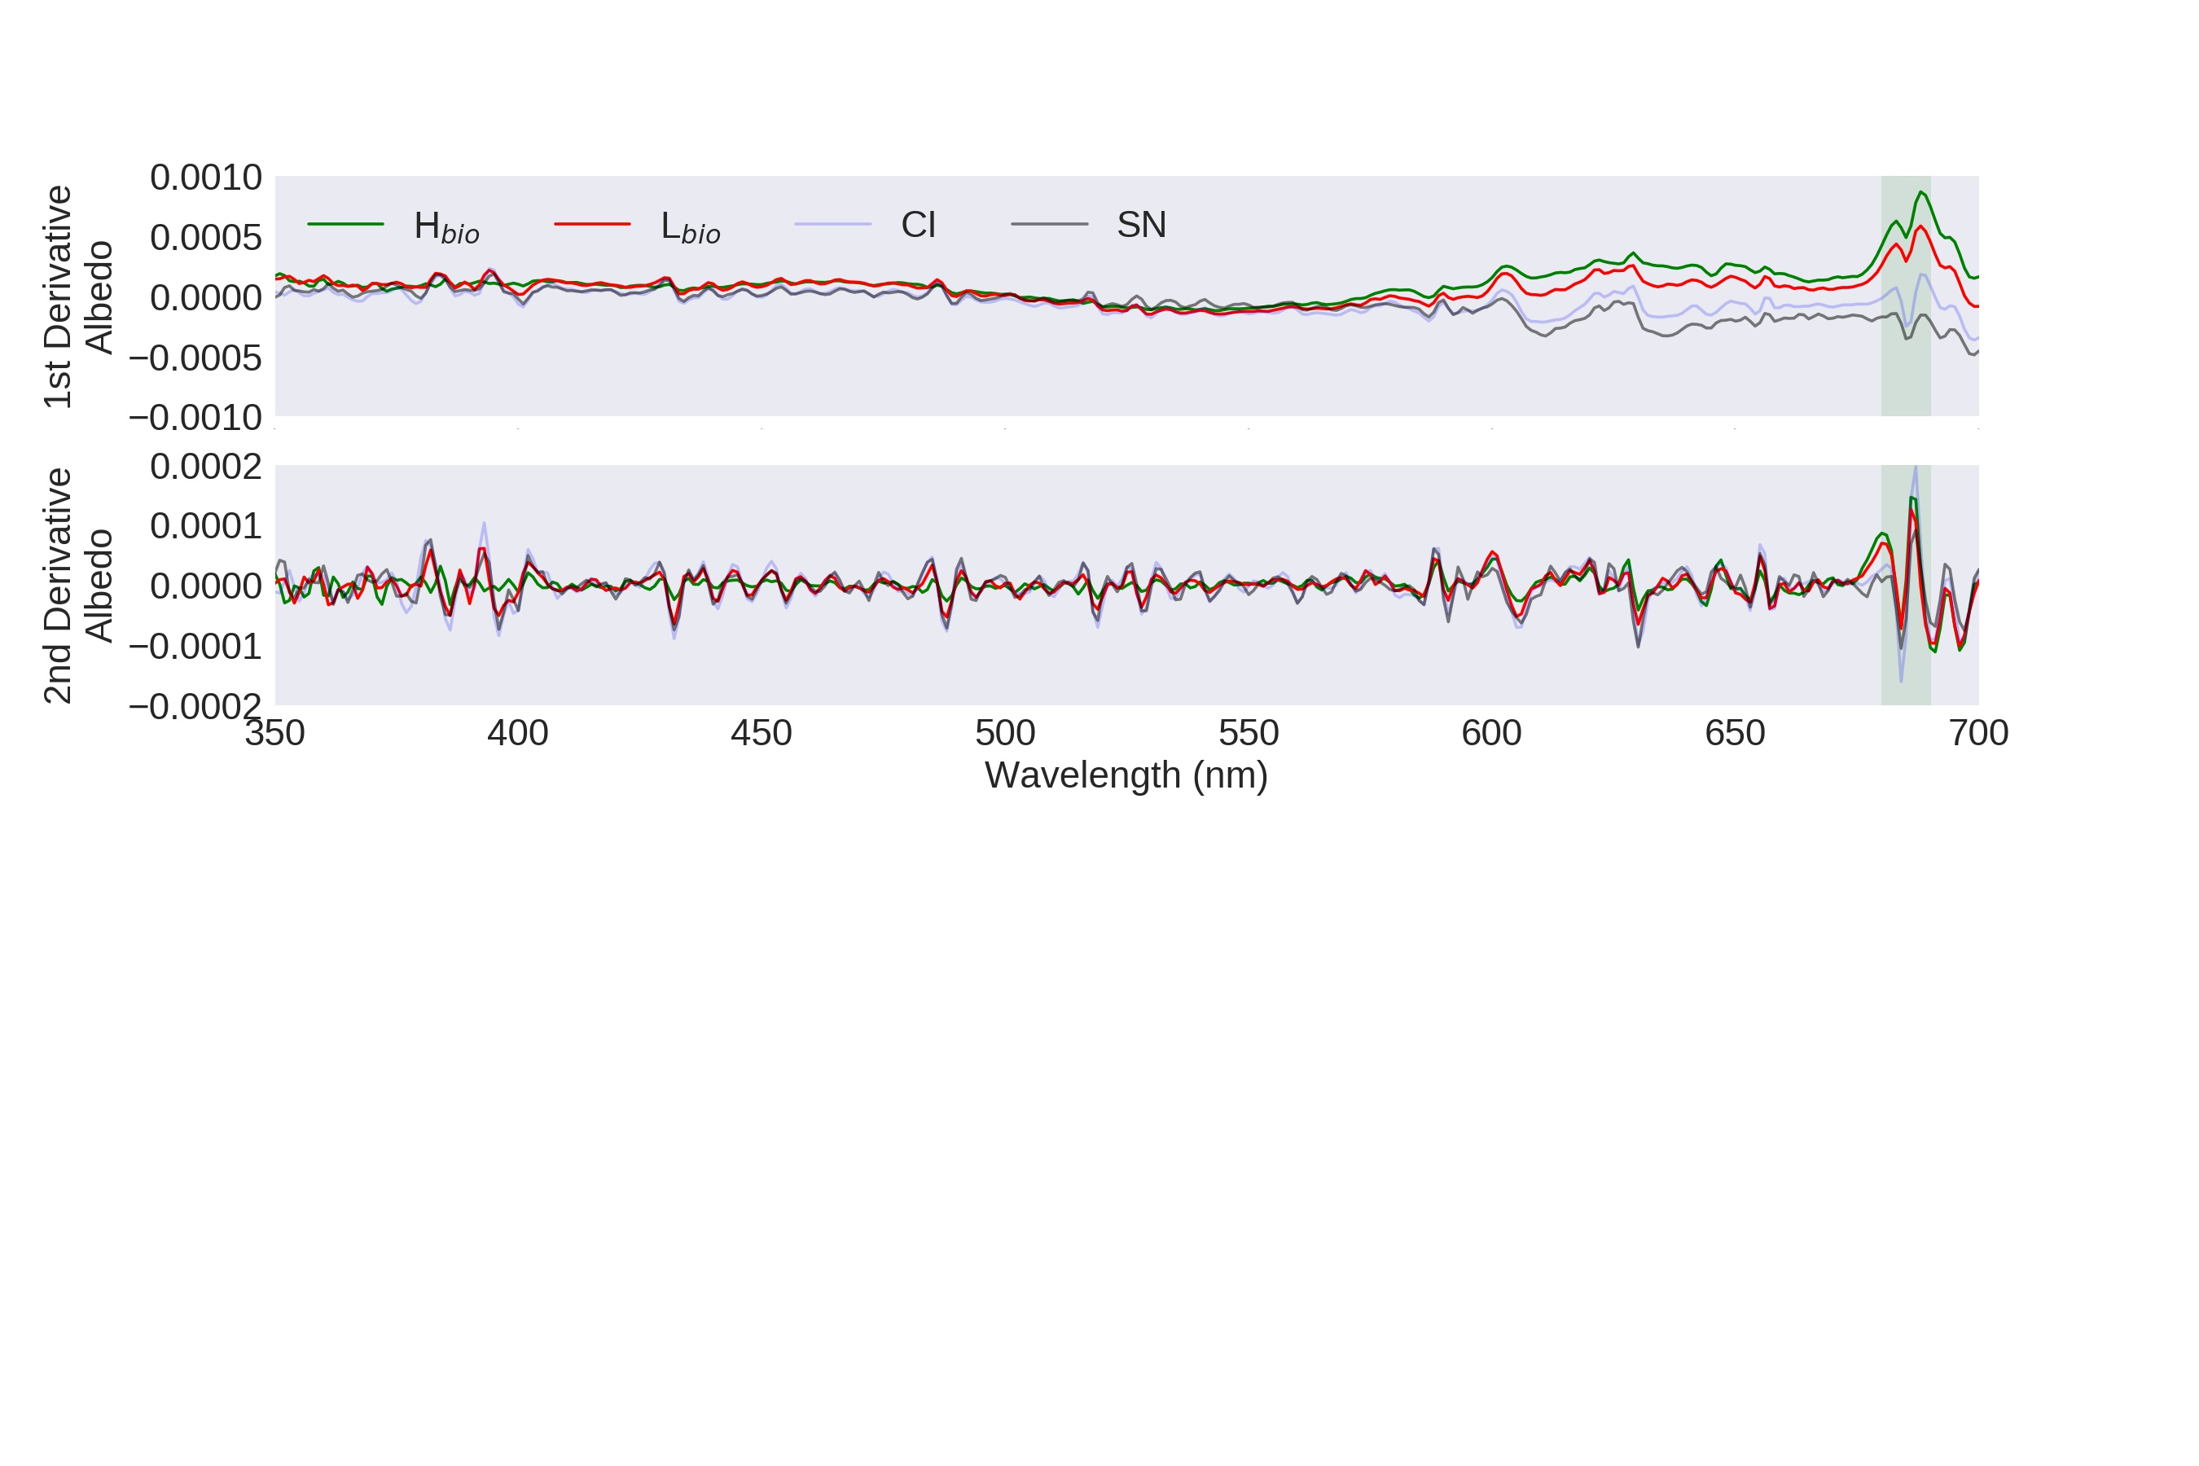
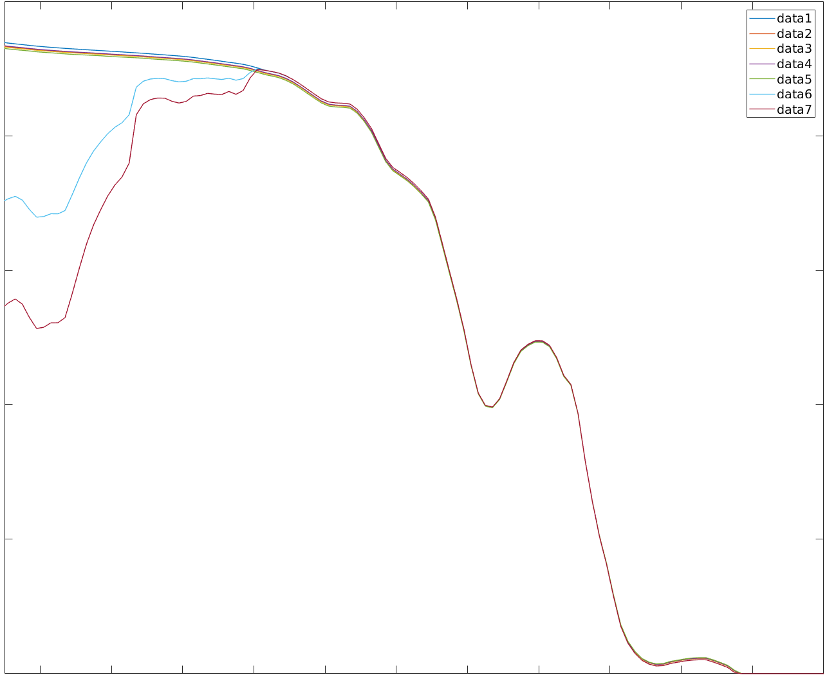
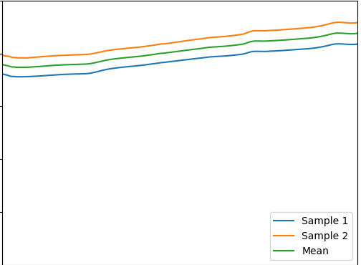
A
0.0010
0.0005
1st Derivative
0.0000
-0.0005
-0.0010
0.0002
0.0001
2nd Derivative
0.0000
-0.0001
-0.0002
0.35
0.40
0.45
0.50
0.55
0.60
0.65
0.70
Wavelength (µm)
B
F
C
0.5
1.0
Clean ice
342 µg/g MN-DUST
0.4
342 µg/g HI-DUST
0.8
342 µg/g LO-DUST
519 µg/g MN-DUST
349 µg/g glacier algae
0.3
646 µg/g glacier algae
0.6
Albedo
Reflectance
0.2
0.4
0.1
0.2
0
0
0.4
0.6
0.8
1.0
1.2
1.4
0.4
0.6
0.8
1.0
1.2
1.4
1.6
1.8
Wavelength (µm)
Wavelength (µm)

Slide 4
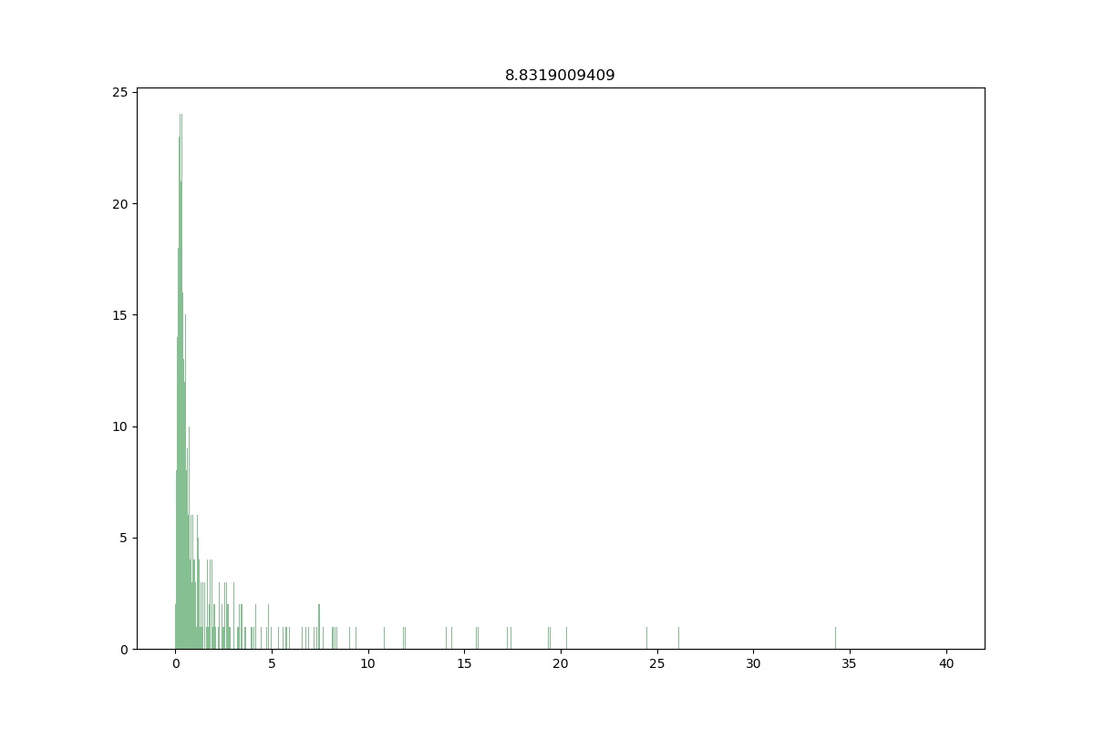
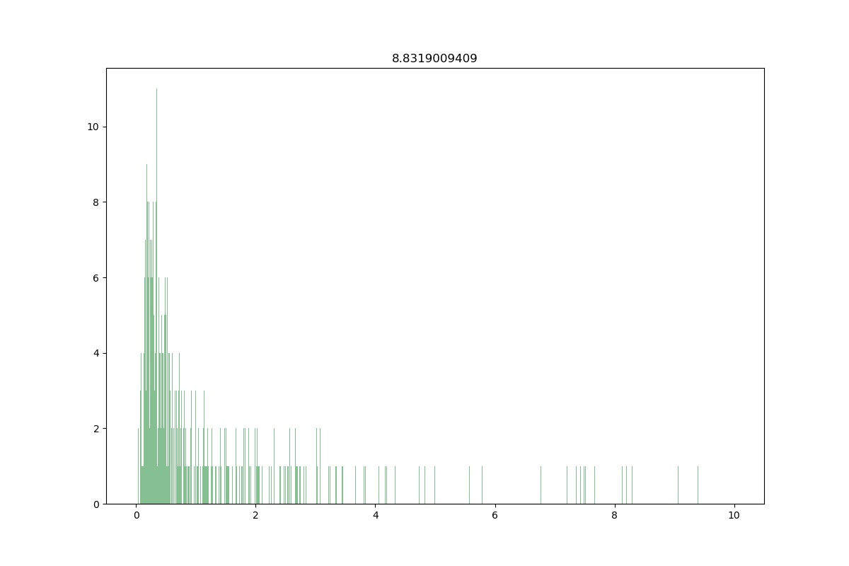
25
12
10
i
20
8
Frequency
Frequency
6
15
4
12
2
0
0
2
4
5
Particle diameter (µm)
0
0
5
10
15
20
25
30
35
40
Particle diameter (µm)

Slide 5
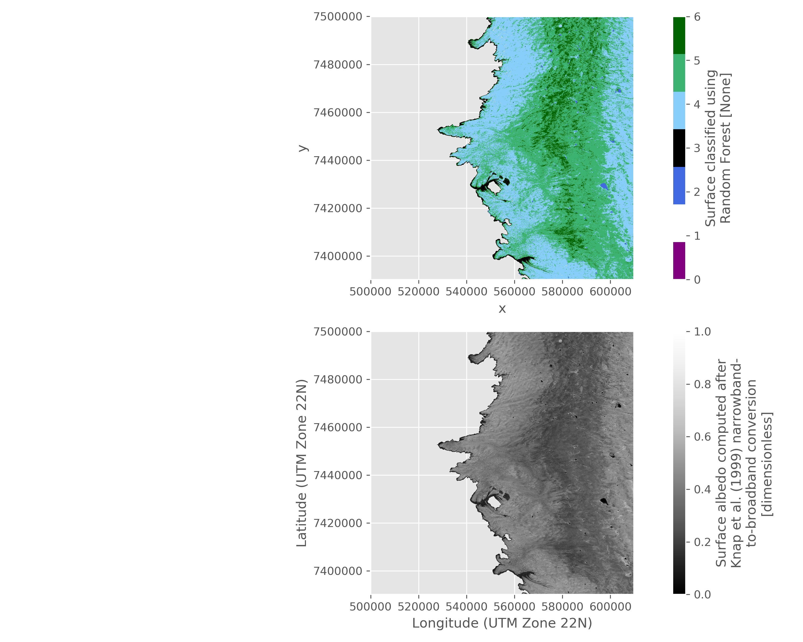
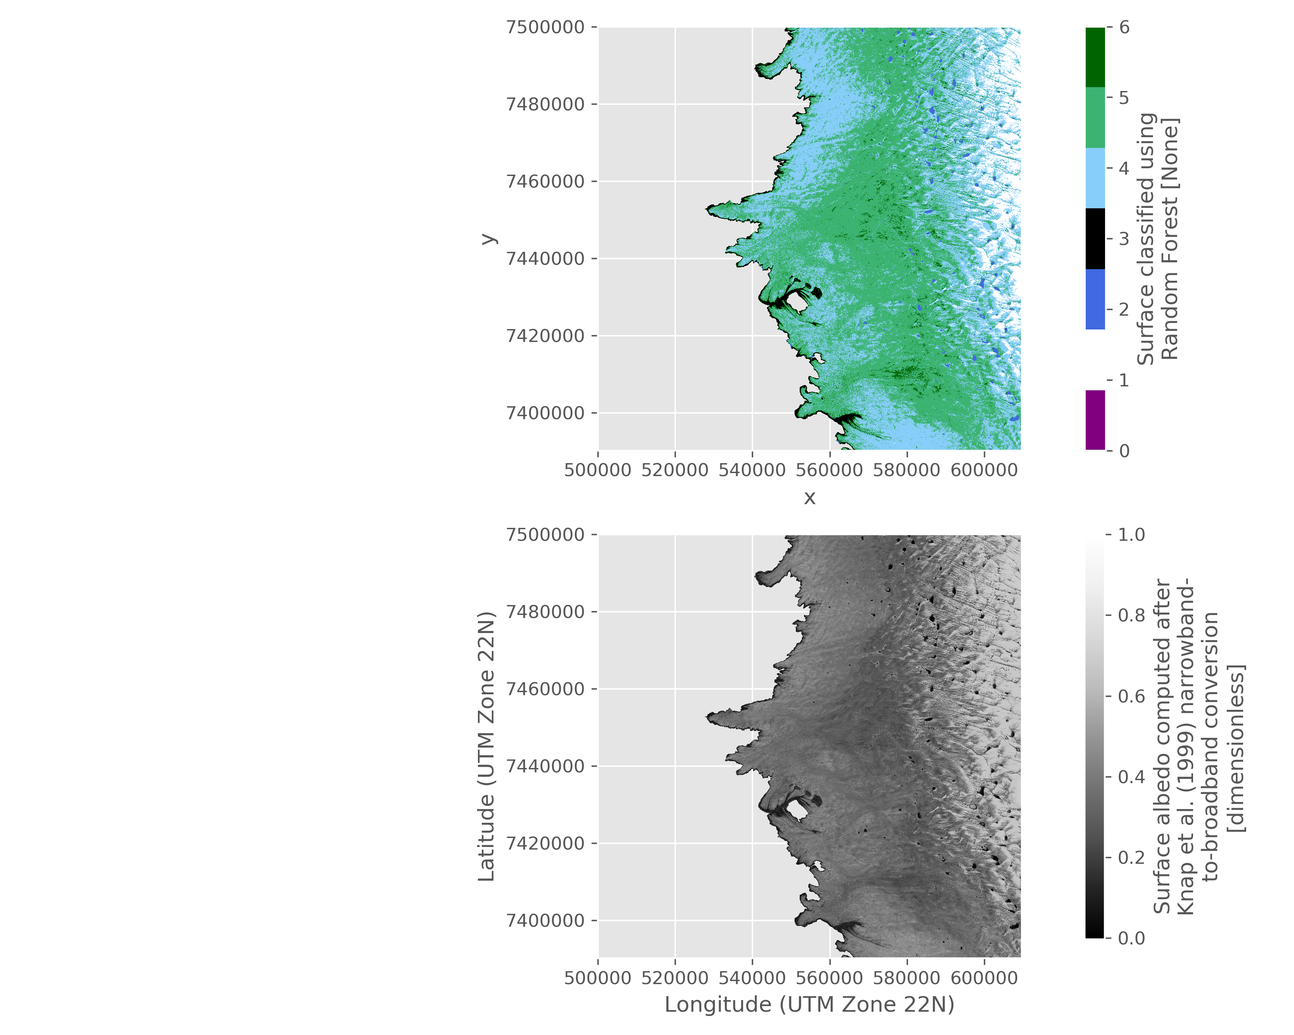
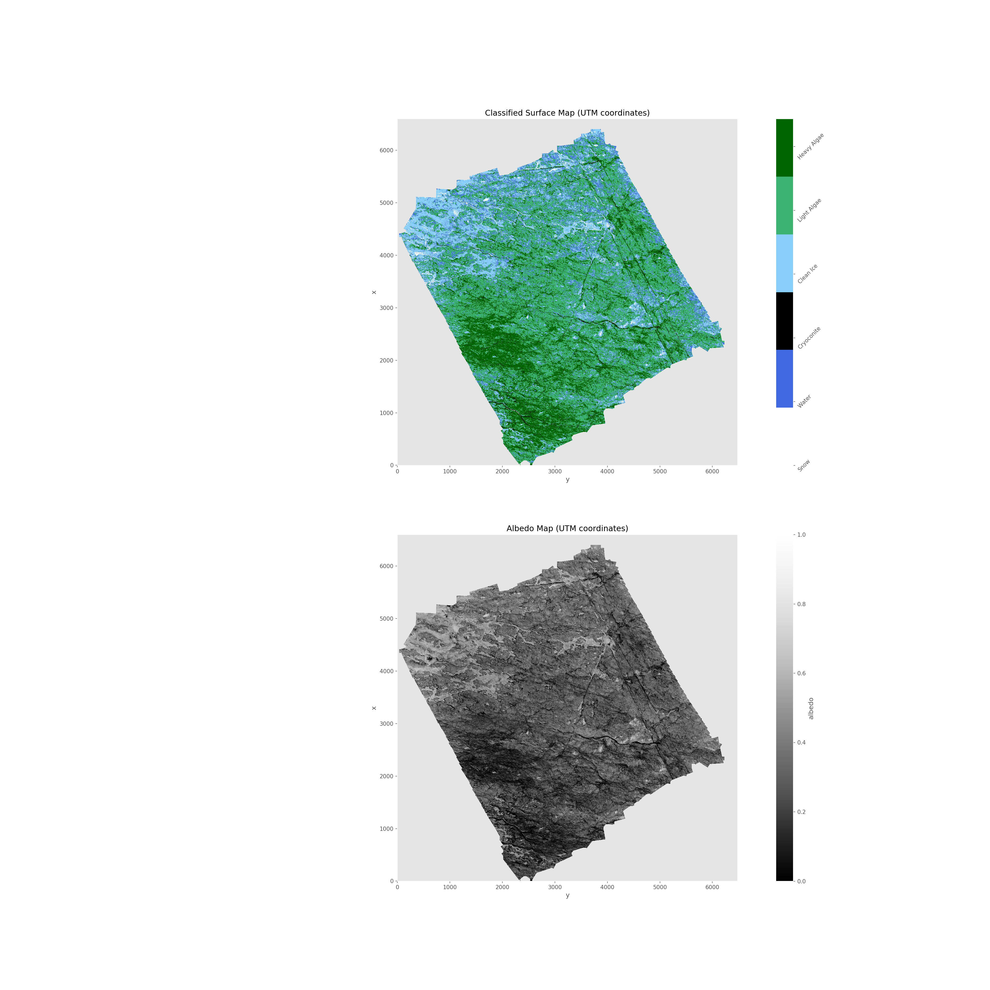
A
Surface Classes
D
SN
WAT
CC
CI
LA
HA
67.615437
C
2016
2017
Latitude (decimal degrees)
Field
Site
B
E
67.599527
51.000235
Longitude (decimal degrees)
48.418656
2016
0
0.2
0.4
0.6
0.8
1.0
2017
50 km
Albedo
F
G
UAV
UAV
100 m

Slide 6
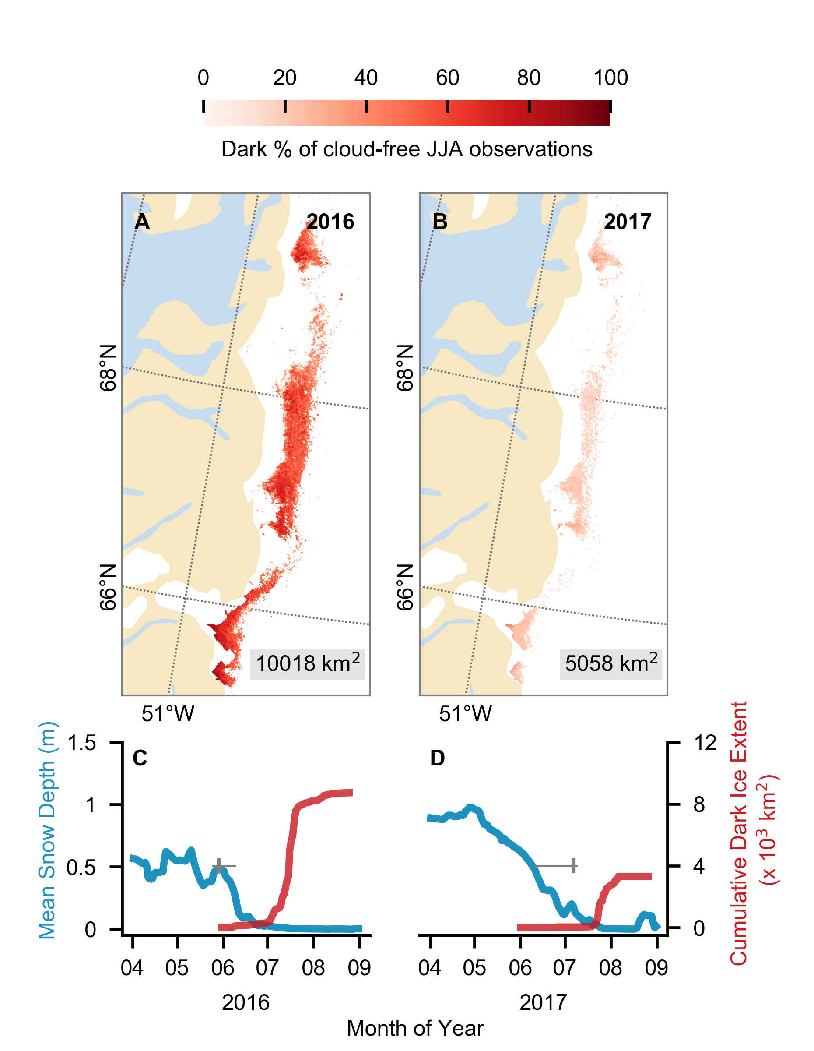

Slide 7
Model inputs
model
Model Outputs
In vivo absorption
coefficients and mass
mixing ratios for individual
pigments, n and water
fraction in cell
Empirical measurements
of cell MAC
Radiative transfer
Parameters:
no. vertical layers, density,
grain size, incoming
Irradiance, two stream
approximation type, impurity
types and mass mixing
ratios.
PSD
mixing
model
Bio-optical
model
polydisperse
Mie or GO
model
2-stream
RTM
Surface albedo
Lookup library of single
scattering optical properties
for impurities and ice grains
(SSA, g, MAC)
n, k, MAC
for entire cells
monodisperse
Subsurface light
field
Energy absorbed
per vertical layer
k and n for ice crystals
From Warren and
Brandt (2008)
Ice grain or impurity
dimensions

Slide 8
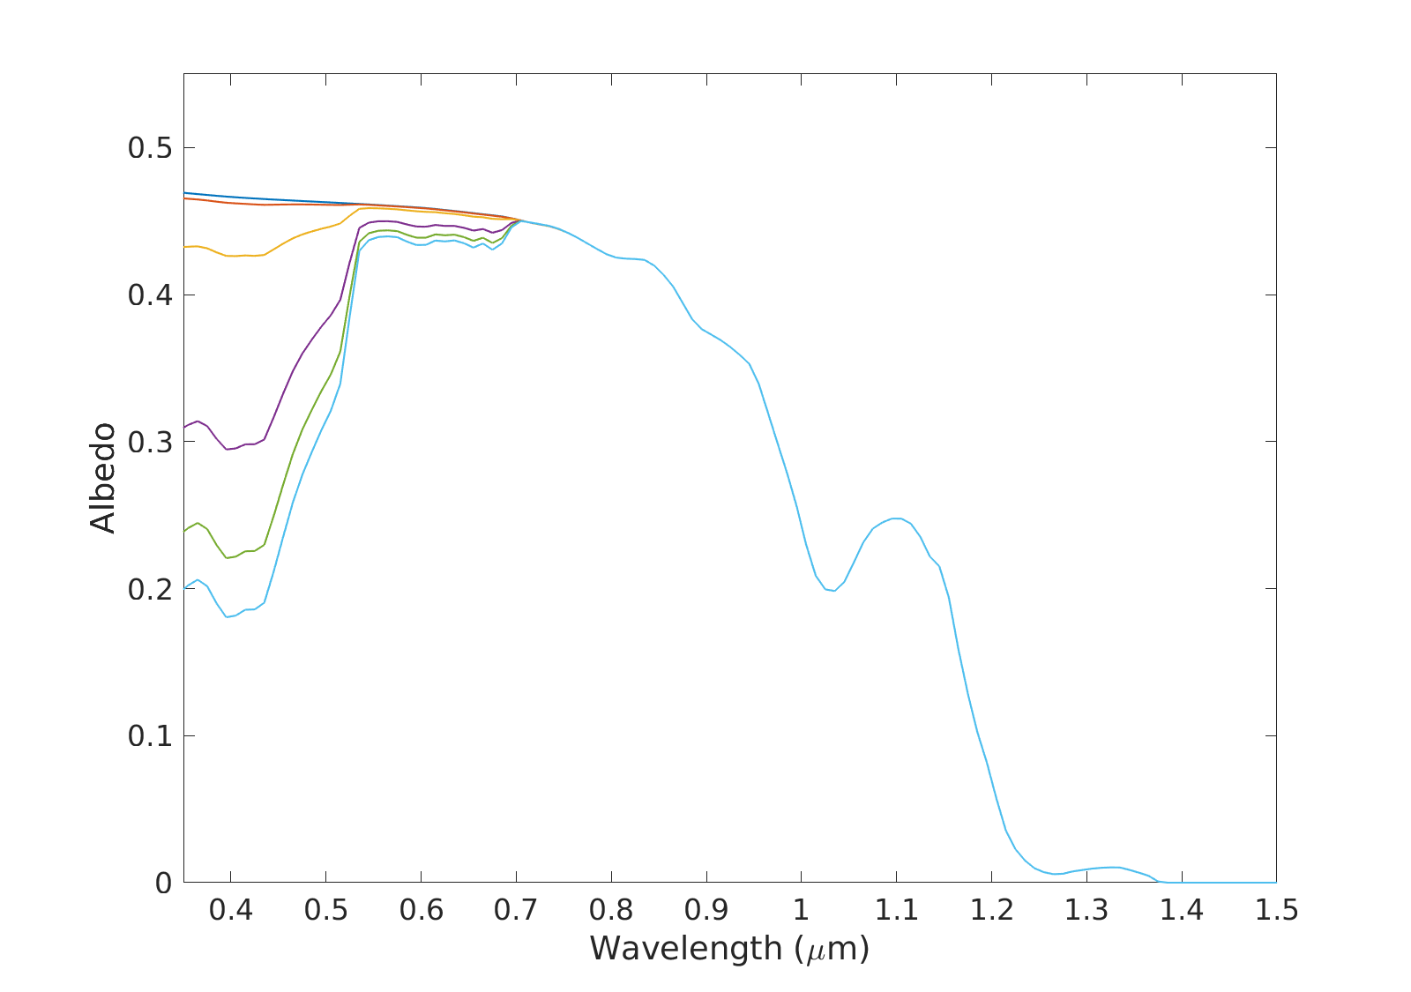





A
B
Clean Ice
0.383
0.383
10 μg_{LAP}/g_{ice}
0.382
0.382
100 μg_{LAP}/g_{ice}
0.373
0.373
500 μg_{LAP}/g_{ice}
800 μg_{LAP}/g_{ice}
1000 μg_{LAP}/g_{ice}
0.337
0.339
0.315
0.318
0.303
0.306
2 x 40 µm cells
4 x 40 µm cells
C
D
0.383
0.383
0.382
0.382
0.373
0.373
0.341
0.337
0.321
0.316
0.310
0.303
6 x 40 µm cells
6 x 20 µm cells
E
F
0.383
0.383
0.382
0.382
0.373
0.373
0.337
0.338
0.315
0.316
0.303
0.304
6 x 60 µm cells
6 x 120 µm cells

Slide 9
Supp Info: Mineral cleaning and PSD methods
Mineral dust sampling and particle size distribution (PSD).
High algal biomass ice samples were collected in sterile sample bags and melted at ambient temperatures (5-10 °C). The thawed samples were filtered onto glass fiber filters (0.7 μm pore size), from which the solids were removed into a glass jar using a stainless steel spatula. In 50 mL centrifuge tubes, the samples were treated using 30% H₂O₂ (w/w) (Honeywell Fluka™) to remove the organic fraction. The samples (1-2 g) were sonicated (VWR ultrasonic cleaner) in 45 mL of the H₂O₂ treatment for 10 min to disaggregate the material. The samples were left in the H₂O₂ treatment for 48 h, after which they were centrifuged for 10 min at 4000 rpm (Eppendorf centrifuge 5810). The supernatant was removed, and the H₂O₂ solution was replaced. This process was repeated up to ten times until no more organic oxidation was observed. The remaining mineral fraction was washed three times in water (Sartorius arium® pro ultrapure water), with centrifugation after each wash.
A 5 mg of H₂O₂-treated sample was suspended in 10 mL of ultrapure water. The sample was sonicated to disaggregate the grains. The suspension was dispersed onto a 0.2 μm polycarbonate filter (Sartorius Track-Etch Membrane, 0.2 μm). Once dry, a section of each filter was adhered to a stainless steel SEM stub using an adhesive carbon tab. The sample was coated with 8 nm of Ir (Agar high resolution sputter coater). The PSD was determined using a Zeiss Ultra Plus field emission scanning electron microscope (FE-SEM) operated at 20 kV. Automated particle counting software was used to determine the PSD in an area of approximately 1 mm².

Slide 10
Data collection
Pre-processing
Model training
Model Deployment
Visualization and analysis
Spectra reduced to 5
“UAV” wavelengths
Random Forest
Classifier
Trained
RF model applied to
multispectral
UAV images
Field Spectroscopy
Spectral data
labelled according
to sample
analysis
Trained Model
Classified
UAV/S2 maps,
albedo maps
and coverage
data
Sample removal
and analysis
UAV flights and S2
data acquisition
Spectra reduced to 9
“S2” wavelengths
Random Forest
Classifier
Trained
RF model applied to
multispectral
S2 images
Spectra acquired using ASD field spec and assigned to a surface class on the basis of sample analysis and on site observations
The spectral data are reduced down to only those wavelengths that match the sensitivity of the UAV camera and then the S2 satellite. All data are already normalised between 0-1.
The reduced spectra are used to train a classification model. Reflectance at each wavelength are feature vectrors and surface class are classification labels. Model performance is assessed using a hold-out test set. Separate models are trained for the UAV and S2 data.
The trained model is used to predict the surface class of each pixel in UAV and S2 multispectral images. At the same time the albedo is calculated from the reflectance using a narrow-broadband conversion equation.
The result is maps of surface class and albedo that are also analysed to provide coverage statistics for each surface class and to quantify algal coverage

Slide 11
Classifier Performance Metrics
A: Model | Accuracy | Precision | Recall | F1 Score
K-Nearest Neighbours | 0.90 | 0.74 | 0.78 | 0.76
Naive-bayes | 0.90 | 0.80 | 0.81 | 0.80
Support Vector Machine | 0.94 | 0.89 | 0.87 | 0.88
Random Forest | 0.99 | 0.99 | 0.95 | 0.97
Ensemble | 0.92 | 0.76 | 0.81 | 0.78
RF performance on test set | 0.90 | 0.91 | 0.90 | 0.90
B: Model | Accuracy | Precision | Recall | F1 Score
K-Nearest Neighbours | 0.89 | 0.90 | 0.89 | 0.87
Naive-bayes | 0.89 | 0.89 | 0.89 | 0.89
Support Vector Machine | 0.96 | 0.96 | 0.96 | 0.96
Random Forest | 0.99 | 0.99 | 0.99 | 0.99
Ensemble | 0.93 | 0.93 | 0.93 | 0.93
RF performance on test set | 0.92 | 0.93 | 0.92 | 0.93

Slide 12
ASD v UAV v S2 comparison

Slide 13
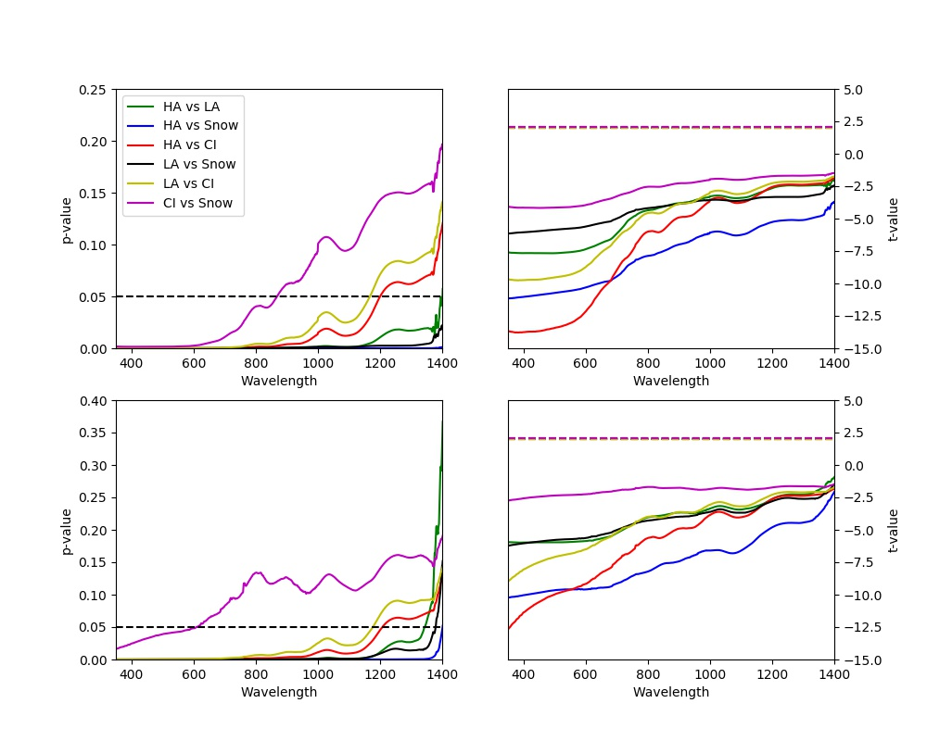
A
0.25
Hbio vs Lbio
Lbio vs SN
p-value
Hbio vs SN
Lbio vs CI
Hbio vs CI
SN vs CI
0.15
0.05
0
0.4
0.6
0.8
1.0
1.2
1.4
Wavelength (µm)
B
5
0
t-statistic
-5
-10
-15
0.4
0.6
0.8
1.0
1.2
1.4
Wavelength (µm)

Slide 14
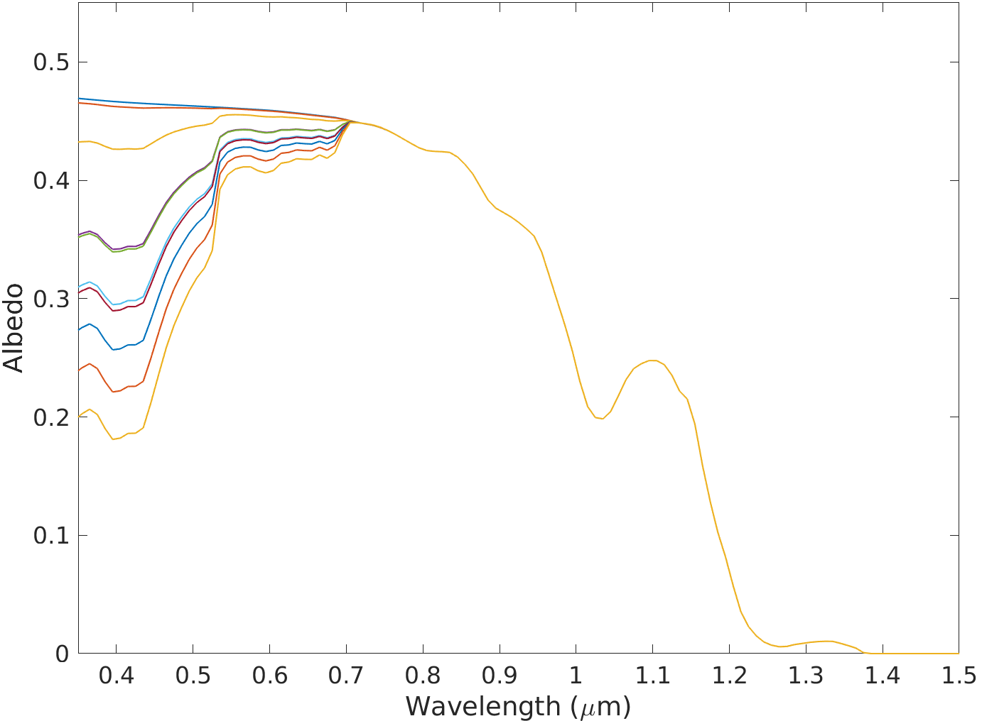
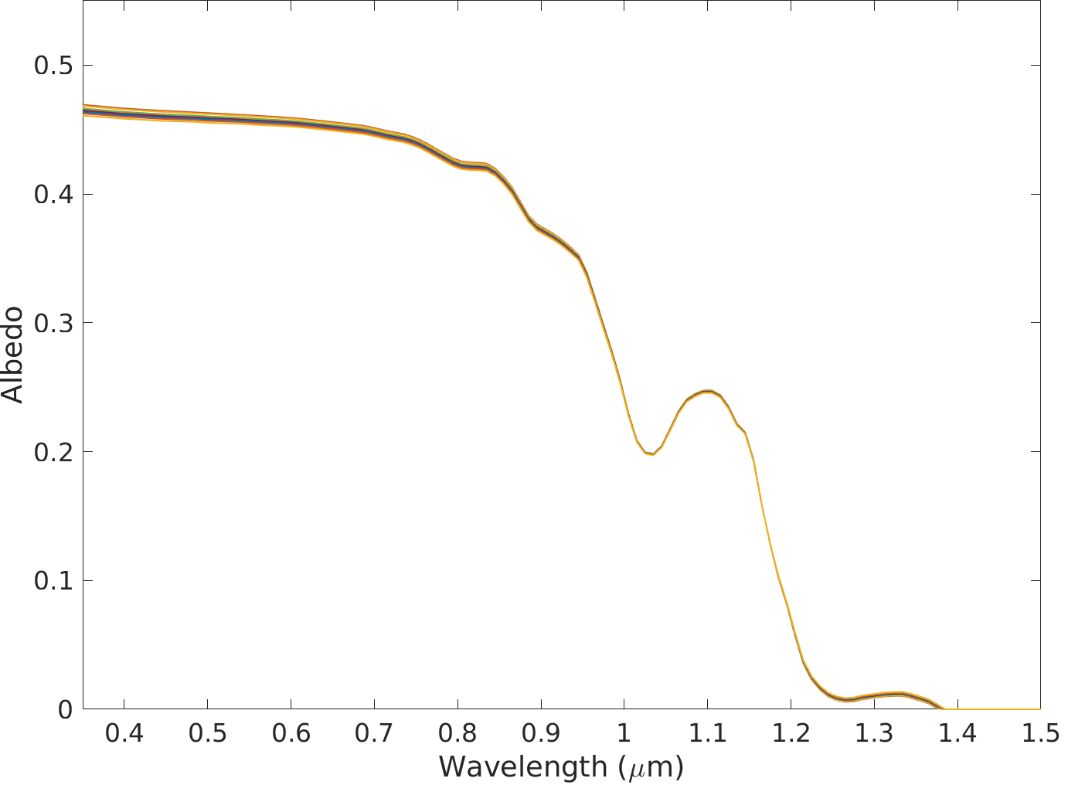


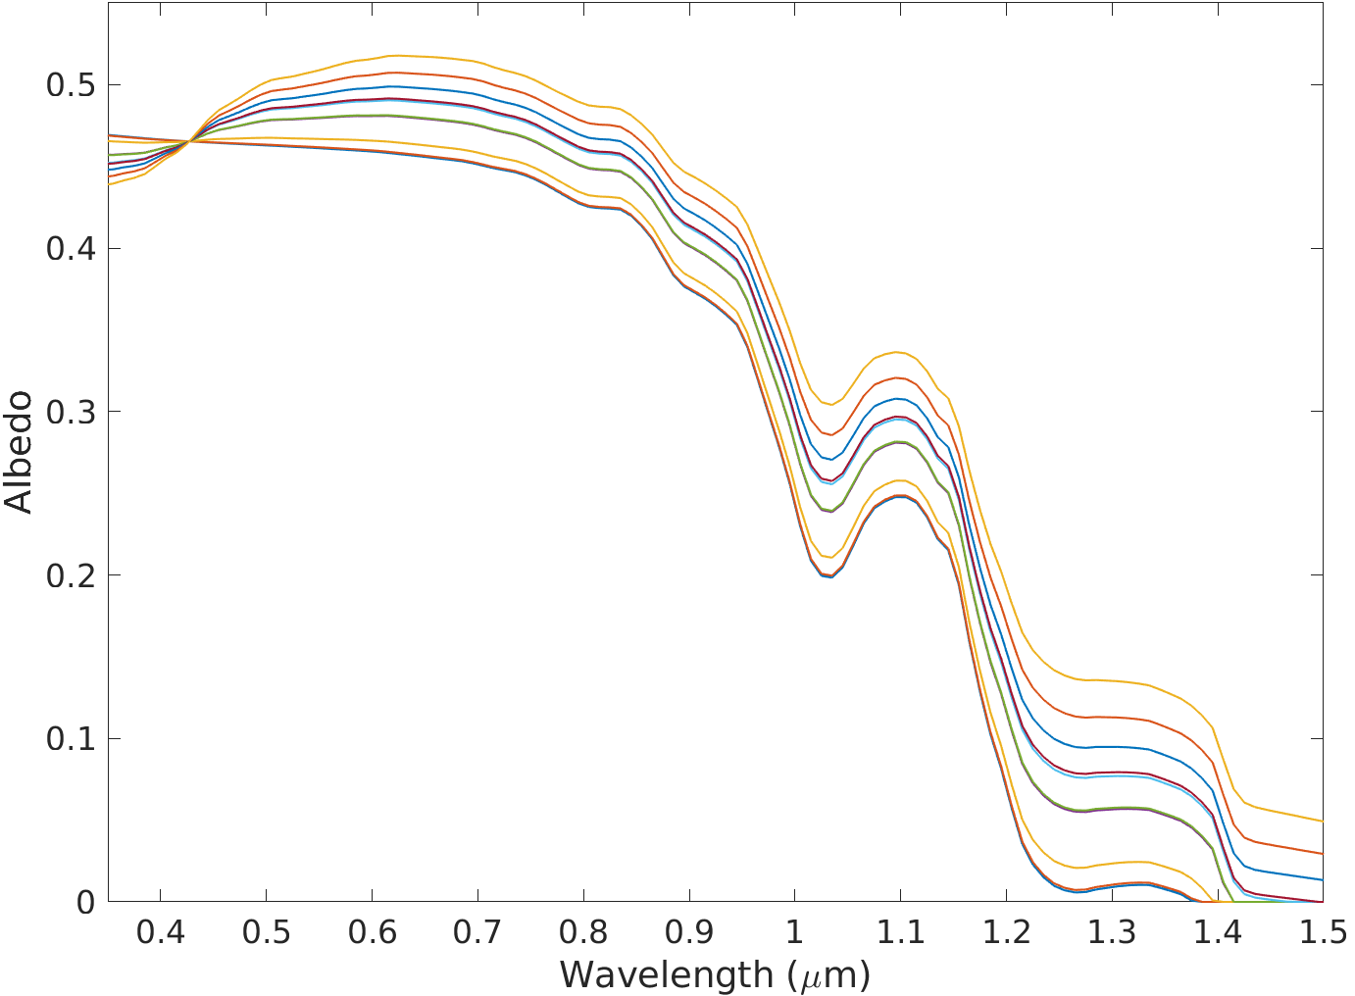
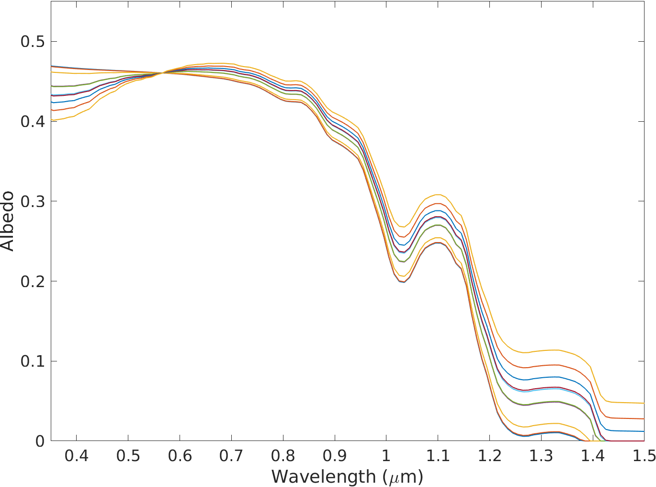
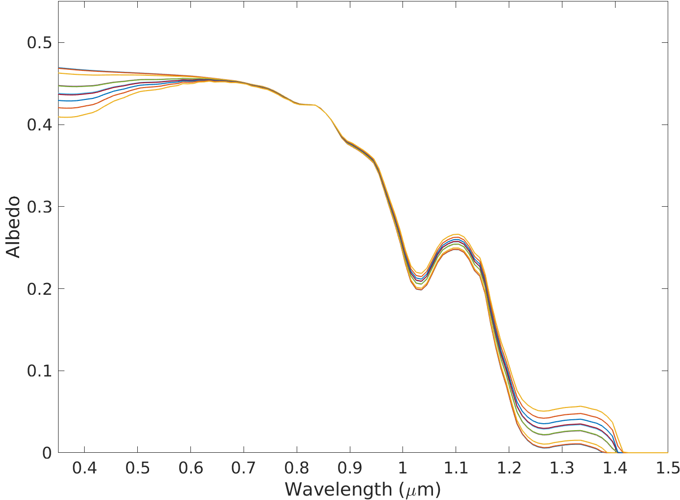
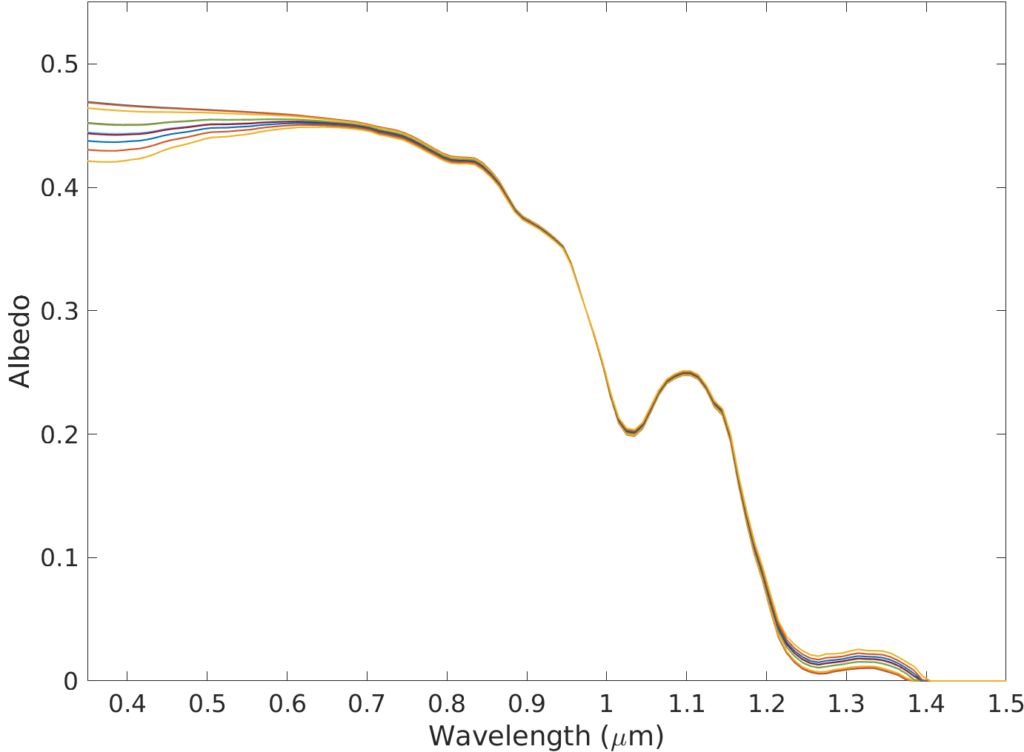
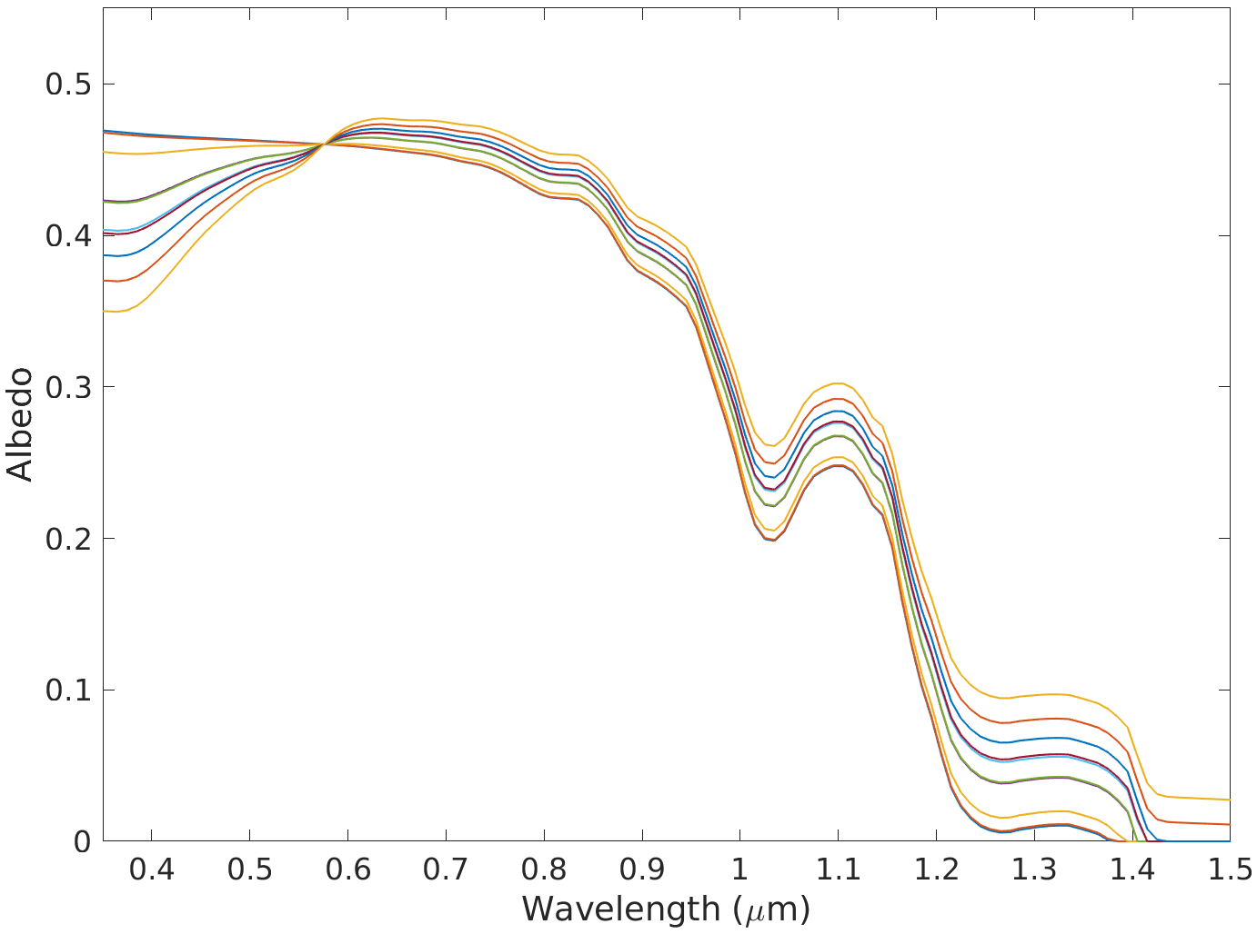
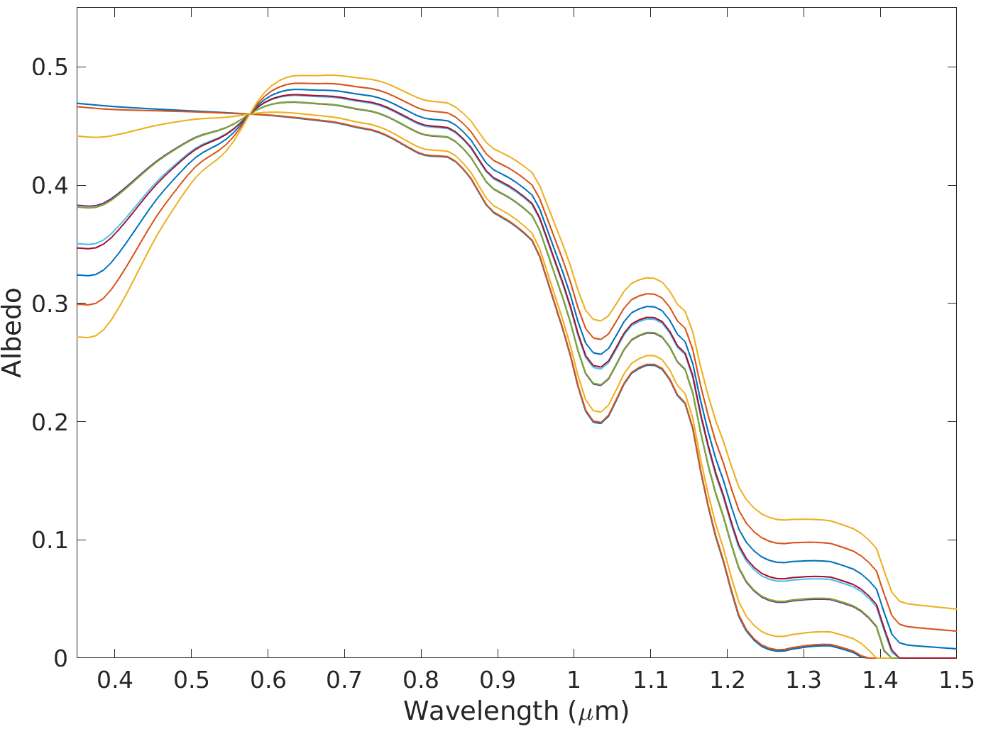
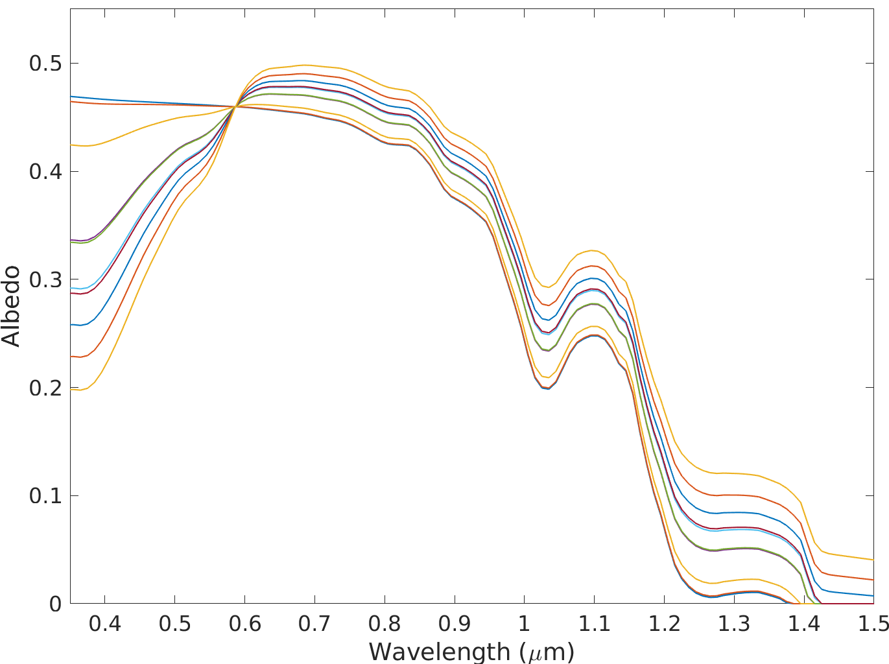
A: Glacier Algae
B: MN-DUST
C: HI-DUST
D: LO-DUST
E: DUST F1
F: DUST F2
G: DUST F3
H: DUST F4
I: DUST P1
Legend
Clean Ice
10 μg_{LAP}/g_{ice}
100 μg_{LAP}/g_{ice}
342 μg_{LAP}/g_{ice}
349 μg_{LAP}/g_{ice}
500 μg_{LAP}/g_{ice}
519 μg_{LAP}/g_{ice}
646 μg_{LAP}/g_{ice}
J: DUST P2
J: DUST P3
800 μg_{LAP}/g_{ice}
1000 μg_{LAP}/g_{ice}

Slide 15
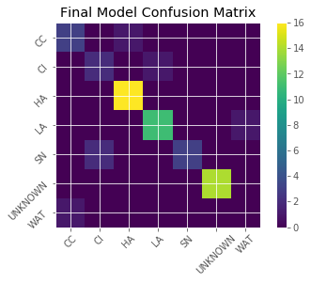
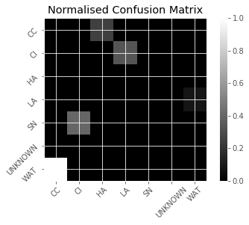
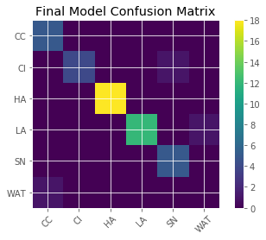
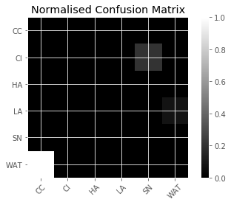
A
B
UAV
C
D
Sentinel-2

