Slide 1
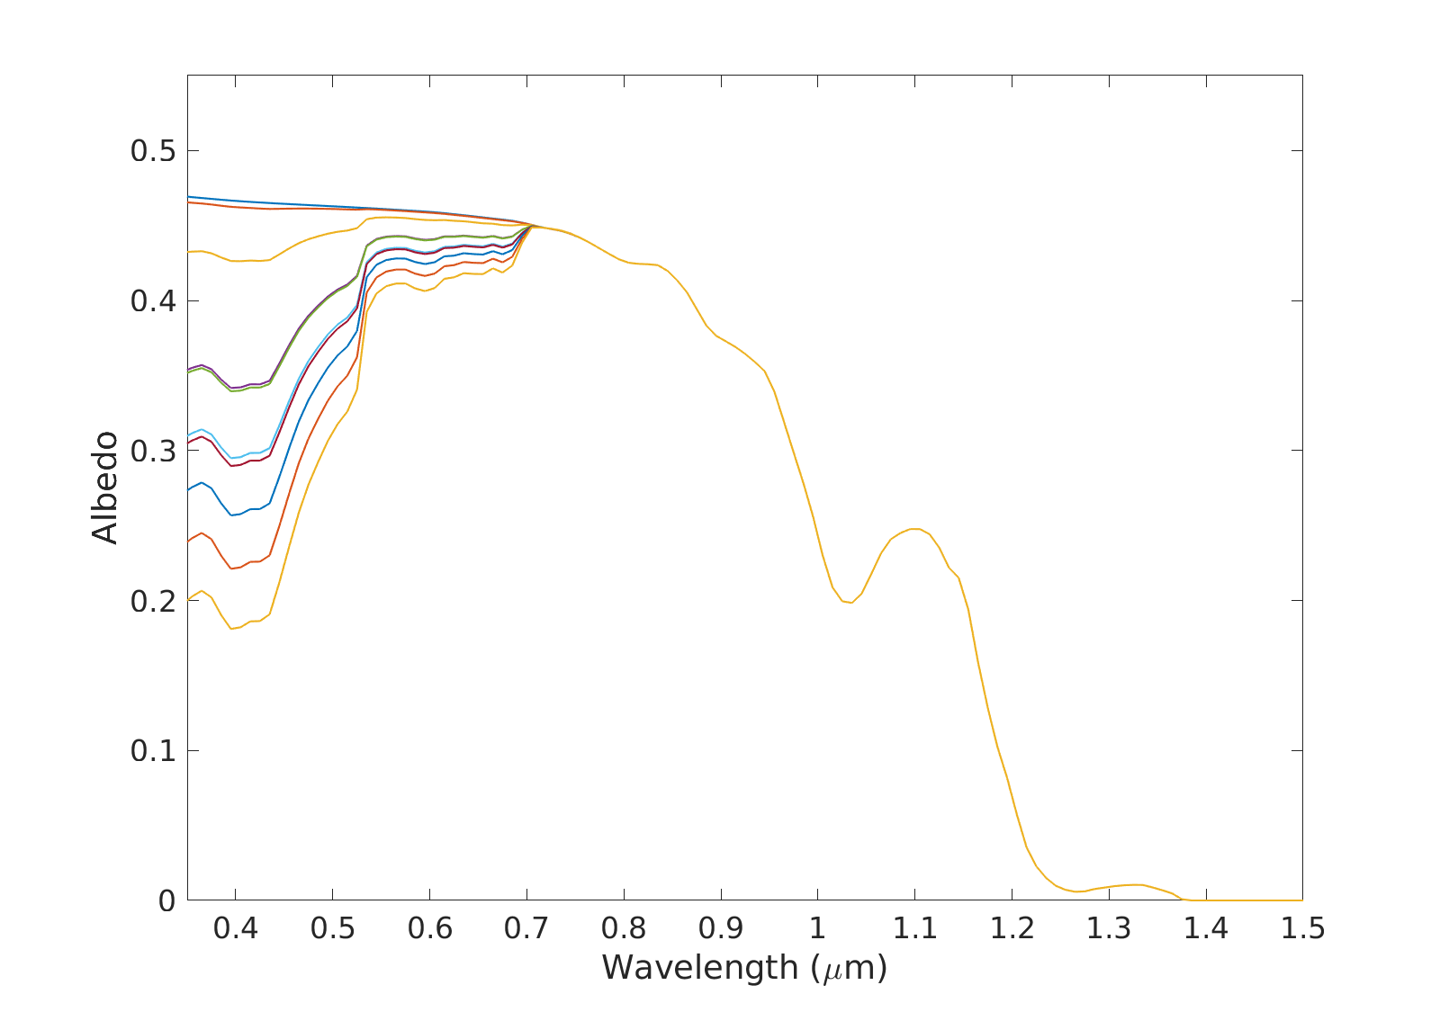
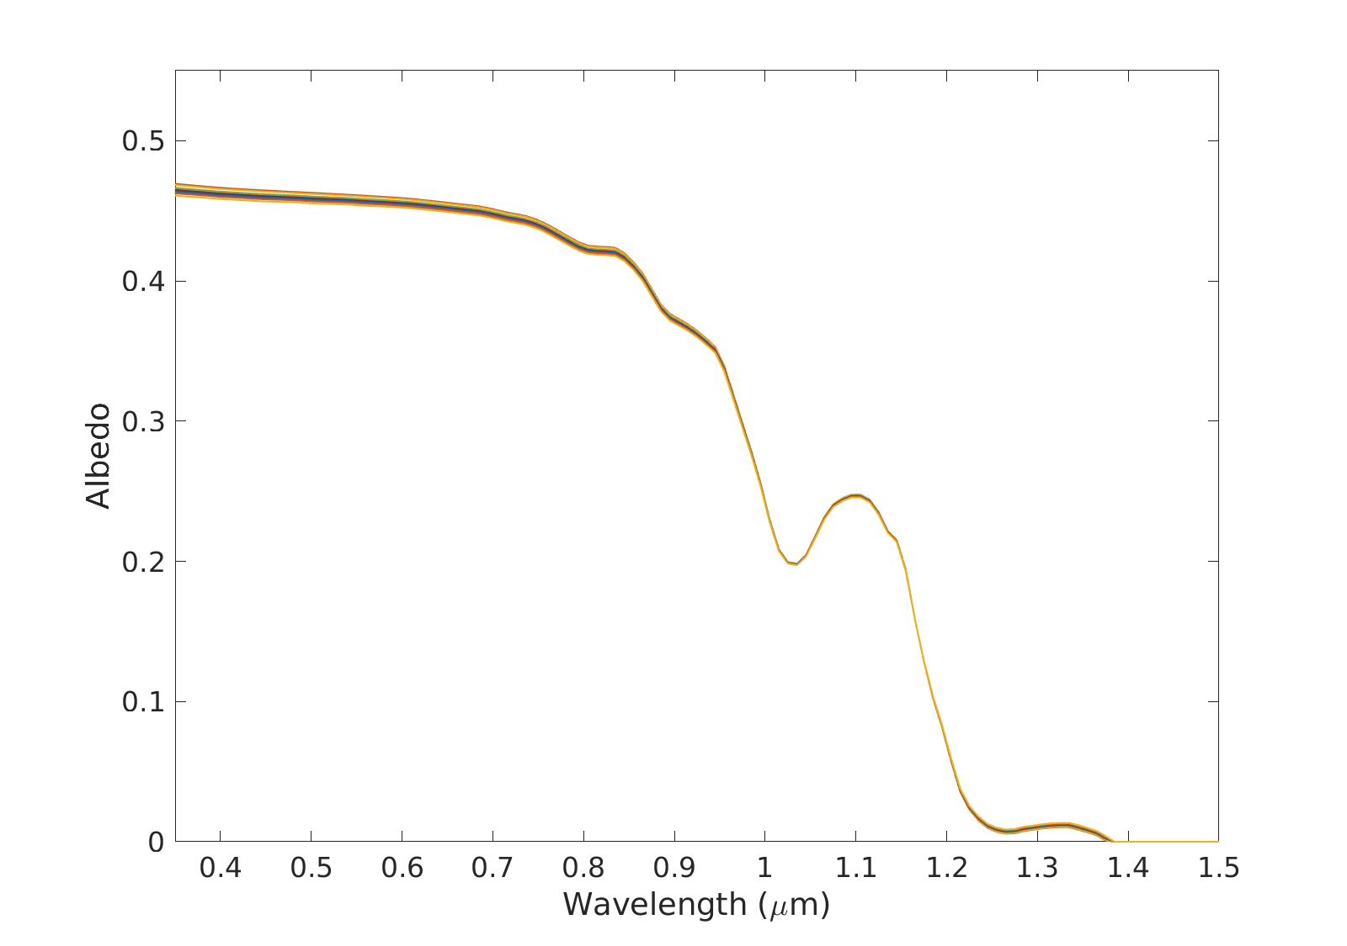


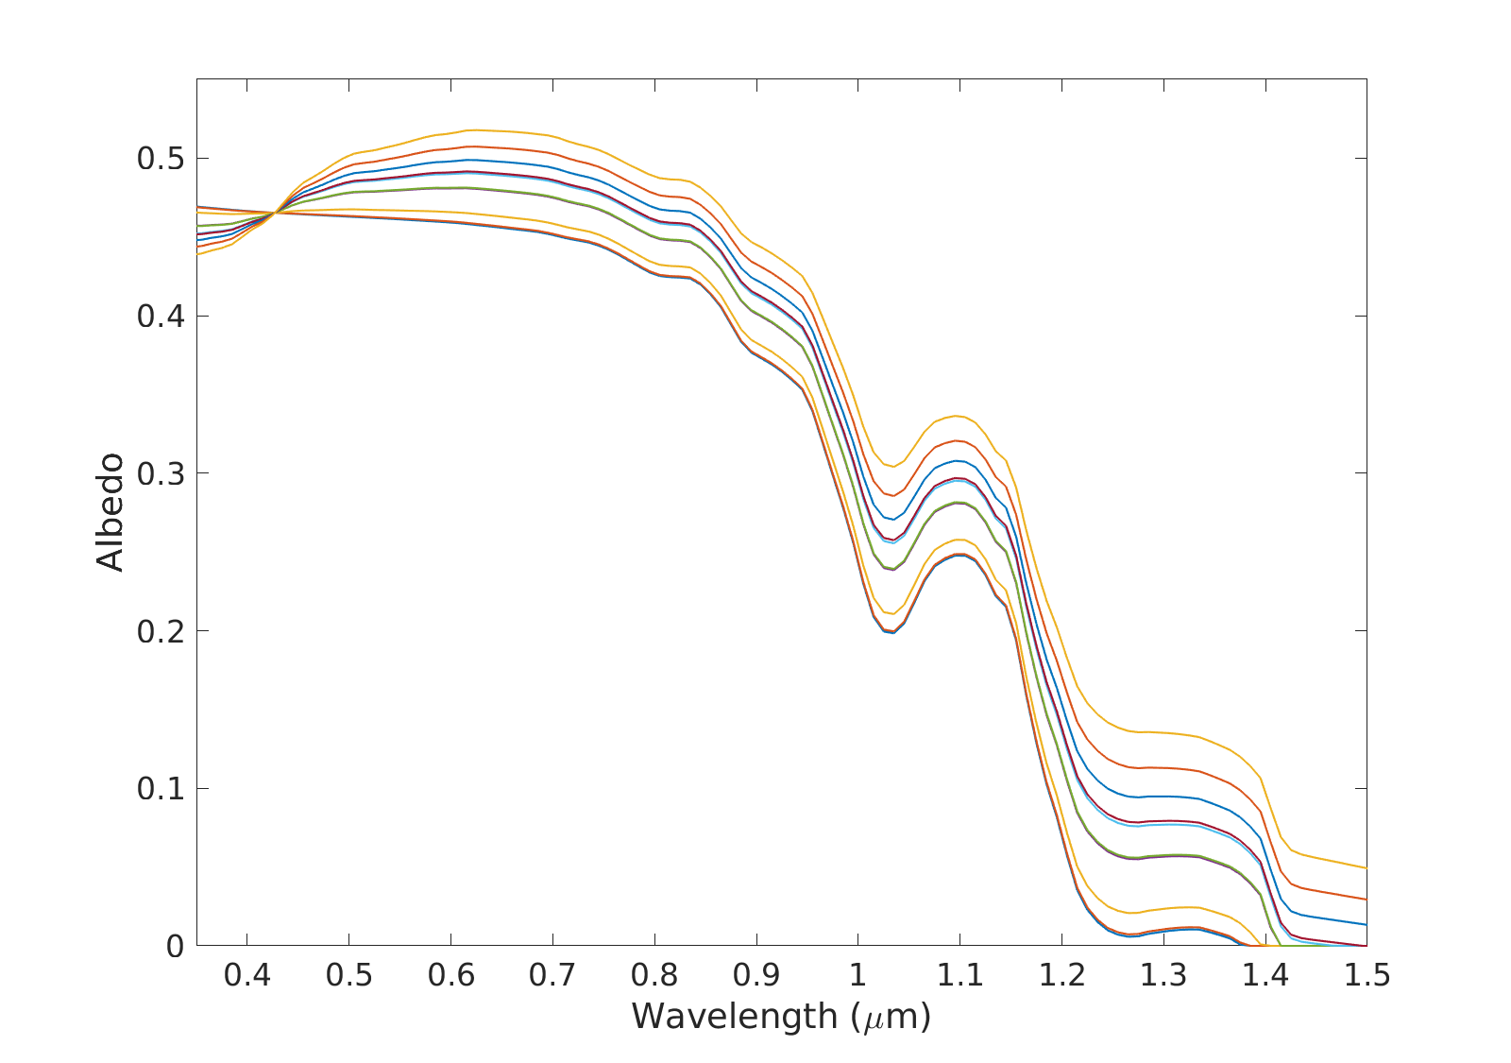
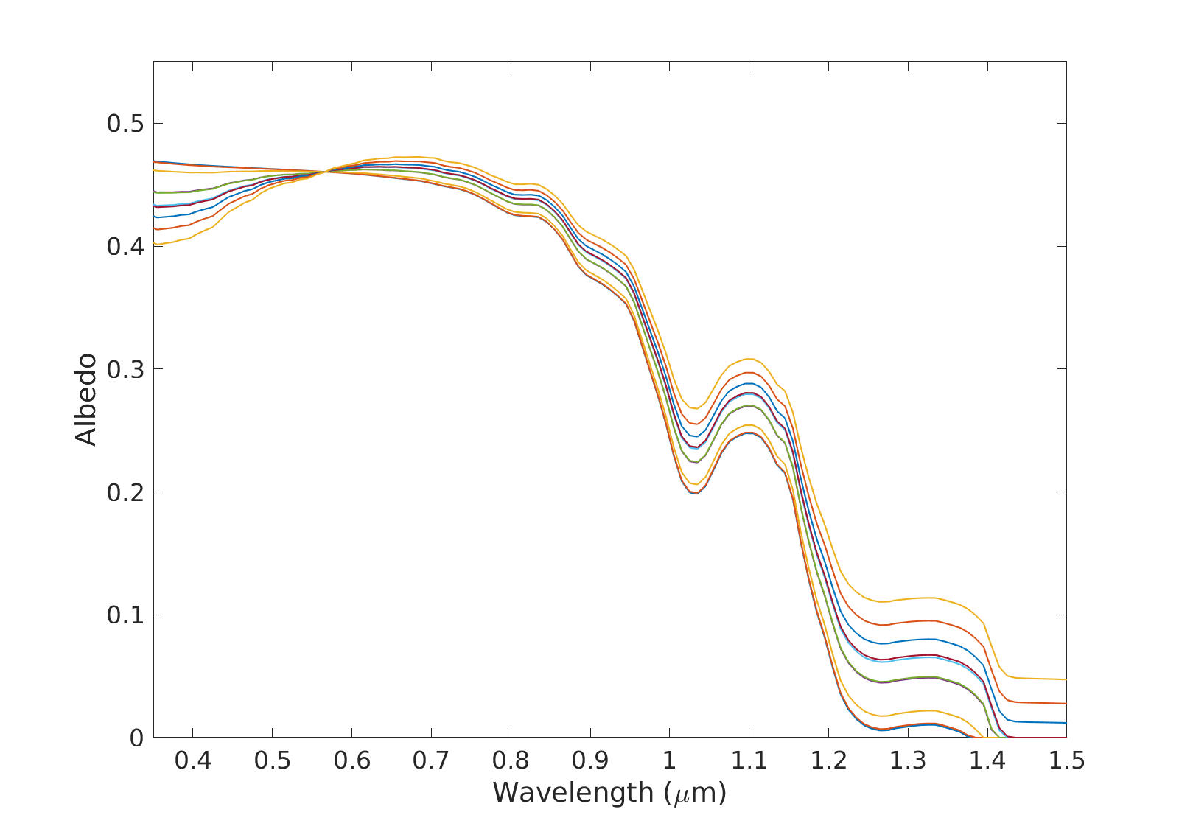
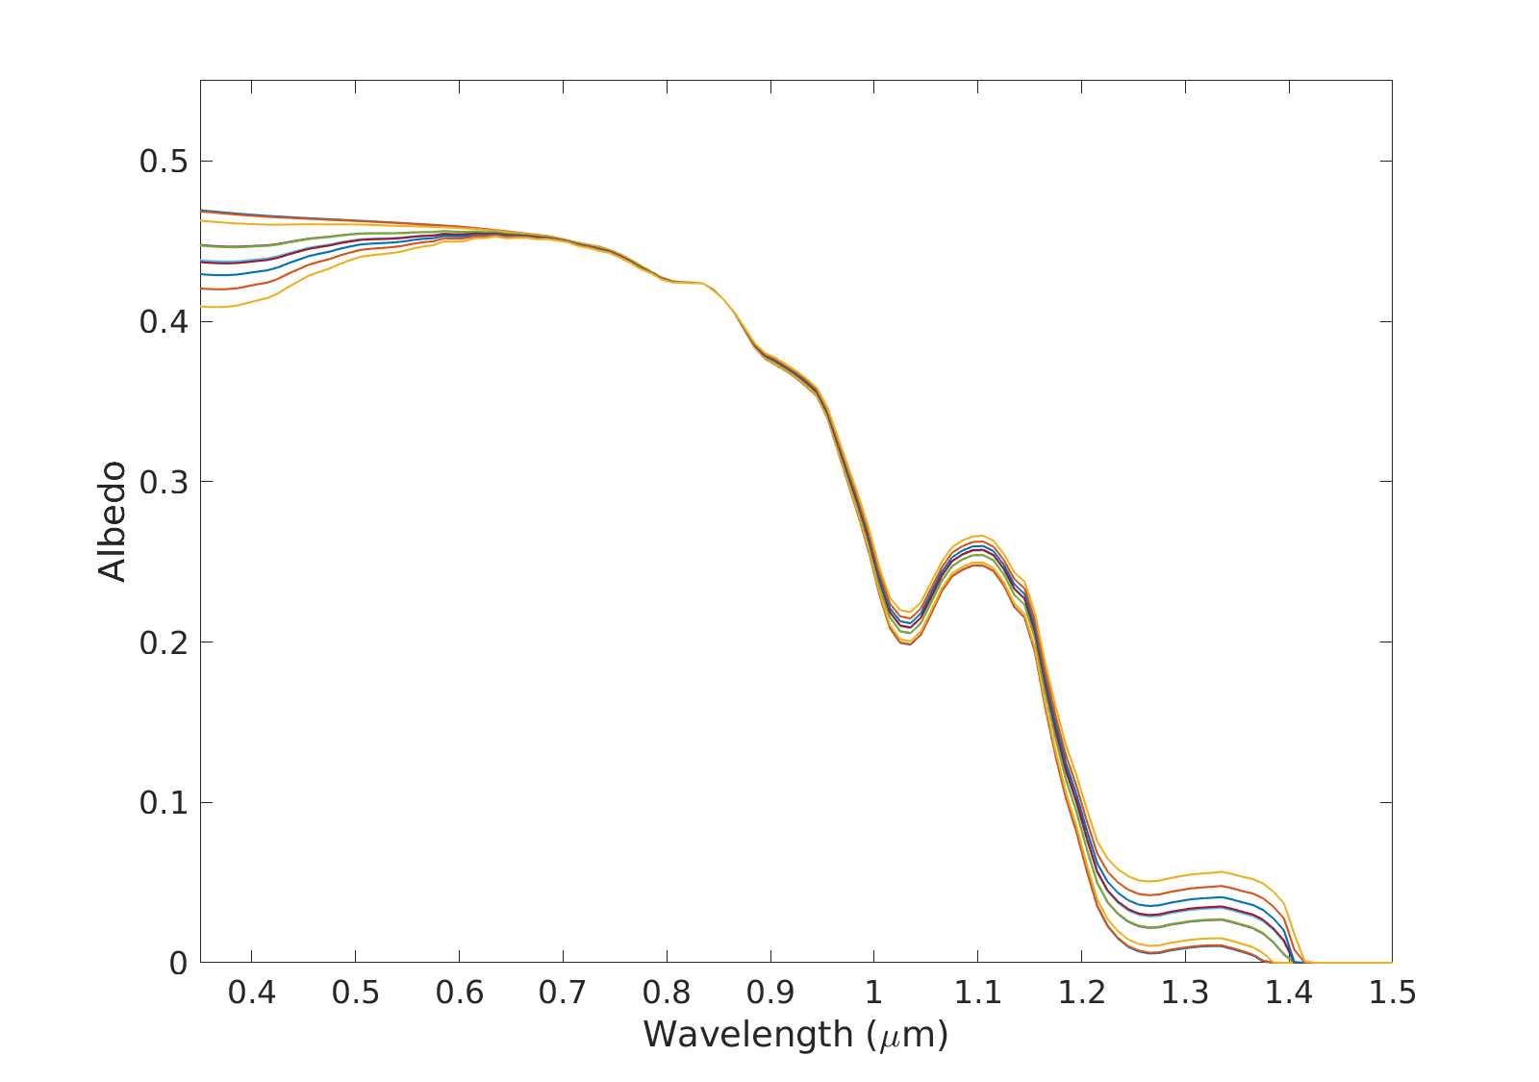
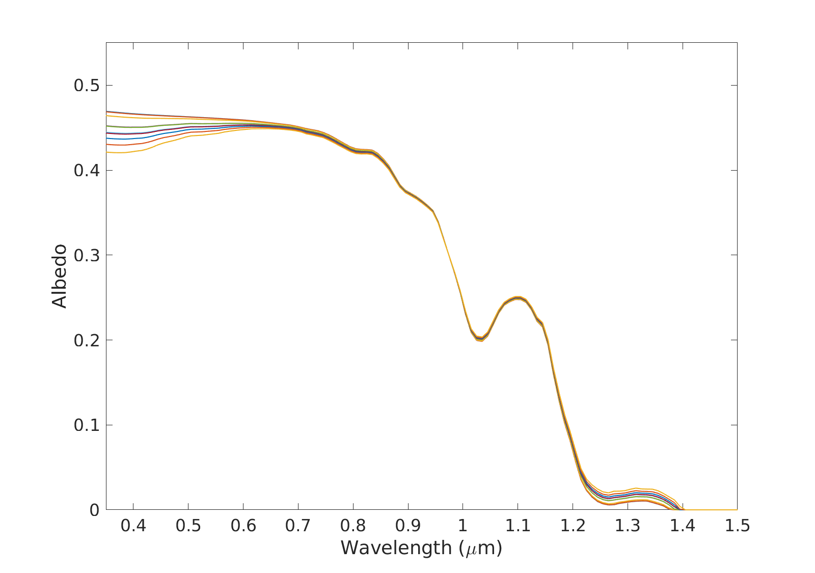
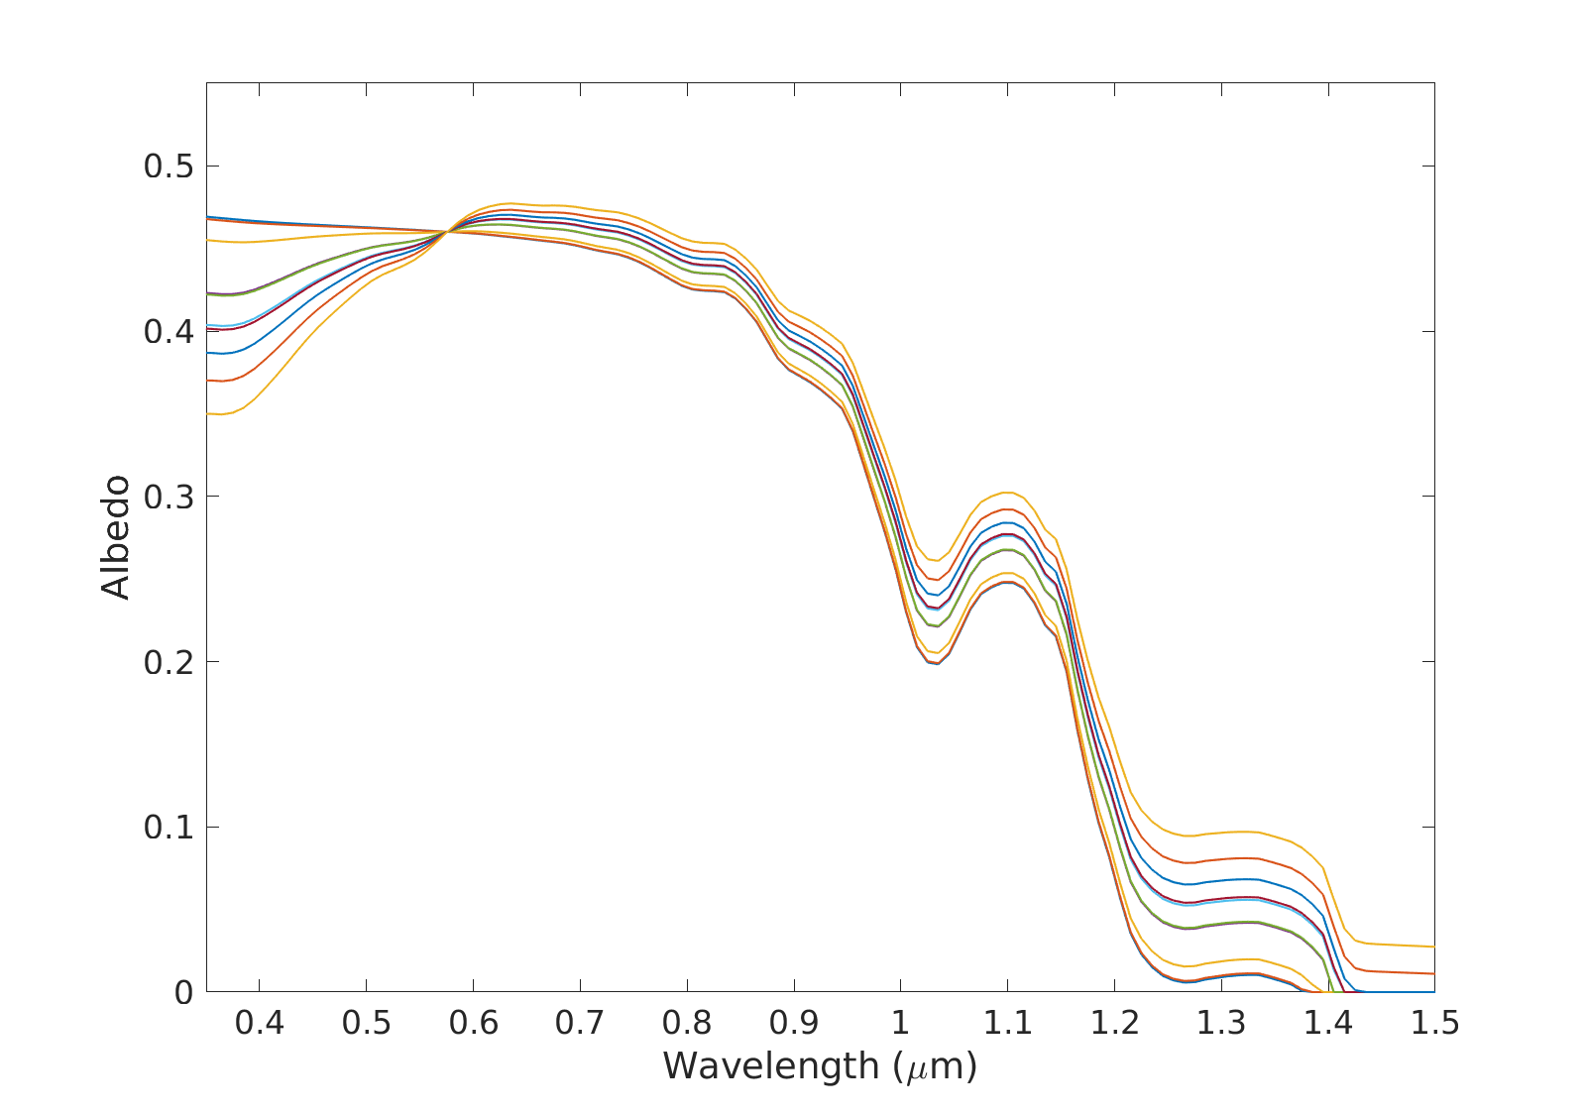
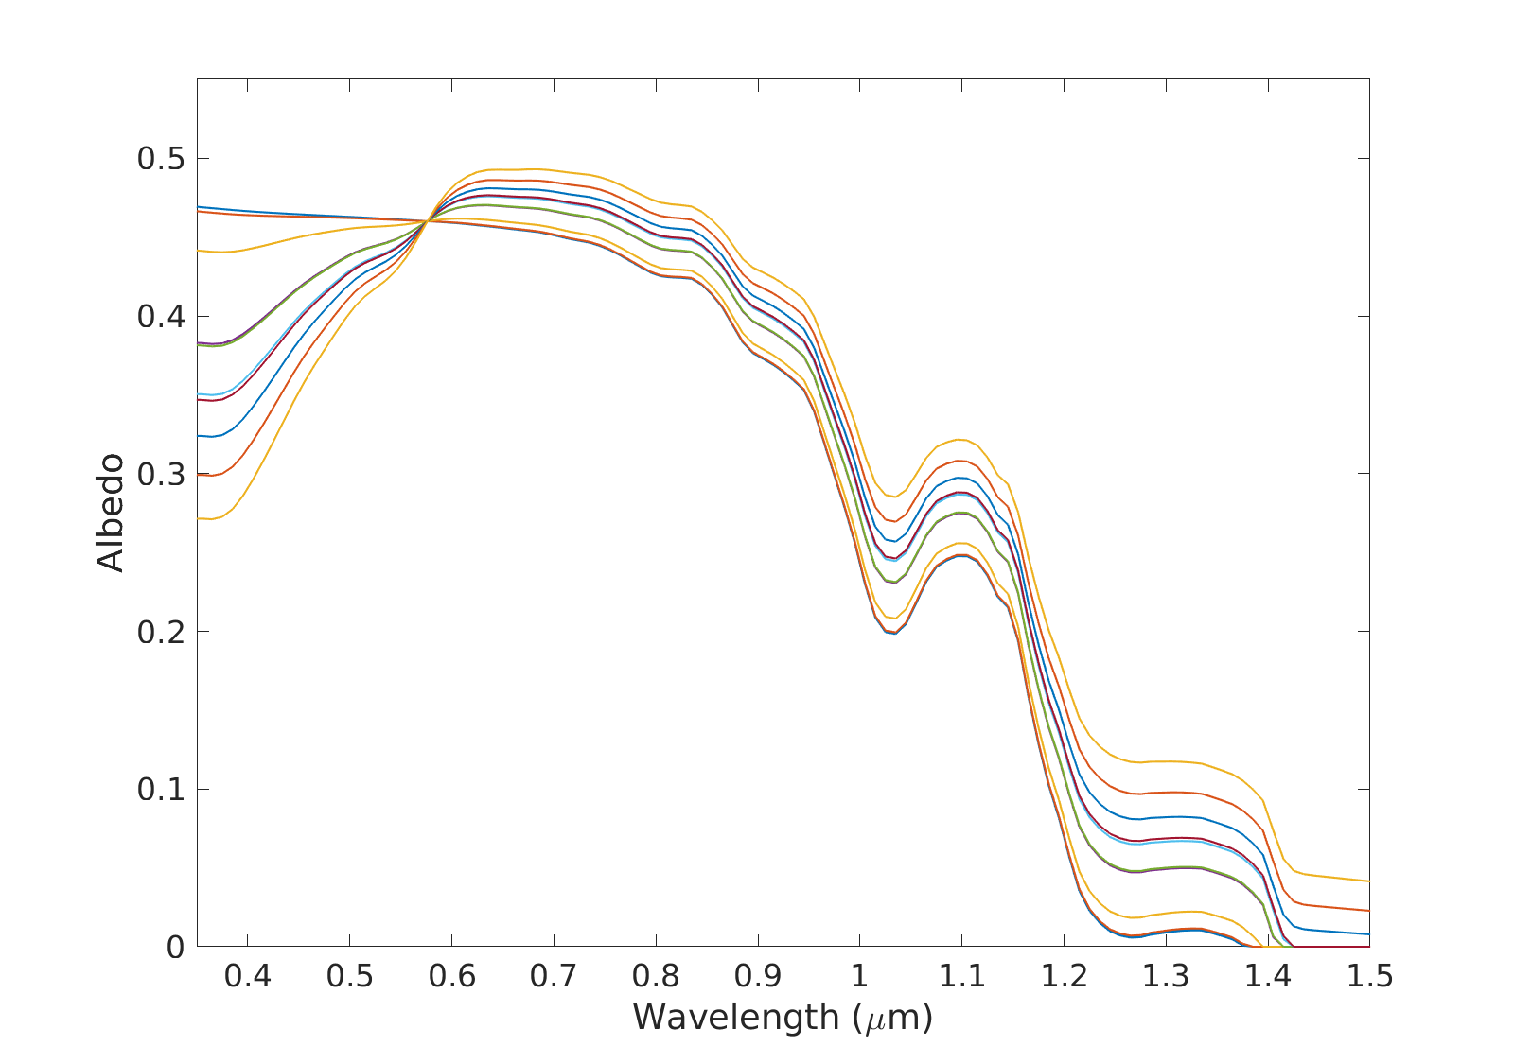
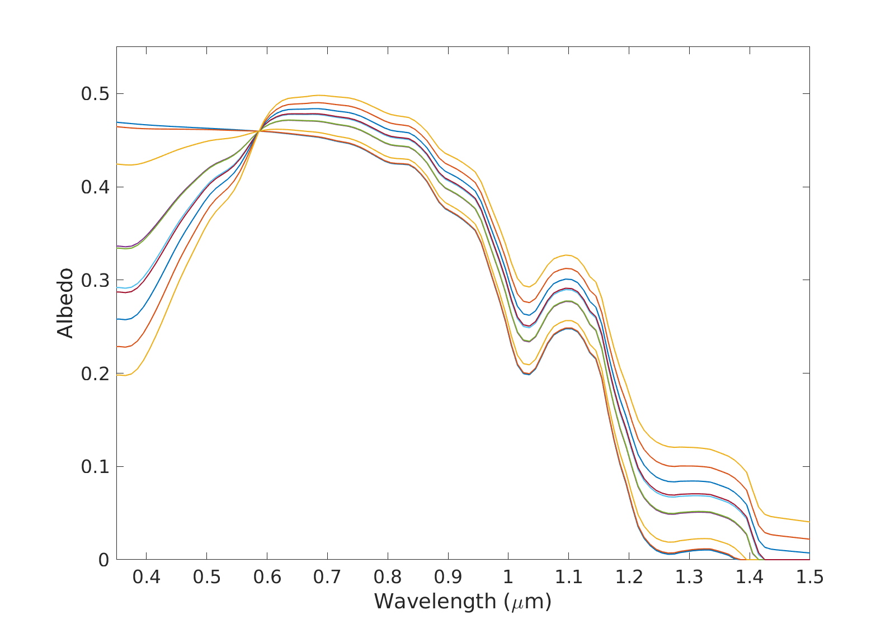
A: Glacier Algae
B: MN-DUST
C: HI-DUST
D: LO-DUST
E: DUST F1
F: DUST F2
G: DUST F3
H: DUST F4
I: DUST P1
Legend
Clean Ice
10 μg_{LAP}/g_{ice}
100 μg_{LAP}/g_{ice}
342 μg_{LAP}/g_{ice}
349 μg_{LAP}/g_{ice}
500 μg_{LAP}/g_{ice}
519 μg_{LAP}/g_{ice}
646 μg_{LAP}/g_{ice}
J: DUST P2
J: DUST P3
800 μg_{LAP}/g_{ice}
1000 μg_{LAP}/g_{ice}

