Slide 1
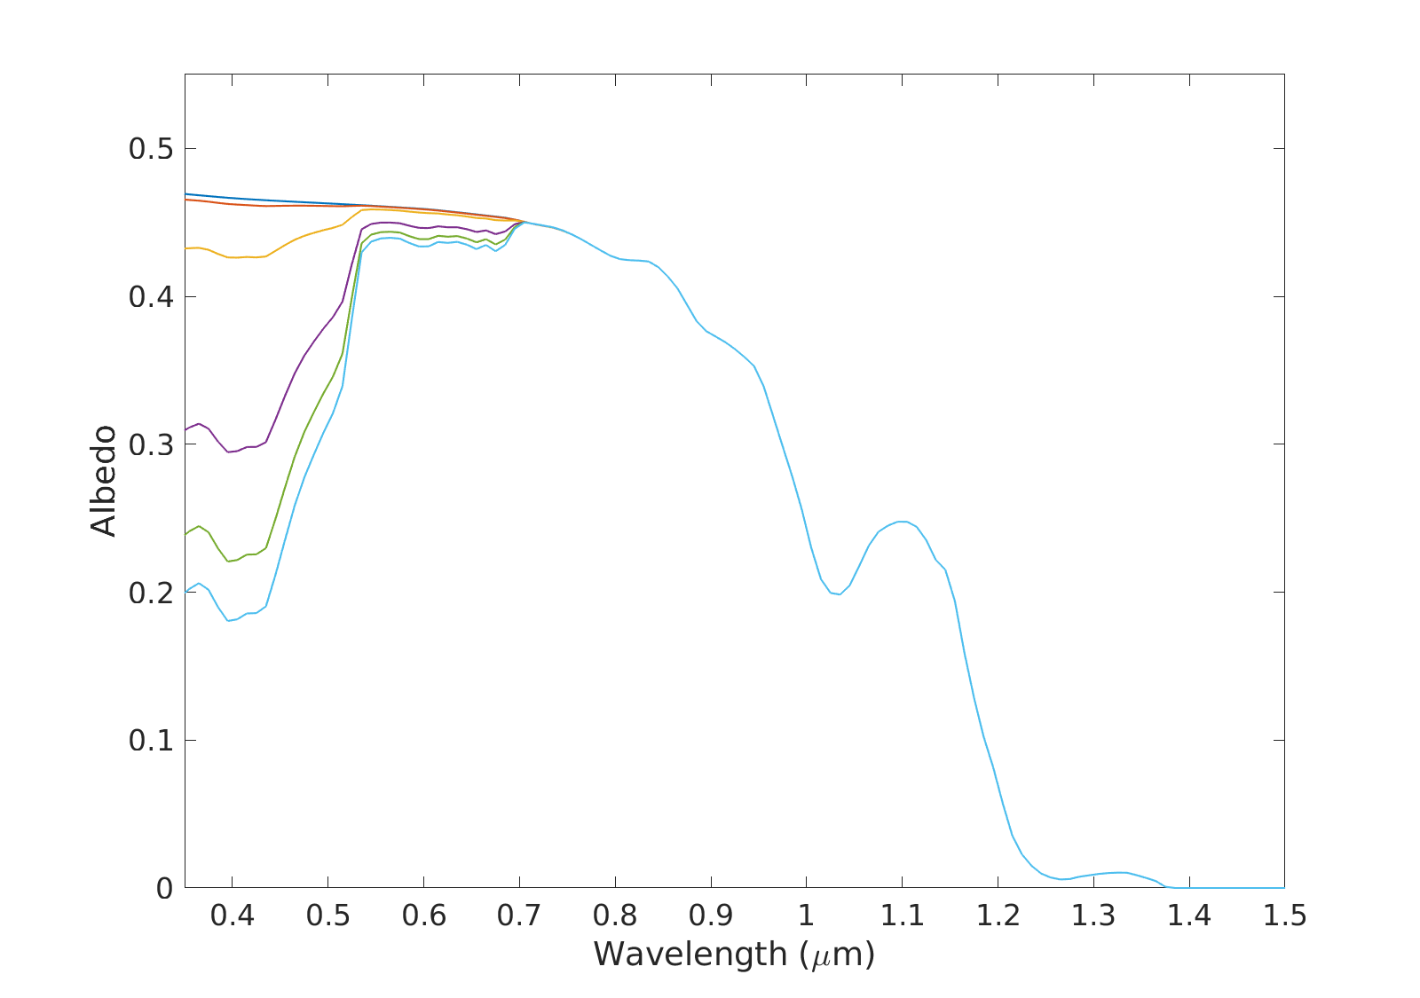





A
B
Clean Ice
0.383
0.383
10 μg_{LAP}/g_{ice}
0.382
0.382
100 μg_{LAP}/g_{ice}
0.373
0.373
500 μg_{LAP}/g_{ice}
800 μg_{LAP}/g_{ice}
1000 μg_{LAP}/g_{ice}
0.337
0.339
0.315
0.318
0.303
0.306
2 x 40 µm cells
4 x 40 µm cells
C
D
0.383
0.383
0.382
0.382
0.373
0.373
0.341
0.337
0.321
0.316
0.310
0.303
6 x 40 µm cells
6 x 20 µm cells
E
F
0.383
0.383
0.382
0.382
0.373
0.373
0.337
0.338
0.315
0.316
0.303
0.304
6 x 60 µm cells
6 x 120 µm cells
Simulated albedo with 10 – 1000 µg/g algae of varying cell size. Broadband albedo is printed beneath each curve.

