Slide 1
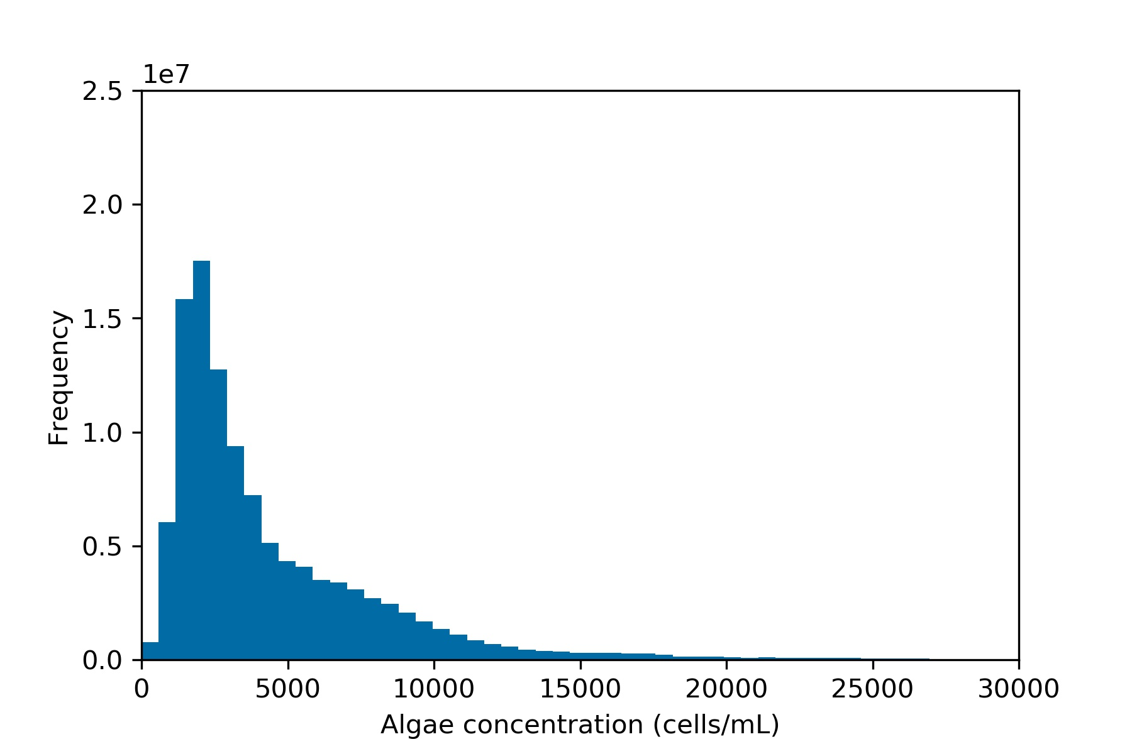
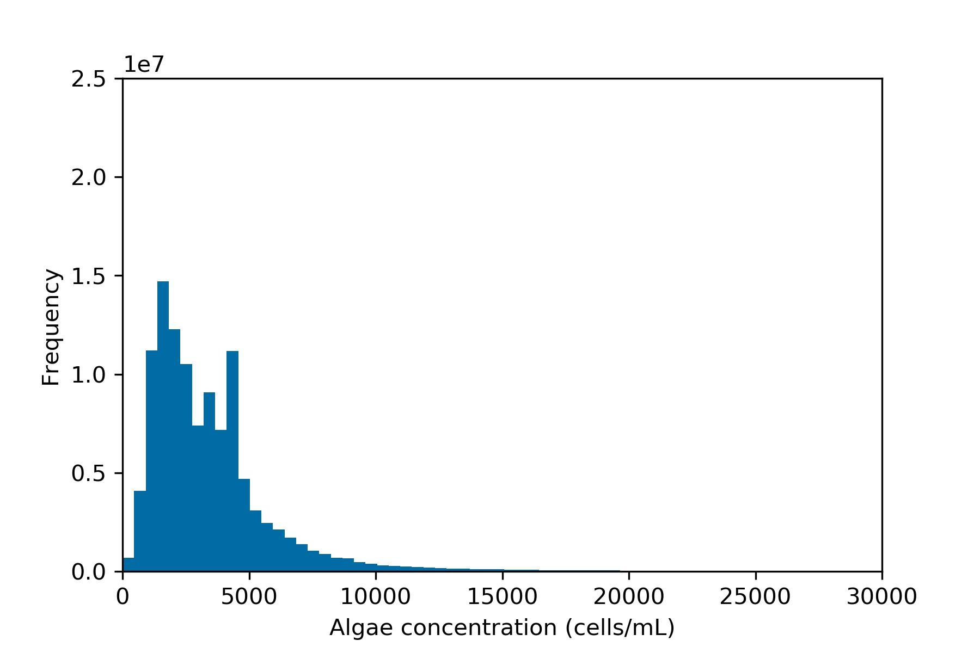
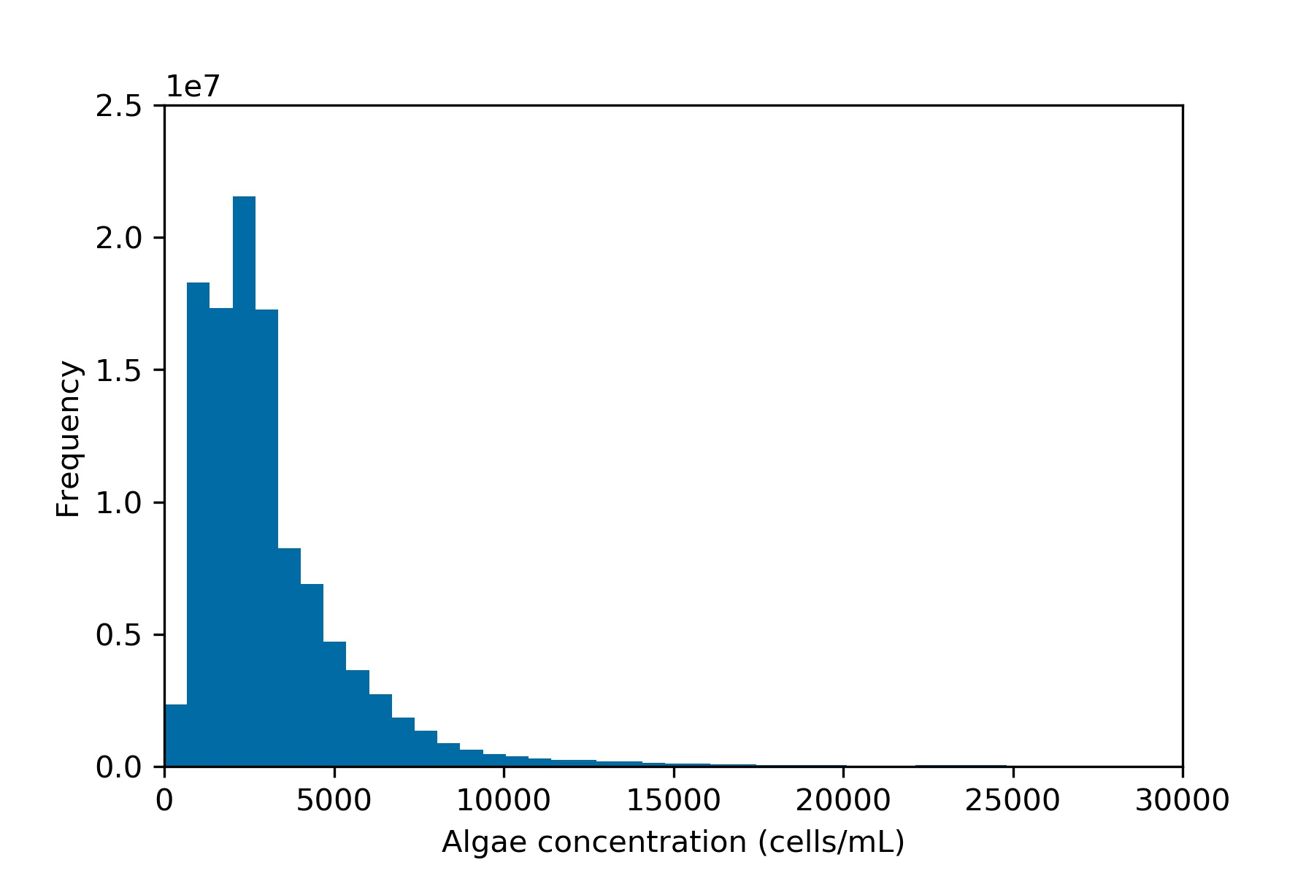
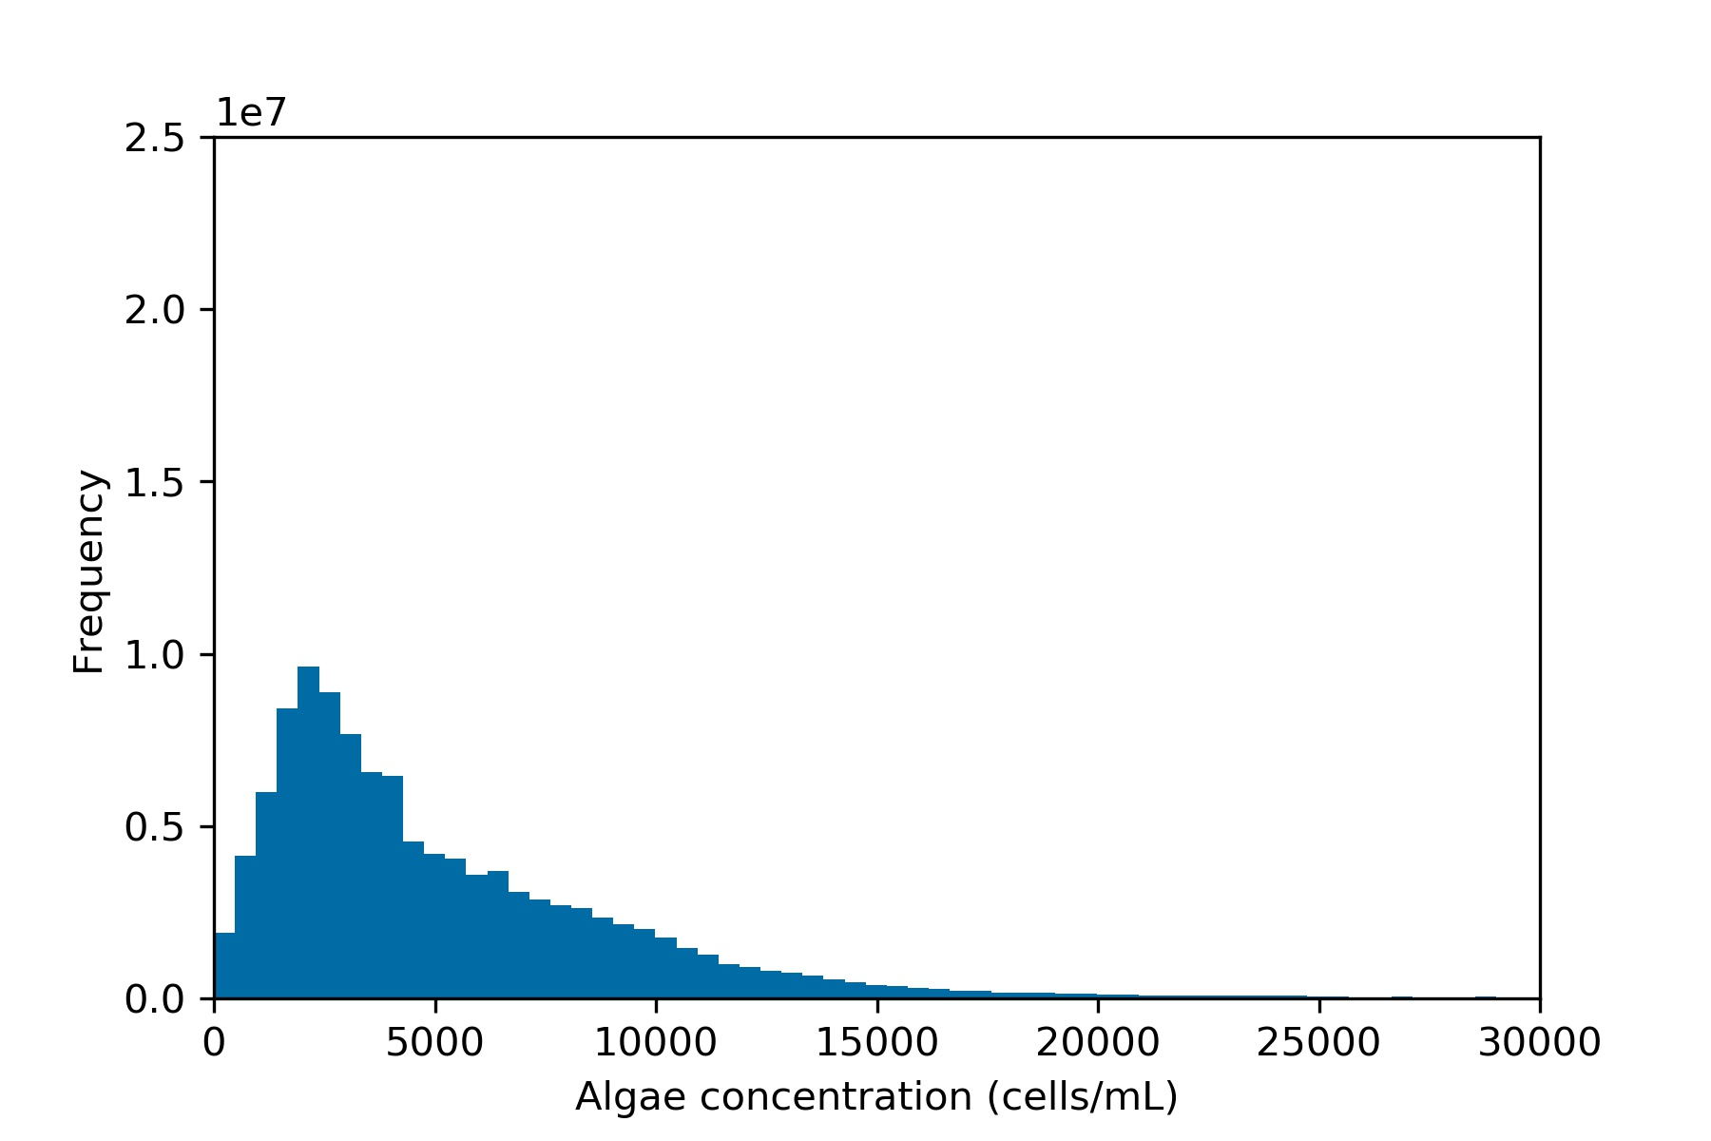
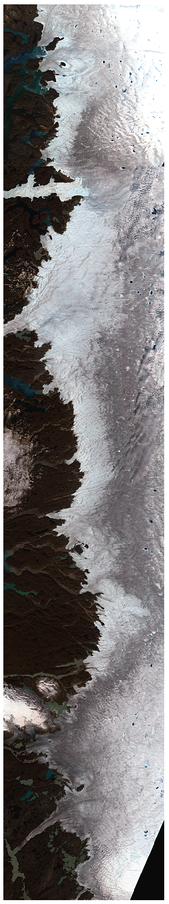
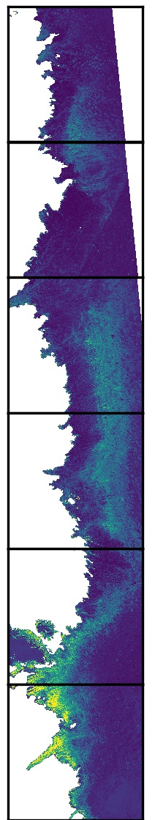
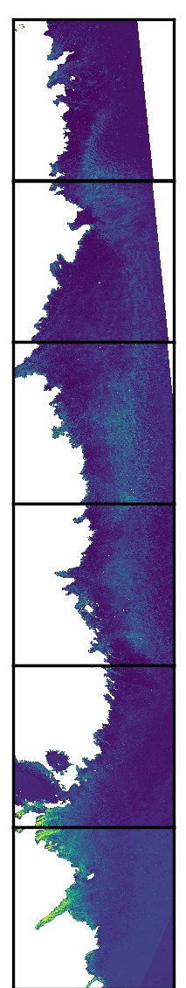
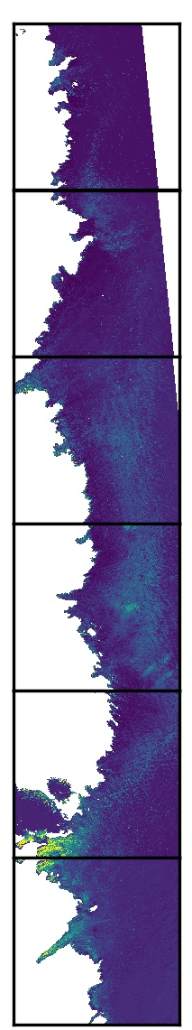
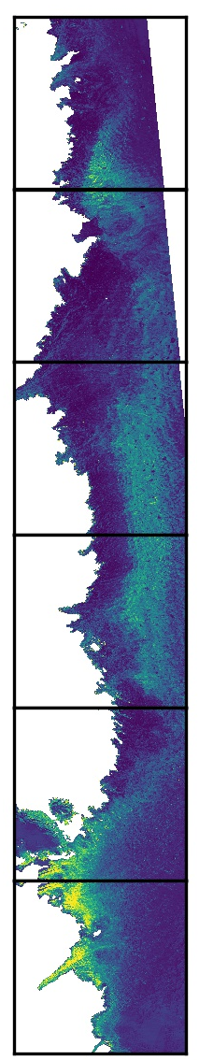
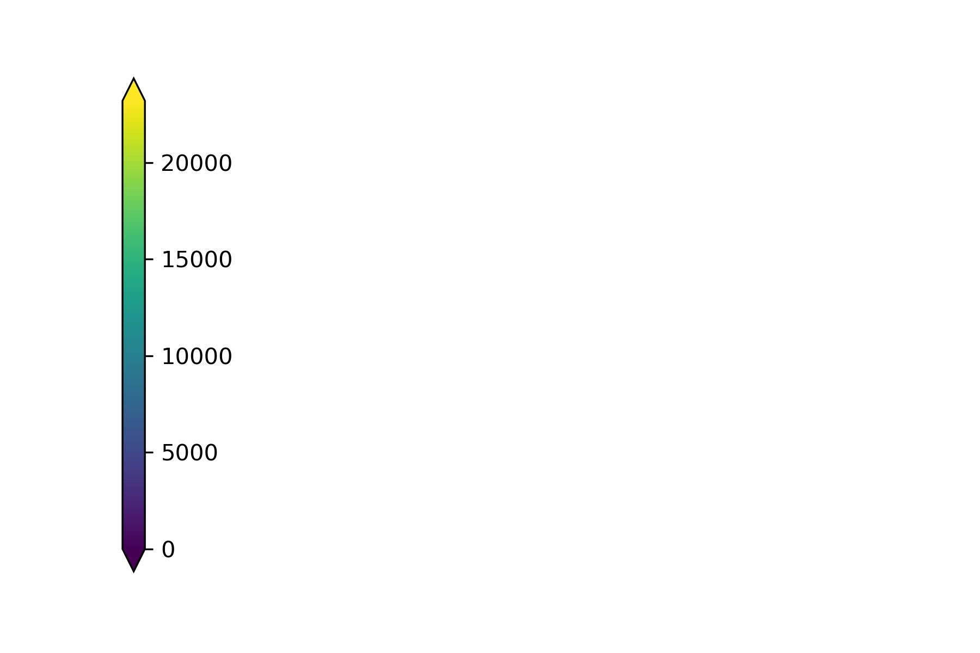
2.5
1e7
2.0
Frequency
1.5
1.0
0.5
0
0
0
0
0
0
0
5000
5000
5000
0
10000
10000
10000
5000
20000
20000
20000
10000
20000
25000
25000
25000
25000
15000
30000
15000
30000
15000
30000
15000
30000
Algal Concentration (cells/mL)
Algal Concentration (cells/mL)
Algal Concentration (cells/mL)
Algal Concentration
(cells/mL)
78000
A
B
C
D
E
77000
DA1
76000
DA2
75000
2016
2017
2018
2019
cells/mL
74000
DA3
73000
DA4
72000

