Slide 1
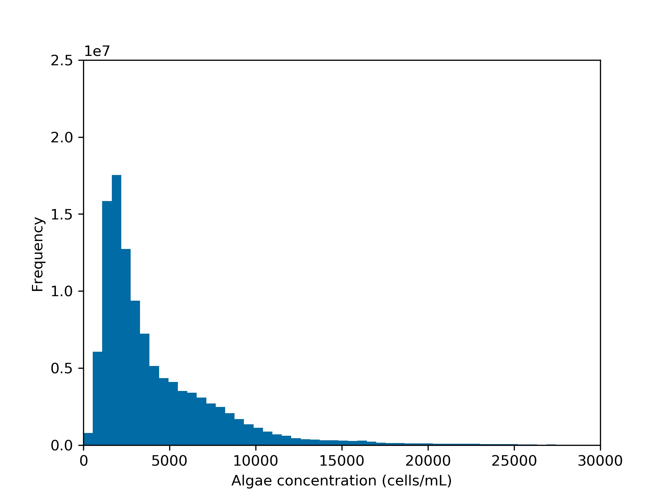
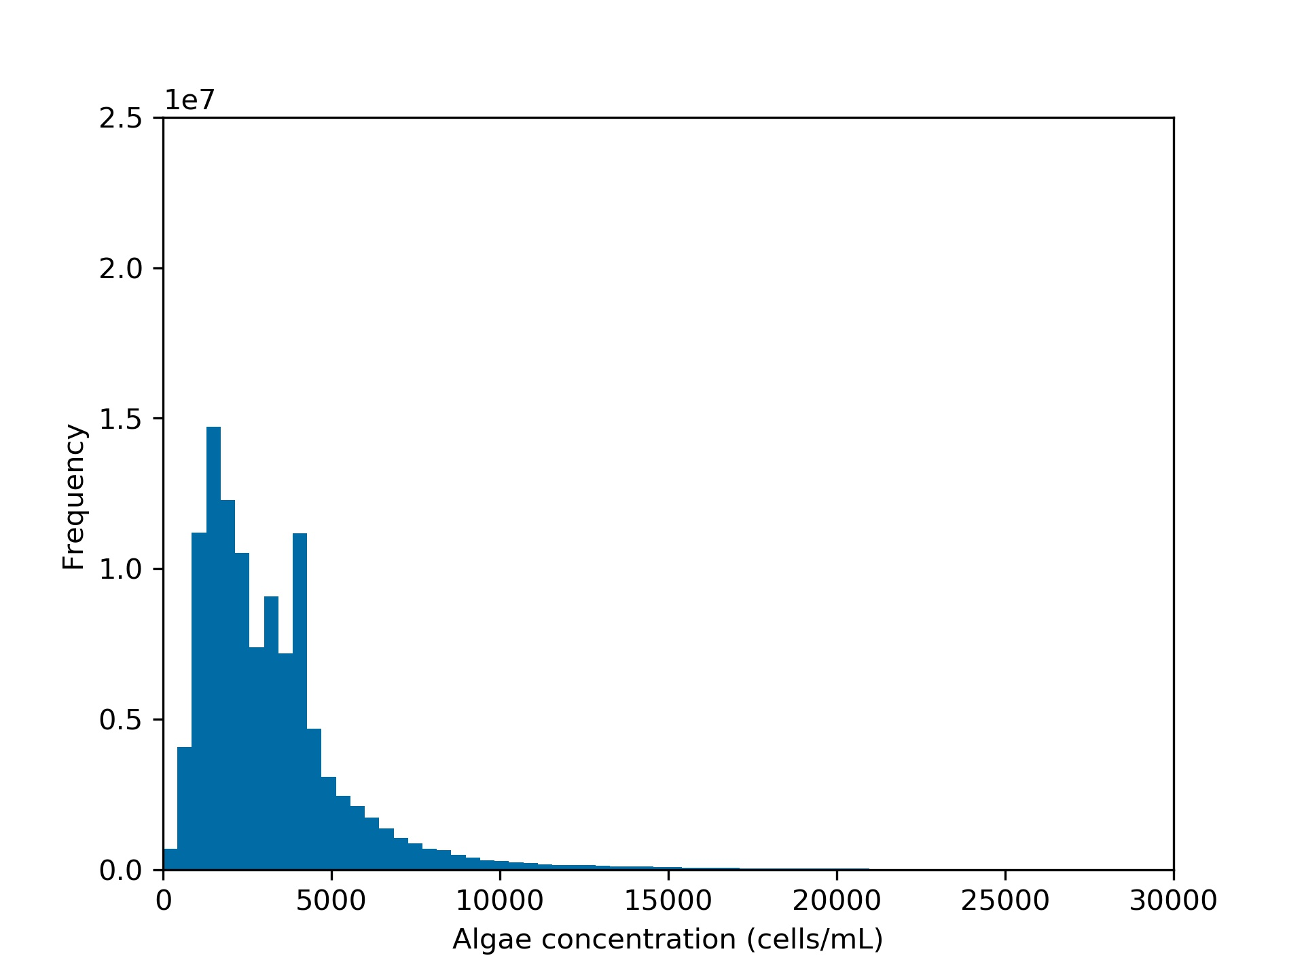
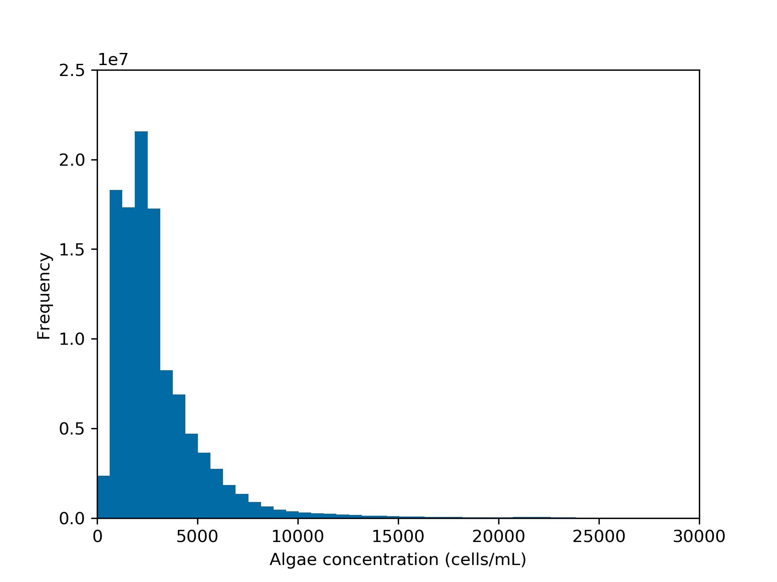
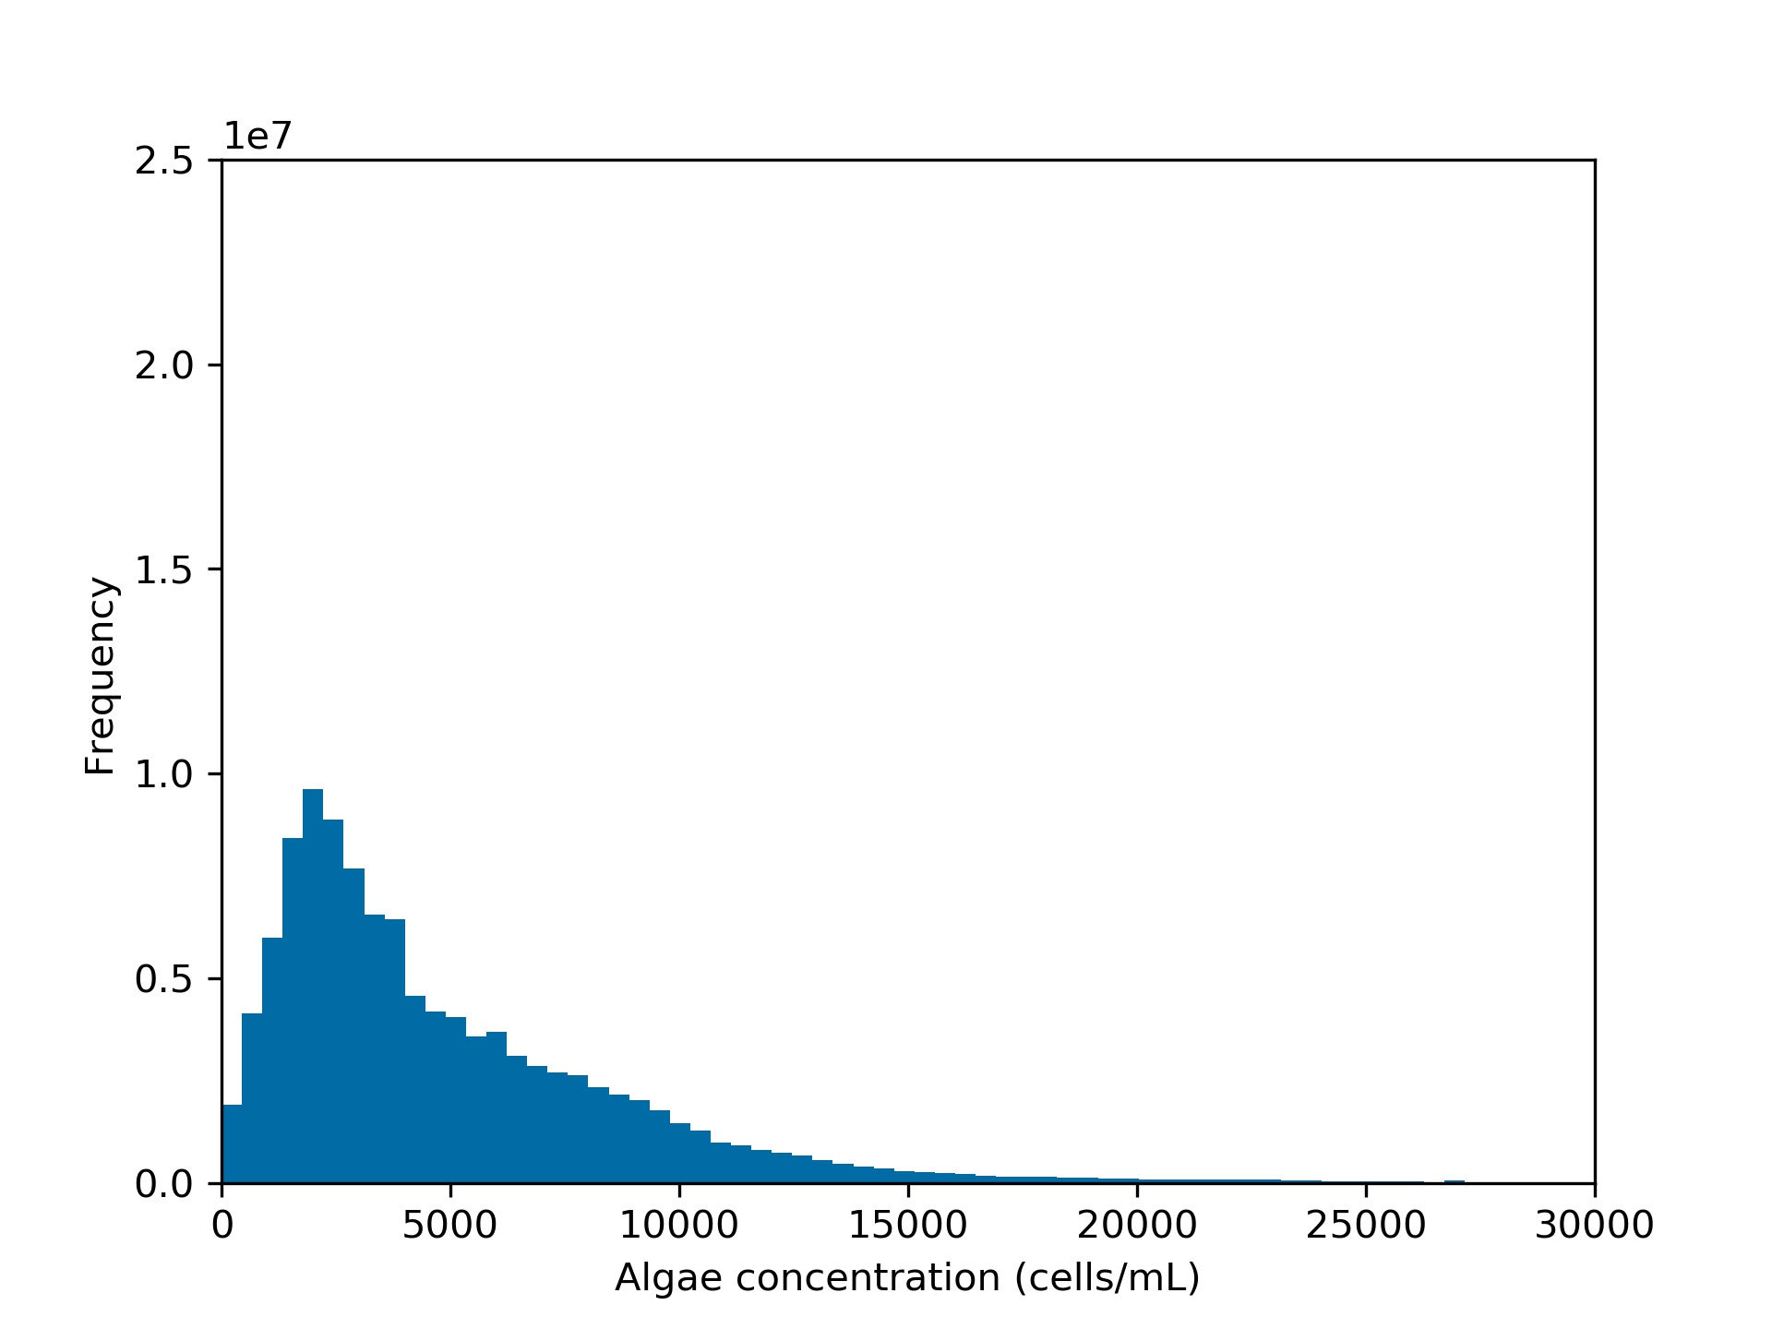
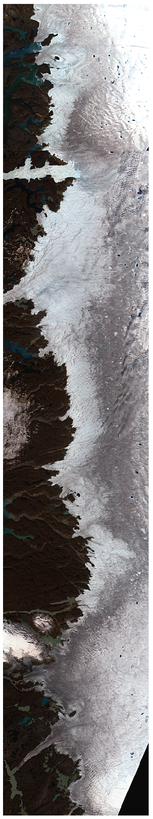
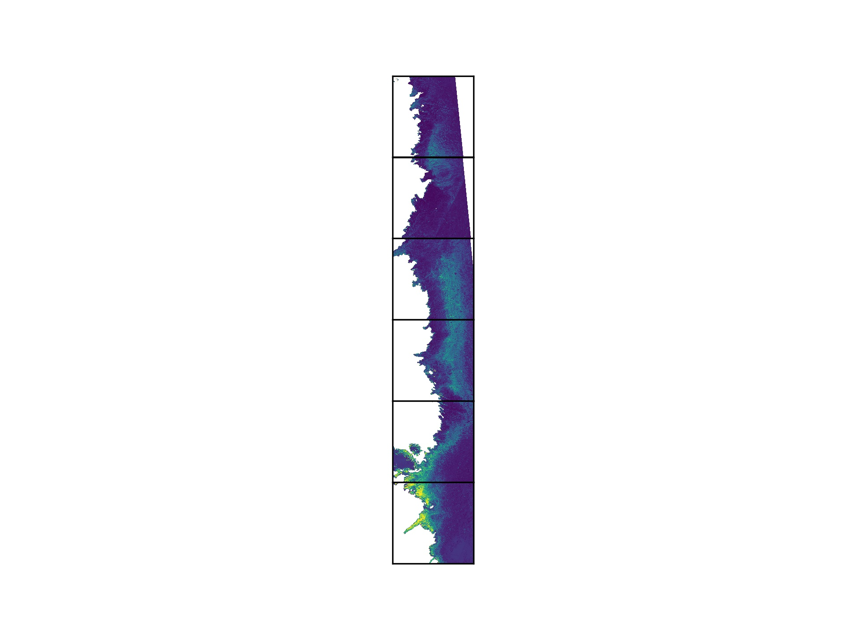
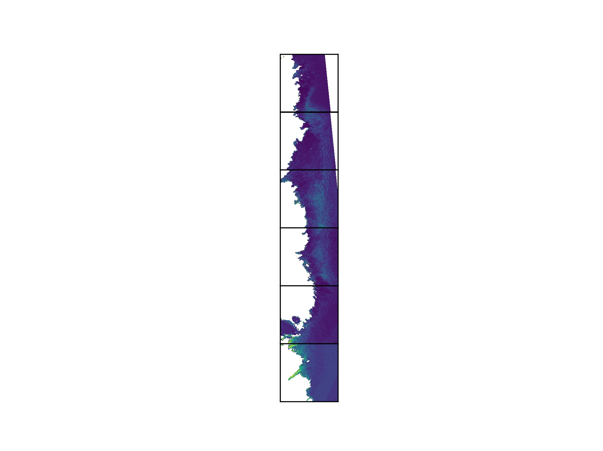
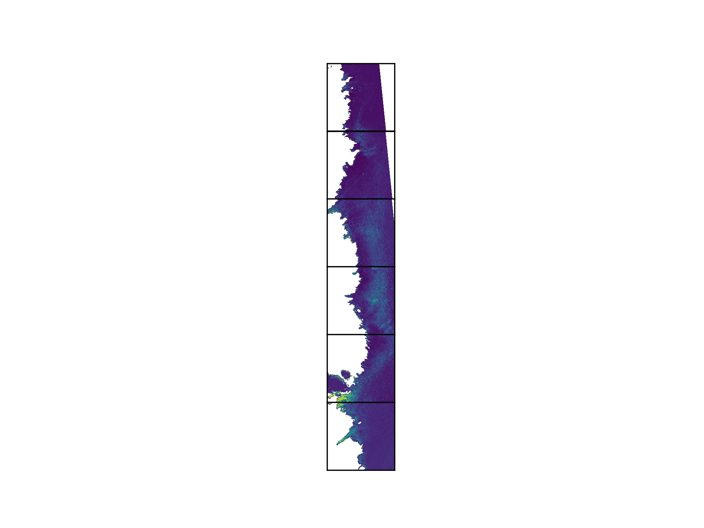
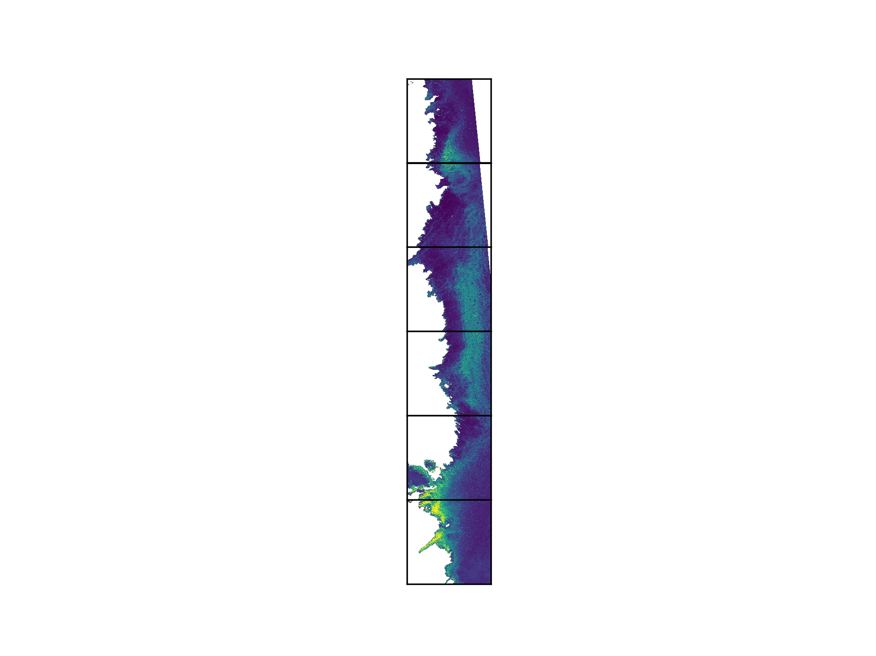
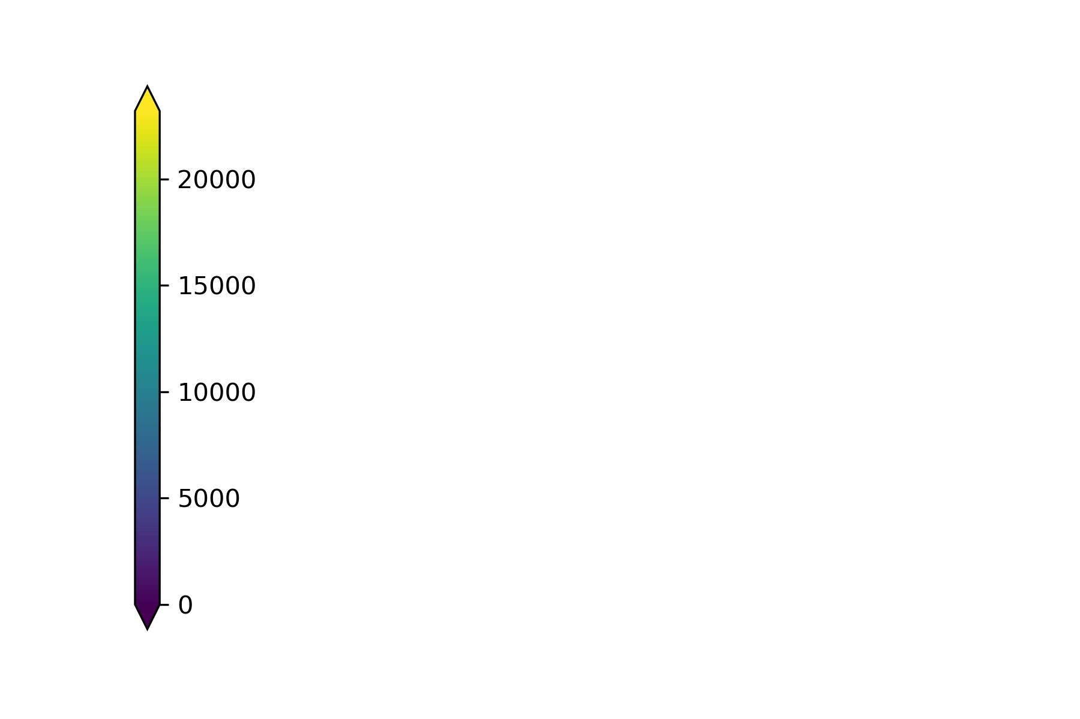
2.5
1e7
2.0
Frequency
1.5
1.0
0.5
0
0
0
0
0
0
5000
5000
5000
0
10000
10000
10000
5000
10000
20000
25000
15000
15000
30000
15000
30000
20000
20000
20000
25000
25000
25000
30000
15000
30000
Algal Concentration (cells/mL)
Algal Concentration (cells/mL)
Algal Concentration (cells/mL)
Algal Concentration
(cells/mL)
78000
D
A
B
C
E
77000
DA1
76000
DA2
2016
2017
2018
2019
75000
74000
DA3
73000
DA4
72000
cells/mL
0
5000
10000
15000
20000

