Slide 1
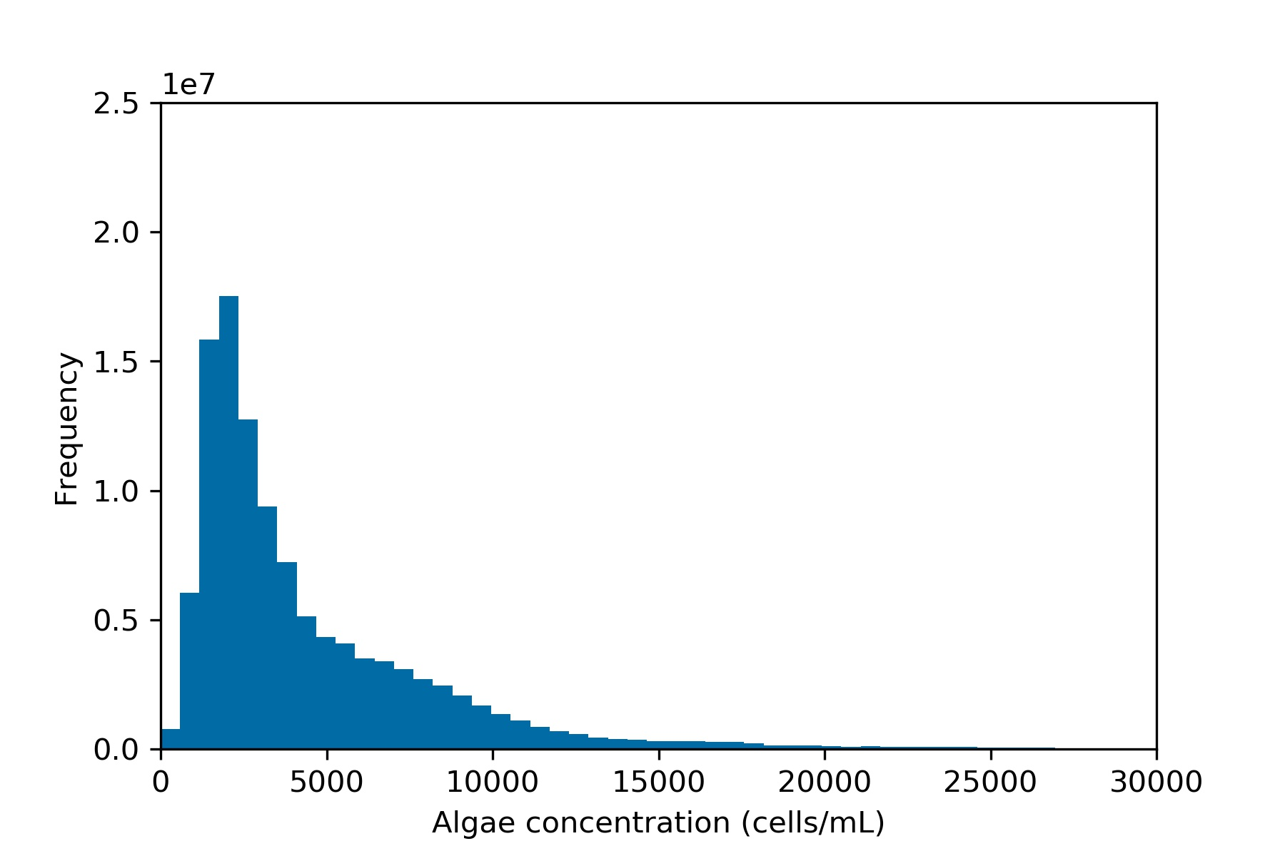
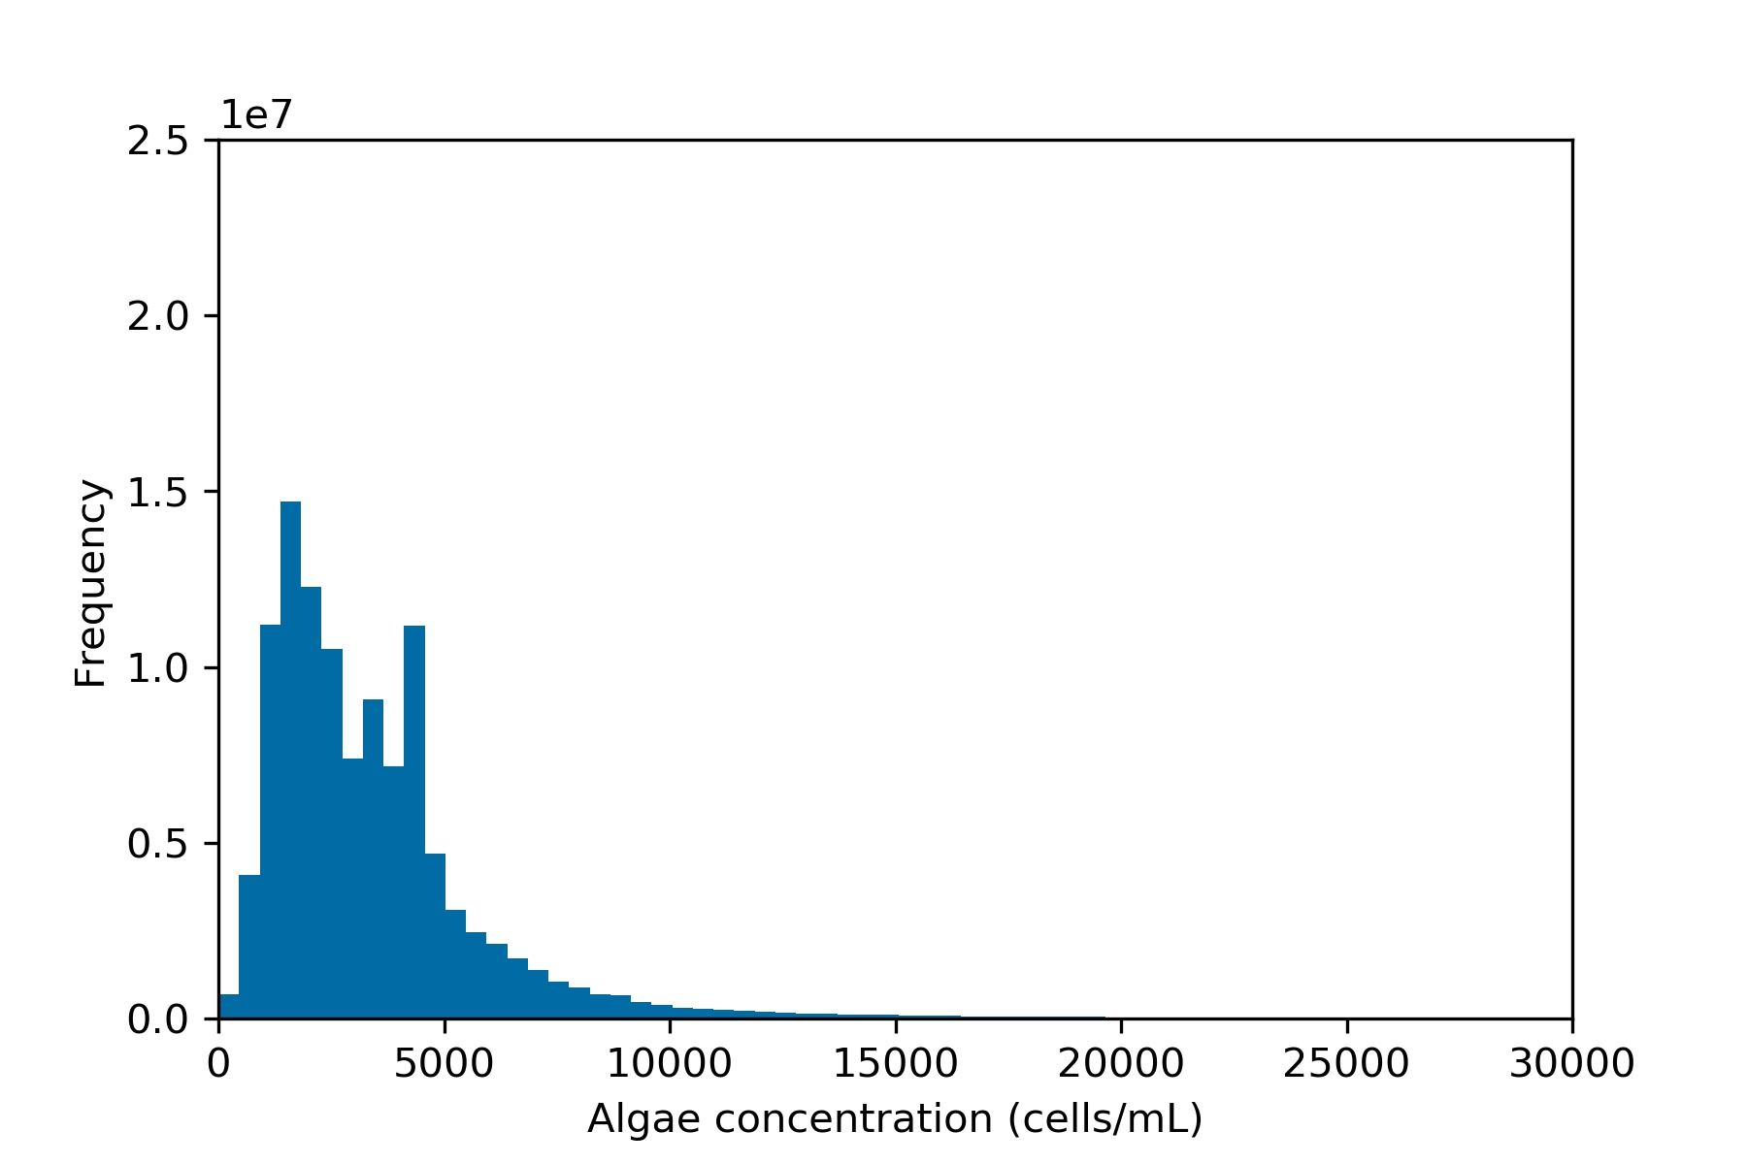
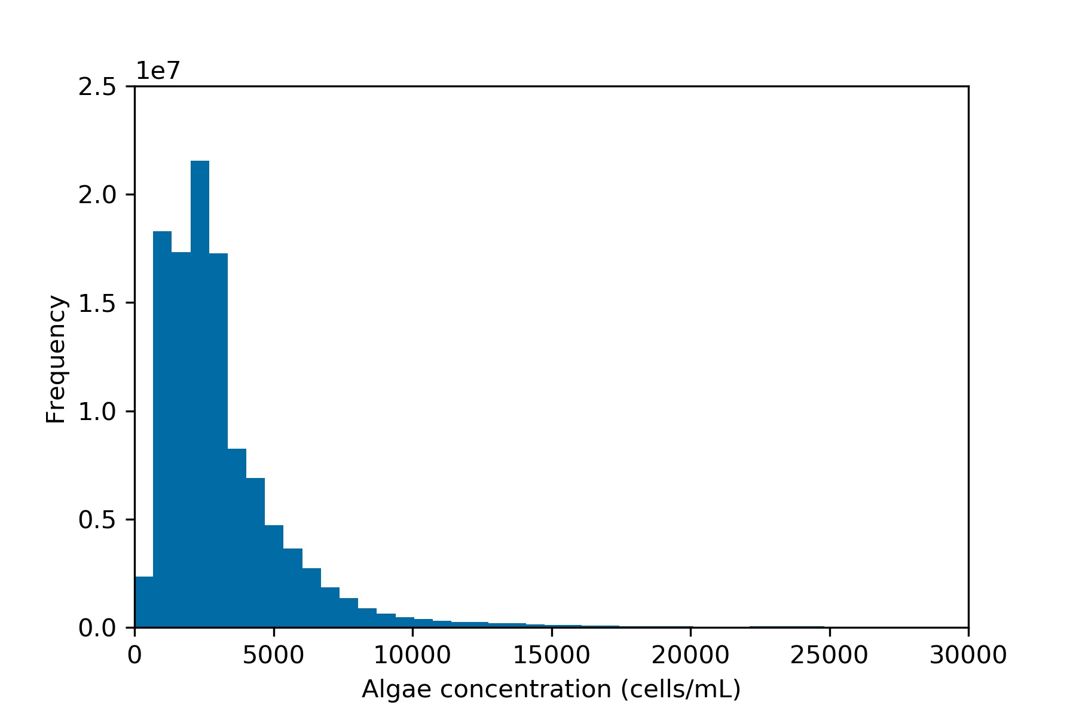
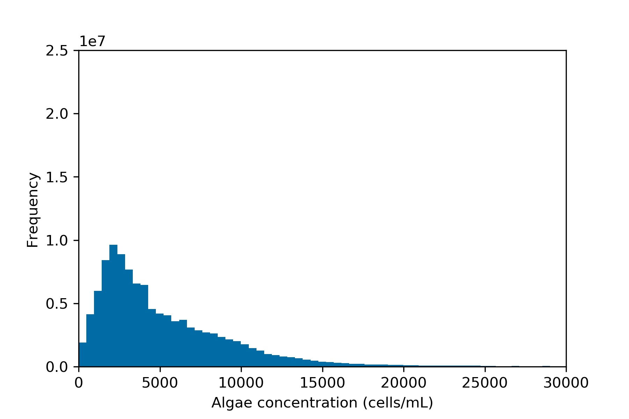
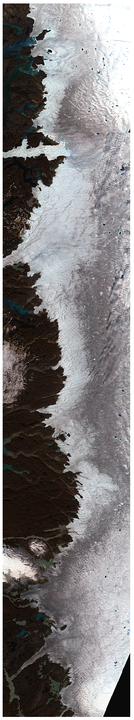
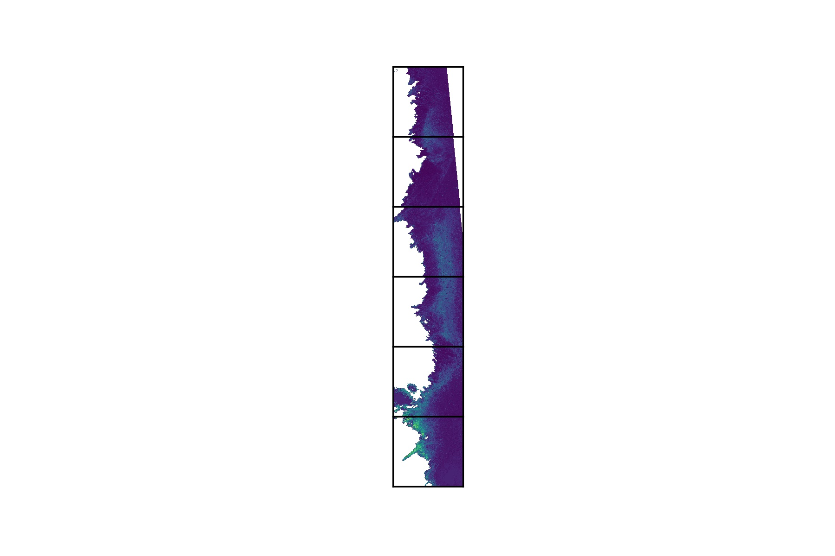
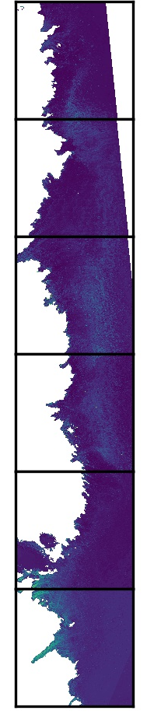

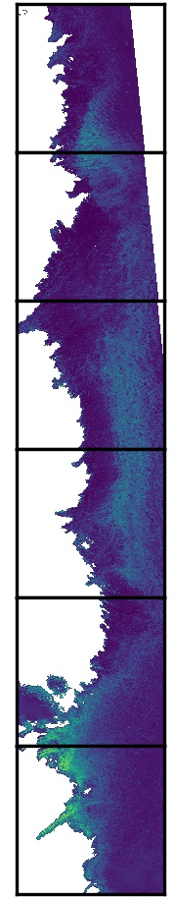
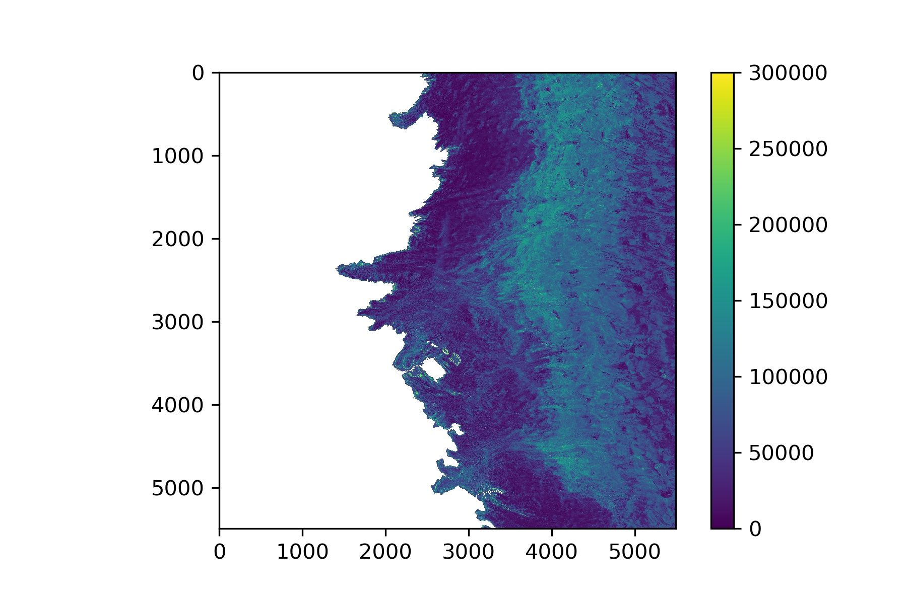
1e7
2.5
2.0
1.5
Frequency
1.0
0.5
0
0
5000
10000
25000
15000
15000
20000
30000
5000
20000
30000
0
20000
30000
0
30000
10000
25000
5000
5000
10000
25000
10000
25000
15000
15000
20000
Algal Concentration (cells/mL)
Algal Concentration (cells/mL)
Algal Concentration (cells/mL)
Algal Concentration (cells/mL)
78000
A
B
C
D
E
34800
77000
29000
DA1
76000
23200
DA2
0
5800
75000
2016
2017
2018
2019
cells/mL
17400
74000
DA3
11600
73000
5800
DA4
72000
0

