Slide 1
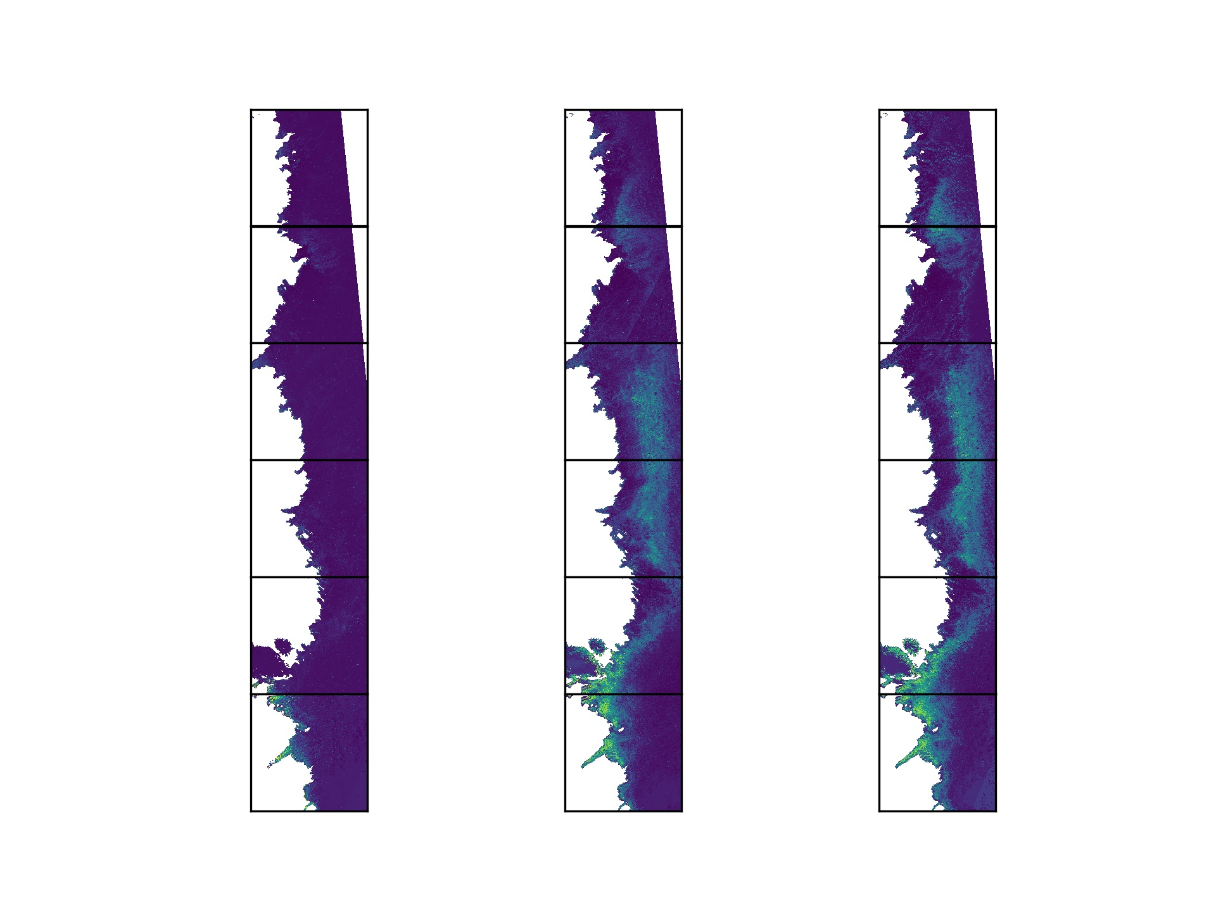
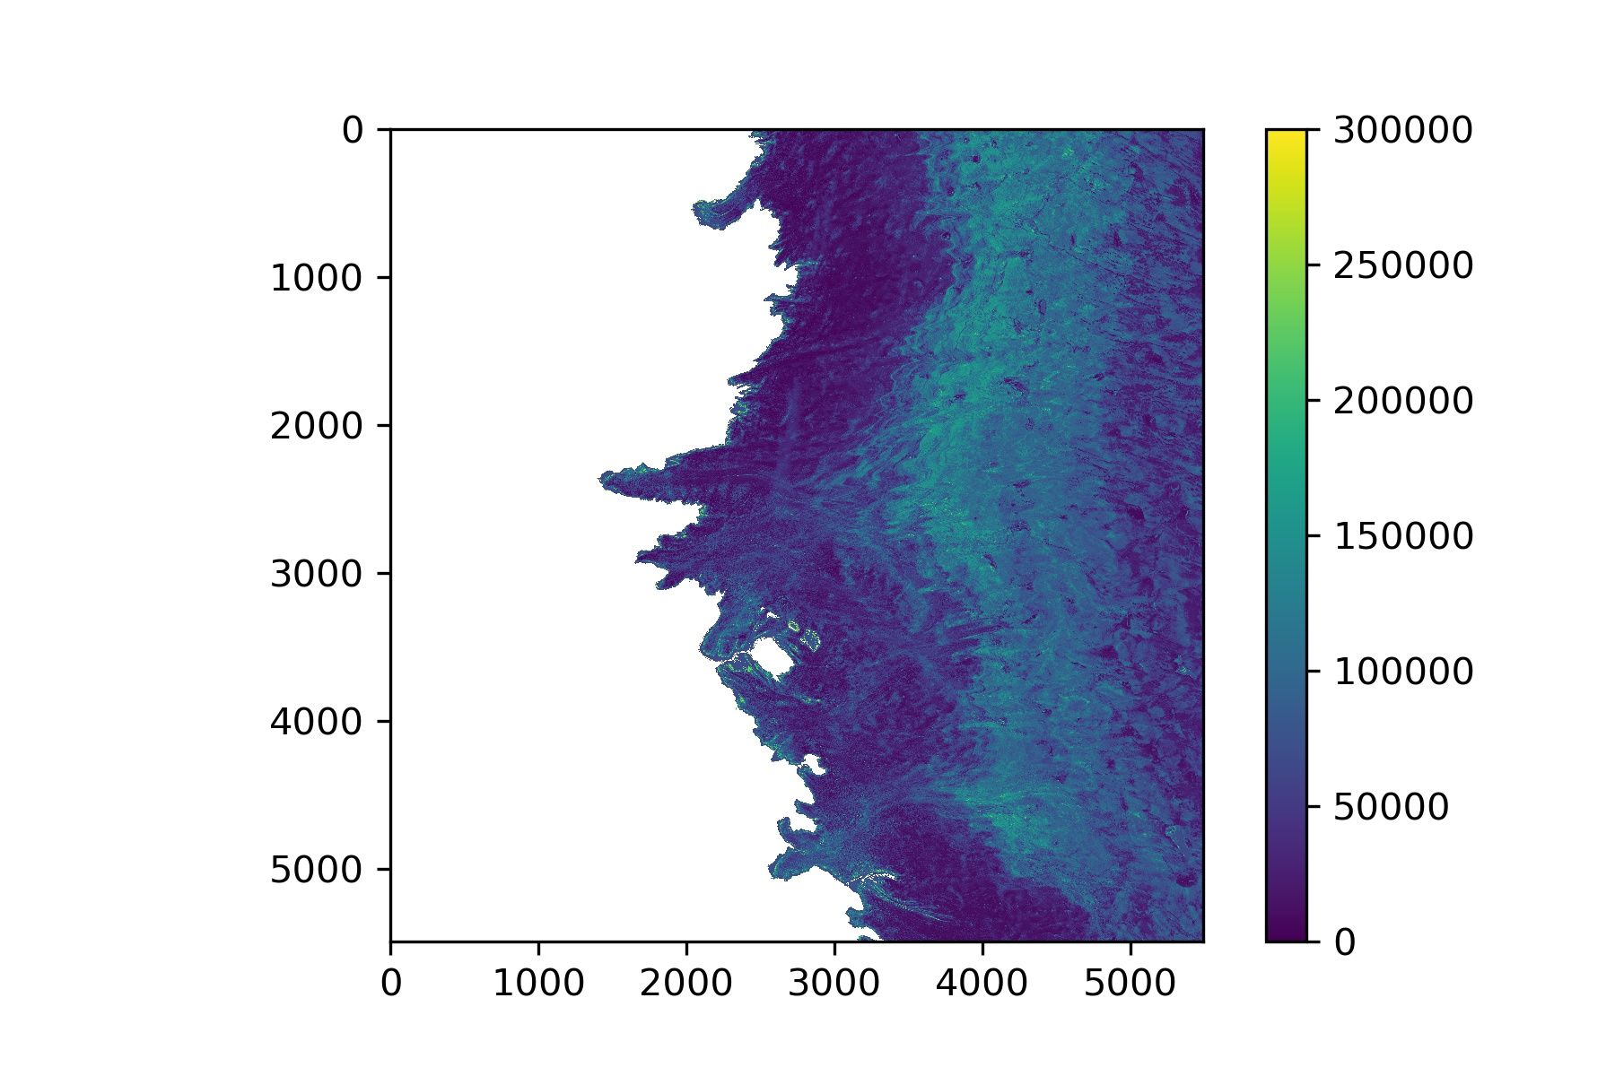
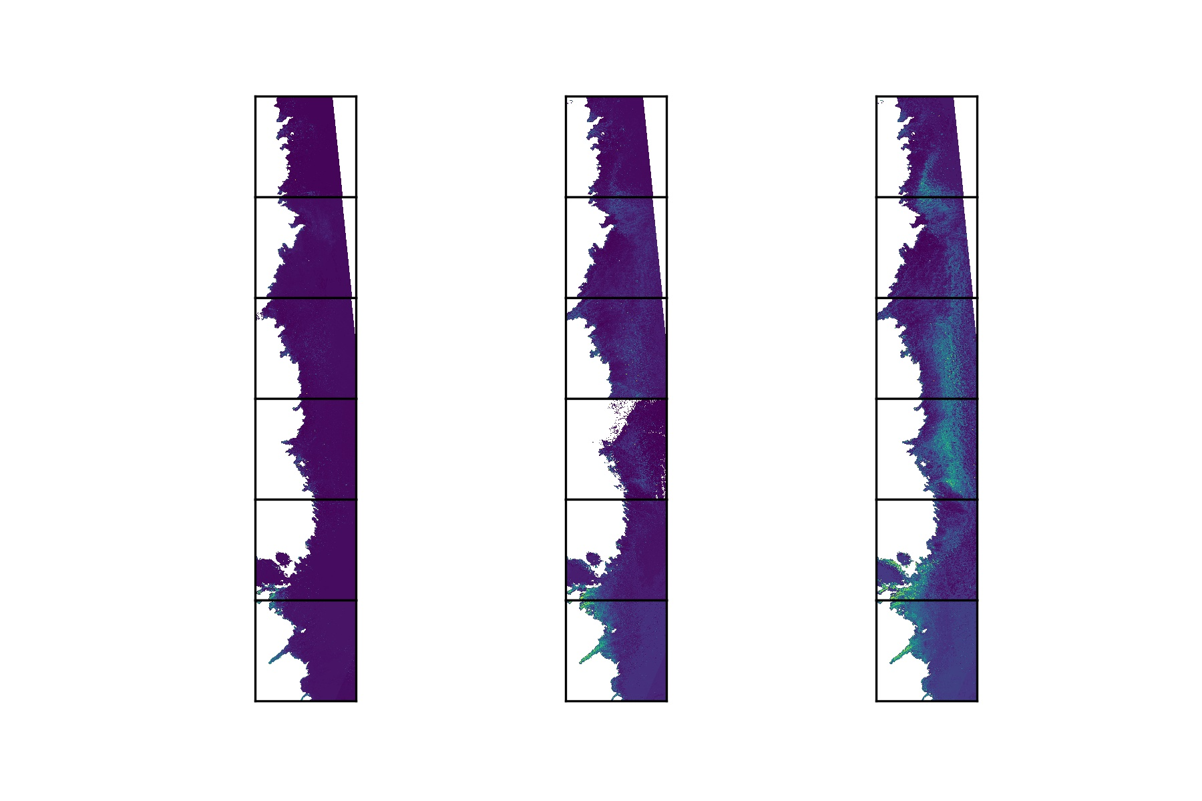
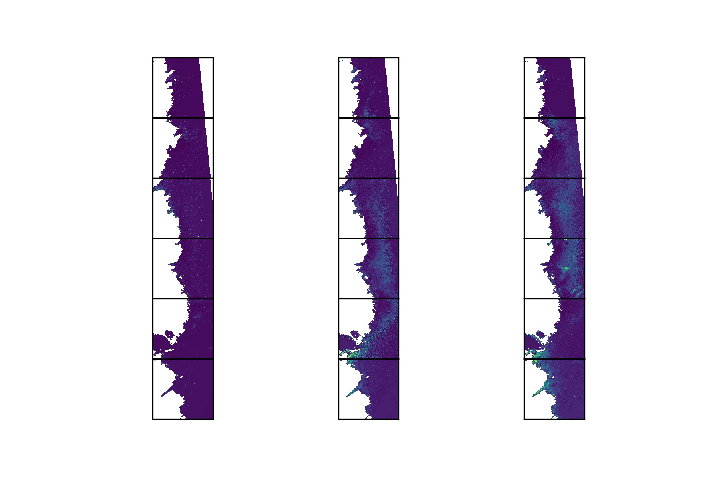
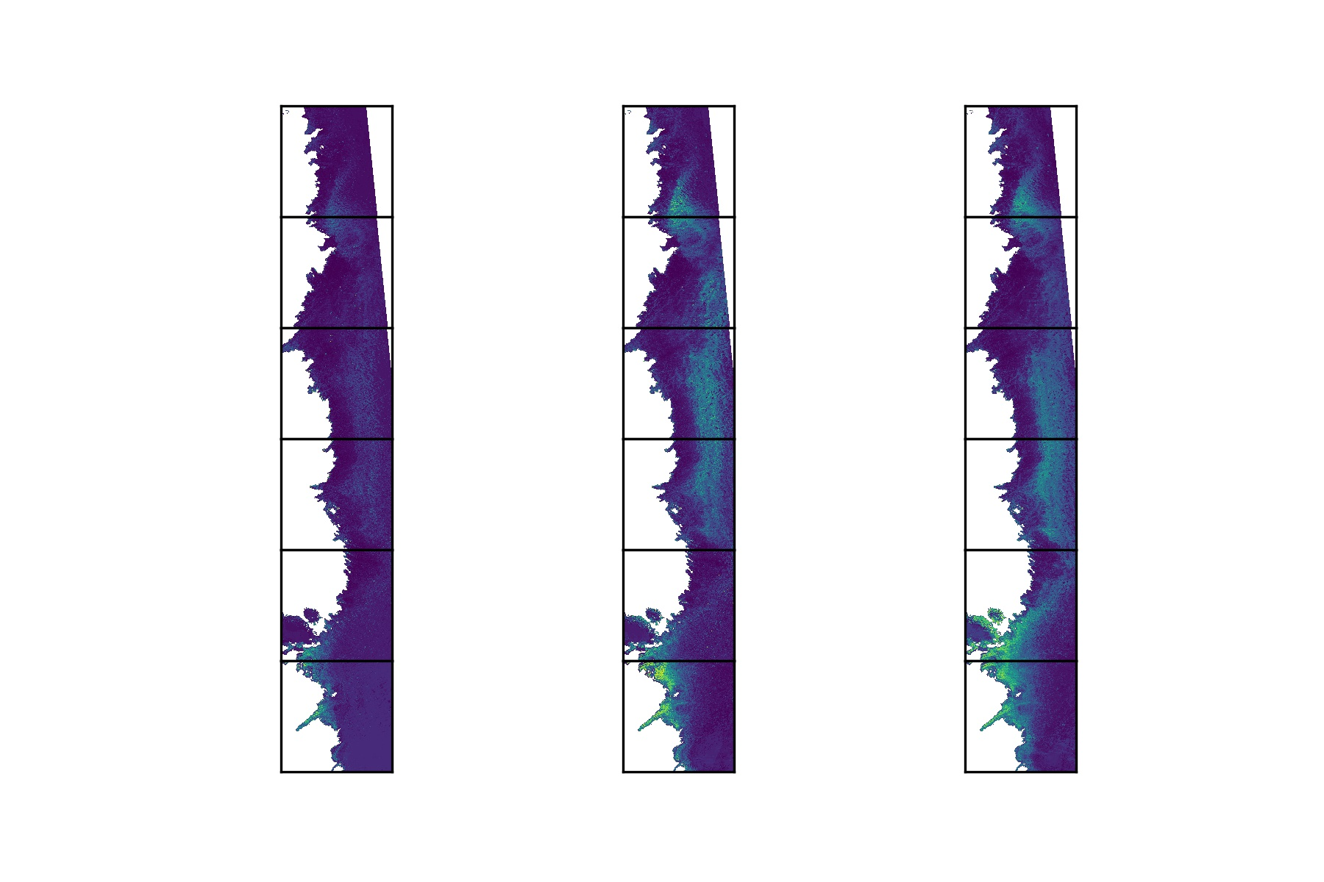
Jun
Jul
Aug
Jun
Jul
Aug
78000
2016
2017
cells/mL
72000
0
5800
11600
17400
23200
29000
34800
2018
2019
Jun
Jul
Aug
Jun
Jul
Aug

