Slide 1
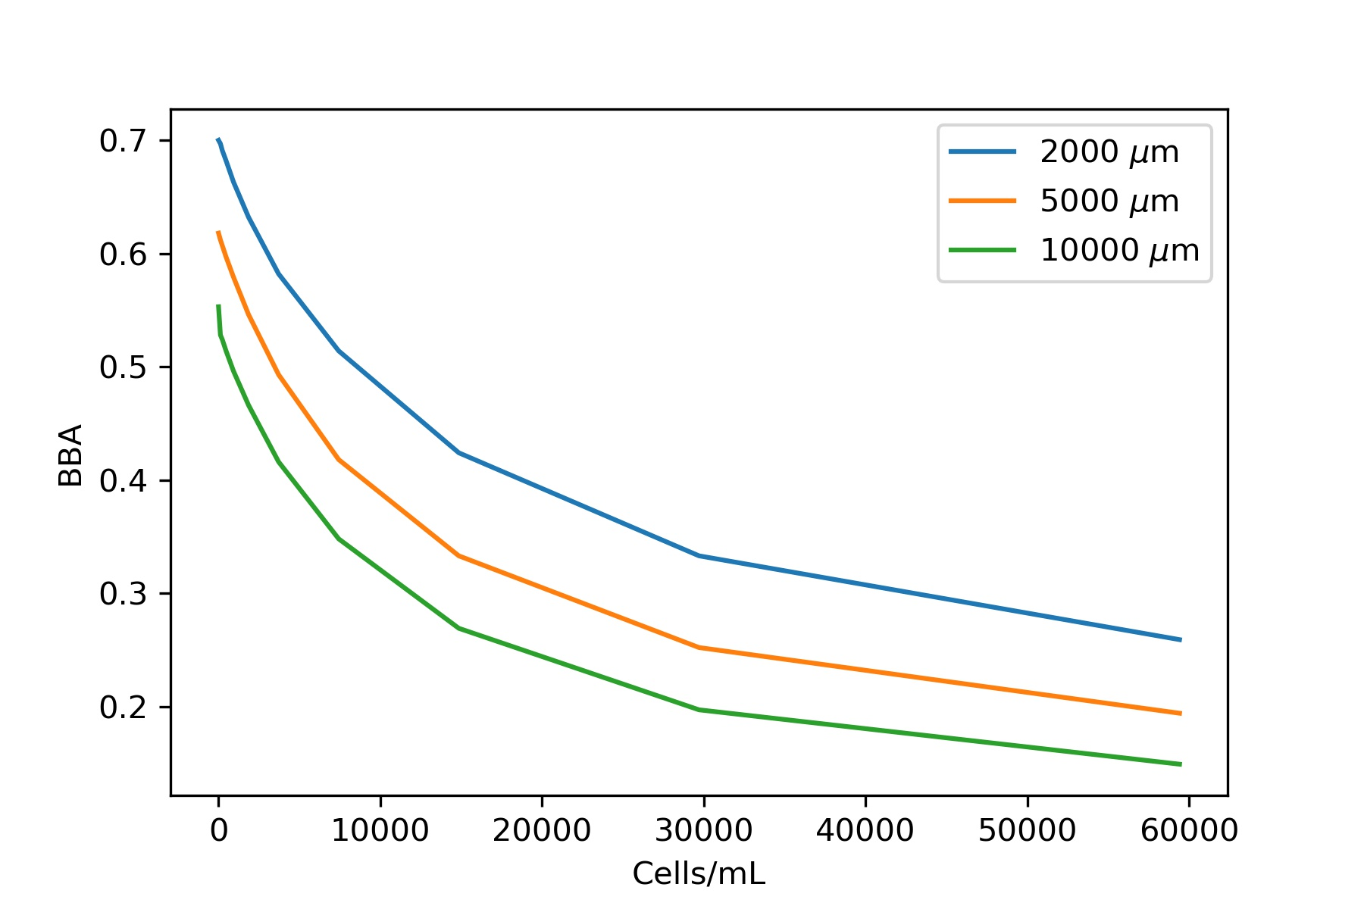
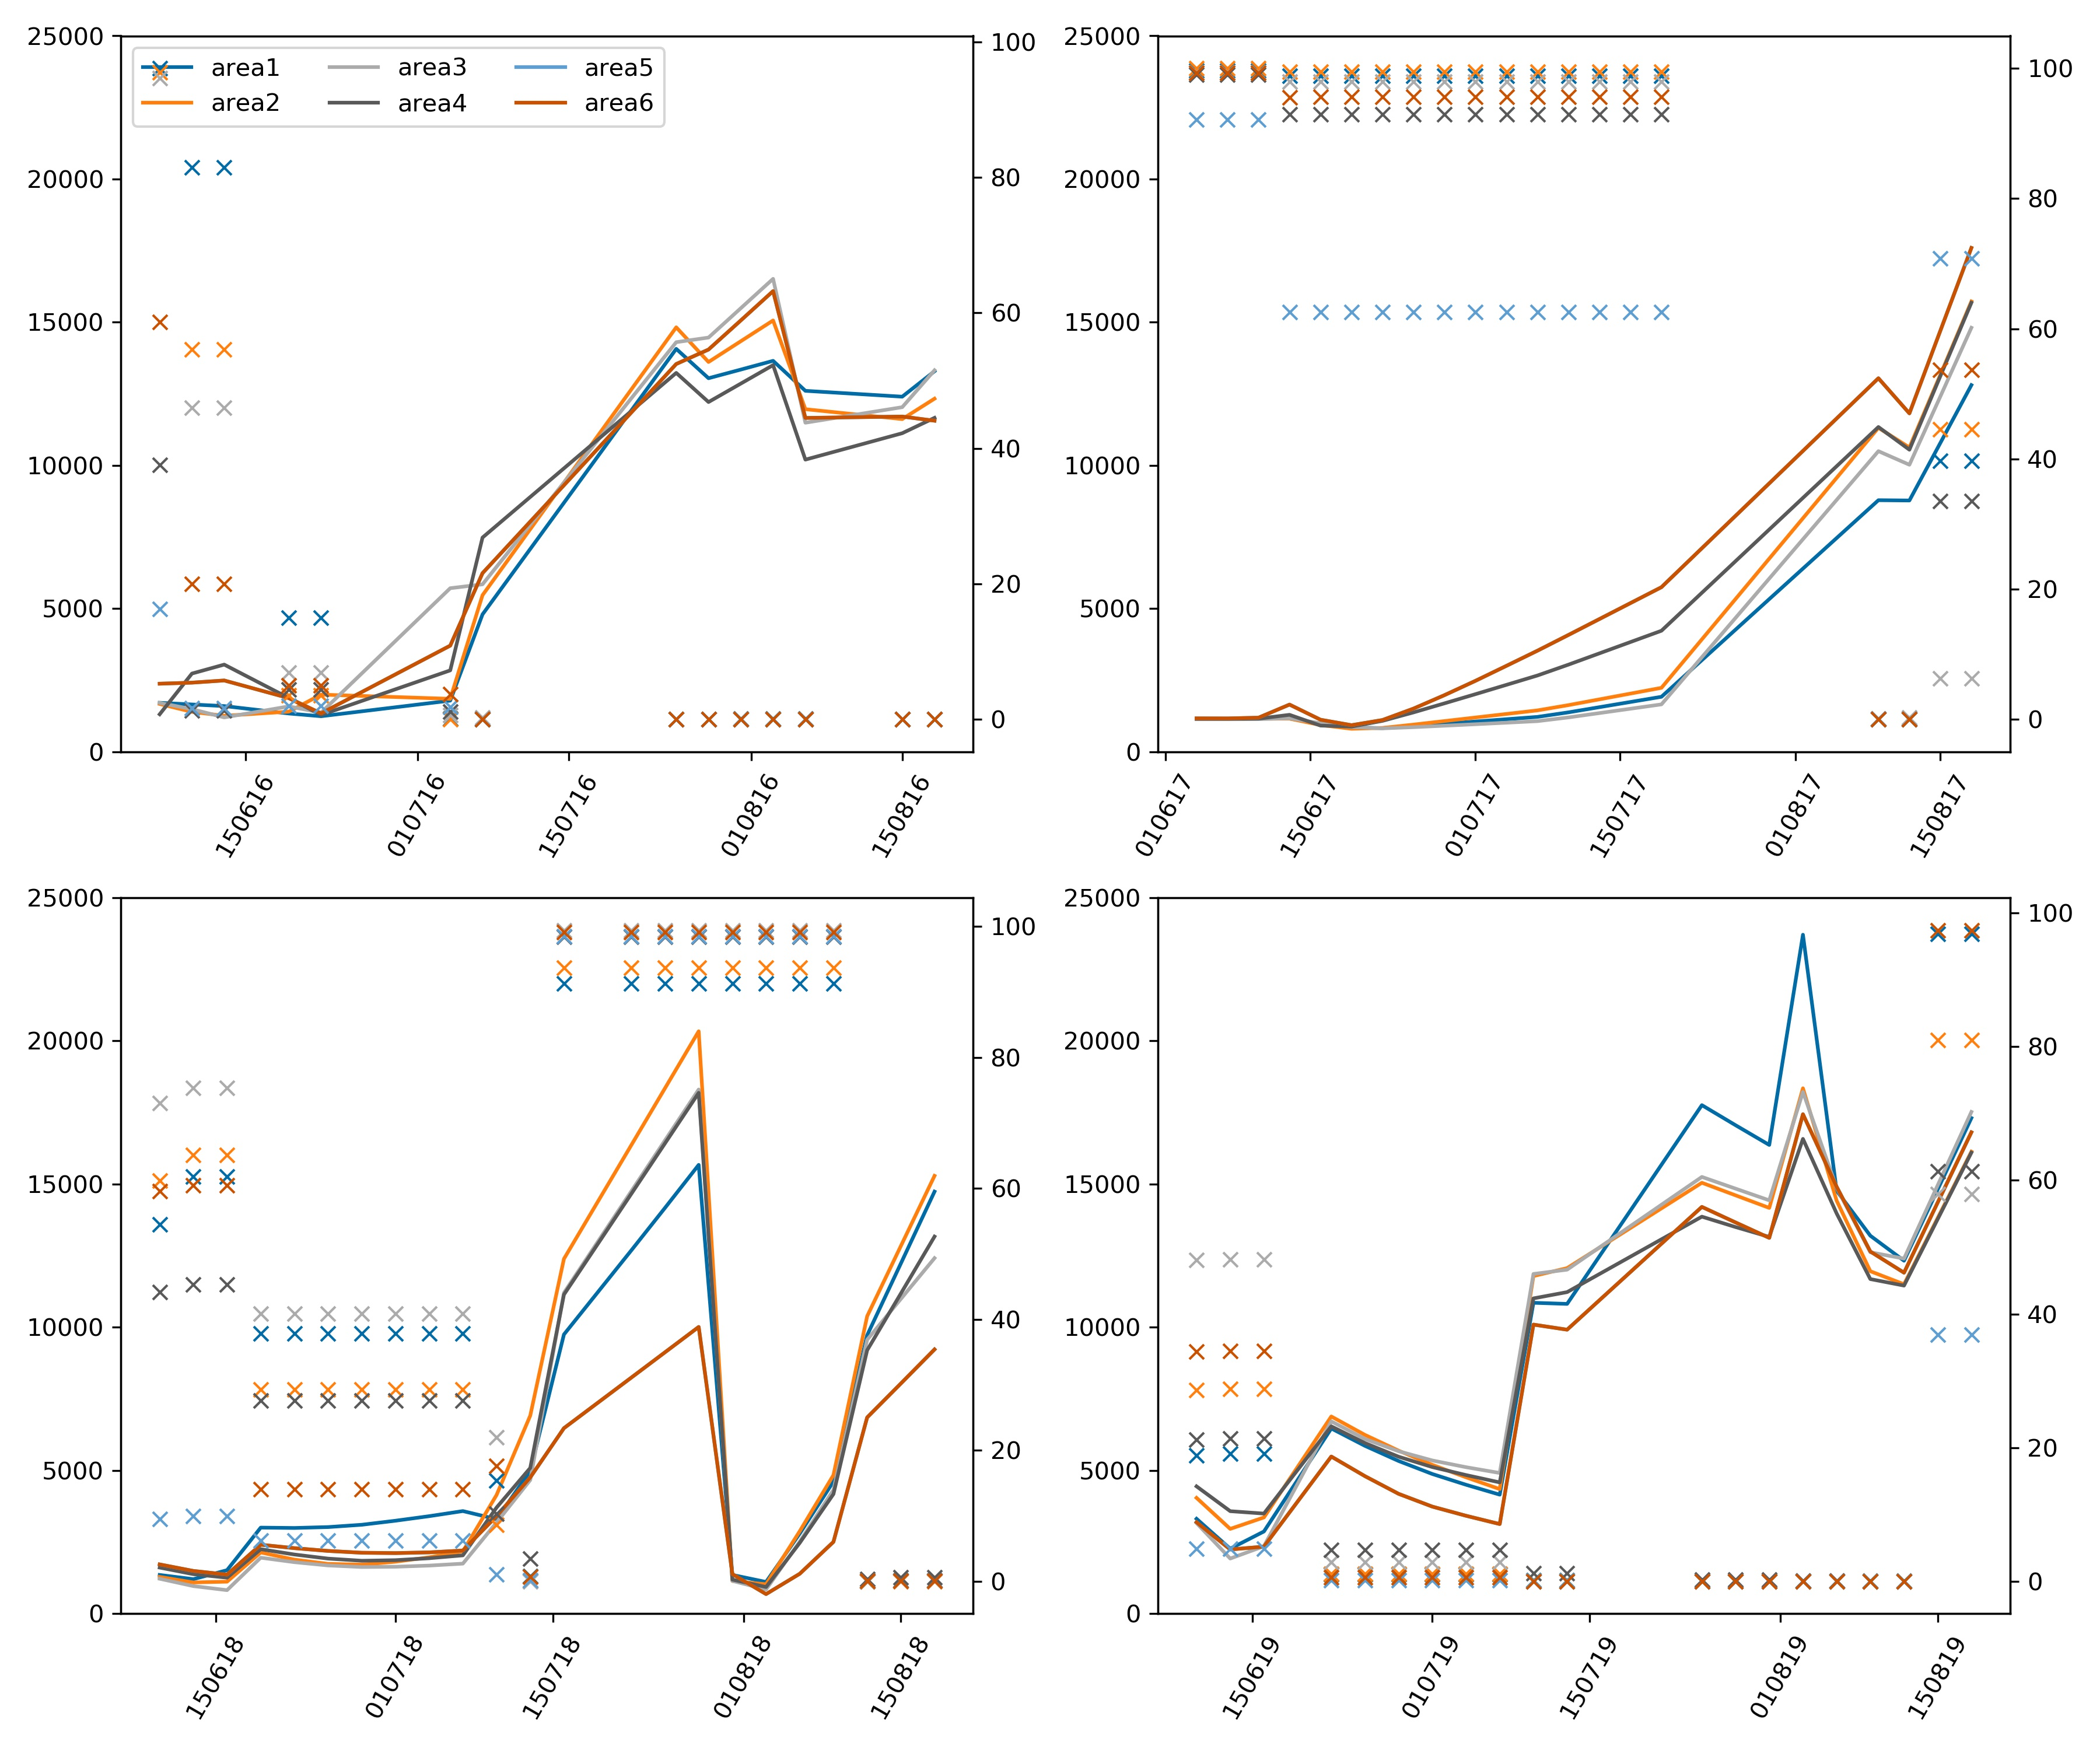
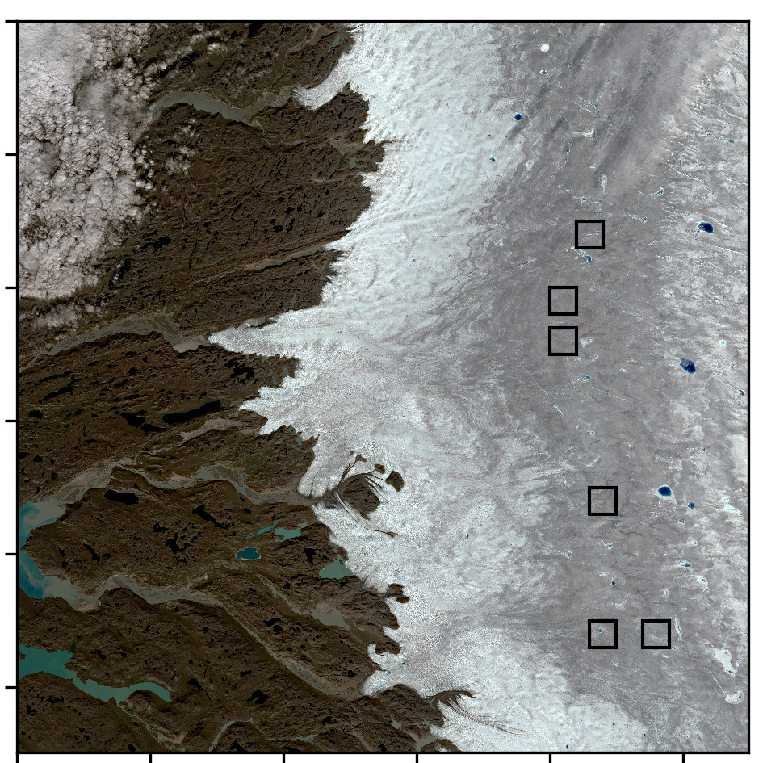
A
C
2016
2017
B
2018
2019
Algal concentration (cells/mL)
snow cover (%)
Date (dd/mm/yy)

