Slide 1
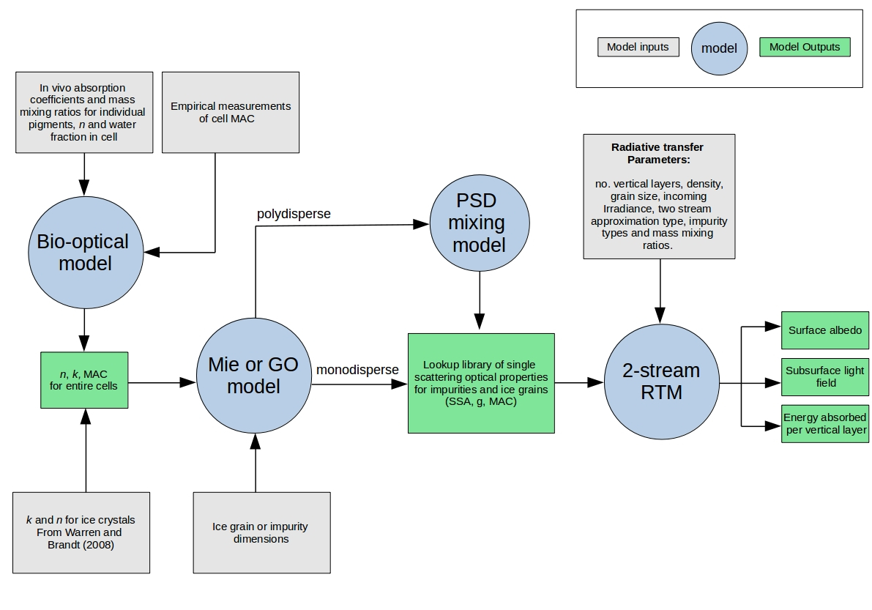
Toon et al.
2 stream solver
Layer optical properties
Optical thickness, single scattering albedo, asymmery parameter
OUTPUTS
Albedo
Absorbed energy
Heating rate
Actinic flux
Net fluxes
RTM feeder
Adding-doubling solver

