Slide 1

LAB: TAKE CONTROL OVER REVIT BY CREATING TOOLS WITH PYREVIT
Jean-Marc Couffin, Architect DPLG, Senior BIM specialist
BIM One Inc.

Slide 2
Digital Built Week Americas 2022
Questions related to specific materials, methods, and services will be addressed at the conclusion of this presentation.
No! Just ask. Don’t be shy!

Slide 3

Session Description
This presentation will run you through the process and the tools for you to create a custom toolbar with a set of custom tools thanks to pyRevit, some python coding or a dynamo script. The idea is to empower advanced users of Revit and help them structure a toolbox to improve their productivity and get rid of the repetitive or tedious tasks.
Learning Objectives
At the end of this session, participants will be able to:
Get to know the structure of pyRevit Framework, its capabilities, and its set of tools
Create a simple toolbar for Revit
Create scripts to populate our toolbar
Propose a way to distribute the toolbar across an organization

Slide 4
1. Have the lab Handout with you
3. Prerequisites are here: https://bit.ly/38VAcTf
But you should be already good to go
2. Final Code is hosted here for reference
https://bit.ly/3zeOc54

Slide 5
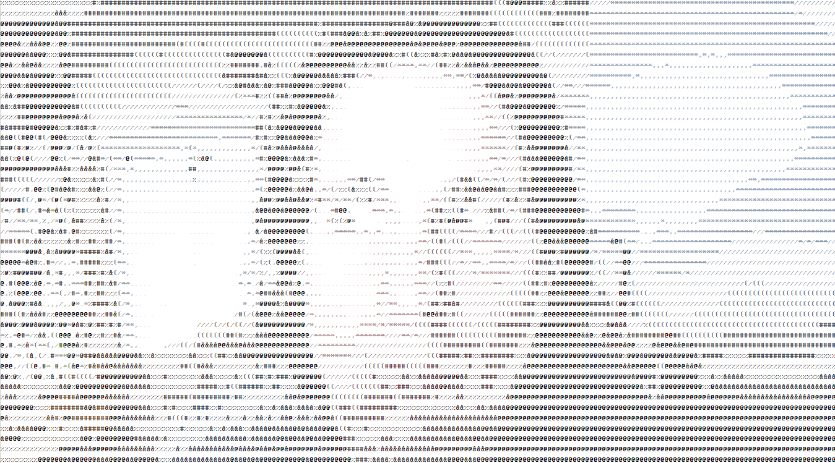
Who am I?
Architect 18 years or so
10 years in the BIM bubble
Since I was 10 in a relationship with computers
With BIM One Inc, BIM Consulting for 4 years.
I live in Czech Republic
Worked all over the world
BIM One is a Canadian firm specializing in project management and implementation of technologies related to information modeling.
32 BIM experts at the service of professionals, owners and entrepreneurs aiming towards a digital transition.
Strategic, operational or even technical consulting services.

Slide 6
pyRevit is a framework
Not only a set of tools to do stuffs in Revit
But also to build your own tools!
And the best, it is open source and free

Slide 7

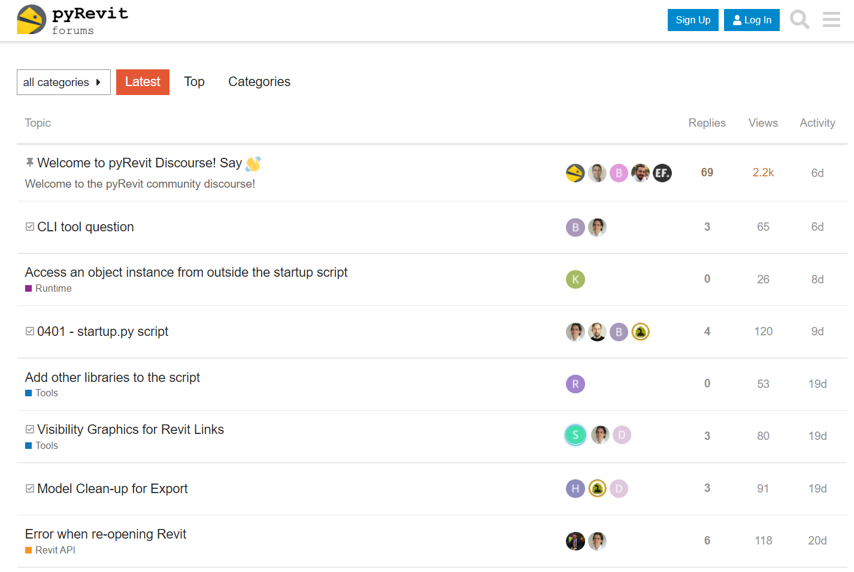
pyRevit is a community
https://discourse.pyrevitlabs.io/

Slide 8
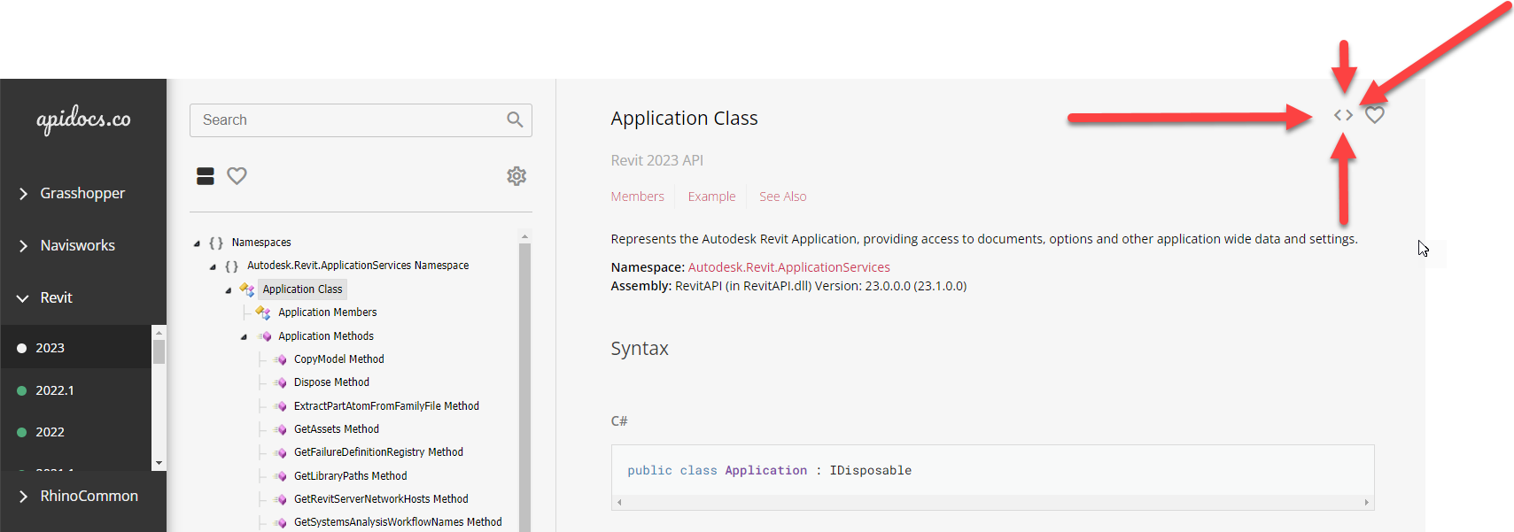
pyRevit relies on the RevitAPI
Thanks to Gui Talarico we have a searchable website for reference

Slide 9
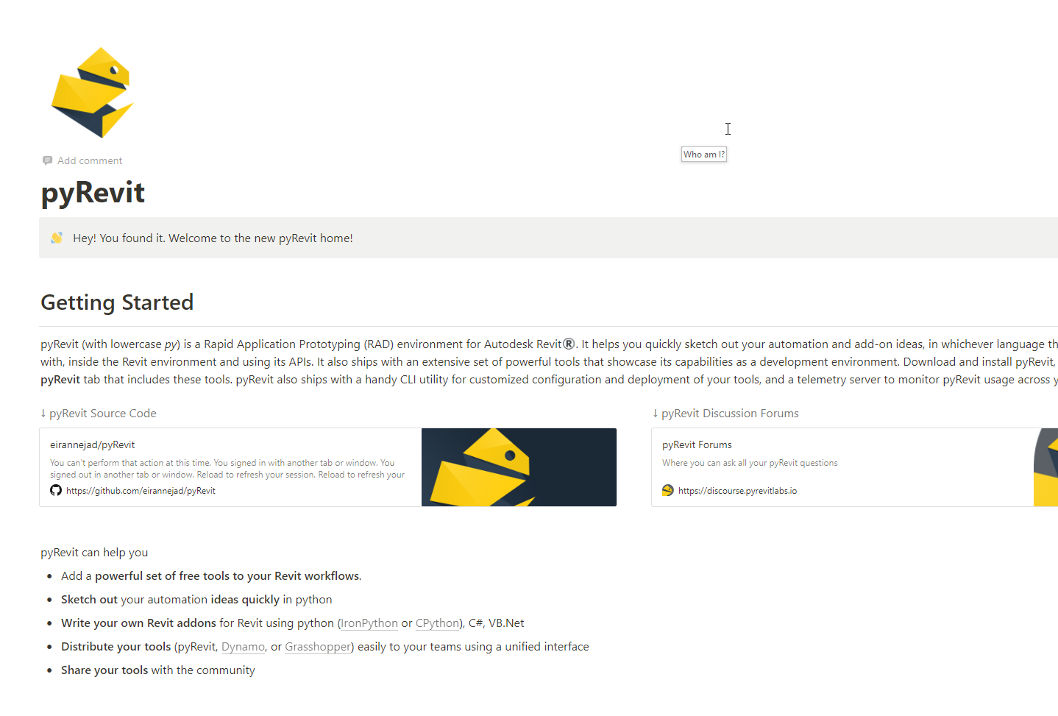
pyRevit is well documented
pyrevit Notion
https://www.notion.so/pyrevitlabs/pyRevit-bd907d6292ed4ce997c46e84b6ef67a0
And
Modules
https://pyrevit.readthedocs.io/en/latest/

Slide 10

Enough presentation Hands-on time

Slide 11
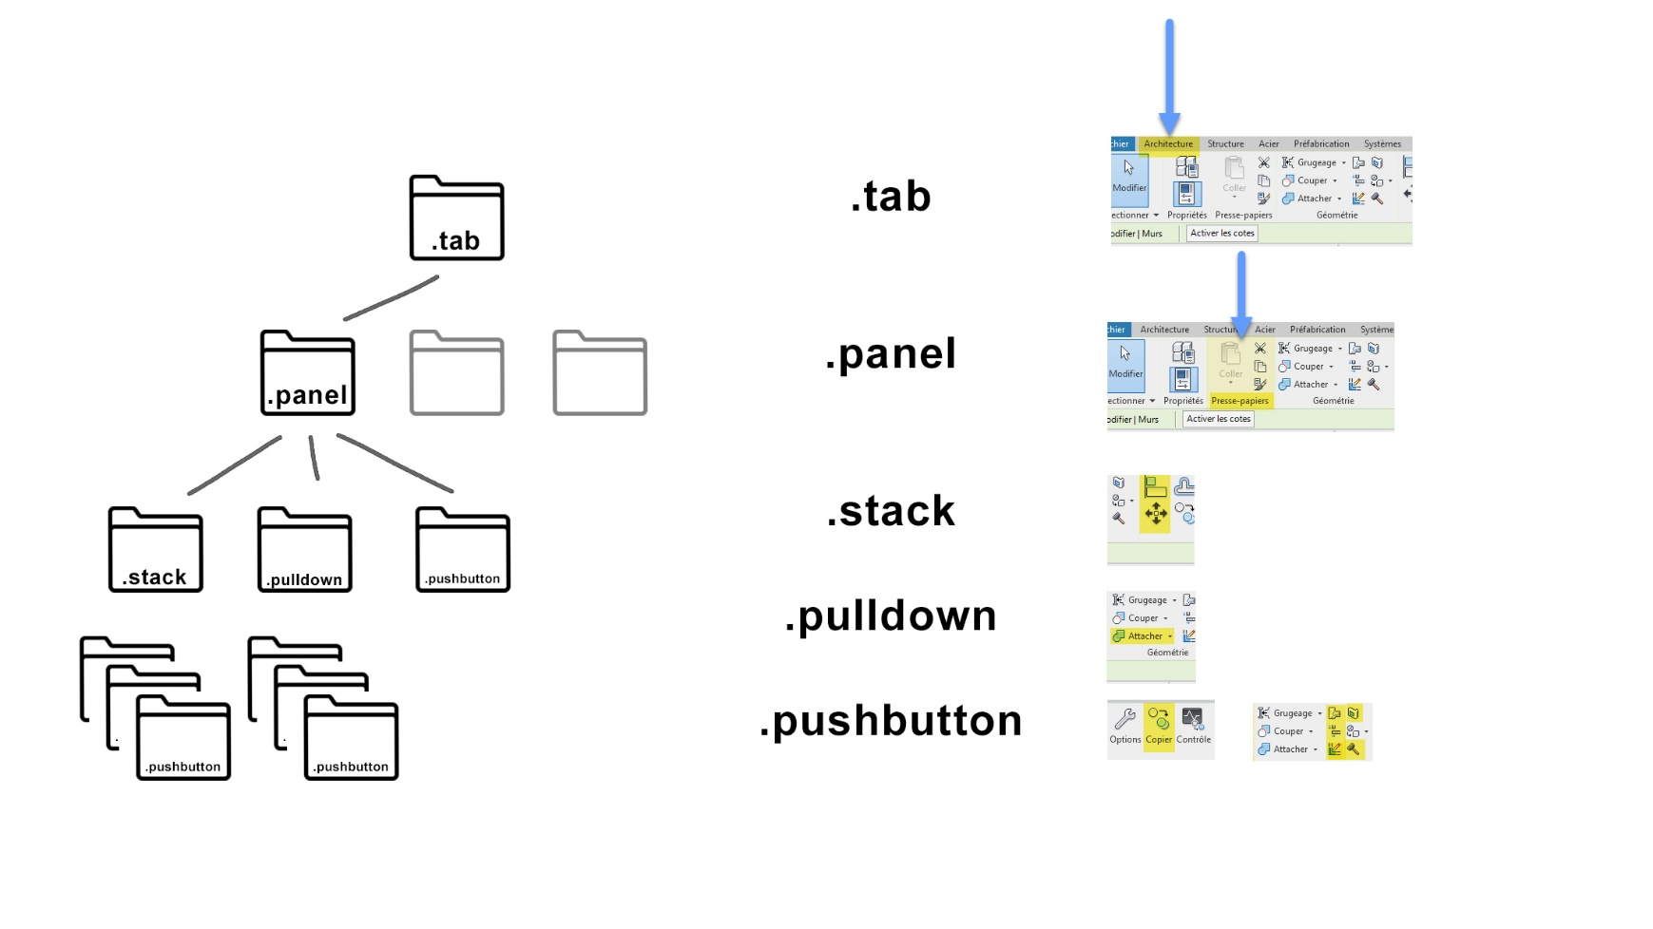

Slide 12
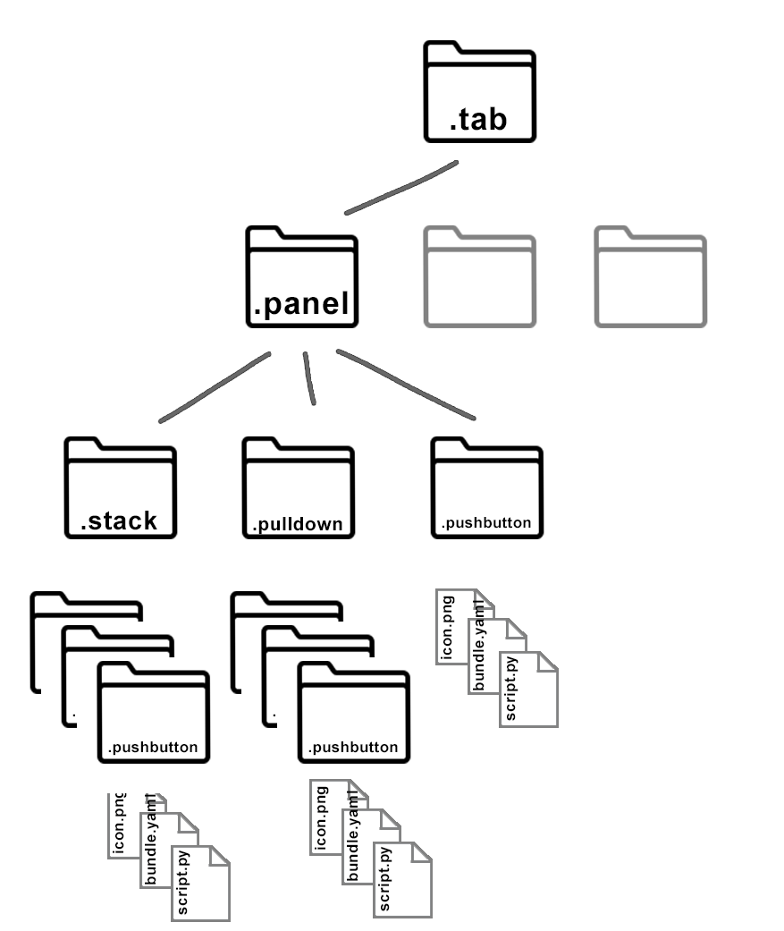

Slide 13
Reminder Speaker and Session Feedback is Appreciated
Go to Sessions
Select this Session
Select Session Rating
LAB: TAKE CONTROL OVER REVIT BY CREATING TOOLS WITH PYREVIT
Session ID
Jean-Marc Couffin

Slide 14
Visit me at the Speaker Lounge
I will be at the Speaker Lounge outside the Exhibition Hall for further conversations. Please join me there at this time:
After the presentation
Or come and chat anytime during BILT

Slide 15
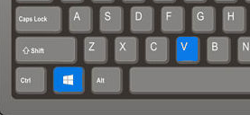

Takeaway tricks?
In Windows, WIN+V gives you the cut and paste history (+pin)
In any Github repository, get to edit the code in vscode on the web

Slide 16


Questions?
LAB: TAKE CONTROL OVER REVIT BY CREATING TOOLS WITH PYREVIT
Jean-Marc Couffin
BIM One Inc.
Jmcouffin+bilt@gmail.com
@JeanMarcCouffin
jmcouffin

