Slide 1

Notes:
[walk up, hold up the card if you have one]

Slide 2
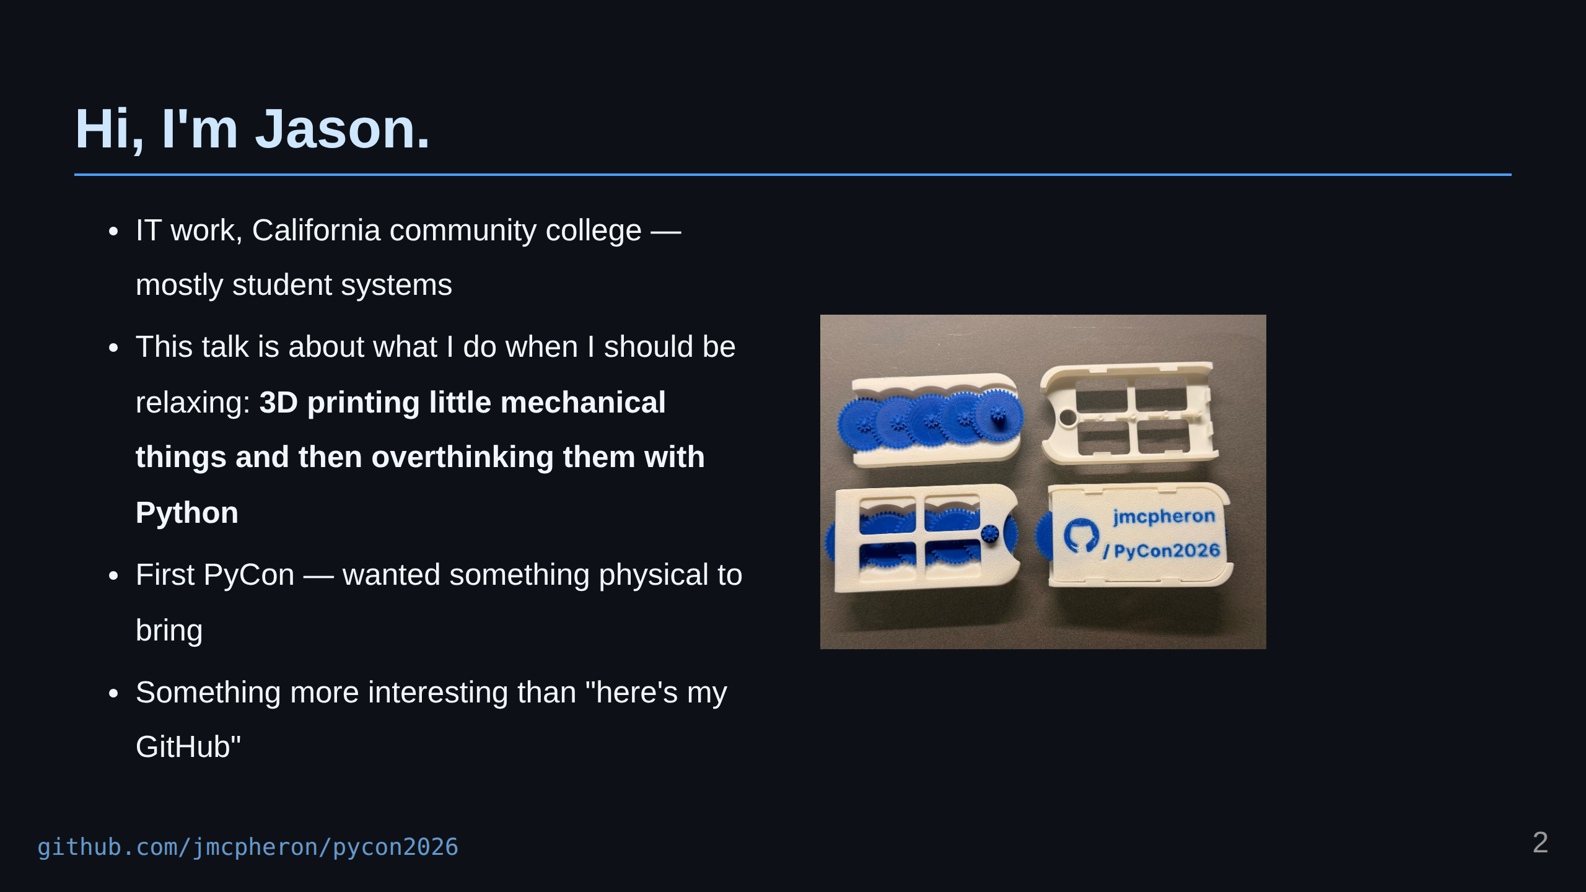
Notes:
I work in IT for a community college here in California, mostly around student systems. But this talk is about one of my hobbies, which is 3D printing little mechanical things and then overthinking them with Python. This is my first PyCon, and I wanted to make something physical to bring with me. Partly because 3D printing is fun. Partly because I like making small mechanical objects. And partly because conferences full of strangers can be a little intimidating, so I wanted a conversation starter. Something I could hand someone that was more interesting than just saying, "Here's my GitHub."

Slide 3
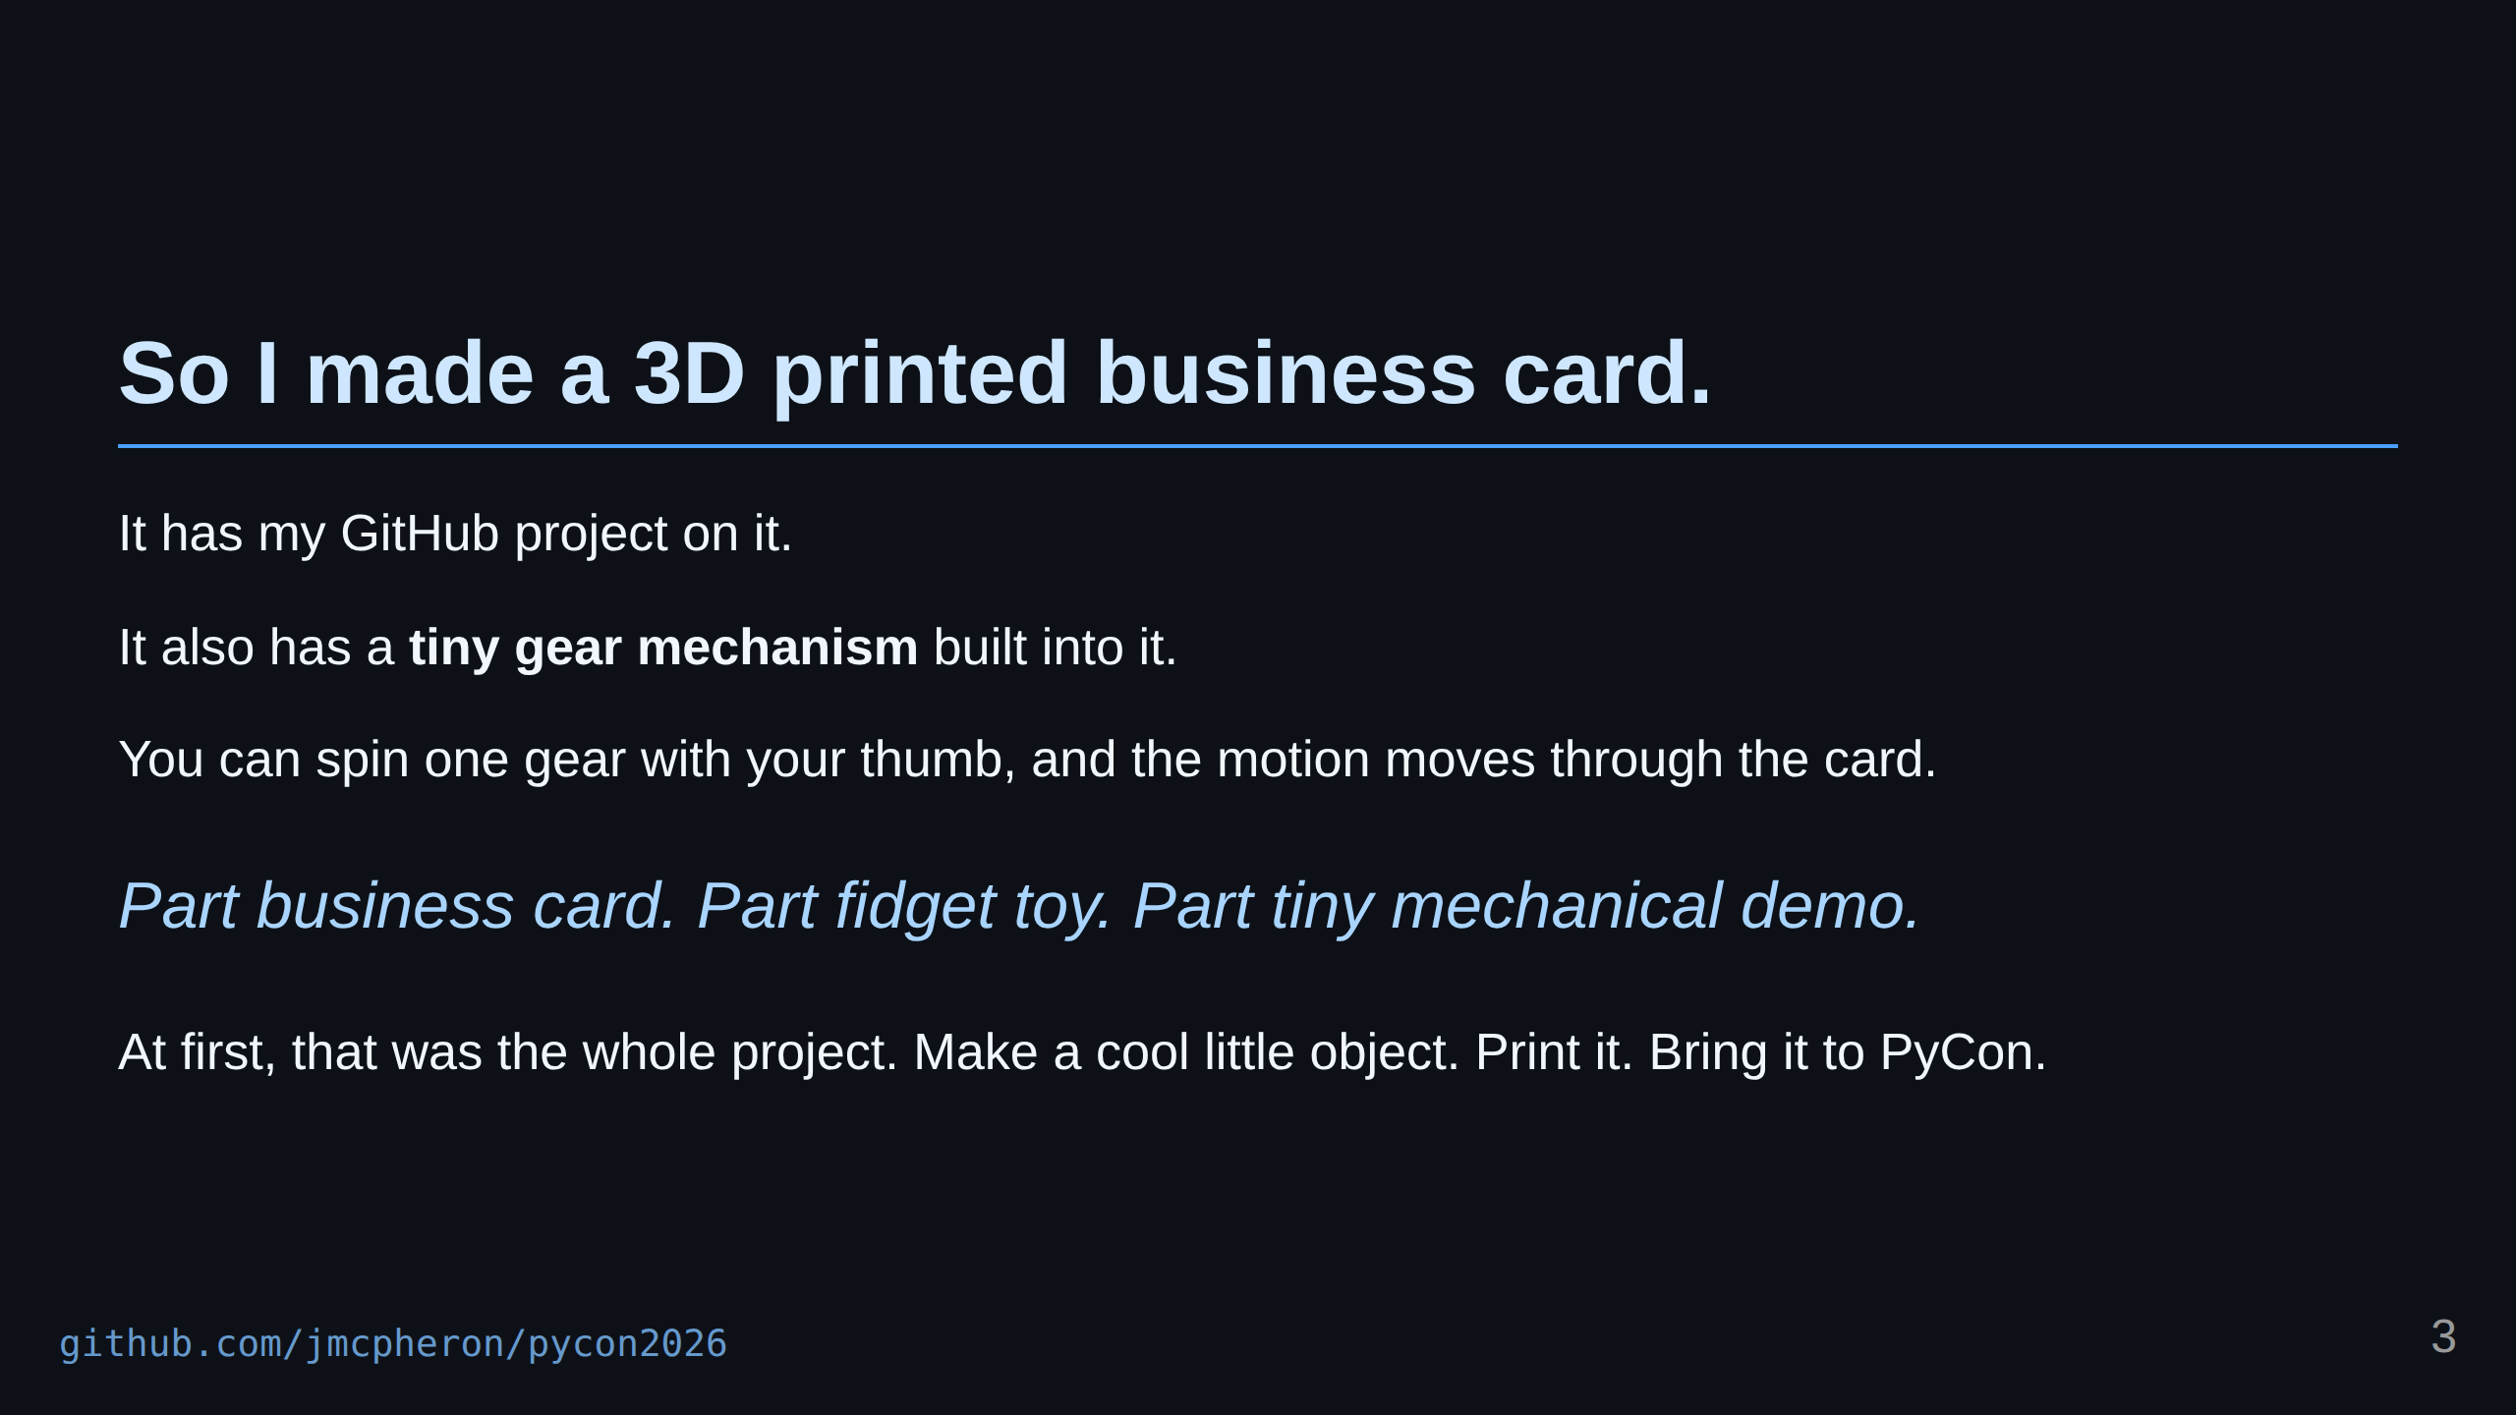
Notes:
It has my GitHub project on it, but it also has a tiny gear mechanism built into it. You can spin one gear with your thumb, and the motion moves through the card. It is part business card, part fidget toy, and part tiny mechanical demo. At first, that was the whole project. Make a cool little object. Print it. Bring it to PyCon. Use it as an excuse to talk to people.

Slide 4
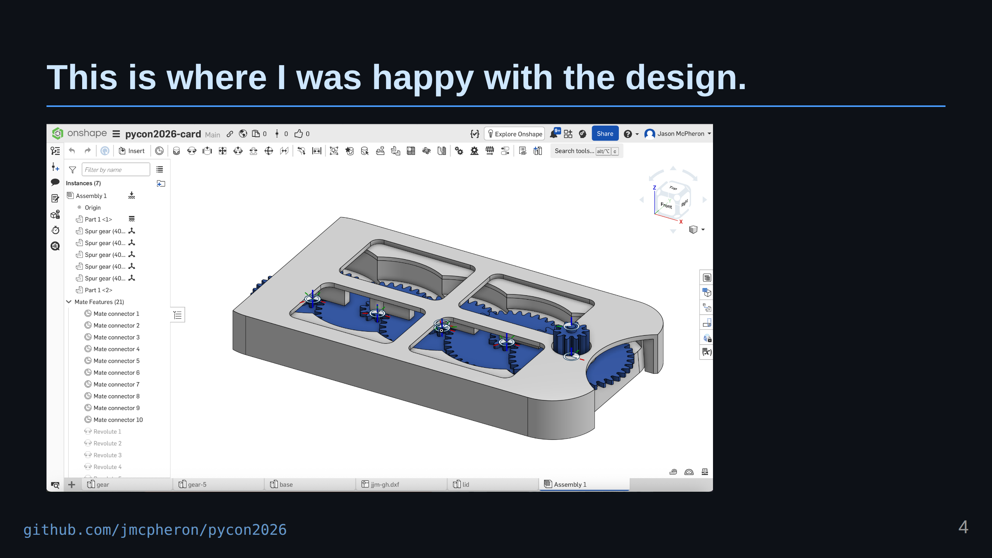
Notes:
The design started in Onshape. Parts, mate connectors, revolute joints so the gears actually spin, even the mesh ratios set up so Onshape knows how they drive each other. When I got to this point — assembly done, gears moving, lid fitting — I was just happy with it as a 3D design. That felt like the project. And then I had the thought that probably gets a lot of us into trouble: "This is nice, but how do I force Python into this?" What could I actually do with it if I exported it and dropped it in a repo? How much Python tooling could I throw at a STEP file and get something interesting out?

Slide 5
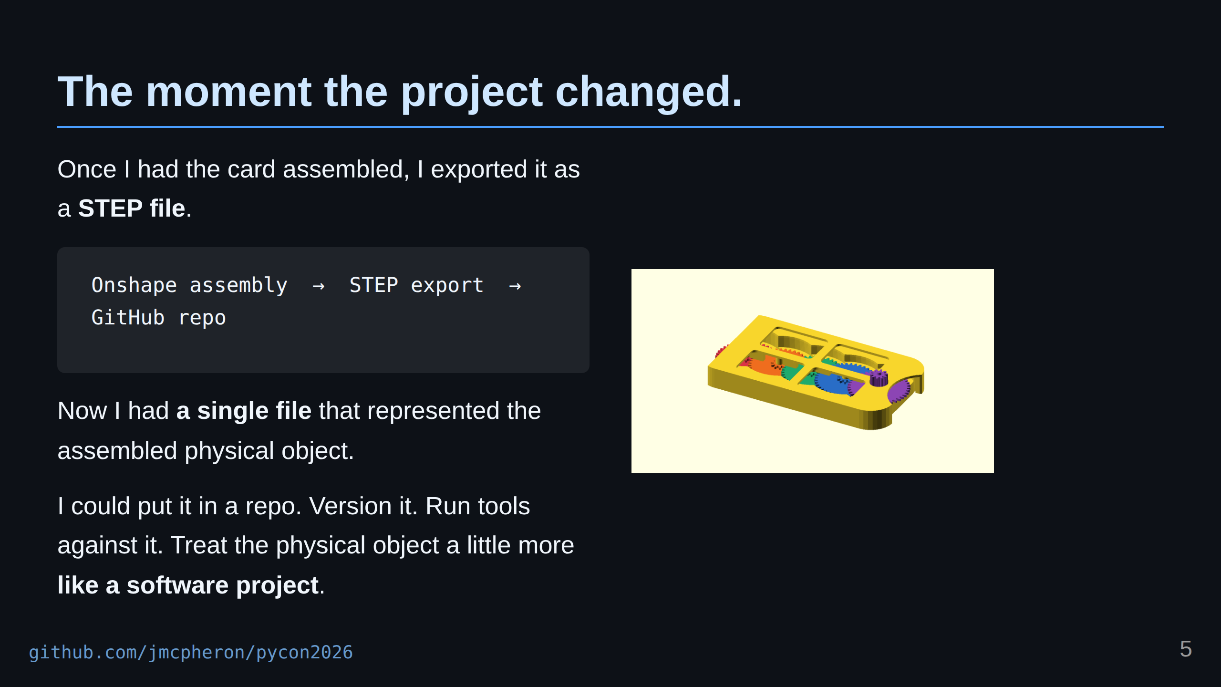
Notes:
Once I had the card assembled, I exported it as a STEP file. That was the moment where the project changed for me. Because now I had a single file that represented the assembled physical object. I could put that file in a GitHub repo. I could version it. I could run tools against it. I could start treating the physical object a little more like a software project.

Slide 6
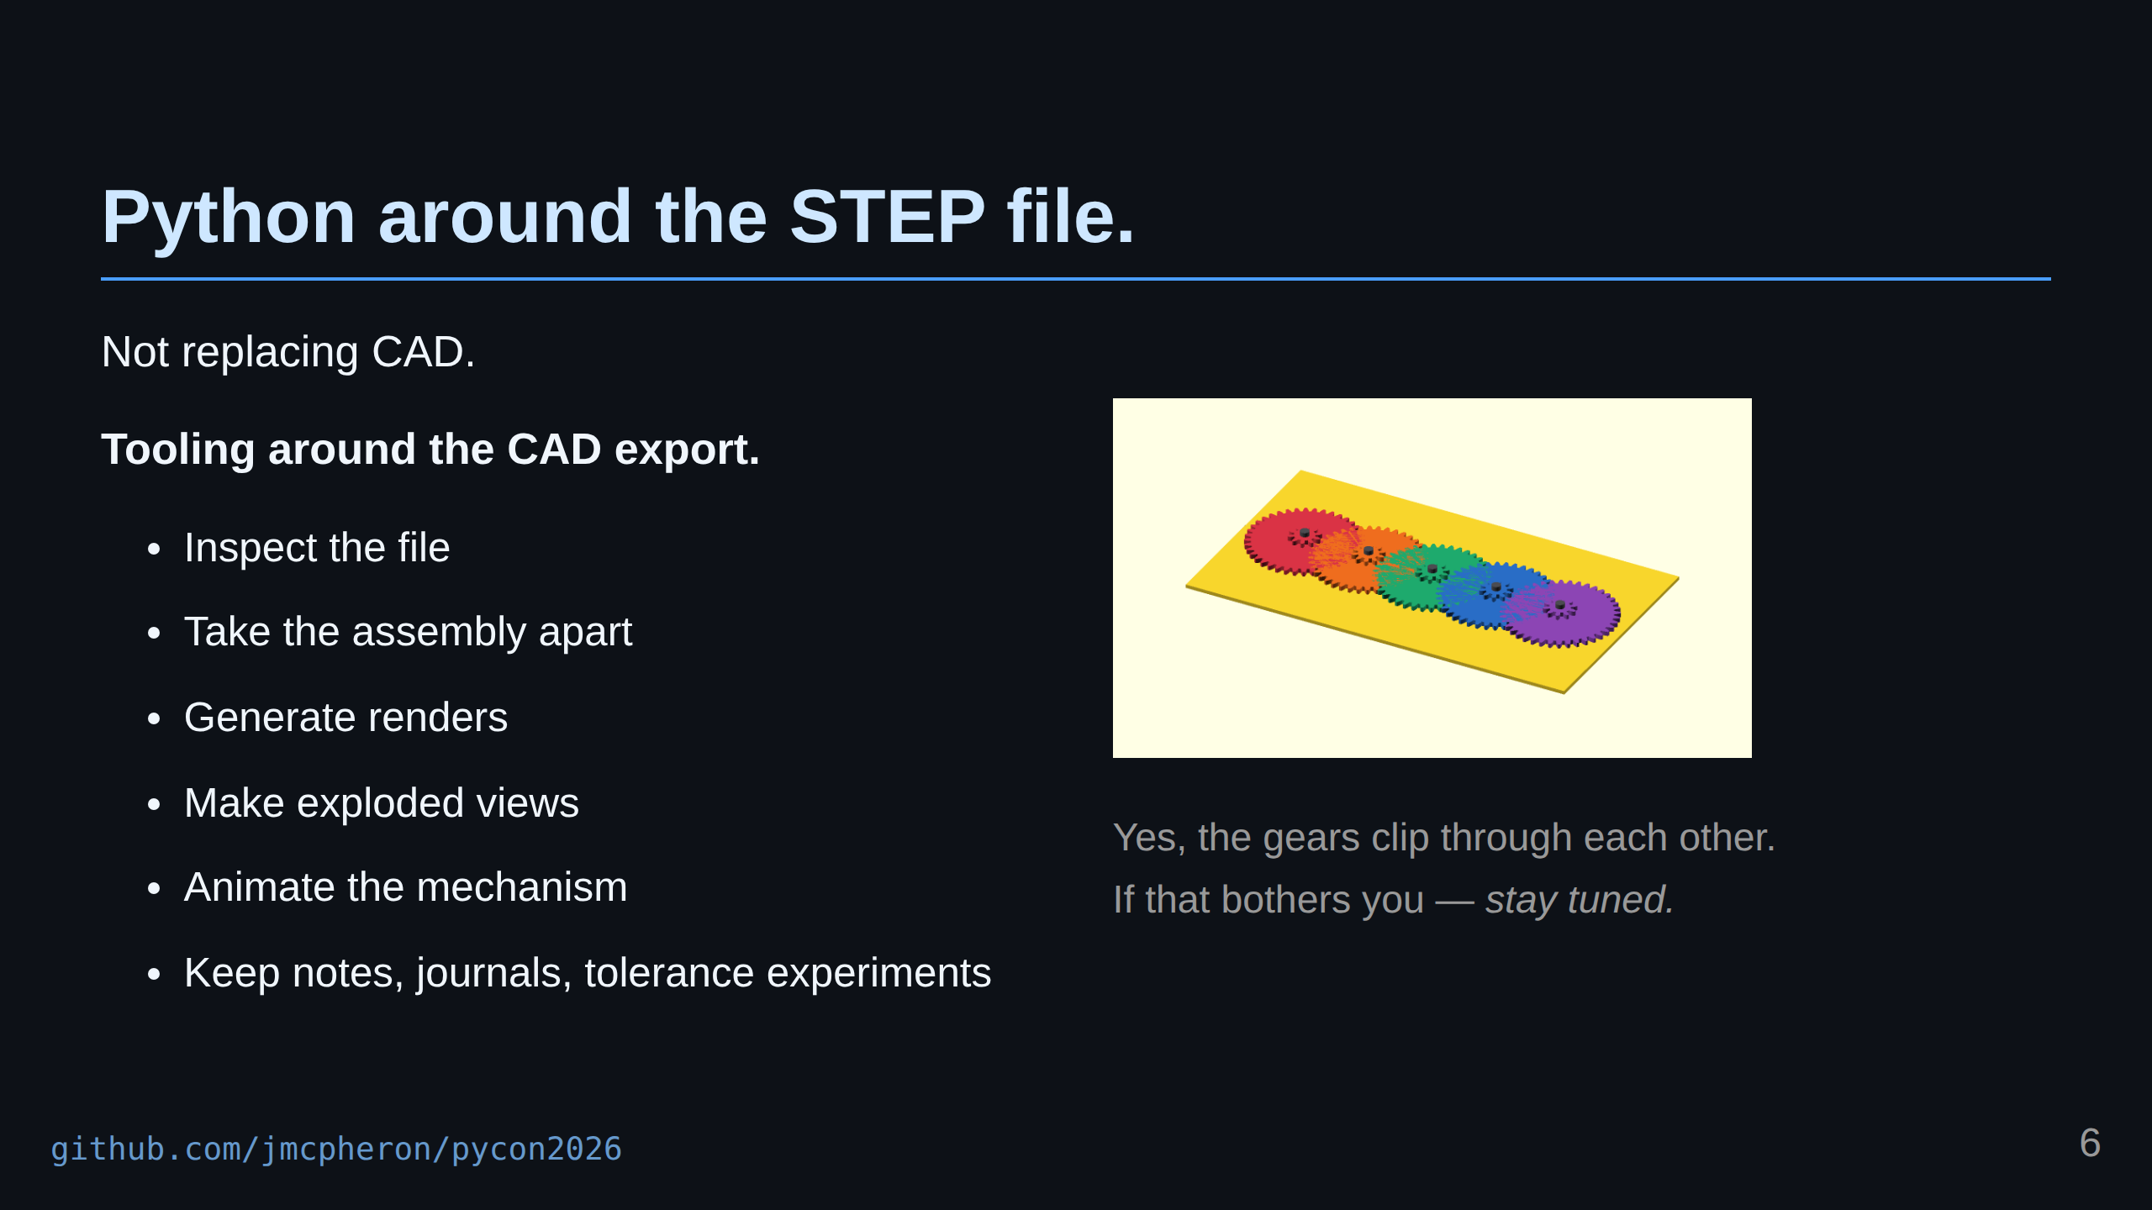
Notes:
So the Python part became less about replacing CAD, and more about building tooling around the CAD export. The design still happens in Onshape. But once the STEP file is in the repo, Python can start doing useful things around it. Quick aside on this GIF: yes, the gears are clipping through each other. The render does not know about the mesh ratios, so each gear just spins at the same rate. If that bothers you, hang on — I'll come back to it in a minute. It can inspect the file. It can help take the assembly apart. It can generate renders. It can make exploded views. It can create animated GIFs that show the mechanism moving. And it can help keep track of all the little notes around the object: explainers, development journals, tolerance problems, print settings, experiments, and the general story of how the thing changed over time. That became the real project. Not just the card itself, but the workflow around the card.

Slide 7
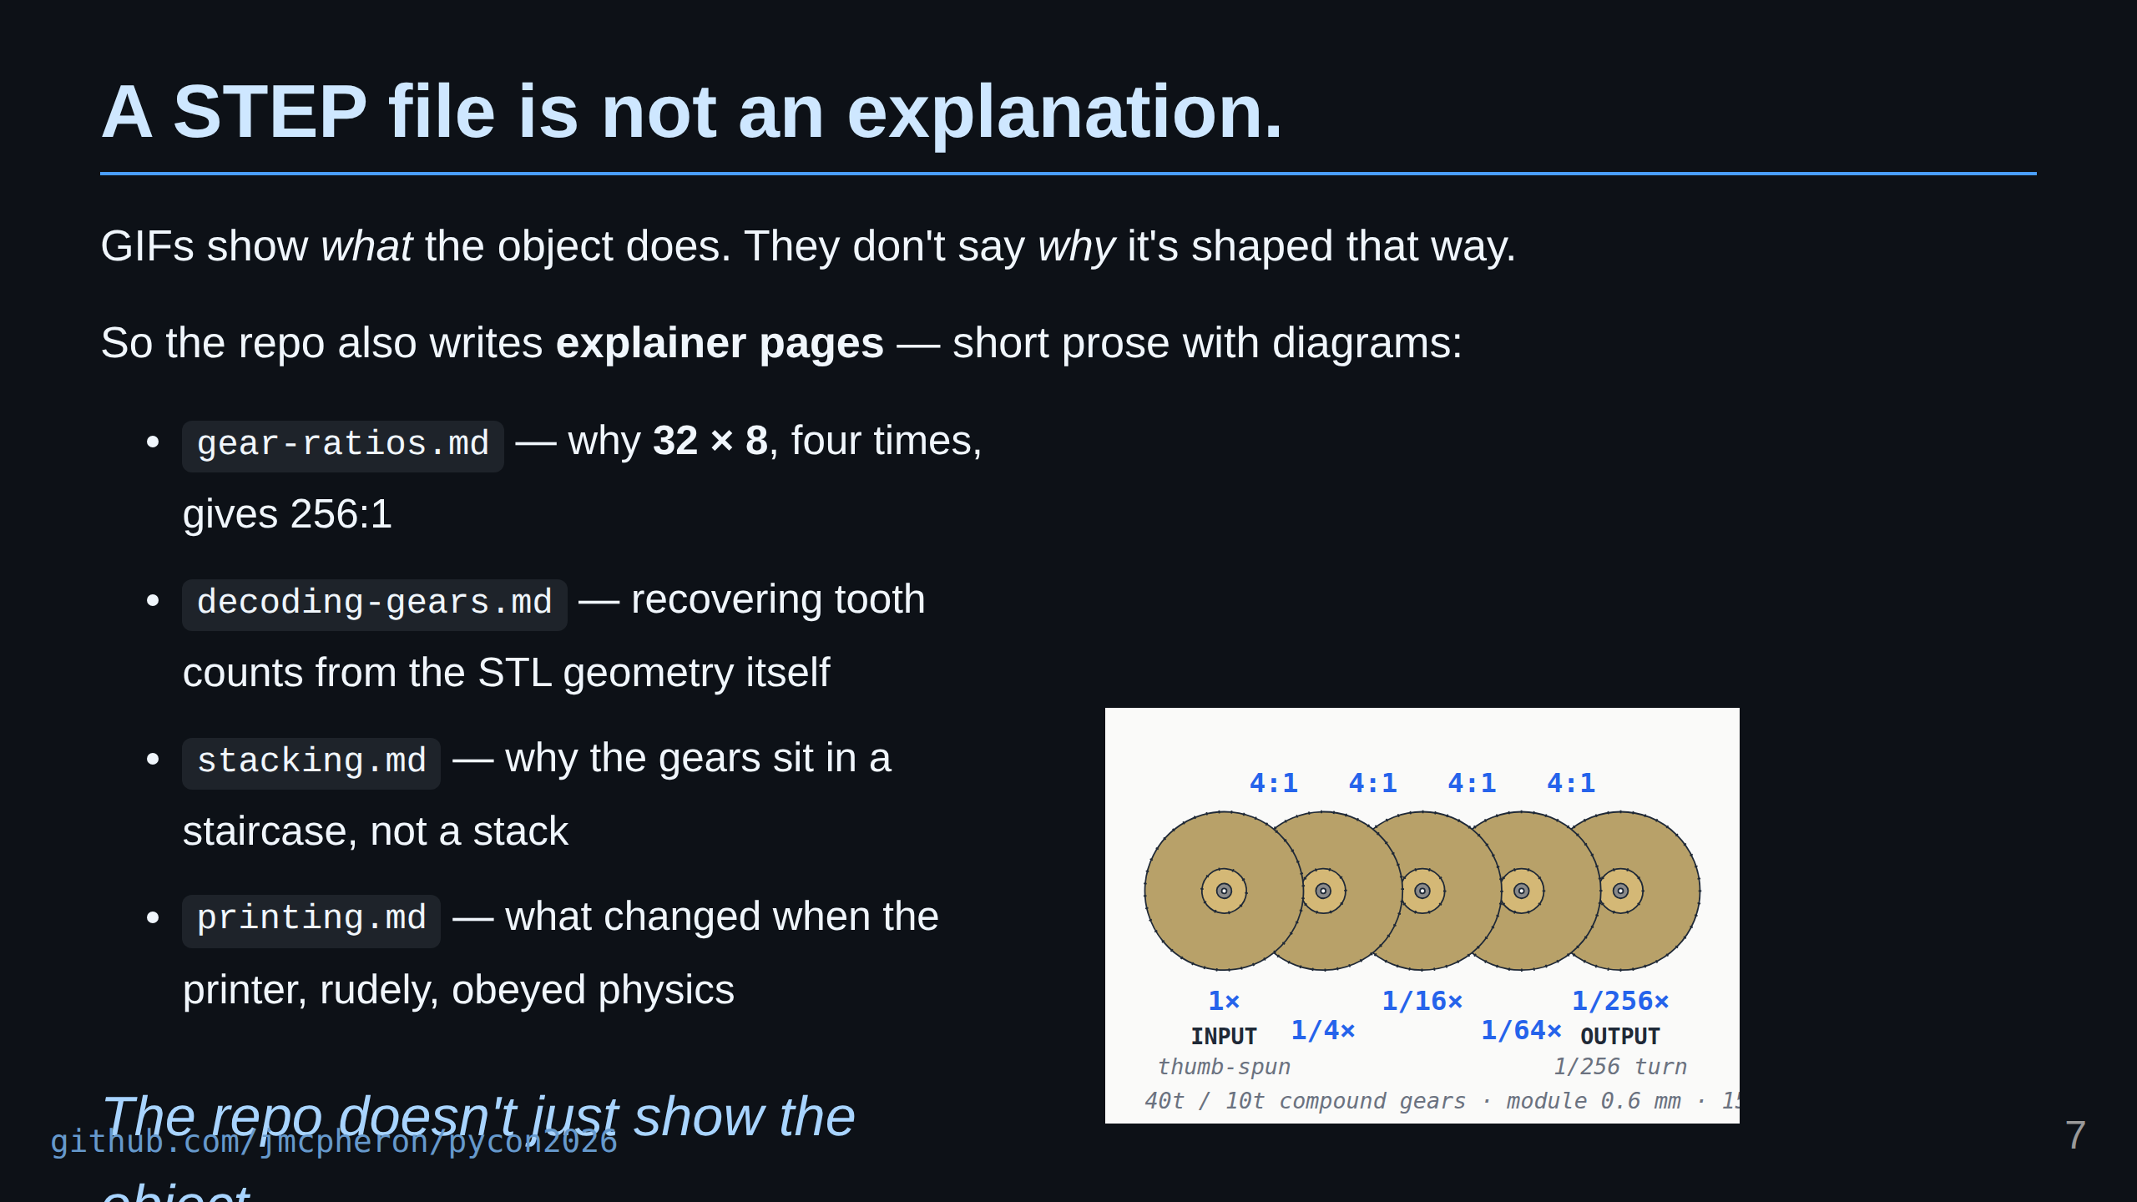
Notes:
A GIF is great, but it only shows what the object does. It does not tell you why it is shaped the way it is. Why those tooth counts. Why those ratios. Why the gears are stacked the way they are. So alongside the renders, the repo also writes explainer pages. Short prose with diagrams. Why 32 times 8, four times over, gives 256 to 1. How you can recover the tooth counts from the STL geometry itself, after the fact. Why the gears sit in a staircase instead of a clean stack. And what had to change when the printer, very rudely, obeyed physics. The renders are the gallery. The explainers are the museum placard next to it.

Slide 8
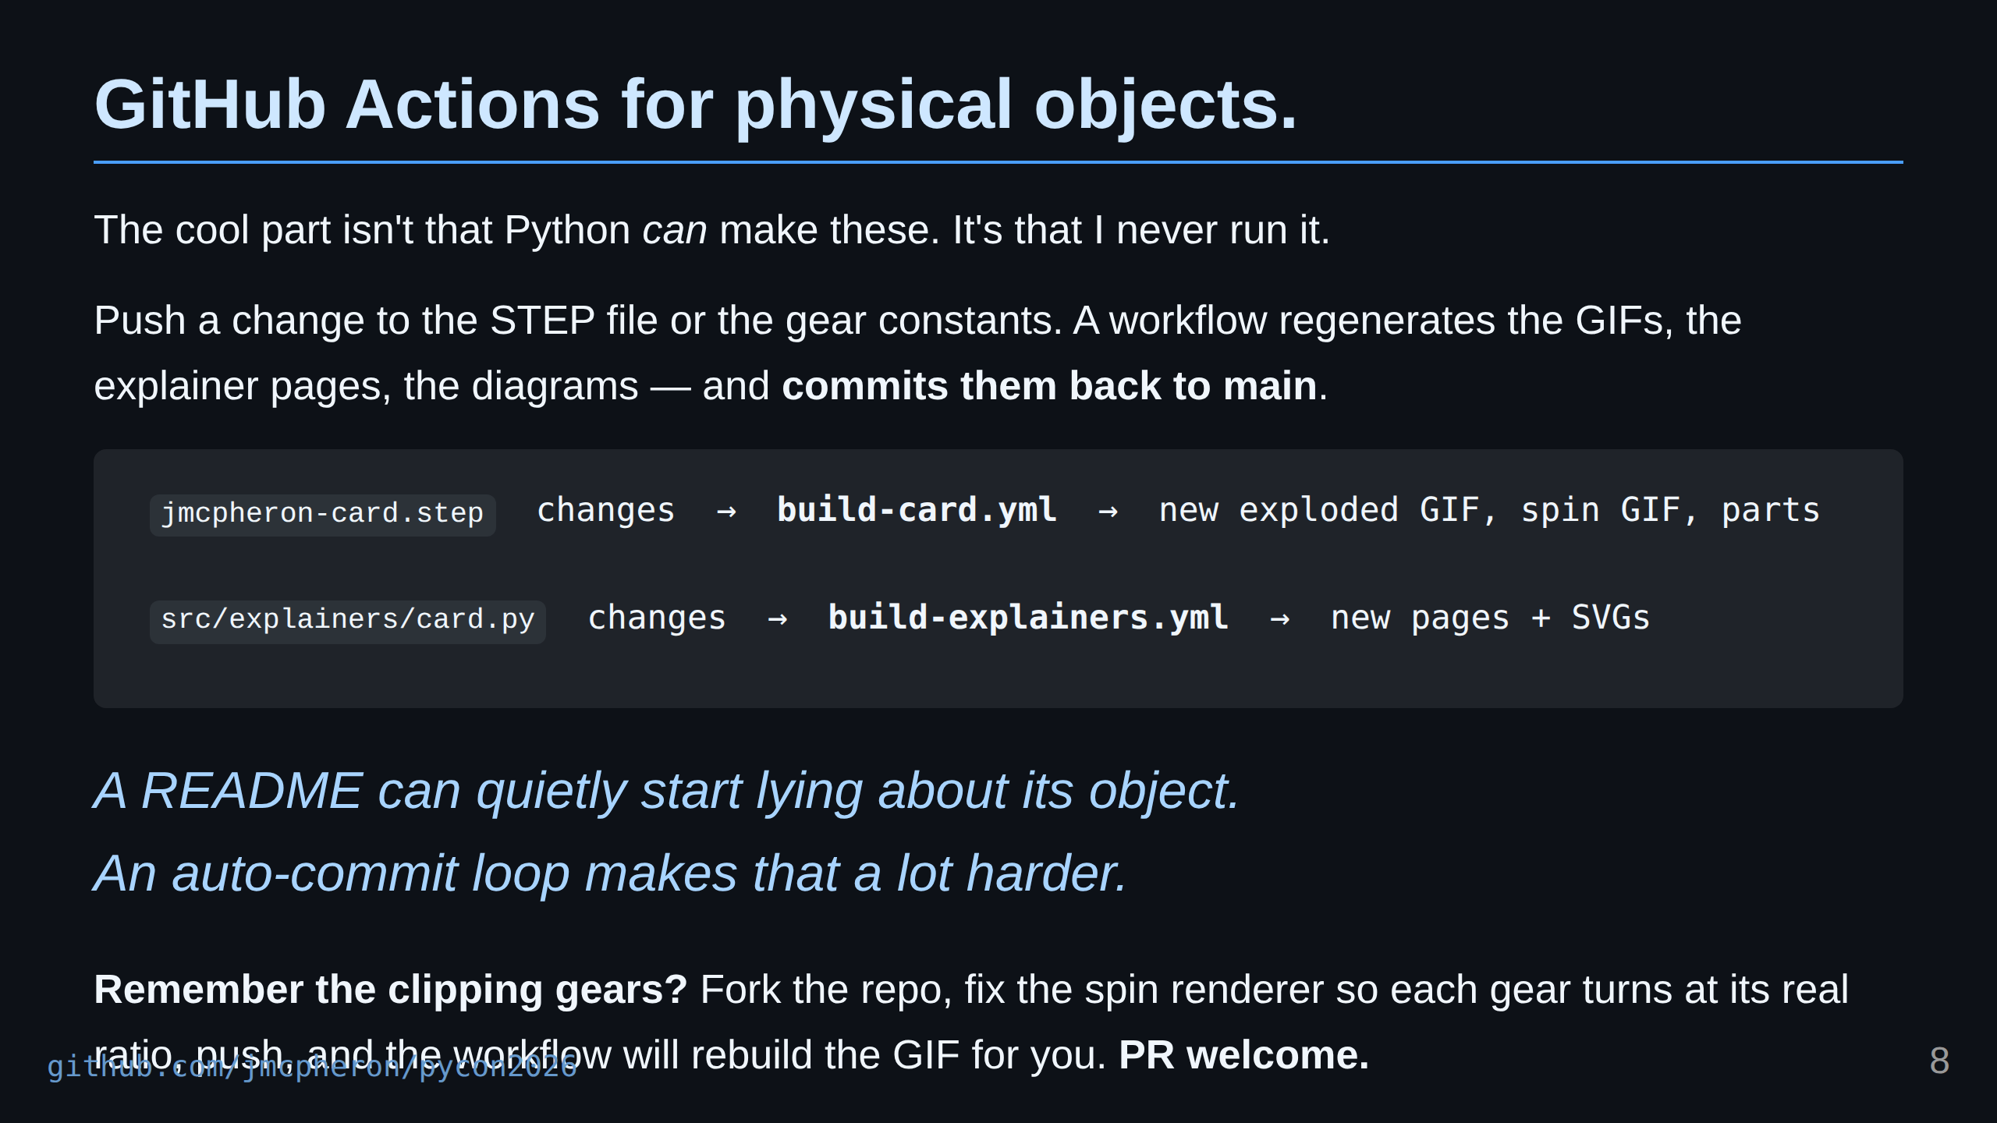
Notes:
Here is the part I actually like about using GitHub Actions for this. It is not that Python can make renders and exploded views and diagrams. We already saw that. It is that I almost never run any of it. When I push a change to the STEP file, a workflow runs in the cloud, regenerates the exploded GIF and the spinning GIF, and commits the new files back to main. When I push a change to the gear constants in card.py, a different workflow rebuilds every explainer page and every SVG, and commits those back too. And here is the open invitation. Remember the spin GIF where the gears clip through each other? That is a real, small, fixable bug in the renderer. Fork the repo, fix it so each gear turns at its own ratio, push it up, and the workflow will rebuild the GIF on its own. I would genuinely love a PR. Screenshots get stale. Documentation gets stale. A repo can quietly start lying about the object it contains. An auto-commit loop is my attempt to make that a little harder.

Slide 9
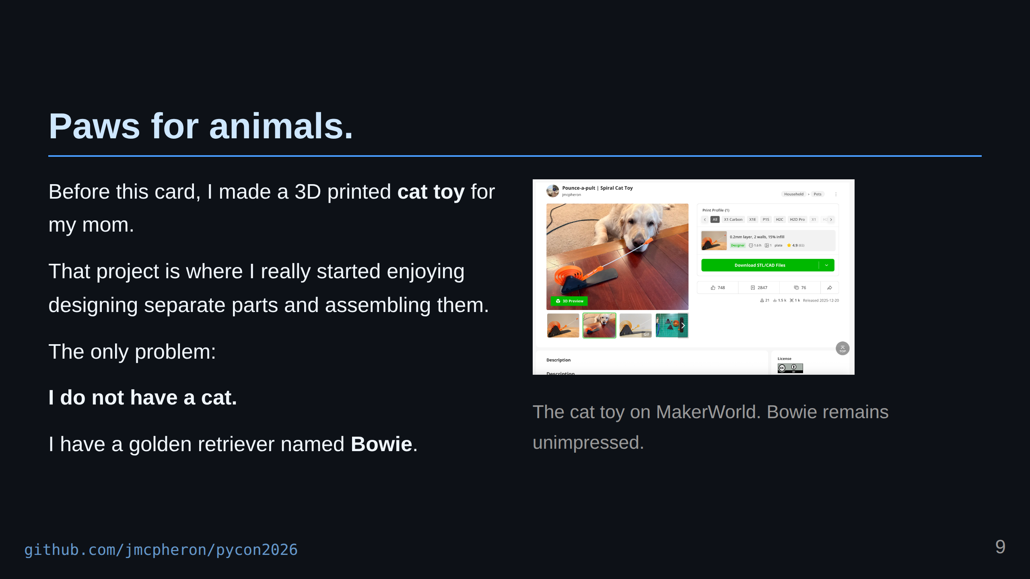
Notes:
Before this card, I had another little Onshape project. For Christmas, my mom asked me to design a 3D printed cat toy. That project is where I really started learning how much I enjoy making separate parts in Onshape and then assembling them into a complete object. There is something extremely satisfying about designing individual pieces, bringing them together, and then seeing the assembled product. It feels like the model becomes real before you ever print it. The only problem is that I do not have a cat. I have a golden retriever named Bowie. But that cat toy became useful for the Python side of the project too. It was a different STEP file. A different object. A different assembly. And I could try running it through a similar workflow. That helped me think about whether I was building tools for one very specific business card, or whether I was building a more general little pipeline for understanding 3D projects.

Slide 10
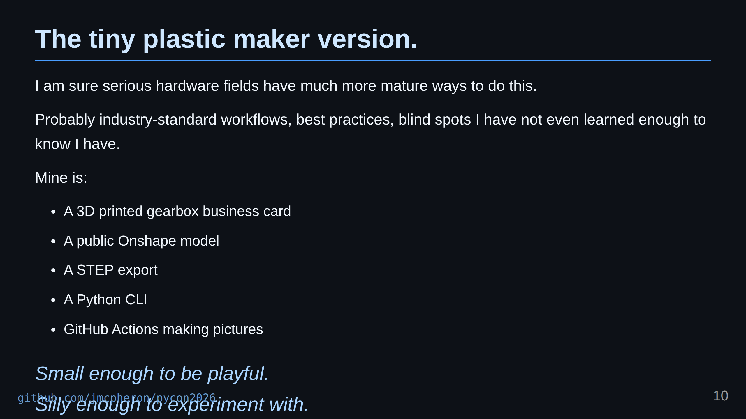
Notes:
I do not want to oversell this. I am sure that in serious hardware, robotics, aerospace, manufacturing, and embedded systems, there are much more mature ways to do this. There are probably industry-standard workflows, best practices, blind spots I have not even learned enough to know I have, and whole categories of tooling that solve parts of this properly. My version is the tiny plastic maker version. It is a 3D printed gearbox business card, a public Onshape model, a STEP export, a Python CLI, and GitHub Actions making pictures. But that is what I like about it. It is small enough to be playful. It is silly enough to experiment with. And it points at a serious idea.

Slide 11
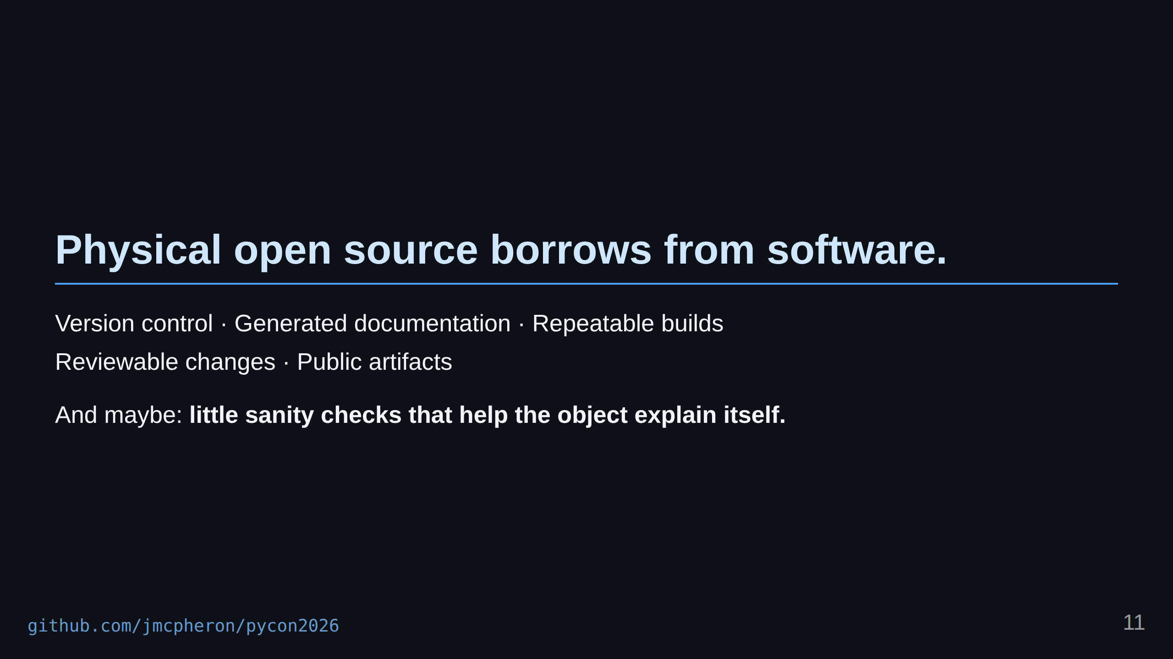

Slide 12
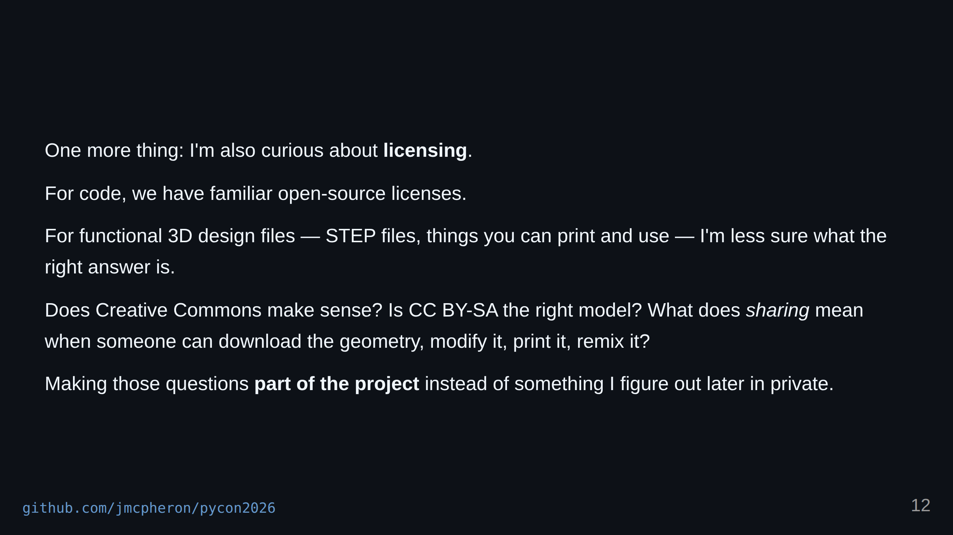
Notes:
Physical open-source projects can borrow some habits from software. Version control. Generated documentation. Repeatable builds. Reviewable changes. Public artifacts. And maybe even little sanity checks that help the object explain itself. I am also interested in the licensing side of this. For code, we have a pretty familiar set of open-source licenses. For 3D design files, especially functional objects, I am less sure what the right answer is. Does Creative Commons make sense for STEP files? Is CC BY-SA the right model? What does sharing mean when someone can download the geometry, modify it, print it, remix it, or manufacture it? I do not have a perfect answer to that. But it is one of the reasons I like having the project public. It makes those questions part of the project instead of something I figure out later in private.

Slide 13
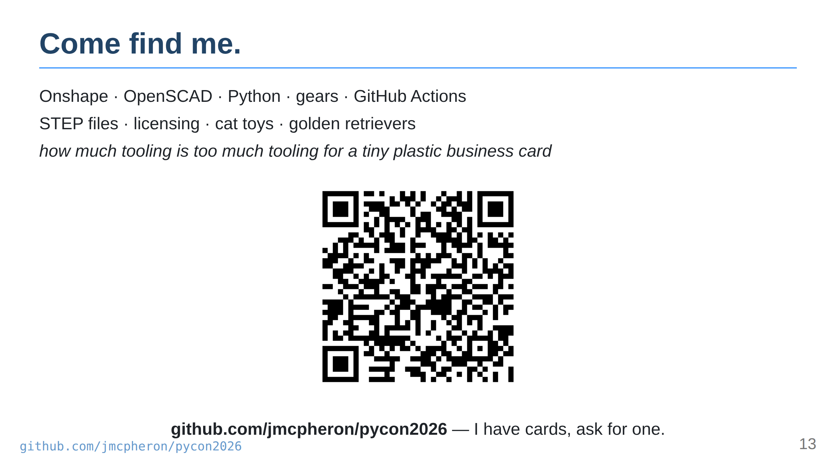
Notes:
So if you see me around, come find me. I can show you the card. We can talk about Onshape, OpenSCAD, Python, gears, GitHub Actions, STEP files, licensing, cat toys, or how much tooling is too much tooling for a tiny plastic business card. The repo is jmcpheron slash pycon2026. Thank you.

