Slide 1
A phone signs; another wallet pays
Sign and Burn
Onboarding and three shielded transactions
A signing browser holds passkey access and the console ledger.
A separate wallet pays for deployment and transaction gas.
Test network only. This walkthrough describes the implementation and its limits.
It is not an audit or a claim of protection against a compromised device.
01
Notes:
Source: notes/onboarding-walkthrough.md
Captured application commit: f13bf89
# A phone signs; another wallet pays
A sample Sign and Burn onboarding, followed by three shielded transactions. The signing browser
keeps the passkey access and the console's ledger. A second browser holds the wallet that pays gas.
The wallet can belong to you or to someone helping you. It does not become an owner of the Safe.
**Test network only.** This walkthrough describes the current implementation and its limits. It
is not an audit or a claim of protection against a compromised device.
Each screenshot is paired with a diagram of the signing phone, its passkey and page memory,
the data disclosed outside the page, and the seat's state. Gold marks the passkey; violet marks
private seeds; blue marks public values; coral marks signed approvals; green marks the chain.
The phone prompts and physical objects are explanatory illustrations, not native dialogs. A public
value is not a private seed. Click a diagram to read it at full size.

Slide 2
A phone signs; another wallet pays
A sample Sign and Burn onboarding, followed by three shielded transactions. The signing browser keeps the passkey access and the console's ledger. A second browser holds the wallet that pays gas. The wallet can belong to you or to someone helping you. It does not become an owner of the Safe.
Test network only. This walkthrough describes the current implementation and its limits. It is not an audit or a claim of protection against a compromised device.
Each screenshot is paired with a diagram of the signing phone, its passkey and page memory, the data disclosed outside the page, and the seat's state. Gold marks the passkey; violet marks private seeds; blue marks public values; coral marks signed approvals; green marks the chain. The phone prompts and physical objects are explanatory illustrations, not native dialogs. A public value is not a private seed. Zoom in to read the screenshots and diagrams at full size.
02
Notes:
Source: notes/onboarding-walkthrough.md
Captured application commit: f13bf89
A sample Sign and Burn onboarding, followed by three shielded transactions. The signing browser
keeps the passkey access and the console's ledger. A second browser holds the wallet that pays gas.
The wallet can belong to you or to someone helping you. It does not become an owner of the Safe.
**Test network only.** This walkthrough describes the current implementation and its limits. It
is not an audit or a claim of protection against a compromised device.
Each screenshot is paired with a diagram of the signing phone, its passkey and page memory,
the data disclosed outside the page, and the seat's state. Gold marks the passkey; violet marks
private seeds; blue marks public values; coral marks signed approvals; green marks the chain.
The phone prompts and physical objects are explanatory illustrations, not native dialogs. A public
value is not a private seed. Click a diagram to read it at full size.

Slide 3
About these screenshots
These are screenshots of the running page at application commit f13bf89, captured on 2026-10-09. The signing browser is Chromium at a phone width of 390 pixels, with no wallet and a virtual passkey. A separate browser context plays the payer. Both use local Anvil, chain 31337, with the project's pinned Base Sepolia contract bytecode. The published page uses Base Sepolia, chain 84532; the pictures therefore say Local Anvil. All accounts and approvals shown are disposable test data. The local build changes the console configuration, so its displayed fingerprint also differs from the published Base Sepolia image.
This is a phone-shaped browser rehearsal, not a test on an iPhone or Android device. The virtual passkey handles the native dialogs automatically. The screenshots do not show Face ID, Touch ID, a password manager dialog, or a real MetaMask confirmation. The buttons and screen states are real; the appearance and PRF support of those native prompts depend on your browser and authenticator. Recorded real-device checks are in the live test table.
03
Notes:
Source: notes/onboarding-walkthrough.md
Captured application commit: f13bf89
These are screenshots of the running page at application commit `f13bf89`, captured on 2026-10-09. The signing browser is Chromium
at a phone width of 390 pixels, with no wallet and a virtual passkey. A separate browser context
plays the payer. Both use local Anvil, chain 31337, with the project's pinned Base Sepolia contract
bytecode. The published page uses Base Sepolia, chain 84532; the pictures therefore say Local Anvil.
All accounts and approvals shown are disposable test data. The local build changes the console
configuration, so its displayed fingerprint also differs from the published Base Sepolia image.
This is a phone-shaped browser rehearsal, not a test on an iPhone or Android device. The virtual
passkey handles the native dialogs automatically. The screenshots do not show Face ID, Touch ID,
a password manager dialog, or a real MetaMask confirmation. The buttons and screen states are real;
the appearance and PRF support of those native prompts depend on your browser and authenticator.
Recorded real-device checks are in [the live test table](testing/live.md).

Slide 4
What you do, and when gas is needed
Step | On the signing phone | On the payer's device | Gas paid?
Create passkey | Approve the native creation prompt | Nothing | No
Prepare key 0 | Approve a passkey assertion with a PRF output | Nothing | No
Deploy | Copy the build request; wait | Review, connect wallet, confirm deployment | Yes, from the wallet
Fund | Copy the Safe address or reuse the build link | Confirm a transfer into the Safe | Yes, plus the test ETH sent
Each shielded transfer | Review, hold, approve one passkey assertion; copy approval link | Review the same approval; confirm its send | Yes, from the wallet
Retry a refused send | Keep the same approval and ledger; no new passkey tap | Send that existing approval again | Only when a transaction is actually sent and included
04
Notes:
Source: notes/onboarding-walkthrough.md
Captured application commit: f13bf89
Step | On the signing phone | On the payer's device | Gas paid?
Create passkey | Approve the native creation prompt | Nothing | No
Prepare key 0 | Approve a passkey assertion with a PRF output | Nothing | No
Deploy | Copy the build request; wait | Review, connect wallet, confirm deployment | Yes, from the wallet
Fund | Copy the Safe address or reuse the build link | Confirm a transfer into the Safe | Yes, plus the test ETH sent
Each shielded transfer | Review, hold, approve one passkey assertion; copy approval link | Review the same approval; confirm its send | Yes, from the wallet
Retry a refused send | Keep the same approval and ledger; no new passkey tap | Send that existing approval again | Only when a transaction is actually sent and included

Slide 5
What you do, and when gas is needed
The Safe supplies the transfer amount. The payer supplies gas. If a usable wallet is on the phone, connect it there and use the local Build or Send path instead of copying a link. The passkey, PRF, console and disclosure order are the same; the extra payer browser is optional.
05
Notes:
Source: notes/onboarding-walkthrough.md
Captured application commit: f13bf89
The Safe supplies the transfer amount. The payer supplies gas. If a usable wallet is on the phone,
connect it there and use the local Build or Send path instead of copying a link. The passkey,
PRF, console and disclosure order are the same; the extra payer browser is optional.

Slide 6
First, which key is which?
“Signing exposes the private key” needs a distinction. Normal passkey use does not export the passkey's private key. This application does receive other secret material through the PRF extension.
06
Notes:
Source: notes/onboarding-walkthrough.md
Captured application commit: f13bf89
“Signing exposes the private key” needs a distinction. Normal passkey use does not export the
passkey's private key. This application does receive other secret material through the PRF extension.

Slide 7
First, which key is which? (1)
Part | What it does | What the page or others can see
Passkey P-256 private key | Makes the WebAuthn curve signature | WebAuthn does not return it to the page. The authenticator or credential provider holds it.
Passkey P-256 public key | Lets Safe's passkey signer check that signature | Returned at passkey creation; public on-chain when its signer is deployed. It is not the rotating key.
Passkey PRF secret | Produces repeatable outputs for the requested salts | The page gets outputs, not this underlying secret.
seed(n) | Produces all 67 private hash-chain starting values for one-time key n | Returned to the signing page by the PRF. It passes through page and console memory. This is private signing material.
07
Notes:
Source: notes/onboarding-walkthrough.md
Captured application commit: f13bf89
Part | What it does | What the page or others can see
Passkey P-256 private key | Makes the WebAuthn curve signature | WebAuthn does not return it to the page. The authenticator or credential provider holds it.
Passkey P-256 public key | Lets Safe's passkey signer check that signature | Returned at passkey creation; public on-chain when its signer is deployed. It is not the rotating key.
Passkey PRF secret | Produces repeatable outputs for the requested salts | The page gets outputs, not this underlying secret.
seed(n) | Produces all 67 private hash-chain starting values for one-time key n | Returned to the signing page by the PRF. It passes through page and console memory. This is private signing material.

Slide 8
First, which key is which? (2)
Part | What it does | What the page or others can see
One-time signature | Authorizes this approval and its next fingerprint | Reveals 67 selected positions along the private hash chains. A position can be a chain's starting value. It does not disclose the whole seed.
Full one-time public key | The 67 hash-chain endpoints | Anyone with the message and one-time signature can compute these endpoints.
One-time fingerprint | Hash commitment to those endpoints, with their context | Stored on-chain before that key signs. It is not the full public key.
Gas wallet | Sends the prepared calls and pays their gas | Has its own account and keys. It is separate from the passkey and the seat's one-time keys.
08
Notes:
Source: notes/onboarding-walkthrough.md
Captured application commit: f13bf89
Part | What it does | What the page or others can see
One-time signature | Authorizes this approval and its next fingerprint | Reveals 67 selected positions along the private hash chains. A position can be a chain's starting value. It does not disclose the whole seed.
Full one-time public key | The 67 hash-chain endpoints | Anyone with the message and one-time signature can compute these endpoints.
One-time fingerprint | Hash commitment to those endpoints, with their context | Stored on-chain before that key signs. It is not the full public key.
Gas wallet | Sends the prepared calls and pays their gas | Has its own account and keys. It is separate from the passkey and the seat's one-time keys.

Slide 9
First, which key is which?
The passkey is used repeatedly. The one-time key is used for one approval only. The next sections follow key 0, then key 1, then key 2.
09
Notes:
Source: notes/onboarding-walkthrough.md
Captured application commit: f13bf89
The passkey is used repeatedly. The one-time key is used for one approval only. The next sections
follow key 0, then key 1, then key 2.

Slide 10
1. On the phone: make the passkey
Press Make a passkey. Expect your browser or credential provider to ask where to create it and to require user verification, such as a face, fingerprint or PIN.
10
Notes:
Source: notes/onboarding-walkthrough.md
Captured application commit: f13bf89
Press **Make a passkey**. Expect your browser or credential provider to ask where to create it and
to require user verification, such as a face, fingerprint or PIN.

Slide 11
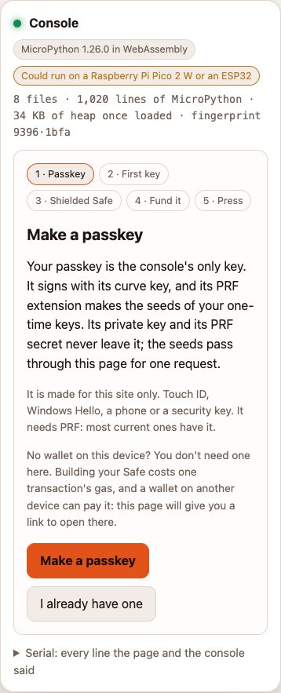
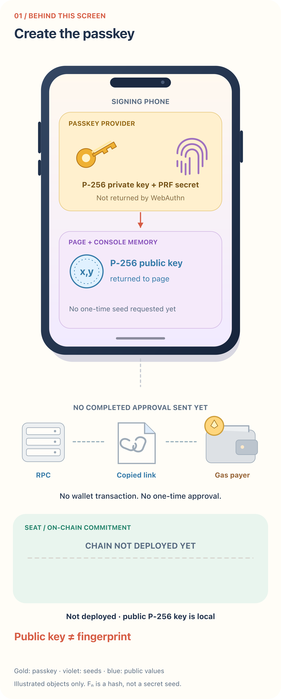
make a passkey
What the user sees
What happens behind it
11
Notes:
Source: notes/onboarding-walkthrough.md
Captured application commit: f13bf89
1. On the phone: make the passkey
screenshots/onboarding/01-phone-passkey.png
infographics/onboarding/01-phone-passkey.svg

Slide 12
1. On the phone: make the passkey
The page calls navigator.credentials.create({ publicKey: ... }). It asks for P-256 (alg: -7), a discoverable credential, required user verification and the prf extension. It records the credential ID, public coordinates and site domain; it does not record the passkey private key. The passkey belongs to the site's domain. A passkey made on localhost is not one for signandburn.app.
Gas: none. On-chain change: none. Exposure: the page receives the passkey public key and credential metadata. No one-time approval has been made.
“I already have one” is a different path. The page asks for two ordinary WebAuthn assertions to recover the existing passkey's P-256 public key. Those are not two signatures with a one-time key. A synced passkey does not sync this application's ledger: do not alternate signing browsers for one seat while an approval might be waiting.
12
Notes:
Source: notes/onboarding-walkthrough.md
Captured application commit: f13bf89
The page calls `navigator.credentials.create({ publicKey: ... })`. It asks for P-256 (`alg: -7`),
a discoverable credential, required user verification and the `prf` extension. It records the
credential ID, public coordinates and site domain; it does not record the passkey private key.
The passkey belongs to the site's domain. A passkey made on localhost is not one for signandburn.app.
**Gas:** none. **On-chain change:** none. **Exposure:** the page receives the passkey public key and
credential metadata. No one-time approval has been made.
“I already have one” is a different path. The page asks for two ordinary WebAuthn assertions to
recover the existing passkey's P-256 public key. Those are not two signatures with a one-time key.
A synced passkey does not sync this application's ledger: do not alternate signing browsers for
one seat while an approval might be waiting.

Slide 13
2. On the phone: prepare the first one-time key
Press Tap to make key 0. This is another user-verification prompt, not a wallet transaction.
13
Notes:
Source: notes/onboarding-walkthrough.md
Captured application commit: f13bf89
Press **Tap to make key 0**. This is another user-verification prompt, not a wallet transaction.

Slide 14
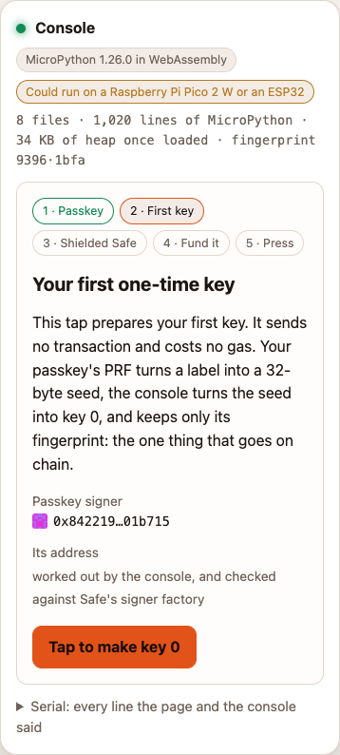
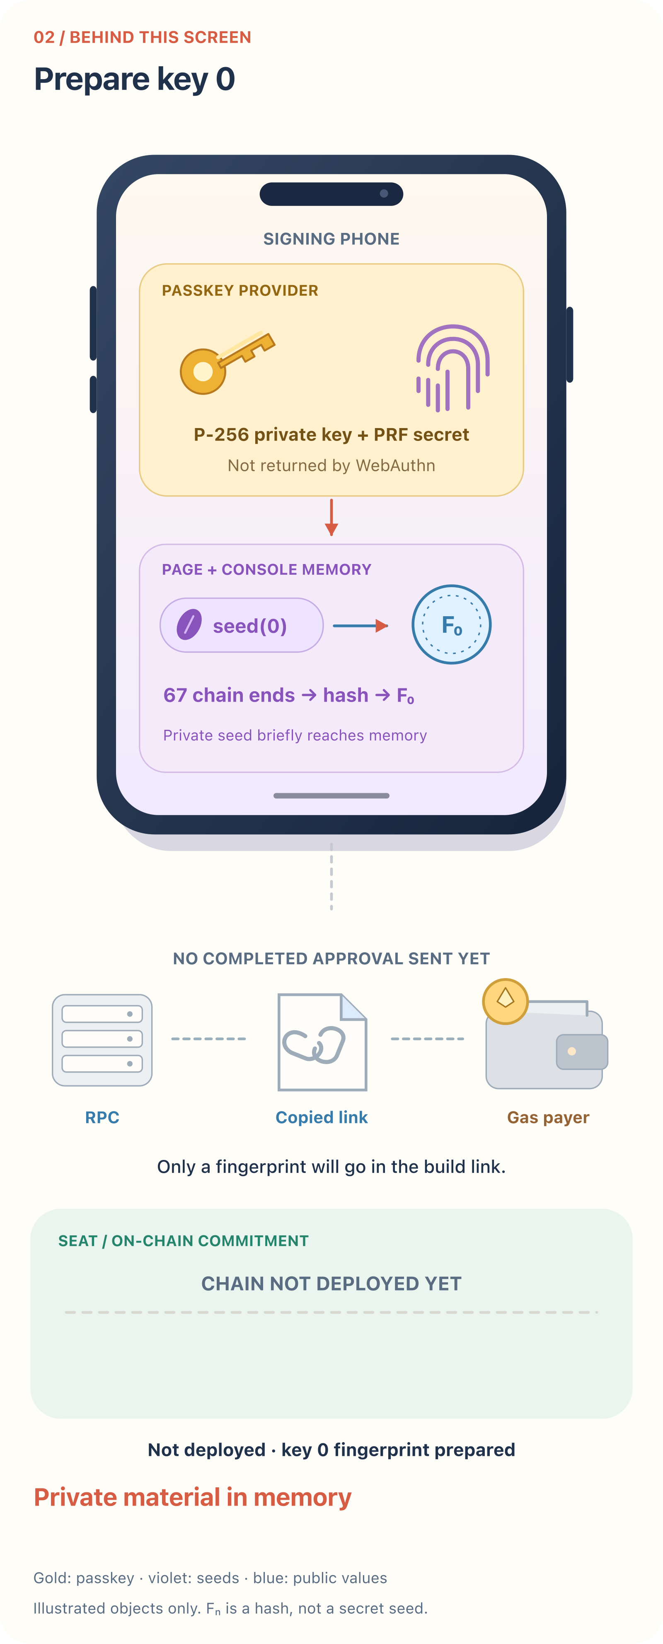
prepare key 0
What the user sees
What happens behind it
14
Notes:
Source: notes/onboarding-walkthrough.md
Captured application commit: f13bf89
2. On the phone: prepare the first one-time key
screenshots/onboarding/02-phone-first-key.png
infographics/onboarding/02-phone-first-key.svg

Slide 15
2. On the phone: prepare the first one-time key
The page calls navigator.credentials.get({ publicKey: ... }) with a fresh challenge and one PRF salt for key 0. The PRF returns seed(0). The console derives 67 chain starts, hashes each to its endpoint, then hashes the endpoints into key 0's fingerprint. The first-key setup uses the PRF output; it does not make a one-time transaction signature.
Gas: none. On-chain change: none. Exposure: seed(0) is briefly in the signing page and console. The browser record keeps the fingerprint and predicted addresses, not the seed. A hostile page or extension able to read that memory could capture the seed at this point, before any shielded transaction exists. Public-key disclosure is not the only exposure to consider.
A missing PRF result stops this path. Device support is something to test, not something a phone screenshot establishes.
15
Notes:
Source: notes/onboarding-walkthrough.md
Captured application commit: f13bf89
The page calls `navigator.credentials.get({ publicKey: ... })` with a fresh challenge and one PRF
salt for key 0. The PRF returns `seed(0)`. The console derives 67 chain starts, hashes each to its
endpoint, then hashes the endpoints into key 0's fingerprint. The first-key setup uses the PRF
output; it does not make a one-time transaction signature.
**Gas:** none. **On-chain change:** none. **Exposure:** `seed(0)` is briefly in the signing page and
console. The browser record keeps the fingerprint and predicted addresses, not the seed.
A hostile page or extension able to read that memory could capture the seed at this point, before
any shielded transaction exists. Public-key disclosure is not the only exposure to consider.
A missing PRF result stops this path. Device support is something to test, not something a phone
screenshot establishes.

Slide 16
3. On the phone: give someone the build request
The addresses are worked out before deployment. Connect a wallet remains available. If this phone has no wallet, press Copy link and send the plain URL to the person paying.
16
Notes:
Source: notes/onboarding-walkthrough.md
Captured application commit: f13bf89
The addresses are worked out before deployment. **Connect a wallet** remains available. If this
phone has no wallet, press **Copy link** and send the plain URL to the person paying.

Slide 17
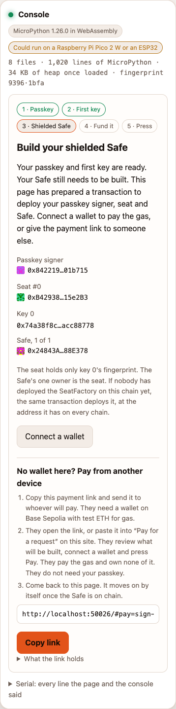
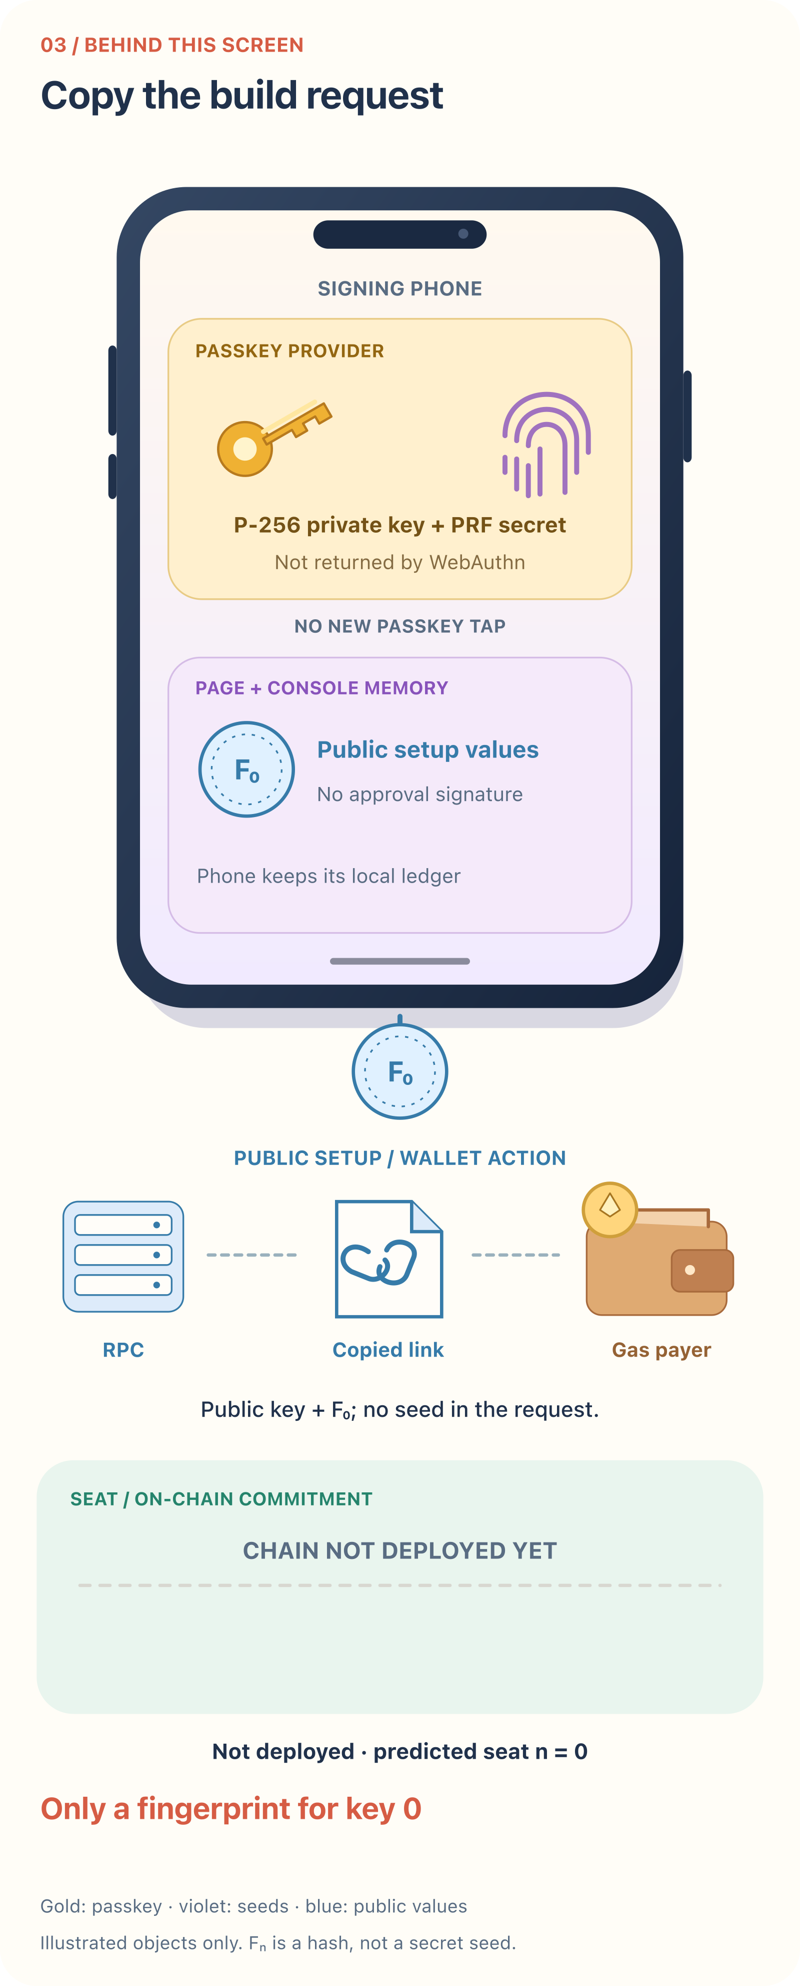
the build request and copy link
What the user sees
What happens behind it
17
Notes:
Source: notes/onboarding-walkthrough.md
Captured application commit: f13bf89
3. On the phone: give someone the build request
screenshots/onboarding/03-phone-build-link.png
infographics/onboarding/03-phone-build-link.svg

Slide 18
3. On the phone: give someone the build request
This is an unsigned build request. It holds the passkey's public coordinates, seat number, key 0's fingerprint and chain identifier. It does not contain a seed or a one-time approval signature. The payer's page rebuilds the calls and addresses from those values rather than accepting arbitrary calls from the link.
Gas: still none. Exposure: public setup values go to whoever receives the link, including the messaging service used to send it. A build link is different from the signed approval link below.
18
Notes:
Source: notes/onboarding-walkthrough.md
Captured application commit: f13bf89
This is an unsigned build request. It holds the passkey's public coordinates, seat number, key 0's
fingerprint and chain identifier. It does not contain a seed or a one-time approval signature.
The payer's page rebuilds the calls and addresses from those values rather than accepting arbitrary
calls from the link.
**Gas:** still none. **Exposure:** public setup values go to whoever receives the link, including
the messaging service used to send it. A build link is different from the signed approval link below.

Slide 19
4. On the payer's device: review, connect, deploy
The payer opens the link, or opens Pay for a request on this site and pastes it.
19
Notes:
Source: notes/onboarding-walkthrough.md
Captured application commit: f13bf89
The payer opens the link, or opens **Pay for a request** on this site and pastes it.

Slide 20
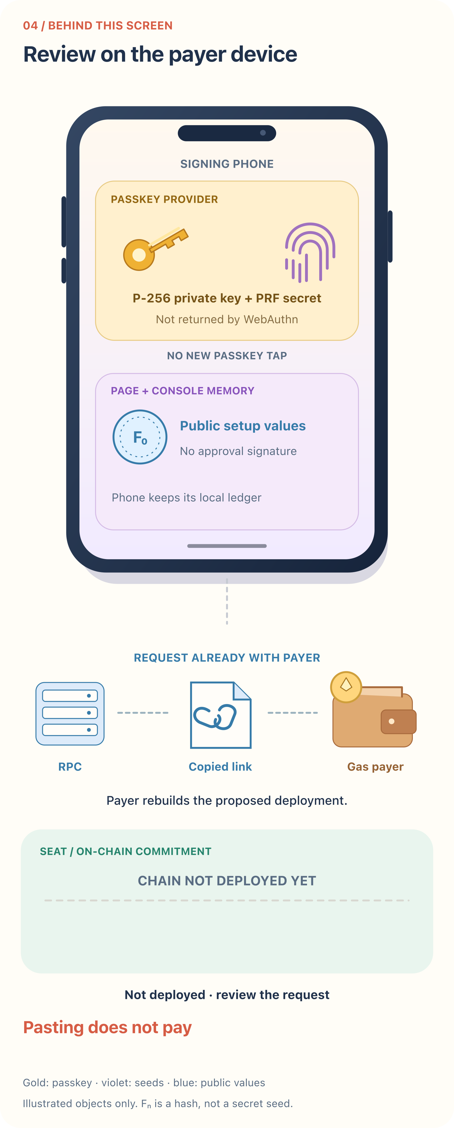
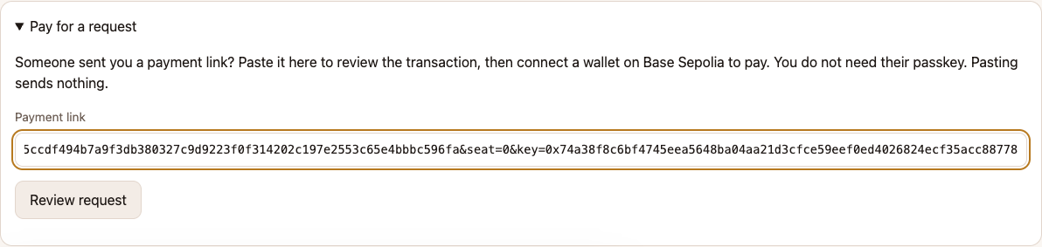
paste the payment link
What the user sees
What happens behind it
20
Notes:
Source: notes/onboarding-walkthrough.md
Captured application commit: f13bf89
4. On the payer's device: review, connect, deploy
screenshots/onboarding/04-payer-paste.png
infographics/onboarding/04-payer-paste.svg

Slide 21
4. On the payer's device: review, connect, deploy
Pasting reviews the request here. It does not visit the pasted host or send a wallet transaction. The payer connects a browser wallet. With multiple wallets, the page asks which to use.
21
Notes:
Source: notes/onboarding-walkthrough.md
Captured application commit: f13bf89
Pasting reviews the request here. It does not visit the pasted host or send a wallet transaction.
The payer connects a browser wallet. With multiple wallets, the page asks which to use.

Slide 22
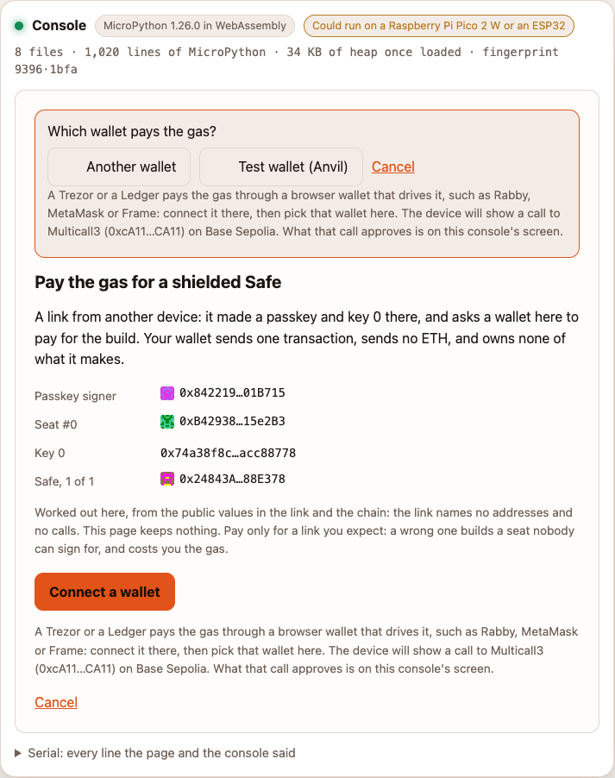
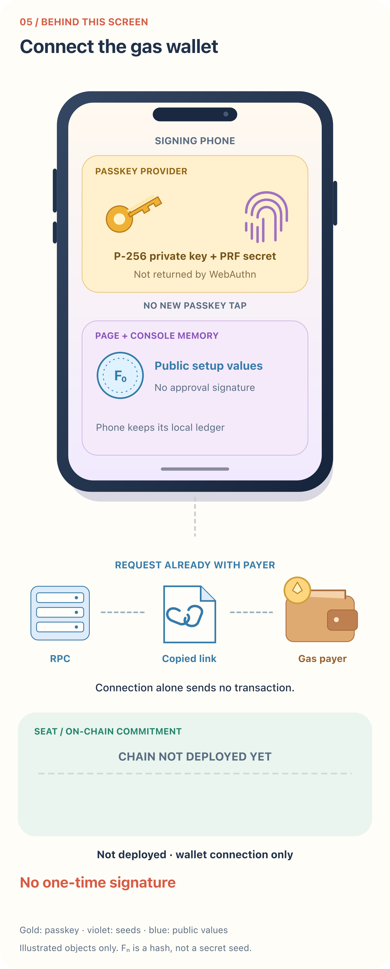
choose the gas wallet
What the user sees
What happens behind it
22
Notes:
Source: notes/onboarding-walkthrough.md
Captured application commit: f13bf89
4. On the payer's device: review, connect, deploy
screenshots/onboarding/05-payer-choose-wallet.png
infographics/onboarding/05-payer-choose-wallet.svg

Slide 23
4. On the payer's device: review, connect, deploy
The payer checks the predicted Safe and seat, then presses Pay: one transaction.
23
Notes:
Source: notes/onboarding-walkthrough.md
Captured application commit: f13bf89
The payer checks the predicted Safe and seat, then presses **Pay: one transaction**.

Slide 24
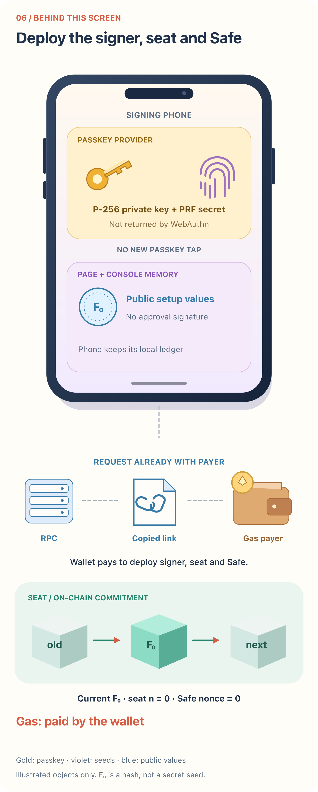
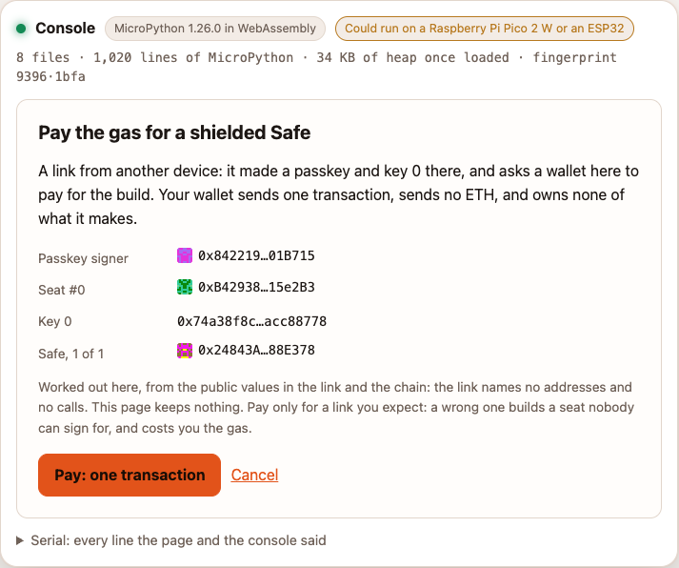
review the deployment
What the user sees
What happens behind it
24
Notes:
Source: notes/onboarding-walkthrough.md
Captured application commit: f13bf89
4. On the payer's device: review, connect, deploy
screenshots/onboarding/06-payer-build.png
infographics/onboarding/06-payer-build.svg

Slide 25
4. On the payer's device: review, connect, deploy
Expect a separate wallet confirmation after pressing Pay. The payer needs Base Sepolia ETH for gas on the published site. A Trezor or Ledger can be used through a browser wallet that drives it. The stand-in wallet in these pictures is not a screenshot of MetaMask's confirmation.
The transaction deploys the passkey signer, seat and 1-of-1 Safe, plus the SeatFactory if needed. Already deployed parts are skipped. The seat becomes the Safe's one owner. The payer owns none of it.
Exposure: the passkey P-256 public key is now public through its signer. The seat holds key 0's fingerprint, not its full one-time public key. The gas account is a separate signer; a normal EOA transaction signature also allows its public key to be recovered by those who receive it.
If the wallet says a request is already waiting, open it and finish or cancel the pending request, then reconnect. A connection attempt does not send the deployment or approval transaction.
25
Notes:
Source: notes/onboarding-walkthrough.md
Captured application commit: f13bf89
Expect a separate wallet confirmation after pressing Pay. The payer needs Base Sepolia ETH for gas
on the published site. A Trezor or Ledger can be used through a browser wallet that drives it.
The stand-in wallet in these pictures is not a screenshot of MetaMask's confirmation.
The transaction deploys the passkey signer, seat and 1-of-1 Safe, plus the SeatFactory if needed.
Already deployed parts are skipped. The seat becomes the Safe's one owner. The payer owns none of it.
**Exposure:** the passkey P-256 public key is now public through its signer. The seat holds key 0's
fingerprint, not its full one-time public key. The gas account is a separate signer; a normal EOA
transaction signature also allows its public key to be recovered by those who receive it.
If the wallet says a request is already waiting, open it and finish or cancel the pending request,
then reconnect. A connection attempt does not send the deployment or approval transaction.

Slide 26
5. Put spending ETH in the Safe
Gas money and Safe money are separate. The payer's wallet pays transaction fees. The Safe needs its own balance for the transfers it will make.
26
Notes:
Source: notes/onboarding-walkthrough.md
Captured application commit: f13bf89
Gas money and Safe money are separate. The payer's wallet pays transaction fees. The Safe needs
its own balance for the transfers it will make.

Slide 27
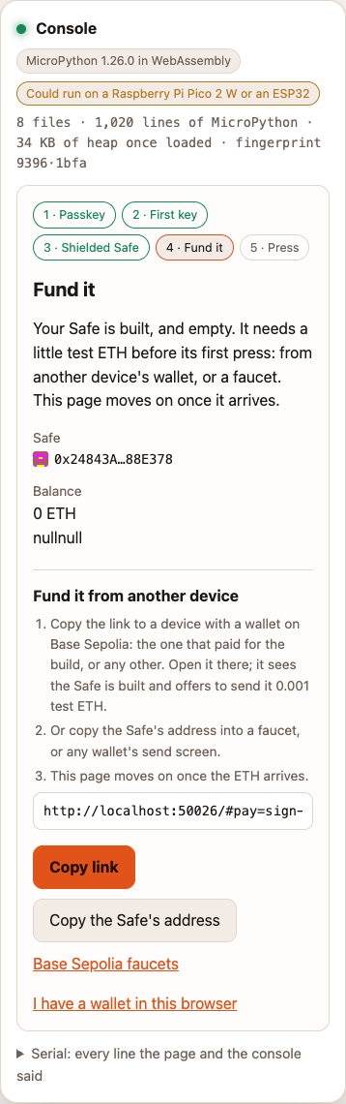
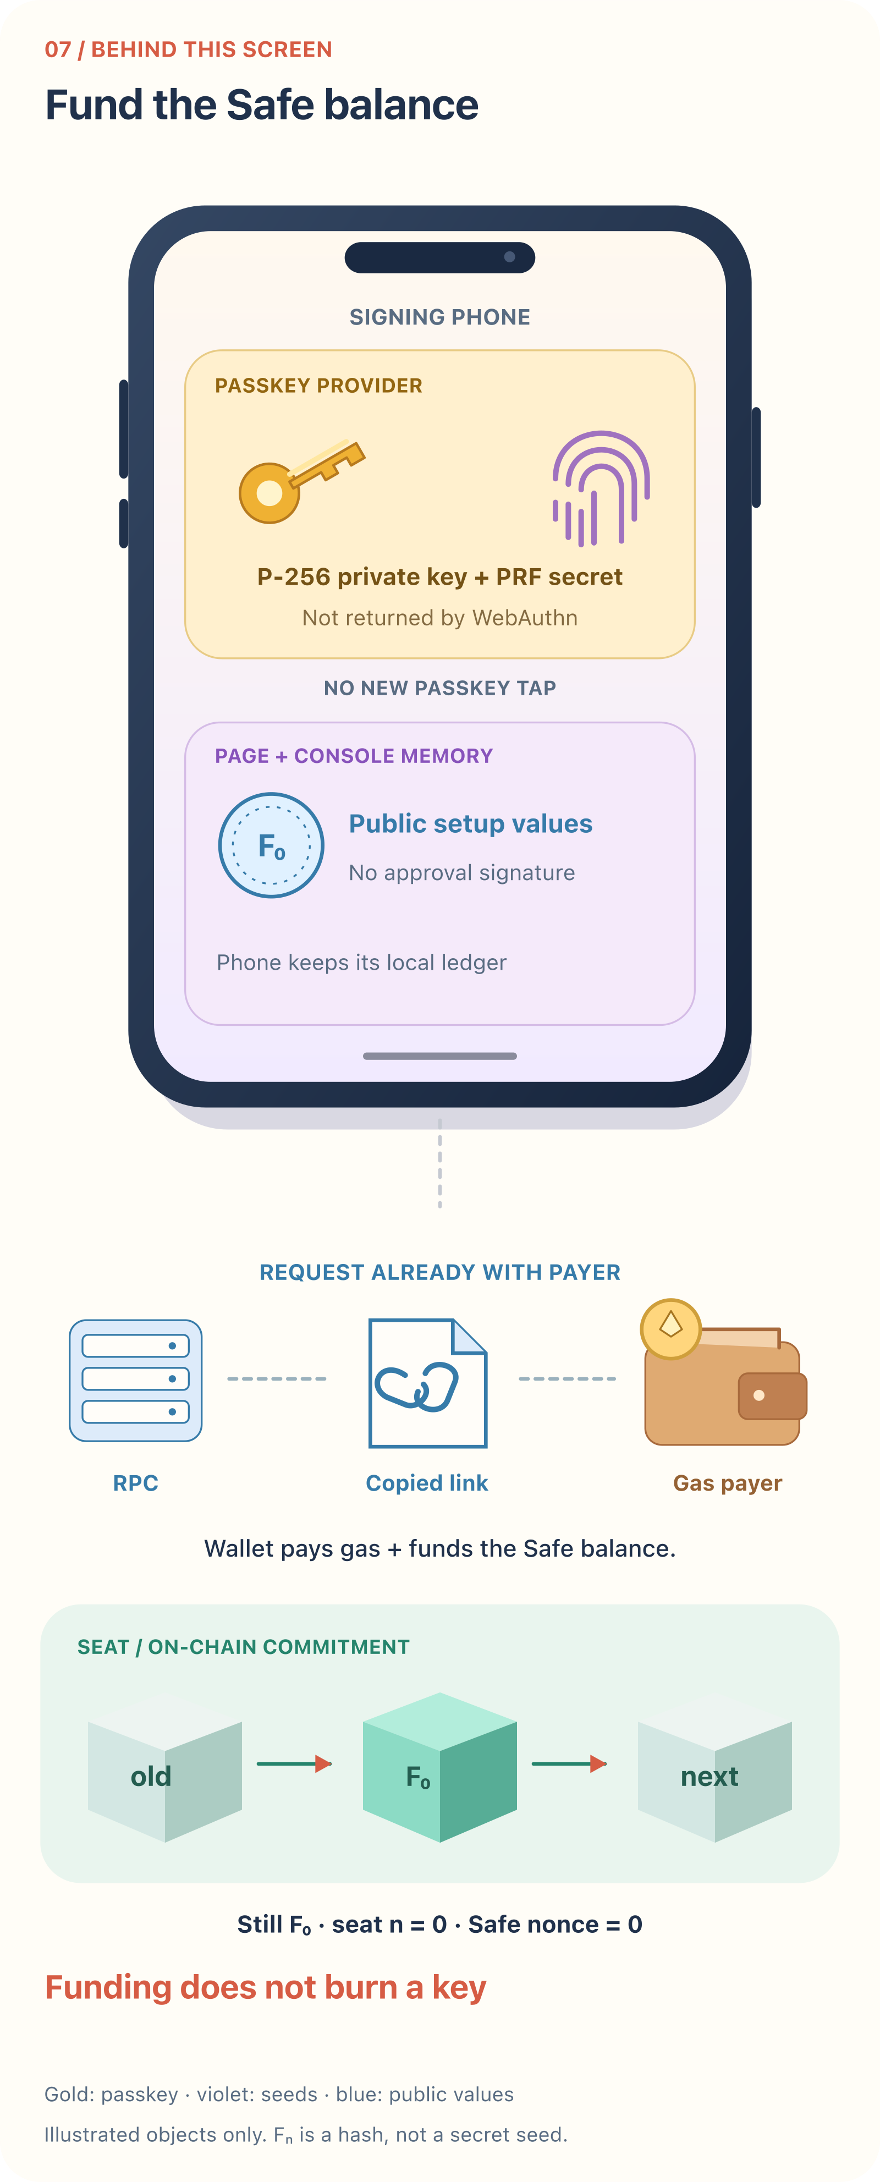
the deployed Safe still needs funds
What the user sees
What happens behind it
27
Notes:
Source: notes/onboarding-walkthrough.md
Captured application commit: f13bf89
5. Put spending ETH in the Safe
screenshots/onboarding/07-phone-fund.png
infographics/onboarding/07-phone-fund.svg

Slide 28
5. Put spending ETH in the Safe
The stray nullnull text in this captured funding screen is a display bug, not transaction data. The capture keeps it as shown by the page.
The payer can send 0.001 test ETH to the Safe, or someone can send test ETH to its address by another route. This is a separate wallet transaction, with its own gas. It does not consume a one-time signing key. The phone watches the chain and moves on when the funds arrive.
28
Notes:
Source: notes/onboarding-walkthrough.md
Captured application commit: f13bf89
The stray `nullnull` text in this captured funding screen is a display bug, not transaction data.
The capture keeps it as shown by the page.
The payer can send **0.001 test ETH** to the Safe, or someone can send test ETH to its address by
another route. This is a separate wallet transaction, with its own gas. It does not consume a
one-time signing key. The phone watches the chain and moves on when the funds arrive.

Slide 29
6. First shielded transaction: key 0 sends 0.0001 test ETH
On the phone, enter the recipient and amount. Read the console's explanation and transaction hash. Hold the button for two seconds. Reject remains a separate press.
29
Notes:
Source: notes/onboarding-walkthrough.md
Captured application commit: f13bf89
On the phone, enter the recipient and amount. Read the console's explanation and transaction hash.
Hold the button for two seconds. Reject remains a separate press.

Slide 30
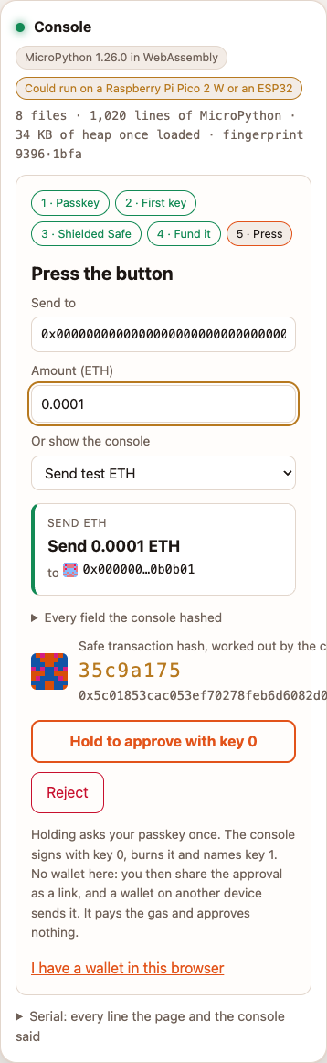
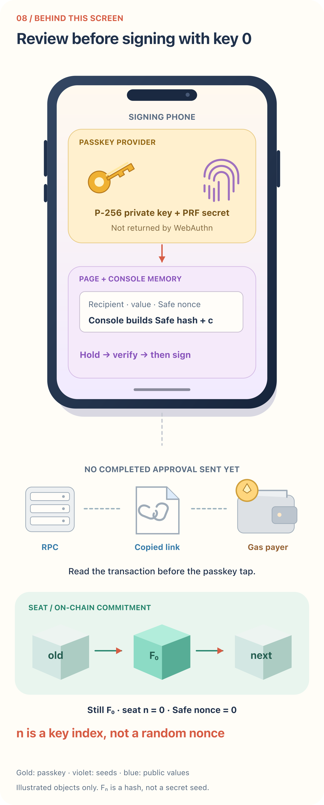
review before the passkey tap
What the user sees
What happens behind it
30
Notes:
Source: notes/onboarding-walkthrough.md
Captured application commit: f13bf89
6. First shielded transaction: key 0 sends 0.0001 test ETH
screenshots/onboarding/09-phone-review.png
infographics/onboarding/09-phone-review.svg

Slide 31
6. First shielded transaction: key 0 sends 0.0001 test ETH
The captured phone layout clips the long hash and some label text. The short check code is visible; the desktop payer screenshot below shows the full hash. That clipping is a layout limitation of the current page, not redaction applied to these screenshots.
At this point, no one-time signature for the transaction has been made. The console has built the Safe transaction hash and challenge c from the displayed fields, chain, seat, Safe and key number. It does not accept a precomputed hash supplied by the payer or wallet.
31
Notes:
Source: notes/onboarding-walkthrough.md
Captured application commit: f13bf89
The captured phone layout clips the long hash and some label text. The short check code is visible;
the desktop payer screenshot below shows the full hash. That clipping is a layout limitation of
the current page, not redaction applied to these screenshots.
At this point, no one-time signature for the transaction has been made. The console has built the
Safe transaction hash and challenge `c` from the displayed fields, chain, seat, Safe and key number.
It does not accept a precomputed hash supplied by the payer or wallet.

Slide 32
What the passkey method returns
The application requests an assertion with two PRF outputs. This is the shape of the request; it omits credential selection and byte conversion:
32
Notes:
Source: notes/onboarding-walkthrough.md
Captured application commit: f13bf89
The application requests an assertion with two PRF outputs. This is the shape of the request;
it omits credential selection and byte conversion:

Slide 33
The approval passkey request
navigator.credentials.get({
publicKey: {
rpId: siteDomain,
challenge: c,
userVerification: "required",
extensions: {
prf: { eval: { first: salt(0), second: salt(1) } }
}
}
});
Request shape only. Credential selection and byte conversion omitted.
33
Notes:
Source: notes/onboarding-walkthrough.md
Captured application commit: f13bf89
navigator.credentials.get({
publicKey: {
rpId: siteDomain,
challenge: c,
userVerification: "required",
extensions: {
prf: { eval: { first: salt(0), second: salt(1) } }
}
}
});
Request shape only. Credential selection and byte conversion omitted.

Slide 34
What the passkey method returns
The response has two different jobs:
1. A WebAuthn P-256 assertion. More precisely, the passkey signs authenticator data plus the SHA-256 hash of the client-data JSON, which contains challenge c and the origin. It does not simply sign the raw bytes of c.
2. PRF outputs seed(0) and seed(1). These are private one-time signing material returned to the page. They are not the passkey private key, and they are not derived by recovering a secret from its P-256 signature.
The console checks the assertion's challenge and user-verification fields. It checks that seed(0) produces the fingerprint the seat expects. It derives key 1's fingerprint from seed(1), builds m from c and that next fingerprint, and signs m with one-time key 0. Only the one-time signature binds the next fingerprint in this v1 format; the P-256 challenge does not include it. See the open authorization question.
The console records the signed approval in its ledger before returning it. Key 0 must never sign another message, even though the chain still expects key 0 until the approval lands. The application does not intentionally save or log seeds. Clearing references is not a proof that all copies have been erased from JavaScript or WebAssembly memory.
34
Notes:
Source: notes/onboarding-walkthrough.md
Captured application commit: f13bf89
The response has two different jobs:
1. A WebAuthn P-256 assertion. More precisely, the passkey signs authenticator data plus the
SHA-256 hash of the client-data JSON, which contains challenge `c` and the origin. It does not
simply sign the raw bytes of `c`.
2. PRF outputs `seed(0)` and `seed(1)`. These are private one-time signing material returned to the
page. They are not the passkey private key, and they are not derived by recovering a secret
from its P-256 signature.
The console checks the assertion's challenge and user-verification fields. It checks that
`seed(0)` produces the fingerprint the seat expects. It derives key 1's fingerprint from
`seed(1)`, builds `m` from `c` and that next fingerprint, and signs `m` with one-time key 0.
Only the one-time signature binds the next fingerprint in this v1 format; the P-256 challenge
does not include it. See [the open authorization question](research.md#1-complete-authorization).
The console records the signed approval in its ledger before returning it. Key 0 must never sign
another message, even though the chain still expects key 0 until the approval lands.
The application does not intentionally save or log seeds. Clearing references is not a proof that
all copies have been erased from JavaScript or WebAssembly memory.

Slide 35
The signature leaves before the on-chain burn
The page sends the completed approval to the RPC for simulation. That call costs no gas and changes no chain state, but it is a disclosure to the RPC operator. It includes the one-time signature and the P-256 assertion. Anyone with the approval and its public context can compute the 67 one-time public-key endpoints.
The phone then offers a signed payment link. It contains the signatures, next fingerprint and transaction fields, not the seeds. The URL fragment is not sent in the ordinary request for the page, but copying it into a message discloses it to the recipient and potentially the messaging service. A fragment is not encrypted storage.
35
Notes:
Source: notes/onboarding-walkthrough.md
Captured application commit: f13bf89
The page sends the completed approval to the RPC for simulation. That call costs no gas and changes
no chain state, but it is a disclosure to the RPC operator. It includes the one-time signature and
the P-256 assertion. Anyone with the approval and its public context can compute the 67 one-time
public-key endpoints.
The phone then offers a signed payment link. It contains the signatures, next fingerprint and
transaction fields, not the seeds. The URL fragment is not sent in the ordinary request for the
page, but copying it into a message discloses it to the recipient and potentially the messaging
service. A fragment is not encrypted storage.

Slide 36
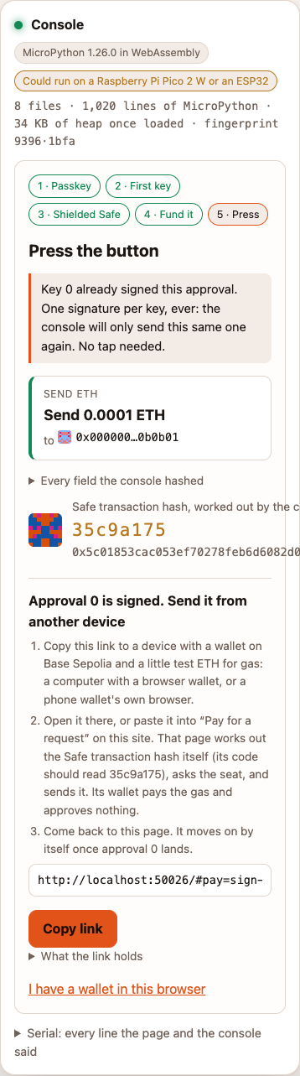
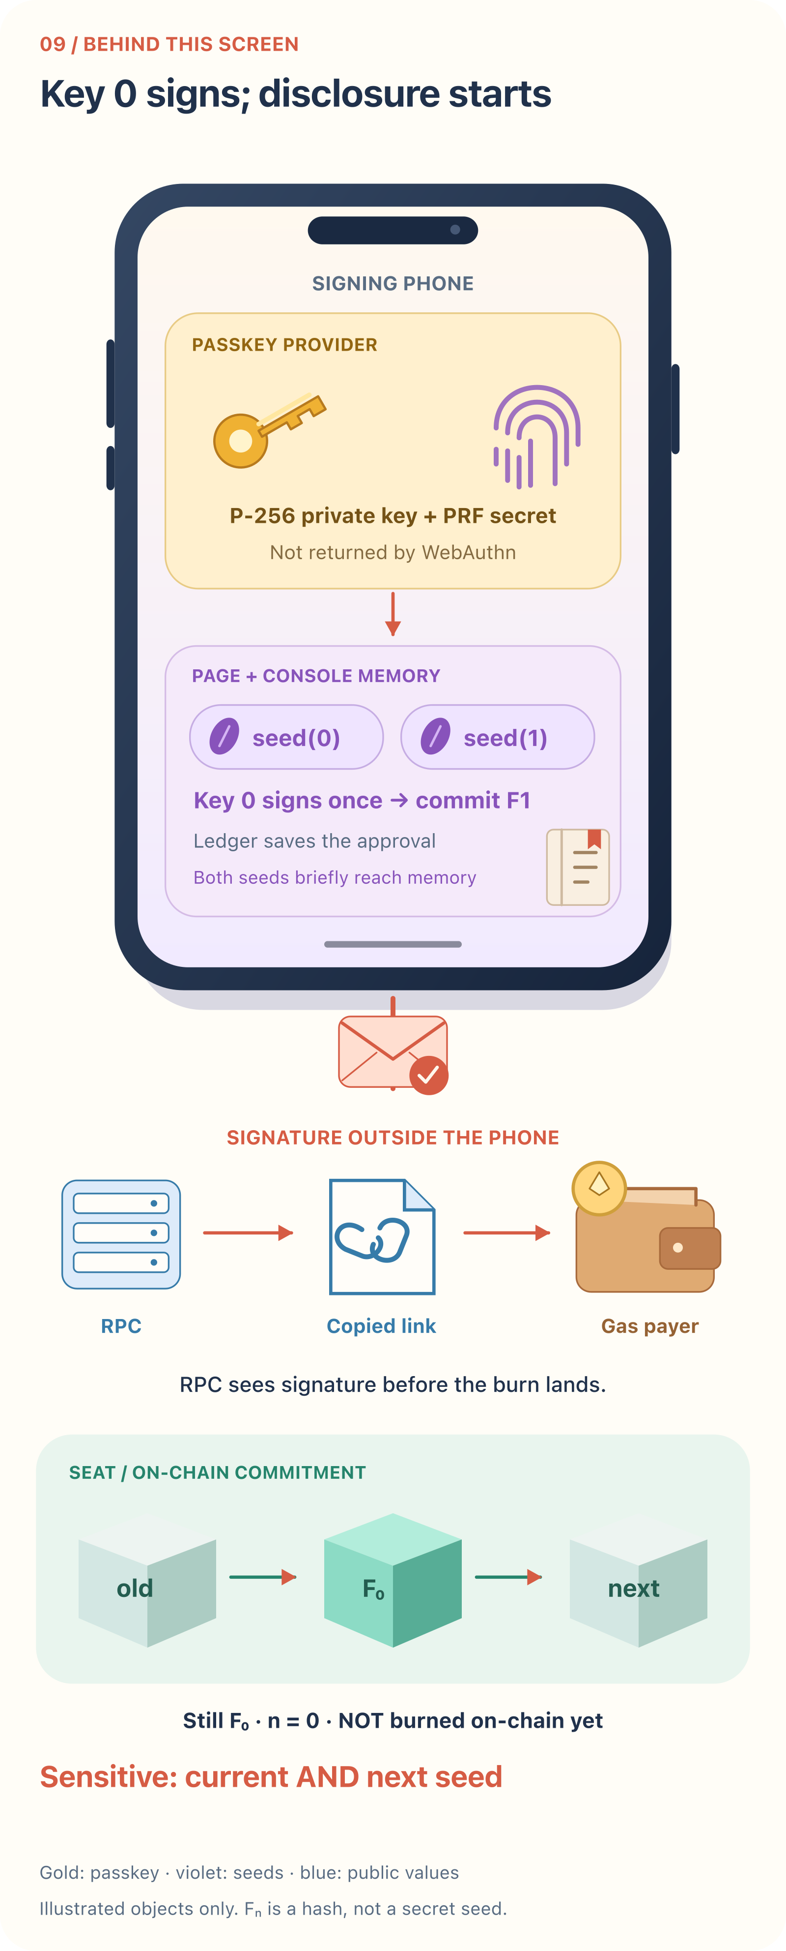
key 0 has signed and is waiting for a payer
What the user sees
What happens behind it
36
Notes:
Source: notes/onboarding-walkthrough.md
Captured application commit: f13bf89
The signature leaves before the on-chain burn
screenshots/onboarding/10-phone-signed-link.png
infographics/onboarding/10-phone-signed-link.svg

Slide 37
The signature leaves before the on-chain burn
The payer opens that link. Their console computes the hash again from the fields; compare its check code with the phone's. The payer's RPC receives the approval for simulation too.
37
Notes:
Source: notes/onboarding-walkthrough.md
Captured application commit: f13bf89
The payer opens that link. Their console computes the hash again from the fields; compare its
check code with the phone's. The payer's RPC receives the approval for simulation too.

Slide 38
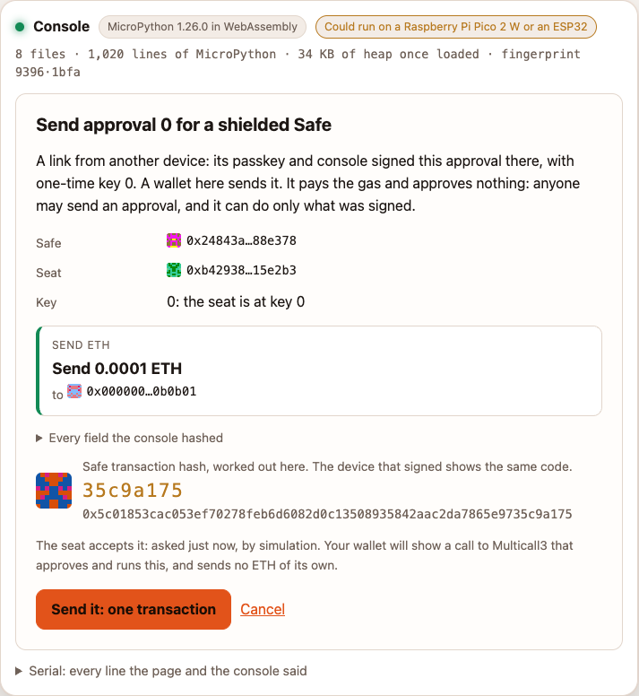
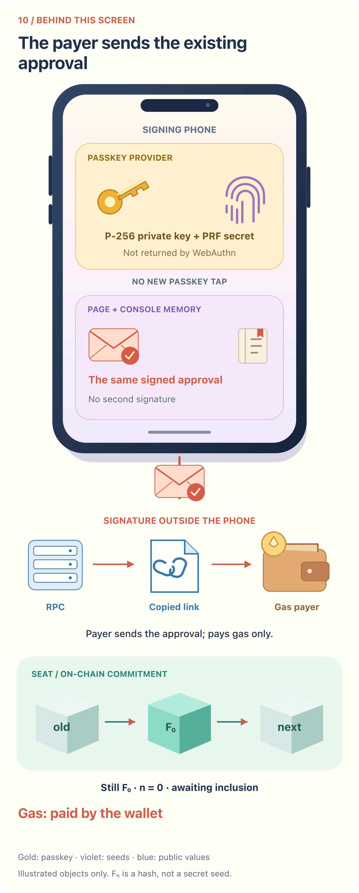
send the approval already signed on the phone
What the user sees
What happens behind it
38
Notes:
Source: notes/onboarding-walkthrough.md
Captured application commit: f13bf89
The signature leaves before the on-chain burn
screenshots/onboarding/11-payer-approval.png
infographics/onboarding/11-payer-approval.svg

Slide 39
The signature leaves before the on-chain burn
Pressing Send it: one transaction asks the payer's wallet to send a Multicall3 transaction. The wallet pays gas; it does not make the seat's approval. The call approves with the seat and tries to execute the Safe transaction.
Once the transaction is broadcast, its recipients can read the signatures. Do not assume every network has a public mempool or that a private relay keeps transaction data private forever. After inclusion, the signatures remain in on-chain transaction data.
When Seat.approve succeeds, it replaces key 0's fingerprint with key 1's and advances n to 1. The example's Safe also runs the transfer. The phone sees this and displays the result.
39
Notes:
Source: notes/onboarding-walkthrough.md
Captured application commit: f13bf89
Pressing **Send it: one transaction** asks the payer's wallet to send a Multicall3 transaction.
The wallet pays gas; it does not make the seat's approval. The call approves with the seat and
tries to execute the Safe transaction.
Once the transaction is broadcast, its recipients can read the signatures. Do not assume every
network has a public mempool or that a private relay keeps transaction data private forever.
After inclusion, the signatures remain in on-chain transaction data.
When `Seat.approve` succeeds, it replaces key 0's fingerprint with key 1's and advances `n` to 1.
The example's Safe also runs the transfer. The phone sees this and displays the result.

Slide 40
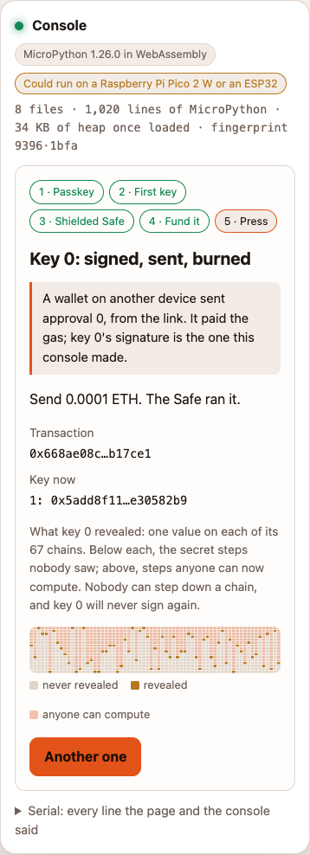
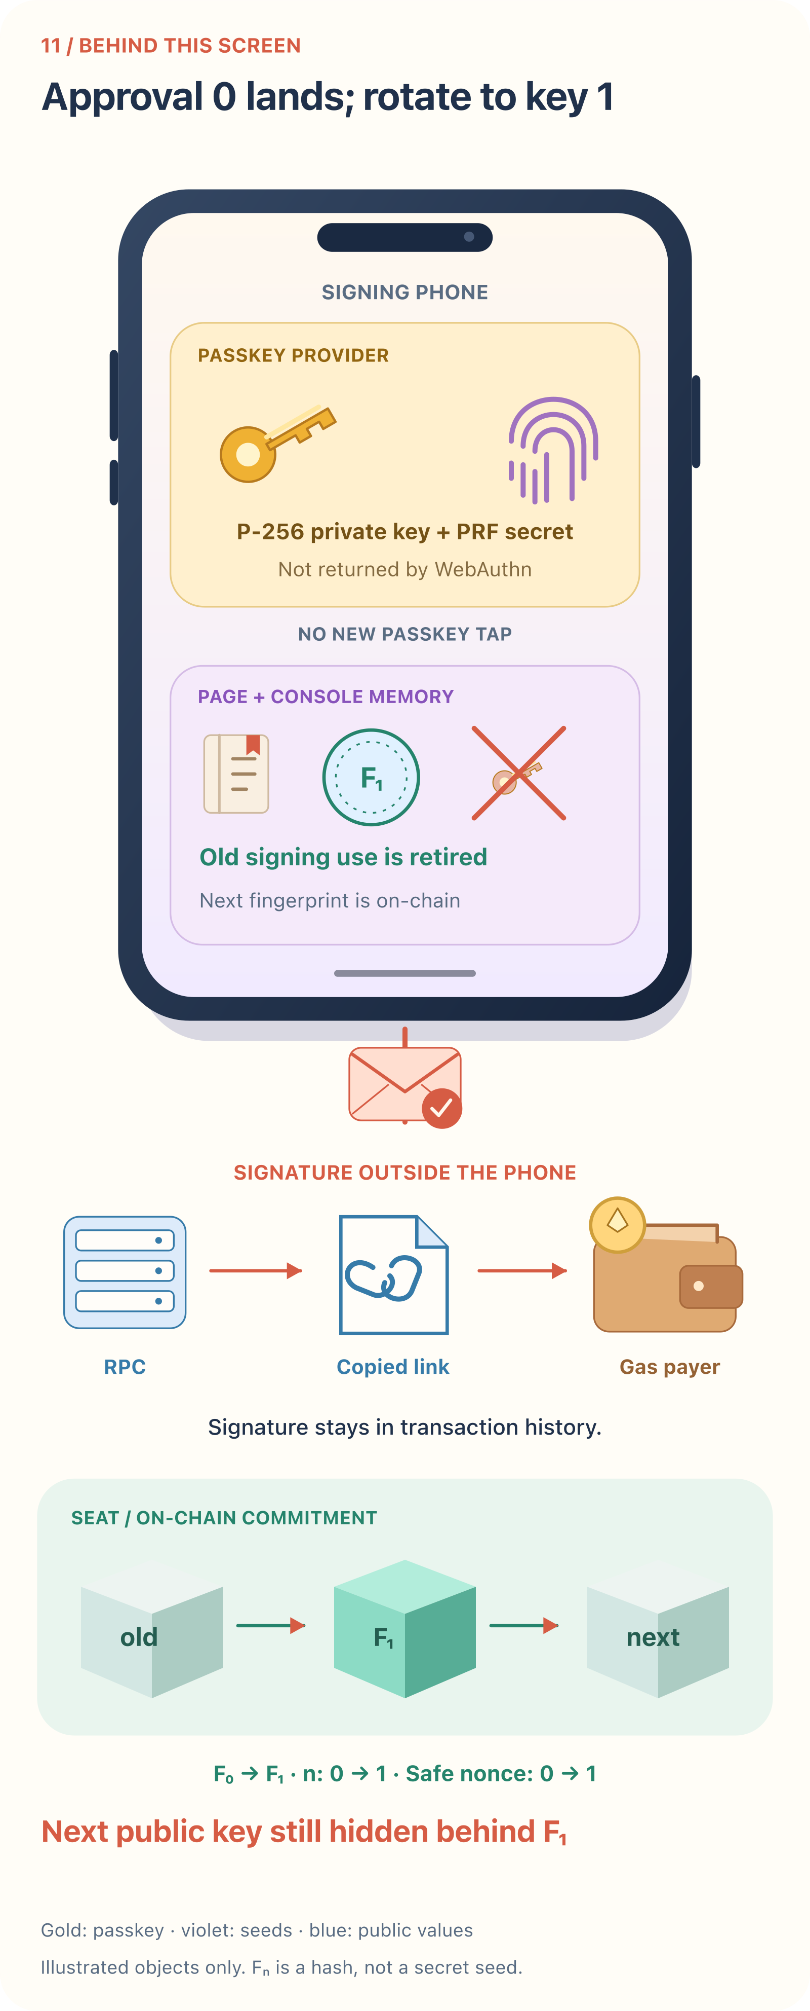
first approval landed; key 0 is burned on-chain
What the user sees
What happens behind it
40
Notes:
Source: notes/onboarding-walkthrough.md
Captured application commit: f13bf89
The signature leaves before the on-chain burn
screenshots/onboarding/12-phone-first-done.png
infographics/onboarding/12-phone-first-done.svg

Slide 41
7. Two more shielded transactions
The same phone remains the signer. The same other browser remains the payer. There is no deployment step again. Each new approval gets one passkey assertion and one new pair of PRF outputs.
41
Notes:
Source: notes/onboarding-walkthrough.md
Captured application commit: f13bf89
The same phone remains the signer. The same other browser remains the payer. There is no deployment
step again. Each new approval gets one passkey assertion and one new pair of PRF outputs.

Slide 42
7. Two more shielded transactions
Example | Safe sends | Key signs | PRF outputs returned to the phone | State after the approval lands
First | 0.0001 test ETH | 0 | seed(0), seed(1) | Seat expects key 1; Safe nonce 1
Second | 0.0002 test ETH | 1 | seed(1), seed(2) | Seat expects key 2; Safe nonce 2
Third | 0.0001 test ETH | 2 | seed(2), seed(3) | Seat expects key 3; Safe nonce 3
42
Notes:
Source: notes/onboarding-walkthrough.md
Captured application commit: f13bf89
Example | Safe sends | Key signs | PRF outputs returned to the phone | State after the approval lands
First | 0.0001 test ETH | 0 | seed(0), seed(1) | Seat expects key 1; Safe nonce 1
Second | 0.0002 test ETH | 1 | seed(1), seed(2) | Seat expects key 2; Safe nonce 2
Third | 0.0001 test ETH | 2 | seed(2), seed(3) | Seat expects key 3; Safe nonce 3

Slide 43
7. Two more shielded transactions
The same method applies at key 27: the console reads n = 27 from the seat, asks for PRF outputs seed(27) and seed(28), signs once with key 27, and commits key 28's fingerprint. The seat advances to n = 28 only when that approval lands. n is an approval index, not a random nonce, and it is separate from the Safe transaction nonce.
43
Notes:
Source: notes/onboarding-walkthrough.md
Captured application commit: f13bf89
The same method applies at key 27: the console reads `n = 27` from the seat, asks for PRF
outputs `seed(27)` and `seed(28)`, signs once with key 27, and commits key 28's fingerprint.
The seat advances to `n = 28` only when that approval lands. `n` is an approval index, not a
random nonce, and it is separate from the Safe transaction nonce.

Slide 44
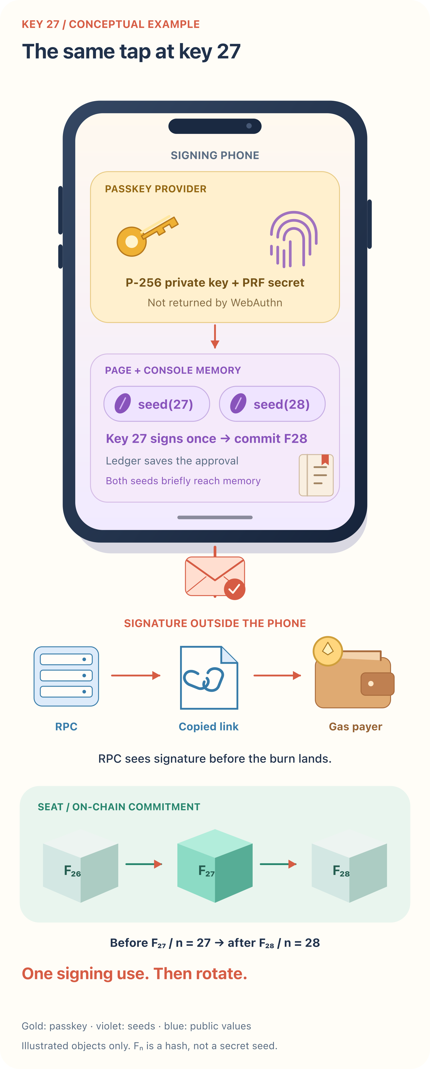
The same passkey method at key 27
The console reads seat n = 27.
The PRF returns seed(27) and seed(28) to the signing page.
Key 27 signs once and names the next fingerprint. The seat advances to n = 28 only when the approval lands.
The seat index and Safe transaction nonce are separate counters.
Conceptual example. The captured transactions use keys 0, 1 and 2.
44
Notes:
Source: notes/onboarding-walkthrough.md
Captured application commit: f13bf89
7. Two more shielded transactions
Conceptual example only, not another captured transaction.
infographics/onboarding/key-27.svg

Slide 45
7. Two more shielded transactions
This diagram is a conceptual example, not an additional captured transaction.
This illustrates why the seeds are a separate risk: seed(1) is returned while approving with key 0, then returned again when key 1 signs. The fingerprint of the next key hides its public key from the chain; it does not hide that seed from a compromised signing page during the tap.
45
Notes:
Source: notes/onboarding-walkthrough.md
Captured application commit: f13bf89
This diagram is a conceptual example, not an additional captured transaction.
This illustrates why the seeds are a separate risk: `seed(1)` is returned while approving with
key 0, then returned again when key 1 signs. The fingerprint of the next key hides its public key
from the chain; it does not hide that seed from a compromised signing page during the tap.

Slide 46
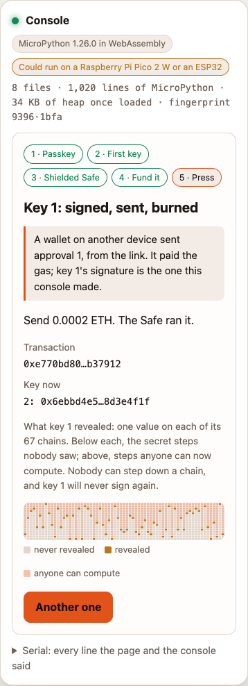
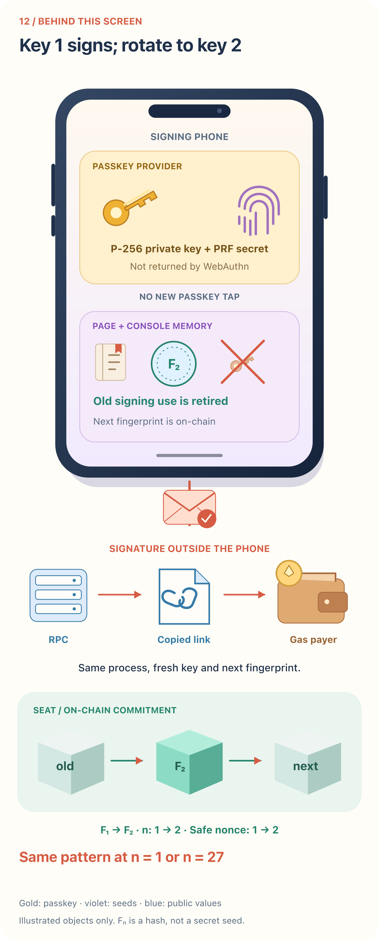
second approval landed; key 1 is burned
What the user sees
What happens behind it
46
Notes:
Source: notes/onboarding-walkthrough.md
Captured application commit: f13bf89
7. Two more shielded transactions
screenshots/onboarding/14-phone-second-done.png
infographics/onboarding/14-phone-second-done.svg

Slide 47
7. Two more shielded transactions
For the third example, the payer rejects the wallet's send confirmation. The phone is reloaded. It still offers approval 2, already signed. Reloading does not justify another signature or let the user change this waiting approval. The payer retries the same approval without another tap on the phone.
47
Notes:
Source: notes/onboarding-walkthrough.md
Captured application commit: f13bf89
For the third example, the payer rejects the wallet's send confirmation. The phone is reloaded.
It still offers approval 2, already signed. Reloading does not justify another signature or let
the user change this waiting approval. The payer retries the same approval without another tap
on the phone.

Slide 48
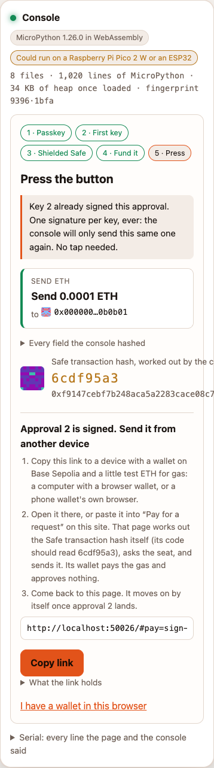
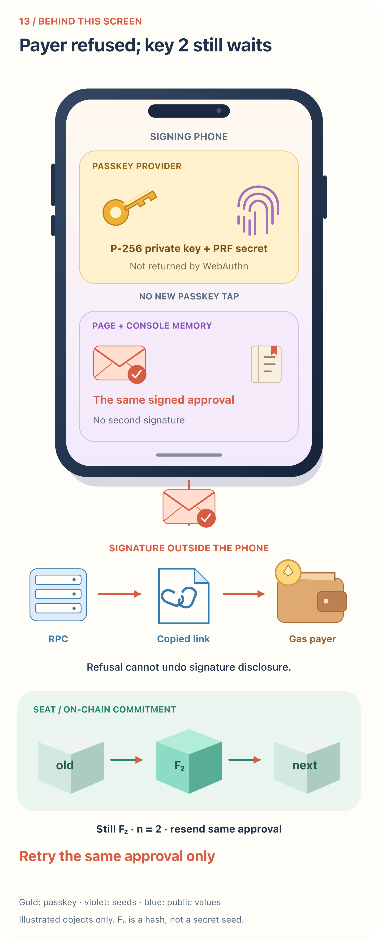
the same key 2 approval waits after refusal and reload
What the user sees
What happens behind it
48
Notes:
Source: notes/onboarding-walkthrough.md
Captured application commit: f13bf89
7. Two more shielded transactions
screenshots/onboarding/13-phone-waiting-after-refusal.png
infographics/onboarding/13-phone-waiting-after-refusal.svg

Slide 49
7. Two more shielded transactions
After the payer accepts the retry, key 2 burns on-chain and the Safe makes the third transfer. The three transfers total 0.0004 test ETH. With a starting Safe balance of 0.001, the Safe has 0.0006 test ETH left in this example. Gas was paid separately by the payer.
49
Notes:
Source: notes/onboarding-walkthrough.md
Captured application commit: f13bf89
After the payer accepts the retry, key 2 burns on-chain and the Safe makes the third transfer.
The three transfers total 0.0004 test ETH. With a starting Safe balance of 0.001, the Safe has
0.0006 test ETH left in this example. Gas was paid separately by the payer.

Slide 50
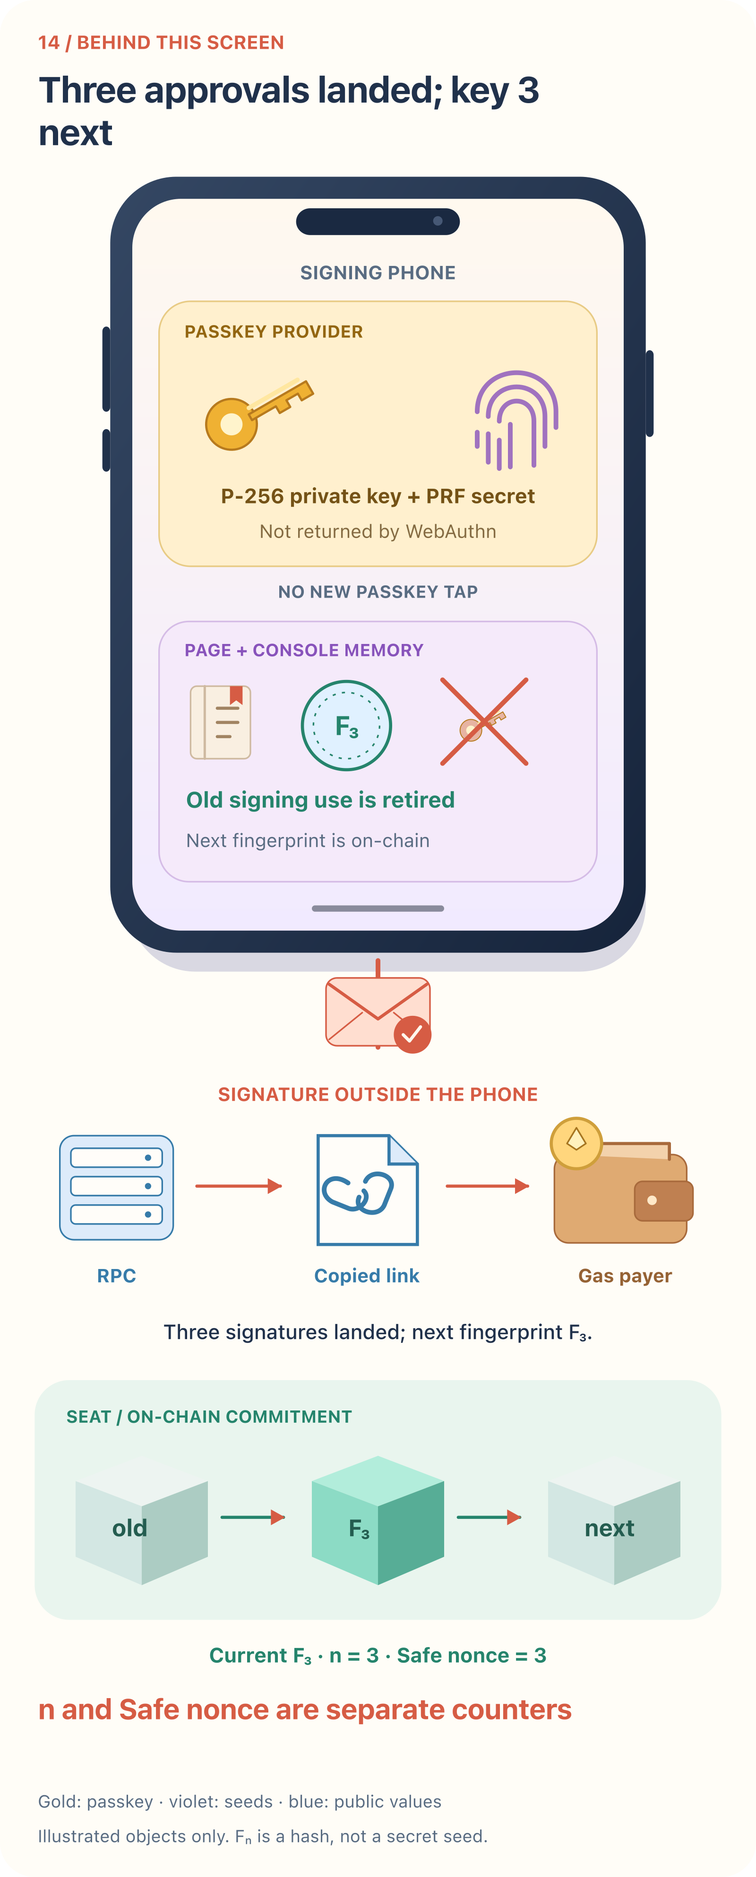
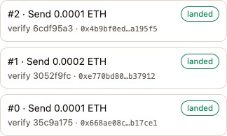
three approvals in the local ledger
What the user sees
What happens behind it
50
Notes:
Source: notes/onboarding-walkthrough.md
Captured application commit: f13bf89
7. Two more shielded transactions
screenshots/onboarding/16-phone-history.png
infographics/onboarding/16-phone-history.svg

Slide 51
7. Two more shielded transactions
A landed approval and a successful Safe execution are separate outcomes. The implementation can burn the key and keep the seat's vote even if Safe execution fails. A payer's successful receipt alone does not establish that the transfer ran. Check the page's execution result and Safe nonce. The screenshots above show successful executions; the refusal did not land until retried.
51
Notes:
Source: notes/onboarding-walkthrough.md
Captured application commit: f13bf89
A landed approval and a successful Safe execution are separate outcomes. The implementation can
burn the key and keep the seat's vote even if Safe execution fails. A payer's successful receipt
alone does not establish that the transfer ran. Check the page's execution result and Safe nonce.
The screenshots above show successful executions; the refusal did not land until retried.

Slide 52
Where the theoretical exposures are (1)
Place or moment | What is exposed | What that means
Signing page after a PRF call | Current and, for an approval, next seeds; assertion; then the completed approval | Malware with access to this memory can steal private one-time material. This exceeds the intended public-signature exposure.
First-key setup | seed(0) briefly reaches the page | Seed exposure can precede any transaction approval.
Simulation RPC | Completed approval and transaction details | Gas-free does not mean private. The one-time public key can be computed before the burn lands.
Copied approval link, messaging service, payer or hypothetical relayer | Completed approval, transaction fields and next fingerprint | They can submit the existing approval. They do not receive seeds through the intended link format. No relayer service is built here.
52
Notes:
Source: notes/onboarding-walkthrough.md
Captured application commit: f13bf89
Place or moment | What is exposed | What that means
Signing page after a PRF call | Current and, for an approval, next seeds; assertion; then the completed approval | Malware with access to this memory can steal private one-time material. This exceeds the intended public-signature exposure.
First-key setup | seed(0) briefly reaches the page | Seed exposure can precede any transaction approval.
Simulation RPC | Completed approval and transaction details | Gas-free does not mean private. The one-time public key can be computed before the burn lands.
Copied approval link, messaging service, payer or hypothetical relayer | Completed approval, transaction fields and next fingerprint | They can submit the existing approval. They do not receive seeds through the intended link format. No relayer service is built here.

Slide 53
Where the theoretical exposures are (2)
Place or moment | What is exposed | What that means
Payer wallet and its transaction infrastructure | Calls and signatures submitted for broadcast | The approval is visible before inclusion. A compromised payer cannot be assumed to keep it private.
Included transaction | Signatures and transaction fields, permanently | The old key is retired on-chain if the approval succeeds. Only the next key's fingerprint is committed.
Cleared ledger or a second signing browser | The console can lose knowledge of an already disclosed signature | A second signature with the same one-time key can reveal more chain positions and enable forgery attempts. Reuse breaks the design's assumption.
Compromised OS, authenticator or synced credential account | Depends on what the attacker controls | An attacker may invoke the passkey or capture outputs. The application does not protect a compromised signing environment.
53
Notes:
Source: notes/onboarding-walkthrough.md
Captured application commit: f13bf89
Place or moment | What is exposed | What that means
Payer wallet and its transaction infrastructure | Calls and signatures submitted for broadcast | The approval is visible before inclusion. A compromised payer cannot be assumed to keep it private.
Included transaction | Signatures and transaction fields, permanently | The old key is retired on-chain if the approval succeeds. Only the next key's fingerprint is committed.
Cleared ledger or a second signing browser | The console can lose knowledge of an already disclosed signature | A second signature with the same one-time key can reveal more chain positions and enable forgery attempts. Reuse breaks the design's assumption.
Compromised OS, authenticator or synced credential account | Depends on what the attacker controls | An attacker may invoke the passkey or capture outputs. The application does not protect a compromised signing environment.

Slide 54
Where the theoretical exposures are
There is no built-in expiry on the signed approval. Time between disclosure and inclusion can be long, especially when a link is sent to another person. The console treats the key as used for signing immediately; the seat retires it only when the approval lands. Keep the signing browser's ledger, use one signing browser per seat, and resend the same waiting approval.
Revealing a public key is not ordinary private-key extraction. The theoretical curve-breaking scenario concerns public curve keys; the passkey's P-256 public key is already public after its signer is deployed. The one-time half is intended to require an additional hash-based signature. It does not make the signing page trustworthy, and it does not protect the gas wallet's funds.
54
Notes:
Source: notes/onboarding-walkthrough.md
Captured application commit: f13bf89
There is no built-in expiry on the signed approval. Time between disclosure and inclusion can be
long, especially when a link is sent to another person. The console treats the key as used for
signing immediately; the seat retires it only when the approval lands. Keep the signing browser's
ledger, use one signing browser per seat, and resend the same waiting approval.
Revealing a public key is not ordinary private-key extraction. The theoretical curve-breaking
scenario concerns public curve keys; the passkey's P-256 public key is already public after its
signer is deployed. The one-time half is intended to require an additional hash-based signature.
It does not make the signing page trustworthy, and it does not protect the gas wallet's funds.

Slide 55
Sources and limits
This walkthrough was checked against passkey methods, console signing and the ledger, the page's signing and simulation order, payment links, one-time key derivation, and the seat's checks and rotation. The capture run checked one passkey assertion per fresh approval, three Safe executions, key-number advances, and the same approval surviving refusal and reload. The native prompts, real phone PRF support, a live MetaMask session and a real second-device flow were not tested here.
55
Notes:
Source: notes/onboarding-walkthrough.md
Captured application commit: f13bf89
This walkthrough was checked against [passkey methods](../site/src/passkey.mjs),
[console signing and the ledger](../console/core.py), [the page's signing and simulation order](../site/src/main.mjs),
[payment links](../site/src/pay.mjs), [one-time key derivation](../reference/python/sign_and_burn.py),
and [the seat's checks and rotation](../contracts/src/Seat.sol).
The capture run checked one passkey assertion per fresh approval, three Safe executions,
key-number advances, and the same approval surviving refusal and reload. The native prompts,
real phone PRF support, a live MetaMask session and a real second-device flow were not tested here.
Complete source walkthrough:
# A phone signs; another wallet pays
A sample Sign and Burn onboarding, followed by three shielded transactions. The signing browser
keeps the passkey access and the console's ledger. A second browser holds the wallet that pays gas.
The wallet can belong to you or to someone helping you. It does not become an owner of the Safe.
**Test network only.** This walkthrough describes the current implementation and its limits. It
is not an audit or a claim of protection against a compromised device.
Each screenshot is paired with a diagram of the signing phone, its passkey and page memory,
the data disclosed outside the page, and the seat's state. Gold marks the passkey; violet marks
private seeds; blue marks public values; coral marks signed approvals; green marks the chain.
The phone prompts and physical objects are explanatory illustrations, not native dialogs. A public
value is not a private seed. Click a diagram to read it at full size.
## About these screenshots
These are screenshots of the running page at application commit `f13bf89`, captured on 2026-10-09. The signing browser is Chromium
at a phone width of 390 pixels, with no wallet and a virtual passkey. A separate browser context
plays the payer. Both use local Anvil, chain 31337, with the project's pinned Base Sepolia contract
bytecode. The published page uses Base Sepolia, chain 84532; the pictures therefore say Local Anvil.
All accounts and approvals shown are disposable test data. The local build changes the console
configuration, so its displayed fingerprint also differs from the published Base Sepolia image.
This is a phone-shaped browser rehearsal, not a test on an iPhone or Android device. The virtual
passkey handles the native dialogs automatically. The screenshots do not show Face ID, Touch ID,
a password manager dialog, or a real MetaMask confirmation. The buttons and screen states are real;
the appearance and PRF support of those native prompts depend on your browser and authenticator.
Recorded real-device checks are in [the live test table](testing/live.md).
## What you do, and when gas is needed
| Step | On the signing phone | On the payer's device | Gas paid? |
|---|---|---|---|
| Create passkey | Approve the native creation prompt | Nothing | No |
| Prepare key 0 | Approve a passkey assertion with a PRF output | Nothing | No |
| Deploy | Copy the build request; wait | Review, connect wallet, confirm deployment | Yes, from the wallet |
| Fund | Copy the Safe address or reuse the build link | Confirm a transfer into the Safe | Yes, plus the test ETH sent |
| Each shielded transfer | Review, hold, approve one passkey assertion; copy approval link | Review the same approval; confirm its send | Yes, from the wallet |
| Retry a refused send | Keep the same approval and ledger; no new passkey tap | Send that existing approval again | Only when a transaction is actually sent and included |
The Safe supplies the transfer amount. The payer supplies gas. If a usable wallet is on the phone,
connect it there and use the local Build or Send path instead of copying a link. The passkey,
PRF, console and disclosure order are the same; the extra payer browser is optional.
## First, which key is which?
“Signing exposes the private key” needs a distinction. Normal passkey use does not export the
passkey's private key. This application does receive other secret material through the PRF extension.
| Part | What it does | What the page or others can see |
|---|---|---|
| Passkey P-256 private key | Makes the WebAuthn curve signature | WebAuthn does not return it to the page. The authenticator or credential provider holds it. |
| Passkey P-256 public key | Lets Safe's passkey signer check that signature | Returned at passkey creation; public on-chain when its signer is deployed. It is not the rotating key. |
| Passkey PRF secret | Produces repeatable outputs for the requested salts | The page gets outputs, not this underlying secret. |
| `seed(n)` | Produces all 67 private hash-chain starting values for one-time key `n` | Returned to the signing page by the PRF. It passes through page and console memory. This is private signing material. |
| One-time signature | Authorizes this approval and its next fingerprint | Reveals 67 selected positions along the private hash chains. A position can be a chain's starting value. It does not disclose the whole seed. |
| Full one-time public key | The 67 hash-chain endpoints | Anyone with the message and one-time signature can compute these endpoints. |
| One-time fingerprint | Hash commitment to those endpoints, with their context | Stored on-chain before that key signs. It is not the full public key. |
| Gas wallet | Sends the prepared calls and pays their gas | Has its own account and keys. It is separate from the passkey and the seat's one-time keys. |
The passkey is used repeatedly. The one-time key is used for one approval only. The next sections
follow key 0, then key 1, then key 2.
## 1. On the phone: make the passkey
Press **Make a passkey**. Expect your browser or credential provider to ask where to create it and
to require user verification, such as a face, fingerprint or PIN.
| What the user sees | What happens behind it |
|---|---|
| ![Phone: make a passkey](screenshots/onboarding/01-phone-passkey.png) | [![Diagram: Phone: make a passkey](infographics/onboarding/01-phone-passkey.svg)](infographics/onboarding/01-phone-passkey.svg) |
The page calls `navigator.credentials.create({ publicKey: ... })`. It asks for P-256 (`alg: -7`),
a discoverable credential, required user verification and the `prf` extension. It records the
credential ID, public coordinates and site domain; it does not record the passkey private key.
The passkey belongs to the site's domain. A passkey made on localhost is not one for signandburn.app.
**Gas:** none. **On-chain change:** none. **Exposure:** the page receives the passkey public key and
credential metadata. No one-time approval has been made.
“I already have one” is a different path. The page asks for two ordinary WebAuthn assertions to
recover the existing passkey's P-256 public key. Those are not two signatures with a one-time key.
A synced passkey does not sync this application's ledger: do not alternate signing browsers for
one seat while an approval might be waiting.
## 2. On the phone: prepare the first one-time key
Press **Tap to make key 0**. This is another user-verification prompt, not a wallet transaction.
| What the user sees | What happens behind it |
|---|---|
| ![Phone: prepare key 0](screenshots/onboarding/02-phone-first-key.png) | [![Diagram: Phone: prepare key 0](infographics/onboarding/02-phone-first-key.svg)](infographics/onboarding/02-phone-first-key.svg) |
The page calls `navigator.credentials.get({ publicKey: ... })` with a fresh challenge and one PRF
salt for key 0. The PRF returns `seed(0)`. The console derives 67 chain starts, hashes each to its
endpoint, then hashes the endpoints into key 0's fingerprint. The first-key setup uses the PRF
output; it does not make a one-time transaction signature.
**Gas:** none. **On-chain change:** none. **Exposure:** `seed(0)` is briefly in the signing page and
console. The browser record keeps the fingerprint and predicted addresses, not the seed.
A hostile page or extension able to read that memory could capture the seed at this point, before
any shielded transaction exists. Public-key disclosure is not the only exposure to consider.
A missing PRF result stops this path. Device support is something to test, not something a phone
screenshot establishes.
## 3. On the phone: give someone the build request
The addresses are worked out before deployment. **Connect a wallet** remains available. If this
phone has no wallet, press **Copy link** and send the plain URL to the person paying.
| What the user sees | What happens behind it |
|---|---|
| ![Phone: the build request and copy link](screenshots/onboarding/03-phone-build-link.png) | [![Diagram: Phone: the build request and copy link](infographics/onboarding/03-phone-build-link.svg)](infographics/onboarding/03-phone-build-link.svg) |
This is an unsigned build request. It holds the passkey's public coordinates, seat number, key 0's
fingerprint and chain identifier. It does not contain a seed or a one-time approval signature.
The payer's page rebuilds the calls and addresses from those values rather than accepting arbitrary
calls from the link.
**Gas:** still none. **Exposure:** public setup values go to whoever receives the link, including
the messaging service used to send it. A build link is different from the signed approval link below.
## 4. On the payer's device: review, connect, deploy
The payer opens the link, or opens **Pay for a request** on this site and pastes it.
| What the user sees | What happens behind it |
|---|---|
| ![Payer: paste the payment link](screenshots/onboarding/04-payer-paste.png) | [![Diagram: Payer: paste the payment link](infographics/onboarding/04-payer-paste.svg)](infographics/onboarding/04-payer-paste.svg) |
Pasting reviews the request here. It does not visit the pasted host or send a wallet transaction.
The payer connects a browser wallet. With multiple wallets, the page asks which to use.
| What the user sees | What happens behind it |
|---|---|
| ![Payer: choose the gas wallet](screenshots/onboarding/05-payer-choose-wallet.png) | [![Diagram: Payer: choose the gas wallet](infographics/onboarding/05-payer-choose-wallet.svg)](infographics/onboarding/05-payer-choose-wallet.svg) |
The payer checks the predicted Safe and seat, then presses **Pay: one transaction**.
| What the user sees | What happens behind it |
|---|---|
| ![Payer: review the deployment](screenshots/onboarding/06-payer-build.png) | [![Diagram: Payer: review the deployment](infographics/onboarding/06-payer-build.svg)](infographics/onboarding/06-payer-build.svg) |
Expect a separate wallet confirmation after pressing Pay. The payer needs Base Sepolia ETH for gas
on the published site. A Trezor or Ledger can be used through a browser wallet that drives it.
The stand-in wallet in these pictures is not a screenshot of MetaMask's confirmation.
The transaction deploys the passkey signer, seat and 1-of-1 Safe, plus the SeatFactory if needed.
Already deployed parts are skipped. The seat becomes the Safe's one owner. The payer owns none of it.
**Exposure:** the passkey P-256 public key is now public through its signer. The seat holds key 0's
fingerprint, not its full one-time public key. The gas account is a separate signer; a normal EOA
transaction signature also allows its public key to be recovered by those who receive it.
If the wallet says a request is already waiting, open it and finish or cancel the pending request,
then reconnect. A connection attempt does not send the deployment or approval transaction.
## 5. Put spending ETH in the Safe
Gas money and Safe money are separate. The payer's wallet pays transaction fees. The Safe needs
its own balance for the transfers it will make.
| What the user sees | What happens behind it |
|---|---|
| ![Phone: the deployed Safe still needs funds](screenshots/onboarding/07-phone-fund.png) | [![Diagram: Phone: the deployed Safe still needs funds](infographics/onboarding/07-phone-fund.svg)](infographics/onboarding/07-phone-fund.svg) |
The stray `nullnull` text in this captured funding screen is a display bug, not transaction data.
The capture keeps it as shown by the page.
The payer can send **0.001 test ETH** to the Safe, or someone can send test ETH to its address by
another route. This is a separate wallet transaction, with its own gas. It does not consume a
one-time signing key. The phone watches the chain and moves on when the funds arrive.
## 6. First shielded transaction: key 0 sends 0.0001 test ETH
On the phone, enter the recipient and amount. Read the console's explanation and transaction hash.
Hold the button for two seconds. Reject remains a separate press.
| What the user sees | What happens behind it |
|---|---|
| ![Phone: review before the passkey tap](screenshots/onboarding/09-phone-review.png) | [![Diagram: Phone: review before the passkey tap](infographics/onboarding/09-phone-review.svg)](infographics/onboarding/09-phone-review.svg) |
The captured phone layout clips the long hash and some label text. The short check code is visible;
the desktop payer screenshot below shows the full hash. That clipping is a layout limitation of
the current page, not redaction applied to these screenshots.
At this point, no one-time signature for the transaction has been made. The console has built the
Safe transaction hash and challenge `c` from the displayed fields, chain, seat, Safe and key number.
It does not accept a precomputed hash supplied by the payer or wallet.
### What the passkey method returns
The application requests an assertion with two PRF outputs. This is the shape of the request;
it omits credential selection and byte conversion:
```js
navigator.credentials.get({
publicKey: {
rpId: siteDomain,
challenge: c,
userVerification: "required",
extensions: {
prf: { eval: { first: salt(0), second: salt(1) } }
}
}
});
```
The response has two different jobs:
1. A WebAuthn P-256 assertion. More precisely, the passkey signs authenticator data plus the
SHA-256 hash of the client-data JSON, which contains challenge `c` and the origin. It does not
simply sign the raw bytes of `c`.
2. PRF outputs `seed(0)` and `seed(1)`. These are private one-time signing material returned to the
page. They are not the passkey private key, and they are not derived by recovering a secret
from its P-256 signature.
The console checks the assertion's challenge and user-verification fields. It checks that
`seed(0)` produces the fingerprint the seat expects. It derives key 1's fingerprint from
`seed(1)`, builds `m` from `c` and that next fingerprint, and signs `m` with one-time key 0.
Only the one-time signature binds the next fingerprint in this v1 format; the P-256 challenge
does not include it. See [the open authorization question](research.md#1-complete-authorization).
The console records the signed approval in its ledger before returning it. Key 0 must never sign
another message, even though the chain still expects key 0 until the approval lands.
The application does not intentionally save or log seeds. Clearing references is not a proof that
all copies have been erased from JavaScript or WebAssembly memory.
### The signature leaves before the on-chain burn
The page sends the completed approval to the RPC for simulation. That call costs no gas and changes
no chain state, but it is a disclosure to the RPC operator. It includes the one-time signature and
the P-256 assertion. Anyone with the approval and its public context can compute the 67 one-time
public-key endpoints.
The phone then offers a signed payment link. It contains the signatures, next fingerprint and
transaction fields, not the seeds. The URL fragment is not sent in the ordinary request for the
page, but copying it into a message discloses it to the recipient and potentially the messaging
service. A fragment is not encrypted storage.
| What the user sees | What happens behind it |
|---|---|
| ![Phone: key 0 has signed and is waiting for a payer](screenshots/onboarding/10-phone-signed-link.png) | [![Diagram: Phone: key 0 has signed and is waiting for a payer](infographics/onboarding/10-phone-signed-link.svg)](infographics/onboarding/10-phone-signed-link.svg) |
The payer opens that link. Their console computes the hash again from the fields; compare its
check code with the phone's. The payer's RPC receives the approval for simulation too.
| What the user sees | What happens behind it |
|---|---|
| ![Payer: send the approval already signed on the phone](screenshots/onboarding/11-payer-approval.png) | [![Diagram: Payer: send the approval already signed on the phone](infographics/onboarding/11-payer-approval.svg)](infographics/onboarding/11-payer-approval.svg) |
Pressing **Send it: one transaction** asks the payer's wallet to send a Multicall3 transaction.
The wallet pays gas; it does not make the seat's approval. The call approves with the seat and
tries to execute the Safe transaction.
Once the transaction is broadcast, its recipients can read the signatures. Do not assume every
network has a public mempool or that a private relay keeps transaction data private forever.
After inclusion, the signatures remain in on-chain transaction data.
When `Seat.approve` succeeds, it replaces key 0's fingerprint with key 1's and advances `n` to 1.
The example's Safe also runs the transfer. The phone sees this and displays the result.
| What the user sees | What happens behind it |
|---|---|
| ![Phone: first approval landed; key 0 is burned on-chain](screenshots/onboarding/12-phone-first-done.png) | [![Diagram: Phone: first approval landed; key 0 is burned on-chain](infographics/onboarding/12-phone-first-done.svg)](infographics/onboarding/12-phone-first-done.svg) |
## 7. Two more shielded transactions
The same phone remains the signer. The same other browser remains the payer. There is no deployment
step again. Each new approval gets one passkey assertion and one new pair of PRF outputs.
| Example | Safe sends | Key signs | PRF outputs returned to the phone | State after the approval lands |
|---|---|---|---|---|
| First | 0.0001 test ETH | 0 | `seed(0)`, `seed(1)` | Seat expects key 1; Safe nonce 1 |
| Second | 0.0002 test ETH | 1 | `seed(1)`, `seed(2)` | Seat expects key 2; Safe nonce 2 |
| Third | 0.0001 test ETH | 2 | `seed(2)`, `seed(3)` | Seat expects key 3; Safe nonce 3 |
The same method applies at key 27: the console reads `n = 27` from the seat, asks for PRF
outputs `seed(27)` and `seed(28)`, signs once with key 27, and commits key 28's fingerprint.
The seat advances to `n = 28` only when that approval lands. `n` is an approval index, not a
random nonce, and it is separate from the Safe transaction nonce.
![Conceptual example: the same passkey method at key 27](infographics/onboarding/key-27.svg)
This diagram is a conceptual example, not an additional captured transaction.
This illustrates why the seeds are a separate risk: `seed(1)` is returned while approving with
key 0, then returned again when key 1 signs. The fingerprint of the next key hides its public key
from the chain; it does not hide that seed from a compromised signing page during the tap.
| What the user sees | What happens behind it |
|---|---|
| ![Phone: second approval landed; key 1 is burned](screenshots/onboarding/14-phone-second-done.png) | [![Diagram: Phone: second approval landed; key 1 is burned](infographics/onboarding/14-phone-second-done.svg)](infographics/onboarding/14-phone-second-done.svg) |
For the third example, the payer rejects the wallet's send confirmation. The phone is reloaded.
It still offers approval 2, already signed. Reloading does not justify another signature or let
the user change this waiting approval. The payer retries the same approval without another tap
on the phone.
| What the user sees | What happens behind it |
|---|---|
| ![Phone: the same key 2 approval waits after refusal and reload](screenshots/onboarding/13-phone-waiting-after-refusal.png) | [![Diagram: Phone: the same key 2 approval waits after refusal and reload](infographics/onboarding/13-phone-waiting-after-refusal.svg)](infographics/onboarding/13-phone-waiting-after-refusal.svg) |
After the payer accepts the retry, key 2 burns on-chain and the Safe makes the third transfer.
The three transfers total 0.0004 test ETH. With a starting Safe balance of 0.001, the Safe has
0.0006 test ETH left in this example. Gas was paid separately by the payer.
| What the user sees | What happens behind it |
|---|---|
| ![Phone: three approvals in the local ledger](screenshots/onboarding/16-phone-history.png) | [![Diagram: Phone: three approvals in the local ledger](infographics/onboarding/16-phone-history.svg)](infographics/onboarding/16-phone-history.svg) |
A landed approval and a successful Safe execution are separate outcomes. The implementation can
burn the key and keep the seat's vote even if Safe execution fails. A payer's successful receipt
alone does not establish that the transfer ran. Check the page's execution result and Safe nonce.
The screenshots above show successful executions; the refusal did not land until retried.
## Where the theoretical exposures are
| Place or moment | What is exposed | What that means |
|---|---|---|
| Signing page after a PRF call | Current and, for an approval, next seeds; assertion; then the completed approval | Malware with access to this memory can steal private one-time material. This exceeds the intended public-signature exposure. |
| First-key setup | `seed(0)` briefly reaches the page | Seed exposure can precede any transaction approval. |
| Simulation RPC | Completed approval and transaction details | Gas-free does not mean private. The one-time public key can be computed before the burn lands. |
| Copied approval link, messaging service, payer or hypothetical relayer | Completed approval, transaction fields and next fingerprint | They can submit the existing approval. They do not receive seeds through the intended link format. No relayer service is built here. |
| Payer wallet and its transaction infrastructure | Calls and signatures submitted for broadcast | The approval is visible before inclusion. A compromised payer cannot be assumed to keep it private. |
| Included transaction | Signatures and transaction fields, permanently | The old key is retired on-chain if the approval succeeds. Only the next key's fingerprint is committed. |
| Cleared ledger or a second signing browser | The console can lose knowledge of an already disclosed signature | A second signature with the same one-time key can reveal more chain positions and enable forgery attempts. Reuse breaks the design's assumption. |
| Compromised OS, authenticator or synced credential account | Depends on what the attacker controls | An attacker may invoke the passkey or capture outputs. The application does not protect a compromised signing environment. |
There is no built-in expiry on the signed approval. Time between disclosure and inclusion can be
long, especially when a link is sent to another person. The console treats the key as used for
signing immediately; the seat retires it only when the approval lands. Keep the signing browser's
ledger, use one signing browser per seat, and resend the same waiting approval.
Revealing a public key is not ordinary private-key extraction. The theoretical curve-breaking
scenario concerns public curve keys; the passkey's P-256 public key is already public after its
signer is deployed. The one-time half is intended to require an additional hash-based signature.
It does not make the signing page trustworthy, and it does not protect the gas wallet's funds.
## Sources and limits
This walkthrough was checked against [passkey methods](../site/src/passkey.mjs),
[console signing and the ledger](../console/core.py), [the page's signing and simulation order](../site/src/main.mjs),
[payment links](../site/src/pay.mjs), [one-time key derivation](../reference/python/sign_and_burn.py),
and [the seat's checks and rotation](../contracts/src/Seat.sol).
The capture run checked one passkey assertion per fresh approval, three Safe executions,
key-number advances, and the same approval surviving refusal and reload. The native prompts,
real phone PRF support, a live MetaMask session and a real second-device flow were not tested here.

