Slide 1
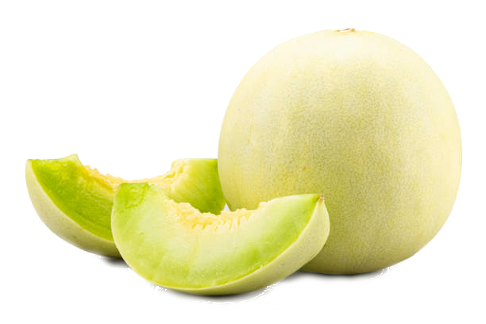
@HoneyDo

Slide 2
Goals
A sticky note on your fridge is forgotten after a day of work
Organized
Collaborative
Privacy-minded
You can’t always be on-call to remind each other what needs doing
Even your chores deserve to be as secure as the rest of your data

Slide 3
Solution
Collaborative chore lists that allow asynchronous assignment of tasks to your family members or verified contacts
@sign integrations ensure you only share your dirty laundry (it needs to be washed) with your partner

Slide 4
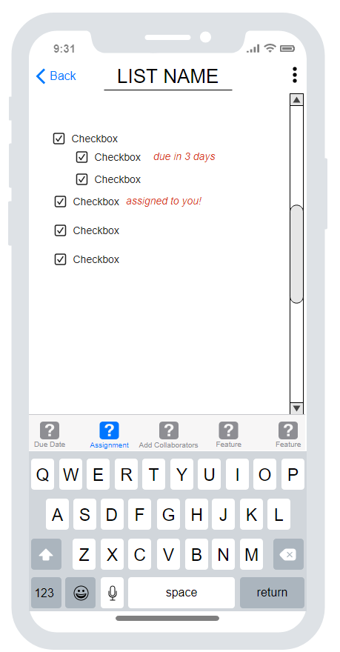
Design
Simple, intuitive design
Task-Oriented, no distractions

Slide 5
Features
Sign in with @sign
Set due dates
Stay on top of different deadlines
Share lists
Get the whole team in order
Assign tasks
Divide up the work
Collaborate

Slide 6
Future development potential
calendar integrations
handwriting input
time- or location-based reminders
See who’s currently working on a task

Slide 7
Things We Would Do Differently
Make a better plan for sharing workload
Have a doc to track progress and structure changes

Slide 8
Things We Learned
Flutters layout structure, not like html
Github merging
The importance of getting started early
Good practice for commenting
Object implementation

