Slide 1
Project 1: Investment Portfolio, an Analytic Approach
John D’Angelo

Slide 2

About the Data
Follows information regarding stocks and other financial resources
Contains stock information since several decades
Data was collected primarily for:
The analysis of Stock trends
Comparison of Currencies
Deeper financial questions

Slide 3
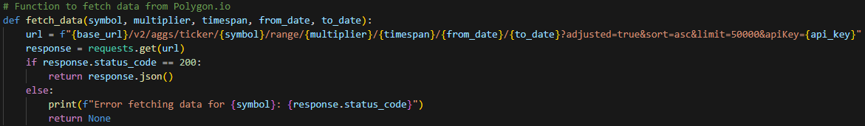
Step 1: Extract
Goal:
Retrieve stock, ETF, and currency information from Polygon using API
Approach:
Use requests python library to retrieve information and load each into individual Pandas dataframe for later use

Slide 4
Step 2: Transform
Goal: Clean import stock information so it can be loaded into SQL server for deeper analysis
Approach:
Use Pandas to perform information cleaning
Process of Cleaning includes:
Dropping unnecessary columns
Dropping missing information
Ensuring data is standardized by their values

Slide 5
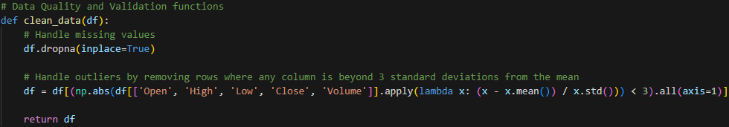
Step 2: Transform - Cont.
Transforming: removing the outliers
Notes:
This example shows how we remove outliers, this is one component of how the data is cleaned within the pipeline.

Slide 6
Step 3: Load
Goal: Move cleaned Stock Information into SQL Server
Optimal Approach:
Create Database
Create tables within the database
Use pyodbc to establish connection with local SQL server and push information from python Pandas dataframe into SQL
- Fully automated - pushes new data every time the pipeline runes

Slide 7
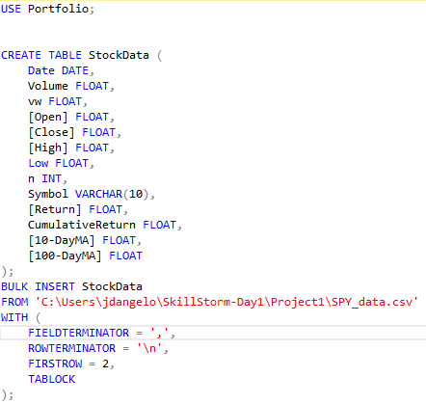
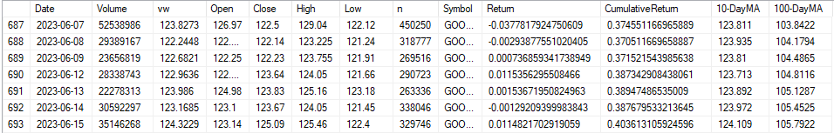
Step 3: Load
My Approach: Create aggregation table, and
import all the gathered data with bulk insert
Notes:
For the data I was working with for this project, I did not see the need to create multiple tables.
It made more sense to me to keep the data together meaning, analytical queries would be faster allowing for quicker data analysis

Slide 8
Step 4: Analysis
Goal: Find complex Analysis using information gathered
Approach:
Use the Python matplotlib library to graph results

Slide 9
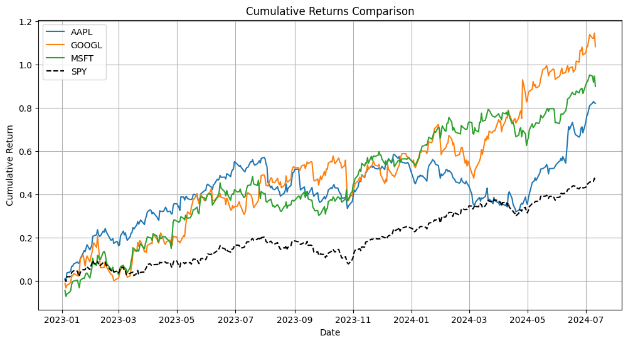
Notes:
Plot the cumulative return over time for three stocks (GOOGL, AAPL, MSFT) on the same graph for easy comparison.
The 3 stocks I chose for my portfolio, GOOGL, AAPL, and MSFT follow very similar trends increasing over the past year.
All 3 of the stocks outperform the SPY of this year with GOOGL performing the best out of the three.
This makes sense, as the stocks chosen are of large tech corporations

Slide 10
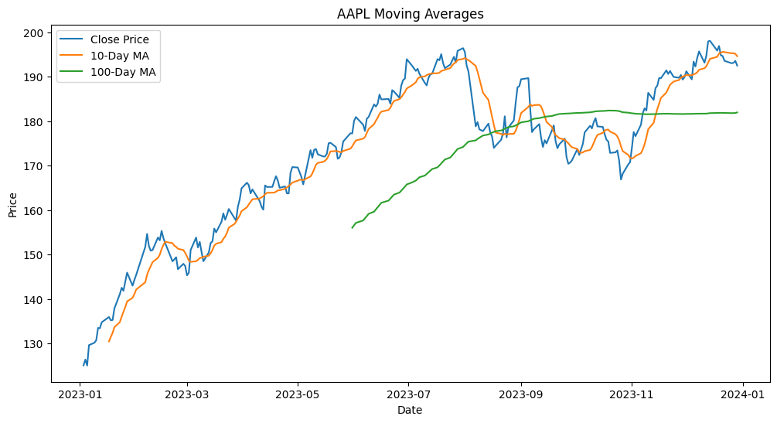
Notes:
Apple price fluctuates day to day, but when looking at the 10-Day Moving AVG, AAPL has been mailing increasing, and the 100-DAY Moving AVG strong growth and stability for more long term investors

Slide 11
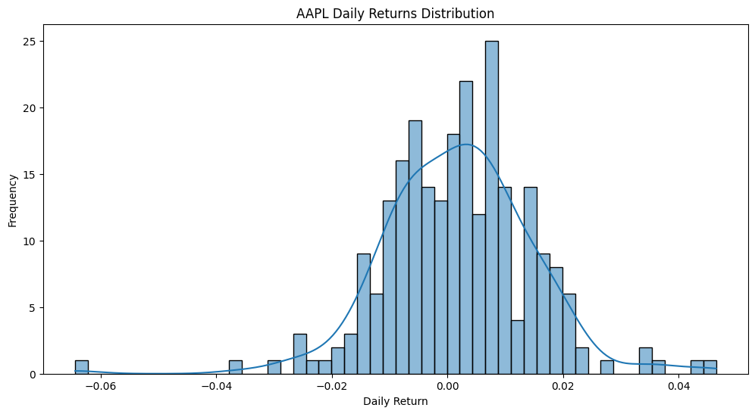
Notes:
Daily Returns Distribution from first glance seems to follow a normal distribution, the highest frequency was between .0 and 0.02, and overall AAPL has more positive daily returns than negative, though it seems relatively even
This distribution graph makes as AAPL cumulative returns have been increasing through the year

Slide 12
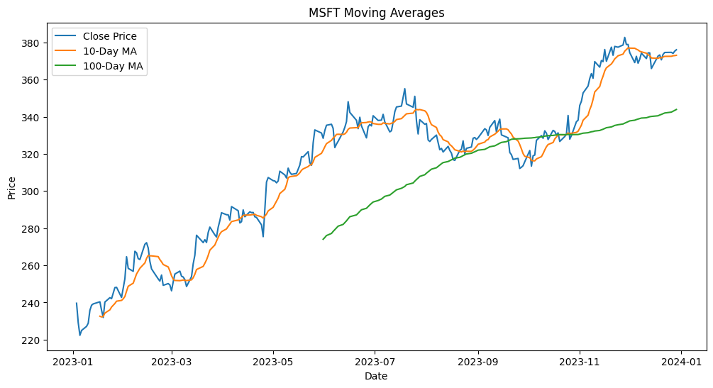
Notes:
Similarly MSFT price fluctuates day to day, but when looking at the 10-Day Moving AVG, MSFT has been mailing increasing, and the 100-DAY Moving AVG strong growth and stability for more long term investors

Slide 13
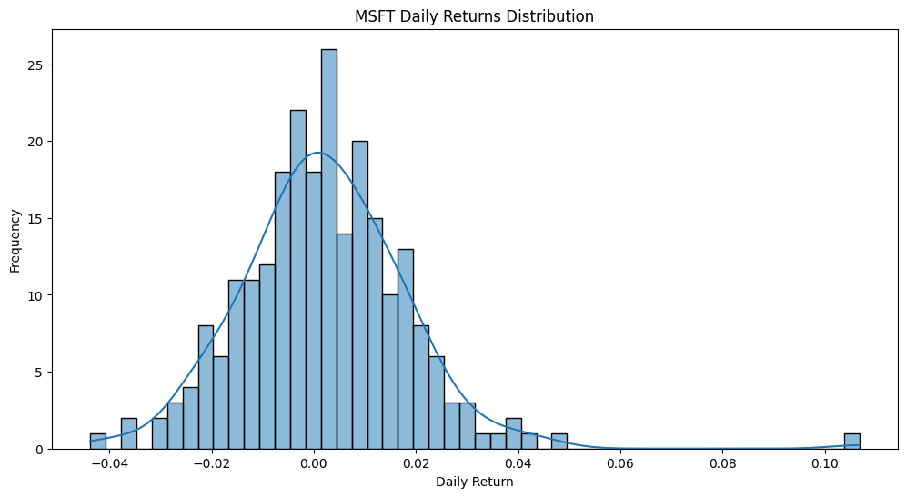
Notes:
Similarly to AAPL, MSFT Daily Returns follow a normal distribution with most days falling between .0 and .02, indicating stable growth

Slide 14
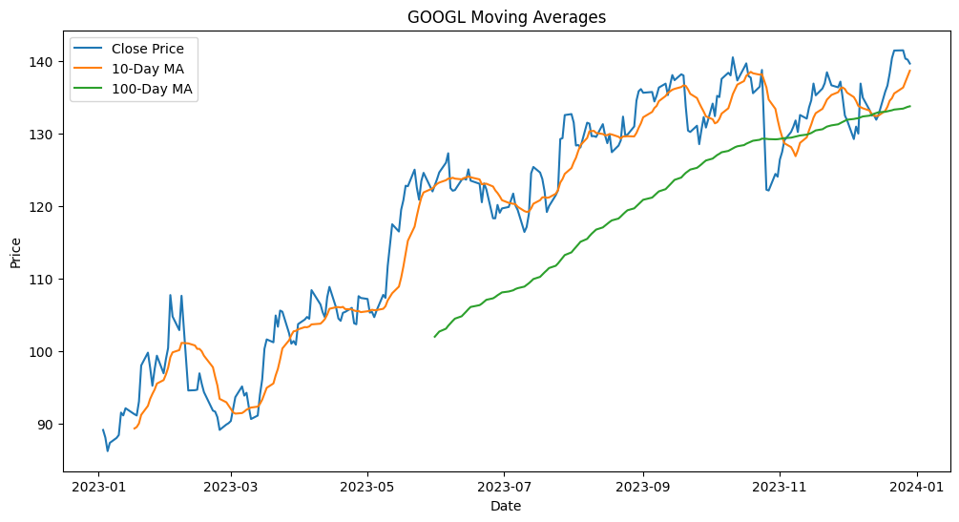
Notes:
price fluctuates day to day, but when looking at the 10-Day Moving AVG, AAPL has been mailing increasing, and the 100-DAY Moving AVG strong growth and stability for more long term investors
You can easily see that with GOOGL’s 100-Day MA, it has the highest slope, indicating its stronger growth comparatively

Slide 15
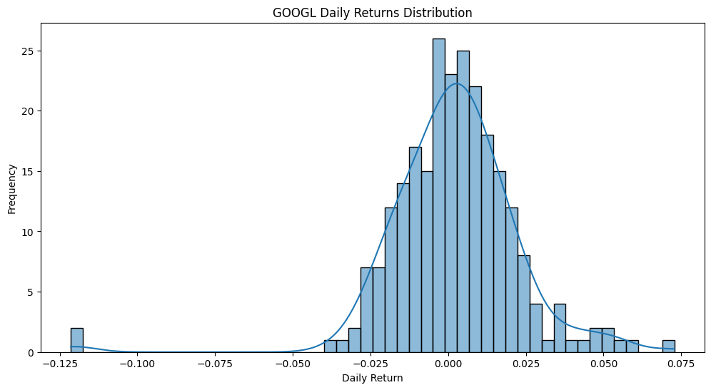

Slide 16
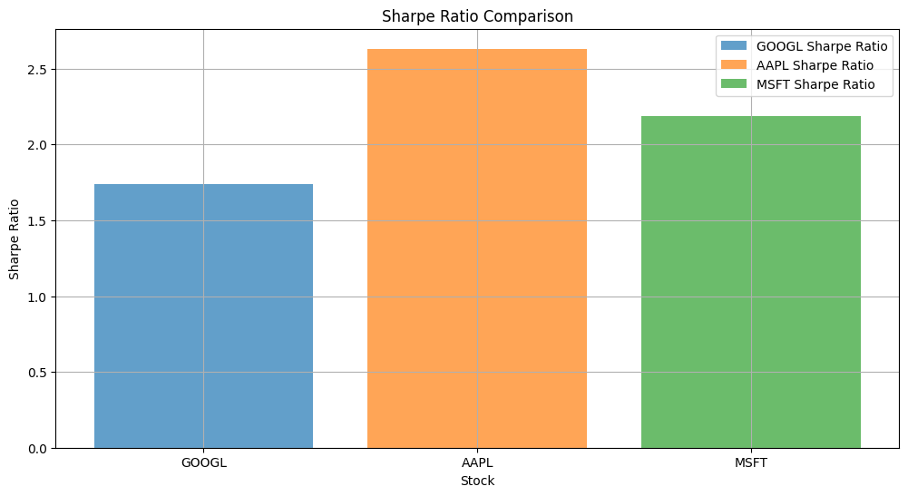
Notes:
The sharpe ratio helps investors judge investments based on risk and return variables, generally higher Sharpe ratio is better.
Between 0 - 1, these are low risk investments
Between 1-2, these are considered good investments
Between 2-3, these are considered very good
Anything above is considered to be outstanding
Despite GOOGL outperforming and showing more promising returns on the cumulative returns graph, it has a lower Sharpe ratio, suggesting that it has a lower reward to risk ratio
Sharpe ratio = ((stocks return - risk free return)/(stndard deviation of the stock))

Slide 17
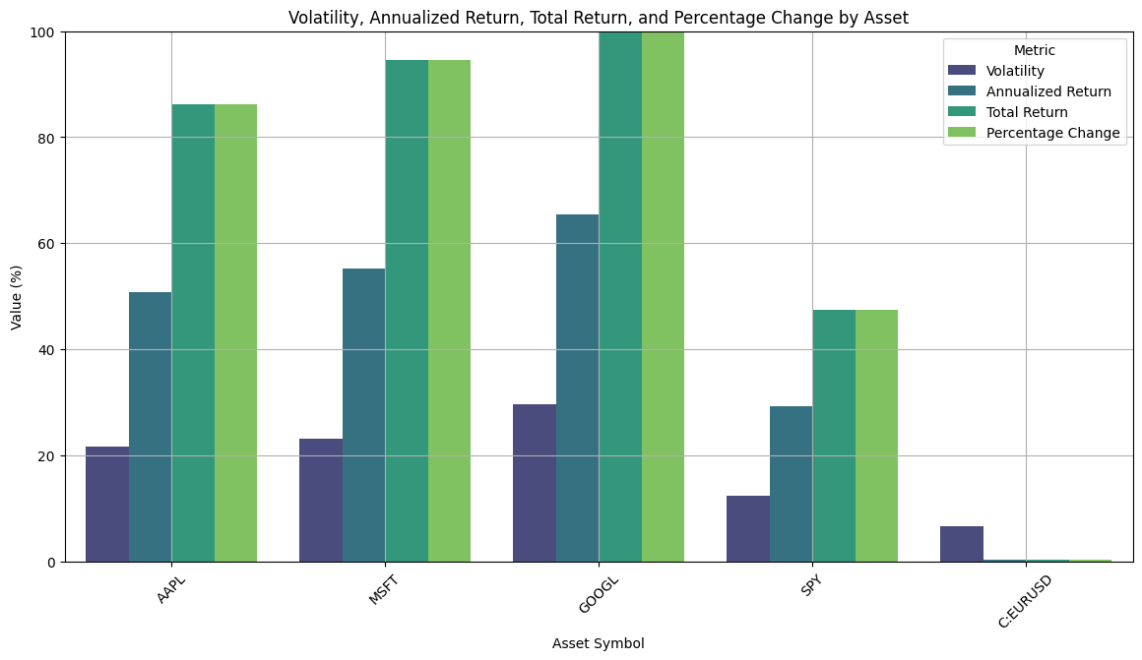
Notes:
Based on this graph, volatility increases from AAPL to MSFT to GOOGL. This makes sense as increases in risk leads to a higher chance of getting abnormal returns.
This helps us visualize why GOOGL, despite having the highest performance, is the lowest on the Sharpe comparison because of its higher risk
You can easily see that all 3 volatilities are greater than SPY
The SPY is a collection of 500 stocks, so it is inherently less risky than any one stock due to diversification
(Volatility and STDEV indicators of risk)

Slide 18
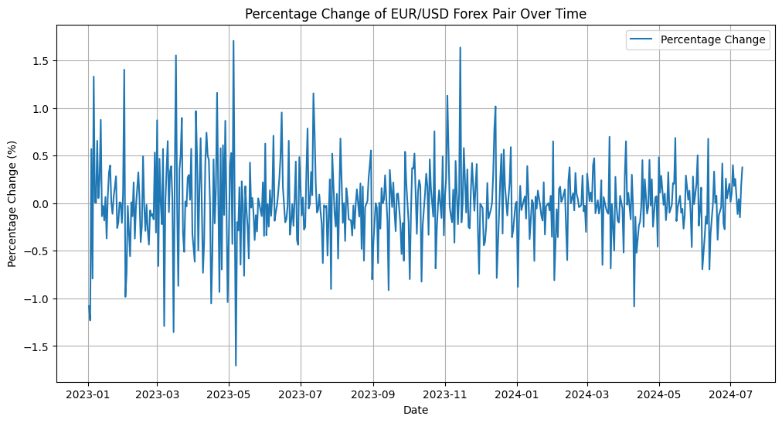
Notes:
By measuring the Percent change, we can track historical performance of the EURO compared to the USD. This tracks how much USD is needed to buy one EURO. When the percent change is positive, the price of a single EURO is decreasing in terms of USD, ie the EURO is getting weaker. When the percent change is negative, the price of a single EURO is increasing in terms of USD, ie the EURO is getting stronger.

Slide 19
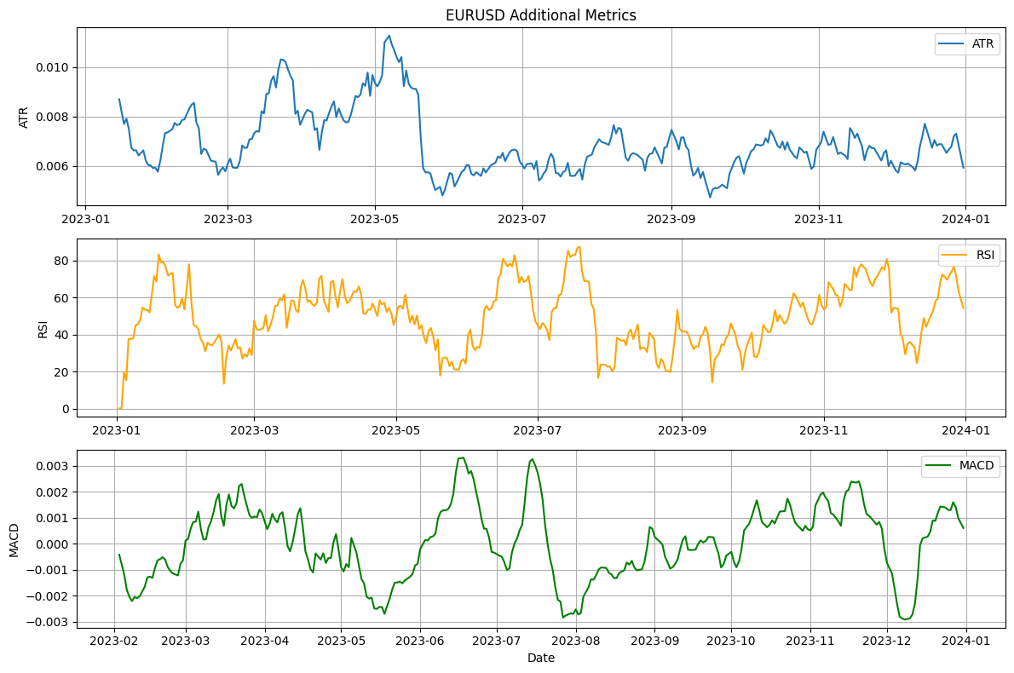
Notes:
1. Average True Range (ATR)
The Average True Range (ATR) is a measure of volatility. It measures the average range of price movement over a specified number of periods. A higher ATR indicates higher volatility, and a lower ATR indicates lower volatility.
The line fluctuates up and down based on the volatility of price movements.
Traders often use ATR to set stop-loss levels, as higher ATR values suggest wider price swings.
2. Relative Strength Index (RSI)
The Relative Strength Index (RSI) is a momentum oscillator that measures the speed and change of price movements. It ranges from 0 to 100 and is used to identify overbought or oversold conditions in a market.
Levels above 70 are considered overbought (suggesting potential selling opportunities).
Levels below 30 are considered oversold (suggesting potential buying opportunities).
Traders look for divergences between price movements and RSI to anticipate trend reversals.
3. Moving Average Convergence Divergence (MACD)
The Moving Average Convergence Divergence (MACD) is a trend-following momentum indicator that shows the relationship between two moving averages of a security’s price.
The histogram shows the distance between the MACD Line and the Signal Line.
Positive histogram values indicate bullish momentum, while negative values indicate bearish momentum.

Slide 20
Questions?

