Slide 1
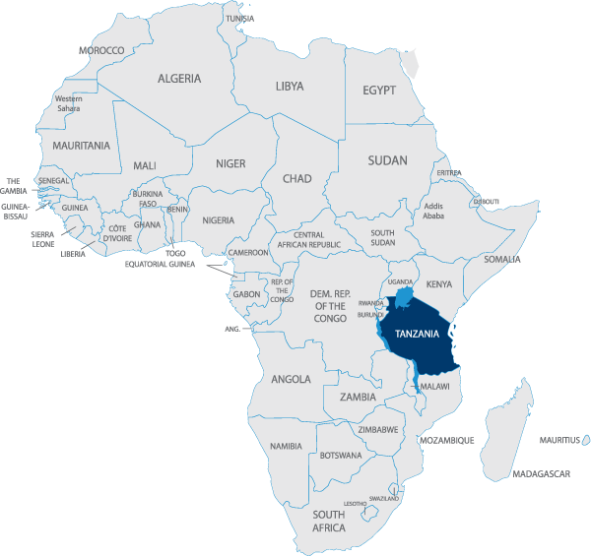

Predicting Tanzanian Water Pump Maintenance Needs
GROUP A

Slide 2
Executive Summary
This project explored the use of a variety of predictive/classification modeling techniques for purposes of predicting the functional status of water pumps located within the country of Tanzania on the basis of data provided via a www.DrivenData.org data challenge competition. Hand-driven and gravity fed water pumps are a key source of potable water throughout much of Africa and a smart understanding of which waterpoints will fail can improve maintenance operations and ensure that clean, potable water is available to communities across Tanzania.
According to Tanzania's Ministry of Water, more than 74,000 such pumps can be found throughout the country. While the installation of these pumps is largely funded via contributions from charitable and other non-governmental organizations (NGO's), their ongoing maintenance is typically the responsibility of the local community within which they reside. Unfortunately, the cost of maintaining the pumps is often beyond the means of the local community, resulting in pumps becoming non-functional. Furthermore, local communities are often unaware of the need to perform the required maintenance due to the apparent lack of any significant problems with a pump until the point it ultimately fails.
In order to predict one of the three classes of the status of the pump (functional, non-functional, functional and needs repair) the following methodology has been followed:
Data Exploration: Investigation of the characteristics of each individual variable contained within the data set, including their data types, range of valid values, their distributions, and missing data values.
Data cleaning and Feature Engineering : development of strategies for handling missing or invalid data values, binning of categorical variable values by frequency and their relationship to the response variable, feature selection method to identify the significant variables.
Predictive / Classification Modeling: Identification, development, and testing of task-appropriate predictive / classification models. Since we were tasked with classifying a pump as being in one of three possible conditions, various classification models were to be evaluated in an attempt to identify that which was most effective at making such classifications / predictions.
Final Model Selection: Predictive/classification models were evaluated on the basis of performance metrics including accuracy, classification error rates, specificity, and sensitivity.

Slide 3
Overview – Business Problem and Data Overview
Develop data-driven Supervised Machine Learning model solution which will allow:
predicting which pumps are functional, which need some repairs, and which don't work at all
Data mission
=
A total of 59,400 observations were recorded for 41 variables.
54.3% of all pumps in the data set were found to be functional, while 38.4% were non functional and 7.3%. had a status of functional needs repair.
The dataset provided has some factors with missing values, however, we identify tables such as num_private and amount_tsh wherein a large proportion of data are zeros.
The widespread incidence of missing data (zeros) throughout the data set is a strong indicator of the need for the development of statistically valid data imputation algorithms for many of the affected variables. There is a need to analyze correlations between independent variables in order to maximize the accuracy of our imputations.
Using different visual technics we can be observe the behavior and distribution of some factors and their relationship the status of the pumps (payment is a clear example of this).
We are also able to identify similarities between certain independent variables.
Data Overview & Exploration

Slide 4
Data Preparation Highlights (see details in Appendix)
Type of variable
Variable
Options reviewed
Actions for most
Impact on model
Numeric
amount_tsh
gps_height
Longitude
District_code
Num_private
Region_code
Id
latitude
construction_year
population
KNN imputation for Lat, Long, gps_height, amount_tsh.
For population, clip outliers and impute with mean
Construction_year fill with median and normalize
Remove informative features
Remove the rows with 0s
Mean of the region
knn imputation methods
Clip outliers
Categorical
Treat features with high number of levels:
Group values with freq < 1% as Others
Create new dummy variable
Drop variables and keep the groups created.
Find similarity and correlation on the features.
Sample categorical :
installer
public_meeting
scheme
scheme_management
management
management_group
permit
Payment
Drop: source class, source type, etc
Do Nothing: waterpoint_type
Feature created: installer
Dummies variables created

Slide 5
Feature Selection & Pre-Modeling
Dummy
Variables for
Categorical
Continuous
Variables
transformation
Chi Squared
Information
Gain
Train, Test
Split
Pre-Modeling
Feature selection for first analysis was made combining the following techniques: 1. business understanding, 2. visualization and 3. feature selection models.
(*)
This are just some of the
feature combinations used
to maximize
the accuracy of the model
(*) Variables showed in chart are those with an attribute importance higher than 30%

Slide 6
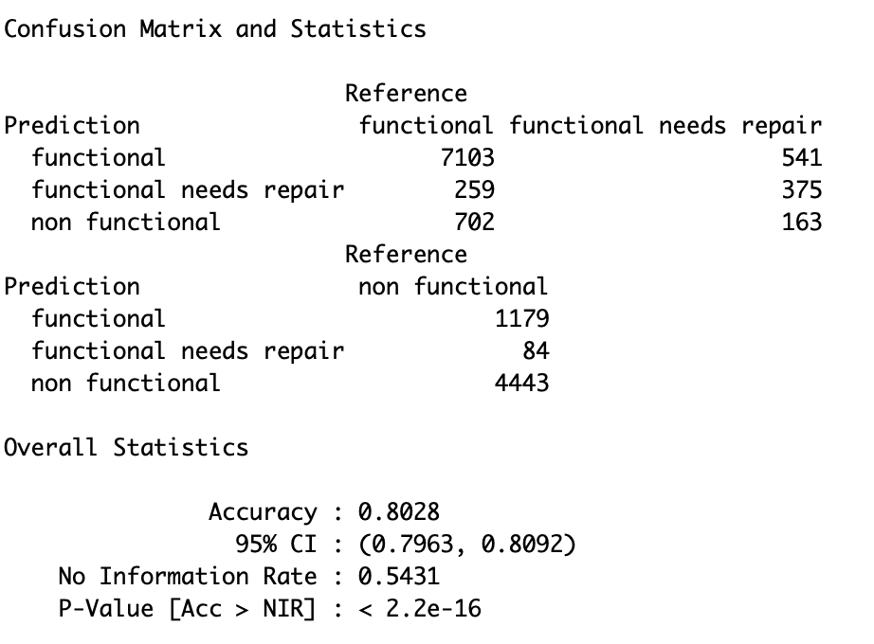
Model Evaluation
Measure used to compare models: Accuracy (Positive/Total)
Algorithm Selected: Random Forest. Best model for classification where data has high number of factors.
Fine tuning of the model:
Initially we run a couple of models doing Cross-Validation with different combination of features (reduce bias) to get the best parameters and avoid overfiting: mtry = 43 and a reasonable number of trees (100). The result for 100 trees was very close to the one got with 1000 performing much faster.
Continue to run the model for different combinations of features with those parameters fixed to find the best combination.
Other algorithms used:
Linear model: the accuracy is significantly lower
XGBoost: required too much computational power (more than 24hours vs 3’) to run the model with a limited grid and the result was not significantly better (0.809)
High Level Model Evaluation
After defining the best model, we run more than 20 different combination of features (and treatment). And the most important features (explaining most of the result) are the following
position (long and lat)
If the waterpoint is dry
gps_height
Waterpoint_type
Amount_tsh
Population
Age
Extraction.type
Quantity
Payment.never
Best Output
With this model we can predict the status of the pumps more than 80% of the time. This percentage is reduced if we want to focus on the non functional and the model is less accurate if we want to focus on functional needs repair.

Slide 7
Moving Forward
Update the model with new data and continue monitoring the results to see how is performing and if there are new trends to consider
Introduce new analysis if our aim is to predict with higher accuracy those pumps in critical status before they stop working and therefore identify main reasons of those failures (better understanding of region resources, population behavior or availability of skilled labor for maintenance and quality of components and replacements)
Collection of the data seems to be manual. This needs to be adjusted and different categories unified using drop-lists for example and assure quality of the data
On the upcoming we will also need to better understand some of the internal features delivered by the government

Slide 8
Appendix A: Data Preparation (1 of 3)
Feature | Comments | Action | Notes
Id | Order feature. | Not considered on the analysis | not considered on the modeling
date_recorded | The date the row was entered - change format to date. | create 2 new features: Age: year(date_recorded) - construction_year Rainy_season: if month(date_recorded) in c(rainy_season_month) -> T or F | both new variables where considered on the analysis
recorded_by | Group entering this row of data - constant - 1 unique value | Removed. Not considered on the analysis | not considered on the modeling
wpt_name | Name of the waterpoint if there is one – factor with 37400 dif values. | not considered on the analysis | not considered on the modeling
num_private | no information on this feature. 98% are 0s. | not considered on the analysis | not considered on the modeling
amount_tsh Total static head | Amount of water available 70% of 0s. This 0s might be valid values. For observations with high values we observed a high percentage of functional waterpoints so it might be an important variable and will try to treat it. | Alternative 1: not consider the variable due to the high number of missing values Alternative 2: fill the 0s with knn imputation based on region, source and waterpoint_type | models with the alternative 2 has better results. As expected is an important feature to predict the status.
gps_height Altitude of the well | wide range of valid values considering mount Kilimanjaro is located in Tanzania. Although 0 might be a valid value, 34% seems a very high value and we will treat/impute them. | Impute missing values with other geographical features: 1. Mean of the region 2. knn using all geographical inputs | alternative 2 has a better results
longitude | 3% of 0s, this is not a valid imput. Valid values between 29 and 40 (aprox.) | Impute missing values with other geographical features: 1. Remove the rows with 0s 2. Mean of the region 3. knn using all geographical inputs | alternative 3 has a better results
latitude | 3% of 0s, this is not a valid imput. Valid values between -1 and -12 (aprox.) | Impute missing values with other geographical features: 1. Remove the rows with 0s 2. Mean of the region 3. knn using all geographical inputs | alternative 3 has a better results
construction_year | Min: 1960 and Max: 2013. high number of missing values: 35% of 0s (not valid) | Alternative 1: fill the missing values with the median (2000) Alternative 2: fill the 0s with knn imputation based on region, source and waterpoint_type | after filling the 0s with the alt 2 we don’t use for the modeling as we already have the age of the waterpoint.
population (around the well) | 36% of 0s. This is not a valid number significant number of observations with 1s. We accept this value as valid few observations with values above 10k. | 1st We clip this outliers to 10k to avoid their impact on the mean (fill 0s) and modeling. 2nd We replace 0s with the mean (calculate without 0s - 218 habitants) | this feature is used in our models as it have a positive impact on the result of the models

Slide 9
Appendix A: Data Preparation (2 of 3)
Feature | Comments | Action | Notes
funder | Who funded the well - factor with high cardinality (2400 different values) | high correlation with installer | not considered on the modeling
installer | Organization that installed the well | Alternative 1: group values with freq < 1% as Others Alternative 2: find similarity on the imputs using the first 3 letters and keep the 15 more frequent values. (new feature called Installer_3) | keep the new feature installer_3
public_meeting | Boolean feature. No clear definition of the meaning. High percentage of 0s. | no treatment to be done. Evaluate if its inclussion has a possitive impact on the modeling
scheme_management - Who operates the waterpoint – factor w 13 levels |  | 3% of missing values
#scheme_name | Who operates the waterpoint - factor with high cardinality: 2869 different obs. High number of missing values | feature manually included. Correlated with scheme_management | not considered for the analysis.
management | How the waterpoint is managed - factor w 12 levels | feature corelated with scheme management but is used to complement the missing values between both
management_group - How the waterpoint is managed - factor w 5 levels (related to managment) |  | binned of management | not considered for the analysis.
permit | Boolean feature. No clear definition of the meaning. High percentage of 0s. | no treatment to be done. Evaluate if its inclussion has a possitive impact on the modeling
payment | What the water costs – factor w 7 levels | We created a new dummy variable called pay: 1 if there is any type of payment (annually, monthly, etc.) and 0 if there is no payment at all. | After trying both alternatives we decided to include the payment factor on the analysis
payment_type | same as payment | as there are not many missing values or a high number of levels on the more granular descriptive variable we keep payment | not considered for the analysis
water_quality | The quality of the water - factor w 8 levels | we created a new dummy variable called water_quality_good where we binned all the levels other than good as 0. | After trying both alternatives we decided to keep the more general
quality_group | binned version of water_quality | as there are not many missing values or a high number of levels on the more granular descriptive variable we keep water_quality | not considered for the analysis
quantity | The quantity of water - factor w 5 levels | we created a new dummy variable called water_quantity_enough where we binned all the levels other than enough as 0. | After trying both alternatives we decided to keep the more general

Slide 10
Appendix A: Data Preparation (3 of 3)
Feature | Comments | Action | Notes
quantity_group | same as quantity | as there are not many missing values or a high number of levels on the more granular descriptive variable we keep quantity | not considered for the analysis
source | The source of the water – factor w 10 levels | Alternative 1: group values with freq < 1% as Others Alternative 2: find similarity on the levels and group manually Alternative 3: do nothing | Results are slightly higher if we do nothing with this feature but to avoid future overfiting and save on resources we will keep alt 1
source_type | binned version of water_quality | as there are not many missing values or a high number of levels on the more granular descriptive variable we keep source | not considered for the analysis
source_class | binned version of water_quality | as there are not many missing values or a high number of levels on the more granular descriptive variable we keep source | not considered for the analysis
waterpoint_type | The kind of waterpoint – factor w 7 levels | Alternative 1: group values with freq < 1% as Others Alternative 2: find similarity on the levels and group manually Alternative 3: do nothing | Results are slightly higher if we do nothing with this feature but to avoid future overfiting and save on resources we will keep alt 1
#waterpoint_type_group | binned version of waterpoint_type | as there are not many missing values or a high number of levels on the more granular descriptive variable we keep waterpoint_type | not considered for the analysis
extraction_type | The kind of extraction the waterpoint uses - factor 18levels | Alternative 1: using extraction_type, group values with freq < 1% as Others Alternative 2: use extraction_type_class Alternative 3: use extraction_type_group | Decision of which feature to include based on the balance results/resources of each of the 3 alternatives. Run the model with 18 levels is not a good option to consider
#extraction_type_group - The kind of extraction the waterpoint uses - factor 13levels (related to extraction type) | binned version of extraction_type - factor w 13 levels
#extraction_type_class - The kind of extraction the waterpoint uses - factor 7levels(related to extraction type) | binned version of extraction_type - factor 7 levels

Slide 11
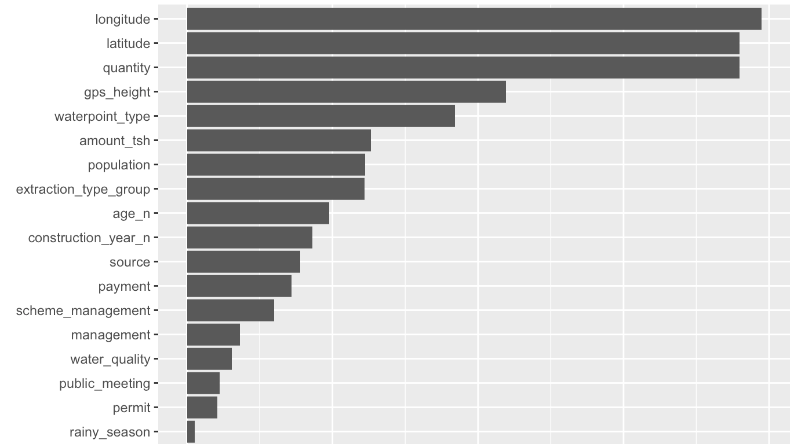
Appendix B: Feature importance

Slide 12
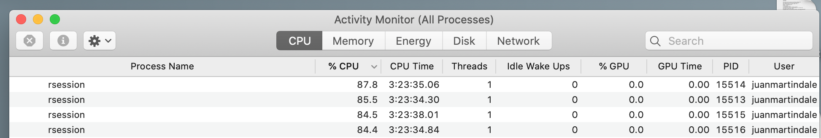
Appendix C:
Computational power required to run the xgboost:
4 cores operating at 85% for aprox 3.5 hours.

Slide 13

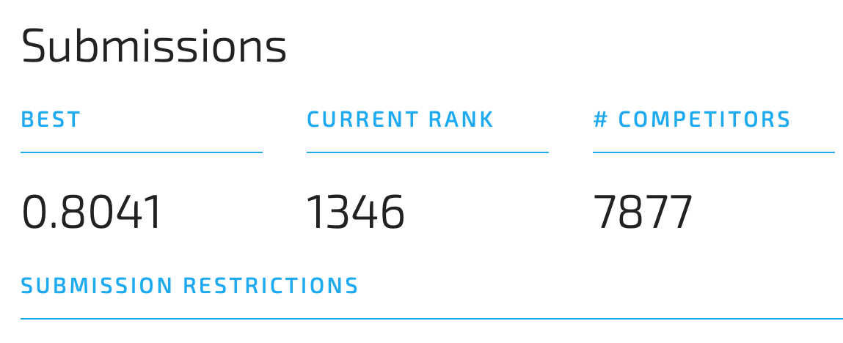
Appendix D: About the competition

Slide 14
Predicting Tanzanian Water Pump Maintenance Needs
Thank you !

