Slide 1
Robotics
Lesson 4 – Direct kinematics

Slide 2
Agenda
Interaction routines for the robot Rob3 in joint angular coordinates
Direct kinematics
Examples
Rob 3 direct kinematics implementation

Slide 3
Rob3 protocol
Initialize Robot
Move a single axis to a specific angle (degree or radians)
Move all axis to specific angles (degree or radians)
Move one axis to specific angle with given speed in degree or radians per unit_time
Move all axis to specific angles in degree or radians per unit_time

Slide 4
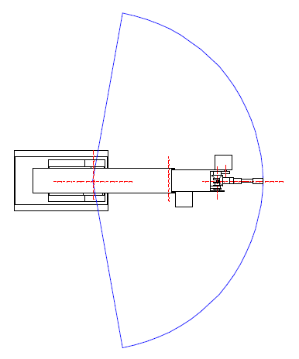
For axis 1
+80º
255 steps
a/160=d/256
0 degree corresponds to 127 steps
0 steps -> -80 degree
function: Steps -> degree
function: degree -> step
0º
127 steps
-80º
0 steps

Slide 5
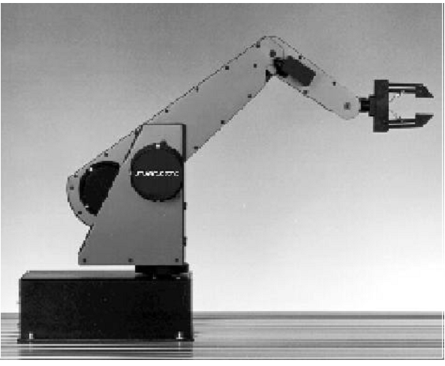
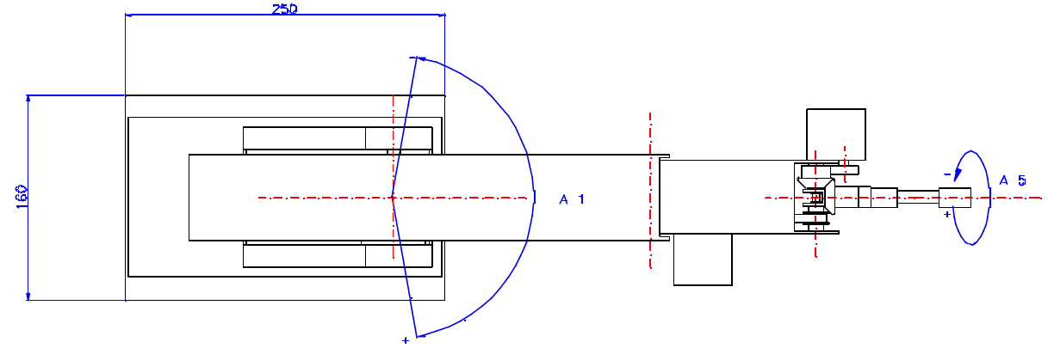
The Rob 3

Slide 6
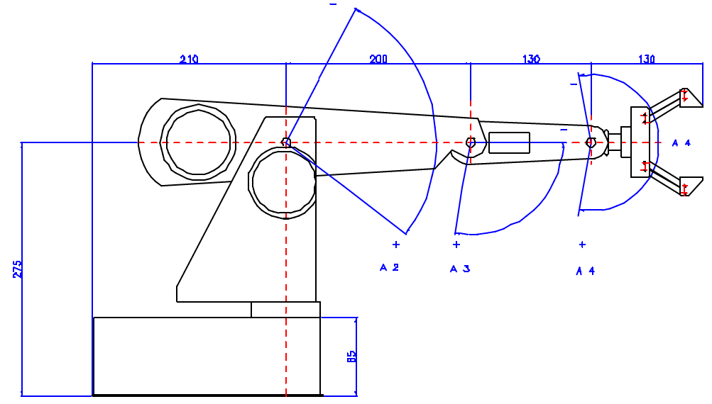
The Rob 3

Slide 7
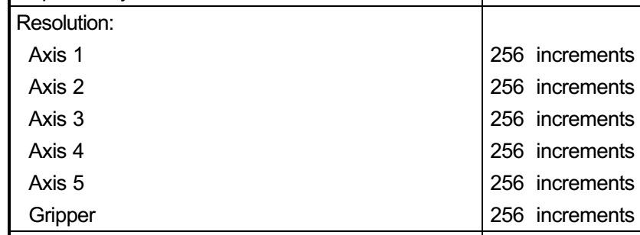
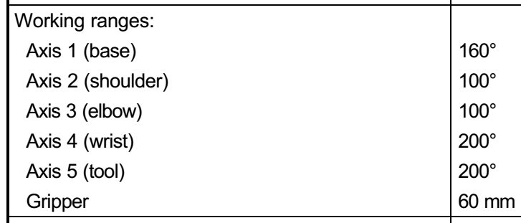
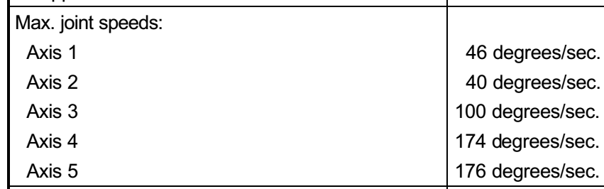
Working range and speed
Resolution

Slide 8
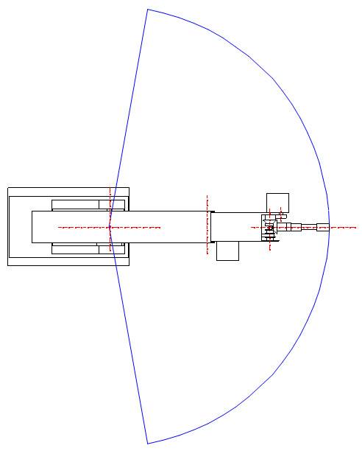
Rob 3: Joint 1

Slide 9
Transformation into steps
Digital value between 0 and 255
Teta_1 ∈ [-80,80] º -------> [0,255] steps
Teta_2 ∈ [-50,+50] º -------> [0,255]
Teta_3 ∈ [0,-100] º -------> [0,255]
Teta_4 ∈ [--100,+100] º -------> [0,255]
Teta_5 ∈ [-100,+100] º -------> [0,255]
Gripper∈ [0, 60]mm -------> [0,255]
Angular resolution for teta_1 = 160/255 = 0.627º/step
Angular resolution for teta_2 = …

Slide 10
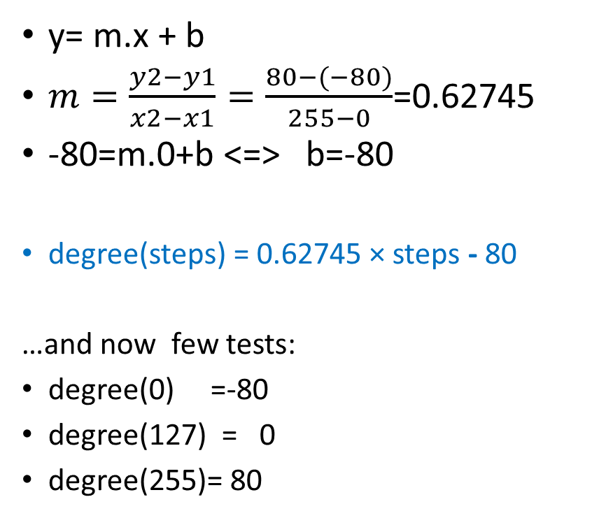
Conversions of steps to degree: Rob3, axis 1
y= m.x + b
$m=\frac{y2−y1}{x2−x1}=\frac{80−(−80)}{255−0}$=0.62745
-80=m.0+b <=> b=-80
degree(steps) = 0.62745 × steps - 80
…and now few tests:
degree(0) =-80
degree(127) = 0
degree(255)= 80
Conversions for other axis are similar

Slide 11
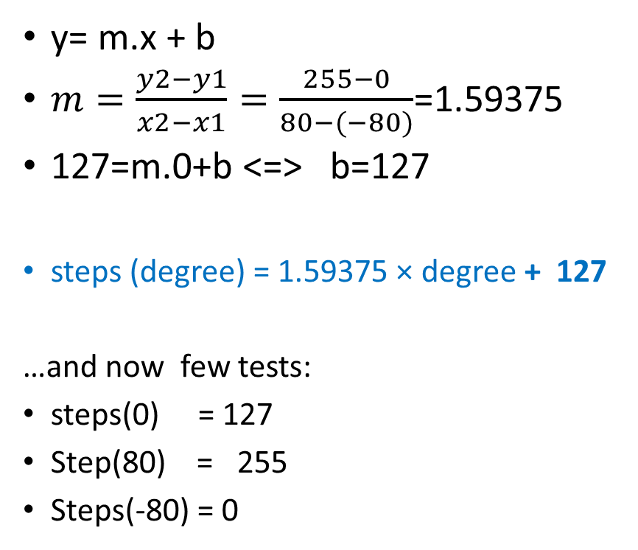
Conversions of degree to steps: Rob3, axis 1
y= m.x + b
$m=\frac{y2−y1}{x2−x1}=\frac{255−0}{80−(−80)}$=1.59375
127=m.0+b <=> b=127
steps (degree) = 1.59375 × degree + 127
…and now few tests:
steps(0) = 127
Step(80) = 255
Steps(-80) = 0
Conversions for other axis are similar

Slide 12
Move one axis
void move_one_axis(TCommPort *Cp,int axis,int steps)
{
int tam;
char Buff[20];
char comando[10]={0x8+axis-1,steps,3,0};
Cp->Enviar(comando,3,tam);
printf("\n%s...", Cp->GetMensagem() );
Sleep(200);
Cp->EsperarRecepcao();
Cp->Receber(Buff,2,tam);
printf("\n%s...", Cp->GetMensagem() );
}
int move_one_axis(int axis, double angle)
{
int steps;
If(axis==1)
steps=degree_to_steps_j_1(angle);
// put code to here to verify movement is allowed
//….
//…
move_one_axis(port, axis, angle);
}

Slide 13
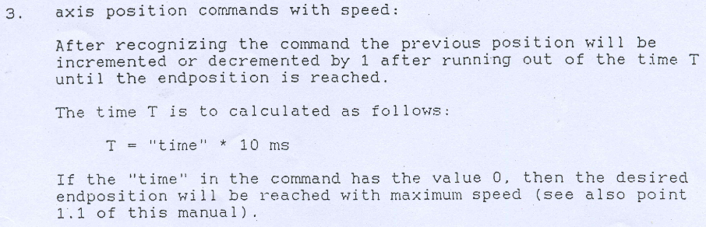
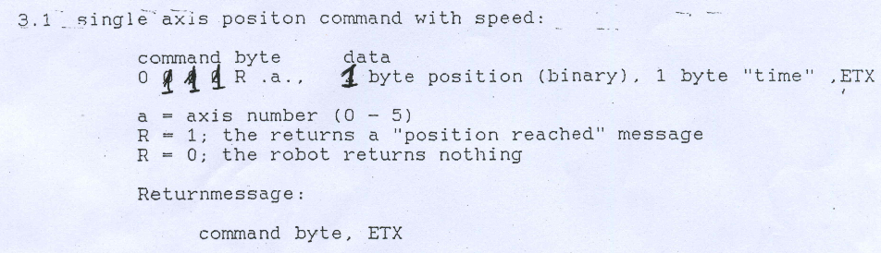
Rob3: move 1 axis with speed (1)

Slide 14
Rob3: move axis 1 with speed (2)
Each step variation corresponds to
THEREFORE, speed_in_steps = number_of_steps / time =
speed_in_steps = (255-0) / 255*T*10ms = 1 step /T*10ms
speed_in_steps = 100/T steps/second

Slide 15
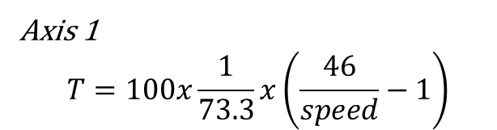
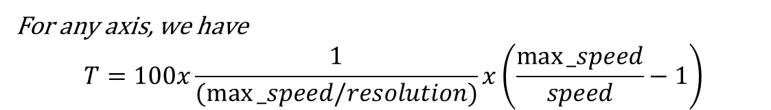
Rob3: move axis 1 with speed (3)
Each step variation corresponds to
46º/ sec ---------------------> 73.3 steps/sec [divide 46 by joint’s angular resolution 0.627]
46º ---------------------> takes 1 second + 73.3*delay_T
We have that speed_in_degrees = 46º / (1 sec + 73.3*T*10ms) [T ranges from 0 to 255]
If we need to determine T as a function of a specified speed, we take the inverse
Axis 1
$$T=100x\frac{1}{73.3}x\left(\frac{46}{speed}−1\right)$$
For any axis, we have
$$T=100x\frac{1}{(max⁡_speed/resolution)}x\left(\frac{max⁡_speed}{speed}−1\right)$$

Slide 16
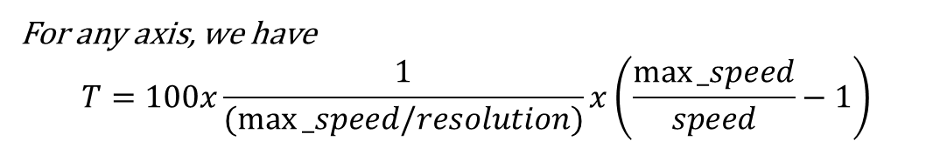
Speed per second to T factor
For any axis, we have
$$T=100x\frac{1}{(max⁡_speed/resolution)}x\left(\frac{max⁡_speed}{speed}−1\right)$$
int speed_to_T(double max_speed, double resolution, double desired_speed)
{
double factor = max_speed/resolution;
int T = 1/factor*( (max_spedd/desired_speed) - 1 );
return (int) T;
}

Slide 17
Testing
int speed_to_T(double max_speed, double resolution, double desired_speed);
T = speed_to_T( 46, 160.0/255.0, 10) // 10º/sec
T = 4.911 ≈ 5
Therefore, if you wish axis 1 to move at 10º/sec , you should set T=5 as the “time” byte to be used in the move axis with speed command.

Slide 18
Forward kinematics

Slide 19
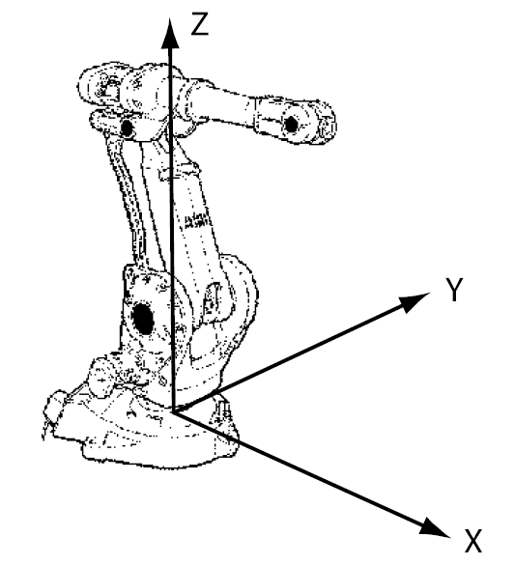
TCP coordinates
Given the characteristics of the robot’s links and joints, how to determine the localization and orientation of the TCP?
TCP (tool center point)

Slide 20
Kinematic equations
Kinematic equations describe the tool frame relative to the base frame as a function of the joint variables.

Slide 21
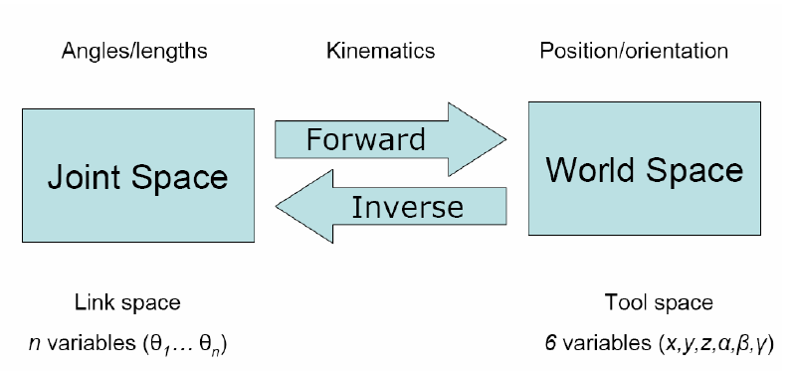
Joint and world coordinates

Slide 22
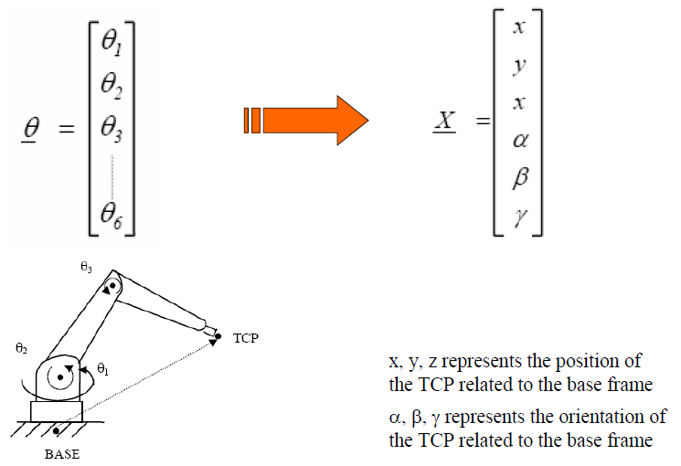
Direct Kinematics (1)

Slide 23
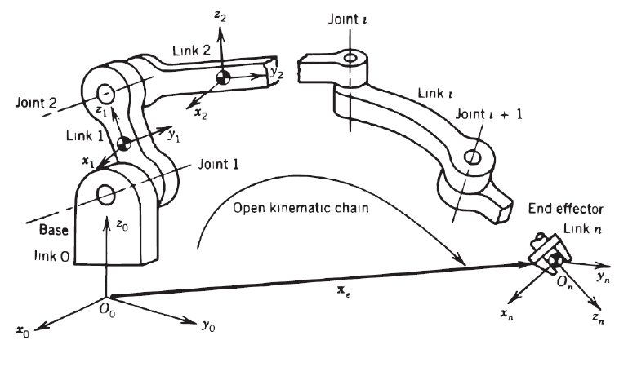
Direct kinematics (2)

Slide 24
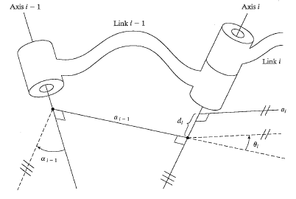
Link connection description
The link offset d and the joint angle θ are two parameters that may be used to describe the nature of the connection between neighboring links.

Slide 25
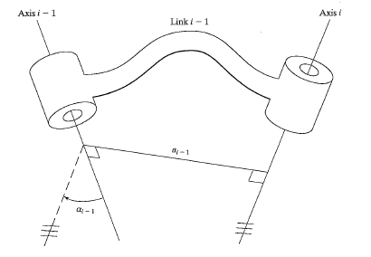
Kinematic function of a link
The kinematic function of a link is to maintain a fixed relationship between the two joint axes it supports. This relationship can be described with two parameters: the link length, a, and the link twist α.

Slide 26
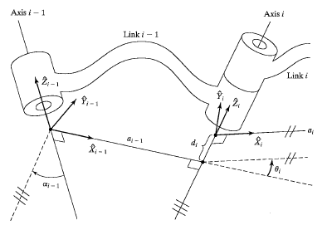
Frames attachment
Link frames are attached so that frame {i} is attached rigidly to link i.

Slide 27
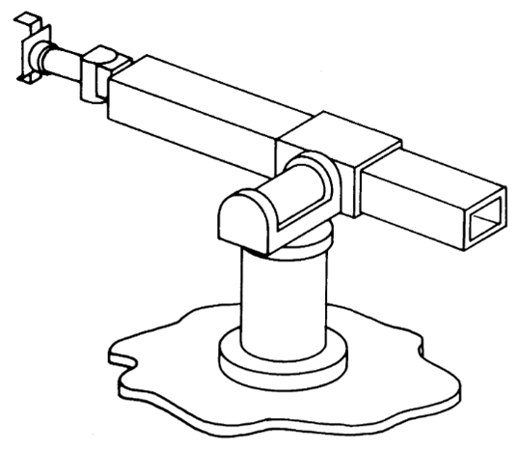
Link-frame attachment procedure
Identify the joint axes and imagine (or draw) infinite lines along them. For steps 2 through 5 below, consider two of these neighboring lines (at axes i and i + 1).
Identify the common perpendicular between them, or point of intersection. At the point of intersection, or at the point where the common perpendicular meets the i th axis, assign the link-frame origin.
Assign the Z_{i-1} axis pointing along the i th joint axis.
Assign the X_{i} axis pointing along the common perpendicular, or, if the axes intersect, assign X_{i} to be normal to the plane containing the two axes.
Assign the Y_{i} axis to complete a right-hand coordinate system.
Assign frame {0} to match frame {1} when the first joint variable is zero. For frame {N}, choose an origin location and X_{N} direction freely, but generally so as to cause as many linkage parameters as possible to become zero. Generally, Z_{N} is the approach axis, Y_{N} is for sliding and X_{N} normal to Z_{N-1}.

Slide 28
Link parameters in terms of the link frames
If the link frames have been attached to the links according to our convention, the following definitions of the link parameters are valid:
a_{i-1} = the distance from Z_{i-1} to Z_{i} measured along X_{i-1}
α_{i-1} = the angle from Z_{i-1} to Z_{i} measured along X_{i-1}
d_{i} = the distance from X_{i-1} to X_{i} measured along Z_{i}
θ_{i} = the angle from X_{i-1} to X_{i} measured along Z

Slide 29

Matrix model

Slide 30
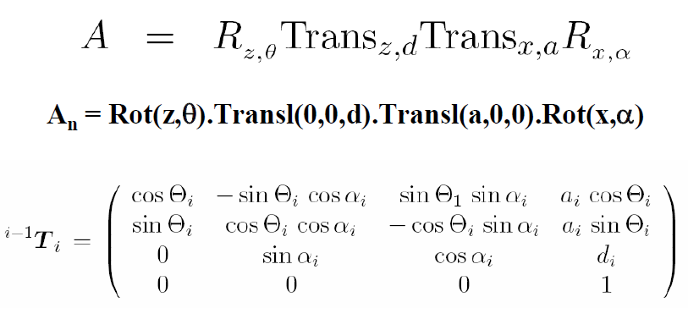
Denavit-Hartenberg Matrix

Slide 31
Example STANFORD Robot

Slide 32
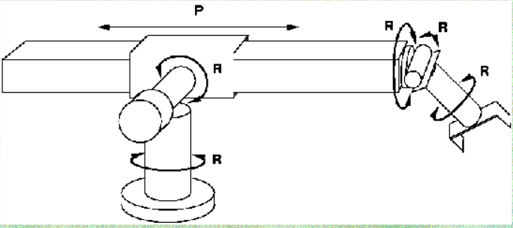
STANFORD’s Joints

Slide 33
Draw imaginary lines along each joint

Slide 34
Origin of reference frames
Along the lines imaginary lines

Slide 35
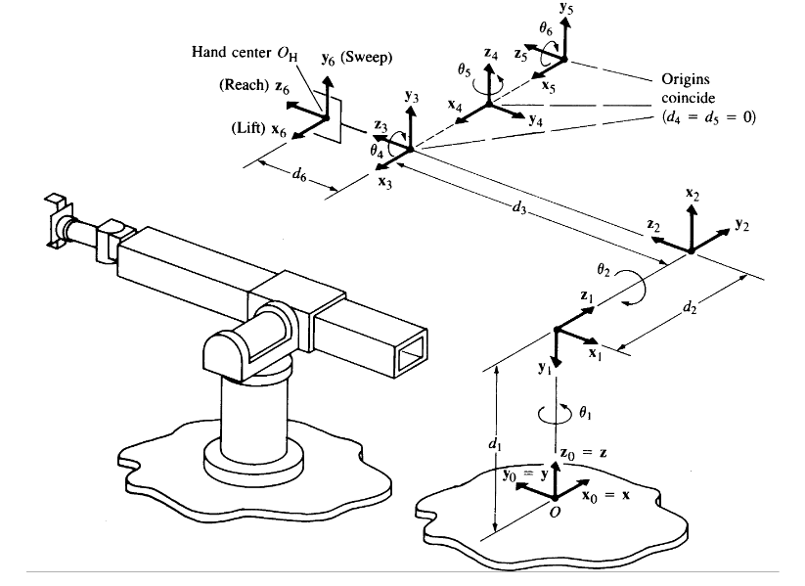
Attach reference frames according to D-H rules

Slide 36
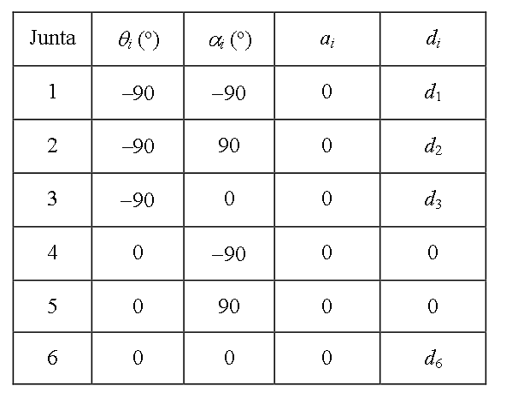
DH parameters for STANFORD Robot

Slide 37
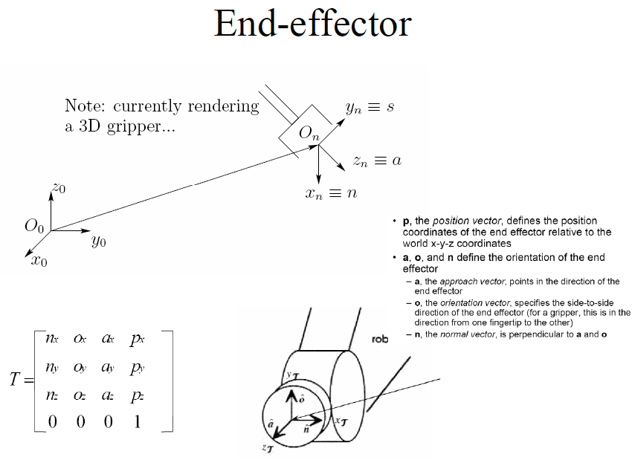
We model end-effector
for ROb3 in posterior slides

Slide 38
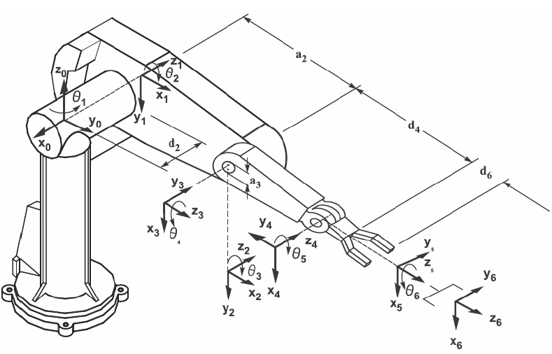
Examples with Robot PUMA

Slide 39
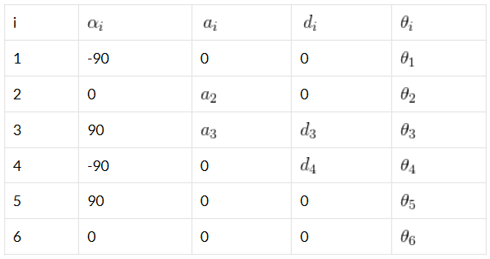
Example with robot PUMA (2)

Slide 40
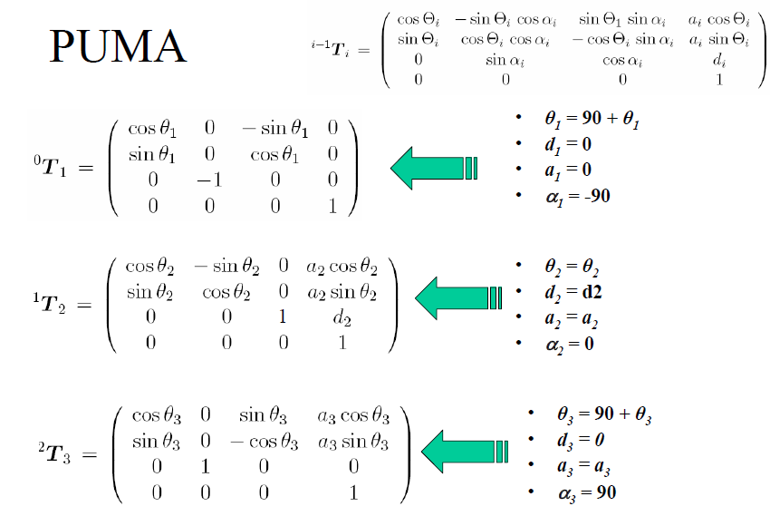

Slide 41
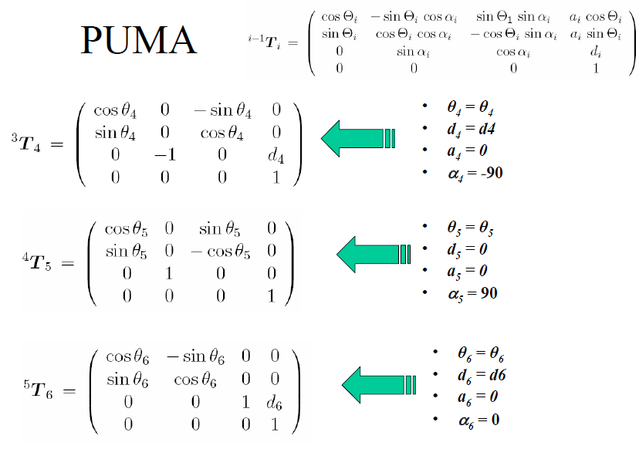

Slide 42
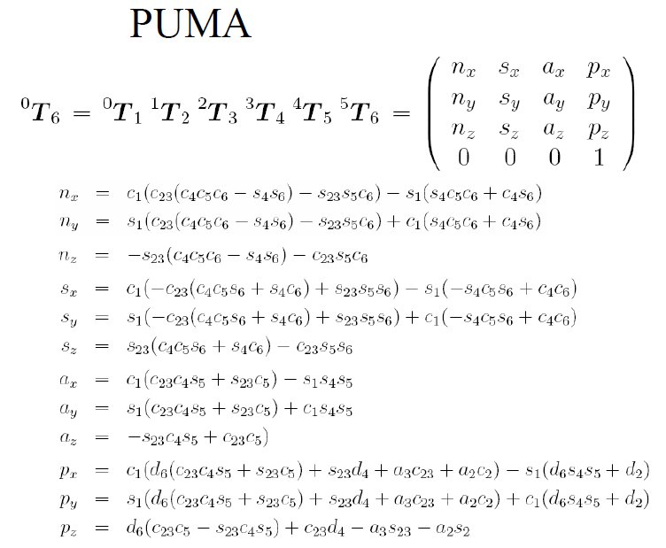

Slide 43
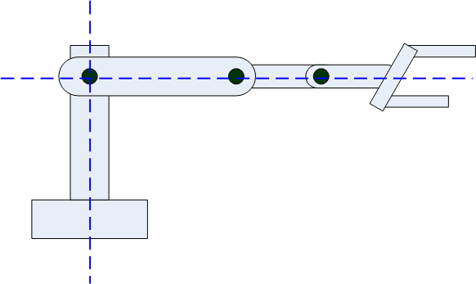
Rob3 (draw imaginary lines)

Slide 44
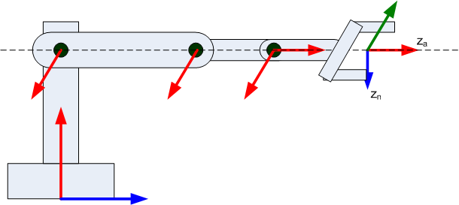
Place z-axis
z-1 axis along i-th joint

Slide 45
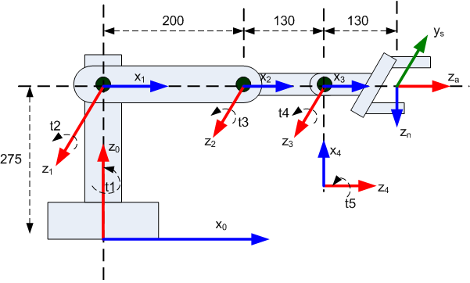
Rob3 (x-axis)
Along common perpendicular to between consecutive z-axis (from z_{i-1} to z_{i}).
If z_{i-1} to z_{i} intercept, x-axis is assigned to be normal to the plane containing the two axis (z_{i-1} to z_{i )}
Assign Y-axis to complete the right-hand coordinate frame.

Slide 46
Rob3 Denavit-Hartenberg
joint | teta_i | alpha_i | a_i | D_
1 | 0 | 90 | 0 | d1
2 | 0 | 0 | a2 | 0
3 | 0 | 0 | a3 | 0
4 | 90 | 90 | 0 | 0
5 | 180 | 0 | 0 | d5

Slide 47
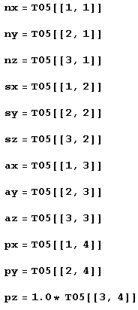
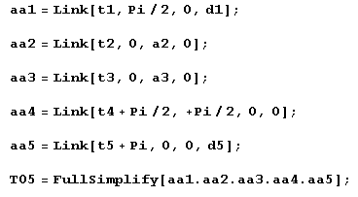
Rob3 DH equations (edited in Mathematica Software)
Transformation matrixes
orientation
position

Slide 48
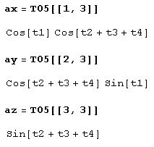
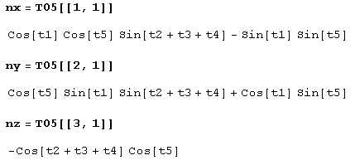
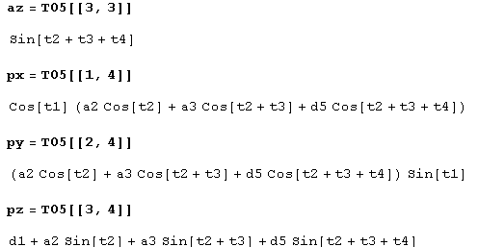
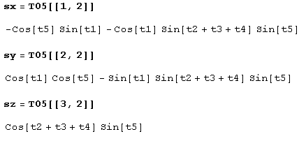
Rob3- DH equations

Slide 49





Performing some tests

Slide 50
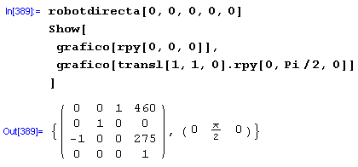
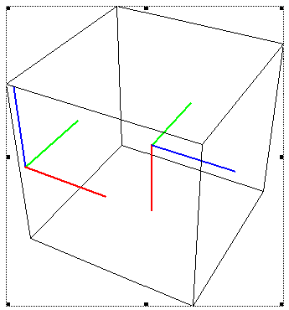
Rob3 with all joints at 0º

Slide 51
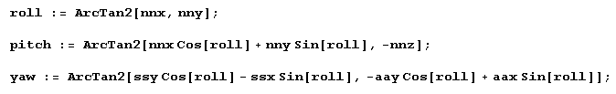
Roll-pitch-yaw
Be carful with arcTan(y/x)

Slide 52
More accurate ArcTan function
It provides the true angle considering the quadrant specified by components x and y.
It firstly tests whether x and y are zero, which returns 0, or otherwise it returns ArcTan(x,y).
There is a C++ double atan2(y,x) // order of parameters swapped
You can’t call atan2 directly if x==0 and y==0 (domain error).
Define ArcTan2 in C++, which prevents the error when calling atan2

Slide 53
Function direct_kinematics for Rob3
//int direct_kinematics(double t1, … [here we ommit variable types]
int direct_kinematics(t1, t2, t3, t4, t5, &x, &y, &z, &roll, &pitch, &yaw){
x = cos(t1)*(a2*cos(t2)+a3*cos(t2+t3)+d5*cos(t2+t3+t4);
//… develop remaining code here
//… a2, a3 and d5 are on the DH table
}

Slide 54
GUI user interface

Slide 55
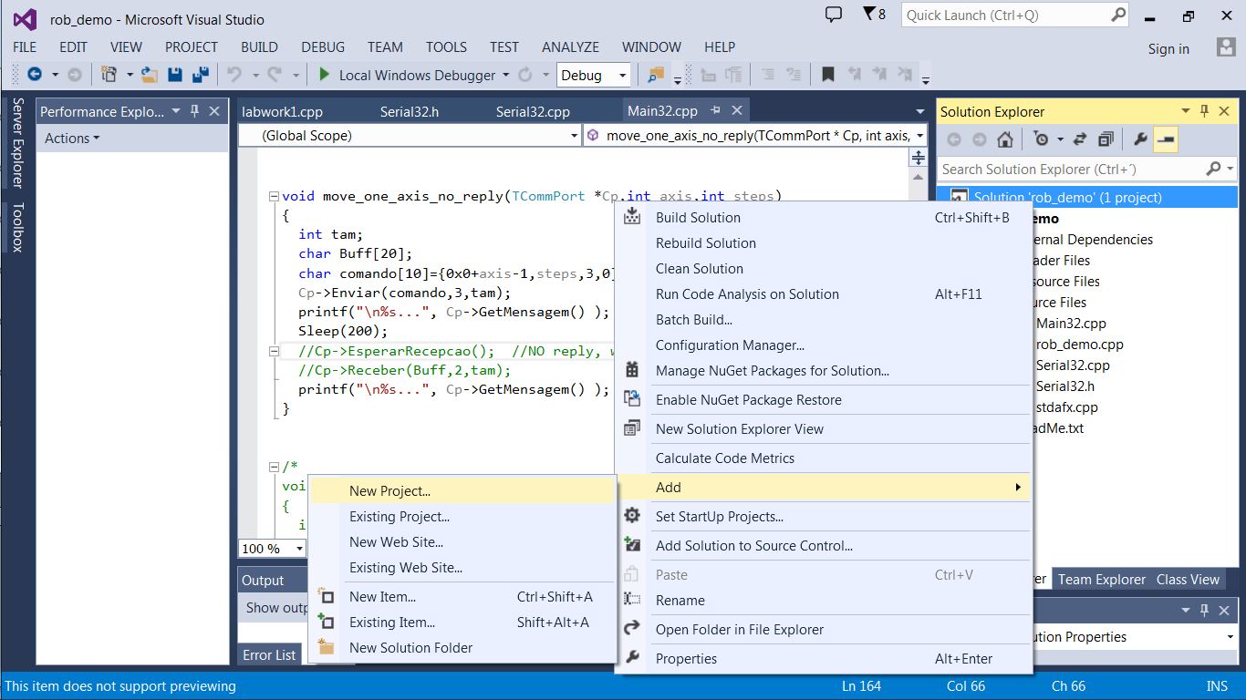
Right click in your solution and create empty project C++

Slide 56
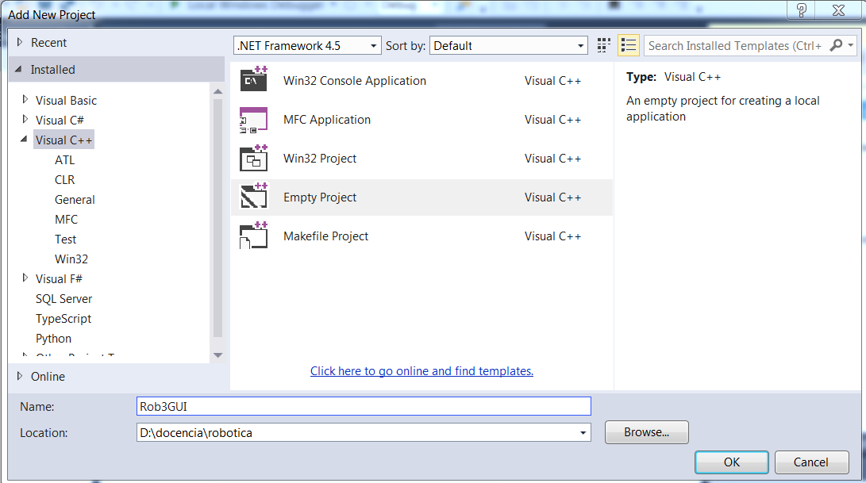
Right click in your solution and create empty project C++

Slide 57
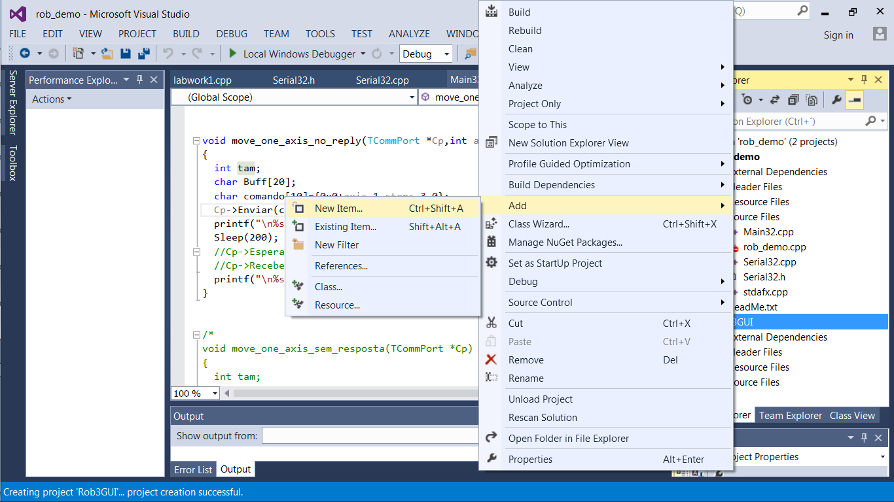
In the solution explorer, right click in the new project and select Add/New Item

Slide 58
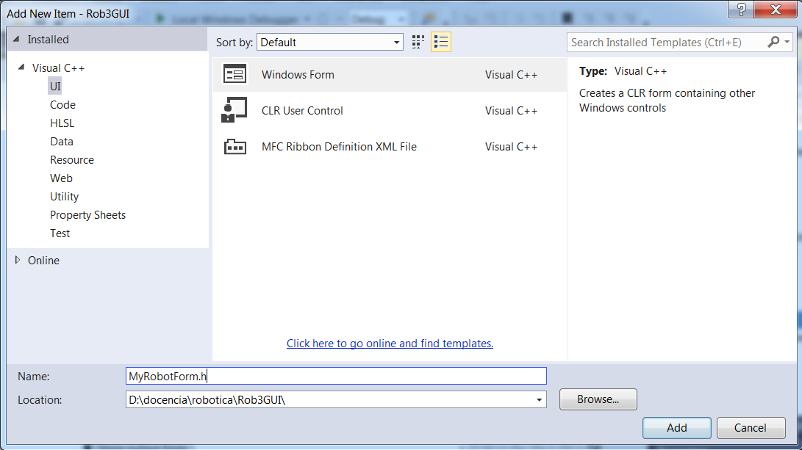
Select Visual C++UI -> Windows form and click add

Slide 59
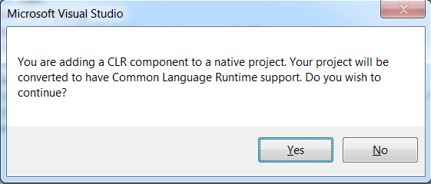
Click “yes” on this message if it appears

Slide 60

Put at least a button in your form

Slide 61

Open the source-code c++ of the just created MyRobotForm.cpp (click on it)

Slide 62
Add the following lines
#include "MyRobotForm.h"
using namespace System::Windows::Forms;
//[MTAThread]
void main(void) {
Application::EnableVisualStyles();
Application::SetCompatibleTextRenderingDefault(false);
Application::Run(gcnew Rob3GUI::MyRobotForm);
}

Slide 63

Open project Properties: right-click on the new project

Slide 64

Goto configuration properties/general /Common language runtime -> Select “Common language Runtime Support /clr”
Don’t click ok yet

Slide 65

In Linker/Advanced/Entry point: write main
Don’t click ok yet

Slide 66

In Linker/System/Subsystem, select Windows(/SUBSYSTEM:WINDOWS)
Click ok NOW.

Slide 67

Add main32.cpp and serial32.cpp to your project

Slide 68


Start filling your User friendly Interface

Slide 69

Add a Tcomport object to the robot class

Slide 70
Put code for buttons events
private: System::Void button2_Click(System::Object^ sender, System::EventArgs^ e) {
Cp->Abrir(L"\\\\.\\com12");
}
private: System::Void button2_Click(System::Object^ sender, System::EventArgs^ e) {
Cp->Abrir(L"\\\\.\\com12");
}
private: System::Void button3_Click(System::Object^ sender, System::EventArgs^ e) {
Cp->Fechar();
}
private: System::Void button1_Click(System::Object^ sender, System::EventArgs^ e) {
void move_one_axis(TCommPort *Cp, int axis, int steps);
int axis = System::Convert::ToInt32(textBox1->Text);
int steps = System::Convert::ToInt32(textBox2->Text);
move_one_axis(Cp, axis, steps); // you have this one already done in main32.cpp
}

Slide 71

Good Work

