Slide 1
Quantitative Methods for the Brain Sciences 200.659
3A
Shreesh P. Mysore, PhD
Dept. of Psychological & Brain Sciences
The Solomon H Snyder Dept of Neuroscience
3A
Random Variables (1-D)

Slide 2
Randomness
1D RVs
2D/Cond. Prob
Corr/Indep
Concept map
Quiz
Coming up
Randomness: lack of predictability in events. (Randomness indicates that outcome is uncertain)
Two kinds of randomness/unpredictability
Deterministic (randomness without chance)
individual events are knowable/defined, in theory
in practice, they happen to not be, because of limitations in measurement.
Example: “chaotic systems”
Said to be deterministically random
Stochastic (randomness with chance)
individual events are truly unknowable. There is “noise” in the system.
Notes:
This view, where randomness simply refers to situations where the certainty of the outcome is at issue, applies to concepts of chance, probability, and information entropy. In these situations, randomness implies a measure of uncertainty, and notions of haphazardness are irrelevant.
Randomness suggests a non-order in a sequence of symbols or steps.
Interesting asides
https://www.quantamagazine.org/a-unified-theory-of-randomness-20160802/

Slide 3
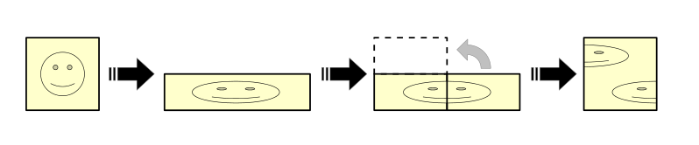
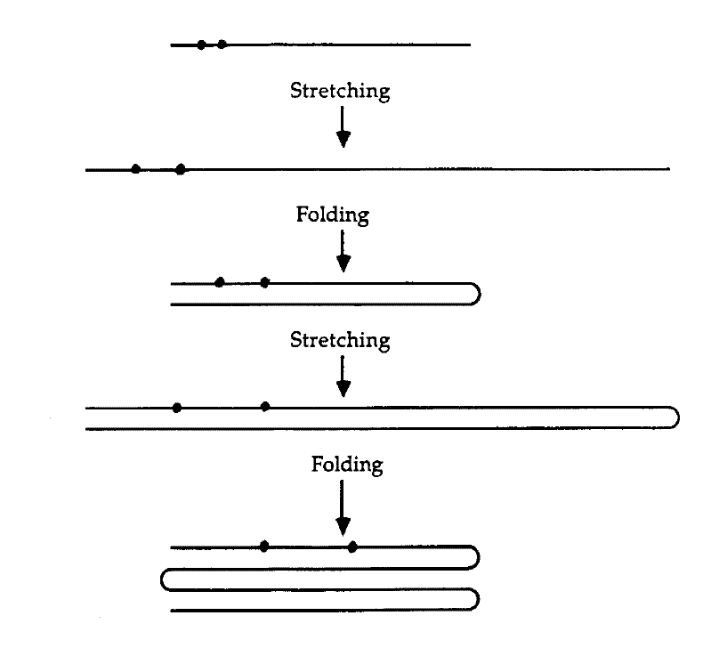
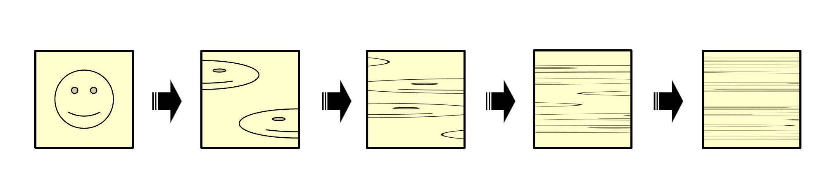

Baker’s transformation
1D RVs
2D/Cond. Prob
Corr/Indep
Concept map
Quiz
Coming up
Sensitivity to initial conditions
Notes:
Two points that start out near each other will eventually get pulled apart by this transformation. This means if you know approximately where the initial point is, you can predict about where about where it will be for a number of applications of the baker's transformation but you would have to know the initial condition exactly if you want to predict where it will be after an arbitrary number of iterations.

Slide 4
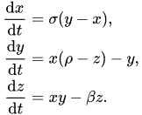
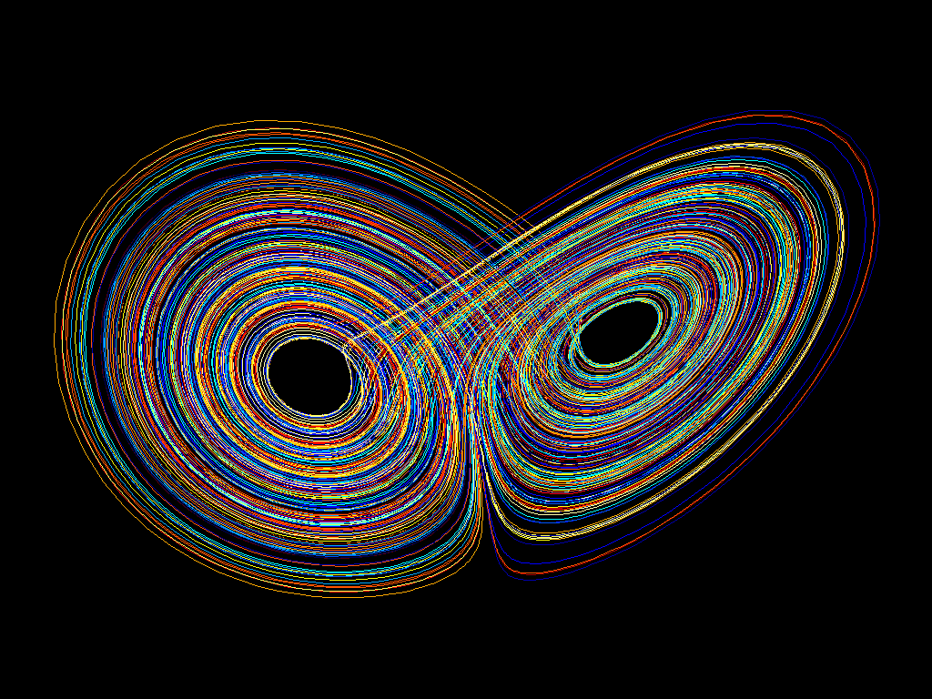
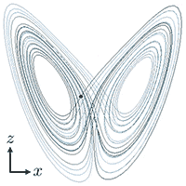
Lorenz attractor
1D RVs
2D/Cond. Prob
Corr/Indep
Concept map
Quiz
Coming up
Sensitivity to initial conditions
Dynamical
system
z
Phase
space:
x
https://en.wikipedia.org/wiki/File:A_Trajectory_Through_Phase_Space_in_a_Lorenz_Attractor.gif
Notes:
Another example of chaotic system with equations.
System by three variables, whose values at any time are defined by equations
Phase space: time is implicit variable.

Slide 5
Randomness
1D RVs
2D/Cond. Prob
Corr/Indep
Concept map
Quiz
Coming up
Random events are individually unpredictable, but the frequency of different outcomes over a large number of events (or "trials") are often predictable.
For example, when throwing two dice and counting the total, the outcome of any particular roll of the dice is unpredictable, but a sum of 7 will randomly occur twice as often as 4,
Monte Carlo methods, which rely on random input, are important techniques in analysis.
Notes:
This view, where randomness simply refers to situations where the certainty of the outcome is at issue, applies to concepts of chance, probability, and information entropy. In these situations, randomness implies a measure of uncertainty, and notions of haphazardness are irrelevant.
Randomness suggests a non-order in a sequence of symbols or steps.

Slide 6
Think-pair-share. 1
1D RVs
2D/Cond. Prob
Corr/Indep
Concept map
Quiz
Coming up
Which of these are random sequences?
[3 2 1 5 4 2 3 5 4 1 3…]
[1 2 2 2 3 2 2 2 1 2 2 1 3 2…]
[1 2 2 2 2 2 1 2 1 2 2 2 2 2 2 1 2 1 1 …]
[1 2 2 1 2 1 1 1 2 2 1 2 1 1 1 2 2 1 2 1 1…]
[1 1 1 1 2 2 2 2 2 2 2 1 1 1 1 1 1 2 2 2 2 …]
[1 2 2 1 2 1 1 2 1 2 1 2 1 1 …]
Common errors:
To think that “Randomness” ⬄ uniform randomness, i.e., absolutely no structure at all
To not be cognizant of local v. global ‘randomness’
To confound “pseudorandomness” with true randomness
To mistake statistical/probabilistic structure for a deterministic pattern (‘hot streak’)
Random (uniformly so)
Random (symmetric pmf, ~”Gaussian”)
Random (loaded/biased die)
Locally random, but not globally→ there is a pattern
Globally random, but not locally (clear local patterns)
Locally and Globally random
Notes:
Tendency: “random” = uniformly random.
Global v. Local randomness
Pseudorandomness vs. actual randomness
Tendency: To mistake statistical structure for a deterministic pattern…
In computing, a hardware random number generator (HRNG) or true random number generator (TRNG) is a device that generates random numbers from a physical process, rather than by means of an algorithm. ... This is in contrast to the paradigm of pseudo-random number generation commonly implemented in computer programs.
The difference between true random number generators(TRNGs) and pseudo-random number generators(PRNGs) is that TRNGs use an unpredictable physical means to generate numbers (like atmospheric noise), and PRNGs use mathematical algorithms (completely computer-generated).
being or involving entities (such as numbers) that are selected by a definite computational process but that satisfy one or more standard tests for statistical randomness

Slide 7
Randomness
1D RVs
2D/Cond. Prob
Corr/Indep
Concept map
Quiz
Coming up
A random variable describes a process whose outcomes do not follow a deterministic pattern, but are described by probability distributions
Mathematical functions describing the possible values of a random variable and their associated probabilities:
Discrete RV: Probability mass function
# cars that pass through Charles and University on Mon
Continuous RV: Probability density function
Gaussian distribution

Slide 8
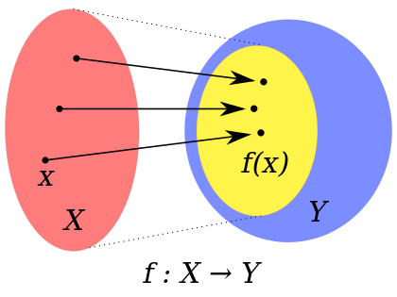
Detour: Functions
1D RVs
2D/Cond. Prob
Corr/Indep
Concept map
Quiz
Coming up
Function
log
Domain (set of possible input values)
Positive numbers
Range/Image (set of output values)
+ve and –ve numbers
Probability mass function
Domain: discrete values
Image: numbers from 0 to 1
Square root?
Domain
Range/image
Codomain
Notes:
Domain: Salmon
Range/Image: Yellow
Co-domain: Blue

Slide 9
Probability distribution
1D RVs
Cond. Prob
Corr/Indep
Concept map
Quiz
Coming up
Discrete RV:
X = {1,2,3,..x_{i},…x_{n}}
pmf: p(X=x_{i}) =p_{i}
p_{i}>=0 (non-negative)
p₁ + p₂ +… + p_{i} +… + p_{n} =1.
Σ_{i=1}^{n} p_{i} = 1
Continuous RV X.
X ε R
pdf: p(x)
non-negative
∫_{-inf}^{inf} p(x) dx = 1
a pdf must be integrated over an interval to yield a probability
p(a≤ X ≤ b) = ∫_{a}^{b} p(x) dx.
p(a≤ X ≤ a) = 0 !
Cumulative distribution function (cdf)
p(X ≤ x_{i}) =Σ^{xi} p(x_{i}) p(-inf ≤ X ≤ b) = ∫_{-inf}^{b} p(x) dx.

Slide 10
Expectation (mean)
1D RVs
2D/Cond. Prob
Corr/Indep
Concept map
Quiz
Coming up
Expectation E(X): If you follow the process indefinitely (upto infinite time), what is the average value?
Long-term average value.
Discrete RV
X = {1, 2.3, 4.7, 5.6}; p_{i}={0.1 ,0.1, 0.7, 0.1}
Sample X infinite times:
What value will you get on average?: E(X) =μ_{x}
E(X) = μ_{x}= 1*0.1 +0.1*2.3 + 0.7*0.1 +0.1*5.6 = 4.18
E(X) = μ_{x} =Σ_{i=1}^{n} x_{i} p_{i}
Continuous RV
X ε R; pdf = p(x).
E(X) = μ_{x} = ∫ _{-inf}^{inf} x p(x) dx
Notes:
Point out notations: E, mu, sigma, and integral (f(x))

Slide 11
Think-pair-share . 2
1D RVs
2D/Cond. Prob
Corr/Indep
Concept map
Quiz
Coming up
I obtain 5 measurements of a random variable (say firing rate of a neuron from 5 trials): X={1 , 4.7 , 4.7 , 5.6 , 1}
How would you compute the mean?
Is your approach consistent with the definition: Σ_{i=1}^{n} x_{i} p_{i}?
If yes, why? If not, why not?
Sample Mean
sample mean = average = (1 + 4.7 + 4.7 + 5.6 + 1) /5 = 3.4
We sampled X five times.
p(x_{i}) for sample = 1/5 (each observation given equal weight; 1/n, generally)
Sample mean = Σ_{i=1}⁵ x_{i *} 1/5
Notes:
Definition: The mean of a random variable weights each outcome x according to its probability p(x). Σ_{i=1}^{n} x_{i} p_{i}

Slide 12
Properties of means
1D RVs
2D/Cond. Prob
Corr/Indep
Concept map
Quiz
Coming up
If a random variable X is adjusted by multiplying by the value b and adding the value a, then the mean is affected as follows:
μ_{ax+b} = aμ_{x}+b
E(aX+b) = aE(X) + b
The mean of the sum of two random variables X and Y is the sum of their means:
μ_{x+y} = μ_{x}+μ_{y}
E(X+Y) = E(X) + E(Y)
Together, indicate “linearity” of the operation.
A linear transformation: output strength varies in direct proportion to the input strength
f(a*x1) = a*f(x1)
f(a*x1 + b*x2) = a*f(x1) + b*f(x2)
NOTE: f(x) =k*x (linear): f(3*x) = 3*(k*x)
But g(x) = k*x + n (not linear transformation, but affine transformation).
(Linear preserves zero; affine does not. More next week in linear algebra…)
Notes:
Affine-ness?

Slide 13

Variance
1D RVs
2D/Cond. Prob
Corr/Indep
Concept map
Quiz
Coming up
Expectation
Continuous RV: E(X) = S x p(x) dx
Discrete RV: E(X) = Σx_{i} p_{i}
Sample: Σx_{i} / n
Aside: Expectation of any function say, g(X), of a RV X
E(g(X))
= ∫ g(x) p(x) dx
= Σ g(x_{i}) p_{i}
Var(X) := E[ (X – E(X)) ² ] = E( (X-μ_{x})²)
Expectation of the squared deviation
Continuous RV: ∫ (x-μ_{x})² p(x) dx
Discrete RV: Σ(x_{i}-μ_{x})² p_{i}
We saw that sample p_{i} = 1/n
So, sample Var should be Σ(x_{i}-μ_{x})² /n
However, sample var: Σ(x_{i}-μ_{x})² / (n-1).
Why? Why not /n?
Var(X) = E(X²) – (E(X))². How?

Slide 14
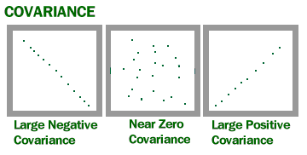
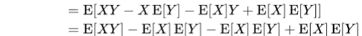
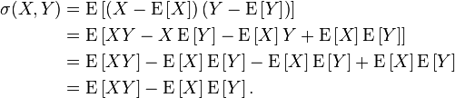
Covariance
1D RVs
2D/Cond. Prob
Corr/Indep
Concept map
Quiz
Coming up
X,Y are two RVs
Covariance: Cov(X,Y)
Cov(X,X) := Var(X) = E(X – E(X)) ²
= E[ (X – E(X)) (X – E(X)) ]
Cov(X,Y) = ?
= E[ (X – E(X)) (Y – E(Y)) ]
Sample variance = Σ(x_{i}-μ_{x})² / (n-1).
Sample Covariance
= Σ(x_{i}-μ_{x}) (y_{i}-μ_{y}) /(n-1)
Because E (X*E(Y)) = E(X*μ_{y}) = μ_{y}*E(X) = E(X)*E(Y)
Cov(X,Y)
Cov(X,X) = Var(X)
Notes:
a²Var(X) + b²Var(Y) + 2abCov(XY)

Slide 15
Properties of variance
1D RVs
2D/Cond. Prob
Corr/Indep
Concept map
Quiz
Coming up
Var(aX) = a²Var(X)
Var(X-Y) = Var(X)+Var(Y) – 2Cov(X,Y)
Var(aX+bY) =?
a²Var(X) + b²Var(Y) + 2abCov(XY)
Notes:
a²Var(X) + b²Var(Y) + 2abCov(XY)

Slide 16
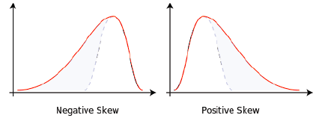
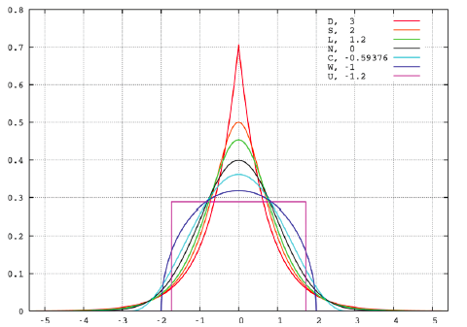
Moments
1D RVs
2D/Cond. Prob
Corr/Indep
Concept map
Quiz
Coming up
Expectation
Discrete RV: E(X) = Σx_{i} p_{i}
Continuous RV: E(X) = ∫ x p(x) dx
Var(X) := E( (X – E(X))² )
Discrete RV: Σ(x_{i}-μ_{x})² p_{i}
Continuous RV: ∫ (x-μ_{x})² p(x) dx
Higher order (nth) moment
∫ x^{n} p(x) dx
∫ (x-μ_{x})^{n} p(x) dx: Central moment
Gaussian
first 2 moments fully describe distribution
Skewness ~ 3rd central moment.
Kurtosis
Measures relative size of the two tails
Measures total size of the two tails
~0→ normal distribution assumed (mesokurtic distrn)
< zero, distribution has light tails (platykurtic).
> zero, distribution has heavier tails (leptokurtic).
Notes:
Skewness essentially measures the relative size of the two tails. Kurtosis is a measure of the combined sizes of the two tails. It measures the amount of probability in the tails.
https://www.spcforexcel.com/knowledge/basic-statistics/are-skewness-and-kurtosis-useful-statistics
kurtosis is close to 0→ normal distribution is often assumed (mesokurtic distribution)
If kurtosis is less than zero, then the distribution is light tails (platykurtic).
If the kurtosis is greater than zero, then the distribution has heavier tails (leptokurtic).

Slide 17

Think-pair-share.3
Formula for variance (is the ?^{th} moment)
2nd central moment
E((x-μ_{x})²) = Σ (x-μ_{x})² p(x) = E(X²) – (E(X))²
Sample variance: Σ(x_{i}-μ_{x})² / (n-1). Why n-1?
Skewness, Kurtosis
3rd central moment; α 4th moment
Properties of means and variances E(aX+bY)=? V(aX+bY) = ?
aE(X)+bE(Y)
a²V(X)+b²V(Y) + 2abCov(XY)
Cov(XY) ?
= E(X-μ_{x})(Y-μ_{y}) = E(XY) – E(X)E(Y);
Sample covariance ?
= (x_{i}-μ_{x})(y_{i}-μ_{y})/(n-1)
μ_{x}
σ_{x}

Slide 18
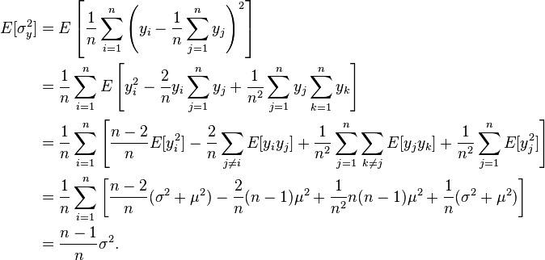


Unbiased sample variance
1D RVs
2D/Cond. Prob
Corr/Indep
Concept map
Quiz
Coming up
Random variable Y: y_{i},p_{i} (μ,σ²)
σ²=Var= Σ(y_{i}-μ_{x})² p_{i}
Sample var = s_{y}² = Σ(y_{i}-μ_{x})² / (n-1).
Why not n? Because (n-1) yields an unbiased estimate of σ²
Sample n times independently: y₁, y₂,… y_{n} (equal probability)
Say, sample Var: s_{y}²
Since sample {y_{i}} is selected randomly, both the quantities above are themselves random variables !!
(The distribution of such random variables is called sampling distribution.)
Ideally, E(s_{y}²) should be σ²
What is it actually? Let’s calculate…
Var(Y) = E(Y²) – (E(Y) ) ²
E(Y²) = Var(Y) + (E(Y) ) ²
= σ²+μ²
E(s_{y}²)
Because y_{j} and y_{k} are independent, and E(y_{j}) = E(y_{k}) = μ.
E(s_{y}²) = (n-1)/n σ² (not σ²; biased!)
To get an unbiased estimate:
E( n/(n-1) * s_{y}²) = n/(n-1) * E(s_{y}²) = σ²
S’_{y}² = n/(n-1) * s_{y}²= Σ(y_{i}-μ_{x})² / (n-1)
Thus, for an unbiased estimate, divide by (n-1) while computing sample variance (not n)!

Slide 19
End.

