Slide 1
Salesforce, PI and IOT

Slide 2
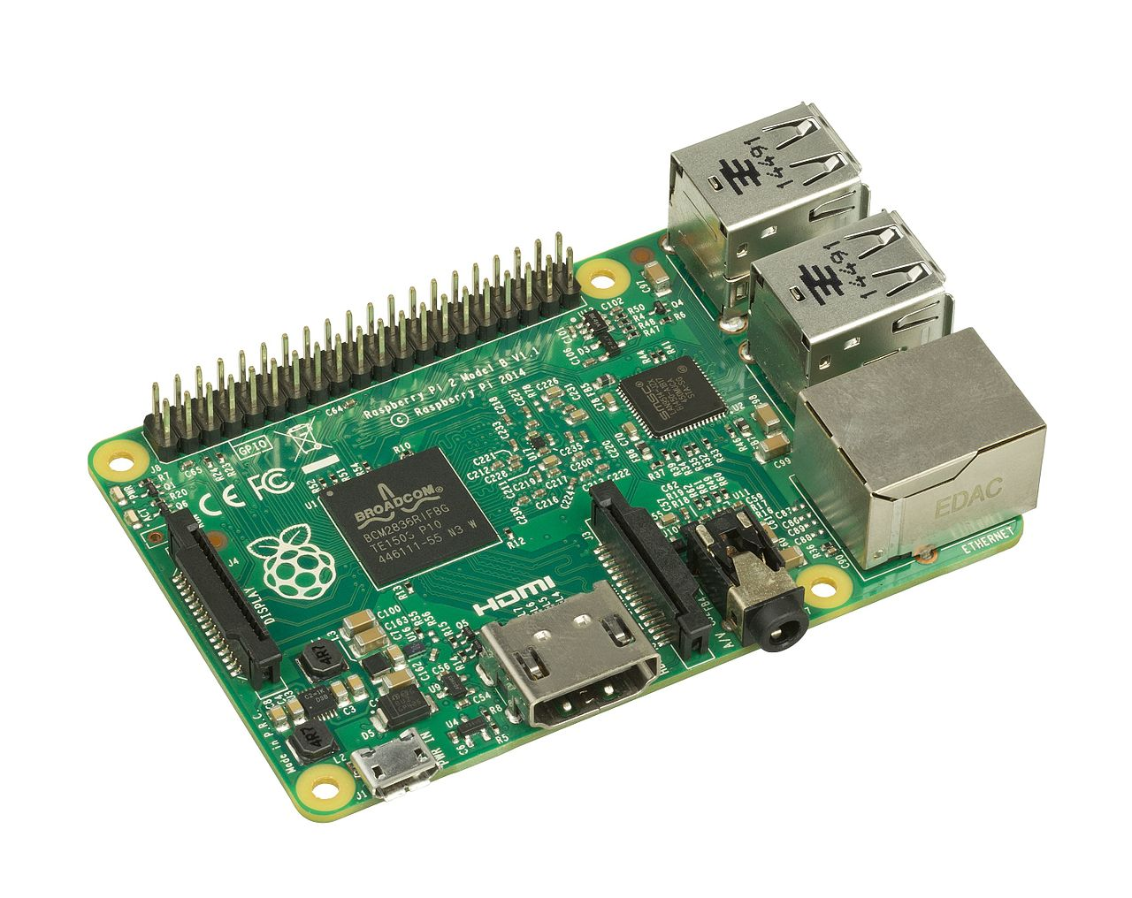
What is a rASPBERRY PI
A single board computer
Runs on Pasberrian (Debian-based linux
operating system)
Has 40 GPIO Pins for using IOT devices

Slide 3
What Do I need to use one?
THINGS THAT YOU NEED TO RUN A NORMAL COMPUTER: A MOUSE, A KEYBOARD, A POWER SUPPLY
A MICRO SD CARD FOR STORAGE
AN HDMI CABLE TO CONNECT TO A MONITOR OR TV
ETHERNET OR WIRELESS ADAPTER

Slide 4
Total cost
THINGS THAT YOU NEED TO RUN A NORMAL COMPUTER: A MOUSE, A KEYBOARD, A POWER SUPPLY (30 USD, 10 for power supply)
A MICRO SD CARD FOR STORAGE (5-10 USD)
AN HDMI CABLE TO CONNECT TO A MONITOR OR TV (5 USD)
ETHERNET OR WIRELESS ADAPTER (5-10 USD)
A CASE (OPTIONAL – 5 USD)
THE BOARD ITSELF (35 USD)
A MICRO SD CARD FORMATTER (5-10 USD)
ANY ADDITIONAL IOT ADD ONS
TOTAL (~105 USD)

Slide 5
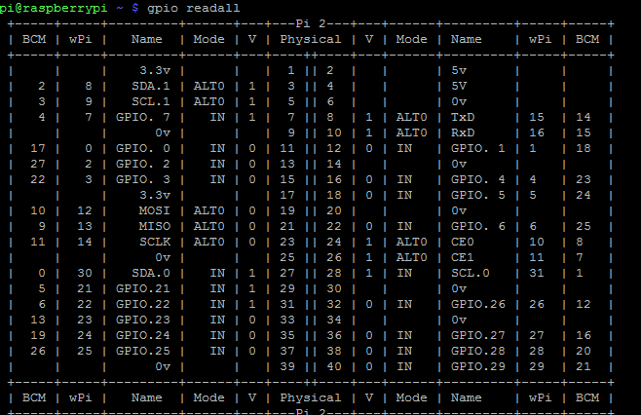
How are the pins organized?
THERE ARE GPIO PINS
WHICH ALLOW FOR INPUT
& OUTPUT
3.3V, 5V,0V (GROUND)
PINS

Slide 6
OS / Libraries needed
DOWNLOAD RASPBIAN (NOOBS – AKA EASY INSTALLER)
https://www.raspberrypi.org/downloads/noobs/
WIRING PI:
Commands:
Git clone git://git.drogon.net/wriingPi
Cd wiringPi (change to the directory where wiring pi was saved)
./build (build wiring pi)
To check that it worked – enter gpio –v (version) and then output by typing gpio readall

Slide 7
Remote Hosting
THERE ARE MANY WAYS TO REMOTELY ACCESS YOU RASBERRY PI. THE EASIEST WAY TO RUN REMOTELY IS TO USE A SERVICE LIKE DATAPLICITY (FREE).
https://www.dataplicity.com/
DATAPLICITY ALSO HAS TUTORIALS ON USING YOUR RASBERRY PI, SETTING UP WEB SERVERS, ETC.

Slide 8
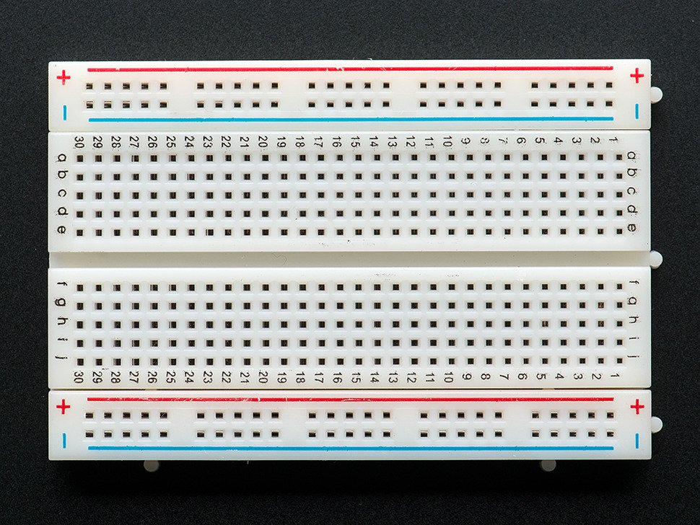
Making a bell bot
THINGS NEEDED:
A BREADBOARD (A PIECE OF PLASTIC WITH METAL INTERLAID STRIPS THAT ALLOW FOR CONNECTIVITY WITHOUT HAVING TO SOLDER)

Slide 9
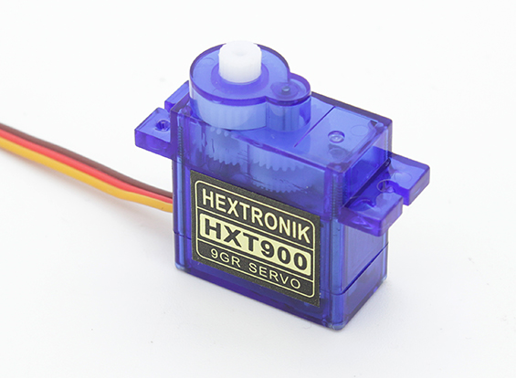
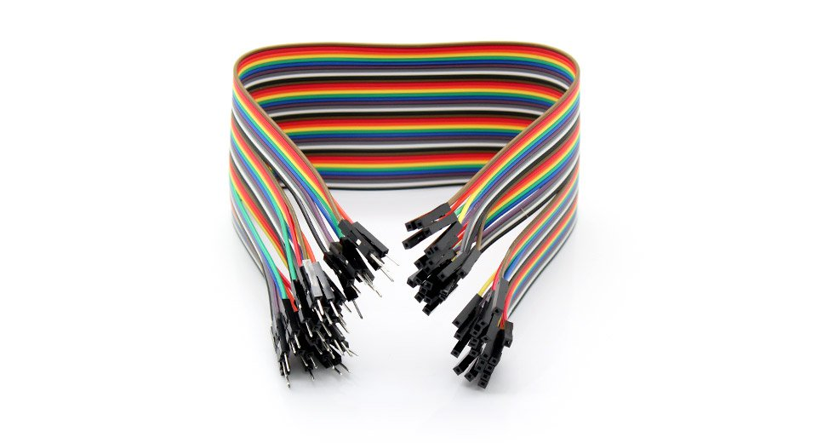
Making a bell bot
THINGS NEEDED:
A SERVO MOTOR
WIRES
A RESISTOR
DOWELS OR SOMETHING TO MOUNT A SERVO WITH

Slide 10
Making a bell bot
AND YOUR BEST FRIEND…

Slide 11

Making a bell bot
THINGS NEEDED:
A HOT GLUE GUN

Slide 12
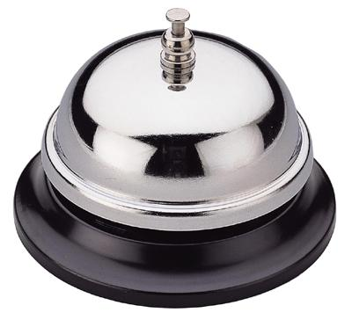
Making a bell bot
THINGS NEEDED:
AND LAST BUT NOT LEAST, A BELL!

Slide 13
ONTO THE CODE

Slide 14
Resources
CODE FOR THIS PROJECT
https://github.com/jmdohn/BellBot
GREAT RESOURCES TO LEARN MORE ABOUT IOT
HACKADAY.IO
DATAPLICITY.COM
WEBSERVICES SALESFORCE
https://developer.salesforce.com/docs/atlas.en-us.apexcode.meta/apexcode/apex_web_services_methods.htm

