Slide 1
Salesforce, PI and IOT
Usage Guidelines
Slide Description: Title Slide
Heading: PayPal Sans Big Thin 53pt Subheading: PayPal Sans Big Light 24pt/16pt
Usage: This is the default cover slide for all branded presentations.
Presentation subtitle
Jeremiah Dohn • January 4, 2016
This box will not be visible in Slide Show mode or when printed.

Slide 2
Agenda
Usage Guidelines
Slide Description: Table of Contents
Heading: PayPal Sans Big 27pt Body: PayPal Sans Big 20pt/ PayPal Sans Big Light 18pt
Usage: The TOC slide is used to describe/outline the contents of the presentation. Try keeping items short and descriptive.
The TOC slide may also be used as a summary slide. Place your summary slide at (or near) the end of the presentation.
Overview of Raspberry Pi
Use of Raspberry Pi
Total Cost of Raspberry Pi & Modules
Setup
Organization of GPIO Pins
OS and Libraries Required
Remote Hosting
Making a Bell Bot
Code
Q&A
This box will not be visible in Slide Show mode or when printed.

Slide 3
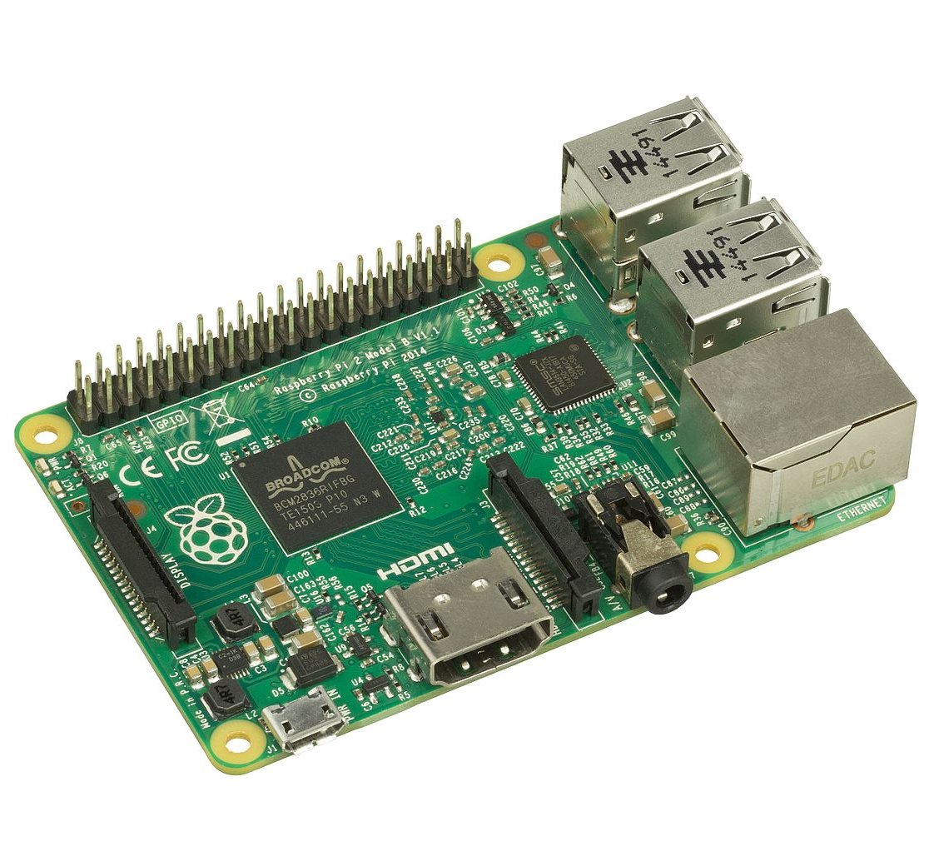
Rasberry PI Overview
Usage Guidelines
Slide Description: Content and Image
Layout Text – Title and Content with Image Heading: PayPal Sans Big 27pt Subheading: PayPal Sans Big Light 20pt Body: PayPal Sans Big Light 16pt/16pt
Usage: This type of slide may be used for content best represented by numbered short sentences followed by bulleted lists of text.
For maximum impact, slide titles should be short and clear.
Pictures or graphics that will enhance the presentation by supporting the slide talking points may be inserted.
To place a picture or graphic on the slide, go to the Insert Tab and click on the Picture Icon. Select a picture from a saved location or from the image library.
The area designated for imagery is set at 6.41” x 7.0”. Images close to those measurements will fit the area best. Ideal image resolution should be between 150dpi and 72 dpi.
What is a Rasberry PI?
A single board computer
Runs on Rasberian (Debian-based linux operating system)
Has 40 GPIO Pins for IOT Devices
For the computer savvy:
Broadcom chip
1.2 GHz quad core CPU
Uses microSD for storage
HDMI, Ethernet, and 4 USB Ports on the model B+ (the most commonly purchased, current model)
This box will not be visible in Slide Show mode or when printed.

Slide 4
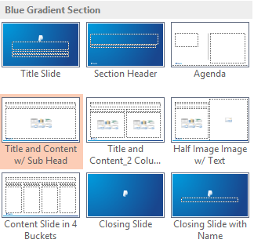
What do I need to use one?
Usage Guidelines
Master Layout Slides
Standard peripherals:
Mouse
Keyboard
Power Supply
Ethernet or wireless adapter
An HDMI Cable for connection to monitor or TV
Raspberry PI Specific:
A microSD card for storage
This box will not be visible in Slide Show mode or when printed.

Slide 5
Total Cost
Usage Guidelines
Slide Description: Table
Layout: Title and Content with Subhead Heading: PayPal Sans Big Thin 27pt Subheading: PayPal Sans Big Light 20pt Table titles: PayPal Sans Big 14pt Table text: PayPal Sans Big Light 14pt /10pt
Usage: These slides are used for information best conveyed with a table.
Once you have placed the cursor into the table, you can use the TAB key to move forward through the table. SHIFT-TAB will move you backwards.
If you need to change the formatting of a table, right click on the table and select format table. If you need to delete sections of a table (rows or columns), select the area in question (by left-clicking and dragging), then right-click on the area you have selected and choose “delete.”
Subtitle
Item | Cost
Mouse, Keyboard, HDMI Cable | 25 USD
Power Supply | 5-10 USD
Ethernet Cable or Wireless Adapter | 5-10 USD
Case (Optional) | 5 USD
Rasbperry PI | 35 USD
MicroSD Card Dongle | 5-10 USD
Additional IOT Add-ons
TOTAL | 105 USD +
This box will not be visible in Slide Show mode or when printed.

Slide 6
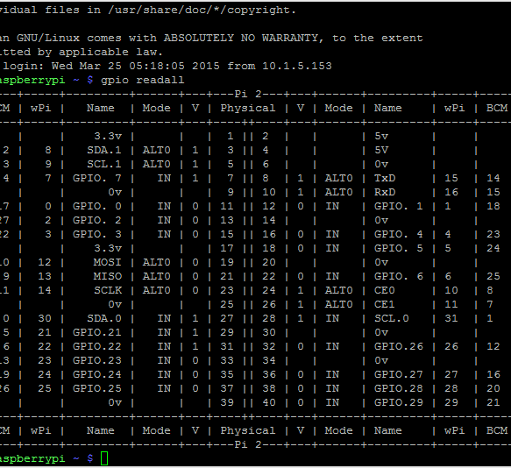
How are the pins organized?
Usage Guidelines
Slide Description: Content and Image
Layout Text – Title and Content with Image Heading: PayPal Sans Big 27pt Subheading: PayPal Sans Big Light 20pt Body: PayPal Sans Big Light 16pt/16pt
Usage: This type of slide may be used for content best represented by numbered short sentences followed by bulleted lists of text.
For maximum impact, slide titles should be short and clear.
Pictures or graphics that will enhance the presentation by supporting the slide talking points may be inserted.
To place a picture or graphic on the slide, go to the Insert Tab and click on the Picture Icon. Select a picture from a saved location or from the image library.
The area designated for imagery is set at 6.41” x 7.0”. Images close to those measurements will fit the area best. Ideal image resolution should be between 150dpi and 72 dpi.
The types of pins:
GPIO (these are what make the IOT Devices accept inputs and provide outputs back to the device)
0v (ground), 3.3v and 5v pins
This box will not be visible in Slide Show mode or when printed.

Slide 7
OS & Libraries Needed
Usage Guidelines
Master Layout Slides
Downlad Rasbian (Noobs) – the ”easy” installer
https://www.raspberrypi.org/downloads/noobs/
Wiring PI:
Commands:
Git clone git://git.drogon.net/wriingPi
Cd wiringPi (change to the directory where wiring pi was saved)
./build (build wiring pi)
To check that it worked – enter gpio –v (version)
View diagram of pins by typing gpio readall (same picture as previous slide)
This box will not be visible in Slide Show mode or when printed.

Slide 8
Remote Hosting
Usage Guidelines
Master Layout Slides
There are many ways to remotely access your Raspberry PI. The easiest way is to use a service like Dataplicity (free).
https://www.dataplicity.com/
Dataplicty also has tutorials on using your Raspberry PI: setting up web servers using flask, GPIO tutorials, securing your remote access, etc.
Other options:
Secure SSH
Recommend generating a private public key pair to restrict SSH to not allow passwords
Use a non-default port
Disallow Root Login over SSH (/etc/ssh/sshd_config – PermitRootLogin no)
This box will not be visible in Slide Show mode or when printed.

Slide 9
Making a Bell Bot
Usage Guidelines
Master Layout Slides
Materials needed:
A breadboard
This is used in order to not require soldering of components and wires together. It is often used in rapid prototyping, and if a permanent solution is required, PCB (Printed Circuit Boards) are made.
A servo motor
A resistor
Wires
Dowels or something to mount the servo
A hot glue gun
A bell
This box will not be visible in Slide Show mode or when printed.

Slide 10
The Code
Usage Guidelines
Slide Description: Plain Divider Slide
Heading: PayPal Sans Big Thin 37pt Subheading: PayPal Sans Big Light 18pt
Usage: Use this slide as a section divider to better organize chapters of content within a presentation.
Additionally, this slide can be used as a high impact quote or descriptor to reinforce content messaging.
Subtitle
This box will not be visible in Slide Show mode or when printed.

Slide 11
Resources
Usage Guidelines
Master Layout Slides
Code for this project:
https://github.com/jmdohn/BellBot
Great resources to learn more about IOT:
Hackaday.io
Dataplicity.com
RasberryPi.org
Arduino.cc
Salesforce Webservices:
https://developer.salesforce.com/docs/atlas.en-us.apexcode.meta/apexcode/apex_web_services_methods.htm
This box will not be visible in Slide Show mode or when printed.

Slide 12
Usage Guidelines
Slide Description: Closing Slide
This is the default closing slide for all branded presentations.
This box will not be visible in Slide Show mode or when printed.

