Slide 1
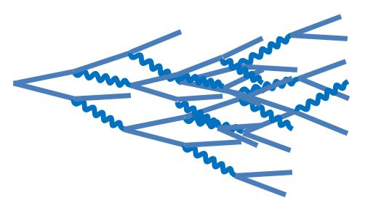
Photo Detector
e/γ
Crystal
x
(0) t_{TOF}
Time of Flight
(1) t_{I}
Interaction / shower development
(2) t_{S}
Scintillation
process
(3) t_{P}
Light propagation time
(4) t_{T}
Photo
detector transit time
(5) t_{D}
DAQ

