Slide 1
Contents
Motivation
Initial Setup
Methodology
Analysis
Conclusion
PH241 Midterm
The Antennae Group
03/13/06 – pg. <number>

Slide 2
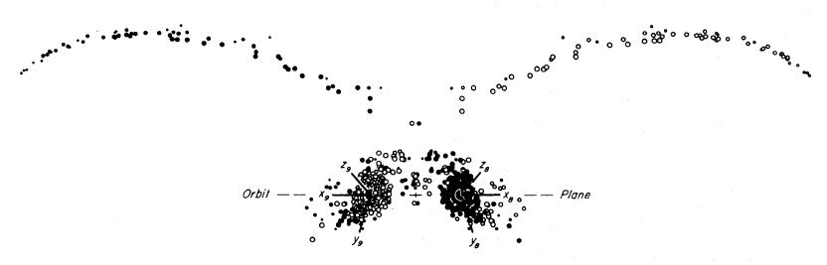
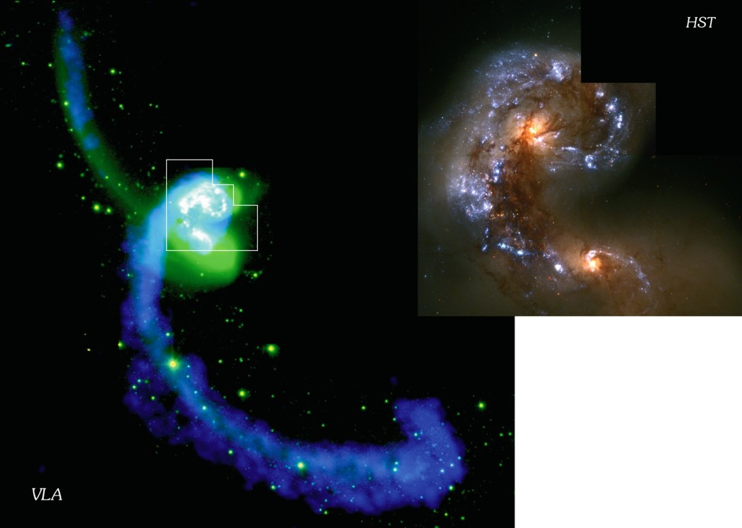
Toomre and Toomre
1972 – T&T set out to model galaxies NGC-4038/9 (i.e. the antennae) and were able to successfully produce an accurate rendering using a fourth order Runge-Kutta integration method.
PH241 Midterm
The Antennae Group
03/13/06 – pg. <number>

Slide 3
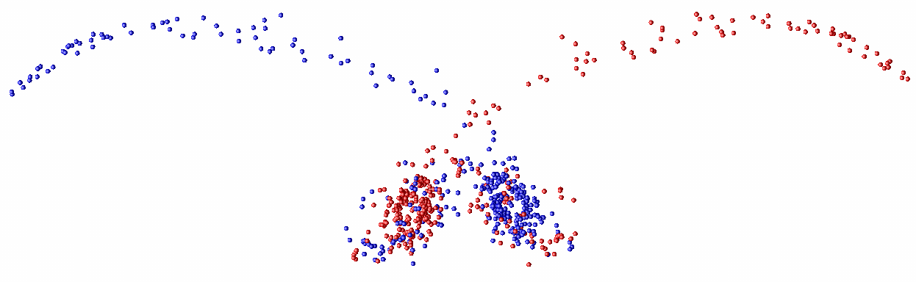
1972 → 2006
PH241 Midterm
The Antennae Group
03/13/06 – pg. <number>

Slide 4
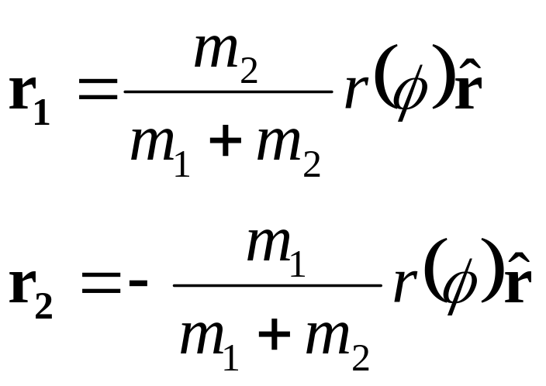
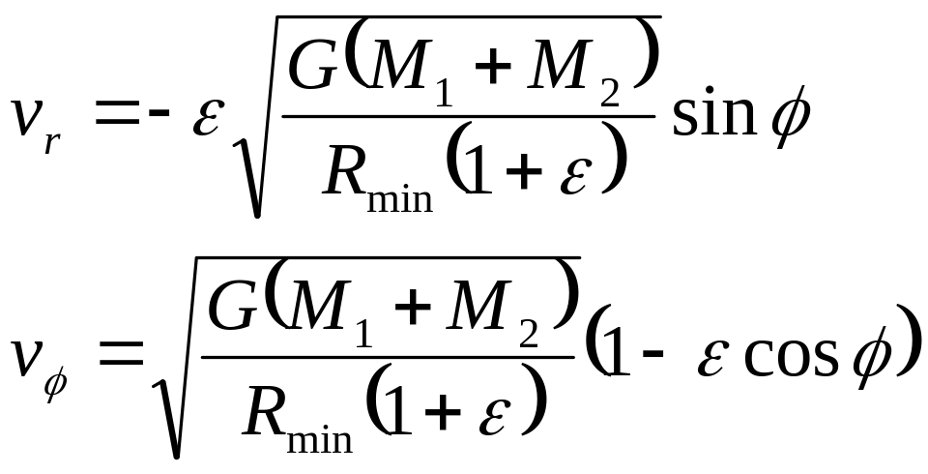
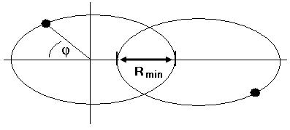
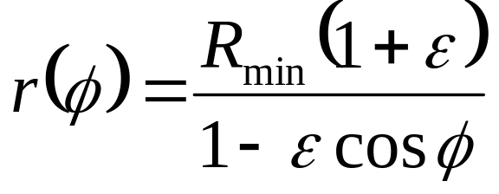
Kepler problem
PH241 Midterm
The Antennae Group
03/13/06 – pg. <number>

Slide 5
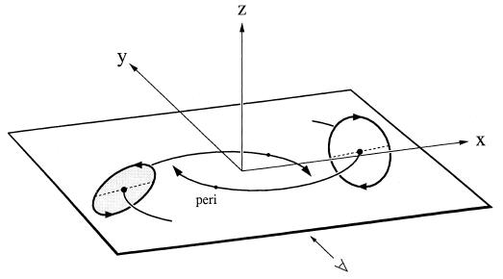
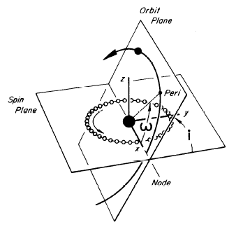
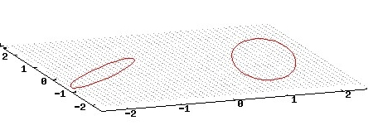
Geometry
PH241 Midterm
The Antennae Group
03/13/06 – pg. <number>

Slide 6
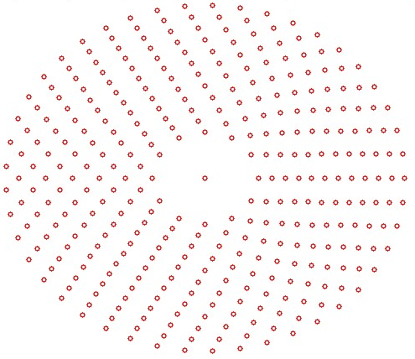
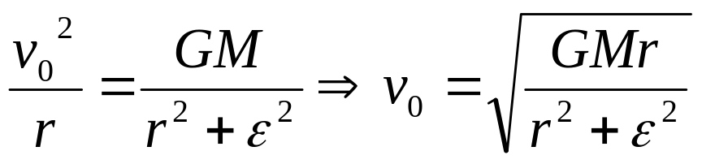
Galaxy Setup
We filled 12 concentric rings of radii 0.2R_{min} to 0.75R_{min} with a step of 0.05R_{min}, with each ring having 3 more particles than the previous
Particles given initial velocity to maintain a circular orbit.
Softening: ε = 0.2
PH241 Midterm
The Antennae Group
03/13/06 – pg. <number>

Slide 7
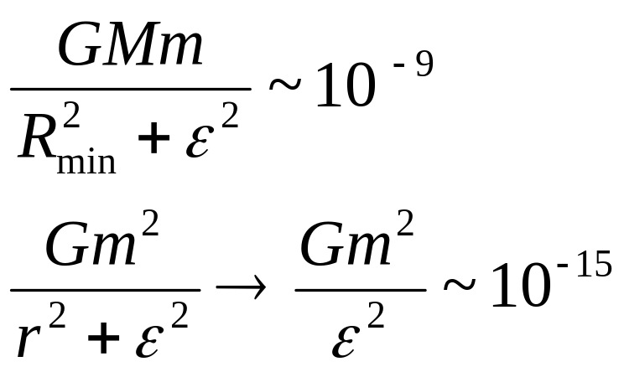
Restricted 3-Body
Send satellite masses to 1.0 E-9 as compared to M = 1 for the center of mass.
PH241 Midterm
The Antennae Group
03/13/06 – pg. <number>

Slide 8
Our Results
PH241 Midterm
The Antennae Group
03/13/06 – pg. <number>

Slide 9
Comparison
PH241 Midterm
The Antennae Group
03/13/06 – pg. <number>

Slide 10
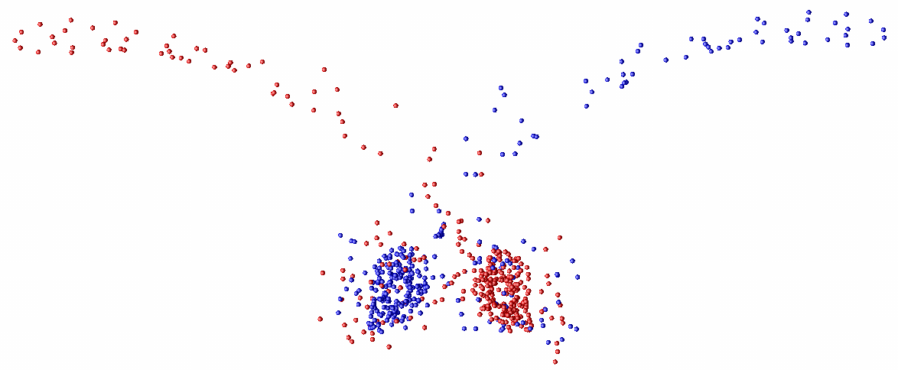
Orbit Plane
φ = 0
φ = 2π/3
PH241 Midterm
The Antennae Group
03/13/06 – pg. <number>

Slide 11
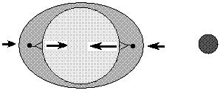
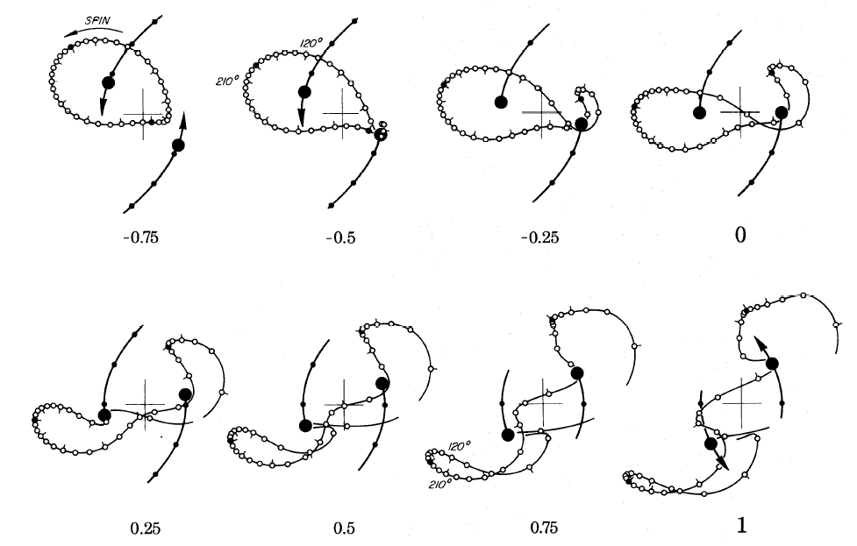
Tidal Forces
PH241 Midterm
The Antennae Group
03/13/06 – pg. <number>

