Slide 1
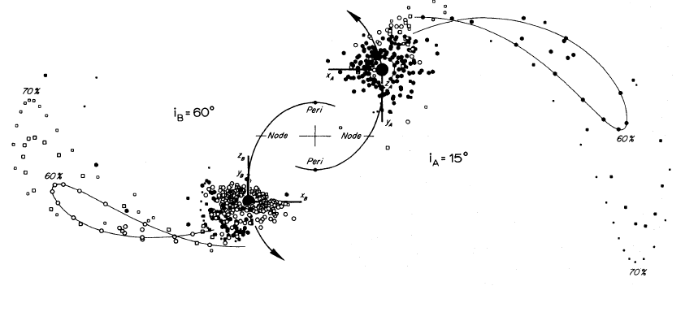

Top-View Comparison to Toomre & Toomre

Slide 2


Side-View Comparison to Toomre & Toomre

