Slide 1
Air Quality App
Matti & Jackie
Comp 730
2025 Fall Semester

Slide 2
Sustainability
-Real time data of air quality in New Hampshire
-Data acquired from Google Maps for pollen and air quality information
Notes:
Jackie

Slide 3
Use Cases
Use Case 1:
Saving allergen profiles to keep track of personal allergen information which will be used in the API requests
Use Case 2:
Creating a new user profile with their information saved
Use Case 3:
Viewing personalized reports that highlight allergens matching a user’s saved profile using the saved allergen profiles and the API request wrapper
Use Case 4:
User's reports are saved so they are not lost upon restart
Notes:
Matti

Slide 4
Use Case Scenarios
Use Case 1:
Saving allergen profiles to keep track of personal allergen information which will be used in the API requests
User logs in with their name
User inputs any allergies they want to add
System saves it to a CSV file
Notes:
Matti

Slide 5
Use Case Scenarios cont.
Use Case 3:
Viewing personalized reports that highlight allergens matching a user’s saved profile using the saved allergen profiles and the API request wrapper
User logs in by inputting name
User selects location
User requests report
System displays report information
Notes:
Jackie

Slide 6
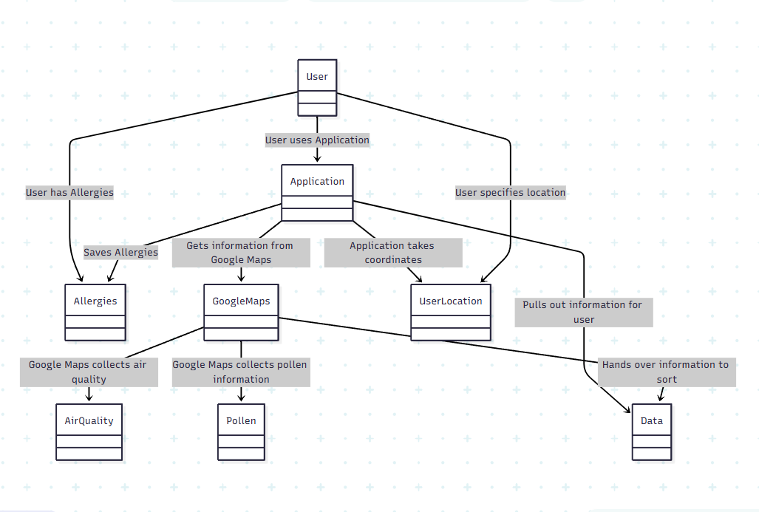
Domain Model
Notes:
Matti

Slide 7
Environment
-VSCode
-Git
-GitHub
-Google Maps API
-Poetry
-Requests library
-Unit test library
Notes:
Matti

Slide 8
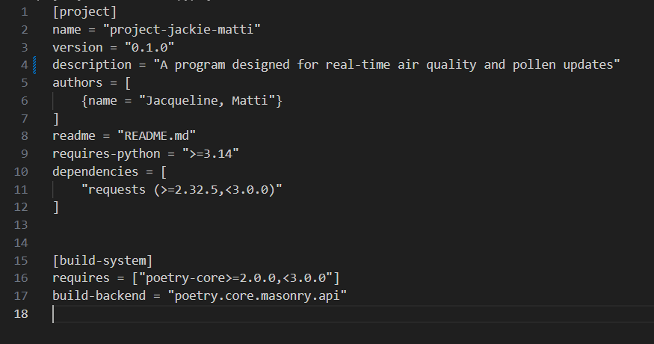
Environment cont.
Notes:
Jackie

Slide 9
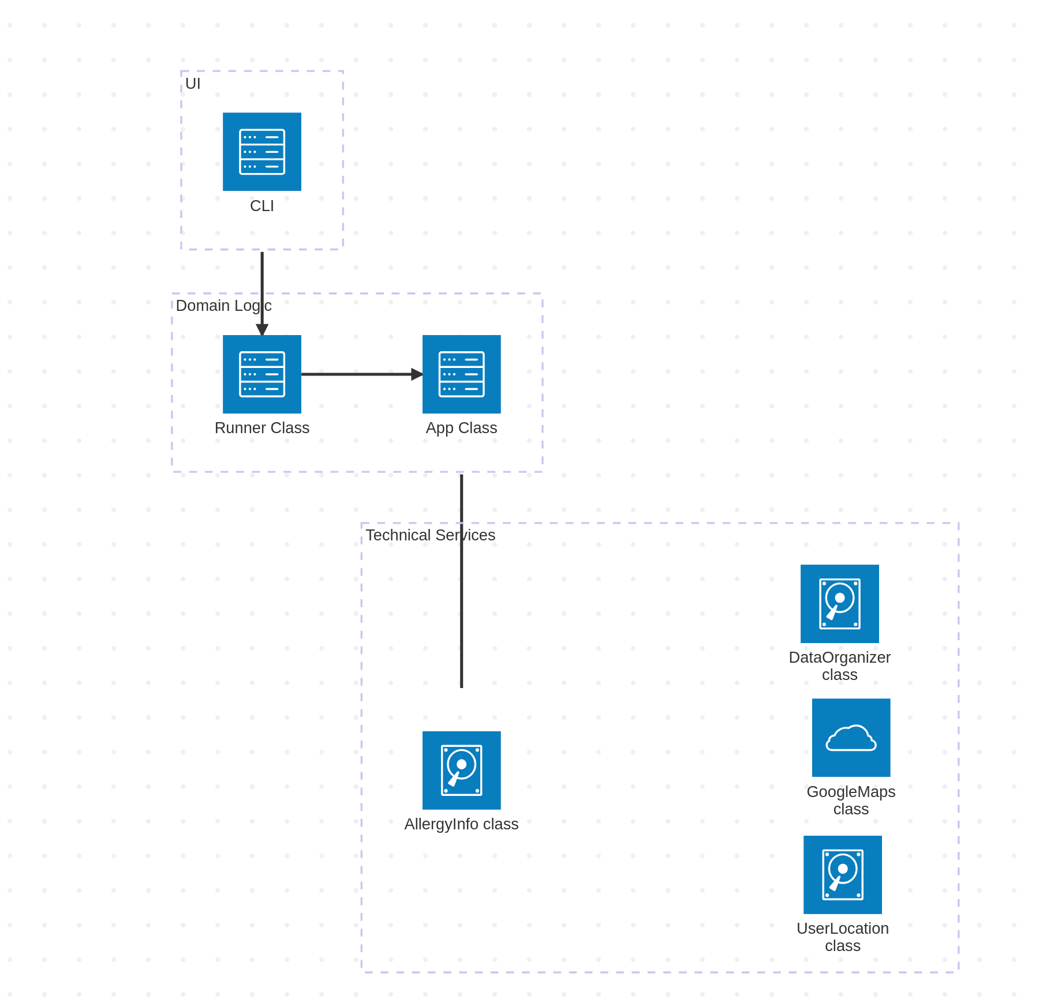
System Architecture
Notes:
Matti UI/Domain Logic
Jackie Technical Services

Slide 10
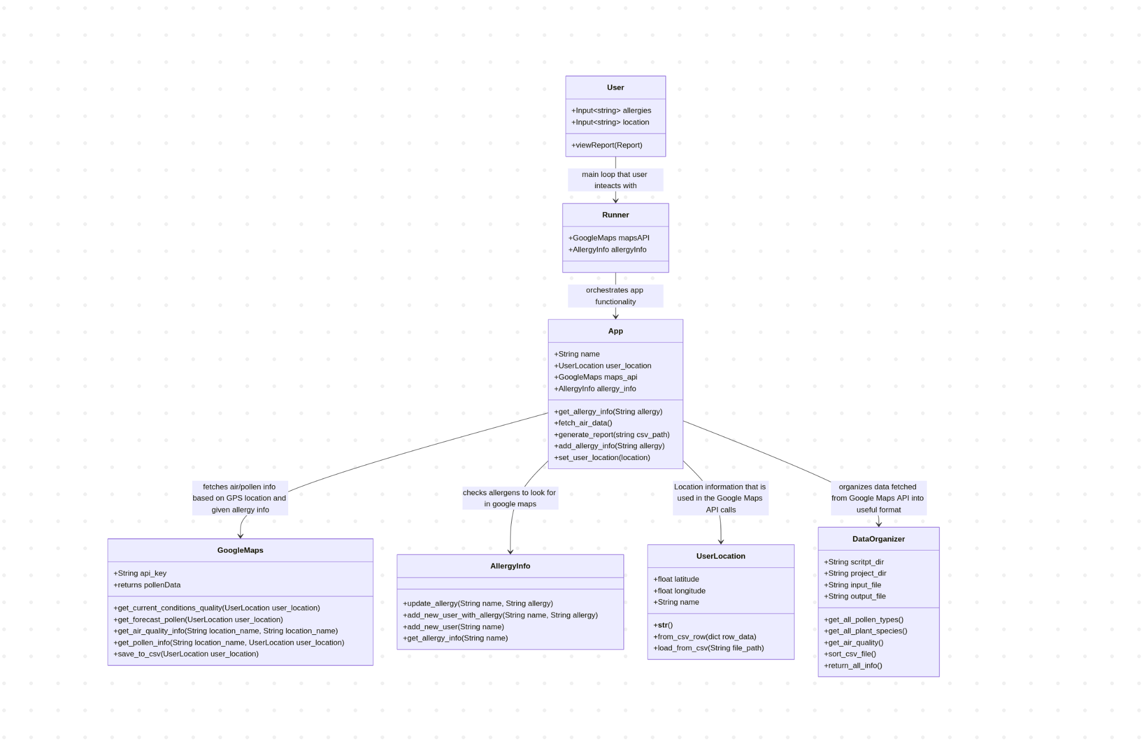
Domain Design
Notes:
Jackie

Slide 11
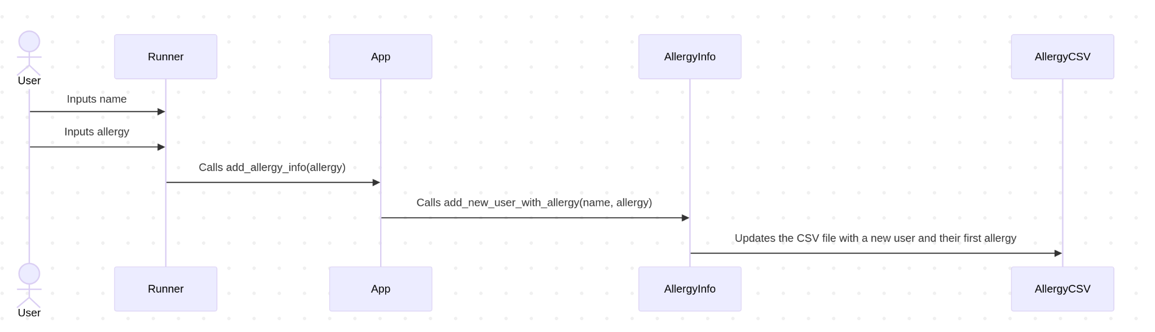
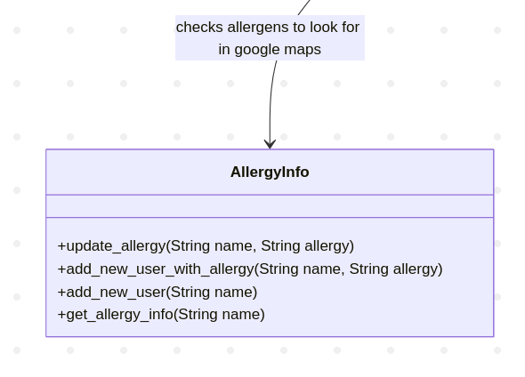
Matti Design

Slide 12
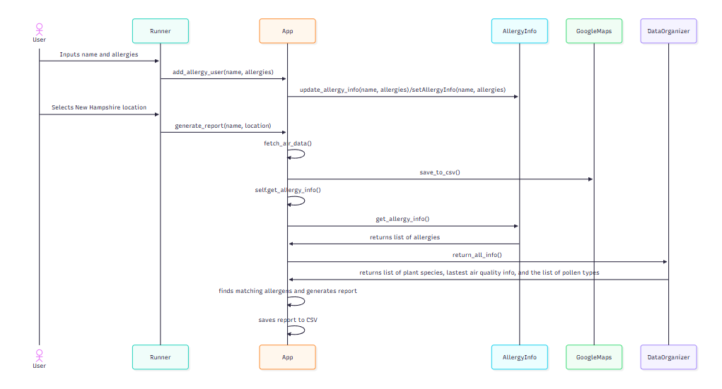
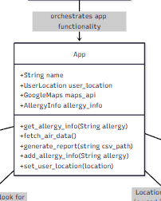
Jackie’s Design

Slide 13
Contributions
Matti: AllergyInfo, Allergies CSV, Runner
Jackie - DataOrganizer, UserLocation, Location CSV
Combined contribution: App, GoogleMaps, Testing, Diagramming, Refactoring

