Slide 1

Winno
Jen, Stephanie, Charis, Kaitlyn, and Zoraida
Hacking Online Dating

Slide 2

Notes:
Problem Statement:
Big data is everywhere especially when it comes to our personal lives. Filtering through different online dating apps and thousands of profiles is a daunting task. What if you had a personalized adviser to guide you through the process?

Slide 3
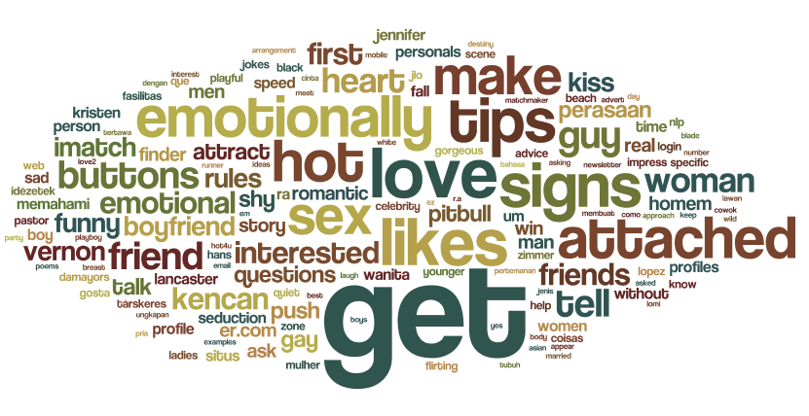
Notes:
To winnow is the process of separating the wheat from the chaff
Goal of Winno - to put online daters back in the driver’s seat by filtering on exactly what they are looking for based on self-reported data, date recaps / evaluations, and guiding behaviors. Think of Winno as your confident girlfriend shepherding you through the online dating jungle offering smart, sassy, and targeted advice.

Slide 4

Notes:
Winno uses your personalized selection criteria to offer specific suggestions just for you when it comes to potential dates.

Slide 5
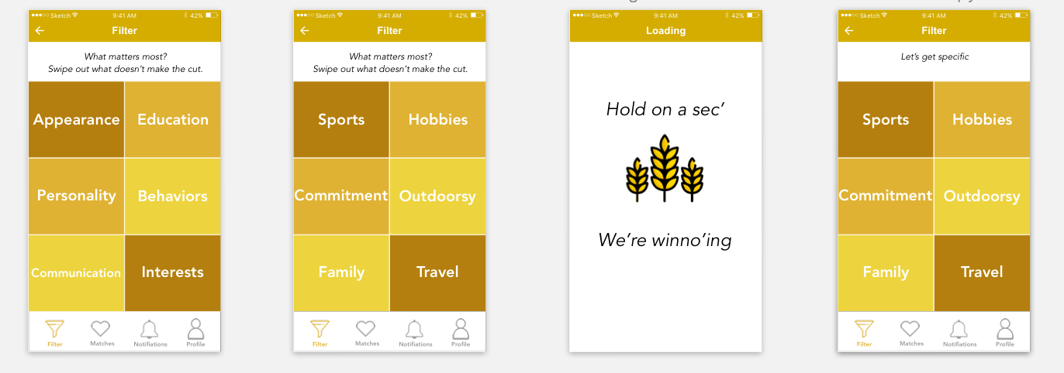
Notes:
Winno provides a set of categories and you choose your priorities. Once you select what’s important to you, the app will ask you to get specific and give more details about what you are looking for in each area.

Slide 6
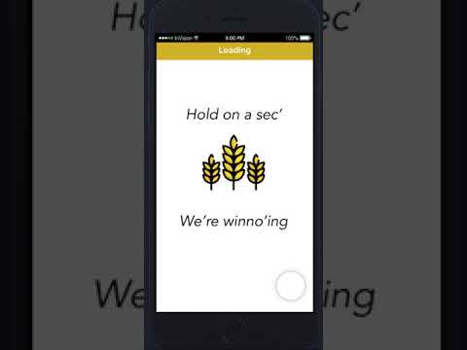
Let’s try it out
Notes:
We spent a bit of time drawing user flows and sketching out what the app map would look like while navigating through their filtering process. We choose to drag out categories that you are less concerned with so as the user you are in complete control as to what matters most to you. Within each broad category, the user can quickly get specific about which details of perspective dates are most critical.

Slide 7
Next Steps
Most proud of:
Quickly taking a concept from Amy Webb’s TED Talk to iterating a working prototype and a concept that would work
What we would do if we had more time:
Add tracking and feedback for potential dates, including surveys
Figure out how to integrate online dating profiles to offer targeted recommendations
Notes:
-biggest technical challenge was lack of API access to data of potential dates’ user profiles, lead us to pivot to focus on self-reported data
Also encountered styling challenges in a beta 2 version 4 of Bootstrap (team was new to it, learning curve)

Slide 8
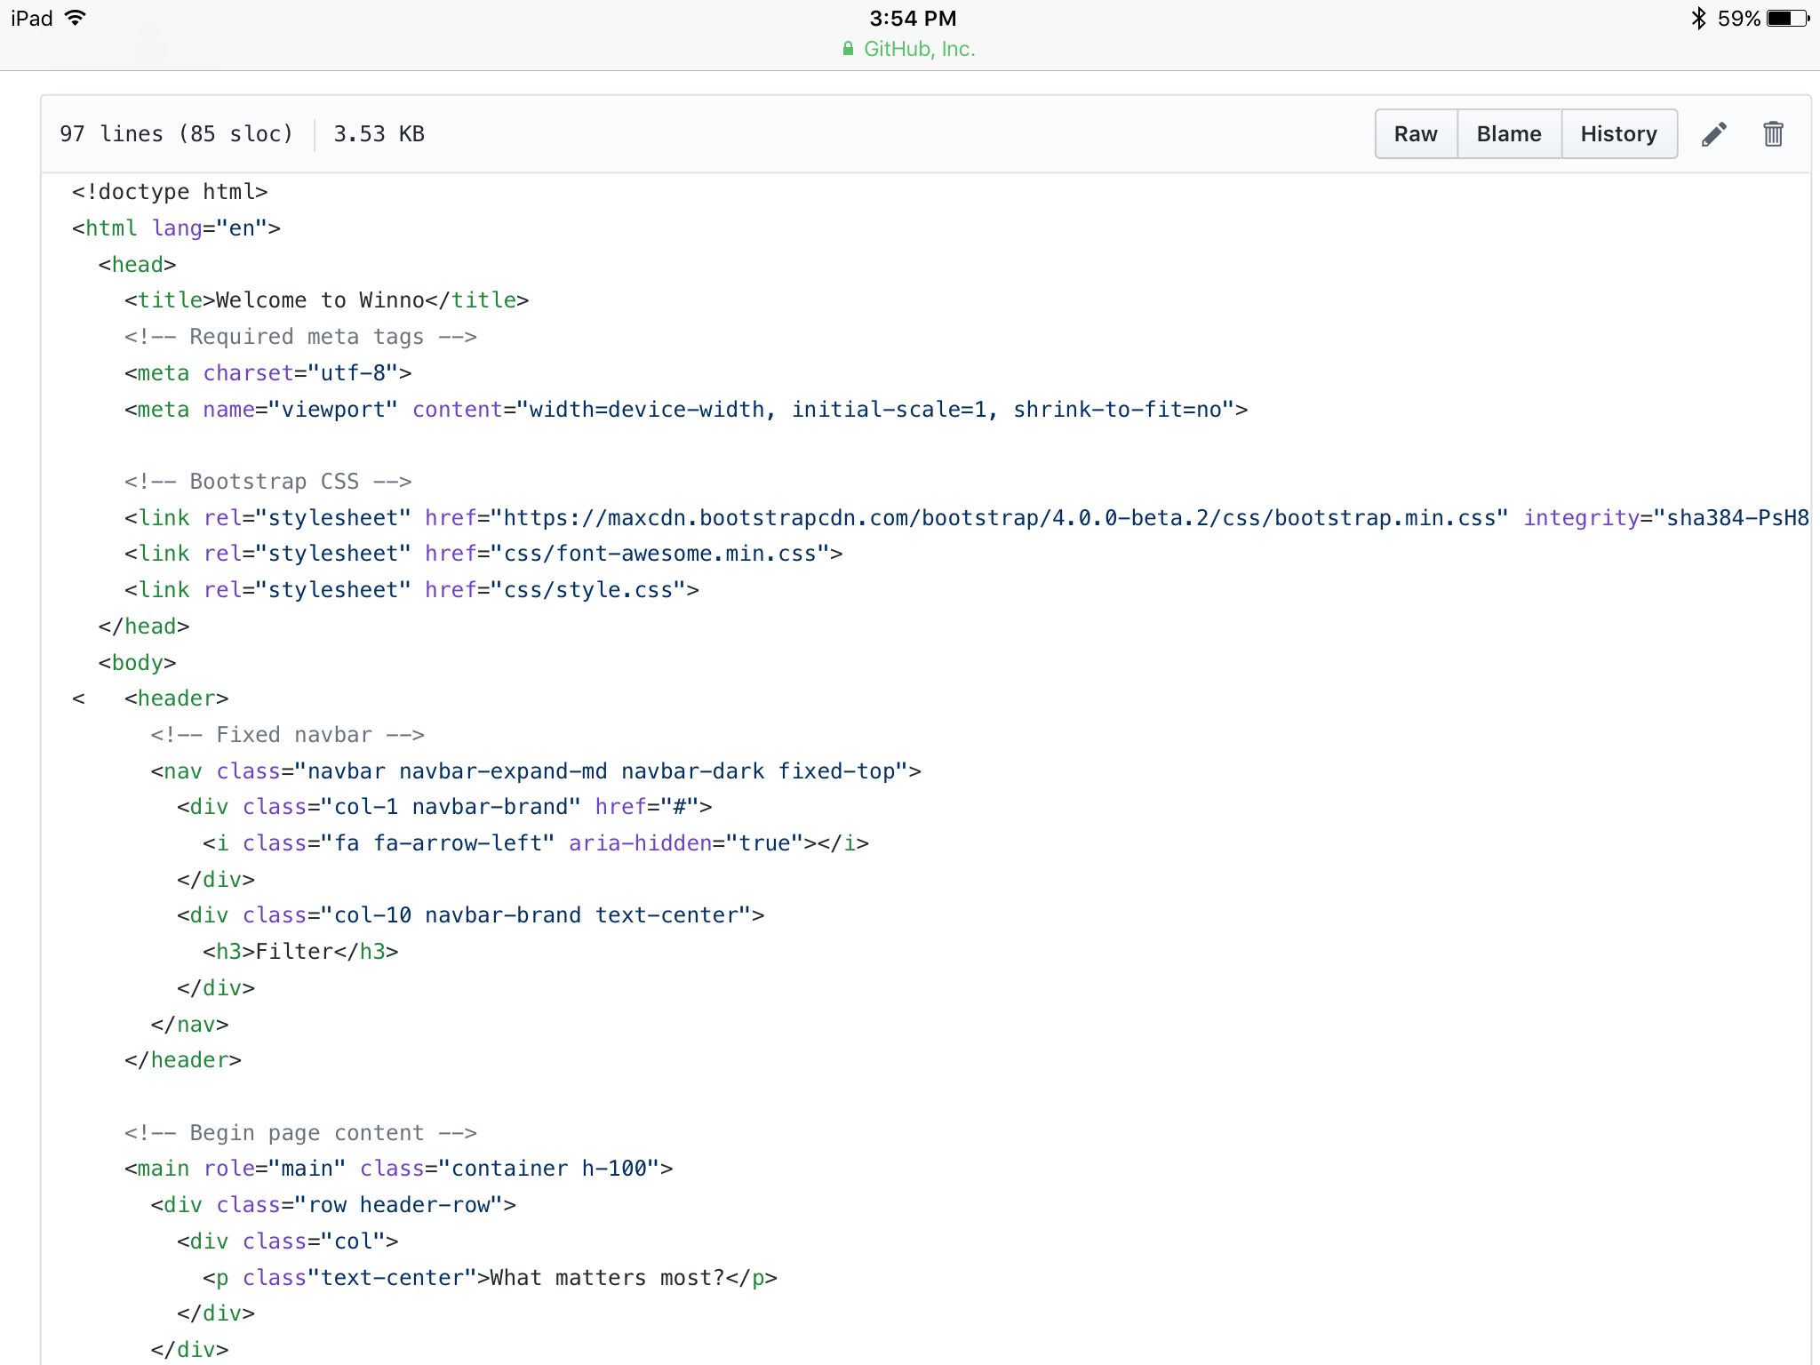
Resources
Bootstrap
Angular
InVision
Sketch
Flaticon
Photoshop
Creative Commons
https://www.ted.com/talks/amy_webb_how_i_hacked_online_dating

