Slide 1
Directing Traffic
Implementing the Mediator Pattern with MediatR

Slide 2
What is the Mediator Pattern?
Behavioral pattern
Responsible for encapsulating how objects interact with one another
Similar to the façade pattern by encapsulating existing functionality. The main differences are
Mediator is known to is colleagues
Mediator adds value to the interaction between colleagues

Slide 3
How does that help me?
With the mediator pattern, communication between objects is encapsulated with a mediator object. Objects no longer communicate directly with each other, but instead communicate through the mediator. This reduces the dependencies between communicating objects, thereby lowering the coupling. https://en.wikipedia.org/wiki/Mediator_pattern

Slide 4
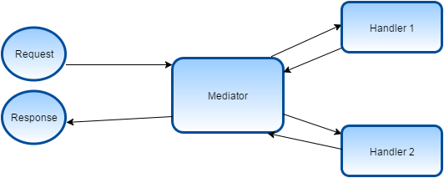

Slide 5
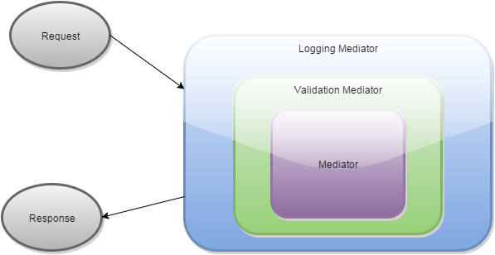

Slide 6
Common Examples
Wizards
Workflows
Decision Trees

Slide 7
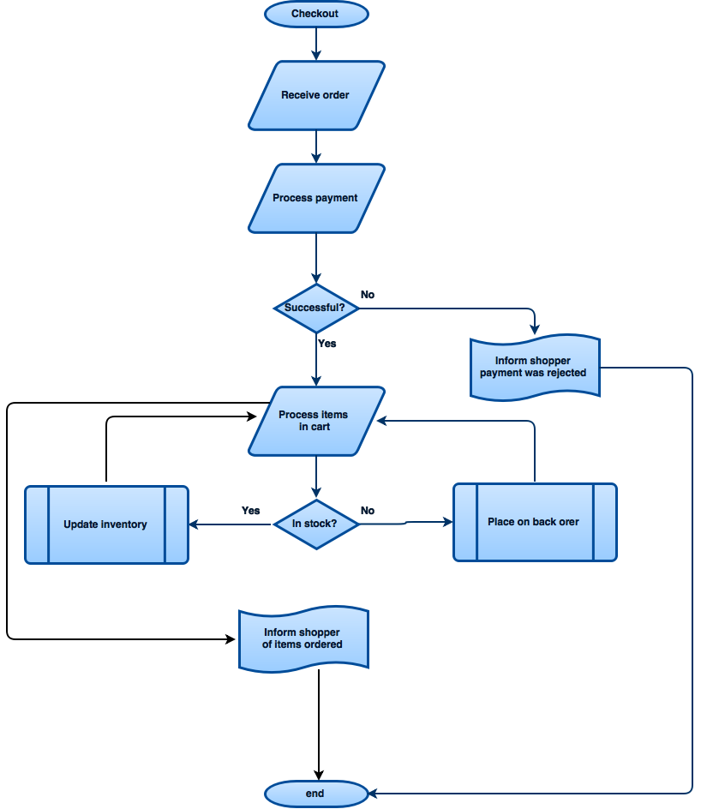
Show me some code already!

Slide 8
How to identify a Mediator
Colleagues have knowledge of the mediator
The mediator expects a response from the colleagues
Value is added by utilizing the mediator
Highly specialized

Slide 9
Not to be confused with
Event Aggregators
Façades
Templates

Slide 10
Jason Meckley
jasonmeckley@gmail.com
@jasonmeckley
Designing web applications since 2001
MCSD
Sr. Consultant at Celerity

