Slide 1
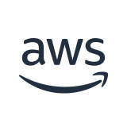
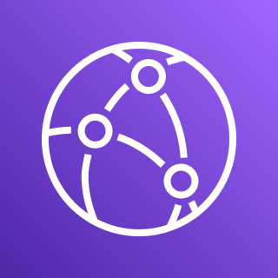


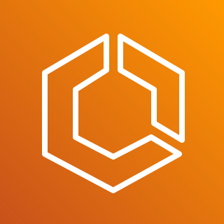
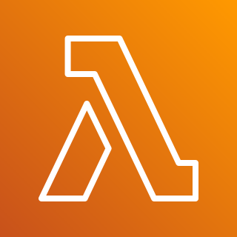


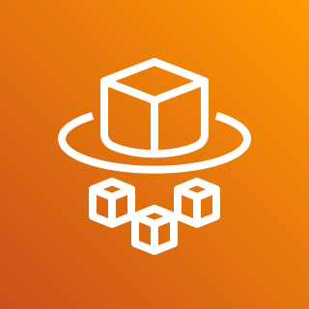
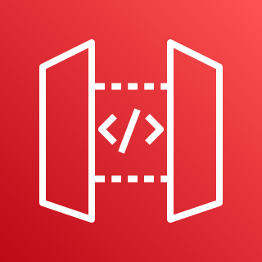

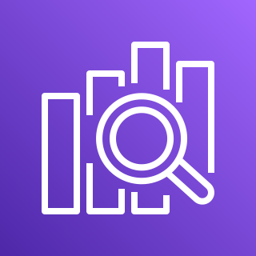
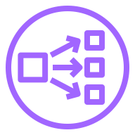

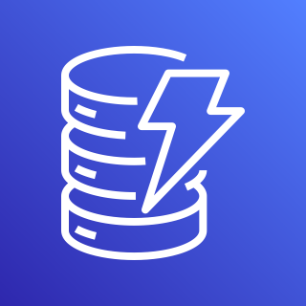

Serverless Chat Architecture
AWS Cloud
CloudFront
App Runner Service VPC
Customer VPC
Amazon ECS
Private subnet
Private subnet
AWS Lambda
AWS Fargate
AWS Fargate
API Gateway
SearchChat
Amazon OpenSearch
Private subnet
Envoy Proxy
Private subnet
Application Load Balancer
Amazon DynamoDB
AWS Lambda
AWS Fargate
AWS Fargate
Message Table
Indexer

