Slide 1

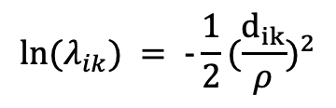
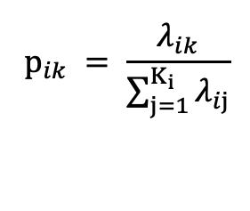

$$Y_{i}\sim multinomial(n_{i}, p_{i})$$
$$⁡p_{ik} = \frac{λ_{ik}}{\sum_{j=1}^{K_{i}}{λ_{ij}}}$$
$$ln⁡(λ_{ik}) = -\frac{1}{2}{(\frac{d_{ik}}{ρ})}^{2}$$
$$ρ\sim lognormal(ln(0.5), 0.5)$$

Slide 2
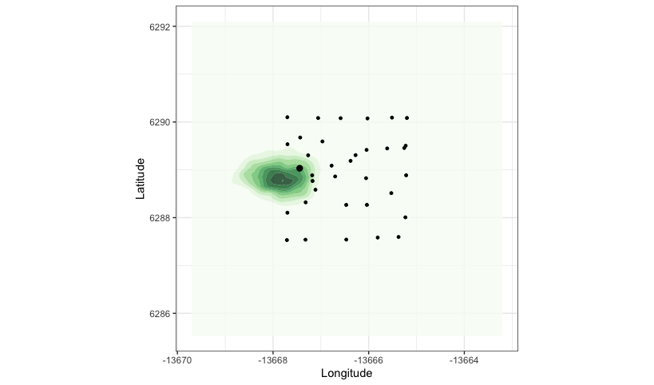
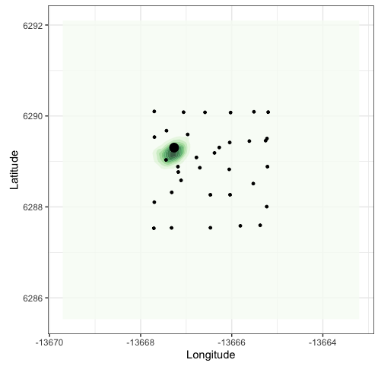
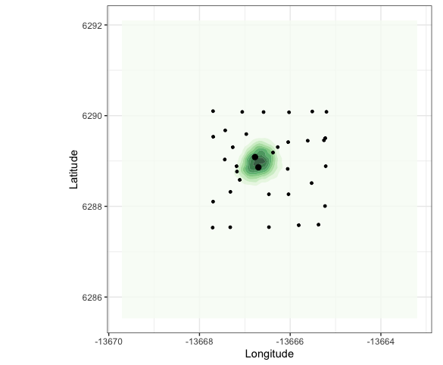
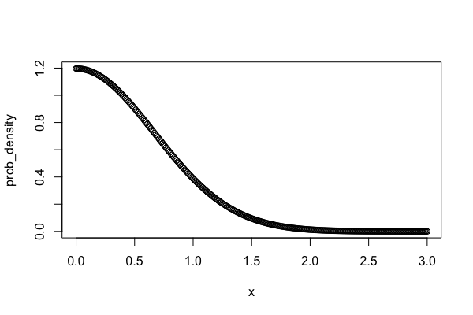
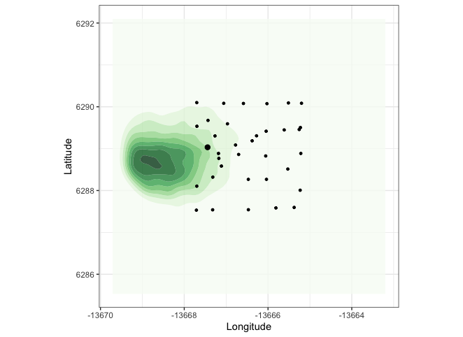
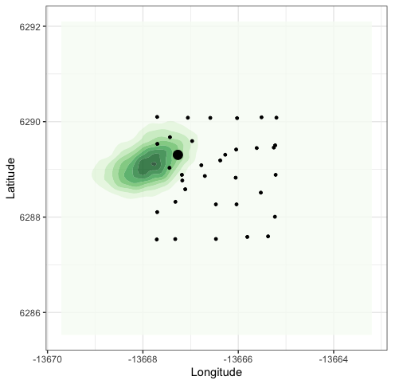
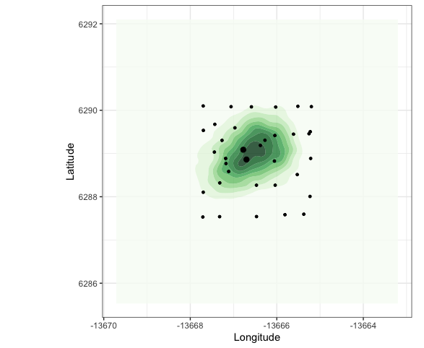
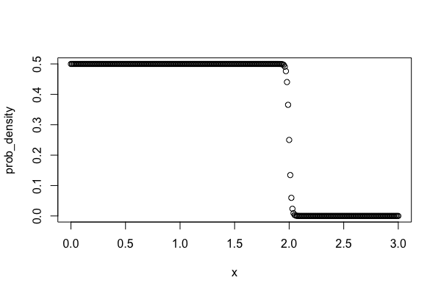

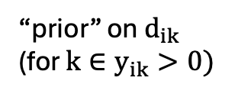




“prior” on $d_{ik}$
(for $k∈y_{ik}>0)$
colony 1024
colony 1373
colony 1399
$$d_{ik}\sim normal**(0, \frac{R_{max}}{3})$$
$$ρ = 0.273$$
** technically halfnormal, as $d_{ik} ≥ 0$
$$d_{ik}\sim uniform**(0,R_{max})$$
$$ρ = 0.489$$
**target+=-log(1+exp(100*(x-2)))

Slide 3
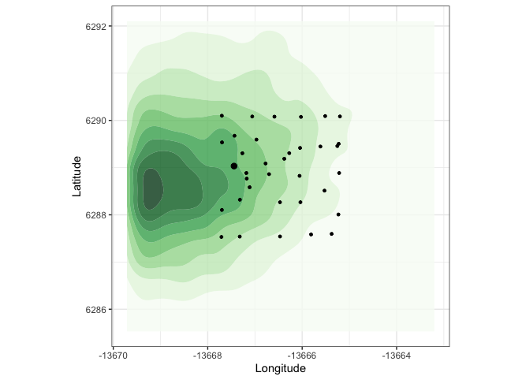
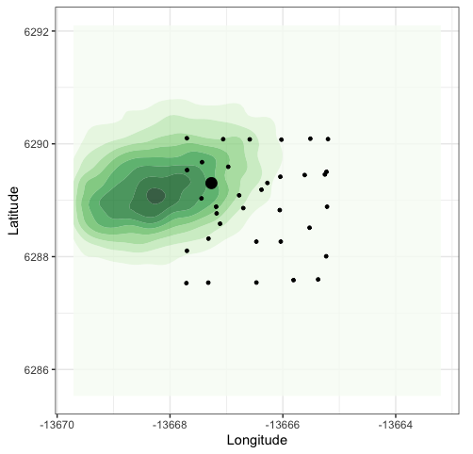
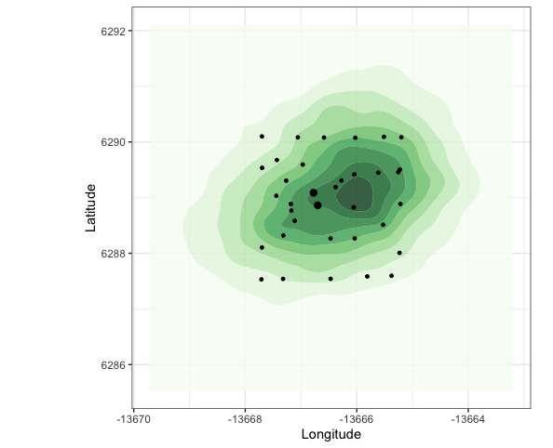
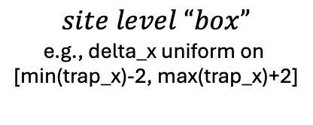

“prior” on $d_{ik}$
(for $k∈y_{ik}>0)$
colony 1024
colony 1373
colony 1399
$$site level “box”$$
e.g., delta_x uniform on
[min(trap_x)-2, max(trap_x)+2]
$$ρ = 0.956$$

Slide 4

$$d_{ik}\sim uniform**(0,R_{max})$$
** not technically uniform, as
target += uniform_lpdf(dis[k] | 0, Rmax)
fails initialization
This is because the target is supplemented after sampling, which means that if a sample outside of [0,Rmax] is drawn, target = -Inf
We also cannot constrain in the transformed parameters block (e.g.,
vector<lower=0, upper=Rmax>[O] dis;
Because transpars contraints are also applied post-sampling, so the sampler again fails initialization (albeit with a more useful warning message…)
A third alternative would be to perform a transformation on delta_x, delta_y to achieve the desired distribution of dis
In the case where each colony is captured at a single trap, this is relatively straightforward. We can sample location parameters using radial coordinates:
parameters {
vector<lower=0, upper=Rmax>[C] r;
vector<lower=0, upper=2*pi()>[C] theta;
}
Then transform to cartesian coordinates and add the trap coordinates as a reference point to position the location within the greater map area:
transformed parameters {
vector[C] delta_x;
vector[C] delta_y;
for (c in C){
delta_x[C] = trap_x[C] + rcos(theta);
delta_y[C] = trap_y[C] + rsin(theta);
}
However for the multiple trap case, the permissible area becomes an intersection of circles (see right)
Rmax
Colonies can be located in the intersection
I cannot think of a nice way to perform this transformation on the location parameter

