Slide 1
Foraging distance / colony density chapter

Slide 2
General overview
Lineage turnover -- How do landscape characteristics influence the probability of detecting a daughter queen in the following spring?
Allelic turnover–how does landscape influence allelic similarity/dissimilarity between year 1 and year 2?
Colony density – How do landscape characteristics influence # of detected colonies; Which specific landcover types are associated with more colonies?
Temporal aspect: accumulation of colonies through season?
Foraging distance-–how do species vary in their “baseline” foraging ranges, and do they differ in their “plasticity” in response to floral resources?
Spatial aggregation / abundance of workers – coefficient of variation of abundance?

Slide 3
Foraging distance
Foraging distance-–how do species vary in their “baseline” foraging ranges, and do they differ in their “plasticity” in response to floral resources?
In landscapes with more seminatural vegetation, are resource patches less attractive to foragers (from Pope & Jha 2018) ** might need to do more simulation to validate whether this works
Spatial aggregation / abundance of workers – coefficient of variation of abundance?

Slide 4
Lineage turnover
How do landscape characteristics influence the probability of detecting a daughter queen in the following spring?
Model: zero-inflated neg binomial?
# of queens detected ~ seminatural_area + interspersion_index + offset
offset = # of colonies observed at that site in the previous year?
site level or transect level?
Impatiens queens recaptures: W (22), SD (1), ED (7), NR (8), PM (4), HR(12)
Mixtus queens recaptures: W (4), SD (0), ED (0), NR (0), PM (1), HR(0)

Slide 5
Allelic turnover
Calculate a dis-similarity metric between years for each transect?
Allelic dissimilarity ~ seminatural_area + interspersion_index
Or maybe better to do a null model/permutational approach—accounting for total number of observations at each location per year

Slide 6
Colony density
Which specific landcover types are associated with more colonies?
Differential abundance analysis? Not totally sure how to do this but could read some papers
How do landscape characteristics influence # of detected colonies?
Temporal aspect: accumulation of colonies through season?

Slide 7
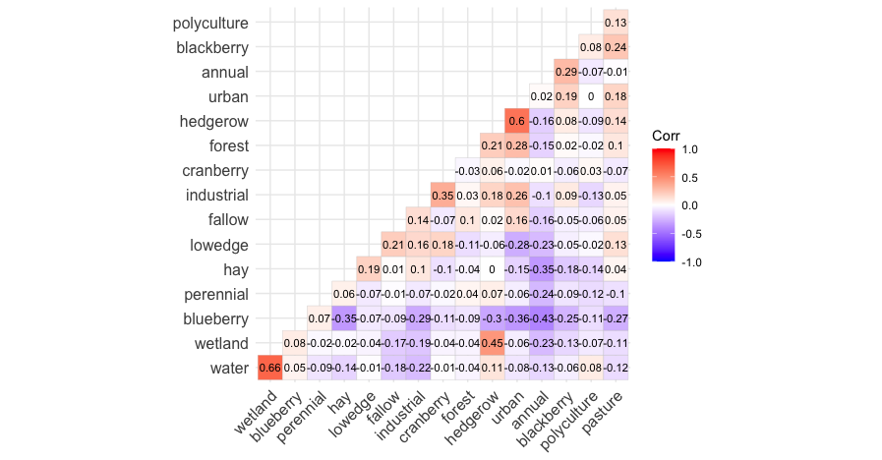
associating specific landcover types with colony density

Slide 8
possible models
Throw all nest-habitable landcover classes (blackberry, urban, hedgerow, low edge, forest, cranberry, blueberry, hay, fallow, perennial, wetland) into a model and see what the multicollinearity looks like?
NMDS (or similar graphical representation?) of landcover “composition”

Slide 9
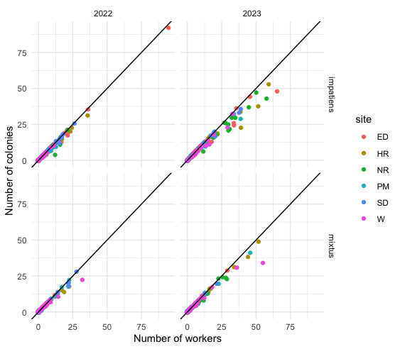
correlation between number of workers & number of colonies
This is at the transect level—so some colonies are being observed at multiple transects
Not sure if it makes more sense to do this at site level?
But only 6 sites

Slide 10
possible models
colony number ~ seminat_area + iji + avg_floral + (1| transect)
worker number ~ seminat_area + iji + avg_floral + (1| transect)
# workers / colony ~ seminat_area + iji + avg_floral + (1| transect)
summed across all timepoints
(this last one would mostly be 1’s)

Slide 11
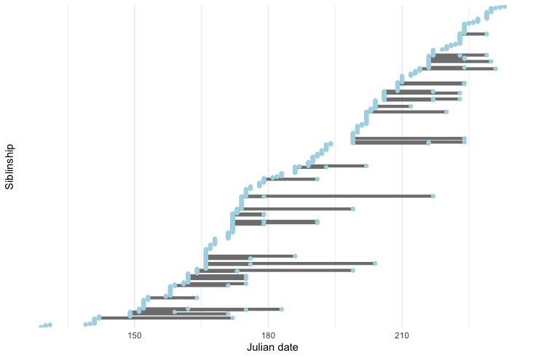
colony temporal span
B. mixtus, 2022

Slide 12
temporal and spatial resolution
Individual timepoints or averaged over year?
Timepoints – I think this is such a cool aspect of the dataset and something we could leverage to make this paper unique—I’m just not sure how. Other pros: can relate Bombus abundance to specific floral communities, not averaged
Averaged – Pros: don’t “double count” colonies, Cons: differences in sampling effort, and sampling effort spent during “peak” season is different than sampling effort spent during early/late season
Transects or site level?
Transects – potentially finer spatial resolution, but we “double count” colonies occurring at multiple transects. May suffer from spatial autocorrelation but there are ways to deal with that via correlation matrices on ”random” intercepts
Full sites—fewer datapoints, larger spatial resolution, may not be a lot of difference in landscape metrics between sites
Things that can only be done at site level:
estimated colony density (e.g., fit distribution of sibship sizes to a truncated Poisson)
assess how complete is our sampling at different landscapes? for different species?
Other options:
instead of measuring at each transect, we could use estimated posteriors for colony locations from foraging distance model

Slide 13
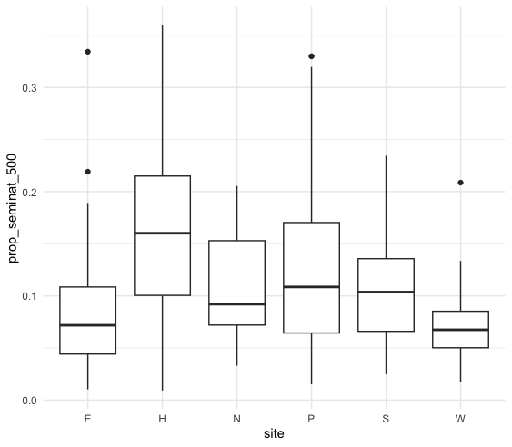
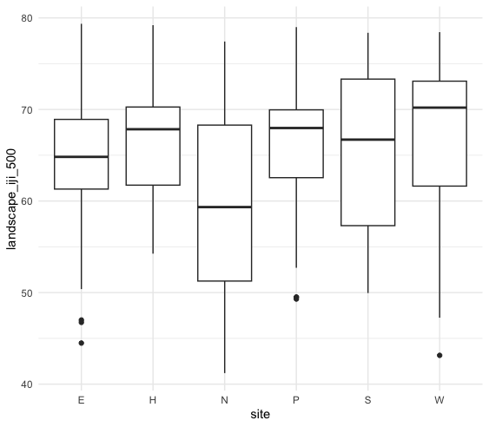
Interspersion + juxtaposition index: approaches 0 if a class is only adjacent to a single other class and equals 100 when a class is equally adjacent to all other classes.

Slide 14
Habitat selection/abundance
How does landscape influence bumblebee density across life stages?
How does this vary between species?
Queen detection
Allelic turnover
Lineage turnover
Nest searching
Colony density
Habitat preference
Type of behaviour (searching vs foraging)
Raw and estimated colony densities
Differential abundance analysis?
Temporal accumulation
Notes:
Start here!

Slide 15
Foraging / Nest Density Framing
Bees are important
Ag intensification leads to fragmentation of seminatural veg + nesting habitat
Bumblebees vary in nesting preferences, foraging distance, phenology, food plant prefs
The interaction of spp traits with biotic/abiotic conditions influences spp response to land use intensification
Questions:
How does foraging distance vary between spp, and to what degree do high quality or abundance floral resources drive this difference?
Do species have different land use type association wrt colony density or nest searching?
At what rate do we observe daughter queen in the following year? Is this different for different spp?

Slide 16
Foraging
Foraging in relation to pollination services
Estimate parameters for patch attractiveness
Pollination ~ colony density + foraging estimates
In this landscape you have XXX colonies producing workers foraging on blueberry—estimate likelihood of foragers from colonies could arrive at blueberries
Incorporate patch attractiveness into Lonsdorf model? (not necessarily use it—build own model)
Predictions of colonies across landscape based on observations and previous chapter

