Slide 1
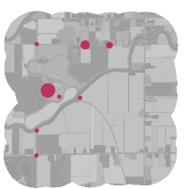
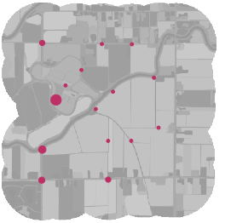
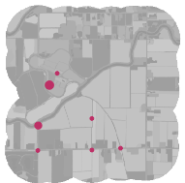
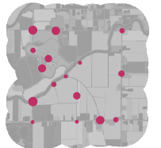
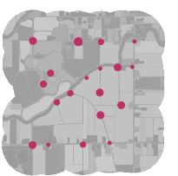
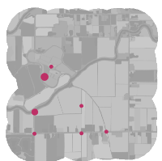
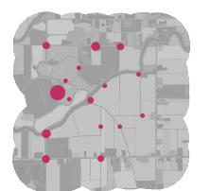
(A)
t = 1
t = 2
t = 3
t = 4
t = 9
t = 10
. . .
period 1
period 2
period 5
(B)
(C)
(D)
n = 8
n = 1
n = 5
n = 5
n = 5
n = 5
n = 5
n = 2
n = 6
n = 5
specimens outside subsite not screened
spp 1
spp 2
spp 3
spp 1
spp 2
spp 3
Notes:
Caption: A subsample of all collected specimens were screened for parasites. Shown here for a single study landscape (Nicomekl River). A) The ten sampling rounds (May – August) were pooled by combining consecutive sampling rounds to form “periods.” All samples in a period collected within a 2-3 week span. B) Within each landscape, closely adjacent points were grouped to form “subsites” (shown here for a single period, but note that subsite boundaries did not change between periods). All transects belonging to a subsite were at least 500 meters distance from transects in the nearest adjacent subsite. Specimens outside subsites were not carried forward, except for queens. C) The number of individuals of each bumble bee species in each subsite x period combination was calculated (shown here for a single period). D) Five individuals of each species were randomly selected for parasite screening. Subsite x period x species combinations with fewer than five representatives were not carried forward for parasite screening.

