Slide 1
25
Accessing Databases with JDBC

Slide 2
It is a capital mistake to theorize before one has data.
  Arthur Conan Doyle
Now go, write it before them in a table, and note it in a book, that it may be for the time to come for ever and ever.
  The Holy Bible, Isaiah 30:8
Get your facts first, and then you can distort them as much as you please.
  Mark Twain
I like two kinds of men: domestic and foreign.
  Mae West

Slide 3
OBJECTIVES
In this chapter you will learn:
Relational database concepts.
To use Structured Query Language (SQL) to retrieve data from and manipulate data in a database.
To use the JDBC API of package java.sql to access databases.

Slide 4
25.1 Introduction
25.2 Relational Databases
25.3 Relational Database Overview: The books Database
25.4 SQL
25.4.1 Basic SELECT Query
25.4.2 WHERE Clause
25.4.3 ORDER BY Clause
25.4.4 Merging Data from Multiple Tables: INNER JOIN
25.4.5 INSERT Statement
25.4.6 UPDATE Statement
25.4.7 DELETE Statement
25.5 Instructions to install MySQL and MySQL Connector/J
25.6 Instructions on Setting MySQL User Account
25.7 Creating Database books in MySQL
25.8 Manipulating Databases with JDBC
25.8.1 Connecting to and Querying a Database
25.8.2 Querying the books Database
25.9 Stored Procedures
25.10 RowSet Interface
25.11 Wrap-Up

Slide 5
25.1 Introduction
Database
  Collection of data
DBMS
  Database management system
  Storing and organizing data
SQL
  Relational database
  Structured Query Language

Slide 6
25.1 Introduction (Cont.)
RDBMS
  Relational database management system
  MySQL
    Open source
    Available for both Windows and Linux
    dev.mysql.com/downloads/mysql/4.0.hml
JDBC
  Java Database Connectivity
  JDBC driver
    Enable Java applications to connect to database
    Enable programmers to manipulate databases using JDBC

Slide 7
Software Engineering Observation 25.1
The separation of the JDBC API from particular database drivers enables developers to change the underlying database without modifying the Java code that accesses the database.

Slide 8
25.2 Relational Databases
Relational database
  Table
    Rows, columns
  Primary key
    Unique data
SQL queries
  Specify which data to select from a table

Slide 9
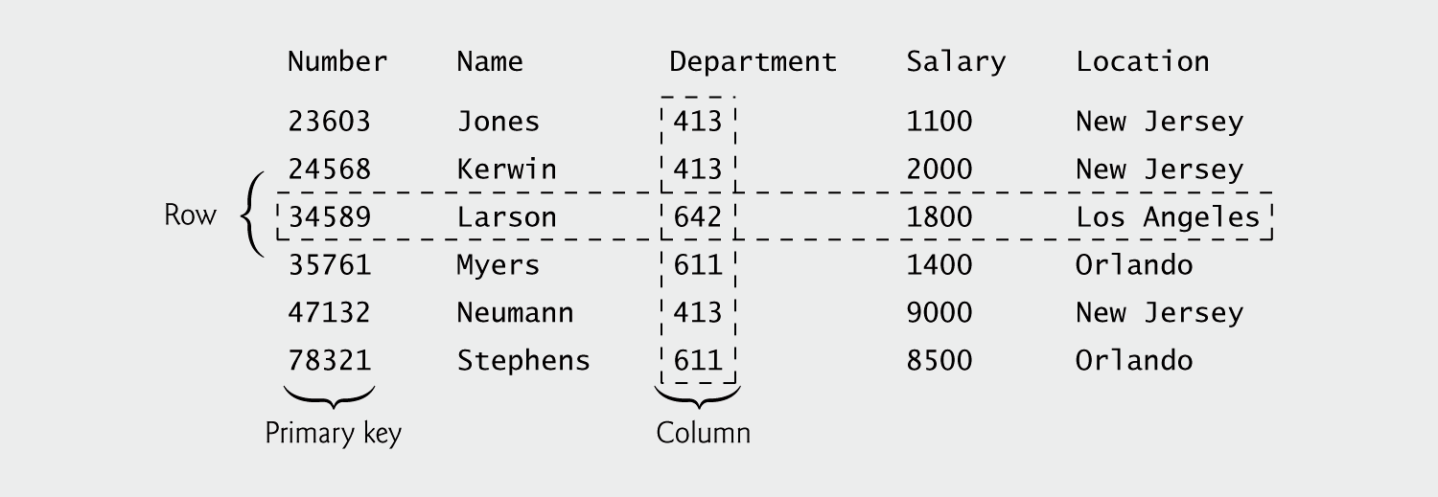
Fig. 25.1 | Employee table sample data.

Slide 10

Fig. 25.2 | Result of selecting distinct Department and Location data from table Employee.

Slide 11
25.3 Relational Database Overview: The books Database
Sample books database
  Four tables
    authors
      authorID, firstName, lastName
    publishers
      publisherID, publisherName
    titles
      isbn, title, editionNumber, copyright, publisherID, imageFile, price
    authorISBN
      authorID, isbn

Slide 12
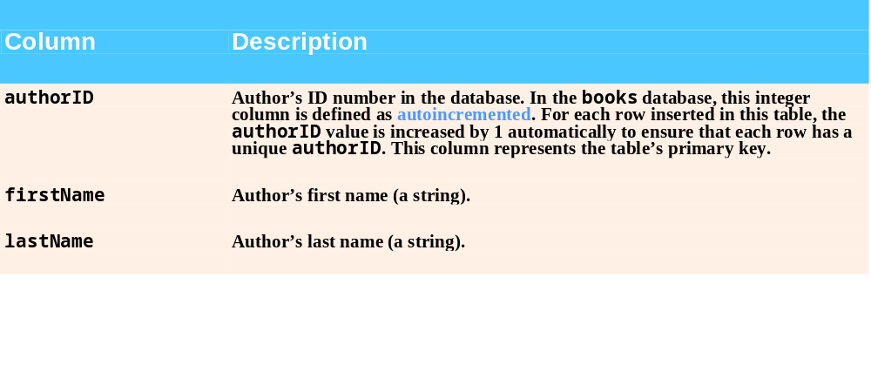
Fig. 25.3 | authors table from books.

Slide 13
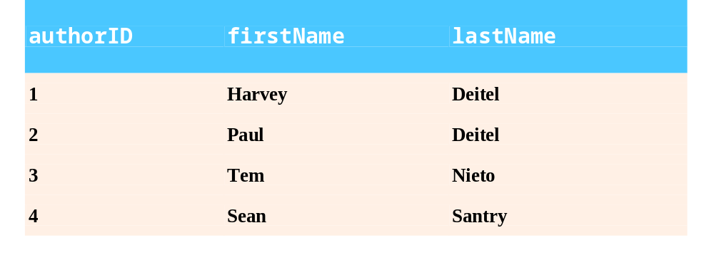
Fig. 25.4 | Sample data from the authors table.

Slide 14
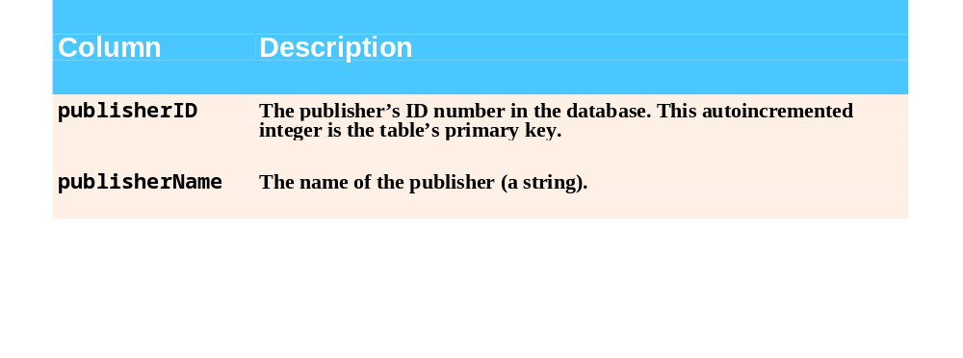
Fig. 25.5 | publishers table from books.

Slide 15

Fig. 25.6 | Data from the publishers table.

Slide 16
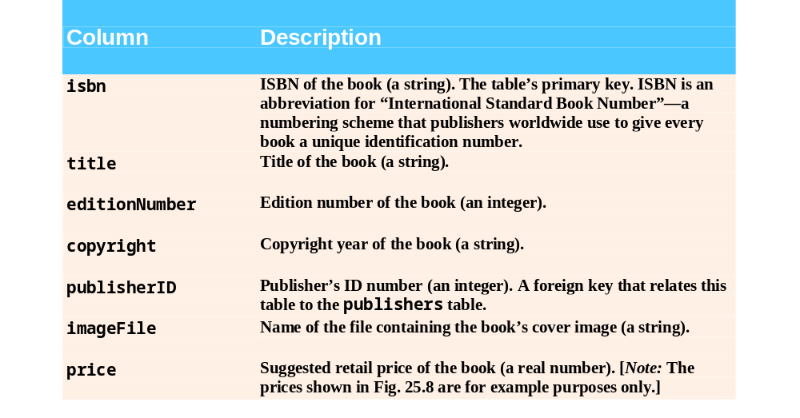
Fig. 25.7 | titles table from books.

Slide 17
25.3 Relational Database Overview: The books Database (Cont.)
Foreign key
  A column
    matches the primary key column in another table
  Helps maintain the Rule of Referential Integrity
    Every foreign key value must appear as another table’s primary key value
Entity-relationship (ER) diagram
  Tables in the database
  Relationships among tables

Slide 18
25.3 Relational Database Overview: The books Database (Cont.)
Rule of Entity Integrity
  Primary key uniquely identifies each row
  Every row must have a value for every column of the primary key
  Value of the primary key must be unique in the table

Slide 19
Common Programming Error 25.1
Not providing a value for every column in a primary key breaks the Rule of Entity Integrity and causes the DBMS to report an error.

Slide 20
Common Programming Error 25.2
Providing the same value for the primary key in multiple rows causes the DBMS to report an error.

Slide 21
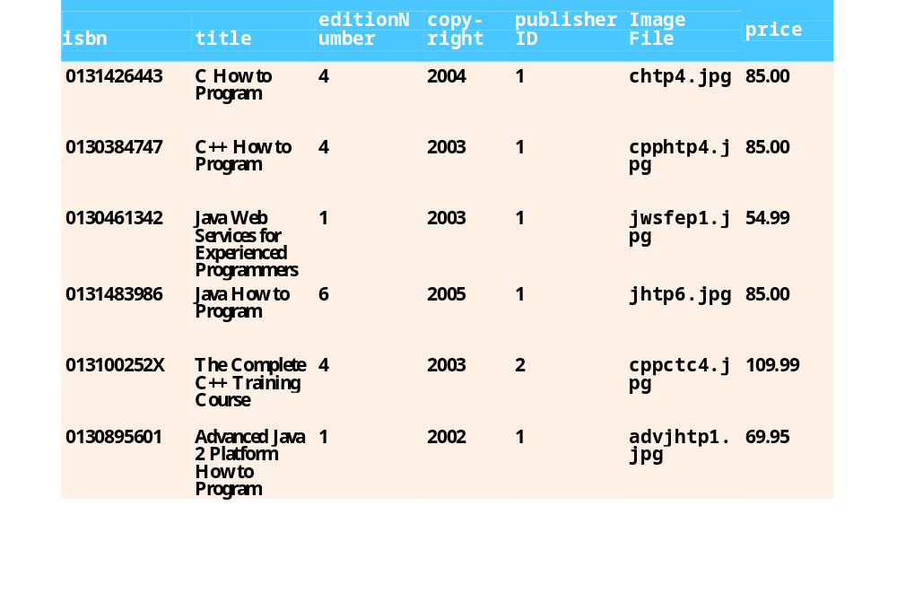
Fig. 25.8 | Sample data from the titles table of books.

Slide 22
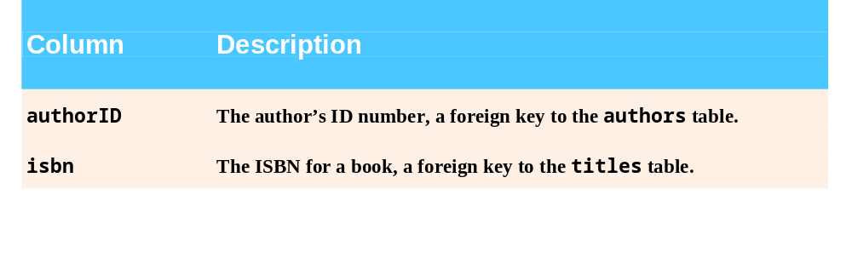
Fig. 25.9 | authorISBN table from books.

Slide 23
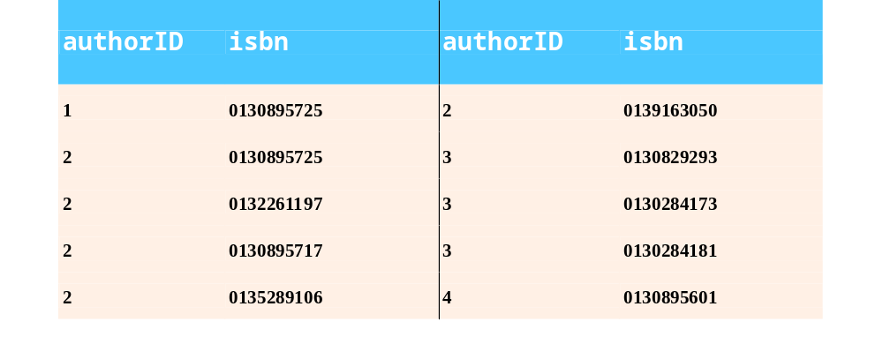
Fig. 25.10 | Sample data from the authorISBN table of books.

Slide 24
Common Programming Error 25.3
Providing a foreign-key value that does not appear as a primary-key value in another table breaks the Rule of Referential Integrity and causes the DBMS to report an error.

Slide 25
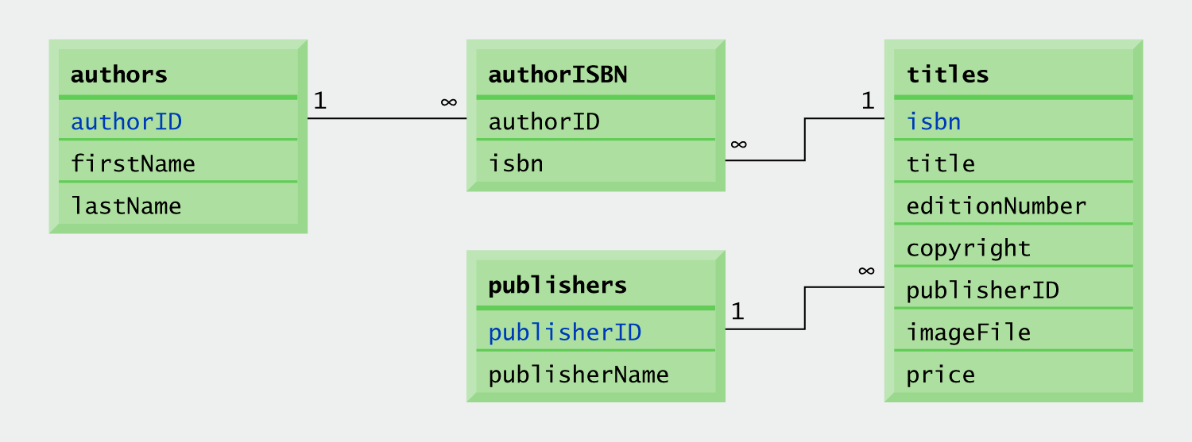
Fig. 25.11 | Table relationships in books.

Slide 26
25.4 SQL
SQL keywords
  SQL queries and statements

Slide 27
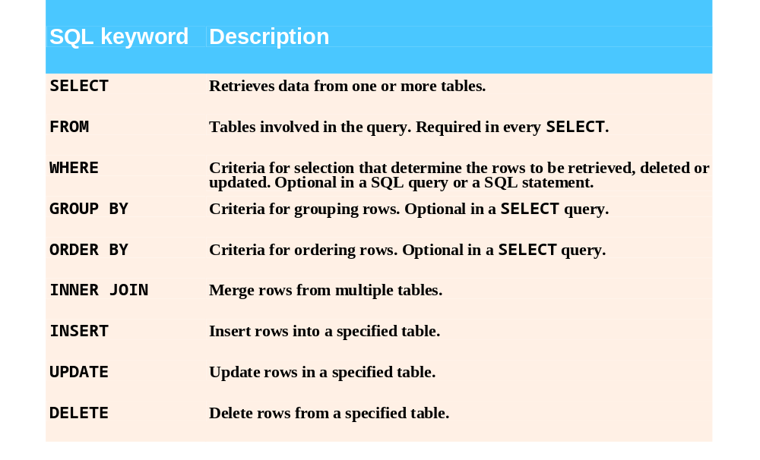
Fig. 25.12 | SQL query keywords.

Slide 28
25.4.1 Basic SELECT Query
Simplest format of a SELECT query
  SELECT * FROM tableName
    SELECT * FROM authors
Select specific fields from a table
  SELECT authorID, lastName FROM authors

Slide 29
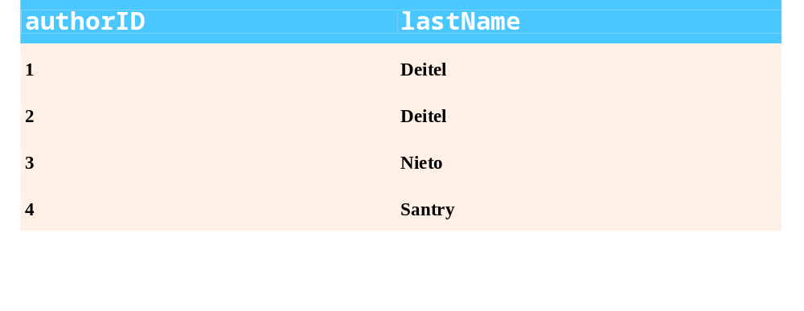
Fig. 25.13 | Sample authorID and lastName data from the authors table.

Slide 30
Software Engineering Observation 25.2
For most queries, the asterisk (*) should not be used to specify column names. In general, programmers process results by knowing in advance the order of the columns in the result—for example selecting authorID and lastName from table authors ensures that the columns will appear in the result with authorID as the first column and lastName as the second column. Programs typically process result columns by specifying the column number in the result (starting from number 1 for the first column). Selecting columns by name also avoids returning unneeded columns and protects against changes in the actual order of the columns in the table(s).

Slide 31
Common Programming Error 25.4
If a programmer assumes that the columns are always returned in the same order from a query that uses the asterisk (*), the program may process the result incorrectly. If the column order in the table(s) changes or if additional columns are added at a later time, the order of the columns in the result would change accordingly.

Slide 32
25.4.2 WHERE Clause
specify the selection criteria
  SELECT columnName1, columnName2, … FROM tableName WHERE criteria
    SELECT title, editionNumber, copyright
      FROM titles
      WHERE copyright > 2002

Slide 33
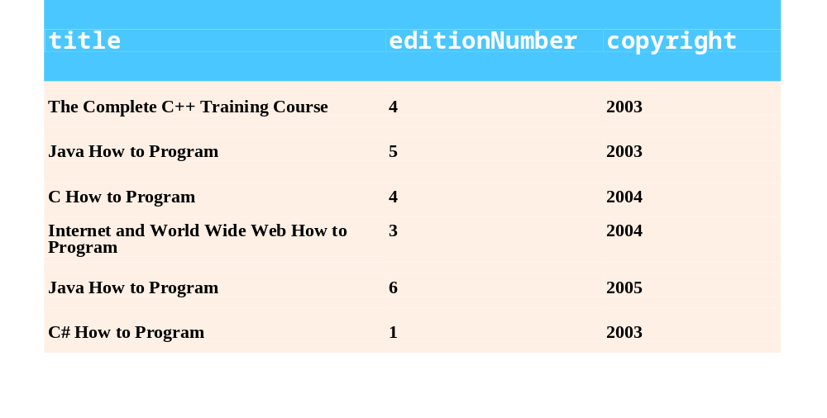
Fig. 25.14 | Sampling of titles with copyrights after 2002 from table titles.

Slide 34
25.4.2 WHERE Clause (Cont.)
WHERE clause condition operators
  <, >, <=, >=, =, <>
  LIKE
    wildcard characters % and _
    SELECT authorID, firstName, lastName
      FROM authors
      WHERE lastName LIKE ‘D%’

Slide 35
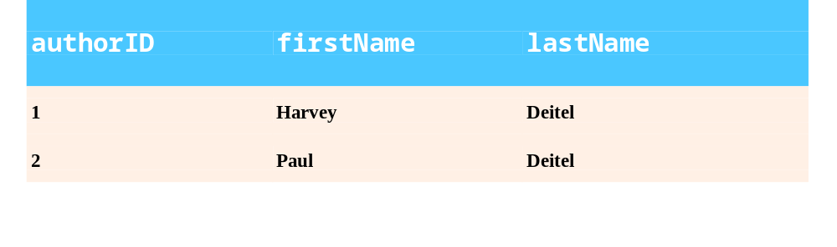
Fig. 25.15 | Authors whose last name starts with D from the authors table.

Slide 36
Portability Tip 25.1
See the documentation for your database system to determine whether SQL is case sensitive on your system and to determine the syntax for SQL keywords (i.e., should they be all uppercase letters, all lowercase letters or some combination of the two?).

Slide 37
Portability Tip 25.2
Read your database system’s documentation carefully to determine whether your system supports the LIKE operator.

Slide 38
Portability Tip 25.3
Some databases use the * character in place of the % character in a pattern.

Slide 39
25.4.2 WHERE Clause (Cont.)
    SELECT authorID, firstName, lastName
      FROM authors
      WHERE lastName LIKE ‘_i%’

Slide 40
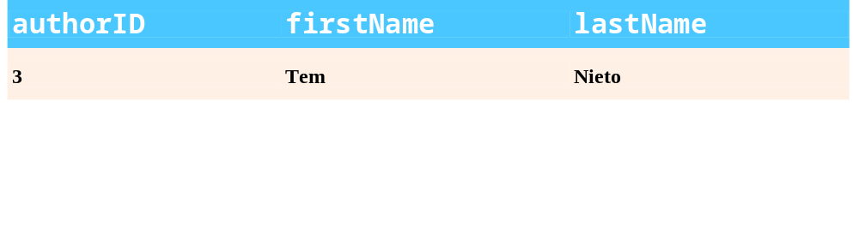
Fig. 25.16 | The only author from the authors table whose last name contains i as the second letter.

Slide 41
Portability Tip 25.4
Some database systems use the ? character in place of the _ character in a pattern.

Slide 42
25.4.3 ORDER BY Clause
Optional ORDER BY clause
  SELECT columnName1, columnName2, … FROM tableName ORDER BY column ASC
    SELECT authorID, firstName, lastName
      FROM authors
      ORDER BY lastName ASC
  SELECT columnName1, columnName2, … FROM tableName ORDER BY column DESC
    SELECT authorID, firstName, lastName
      FROM authors
      ORDER BY lastName DESC

Slide 43
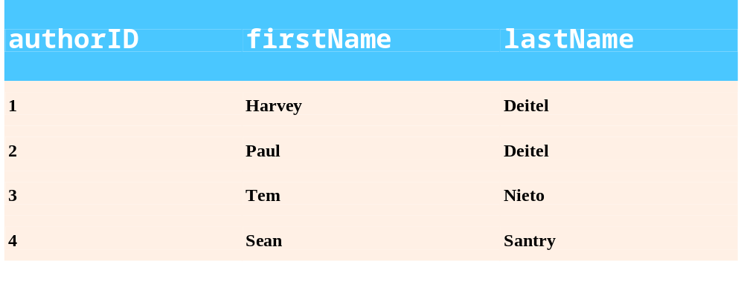
Fig. 25.17 | Sample data from table authors in ascending order by lastName.

Slide 44
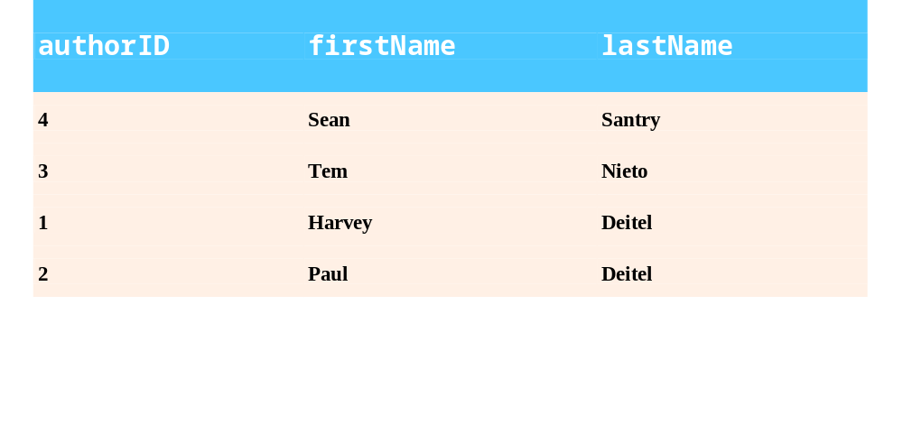
Fig. 25.18 | Sample data from table authors in descending order by lastName.

Slide 45
25.4.3 ORDER BY Clause (Cont.)
ORDER BY multiple fields
  ORDER BY column1 sortingOrder, column2 sortingOrder, …
    SELECT authorID, firstName, lastName
      FROM authors
      ORDER BY lastName, firstName

Slide 46
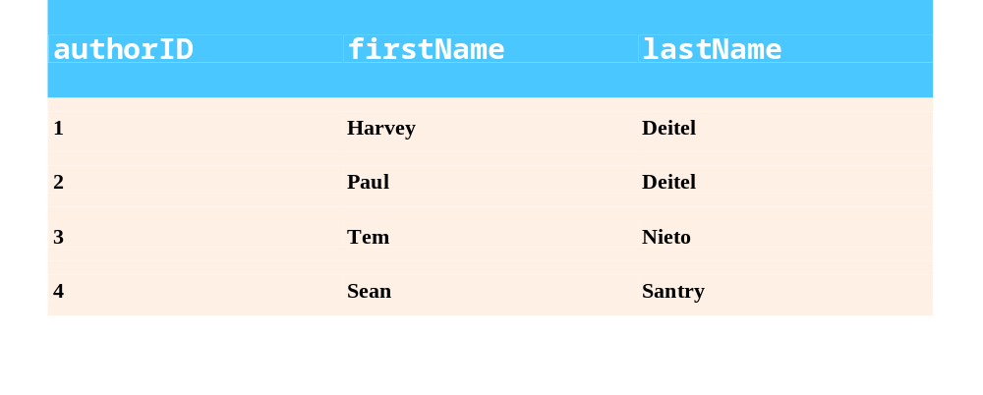
Fig. 25.19 | Sample data from authors in ascending order by lastName and firstName.

Slide 47
25.4.3 ORDER BY Clause (Cont.)
Combine the WHERE and ORDER BY clauses
    SELECT isbn, title, editionNumber, copyright, price
      FROM titles WHERE title LIKE ‘%How to Program’
      ORDER BY title ASC

Slide 48
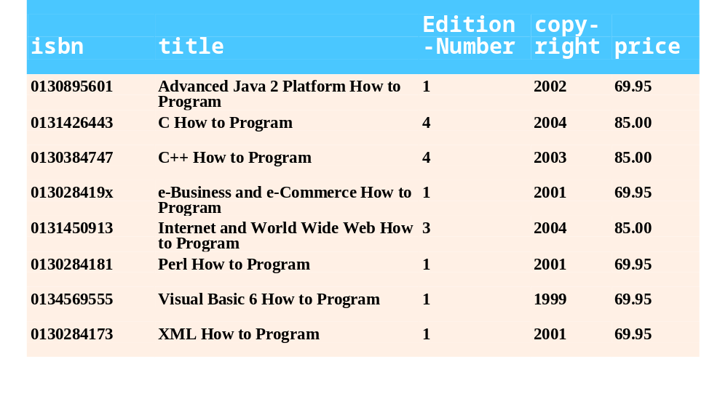
Fig. 25.20 | Sampling of books from table titles whose titles end with How to Program in ascending order by title.

Slide 49
25.4.4 Merging Data from Multiple Tables: INNER JOIN
Split related data into separate tables
Join the tables
  Merge data from multiple tables into a single view
  INNER JOIN
    SELECT columnName1, columnName2, …
  FROM table1
  INNER JOIN table2
  ON table1.columnName = table2.column2Name
    SELECT firstName, lastName, isbn
  FROM authors, authorISBN
  INNER JOIN authorISBN
  ON authors.authorID = authorISBN.authorID
  ORDER BY lastName, firstName

Slide 50
Software Engineering Observation 25.3
If a SQL statement includes columns from multiple tables that have the same name, the statement must precede those column names with their table names and a dot (e.g., authors.authorID).

Slide 51
Common Programming Error 25.5
In a query, failure to qualify names for columns that have the same name in two or more tables is an error.

Slide 52
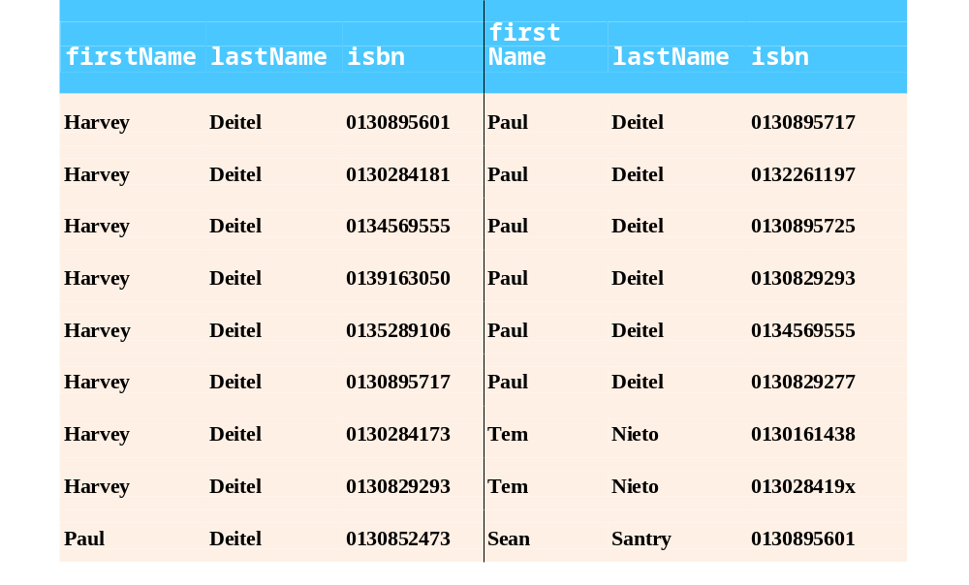
Fig. 25.21 | Sampling of authors and ISBNs for the books they have written in ascending order by lastName and firstName.

Slide 53
25.4.5 INSERT Statement
Insert a row into a table
  INSERT INTO tableName ( columnName1, … , columnNameN )
  VALUES ( value1, … , valueN )
    INSERT INTO authors ( firstName, lastName )
    VALUES ( ‘Sue’, ‘Smith’ )

Slide 54
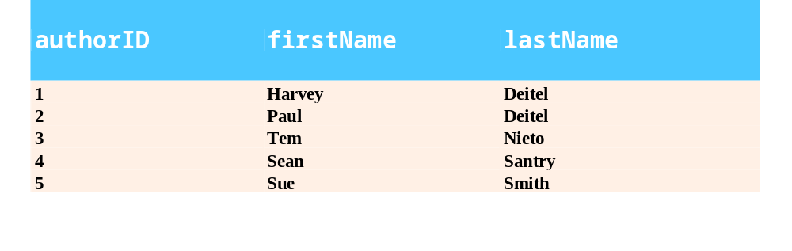
Fig. 25.22 | Sample data from table Authors after an INSERT operation.

Slide 55
Common Programming Error 25.6
It is an error to specify a value for an autoincrement column.

Slide 56
Common Programming Error 25.7
SQL uses the single-quote (') character as a delimiter for strings. To specify a string containing a single quote (e.g., O’Malley) in a SQL statement, the string must have two single quotes in the position where the single-quote character appears in the string (e.g., 'O''Malley'). The first of the two single-quote characters acts as an escape character for the second. Not escaping single-quote characters in a string that is part of a SQL statement is a SQL syntax error.

Slide 57
25.4.6 UPDATE Statement
Modify data in a table
  UPDATE tableName
  SET columnName1 = value1, … , columnNameN = valueN
  WHERE criteria
    UPDATE authors
    SET lastName = ‘Jones’
    WHERE lastName = ‘Smith’ AND firstName = ‘Sue’

Slide 58
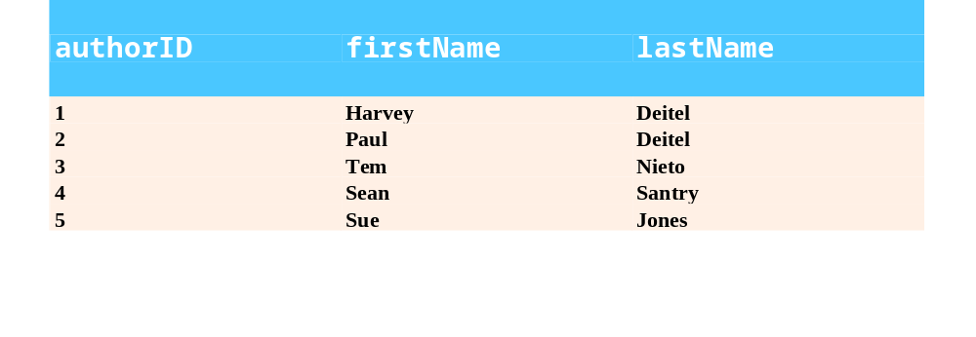
Fig. 25.23 | Sample data from table authors after an UPDATE operation.

Slide 59
25.4.7 DELETE Statement
Remove data from a table
  DELETE FROM tableName WHERE criteria
    DELETE FROM authors
    WHERE lastName = ‘Jones’ AND firstName = ‘Sue’

Slide 60
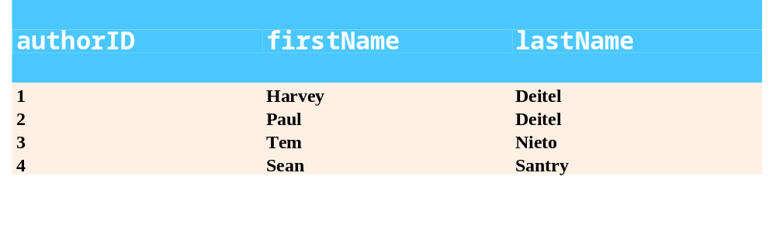
Fig. 25.24 | Sample data from table authors after a DELETE operation.

Slide 61
25.5 Instructions to Install MySQL and MySQL Connector/J
Install MySQL
  Insert CD and change directory to D:\software\MySQL\mysql-4.0.20c-win
  Double click SETUP.EXE
  Following the instruction
Install MySQL Connector/J
  Copy mysql-connector-java-3.0.14-production.zip
  Open mysql-connector-java-3.0.14-production.zip
    Extract its content to the C:\ driv

Slide 62
25.6 Instructions on Setting MySQL User Account
Set up a user account
  Start database server by executing the script C:\mysql\bin\mysqld
  Start the MySQL monitor by executing the command C:\mysql\bin>mysql –h localhost –u root
  Create an account
  mysql> USE mysql;
  mysql> INSERT INTO user SET Host=‘localhost’, User=‘jhtp6’, Password=PASSWORD(‘jhtp6’), Select_priv=‘Y’, Insert_priv=‘Y’,
  Update_priv=‘Y’, Delete_priv=‘Y’,
  Create_priv=‘Y’, Drop_priv=‘Y’,
  References_priv=‘Y’, Execute_priv=‘Y’;
  mysql> FLUSH PRIVILEGES;
  mysql> exit;

Slide 63
25.7 Creating Database books in MySQL
Create books database
  Open Command Prompt
  Change to the C:\mysql\bin directory
  Start database by executing the command C:\mysql\bin\mysqld
  Copy SQL script books.sql to C:\mysql\bin directory
  Open another Command Prompt
  Change to the C:\mysql\bin directory
  Create the books database by executing the command C:\mysql\bin>mysql –h localhost –u jhtp6 –p < books.sql

Slide 64
25.8 Manipulating Databases with JDBC
Connect to a database
Query the database
Display the results of the query in JTable

Slide 65
25.8.1 Connecting to and Querying a Database
DisplayAuthors
  Retrieves the entire authors table
  Displays the data in the standard output stream
  Example illustrates
    Connect to the database
    Query the database
    Process the result

Slide 66
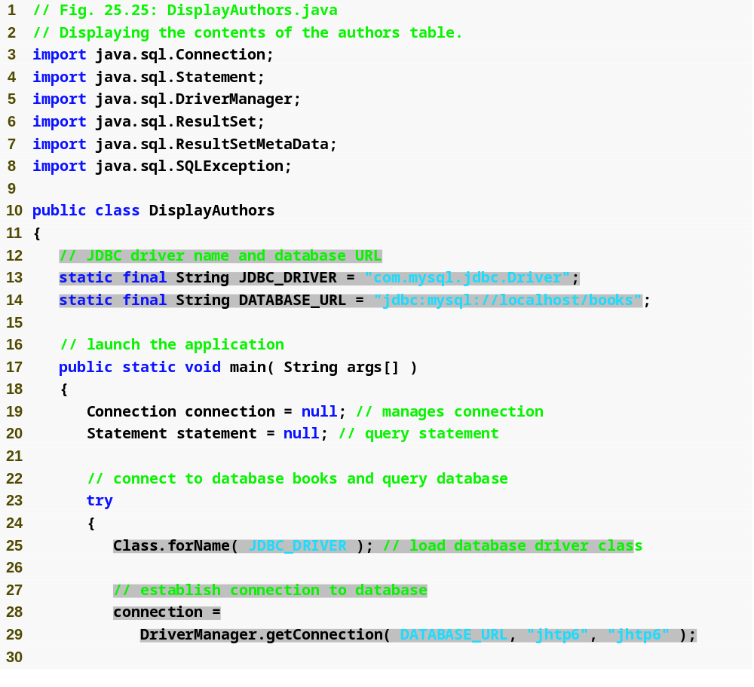
Outline
Imports the JDBC classes and interfaces from package java.sql
DisplayAuthors .java
  (1 of 3)
  Lines 3-8
  Line 13
  Line 14
  Line 25
  Lines 28-29
Declare a String constant that specifies the JDBC driver’s class name
Declare a String constant that specifies the database URL
Loads the class definition for the database driver.
Declare and initialize a Connection reference called connection.

Slide 67
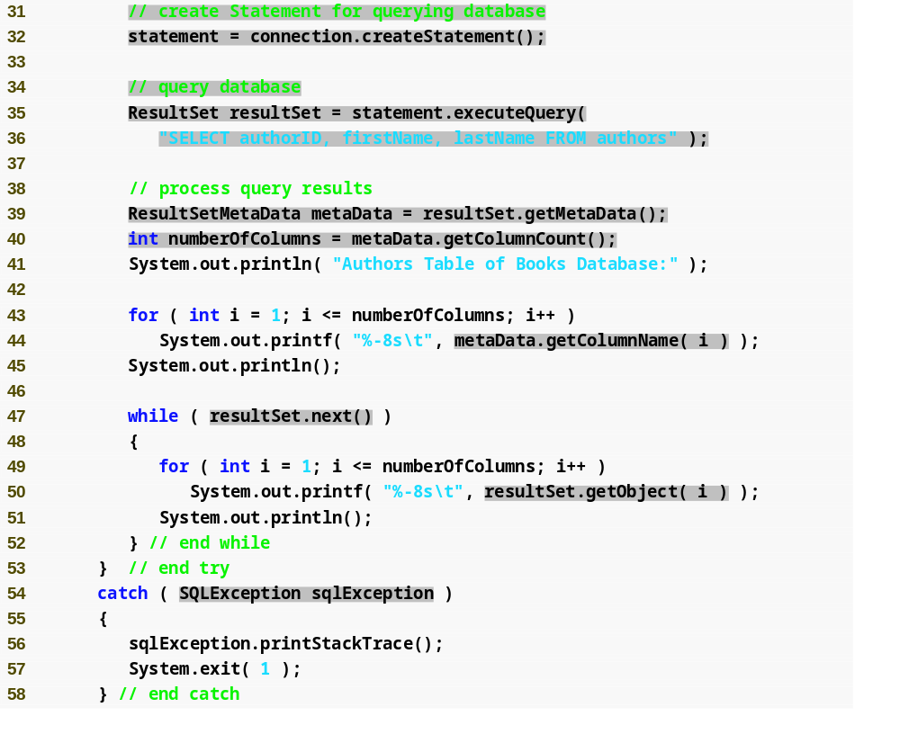
Outline
Invokes Connection method createStatement to obtain an object that implements interface Statement.
Use the Statement object’s executeQuery method to execute a query that selects all the author information from table authors.
DisplayAuthors .java
  (2 of 3)
  Line 32
  Lines 35-36
  Line 39
  Line 40
  Line 44
  Line 47
  Line 50
  Line 54
Obtains the metadata for the ResultSet.
Uses ResultSetMetaData method getColumnCount to retrieve the number of columns in the ResultSet.
Obtain column name using method getColumnName
Position the ResultSet cursor to the first row in the ResultSet with method next
Extract the contents of one column in the current row
Catch SQLException, which is thrown if the query execution or ResultSet process fails

Slide 68
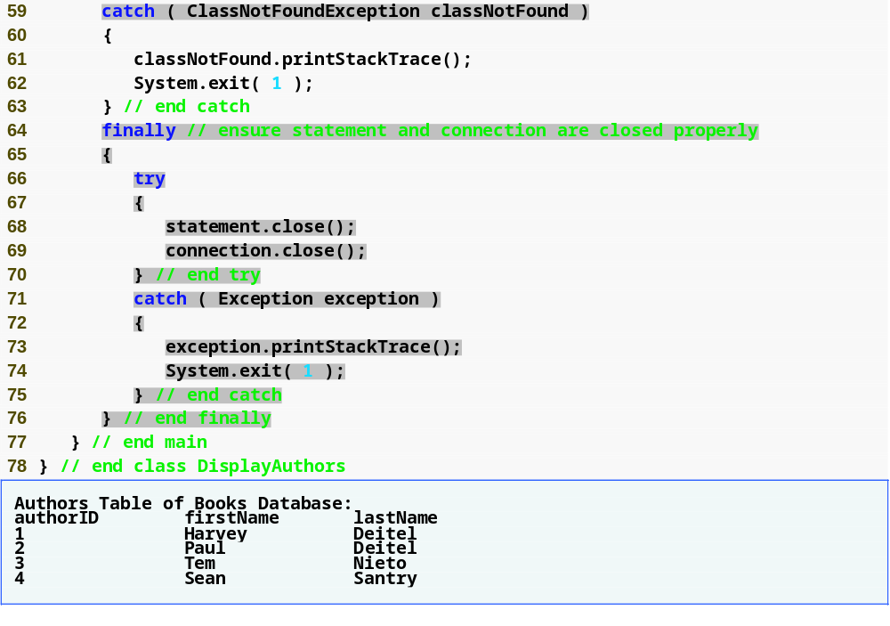
Outline
ClassNotFoundException is thrown if the class loader cannot locate the driver class
DisplayAuthors .java
  (3 of 3)
  Line 69
  Lines 68-69
  Program output
Close the Statement and the database Connection.

Slide 69
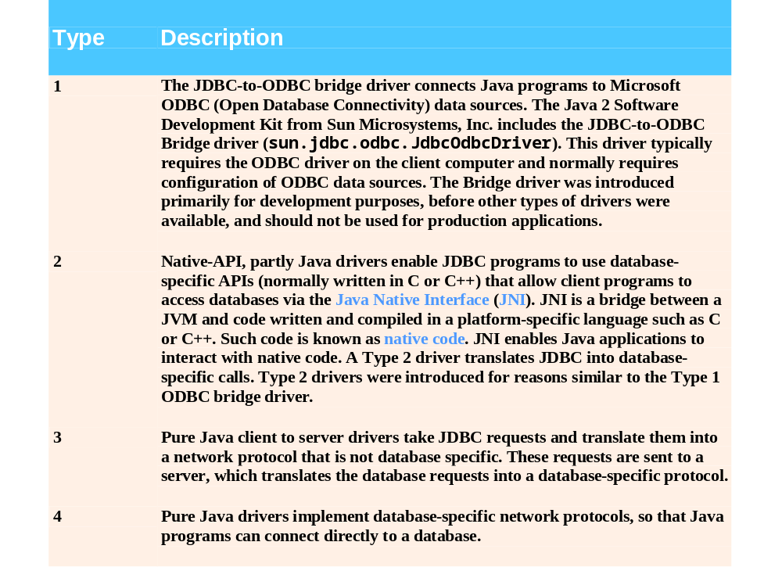
Fig. 25.26 | JDBC driver types.

Slide 70
Software Engineering Observation 25.4
Most major database vendors provide their own JDBC database drivers, and many third-party vendors provide JDBC drivers as well. For more information on JDBC drivers, visit the Sun Microsystems JDBC Web site, servlet.java.sun.com/products/jdbc/drivers.

Slide 71
Software Engineering Observation 25.5
On the Microsoft Windows platform, most databases support access via Open Database Connectivity (ODBC). ODBC is a technology developed by Microsoft to allow generic access to disparate database systems on the Windows platform (and some UNIX platforms). The JDBC-to-ODBC Bridge allows any Java program to access any ODBC data source. The driver is class JdbcOdbcDriver­ in package sun.jdbc.odbc.

Slide 72
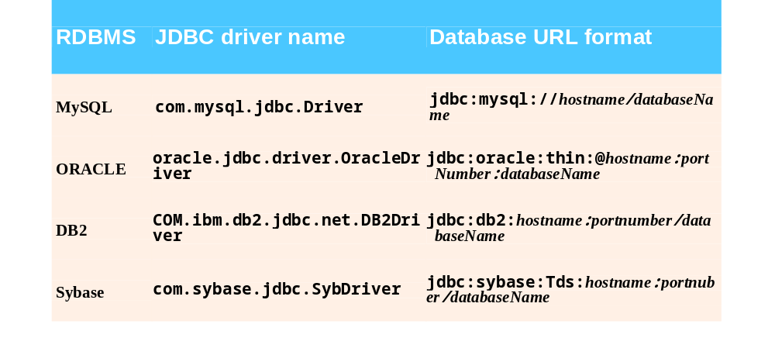
Fig. 25.27 | Popular JDBC driver names and database URL.

Slide 73
Software Engineering Observation 25.6
Most database management systems require the user to log in before accessing the database contents. DriverManager method getConnection is overloaded with versions that enable the program to supply the user name and password to gain access.

Slide 74
Software Engineering Observation 25.7
Metadata enables programs to process ResultSet contents dynamically when detailed information about the ResultSet is not known in advance.

Slide 75
Common Programming Error 25.8
Initially, a ResultSet cursor is positioned before the first row. Attempting to access a ResultSet’s contents before positioning the ResultSet cursor to the first row with method next causes a SQLException.

Slide 76
Performance Tip 25.1
If a query specifies the exact columns to select from the database, the ResultSet contains the columns in the specified order. In this case, using the column number to obtain the column’s value is more efficient than using the column name. The column number provides direct access to the specified column. Using the column name requires a linear search of the column names to locate the appropriate column.

Slide 77
Common Programming Error 25.9
Specifying column number 0 when obtaining values from a ResultSet causes a SQLException.

Slide 78
Common Programming Error 25.10
Attempting to manipulate a ResultSet after closing the Statement that created the ResultSet causes a SQLException. The program discards the ResultSet when the corresponding Statement is closed.

Slide 79
Software Engineering Observation 25.8
Each Statement object can open only one ResultSet object at a time. When a Statement returns a new ResultSet, the Statement closes the prior ResultSet. To use multiple ResultSets in parallel, separate Statement objects must return the ResultSets.

Slide 80
25.8.2 Querying the books Database
Allow the user to enter any query into the program
Display the results of a query in a JTable

Slide 81
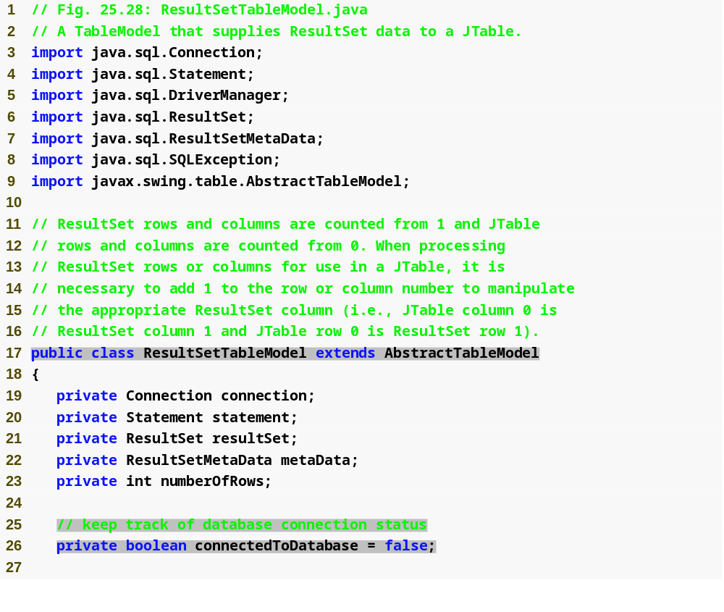
Outline
ResultSetTableModel.java
  (1 of 8)
  Line 17
  Line 26
Class ResultSetTableModel extends class AbstractTableModel, which implements interface TableModel.
Instance variable keeps track of database connection status

Slide 82
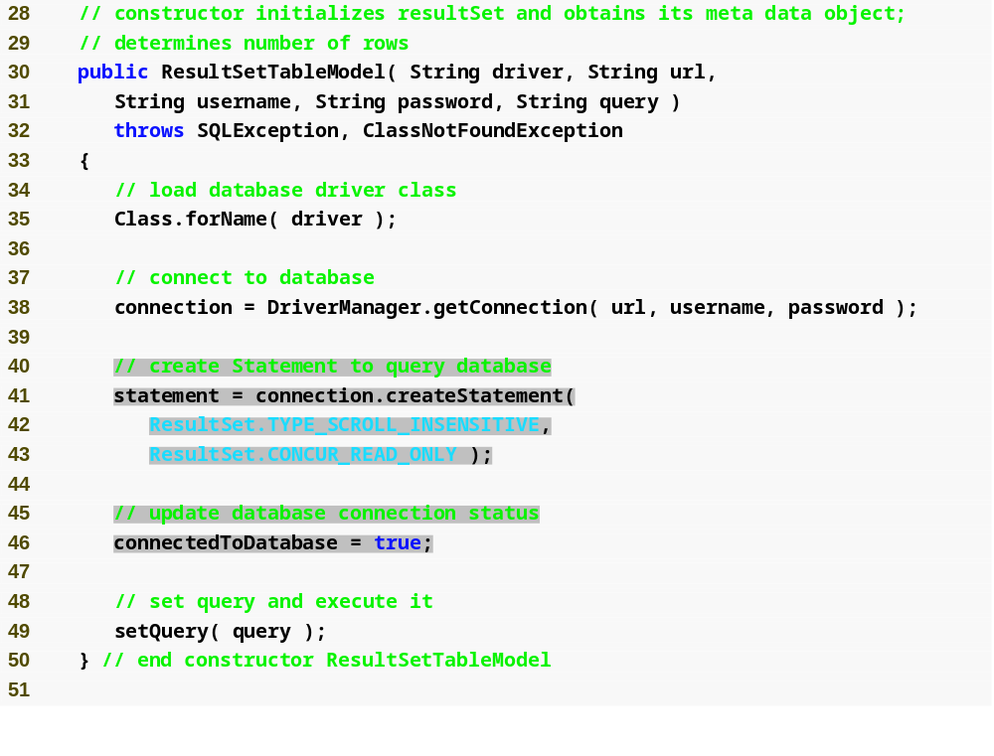
Outline
Constructor accepts five String arguments—the driver class name, the database URL, the username, the password and the default query to perform
Establishes a connection to the database.
ResultSetTableModel.java
  (2 of 8)
  Lines 30-31
  Line 38
  Lines 41-43
  Line 46
  Line 49
Invokes Connection method createStatement to create a Statement object.
Indicate that connect to database is successful
Invokes ResultSetTableModel method setQuery to perform the default query.

Slide 83
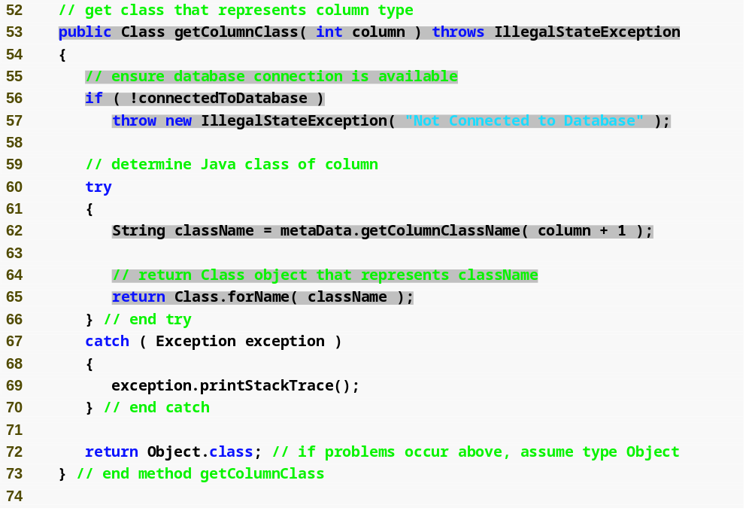
Outline
Verify database connection status
Override method getColumnClass to obtain a Class object that represents the superclass of all objects in a particular column
ResultSetTableModel.java
  (3 of 8)
  Lines 53-73
  Line 56
  Line 62
  Line 65
  Line 72
Obtains the fully qualified class name for the specified column.
Loads the class definition for the class and returns the corresponding Class object.
Returns the default type.

Slide 84
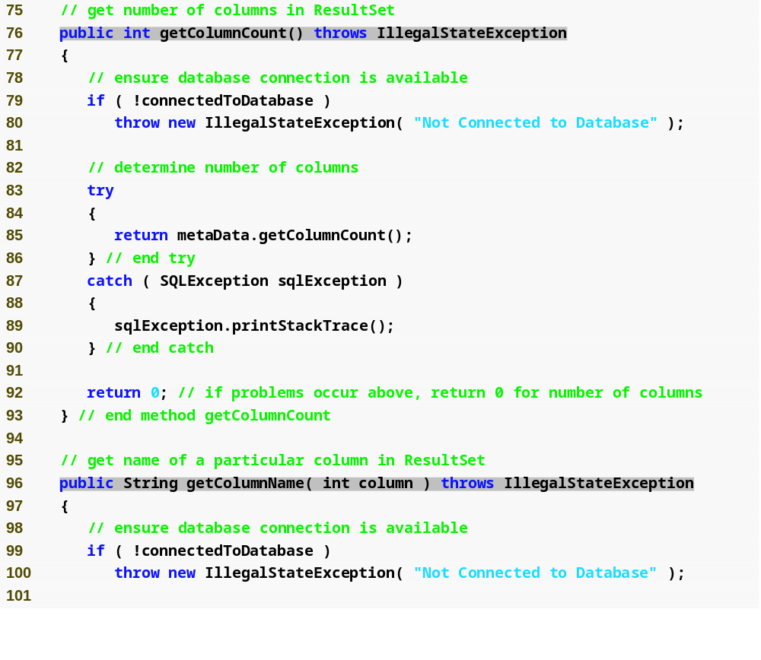
Outline
Override method getColumnCount to obtain the number of columns in the model’s underlying ResultSet
ResultSetTableModel.java
  (4 of 8)
  Lines 76-93
  Line 85
  Lines 96-113
Obtains the number of columns in the ResultSet.
Override method getColumnName to obtain the name of the column in the model’s underlying ResultSet

Slide 85
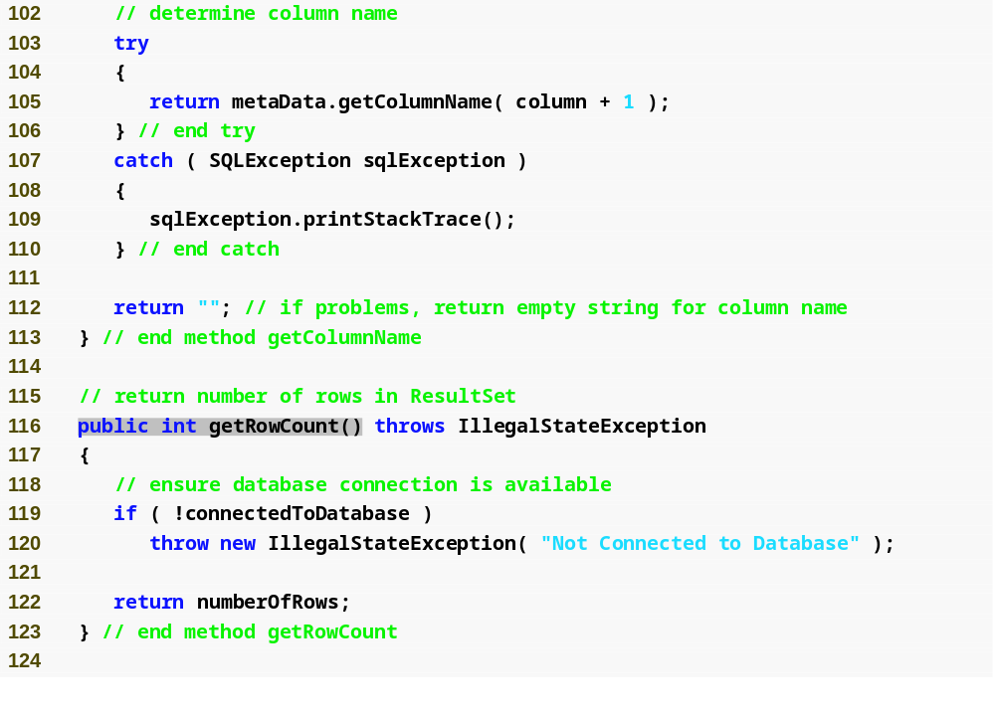
Outline
Obtains the column name from the ResultSet.
ResultSetTableModel.java
  (5 of 8)
  Line 105
  Lines 116-123
Override method getColumnCount to obtain the number of rows in the model’s underlying ResultSet

Slide 86
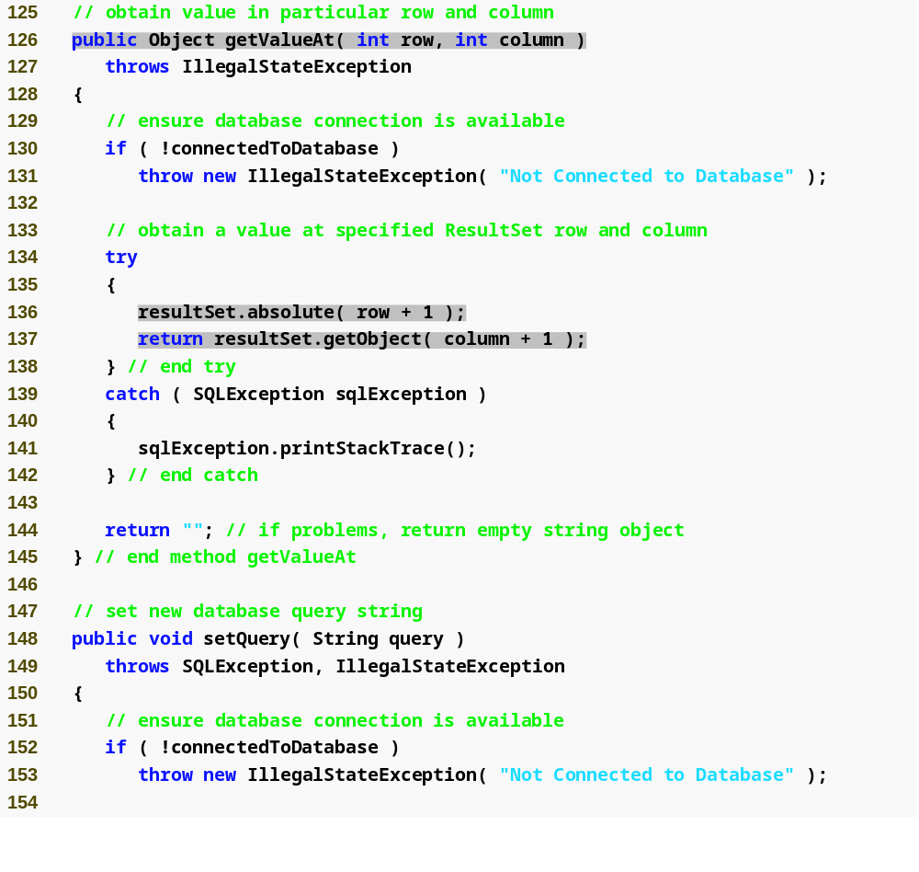
Outline
Override method getValueAt to obtain the Object in a particular row and column of the model’s underlying ResultSet
ResultSetTableModel.java
  (6 of 8)
  Lines 126-145
  Line 136
  Line 137
Uses ResultSet method absolute to position the ResultSet cursor at a specific row.
Uses ResultSet method getObject to obtain the Object in a specific column of the current row.

Slide 87
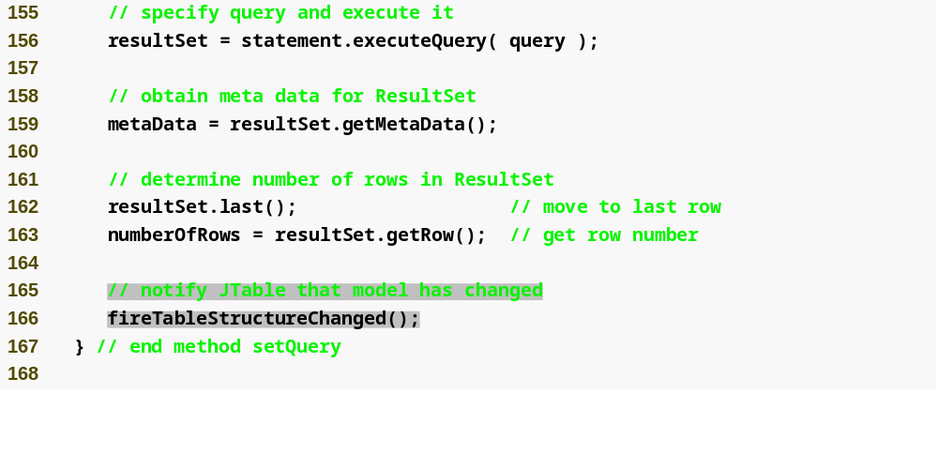
Outline
Executes the query to obtain a new ResultSet.
Uses ResultSet method last to position the ResultSet cursor at the last row in the ResultSet.
ResultSetTableModel.java
  (7 of 8)
  Line 156
  Line 162
  Line 163
  Line 166
Uses ResultSet method getRow to obtain the row number for the current row in the ResultSet.
Invokes method fireTableAStructureChanged to notify any JTable using this ResultSetTableModel object as its model that the structure of the model has changed.

Slide 88
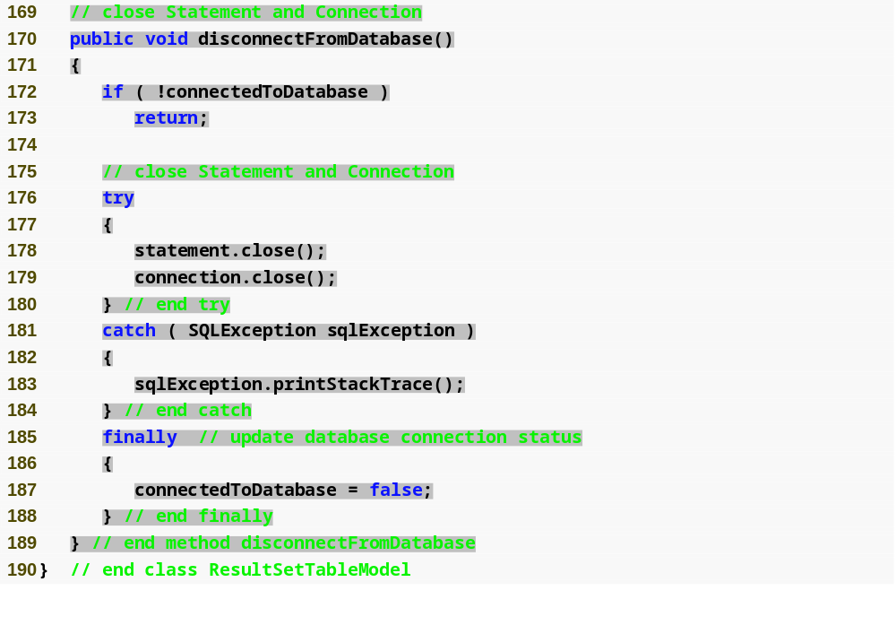
Outline
Verify whether the connection is already terminated
Method disconnectFromDatabase implement an appropriate termination method for class ResultSetTableModel
ResultSetTableModel.java
  (8 of 8)
  Lines 170-189
  Line 172
  Lines 178-179
  Line 187
Close the Statement and Connection if a ResultSetTableModel object is garbage collected.
Set connectedToDatabase to false to ensure that clients do not use an instance of ResultSetTableModel after that instance has already been terminated

Slide 89
Portability Tip 25.5
Some JDBC drivers do not support scrollable ResultSets. In such cases, the driver typically returns a ResultSet in which the cursor can move only forward. For more information, see your database driver documentation.

Slide 90
Portability Tip 25.6
Some JDBC drivers do not support updatable ResultSets. In such cases, the driver typically returns a read-only ResultSet. For more information, see your database driver documentation.

Slide 91
Common Programming Error 25.11
Attempting to update a ResultSet when the database driver does not support updatable ResultSets causes SQLExceptions.

Slide 92
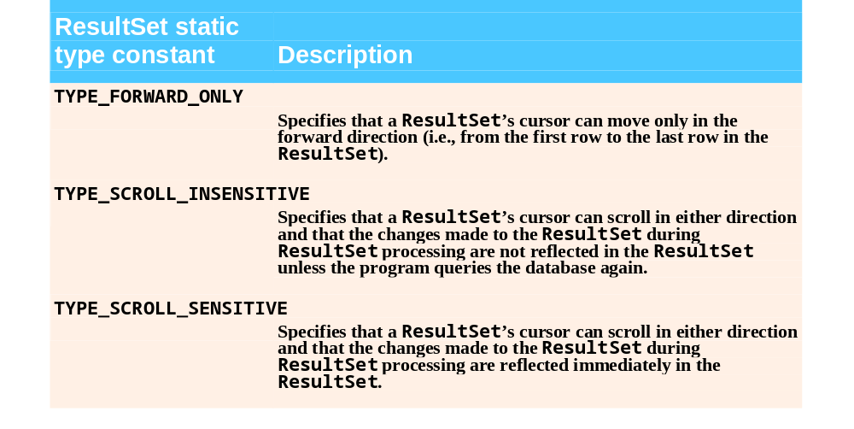
Fig. 25.29 | ResultSet constants for specifying ResultSet type.

Slide 93
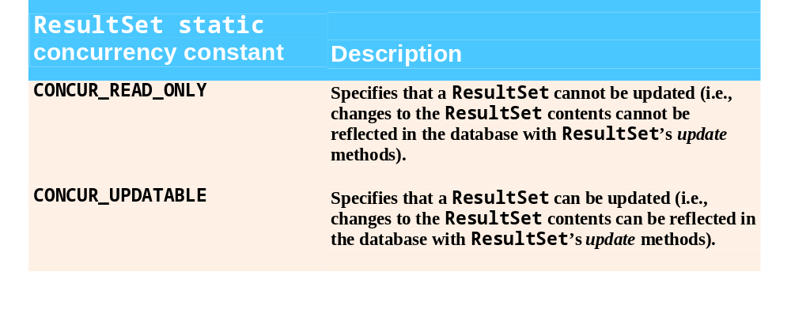
Fig. 25.30 | ResultSet constants for specifying result properties.

Slide 94
Common Programming Error 25.12
Attempting to move the cursor backwards through a ResultSet when the database driver does not support backwards scrolling causes a SQLException.

Slide 95
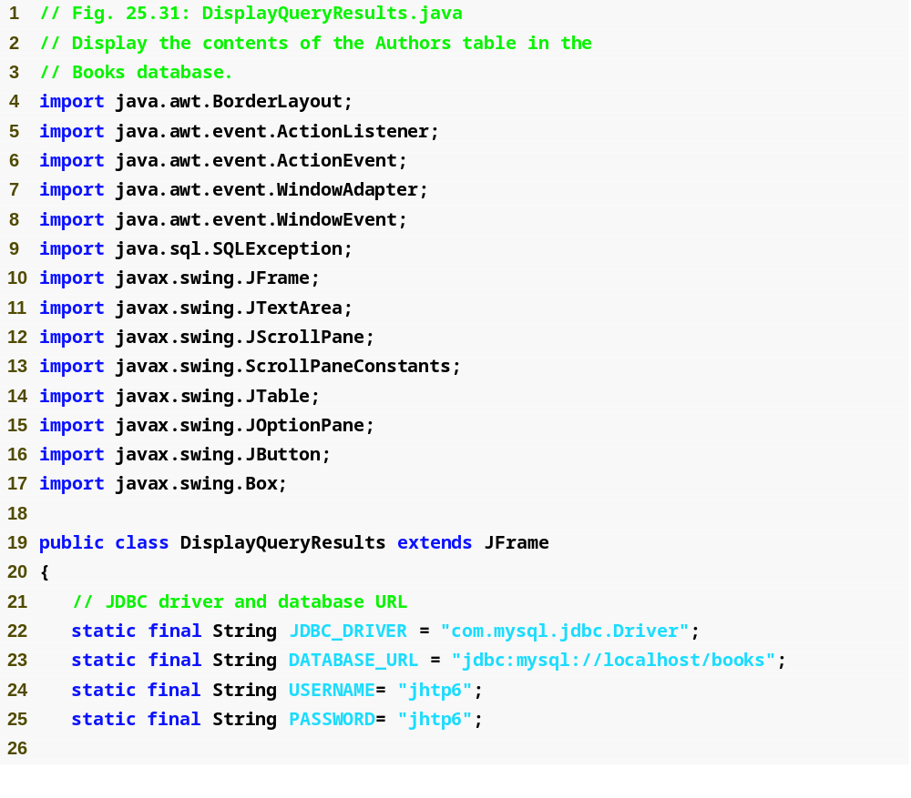
Outline
DisplayQueryResults.java
  (1 of 7)
  Lines 22-25
Declare the database driver class name, database URL, username and password for accessing the database

Slide 96
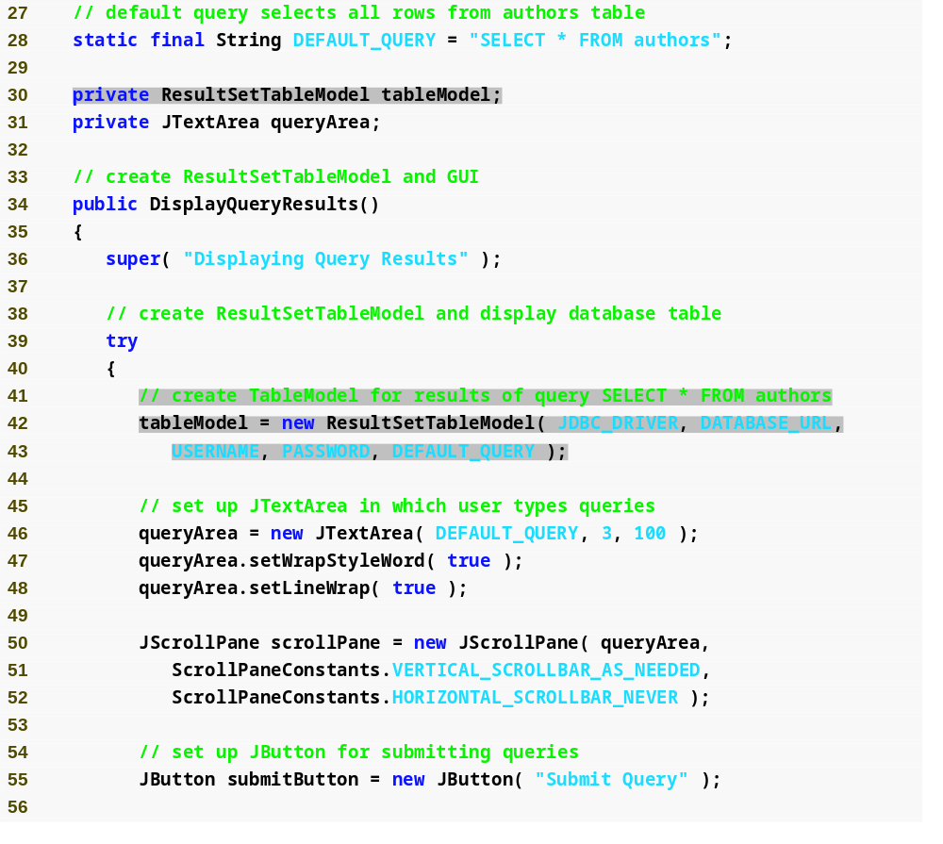
Outline
Declare the default query
Declare tableModel to be a reference to ResultSetTableModel
DisplayQueryResults.java
  (2 of 7)
  Line 28
  Line 30
  Lines 42-43
Create TableModel for results of default query “SELECT * FROM authors”

Slide 97
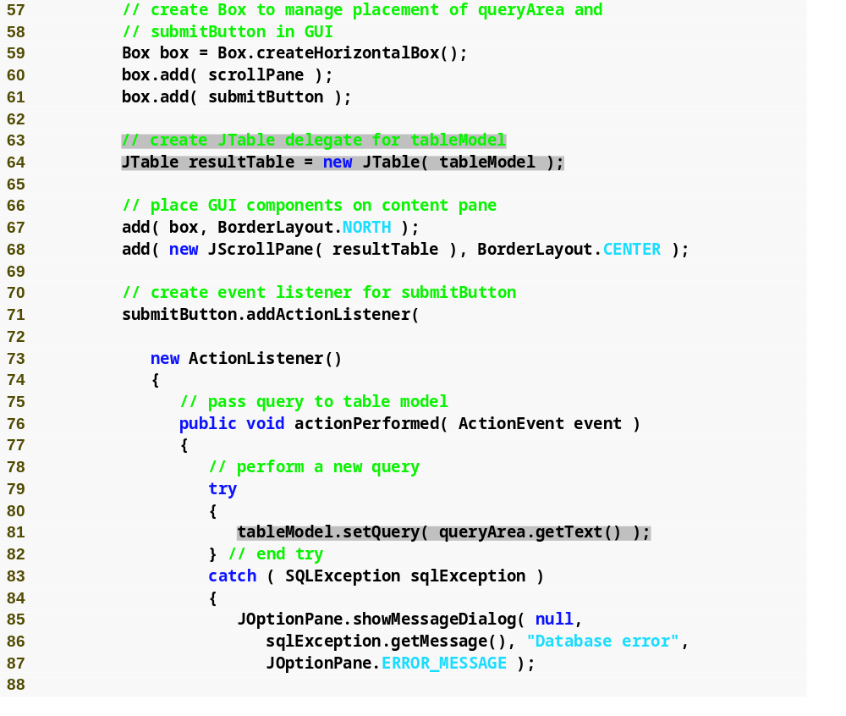
Outline
Create JTable delegate for tableModel
DisplayQueryResults.java
  (3 of 7)
  Line 64
  Lines 71-110
  Line 81
Register an event handler for the submitButton that the user clicks to submit a query to the database
Invoke ResultSetTableModel method setQuery to execute the new query

Slide 98
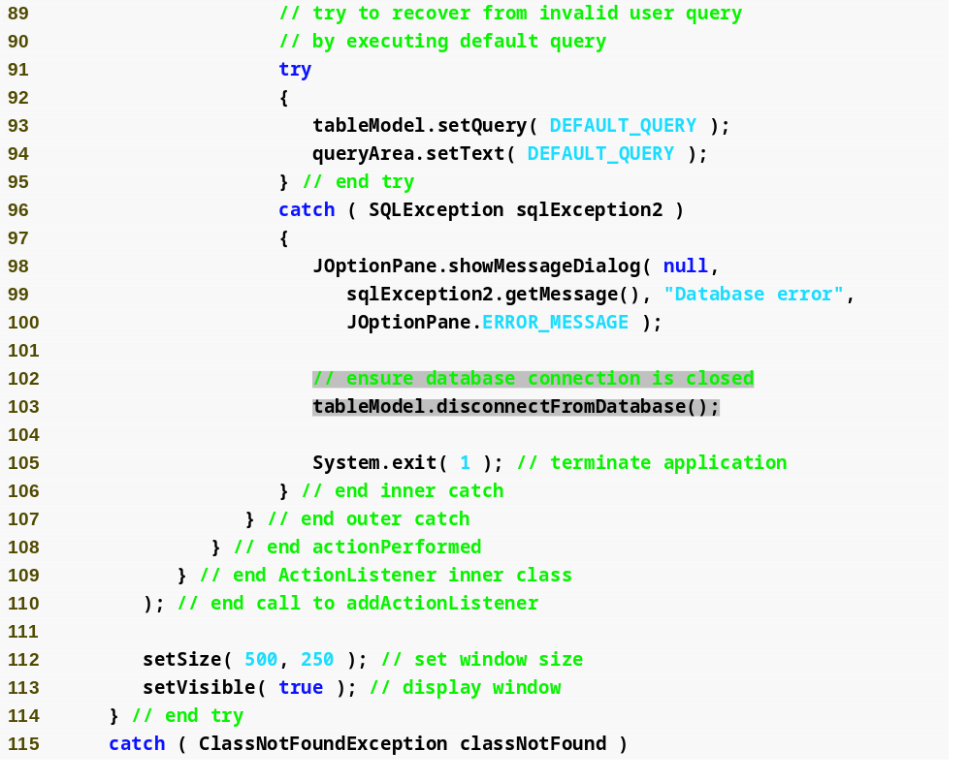
Outline
DisplayQueryResults.java
  (4 of 7)
  Line 103
Ensure that the database connection is closed

Slide 99
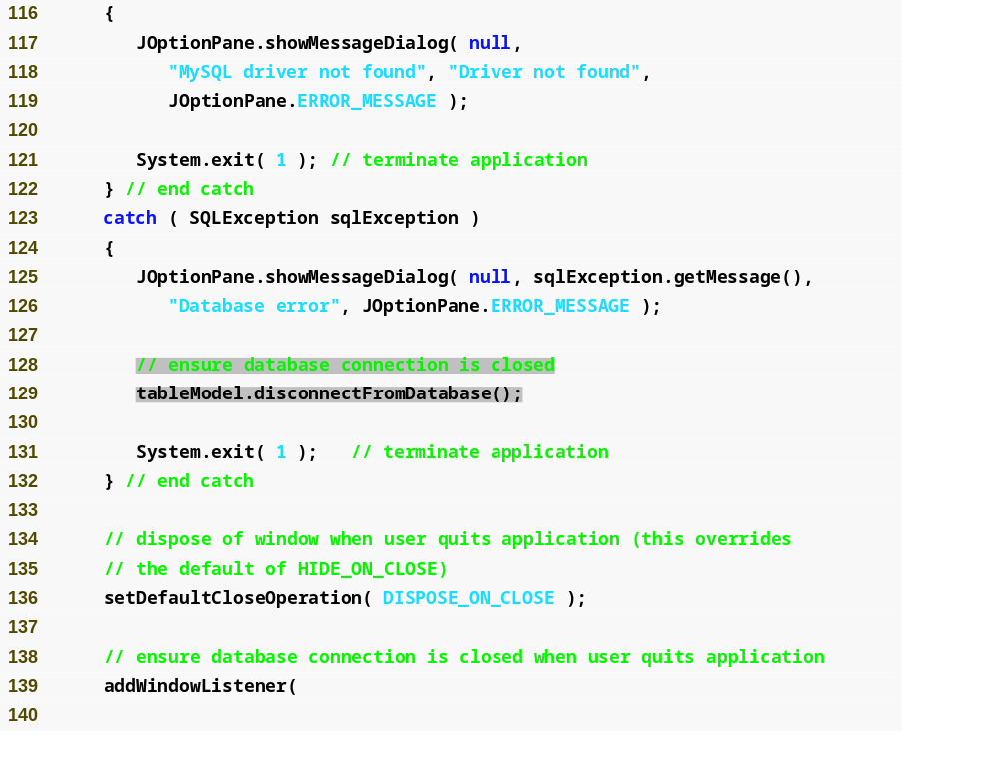
Outline
DisplayQueryResults.java
  (5 of 7)
  Line 129
Ensure that the database connection is closed

Slide 100
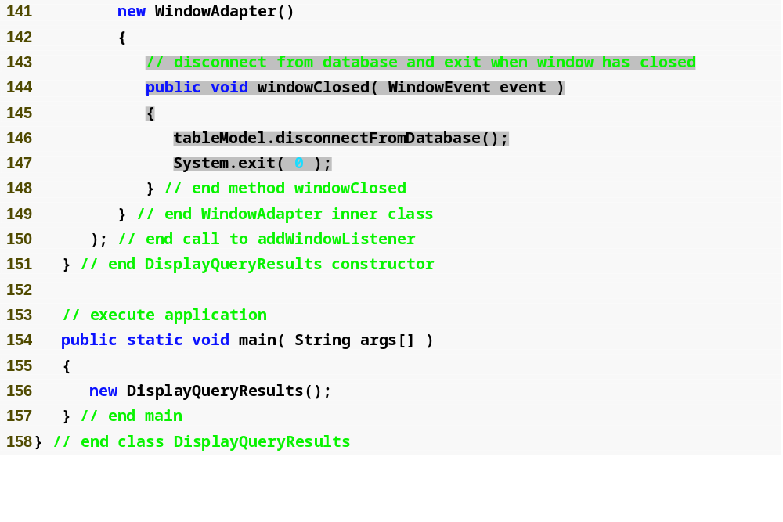
Outline
Ensure that the database connection is closed when window has closed
DisplayQueryResults.java
  (6 of 7)
  Lines 144-148

Slide 101
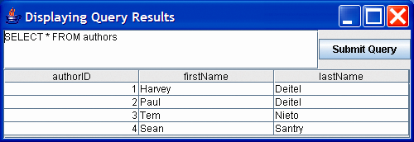
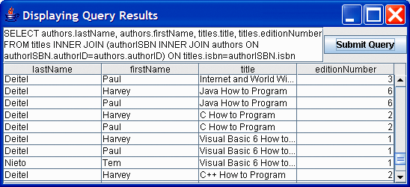
Outline
DisplayQueryResults.java
  (7 of 7)
  Program output

Slide 102
25.9 Stored Procedure
Stored procedures
  Store SQL statements in a database
  Invoke SQL statements by programs accessing the database
Interface CallableStatement
  Receive arguments
  Output parameters

Slide 103
Portability Tip 25.7
Although the syntax for creating stored procedures differs across database management systems, interface CallableStatement provides a uniform interface for specifying input and output parameters for stored procedures and for invoking stored procedures.

Slide 104
Portability Tip 25.8
According to the Java API documentation for interface CallableStatement, for maximum portability between database systems, programs should process the update counts or ResultSets returned from a CallableStatement before obtaining the values of any output parameters.

Slide 105
15.10 RowSet Interface
Interface RowSet
  Configures the database connection automatically
  Prepares query statements automatically
  Provides set methods to specify the properties needed to establish a connection
  Part of the javax.sql package
Two types of RowSet
  Connected RowSet
    Connects to database once and remain connected
  Disconnected RowSet
    Connects to database, executes a query and then closes connection

Slide 106
15.10 RowSet Interface (Cont.)
Package javax.sql.rowset
  JdbcRowSet
    Connected RowSet
    Wrapper around a ResultSet
    Scrollable and updatable by default
  CachedRowSet
    Disconnected RowSet
    Cache the data of ResultSet in memory
    Scrollable and updatable by default
    Serializable
      Can be passed between Java application
    Limitation
      Amount of data that can be stored in memory is limited

Slide 107
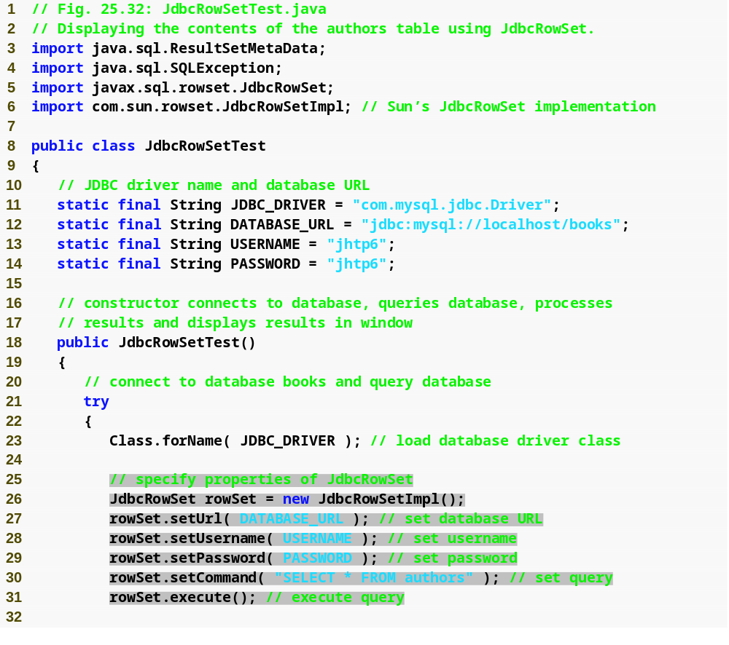
Outline
JdbcRowSetTest.java
  (1 of 3)
  Line 27
  Line 17
  Line 28
  Line 29
  Line 30
  Line 31
Use Sun’s reference implementation of JdbcRowSet interface (JdbcRowSetImpl) to create a JdbcRowSet object
Invoke JdbcRowSet method setUrl to specify the database URL
Invoke JdbcRowSet method setUsername to specify the username
Invoke JdbcRowSet method setUsername to specify the password
Invoke JdbcRowSet method setCommand to specify the query
Invoke JdbcRowSet method execute to execute the query

Slide 108
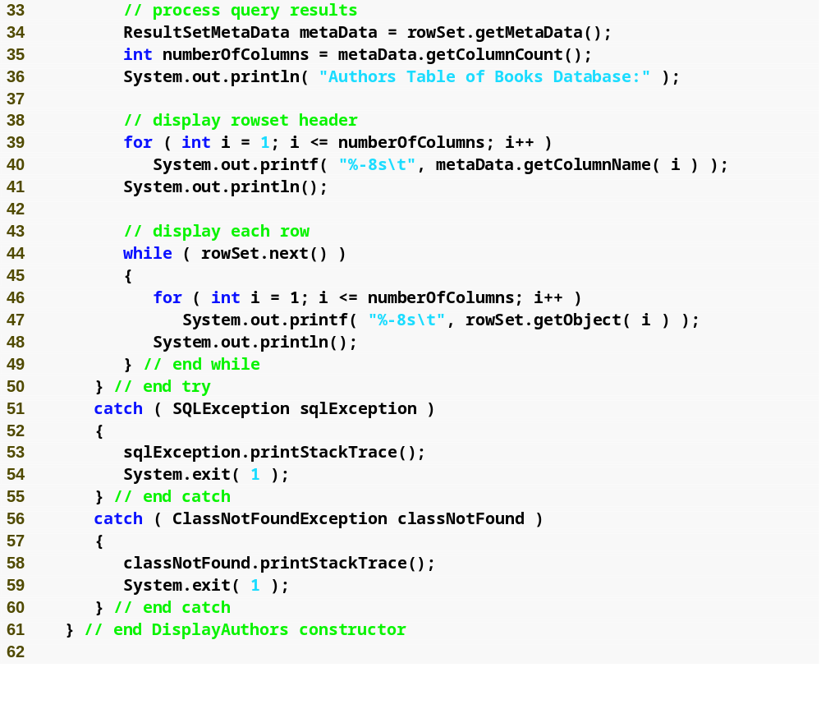
Outline
JdbcRowSetTest.java
  (2 of 3)

Slide 109
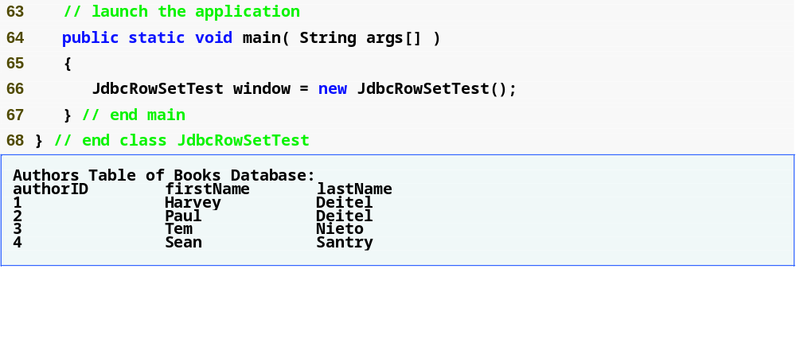
Outline
JdbcRowSetTest.java
  (3 of 3)
  Program output

