Slide 1
Chapter 23: Java Database Connectivity with JDBC
TM
Outline
23.1 Introduction
23.2 Relational-Database Model
23.3 Relational Database Overview: The books Database
23.4 SQL
23.4.1 Basic SELECT Query
23.4.2 WHERE Clause
23.4.3 ORDER BY Clause
23.4.4 Merging Data from Multiple Tables: INNER JOIN
23.4.5 INSERT Statement
23.4.6 UPDATE Statement
23.4.7 DELETE Statement
23.5 Creating Database books in Cloudscape
23.6 Manipulating Databases with JDBC
23.6.1 Connecting to and Querying a Database
23.6.2 Querying the books Database
23.7 Stored Procedures
23.8 Internet and World Wide Web Resources

Slide 2
23.1 Introduction
Database
  Collection of data
DBMS
  Database management system
  Stores and organizes data
SQL
  Relational database
  Structured Query Language

Slide 3
23.1 Introduction (Cont.)
RDBMS
  Relational database management system
  Cloudscape 5.0.4
    www.ibm.com/software/data/cloudscape
JDBC
  Java Database Connectivity
  JDBC driver

Slide 4
23.2 Relational-Database Model
Relational database
  Table
    Rows, columns
  Primary key
    Unique data
SQL statement
  Query

Slide 5
23.2 Relational-Database Model (Cont.)
Number
Name
Department
Salary
Location
23603
Jones
413
1100
New Jersey
24568
Kerwin
413
2000
New Jersey
Row
34589
Larson
642
1800
Los Angeles
35761
Myers
611
1400
Orlando
47132
Neumann
413
9000
New Jersey
78321
Stephens
611
8500
Orlando
Primary key
Column
Fig. 23.1 Employee table sample data.

Slide 6
23.2 Relational-Database Model (Cont.)
Department
Location
413
New Jersey
611
Orlando
642
Los Angeles
Fig. 23.2 Result of selecting distinct Department and Location data from the Employee table.

Slide 7
23.3 Relational Database Overview: The books Database
Sample books database
  Four tables
    authors, publishers, authorISBN and titles
  Relationships among the tables

Slide 8
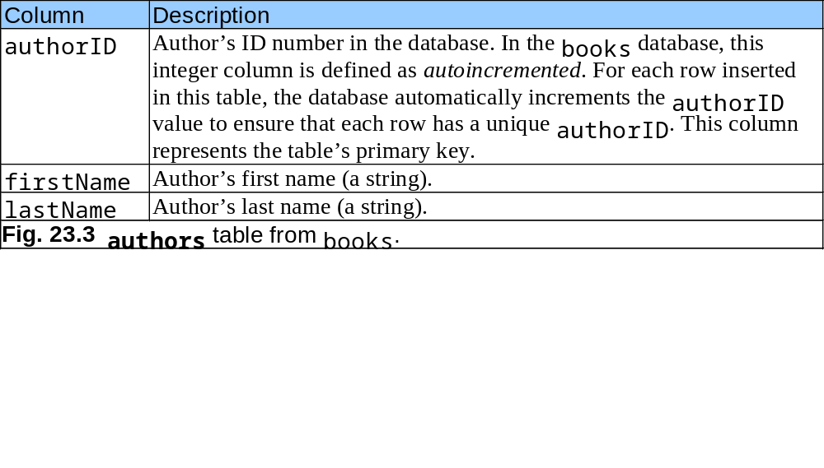
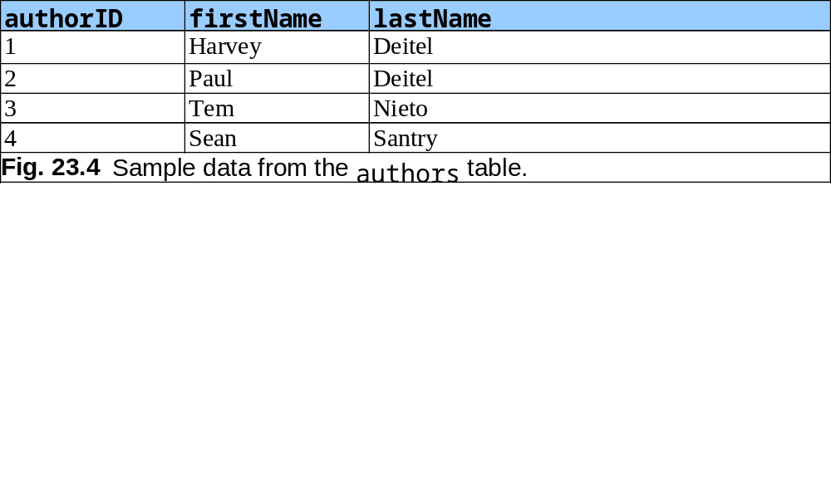
23.3 Relational Database Overview: The books Database (Cont.)

Slide 9
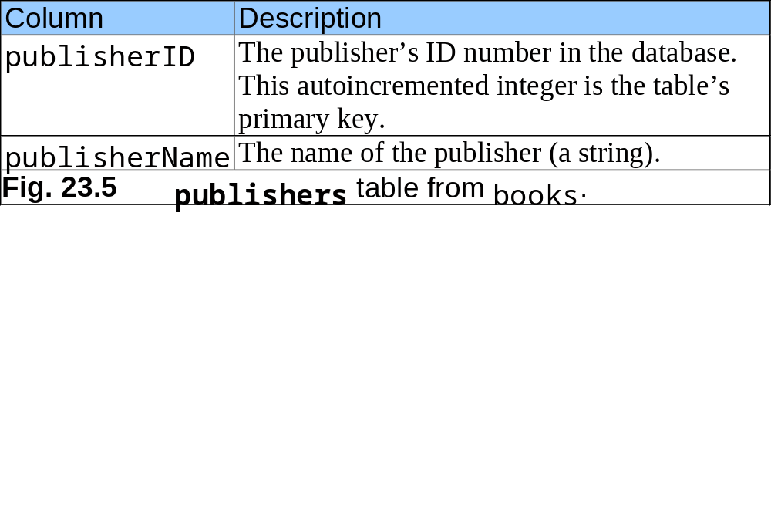
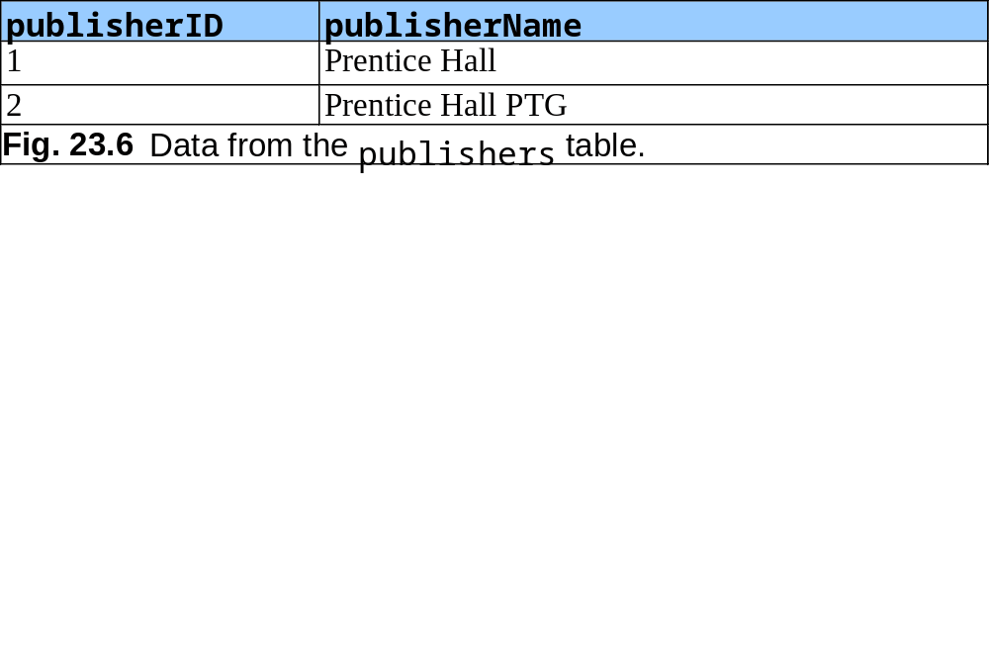
23.3 Relational Database Overview: The books Database (Cont.)

Slide 10
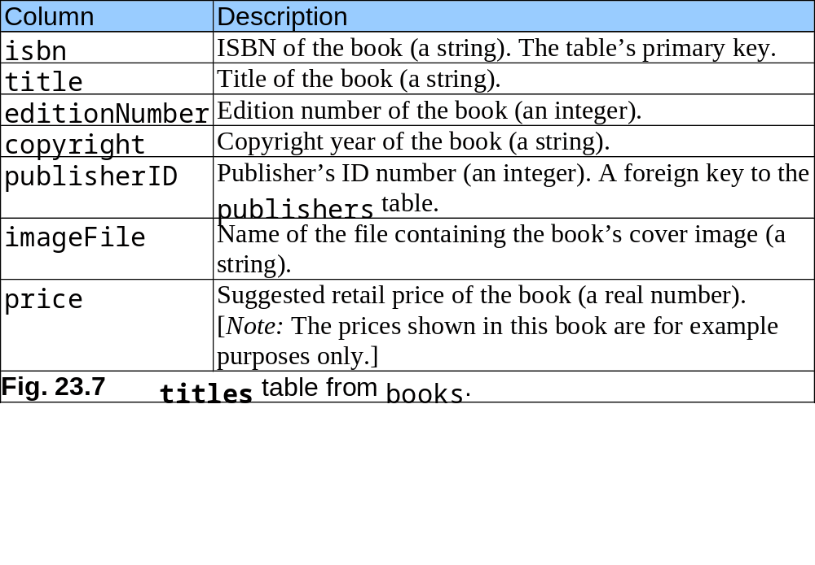
23.3 Relational Database Overview: The books Database (Cont.)

Slide 11
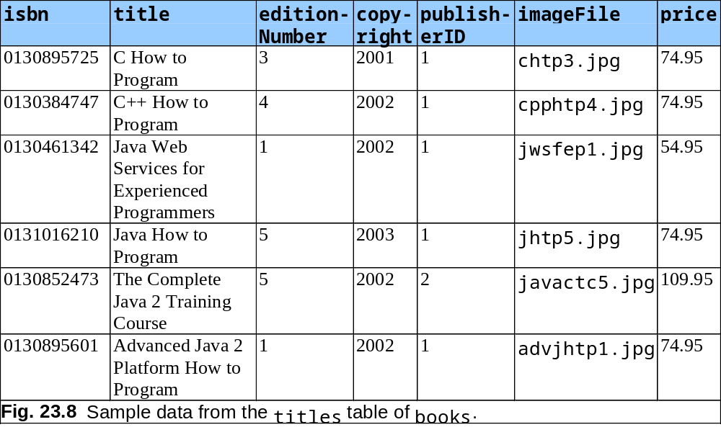
23.3 Relational Database Overview: The books Database (Cont.)

Slide 12
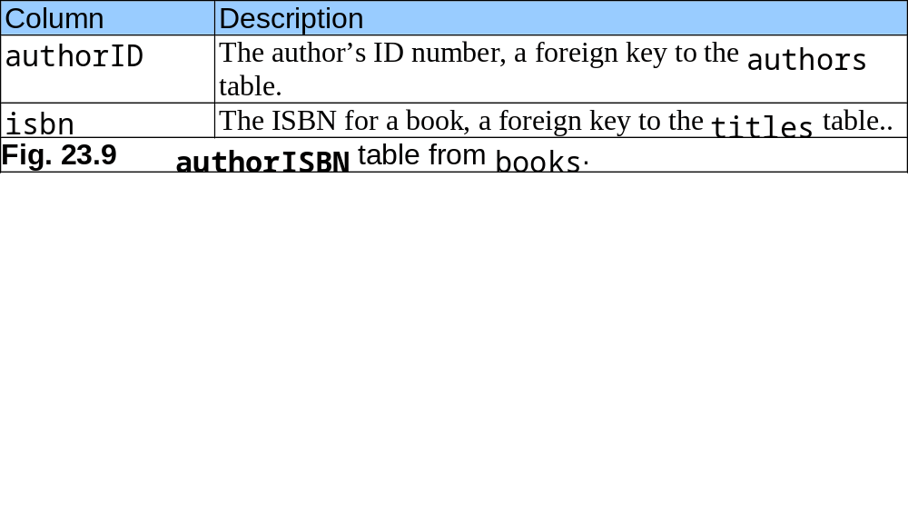
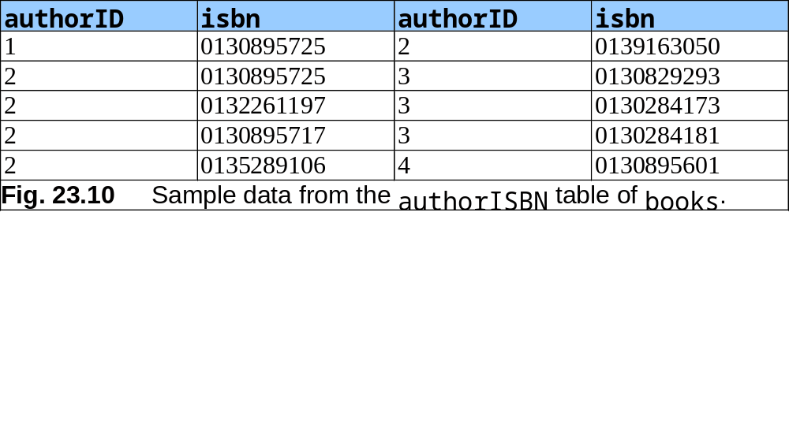
23.3 Relational Database Overview: The books Database (Cont.)

Slide 13
23.3 Relational Database Overview: The books Database (Cont.)
authors
authorISBN
titles
authorID
1
8
authorID
1
isbn
firstName
isbn
8
title
lastName
editionNumber
copyright
publishers
8
publisherID
publisherID
1
imageFile
publisherName
price
Fig. 23.11 Table relationships in books.

Slide 14
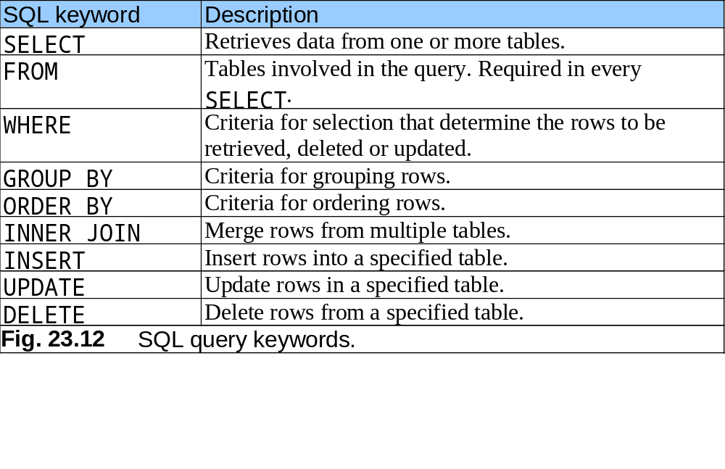
23.4 SQL
SQL overview
SQL keywords

Slide 15
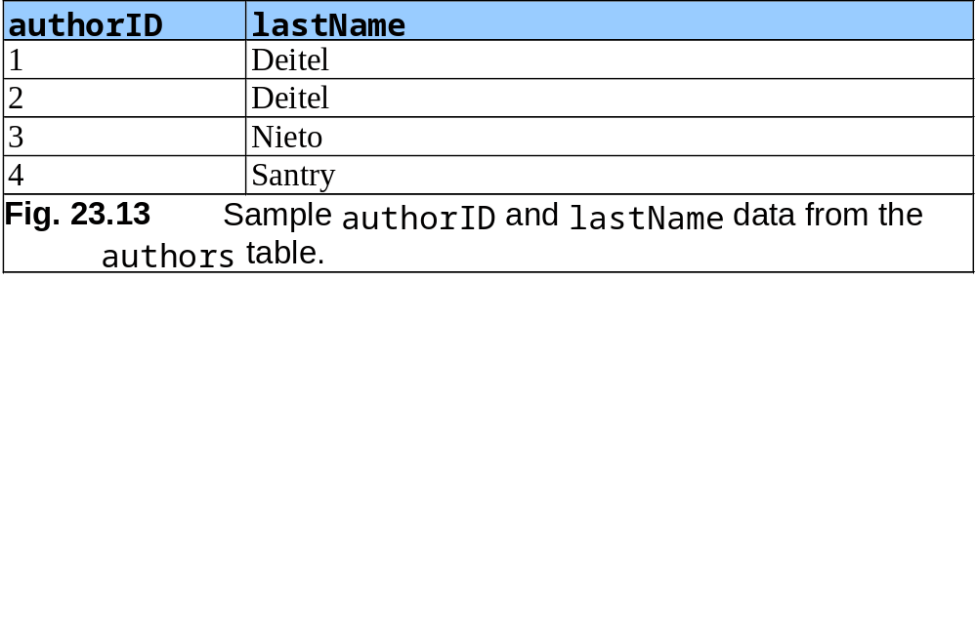
23.4.1 Basic SELECT Query
Simplest form of a SELECT query
  SELECT * FROM tableName
    SELECT * FROM authors
Select specific fields from a table
  SELECT authorID, lastName FROM authors

Slide 16
23.4.2 WHERE Clause
specify the selection criteria
  SELECT columnName1, columnName2, … FROM tableName WHERE criteria
    SELECT title, editionNumber, copyright
      FROM titles
      WHERE copyright > 2000
WHERE clause condition operators
  <, >, <=, >=, =, <>
  LIKE
    wildcard characters % and _

Slide 17
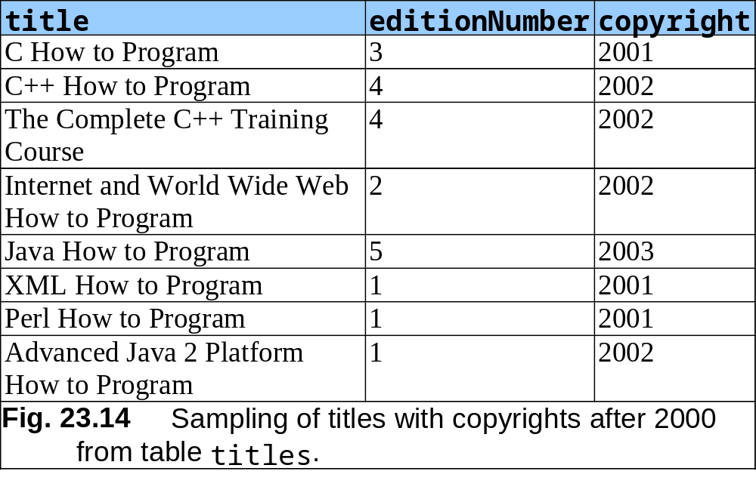
23.4.2 WHERE Clause (Cont.)

Slide 18
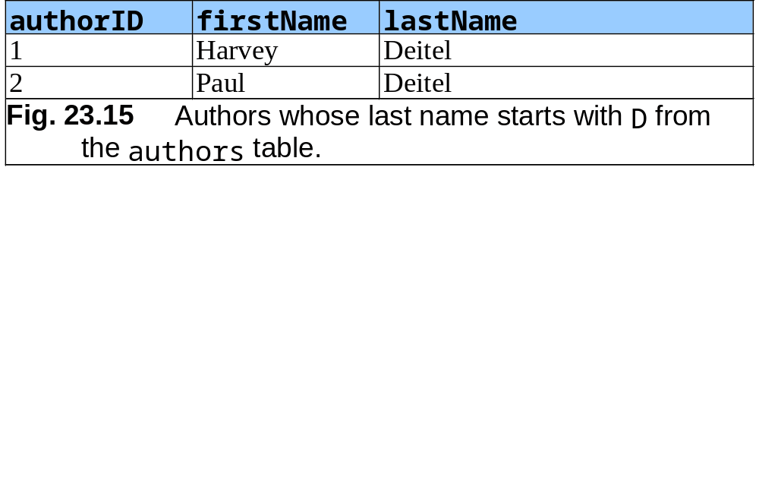
23.4.2 WHERE Clause (Cont.)
    SELECT authorID, firstName, lastName
      FROM authors
      WHERE lastName LIKE ‘D%’

Slide 19
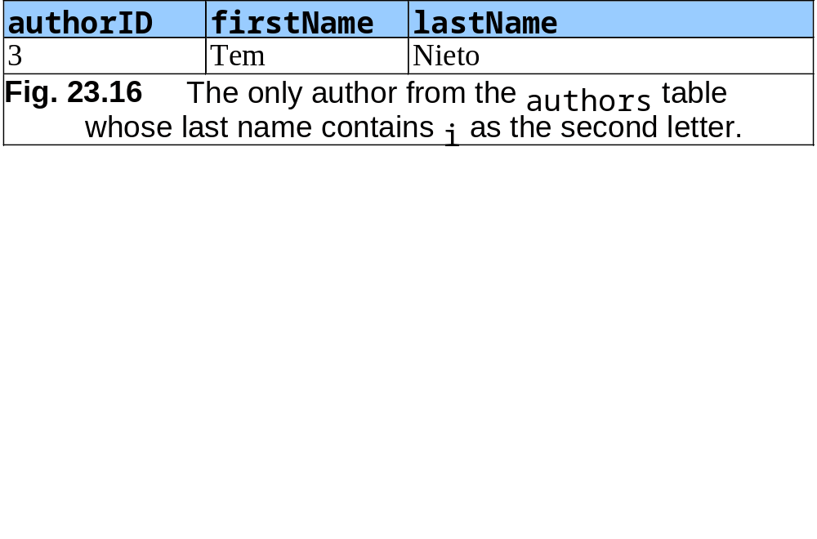
23.4.2 WHERE Clause (Cont.)
    SELECT authorID, firstName, lastName
      FROM authors
      WHERE lastName LIKE ‘_i%’

Slide 20
23.4.3 ORDER BY Clause
Optional ORDER BY clause
  SELECT columnName1, columnName2, … FROM tableName ORDER BY column ASC
  SELECT columnName1, columnName2, … FROM tableName ORDER BY column DESC
ORDER BY multiple fields
  ORDER BY column1 sortingOrder, column2 sortingOrder, …
Combine the WHERE and ORDER BY clauses

Slide 21
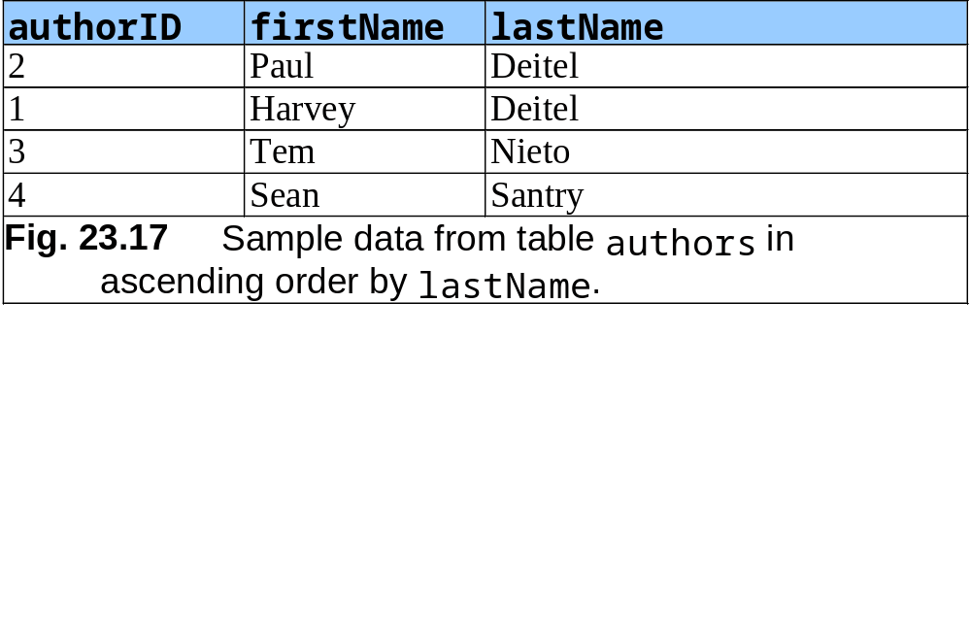
23.4.3 ORDER BY Clause (Cont.)
    SELECT authorID, firstName, lastName
      FROM authors
      ORDER BY lastName ASC

Slide 22
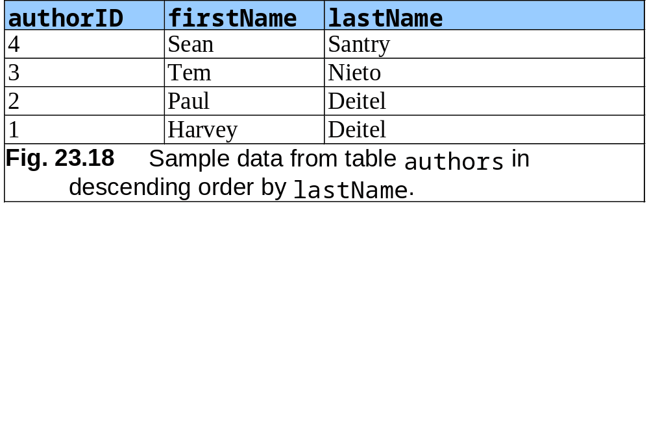
23.4.3 ORDER BY Clause (Cont.)
    SELECT authorID, firstName, lastName
      FROM authors
      ORDER BY lastName DESC

Slide 23
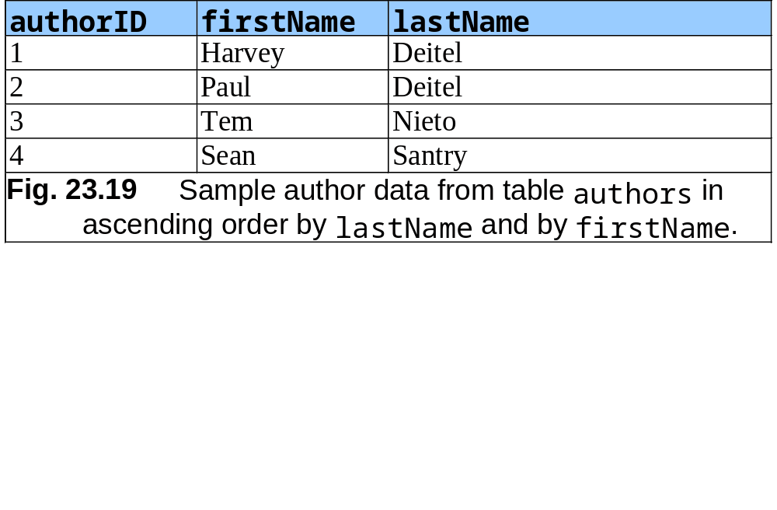
23.4.3 ORDER BY Clause (Cont.)
    SELECT authorID, firstName, lastName
      FROM authors
      ORDER BY lastName, firstName

Slide 24
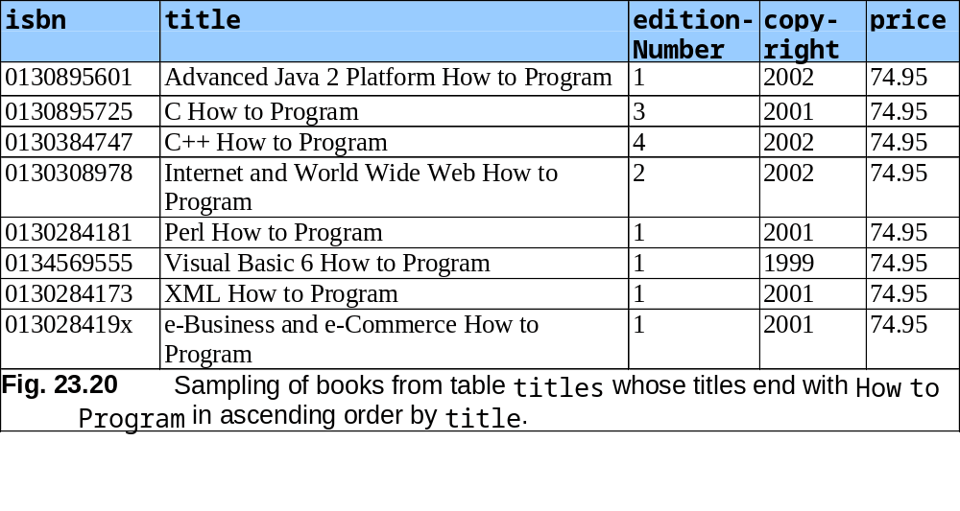
23.4.3 ORDER BY Clause (Cont.)
    SELECT isbn, title, editionNumber, copyright, price
      FROM titles WHERE title LIKE ‘%How to Program’
      ORDER BY title ASC

Slide 25
23.4.4 Merging Data from Multiple Tables: Joining
Split related data into separate tables
Join the tables
  Merge data from multiple tables into a single view
  INNER JOIN
    SELECT columnName1, columnName2, …
  FROM table1
  INNER JOIN table2
  ON table1.columnName = table2.column2Name
    SELECT firstName, lastName, isbn
  FROM authors, authorISBN
  INNER JOIN authorISBN
  ON authors.authorID = authorISBN.authorID
  ORDER BY lastName, firstName

Slide 26
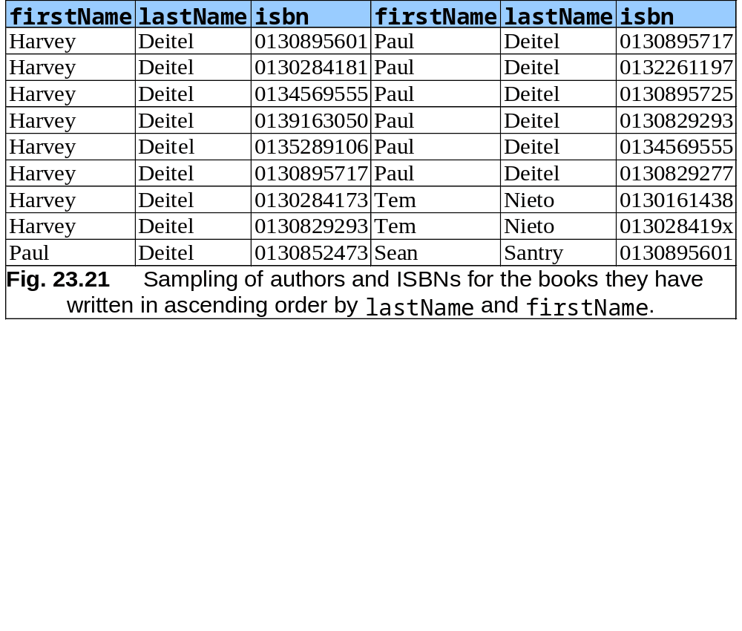
23.4.4 Merging Data from Multiple Tables: Joining (Cont.)

Slide 27
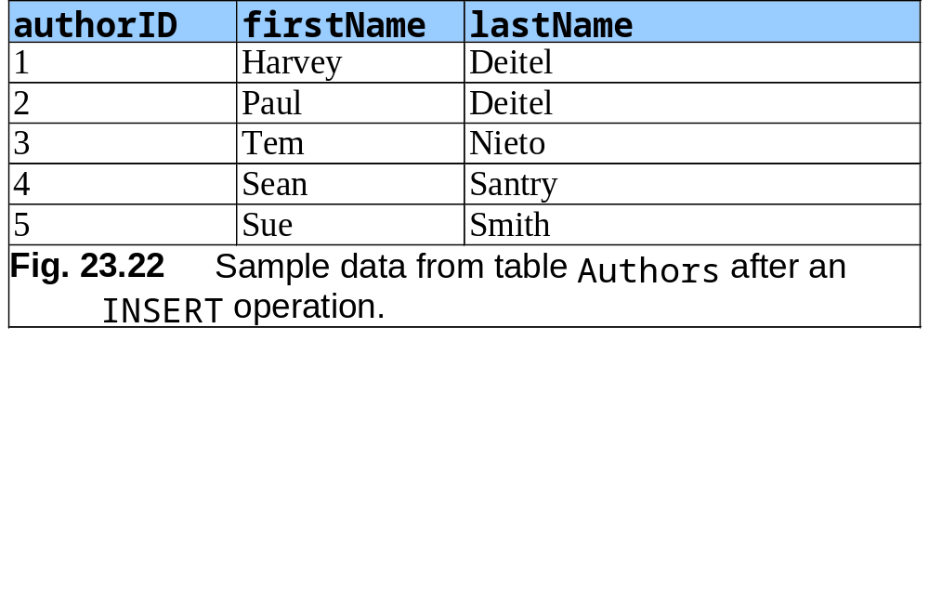
23.4.5 INSERT Statement
Insert a row into a table
  INSERT INTO tableName ( columnName1, … , columnNameN )
  VALUES ( value1, … , valueN )
    INSERT INTO authors ( firstName, lastName )
    VALUES ( ‘Sue’, ‘Smith’ )

Slide 28
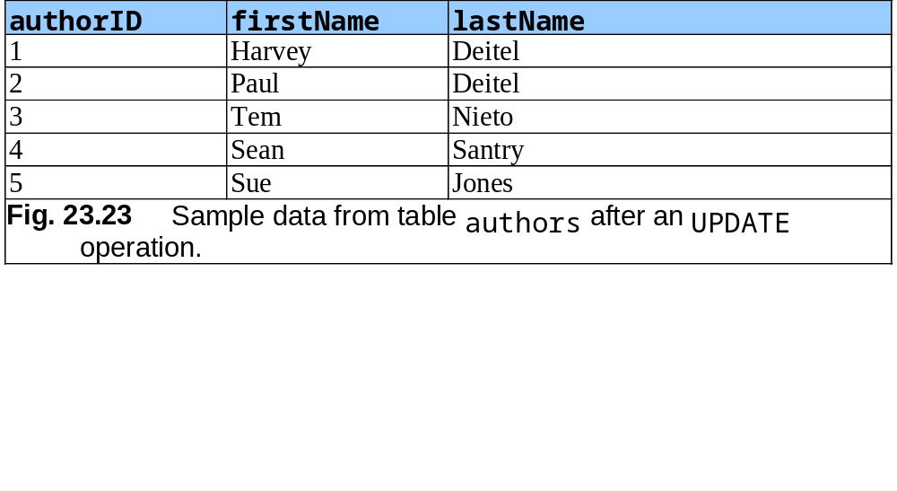
23.4.6 UPDATE Statement
Modify data in a table
  UPDATE tableName
  SET columnName1 = value1, … , columnNameN = valueN
  WHERE criteria
    UPDATE authors
    SET lastName = ‘Jones’
    WHERE lastName = ‘Smith’ AND firstName = ‘Sue’

Slide 29
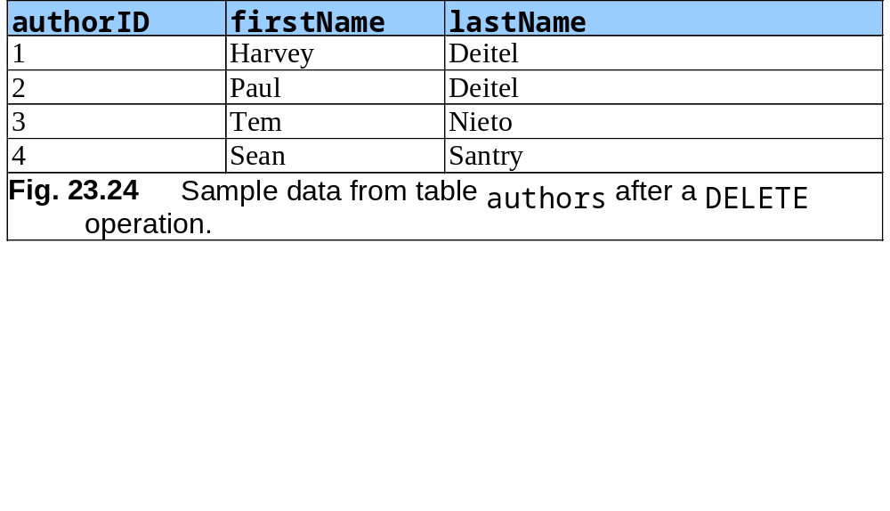
23.4.7 DELETE Statement
Remove data from a table
  DELETE FROM tableName WHERE criteria
    DELETE FROM authors
    WHERE lastName = ‘Jones’ AND firstName = ‘Sue’

Slide 30
23.5 Creating Database books in Cloudscape
Cloudscape – pure-Java embedded database management system
Set classpath
  setCP.bat
Create database books
  createDatabase books.sql
Fig. 23.25 Executing Cloudscape from a command prompt in Windows 2000.

Slide 31
23.6 Manipulating Databases with JDBC
Connect to a database
Query the database
Display the results of the query

Slide 32
23.6.1 Connecting to and Querying a Database
DisplayAuthors
  Retrieves the entire authors table
  Displays the data in a JTextArea

Slide 33
Fig. 23.26
DisplayAuthors.java
Displaying the authors table from the books database.
Line 5
1 // Fig. 23.26: DisplayAuthors.java
2 // Displaying the contents of the authors table.
3
4 import java.awt.*;
5 import java.sql.*;
6 import java.util.*;
7 import javax.swing.*;
8
9 public class DisplayAuthors extends JFrame {
10
11 // JDBC driver name and database URL
12 static final String JDBC_DRIVER = "com.ibm.db2j.jdbc.DB2jDriver";
13 static final String DATABASE_URL = "jdbc:db2j:books";
14
15 // declare Connection and Statement for accessing
16 // and querying database
17 private Connection connection;
18 private Statement statement;
19
20 // constructor connects to database, queries database, processes
21 // results and displays results in window
22 public DisplayAuthors()
23 {
24 super( "Authors Table of Books Database" );
25
Imports package java.sql, which contains classes and interfaces for the JDBC API.

Slide 34
Fig. 23.26
DisplayAuthors.java
Displaying the authors table from the books database.
Line 30
Line 33
Lines 36
Line 43
Line 47
Line 48
26 // connect to database books and query database
27 try {
28
29 // specify location of database on filesystem
30 System.setProperty( "db2j.system.home", "C:/Cloudscape_5.0" );
31
32 // load database driver class
33 Class.forName( JDBC_DRIVER );
34
35 // establish connection to database
36 connection = DriverManager.getConnection( DATABASE_URL );
37
38 // create Statement for querying database
39 statement = connection.createStatement();
40
41 // query database
42 ResultSet resultSet =
43 statement.executeQuery( "SELECT * FROM authors" );
44
45 // process query results
46 StringBuffer results = new StringBuffer();
47 ResultSetMetaData metaData = resultSet.getMetaData();
48 int numberOfColumns = metaData.getColumnCount();
49
Specify location of database
Loads the class definition for the database driver.
Invokes Connection method createStatement to obtain an object that implements interface Statement.
Declare and initialize a Connection reference called connection.
Use the Statement object’s executeQuery method to execute a query that selects all the author information from table authors.
Obtains the metadata for the ResultSet.
Uses ResultSetMetaData method getColumnCount to retrieve the number of columns in the ResultSet.

Slide 35
Fig. 23.26
DisplayAuthors.java
Displaying the authors table from the books database.
Line 51
Line 58
Lines 64-70
50 for ( int i = 1; i <= numberOfColumns; i++ )
51 results.append( metaData.getColumnName( i ) + "\t" );
52
53 results.append( "\n" );
54
55 while ( resultSet.next() ) {
56
57 for ( int i = 1; i <= numberOfColumns; i++ )
58 results.append( resultSet.getObject( i ) + "\t" );
59
60 results.append( "\n" );
61 }
62
63 // set up GUI and display window
64 JTextArea textArea = new JTextArea( results.toString() );
65 Container container = getContentPane();
66
67 container.add( new JScrollPane( textArea ) );
68
69 setSize( 300, 100 ); // set window size
70 setVisible( true ); // display window
71
72 } // end try
73
Append the column names to the StringBuffer results.
Append the data in each ResultSet row to the StringBuffer results.
Create the GUI that displays the StringBuffer results, set the size of the application window and show the application window.

Slide 36
Fig. 23.26
DisplayAuthors.java
Displaying the authors table from the books database.
Lines 94-95
74 // detect problems interacting with the database
75 catch ( SQLException sqlException ) {
76 JOptionPane.showMessageDialog( null, sqlException.getMessage(),
77 "Database Error", JOptionPane.ERROR_MESSAGE );
78
79 System.exit( 1 );
80 }
81
82 // detect problems loading database driver
83 catch ( ClassNotFoundException classNotFound ) {
84 JOptionPane.showMessageDialog( null, classNotFound.getMessage(),
85 "Driver Not Found", JOptionPane.ERROR_MESSAGE );
86
87 System.exit( 1 );
88 }
89
90 // ensure statement and connection are closed properly
91 finally {
92
93 try {
94 statement.close();
95 connection.close();
96 }
97
Close the Statement and the database Connection.

Slide 37
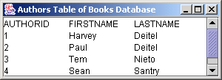
Fig. 23.26
DisplayAuthors.java
Displaying the authors table from the books database.
Program output
98 // handle exceptions closing statement and connection
99 catch ( SQLException sqlException ) {
100 JOptionPane.showMessageDialog( null,
101 sqlException.getMessage(), "Database Error",
102 JOptionPane.ERROR_MESSAGE );
103
104 System.exit( 1 );
105 }
106 }
107
108 } // end DisplayAuthors constructor
109
110 // launch the application
111 public static void main( String args[] )
112 {
113 DisplayAuthors window = new DisplayAuthors();
114 window.setDefaultCloseOperation( JFrame.EXIT_ON_CLOSE );
115 }
116
117 } // end class DisplayAuthors

Slide 38
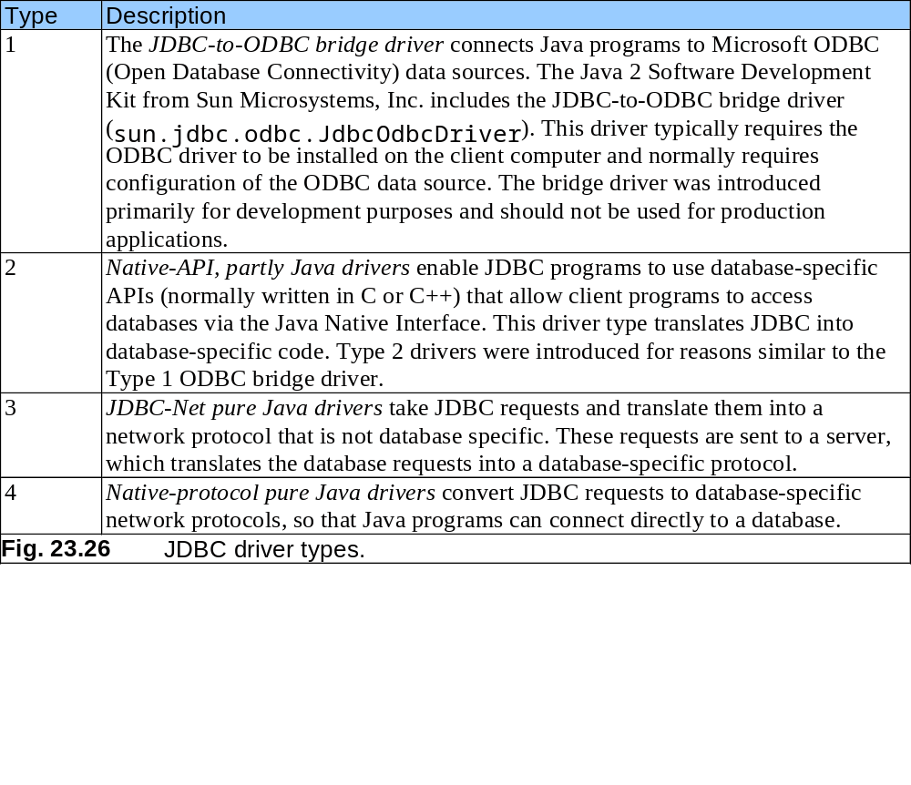
23.6.1 Connecting to and Querying a JDBC Data Source (Cont.)

Slide 39
23.6.2 Querying the books Database
Allow the user to enter any query into the program
Display the results of a query in a JTable

Slide 40
ResultSetTableModel enables a Jtable to display the contents of a ResultSet.
1 // Fig. 23.27: ResultSetTableModel.java
2 // A TableModel that supplies ResultSet data to a JTable.
3
4 import java.sql.*;
5 import java.util.*;
6 import javax.swing.table.*;
7
8 // ResultSet rows and columns are counted from 1 and JTable
9 // rows and columns are counted from 0. When processing
10 // ResultSet rows or columns for use in a JTable, it is
11 // necessary to add 1 to the row or column number to manipulate
12 // the appropriate ResultSet column (i.e., JTable column 0 is
13 // ResultSet column 1 and JTable row 0 is ResultSet row 1).
14 public class ResultSetTableModel extends AbstractTableModel {
15 private Connection connection;
16 private Statement statement;
17 private ResultSet resultSet;
18 private ResultSetMetaData metaData;
19 private int numberOfRows;
20
21 // keep track of database connection status
22 private boolean connectedToDatabase = false;
23

Slide 41
ResultSetTableModel enables a Jtable to display the contents of a ResultSet.
Line 33
Lines 36-38
Line 44
24 // initialize resultSet and obtain its meta data object;
25 // determine number of rows
26 public ResultSetTableModel( String driver, String url,
27 String query ) throws SQLException, ClassNotFoundException
28 {
29 // load database driver class
30 Class.forName( driver );
31
32 // connect to database
33 connection = DriverManager.getConnection( url );
34
35 // create Statement to query database
36 statement = connection.createStatement(
37 ResultSet.TYPE_SCROLL_INSENSITIVE,
38 ResultSet.CONCUR_READ_ONLY );
39
40 // update database connection status
41 connectedToDatabase = true;
42
43 // set query and execute it
44 setQuery( query );
45 }
46
Establishes a connection to the database.
Invokes Connection method createStatement to create a Statement object.
Invokes ResultSetTableModel method setQuery to perform the default query.

Slide 42
ResultSetTableModel enables a Jtable to display the contents of a ResultSet.
Line 56
Line 59
Line 68
47 // get class that represents column type
48 public Class getColumnClass( int column ) throws IllegalStateException
49 {
50 // ensure database connection is available
51 if ( !connectedToDatabase )
52 throw new IllegalStateException( "Not Connected to Database" );
53
54 // determine Java class of column
55 try {
56 String className = metaData.getColumnClassName( column + 1 );
57
58 // return Class object that represents className
59 return Class.forName( className );
60 }
61
62 // catch SQLExceptions and ClassNotFoundExceptions
63 catch ( Exception exception ) {
64 exception.printStackTrace();
65 }
66
67 // if problems occur above, assume type Object
68 return Object.class;
69 }
70
Obtains the fully qualified class name for the specified column.
Loads the class definition for the class and returns the corresponding Class object.
Returns the default type.

Slide 43
ResultSetTableModel enables a Jtable to display the contents of a ResultSet.
Line 80
71 // get number of columns in ResultSet
72 public int getColumnCount() throws IllegalStateException
73 {
74 // ensure database connection is available
75 if ( !connectedToDatabase )
76 throw new IllegalStateException( "Not Connected to Database" );
77
78 // determine number of columns
79 try {
80 return metaData.getColumnCount();
81 }
82
83 // catch SQLExceptions and print error message
84 catch ( SQLException sqlException ) {
85 sqlException.printStackTrace();
86 }
87
88 // if problems occur above, return 0 for number of columns
89 return 0;
90 }
91
92 // get name of a particular column in ResultSet
93 public String getColumnName( int column ) throws IllegalStateException
94 {
95 // ensure database connection is available
96 if ( !connectedToDatabase )
97 throw new IllegalStateException( "Not Connected to Database" );
Obtains the number of columns in the ResultSet.

Slide 44
ResultSetTableModel enables a Jtable to display the contents of a ResultSet.
Line 101
98
99 // determine column name
100 try {
101 return metaData.getColumnName( column + 1 );
102 }
103
104 // catch SQLExceptions and print error message
105 catch ( SQLException sqlException ) {
106 sqlException.printStackTrace();
107 }
108
109 // if problems, return empty string for column name
110 return "";
111 }
112
113 // return number of rows in ResultSet
114 public int getRowCount() throws IllegalStateException
115 {
116 // ensure database connection is available
117 if ( !connectedToDatabase )
118 throw new IllegalStateException( "Not Connected to Database" );
119
120 return numberOfRows;
121 }
122
Obtains the column name from the ResultSet.

Slide 45
ResultSetTableModel enables a Jtable to display the contents of a ResultSet.
Line 133
Line 135
123 // obtain value in particular row and column
124 public Object getValueAt( int row, int column )
125 throws IllegalStateException
126 {
127 // ensure database connection is available
128 if ( !connectedToDatabase )
129 throw new IllegalStateException( "Not Connected to Database" );
130
131 // obtain a value at specified ResultSet row and column
132 try {
133 resultSet.absolute( row + 1 );
134
135 return resultSet.getObject( column + 1 );
136 }
137
138 // catch SQLExceptions and print error message
139 catch ( SQLException sqlException ) {
140 sqlException.printStackTrace();
141 }
142
143 // if problems, return empty string object
144 return "";
145 }
146
Uses ResultSet method absolute to position the ResultSet cursor at a specific row.
Uses ResultSet method getObject to obtain the Object in a specific column of the current row.

Slide 46
ResultSetTableModel enables a Jtable to display the contents of a ResultSet.
Line 156
Line 162
Line 163
Line 166
147 // set new database query string
148 public void setQuery( String query )
149 throws SQLException, IllegalStateException
150 {
151 // ensure database connection is available
152 if ( !connectedToDatabase )
153 throw new IllegalStateException( "Not Connected to Database" );
154
155 // specify query and execute it
156 resultSet = statement.executeQuery( query );
157
158 // obtain meta data for ResultSet
159 metaData = resultSet.getMetaData();
160
161 // determine number of rows in ResultSet
162 resultSet.last(); // move to last row
163 numberOfRows = resultSet.getRow(); // get row number
164
165 // notify JTable that model has changed
166 fireTableStructureChanged();
167 }
168
Executes the query to obtain a new ResultSet.
Uses ResultSet method last to position the ResultSet cursor at the last row in the ResultSet.
Uses ResultSet method getRow to obtain the row number for the current row in the ResultSet.
Invokes method fireTableStructureChanged to notify any JTable using this ResultSetTableModel object as its model that the structure of the model has changed.

Slide 47
ResultSetTableModel enables a Jtable to display the contents of a ResultSet.
Lines 174-175
169 // close Statement and Connection
170 public void disconnectFromDatabase()
171 {
172 // close Statement and Connection
173 try {
174 statement.close();
175 connection.close();
176 }
177
178 // catch SQLExceptions and print error message
179 catch ( SQLException sqlException ) {
180 sqlException.printStackTrace();
181 }
182
183 // update database connection status
184 finally {
185 connectedToDatabase = false;
186 }
187 }
188
189 } // end class ResultSetTableModel
Close the Statement and Connection if a ResultSetTableModel object is garbage collected.

Slide 48
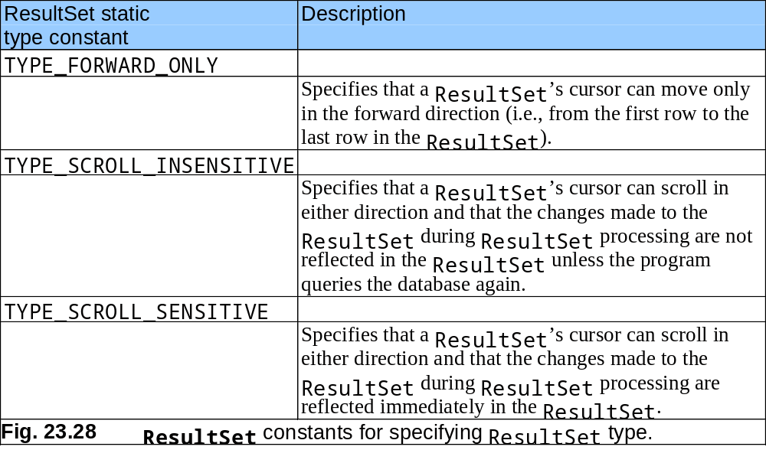
23.6.2 Querying the books Database (Cont.)

Slide 49
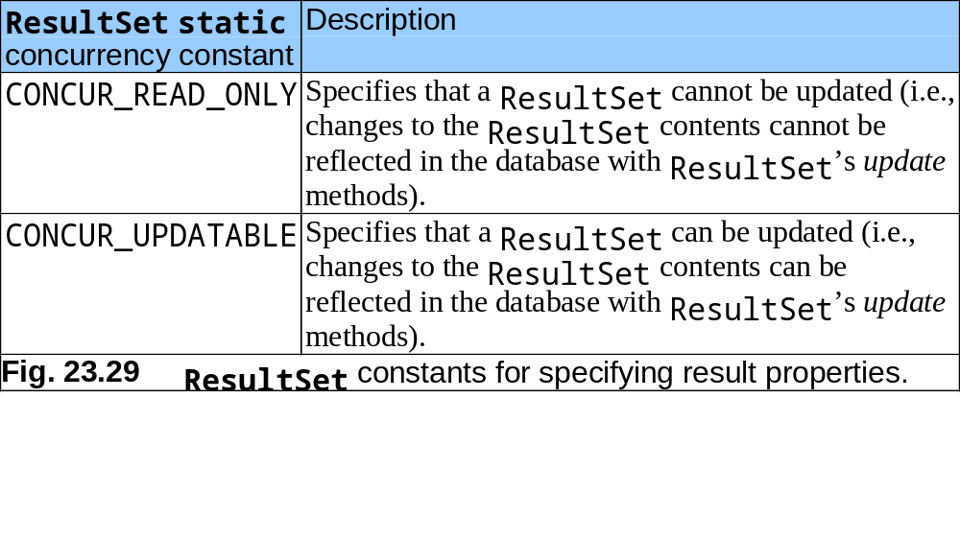
23.6.2 Querying the books Database (Cont.)

Slide 50
DisplayQueryResults for querying database books.
Lines 15, 16, 19
1 // Fig. 23.30: DisplayQueryResults.java
2 // Display the contents of the Authors table in the
3 // Books database.
4
5 import java.awt.*;
6 import java.awt.event.*;
7 import java.sql.*;
8 import java.util.*;
9 import javax.swing.*;
10 import javax.swing.table.*;
11
12 public class DisplayQueryResults extends JFrame {
13
14 // JDBC driver and database URL
15 static final String JDBC_DRIVER = "com.ibm.db2j.jdbc.DB2jDriver";
16 static final String DATABASE_URL = "jdbc:db2j:books";
17
18 // default query selects all rows from authors table
19 static final String DEFAULT_QUERY = "SELECT * FROM authors";
20
21 private ResultSetTableModel tableModel;
22 private JTextArea queryArea;
23
24 // create ResultSetTableModel and GUI
25 public DisplayQueryResults()
26 {
27 super( "Displaying Query Results" );
Define the database driver class name, database URL and default query.

Slide 51
DisplayQueryResults for querying database books.
Lines 36-37
28
29 // create ResultSetTableModel and display database table
30 try {
31
32 // specify location of database on filesystem
33 System.setProperty( "db2j.system.home", "C:/Cloudscape_5.0" );
34
35 // create TableModel for results of query SELECT * FROM authors
36 tableModel = new ResultSetTableModel( JDBC_DRIVER, DATABASE_URL,
37 DEFAULT_QUERY );
38
39 // set up JTextArea in which user types queries
40 queryArea = new JTextArea( DEFAULT_QUERY, 3, 100 );
41 queryArea.setWrapStyleWord( true );
42 queryArea.setLineWrap( true );
43
44 JScrollPane scrollPane = new JScrollPane( queryArea,
45 ScrollPaneConstants.VERTICAL_SCROLLBAR_AS_NEEDED,
46 ScrollPaneConstants.HORIZONTAL_SCROLLBAR_NEVER );
47
48 // set up JButton for submitting queries
49 JButton submitButton = new JButton( "Submit Query" );
50
51 // create Box to manage placement of queryArea and
52 // submitButton in GUI
53 Box box = Box.createHorizontalBox();
54 box.add( scrollPane );
55 box.add( submitButton );
56
Create TableModel for results of query SELECT * FROM authors

Slide 52
DisplayQueryResults for querying database books.
Line 58
Lines 66-110
Line 75
57 // create JTable delegate for tableModel
58 JTable resultTable = new JTable( tableModel );
59
60 // place GUI components on content pane
61 Container c = getContentPane();
62 c.add( box, BorderLayout.NORTH );
63 c.add( new JScrollPane( resultTable ), BorderLayout.CENTER );
64
65 // create event listener for submitButton
66 submitButton.addActionListener(
67
68 new ActionListener() {
69
70 // pass query to table model
71 public void actionPerformed( ActionEvent event )
72 {
73 // perform a new query
74 try {
75 tableModel.setQuery( queryArea.getText() );
76 }
77
78 // catch SQLExceptions when performing a new query
79 catch ( SQLException sqlException ) {
80 JOptionPane.showMessageDialog( null,
81 sqlException.getMessage(), "Database error",
82 JOptionPane.ERROR_MESSAGE );
83
Create JTable delegate for tableModel
Register an event handler for the submitButton that the user clicks to submit a query to the database.
Invokes ResultSetTableModel method setQuery to execute the new query.

Slide 53
DisplayQueryResults for querying database books.
84 // try to recover from invalid user query
85 // by executing default query
86 try {
87 tableModel.setQuery( DEFAULT_QUERY );
88 queryArea.setText( DEFAULT_QUERY );
89 }
90
91 // catch SQLException when performing default query
92 catch ( SQLException sqlException2 ) {
93 JOptionPane.showMessageDialog( null,
94 sqlException2.getMessage(), "Database error",
95 JOptionPane.ERROR_MESSAGE );
96
97 // ensure database connection is closed
98 tableModel.disconnectFromDatabase();
99
100 System.exit( 1 ); // terminate application
101
102 } // end inner catch
103
104 } // end outer catch
105
106 } // end actionPerformed
107
108 } // end ActionListener inner class
109
110 ); // end call to addActionListener
111

Slide 54
DisplayQueryResults for querying database books.
112 // set window size and display window
113 setSize( 500, 250 );
114 setVisible( true );
115
116 } // end try
117
118 // catch ClassNotFoundException thrown by
119 // ResultSetTableModel if database driver not found
120 catch ( ClassNotFoundException classNotFound ) {
121 JOptionPane.showMessageDialog( null,
122 "Cloudscape driver not found", "Driver not found",
123 JOptionPane.ERROR_MESSAGE );
124
125 System.exit( 1 ); // terminate application
126 } // end catch
127
128 // catch SQLException thrown by ResultSetTableModel
129 // if problems occur while setting up database
130 // connection and querying database
131 catch ( SQLException sqlException ) {
132 JOptionPane.showMessageDialog( null, sqlException.getMessage(),
133 "Database error", JOptionPane.ERROR_MESSAGE );
134
135 // ensure database connection is closed
136 tableModel.disconnectFromDatabase();
137
138 System.exit( 1 ); // terminate application
139 }
140

Slide 55
DisplayQueryResults for querying database books.
141 // dispose of window when user quits application (this overrides
142 // the default of HIDE_ON_CLOSE)
143 setDefaultCloseOperation( DISPOSE_ON_CLOSE );
144
145 // ensure database connection is closed when user quits application
146 addWindowListener(
147
148 new WindowAdapter() {
149
150 // disconnect from database and exit when window has closed
151 public void windowClosed( WindowEvent event )
152 {
153 tableModel.disconnectFromDatabase();
154 System.exit( 0 );
155 }
156 }
157 );
158
159 } // end DisplayQueryResults constructor
160
161 // execute application
162 public static void main( String args[] )
163 {
164 new DisplayQueryResults();
165 }
166
167 } // end class DisplayQueryResults

Slide 56
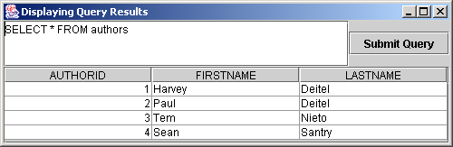
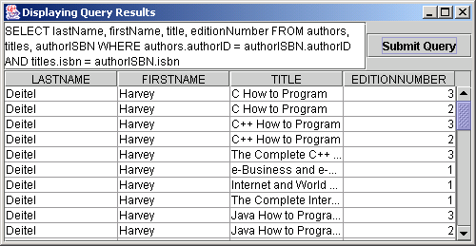
DisplayQueryResults for querying database books.
Program output

Slide 57
23.7 Stored Procedures
Stored procedures
  Store SQL statements in a database
  Invoke SQL statements by programs accessing the database
Interface CallableStatement
  Receive arguments
  Output parameters

Slide 58
23.8 Internet and World Wide Web Resources
Sun Microsystems JDBC home page
  Java.sun.com/products/jdbc
SQL materials
  www.sql.org
Cloudscape database home page
  www.cloudscape.com

