Slide 1
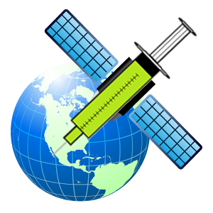
Traveccines
Oriol Gracia Carmona
Álvaro Serrano Morrás
Juan Luis Melero Ollonarte

Slide 2
Traveccines project
The pleasure of travelling
Importance of the profilaxis:
Vaccines
Relevant medical information
User friendly website

Slide 3
Provisional workflow
Input:
Origin country → Target country
Vaccines
Prevention
Databases:
Origin country diseases
Target country diseases
Wanted: Origin\Target

Slide 4
Provisional output
Disease | Vaccine name | Importance | Observations
Name of the disease | Commercial name of the vaccine | Very high | Apply one month before the travel
Name of the disease | Commercial name of the vaccine | Medium | Only necessary in certain zones
Name of the disease | Commercial name of the vaccine | Low | It is very rare or the disease is not important
Additional information: Epidemiological data, nowadays pandemies, other information related to the health safety in the country

Slide 5
Thank you
Oriol Gracia Carmona
Álvaro Serrano Morrás
Juan Luis Melero Ollonarte

