Slide 1

Elm

Slide 2

Notes:
Our journey today begins with JavaScript. ,Lets talk about where we’ve come with javascript
JQuery was released in 2006 and gave an easier api to navigating a document, selecting DOM elements, creating animations, events, and ajax apps. It was the sliced bread of its time and is still heavily used. Jquery is a huge library and creates a crutch for developers. Google introduced Angular in 2010 and brought with it strong opinions on how to structure your projects. Being able to structure data in an MVC . We then saw the move to single page apps in 2013 using React, Vue.js, preact, inferno where the dom could be emulated in json and manipulated only when updates were needed. The ability of separating out javascript into composible components that only worry about managing its own state gave a lot of guarantees that JQuery couldn’t deliver.
Given what we have, we still have one problem that we haven’t been able to conquer, Javascript itself.

Slide 3

Notes:
Our journey today begins with JavaScript. EvLets talk about where we’ve come with javascript
JQuery was released in 2006 and gave an easier api to navigating a document, selecting DOM elements, creating animations, events, and ajax apps. It was the sliced bread of its time and is still heavily used. Jquery is a huge library and creates a crutch for developers. Google introduced Angular in 2010 and brought with it strong opinions on how to structure your projects. Ideas like MVC and MVVM emerged. We then saw the move to single page apps in 2013 using React, Vue.js, preact, inferno where the dom could be emulated in json and manipulated only when updates were needed. The ability of separating out javascript into composible components that only worry about managing its own state gave a lot of guarantees that JQuery couldn’t deliver.
Given what we have and where we’ve come in the language, we still have one problem that we haven’t been able to conquer, Javascript itself.
It was is popularly said that this is 2018, We’re not writing HTML anymore. Some have said to “Accept JavaScript as the ’assembly language’ of the Web and select better tools that ’transpile’ to it. Use anything but JavaScript.” In the last couple years, JS transpilers have taken off and there is a sea of options available. With that said,
Javascript is the language of the internet and there Is no way at the moment to overcome a lot of the weaknesses that it comes with. Don’t get me wrong, Javascript is vital to developers to know and use. There is a great divide in the JavaScript that you should us vs the JavaScript you shouldn’t use.
Douglas Crockford Author of JavaScript, the good parts stated the following.
‘If you stick to the “Good Parts” of JavaScript, you can write wonderful software’
~ Douglas Crockford

Slide 4
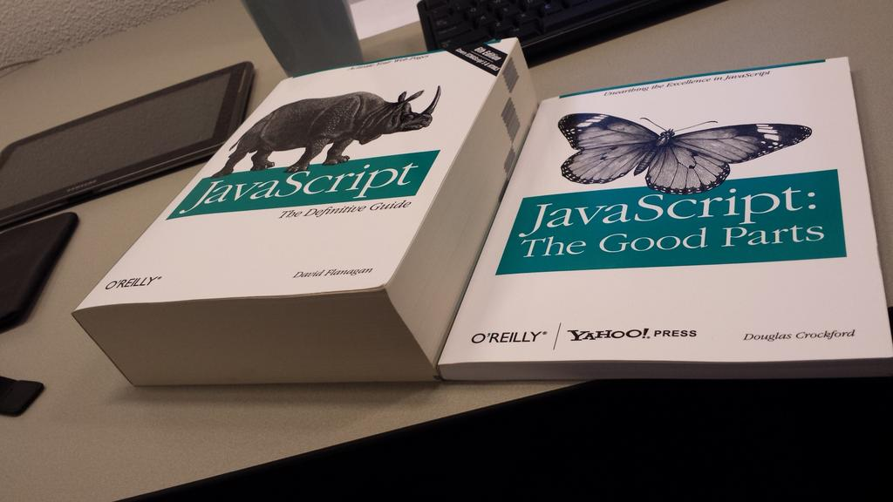

Slide 5
JavaScript is free from weirdness…
0.1 + 0.2 ->0.30000000000000004
0.1 + 0.2 === 0.3 ? // -> false

Slide 6
Quick Esoteric demo! +!()[]

Slide 7

Elm
Core Language/Tooling
Elm Architecture
Notes:
Elm is a strong pure functional programming language that compiles to JavaScript. It competes with projects like React as a tool for creating SPA websites and web apps.

Slide 8
Compiles to JavaScript
Pure functional language
No runtime errors
Great performance
Enforced semantic versioning
Notes:
Compiles to JS: No need to learn each new ECMA script
No runtime errors: handle errors around ”function isn’t defined”
Enforced Semantic versioning:

Slide 9
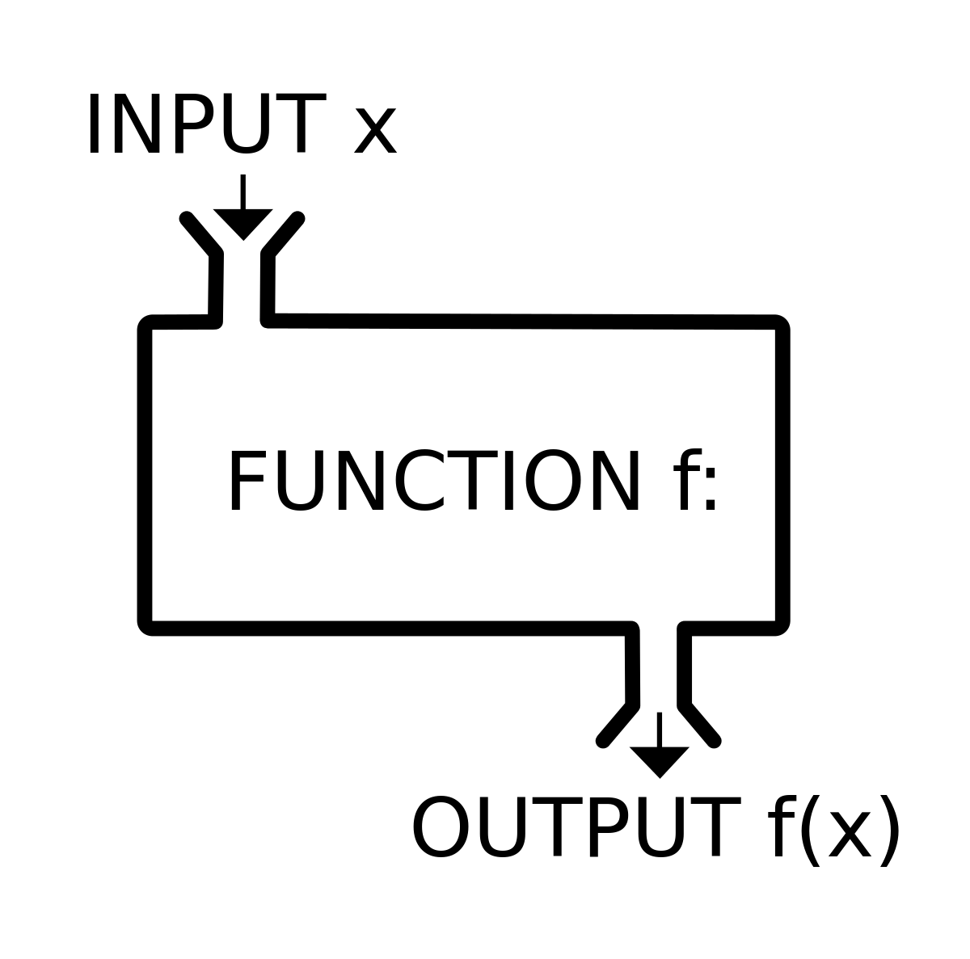
Functions
Notes:
All functions in Elm are pure. This means that within a function,
A pure function is a function where the return value is only determined by its input values, without observable side effects. This is how functions in math work: Math.cos(x) will, for the same value of x, always return the same result. Computing it does not change x. It does not write to log files, do network requests, ask for user input, or change program state. It’s a coffee grinder: beans go in, powder comes out, end of story.

Slide 10
Functions
add x y = x + y
learn msg = “I’m learning ” ++ msg
add 4 2 -- 6
learn “elm” -- “I’m learning elm”
Notes:
Elm is based on 40+ years of Functional Programming research and achievements. Functions are the building blocks of Elm applications. Functions are inherently modular, reusable, and composable because they only depend on their arguments. They are more usable than mutating state in objects.
A Function has a label and arguments that are separated by whitespace. If a function has multiple statements, the last statement evaluated is returned. This design decision promotes smaller purposeful functions that are easier to reuse and compose.
My functions only depend on what I pass them. They don’t rely on global state to work.
add takes two parameters x and y
learn takes one parameter msg

Slide 11
Functions
askVegeta level =
if level > 9000 then
“It’s over 9000!!!”
else
“meh”
askVegeta 42 -- “meh”
askVegeta 10000 -- “It’s over 9000!!!”
Notes:
Functions in Elm have plenty of support for condition checking

Slide 12
Functions
add x y = x + y
mult x y = x * y
x = add 2 (mult 3 4)
x = add 2 12
x = 14
Referential Transparency
f(x) = x + 1
Notes:
When a function is given an argument and it returns the same value, no matter how many times that function was called. It is this is Referentially Transparent.

Slide 13
Currying
multiply x y z = x * y * z
multiply 2 3 4 -- 24
((multiply 2) 3) 4 -- 24
multiplyBy5 = multiply 5
multiplyBy10 = multiplyBy5 2
multiplyBy10 10 -- 100
multiplyBy5 1 7 -- 70
Notes:
Functions are curried by default. Meaning that they take one argument and then return a function taking the next argument. This allows functions to be built up instead of requiring all arguments. If we’re finding that we are passing the same argument in each time, you can look to curry the function.

Slide 14
Piping
result = List.map(\n -> n^2) (List.filter(\n -> n <= 5)(List.range 1 10))
-- [1,4,9,16,25]
Notes:
There are times when calling functions with other functions to perform operations on data structures will become unreadable.

Slide 15
Piping
result = List.range(1 10)
|> List.filter(\n -> n <= 5)
|> List.map(\n -> n^2)
-- [1,4,9,16,25]

Slide 16
Piping
result = List.map(\n -> n^2)
<| List.filter(\n -> n <= 5)
<| List.range(1 10)
-- [1,4,9,16,25]

Slide 17
Typing
Creating and following “contracts”
Notes:
One of Elm’s major benefits is that Users don’t see runtime errors in practice. This is possible because the Elm compiler can analyze your source code very quickly to see how values flow through your program. If a value can ever be used in an invalid way, the compiler tells you about it with a friendly error message. This is called type inference. The compiler figures out what type of values flow in and out of all your functions.

Slide 18
Typing
toFullName person =
person.firstName ++ “ ” ++ person.lastName
fullName = toFullName
{ fistName = “bill”, lastname = “gates” }
Notes:
One of Elm’s major benefits is that Users don’t see runtime errors in practice. This is possible because the Elm compiler can analyze your source code very quickly to see how values flow through your program. If a value can ever be used in an invalid way, the compiler tells you about it with a friendly error message. This is called type inference. The compiler figures out what type of values flow in and out of all your functions.

Slide 19
type annotations
life : Int
life = 42
numbers : List Int
numbers = [1,2,3,5,8]
learn : String -> String
learn msg = “I’m learning ” ++ msg
add : Int -> Int -> Int
add x y = x + y
Notes:
Defining a type is much like defining functions. We begin with the identifier followed by a colon. Each function is curried and takes one argument.
Functions that don’t take arguments yet return a value are constants.
Typing for functions introduce an Arrow, you can think of this arrow like a lambda function, it takes one argument then returns a function that takes another argument. The last type given is the return type.
The beauty of adding type annotations is that is gives the compiler additional context on what it is suppose to be looking for. Unlike Javascript where types aren’t checked even during runtime, elm doesn’t compile.

Slide 20
lists, tuples, and records
names = [“alice”,“bob”,“john”]
numbers = [1,2,3]
List.length names -- 3
List.reverse names -- [“john”,“bob”,“alice”]
double x = x * 2
List.map double numbers -- [2,4,6]
Notes:
Lists can hold many values but the values must be of the same type.

Slide 21
lists, tuples, and records
cat : (String, Int)
cat = (“Sally”, 10)
name = Tuple.first cat -- “Sally”
age = Tuple.second cat -- 10
Notes:
Tuples on the other hand can hold any type. You can put as many values as you want into a tuple. The unfortunate problem with tuples is that extracting and updating a single element isn’t simple. Records to the rescue.

Slide 22
lists, tuples, and records
cat = {name: “fire”, color: “white”, age: 10}
cat.name -- “fire”
cat.color -- “jupiter”
.age cat -- 10
Notes:
Record is a key-value pair, similar to objects in javascript or python.
You cannot ask for a field that does not exist. No field will ever be undefined or null.

Slide 23
immutability
cat = {name: “fire”, color: “white”, age: 10}
ancientCat = { cat | age = cat.age + 100 }
.age cat -- 40
.age ancientCat -- 110
Notes:
Every data structure in elm is immutable. When a value is updated, a new data structure is created. The ”merge” operator works much like the spread operator does in javascript. It takes the record along with every key that it has on the left of the merge operator, and updates the fields on the right.
Be aware that the field you’ve chosen to update must already exist in the record. New fields aren’t allowed here because it will break the record’s type. A new record needs to be created.
You may think that creating everytime is wasteful and inefficient. Many languages, including elm, implement what is called persistent data structures. Once a data structure is created

Slide 24
type aliases
cat = {name: “fire”, color: “white”, age: 10}
type alias Cat =
{ name : String
, color: String
, age: Int }
cat = Cat “fire” “black” 10
Notes:
With type aliases, by defining a type, elm gives us a constructor function that takes in arguments in order.
As we take a look at the field color, we would like to avoid having to write as much runtime validation as possible. Because we delegated it as a String, We will have to validate it via runtime checks. We can do better by leveraging elm’s built in type checking
Elm has what are called Union Types

Slide 25
union types
type alias Cat =
{ name : String
, color: Color
, age: Int }
type Color = Black
| Blue
| White
| Blend Color Color
black_cat = Cat “fire” Black 10
blend_cat = Cat “fire” (Blend Black White) 6
Notes:
With type aliases, by defining a type, elm gives us a constructor function that takes in arguments in order.
As we take a look at the field color, we would like to avoid having to write as much runtime validation as possible. Because we delegated it as a String, We will have to validate it via runtime checks. We can do better by leveraging elm’s built in type checking. By creating a type called Color, we can have Elm
Elm has what are called Union Types. It allows you to represent complex data much more naturally. The way this is read is a color can be Black Or Blue Or White Or Blend. Union types give us constructor functions as well. Blend takes two arguments for its constructor.
You need the parenthesis otherwise Elm will interpret this as passing two arguments to Cat instead of to Blend.
Union types are helpful for many circumstances. It is common to use them to describe the types of messages that a update our models. Other uses are to define different states data could be in such as in a Todo list where data could be completed, active, or a list of tasks. It simply is a state machine that gives your application a limited subset of available possibilities completely backed by the elm compiler for compile time validation.

Slide 26
union types
type Maybe a = just a | Nothing
just -- <function> : a -> Maybe a
Nothing -- Nothing : Maybe a
just “hi” -- just “hello” : Maybe String
just 2.0 -- just 2.0 : Maybe Float
Notes:
Now, Elm doesn’t have the notion of a null value yet null values can happen everywhere. A common example is pulling data back about a user from a database. The user could not exist. How do we handle these situations? Elm defines a special union type called Maybe. Here is the source code in elm.
The way we read this is We Just have a Cat or a User or nothing, where cat or a user could be anything. The letter ‘A’ in Elm here means “Anything.” It could be a record, list of strings, anything. This is the same idea as a Generic type.
If you want to have a Maybe value, you have to use the Nothing or Just constructors to create it. This means that to deal with the data, you have to use a case expression. This means the compiler can ensure that you have definitely covered both possibilities.

Slide 27
union types
type alias User = { name: String, age: Maybe Int }
jack = User “Jack” Nothing
kaitlin = User “Kaitlin” (Just 23)
canBuyOverWatch : User -> Bool
canBuyOverWatch user =
case user.age of
Nothing ->
False
Just age ->
age >= 21
Notes:
In order to get the values out of just functions requires us to use case statements. Think of them as switch statements with build in enhanced pattern matching. In these case statements, elm requires us to handle both the Nothing case and the Just case. If we don’t handle the Nothing case, it will not Compile! This is how elm avoids null references, not defined. etc

Slide 28
Elm
Core Language / Tooling
Elm Architecture
Notes:
Now that we’ve gone through the core language, Lets take a quick look at the tooling available in Elm
how do we create web applications with that knowledge?

Slide 29
JavaScript
Npm/yarn
Babel
Webpack
React
Redux
TypeScript/Flow
Immutable.js
Ramda/lodash_fp
Elm
Notes:
Here are the dev tools that elm has already built in. There isn’t a need to spend days configuring the perfect javascript development environment. All of this is built within Elm. JavaScript fatigue is a real problem and this is one refreshing part about elm. They all work together without special configuration. They are designed to work together and play nicely as a single unit.

Slide 30
elm architecture
Model – the state of your application
Update – a way to update your state
View - a way to view your state in html

Slide 31
Credits:
https://medium.com/javascript-non-grata/the-top-10-things-wrong-with-javascript-58f440d6b3d8
https://www.sitepoint.com/functional-programming-pure-functions/

