Slide 1
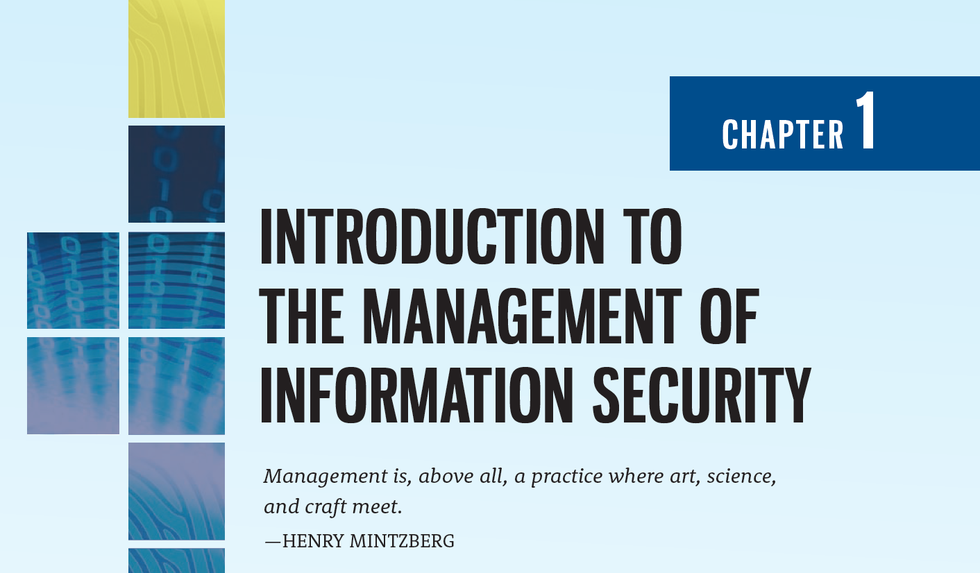

Slide 2
Learning Objectives
Upon completion of this material, you should be able to:
List and discuss the key characteristics of information security
List and describe the dominant categories of threats to information security
Discuss the key characteristics of leadership and management
Describe the importance of the manager’s role in securing an organization’s information assets
Differentiate information security management from general business management

Slide 3
Introduction
IT enables the storage and transportation of information—often a company’s most valuable resource—from one business unit to another
But what happens if the vehicle breaks down, even for a little while?
Astute managers increasingly recognize the critical nature of information security as the vehicle by which the organization’s information assets are secured
The emergence of executive-level InfoSec managers allows for the creation of professionally managed information security teams that have a primary objective to protect information assets, wherever—or whatever—they may be

Slide 4
Introduction (Continued)
Organizations must realize that information security planning and funding decisions involve more than managers of information, the members of the information security team, or the managers of information systems
Altogether, they must involve the entire organization, as represented by three distinct groups of managers and professionals, or communities of interest:
Those in the field of information security
Those in the field of IT
Those from the rest of the organization

Slide 5
Communities of Interest
These three groups should engage in a constructive effort to reach consensus on an overall plan to protect the organization’s information assets:
The information security community protects the organization’s information assets from the many threats they face
The IT community supports the business objectives of the organization by supplying and supporting IT that is appropriate to the organization’s needs
The general business community articulates and communicates organizational policy and objectives and allocates resources to the other groups
Working together, these communities of interest make recommendations to executive management about how to secure an organization’s information assets most effectively

Slide 6
What Is Security?
In general, security means being free from danger. To be secure is to be protected from the risk of loss, damage, unwanted modification, or other hazards
Achieving an appropriate level of security for an organization also depends on the implementation of a multilayered system
Security is often achieved by means of several strategies undertaken simultaneously or used in combination with one another
It is the role of management to ensure that each strategy is properly planned, organized, staffed, directed, and controlled

Slide 7
Specialized Areas of Security
Specialized areas of security include:
Physical security
Operations security
Communications security
Cyber (or computer) security
Network security

Slide 8
Information Security
Information security (InfoSec) focuses on the protection of information and the characteristics that give it value, such as confidentiality, integrity, and availability, and includes the technology that houses and transfers that information through a variety of protection mechanisms such as policy, training and awareness programs, and technology

Slide 9
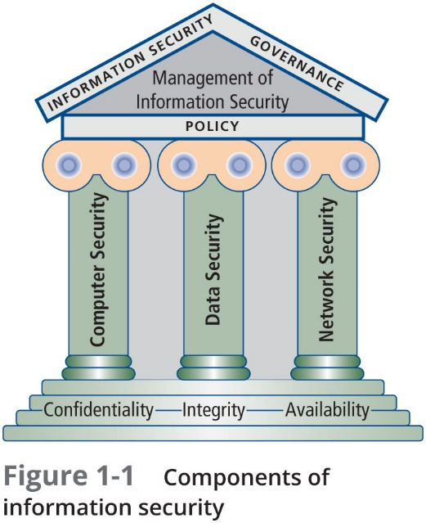

Slide 10
The CIA Triad and the CNSS Model
The NSTISSI (or CNSS) Security Model (also known as the McCumber Cube) provides a more detailed perspective on security
While the NSTISSC model covers the three dimensions of information security, it omits discussion of detailed guidelines and policies that direct the implementation of controls
Another weakness of using this model with too limited an approach is to view it from a single perspective

Slide 11
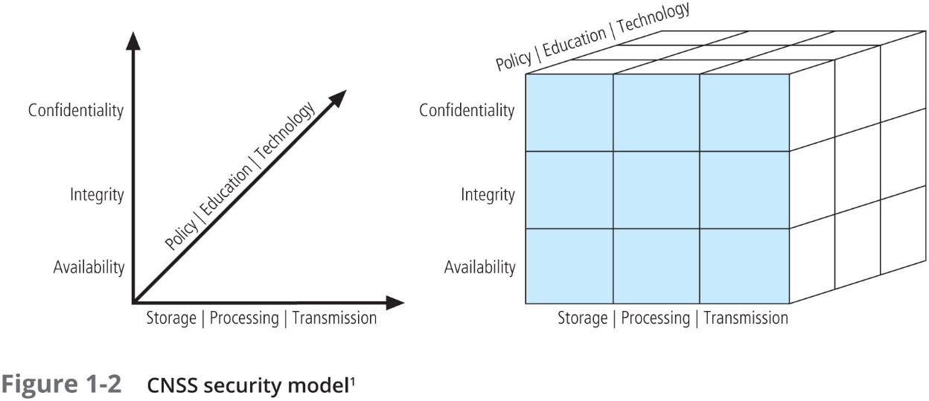

Slide 12
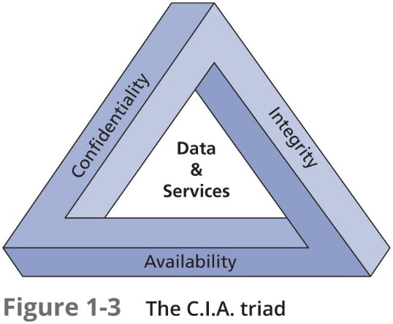
The C.I.A. Triad
The C.I.A. triad—confidentiality, integrity, and availability—has expanded into a more comprehensive list of critical characteristics of information

Slide 13
Confidentiality
Confidentiality is “an attribute of information that describes how data is protected from disclosure or exposure to unauthorized individuals or systems”
Confidentiality means limiting access to information only to those who need it, and preventing access by those who do not
To protect the confidentiality of information, a number of measures are used:
Information classification
Secure document (and data) storage
Application of general security policies
Education of information custodians and end users
Cryptography (encryption)

Slide 14
Integrity
Integrity is “an attribute of information that describes how data is whole, complete, and uncorrupted”
The integrity of information is threatened when it is exposed to corruption, damage, destruction, or other disruption of its authentic state
Corruption can occur while information is being entered, stored, or transmitted

Slide 15
Availability
Availability is “an attribute of information that describes how data is accessible and correctly formatted for use without interference or obstruction”
Availability of information means that users, either people or other systems, have access to it in a usable format
Availability does not imply that the information is accessible to any user; rather, it means it can be accessed when needed by authorized users

Slide 16
Privacy
Privacy is, “in the context of information security, the right of individuals or groups to protect themselves and their information from unauthorized access, providing confidentiality”
Information that is collected, used, and stored by an organization is to be used only for the purposes stated by the data owner at the time it was collected
In this context, privacy does not mean freedom from observation (the meaning usually associated with the word); it means that the information will be used only in ways approved by the person who provided it

Slide 17
Information Aggregation
Many organizations collect, swap, and sell personal information as a commodity
Today, it is possible to collect and combine personal information from several different sources (known as information aggregation) that has resulted in databases that could be used in ways the original data owner has not agreed to or even knows about

Slide 18
Identification
Identification is “the access control mechanism whereby unverified entities who seek access to a resource provide a label by which they are known to the system”
An information system possesses the characteristic of identification when it is able to recognize individual users
Identification and authentication are essential to establishing the level of access or authorization that an individual is granted
Identification is typically performed by means of a user name or other ID

Slide 19
Authentication
Authentication is “the access control mechanism that requires the validation and verification of an unauthenticated entity’s purported identity”
It is the process by which a control establishes whether a user (or system) has the identity it claims to have
Individual users may disclose a personal identification number (PIN), a password, or a passphrase to authenticate their identities to a computer system

Slide 20
Authorization
Authorization is “the access control mechanism that represents the matching of an authenticated entity to a list of information assets and corresponding access levels”
After the identity of a user is authenticated, authorization defines what the user (whether a person or a computer) has been specifically and explicitly permitted by the proper authority to do, such as access, modify, or delete the contents of an information asset

Slide 21
Accountability
Accountability is “the access control mechanism that ensures all actions on a system—authorized or unauthorized—can be attributed to an authenticated identity. Also known as auditability”
Accountability of information occurs when a control provides assurance that every activity undertaken can be attributed to a named person or automated process
Accountability is most commonly associated with system audit logs

Slide 22
Key Concepts of Information Security: Threats and Attacks
Chapter 01: Introduction to the Management of Information Security

Slide 23
Sun Tzu Wu’s The Art of War
Therefore I say: One who knows the enemy and knows himself will not be in danger in a hundred battles
One who does not know the enemy but knows himself will sometimes win, sometimes lose. One who does not know the enemy and does not know himself will be in danger in every battle (Sun Tzu, 500 BC)
To protect your organization’s information, you must:
know yourself; that is, be familiar with the information assets to be protected and the systems, mechanisms, and methods used to store, transport, process, and protect them; and
know your enemy; that is the threats your organization faces

Slide 24
Key Concepts of Information Security: Threats and Attacks
A threat represents a potential risk to an information asset, whereas an attack (or threat event) represents an ongoing act against the asset that could result in a loss
Threat agents damage or steal an organization’s information or physical assets by using exploits to take advantage of a vulnerability where controls are not present or no longer effective
Attack: “an intentional or unintentional act that can damage or otherwise compromise information and the systems that support it”
Exploit: “a technique used to compromise a system… Threat agents may attempt to exploit a system or other information asset by using it illegally for their personal gain”
Vulnerability: “a potential weakness in an asset or its defensive control system(s)”

Slide 25
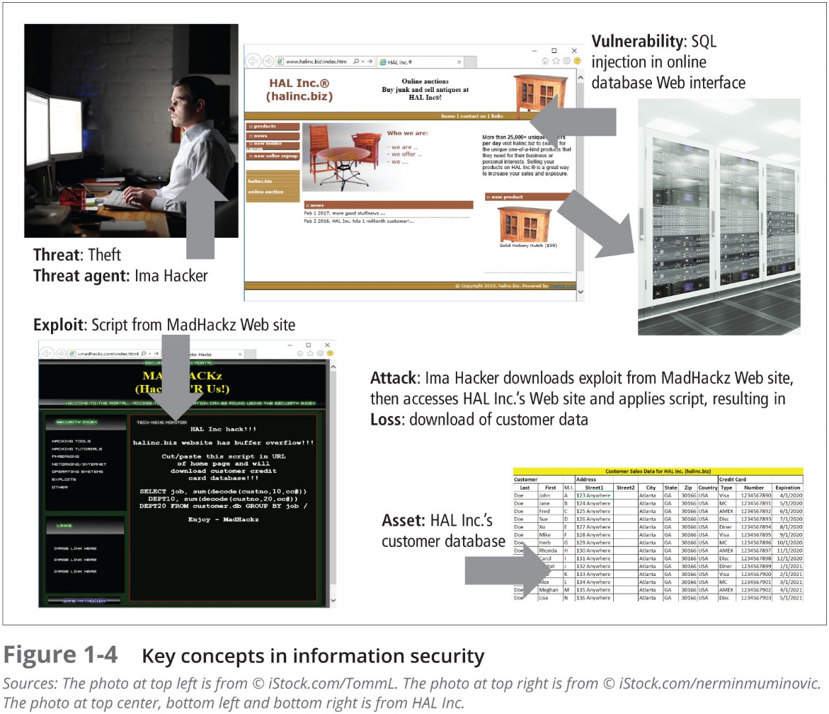

Slide 26
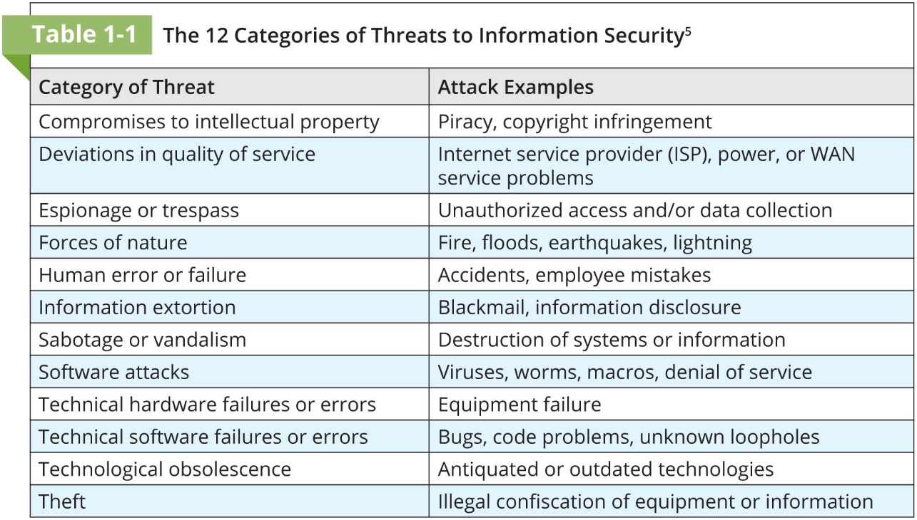

Slide 27
Compromises to Intellectual Property
Intellectual property (IP) can be trade secrets, copyrights, trademarks, and patents
IP is protected by U.S. Copyright and other laws, carries the expectation of proper attribution or credit to its source, and potentially requires the acquisition of permission for its use, as specified in those laws
The unauthorized appropriation of IP constitutes a threat to information security
This category includes two primary areas:
Software piracy
Copyright protection and user registration

Slide 28
Deviations in Quality of Service
An organization’s information system depends on the successful operation of many interdependent support systems, including power grids, data and telecommunications networks, parts suppliers, service vendors, and even janitorial staff and garbage haulers, any of which can be interrupted by severe weather, employee illnesses, or other unforeseen events
Irregularities in Internet service, communications, and power supplies can dramatically affect the availability of information and systems
Subcategories of this threat include the following:
Internet service issues
Communications and other service provider issues
Power irregularities

Slide 29
Espionage or Trespass
When an unauthorized person gains access to information an organization is trying to protect, the act is categorized as espionage or trespass
When information gatherers employ techniques that cross a legal or ethical threshold, they are conducting industrial espionage
In the real world, a hacker frequently spends long hours examining the types and structures of targeted systems and uses skill, guile, and/or fraud to attempt to bypass controls placed on information owned by someone else
Once an attacker gains access to a system, the next step is to increase privileges (privilege escalation) to gain administrator- (or root-) level control

Slide 30
Espionage or Trespass (Continued)
Password attacks fall under the category of espionage or trespass just as lock-picking falls under breaking and entering
Attempting to guess or reverse-calculate a password is often called cracking
There are alternative approaches to password cracking:
Brute force attack
Dictionary password attack
Rainbow tables
Social engineering password attack

Slide 31
Forces of Nature
Forces of nature can present some of the most dangerous threats because they usually occur with little warning and are beyond the control of people
Because it is not possible to avoid these threats, organizations must implement controls to limit damage and prepare contingency plans for continued operations
Force majeure, or “superior force,” includes forces of nature as well as civil disorder and acts of war
Most forces of nature can only be mitigated through insurance, although careful facilities design and placement can reduce the likelihood of damage

Slide 32
Forces of Nature (Continued)
Some typical force of nature attacks include the following:
Fire
Flood
Earthquake
Lightning
Landslide or mudslide
Tornados or severe windstorms
Hurricanes, typhoons, and tropical depressions
Tsunami
Electrostatic discharge (ESD)
Dust contamination

Slide 33
Human Error or Failure
This category includes acts performed without intent or malicious purpose or in ignorance by an authorized user
When people use information systems, mistakes happen; similar errors happen when people fail to follow established policy
Inexperience, improper training, and incorrect assumptions are just a few things that can cause human error or failure
One of the greatest threats to an organization’s information security is its own employees, as they are the threat agents closest to the information
Human error or failure often can be prevented with training, ongoing awareness activities, and controls

Slide 34
Human Error or Failure (Continued)
Some typical human error or failure attacks include the following:
Social engineering
Advance-fee fraud
Phishing
URL manipulation
Web site forgery
Spear phishing
Pretexting

Slide 35
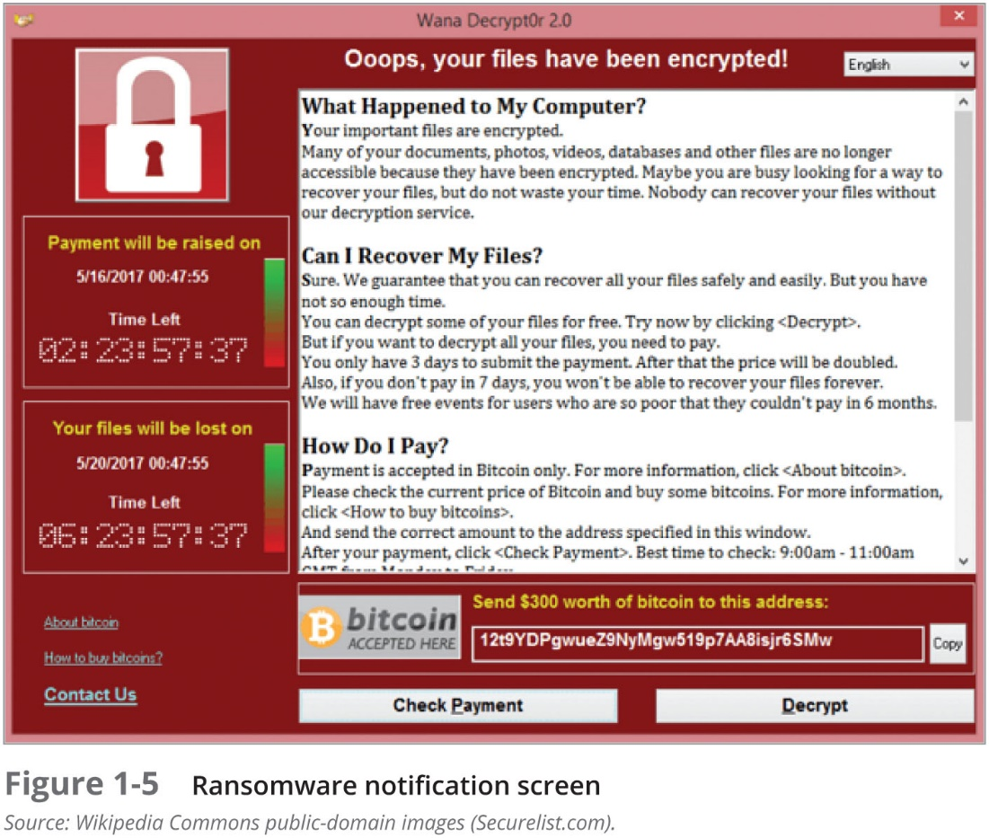
Information Extortion
Information extortion, also known as cyberextortion, is common in the theft of credit card numbers
Recent information extortion attacks have involved specialized forms of malware known as ransomware that encrypt the user’s data and offer to unlock it if the user pays the attacker

Slide 36
Sabotage or Vandalism
This category of threat involves the deliberate sabotage of a computer system or business, or acts of vandalism to destroy an asset or damage the image of an organization
These acts can range from petty vandalism by employees to organized sabotage against an organization
Vandalism to a Web site can erode consumer confidence, diminishing an organization’s sales, net worth, and reputation
Activism in the digital age:
Online activism
Cyberterrorism and cyberwarfare
Positive online activism

Slide 37
Software Attacks
Deliberate software attacks occur when an individual or a group designs and deploys software to attack a system
This software can be used to overwhelm the processing capabilities of online systems or to gain access to protected systems by hidden means
Malware—viruses, worms, Trojan horses, polymorphic threats and hoaxes
Back doors, trap doors, and maintenance hooks
Denial-of-service (DoS) and distributed denial-of-service attacks (DDoS)
E-mail attacks—spam, mail bombs, and social engineering attacks
Communications interception attacks—packet sniffers, spoofing, pharming, and man-in-the-middle attacks

Slide 38
Technical Hardware Failures
Technical hardware failures or errors occur when a manufacturer distributes equipment containing a known or an unknown flaw, which can cause the system to perform outside of expected parameters, resulting in unreliable service or lack of availability
In hardware terms, failures are measured in mean time between failure (MTBF) and mean time to failure (MTTF)
MTBF presumes that the item can be repaired or returned to service, MTTF presumes the item must be replaced
From a repair standpoint, MTBF = MTTF + MTTD + MTTR, where mean time to diagnose (MTTD) examines diagnosis time and mean time to repair (MTTR) calculates repair time

Slide 39
Technical Software Failures
Large quantities of computer code are written, debugged, published, and sold before all their bugs are detected and resolved
Sometimes, combinations of certain software and hardware reveal new failures that range from bugs to untested failure conditions
Sometimes these bugs are not errors, but purposeful shortcuts left by programmers for benign or malign reasons, bypassing security checks to speed up software testing—known as trap doors
Among the most popular bug documentation Web site is Bugtraq, hosted by Security Focus, which provides up-to-the-minute information on the latest security vulnerabilities as well as a thorough archive of past bugs

Slide 40
Technical Software Failures (Continued)
The Open Web Application Security Project (OWASP) list of “The Ten Most Critical Web Application Security Risks” for 2017:
Injection
Broken authentication and session management
Cross-site scripting (XSS)
Broken access control
Security misconfiguration
Sensitive data exposure
Insufficient attack protection
Cross-site request forgery (CSRF)
Using components with known vulnerabilities
Underprotected APIs

Slide 41
Deadly Sins of Software Security
Web Application Sins
Implementation Sins
SQL injection
Web server-related vulnerabilities
Web client-related vulnerabilities (XSS)
Use of magic URLs, predictable cookies, and hidden form fields
Buffer overflow
Format string problems
Integer overflows
C++ catastrophes
Catching exceptions
Command injection
Failure to handle errors correctly
Information leakage
Race conditions
Poor usability
Not updating easily
Executing code with too much privilege
Failure to protect stored data
The sins of mobile code

Slide 42
Deadly Sins of Software Security (Continued)
Cryptographic Sins
Networking Sins
Use of weak password-based systems
Weak random numbers
Using the wrong cryptography
Failure to protect network traffic
Improper use of PKI, especially SSL
Trusting network name resolution

Slide 43
Technological Obsolescence
Antiquated or outdated infrastructure can lead to unreliable and untrustworthy systems
Management must recognize that when technology becomes outdated, there is a risk of losing data integrity from attacks
Ideally, proper planning by management should prevent technology from becoming obsolete, but when obsolescence is clear, management must take immediate action
Perhaps the most significant case of technology obsolescence in recent years is Microsoft’s Windows XP

Slide 44
Theft
The value of information is diminished when it is copied without the owner’s knowledge
Physical theft can be controlled easily using a wide variety of measures, from locked doors to trained security personnel and the installation of alarm systems
Electronic theft, however, is a more complex problem to manage and control
Theft is often an overlapping category with software attacks, espionage or trespass, information extortion, and compromises to intellectual property

Slide 45
Management and Leadership
Chapter 01: Introduction to the Management of Information Security

Slide 46
Management and Leadership
Management is the process of achieving objectives using a given set of resources
A manager is a member of the organization assigned to marshal and administer resources, coordinate the completion of tasks, and handle the many roles necessary to complete the desired objectives
Management roles:
Informational
Interpersonal
Decisional

Slide 47
The Difference Between Leadership and Management
A leader influences employees so that they are willing to accomplish objectives, and is expected to lead by example and demonstrate personal traits that instill a desire in others to follow
By comparison, a manager administers the resources of the organization—creates budgets, authorizes expenditures, and recruits, hires, evaluates, and terminates employees
Leaders do not always perform a managerial function, and managers are often assigned roles in which they are not responsible for personnel
Effective managers can be effective leaders

Slide 48
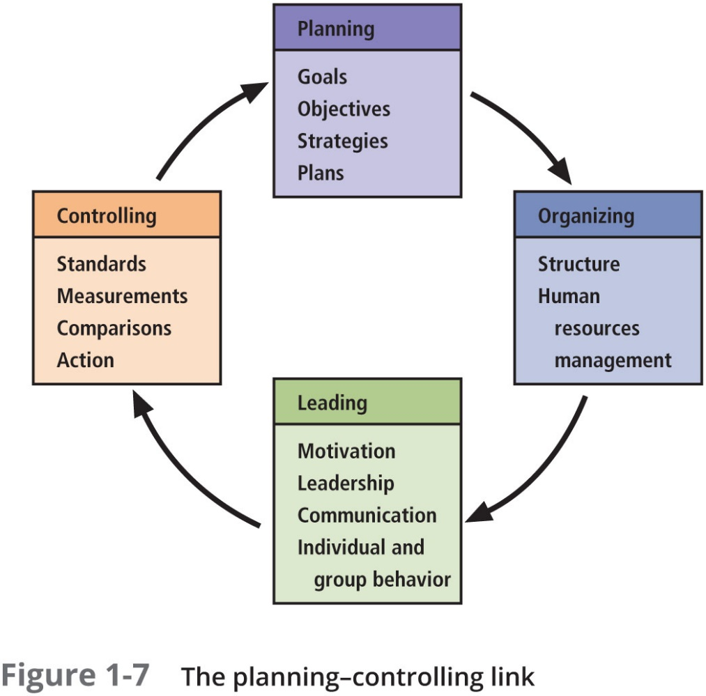
Management Characteristics
Two basic approaches to management are:
Traditional management theory uses the core principles of planning, organizing, staffing, directing, and controlling (POSDC)
Popular management theory categorizes the principles of management into planning, organizing, leading, and controlling (POLC)

Slide 49
Planning
Planning: the process of developing, creating, and implementing strategies for the accomplishment of objectives. Three levels of planning are strategic, tactical, and operational
Organizing: the management function dedicated to the structuring of resources to support the accomplishment of objectives
Leading: encourages the implementation of the planning and organizing functions, and includes supervising employee behavior, performance, attendance, and attitude while ensuring completion of the assigned tasks, goals, and objectives
Controlling: ensures the validity of the organization’s plan—that sufficient progress is made, that impediments to the completion of the task are resolved, and that no additional resources are required

Slide 50
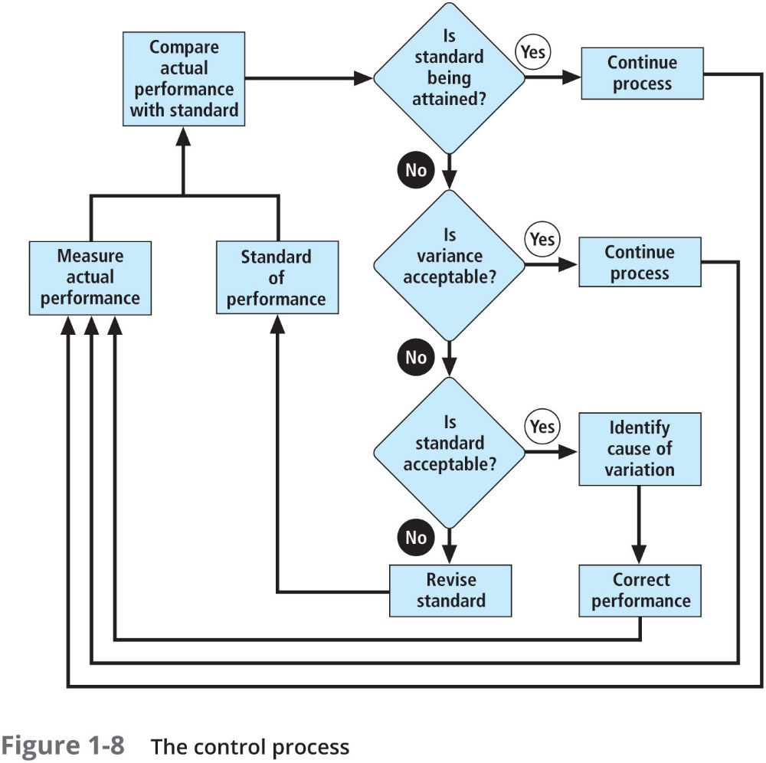

Slide 51
Governance
Governance is “the set of responsibilities and practices exercised by the board and executive management with the goal of providing strategic direction, ensuring that objectives are achieved, ascertaining that risks are managed appropriately, and verifying that the enterprise’s resources are used responsibly”
Governance emphasizes escalating the importance of InfoSec to the uppermost levels of the organization and providing it with an appropriate level of management

Slide 52
Solving Problems
Step 1: Recognize and Define the Problem
Step 2: Gather Facts and Make Assumptions
Step 3: Develop Possible Solutions
Step 4: Analyze and Compare Possible Solutions (Feasibility Analyses)
Step 5: Select, Implement, and Evaluate a Solution

Slide 53
Principles of Information Security Management
Chapter 01: Introduction to the Management of Information Security

Slide 54
Principles of Information Security Management
The unique functions of information security management are known as the six Ps:
Planning
Policy
Programs
Protection
People
Project management

Slide 55
InfoSec Planning
Planning as part of InfoSec management is an extension of the basic planning model discussed earlier in this chapter
Included in the InfoSec planning model are activities necessary to support the design, creation, and implementation of information security strategies
Because the InfoSec strategic plans must support not only the IT use and protection of information assets, but those of the entire organization, it is imperative that the CISO work closely with all senior managers in developing InfoSec strategy

Slide 56
InfoSec Planning (Continued)
Several types of InfoSec plans exist:
Incident response planning
Business continuity planning
Disaster recovery planning
Policy planning
Personnel planning
Technology rollout planning
Risk management planning
Security program planning including education, training and awareness

Slide 57
Policy
Policy is “a set of organizational guidelines that dictate certain behavior within the organization”
In InfoSec, there are three general categories of policy:
Enterprise information security policy (EISP)
Issue-specific security policy (ISSP)
System-specific policies (SysSPs)

Slide 58
Programs
InfoSec operations are specifically managed as separate entities
A security education training and awareness (SETA) program is one such entity
Other programs that may emerge include a physical security program, complete with fire, physical access, gates, guards, and so on

Slide 59
Protection
The protection function is executed via a set of risk management activities, including risk assessment and control, as well as protection mechanisms, technologies, and tools
Each of these mechanisms represents some aspect of the management of specific controls in the overall information security plan

Slide 60
People
People are the most critical link in the information security program
This area of InfoSec includes security personnel and the security of personnel, as well as aspects of the SETA program mentioned earlier

Slide 61
Projects
The final component is the application of thorough project management discipline to all elements of the information security program
Project management involves identifying and controlling the resources applied to the project, as well as measuring progress and adjusting the process as progress is made toward the goal

Slide 62
Project Management
Information security is a process, not a project, however, each element of an information security program must be managed as a project, even if the overall program is perpetually ongoing
How can information security be both a process and a project? It is, in fact, a continuous series, or chain, of projects
Some aspects of information security are not project based; rather, they are managed processes (operations) and are ongoing

Slide 63
Summary
Because businesses and technology have become more fluid, the narrower concept of computer security has been replaced by the broader concept of InfoSec
From an InfoSec perspective, organizations often have three communities of interest: InfoSec managers and professionals, IT managers and professionals, and nontechnical managers and professionals
The C.I.A. triad is based on three desirable characteristics of information: confidentiality, integrity, and availability
To make sound decisions about information security, management must be informed about threats to its people, applications, data, and information systems

Slide 64
Summary (Continued)
Threats or dangers facing an organization’s people, information, and systems fall into the following general categories:
Compromises to intellectual property
Deviations in quality of service
Espionage or trespass
Forces of nature
Human error or failure
Information extortion
Sabotage or vandalism
Software attacks
Technical hardware failures or errors
Technical software failures or errors
Technological obsolescence
Theft

Slide 65
Summary (Continued)
An attack is a deliberate act that takes advantage of a vulnerability to compromise a controlled system. It is accomplished by a threat agent that damages or steals an organization’s information or physical assets. A vulnerability is an identified weakness in a controlled system, where controls are not present or are no longer effective
Poor software development practices can introduce significant risk, but by developing sound development practices, change control, and quality assurance into the process, overall software quality and the security performance of software can be greatly enhanced
In its simplest form, management is the process of achieving objectives by using resources
The important distinction between a leader and a manager is that a leader influences employees so that they are willing to accomplish objectives, whereas a manager creates budgets, authorizes expenditures, and hires employees

Slide 66
Summary (Continued)
The traditional approach to management theory uses the core principles of planning, organizing, staffing, directing, and controlling (POSDC). Another approach to management theory categorizes the principles of management into planning, organizing, leading, and controlling (POLC)
The process that develops, creates, and implements strategies for the accomplishment of objectives is called “planning.” There are three levels of planning: strategic, tactical, and operational
InfoSec management operates like all other management units, but the goals and objectives of the InfoSec management team are different in that they focus on the secure operation of the organization

