Slide 1
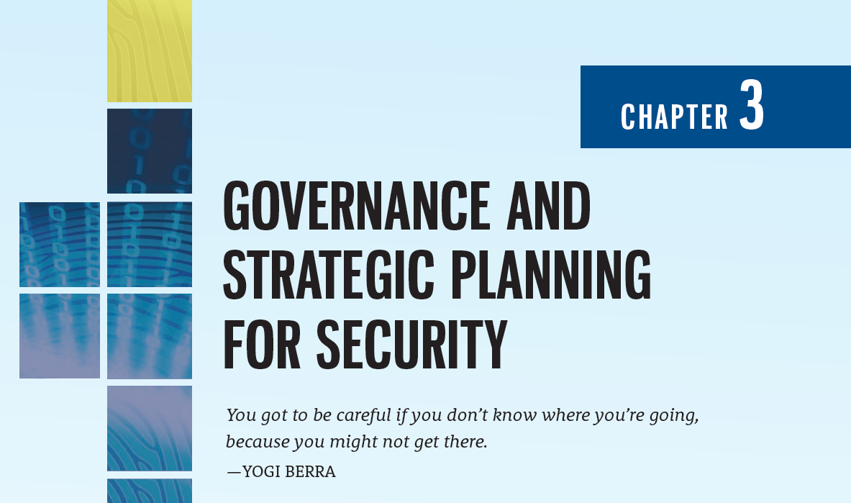

Slide 2
Learning Objectives
Upon completion of this material, you should be able to:
Identify the key organizational stakeholders that are actively involved in planning and compare their roles
Explain strategic organizational planning for information security (InfoSec) and describe its relationship to organization-wide and IT strategic planning
Discuss the importance, benefits, and desired outcomes of information security governance and how such a program would be implemented
Describe the principal components of InfoSec system implementation planning within the organizational planning scheme

Slide 3
The Role of Planning
Chapter 03: Governance and Strategic Planning for Security

Slide 4
Introduction
In a setting where there are continual constraints on resources, both human and financial, good planning enables an organization to make the most out of the materials at hand
While a chief information security officer (CISO) and other InfoSec managers can generate an urgent response to an immediate threat, they are well advised to utilize a portion of their routinely allocated resources toward the long-term viability of the InfoSec program

Slide 5
Introduction (Continued)
Planning involves:
Representatives of the three communities of interest
Individuals internal and external to the organization
Employees
Management
Stockholders and other outside stakeholders
Planning is the dominant means of managing resources in modern organizations and entails the enumeration of a sequence of actions intended to achieve specific goals during a defined period of time, and then controlling the implementation of these steps

Slide 6
Precursors to Planning
To implement effective planning, an organization’s leaders usually begin from previously developed positions that explicitly state the organization’s ethical, entrepreneurial, and philosophical perspectives
Precursor documents developed to support organizational planning include:
Mission statement
Vision statement
Values statement

Slide 7
The Mission Statement
The mission statement explicitly declares the business of the organization and its intended areas of operations
The mission statement explains what the organization does and for whom
Random Widget Works designs and manufactures quality widgets and associated equipment and supplies for use in modern business environments

Slide 8
Vision Statement
The vision statement is an idealistic expression of what the organization wants to become
It expresses where the organization wants to go, whereas the mission statement describes how it wants to get there
They should be ambitious as they are meant to express the aspirations of the organization and to serve as a means for visualizing its future
Random Widget Works will be the preferred manufacturer of choice for every business’s widget equipment needs, with an RWW widget in every gismo in use

Slide 9
Values Statement
By establishing a formal set of organizational principles and qualities in a values statement, as well as benchmarks for measuring behavior against these published values, an organization makes its conduct and performance standards clear to its employees and the public
Random Widget Works values commitment, honesty, integrity, and social responsibility among its employees, and is committed to providing its services in harmony with its corporate, social, legal, and natural environments

Slide 10
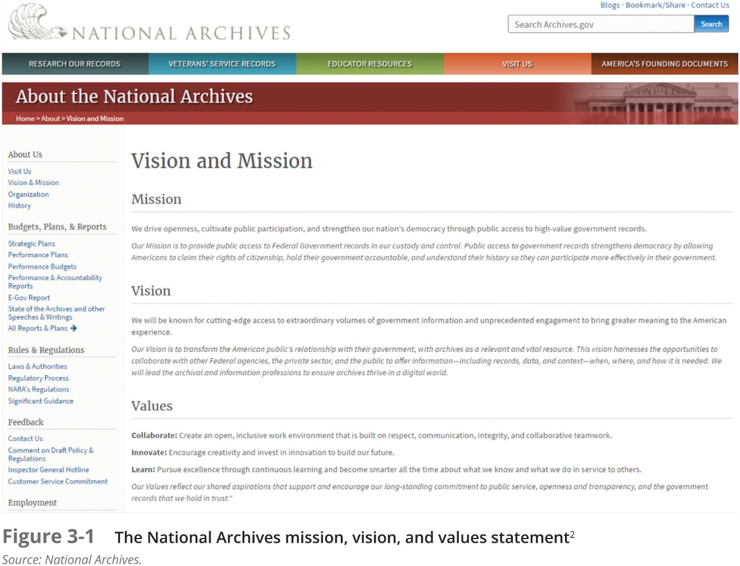

Slide 11
Strategic Planning
Chapter 03: Governance and Strategic Planning for Security

Slide 12
Strategic Planning
Strategic planning is “the process of defining and specifying the long-term direction (strategy) to be taken by an organization, and the allocation and acquisition of resources needed to pursue this effort”
It guides organizational efforts and focuses resources toward specific, clearly defined goals in the midst of an ever-changing environment
First, general strategy is translated into specific strategy; second, overall strategic planning is translated into lower-level tactical and operational planning

Slide 13
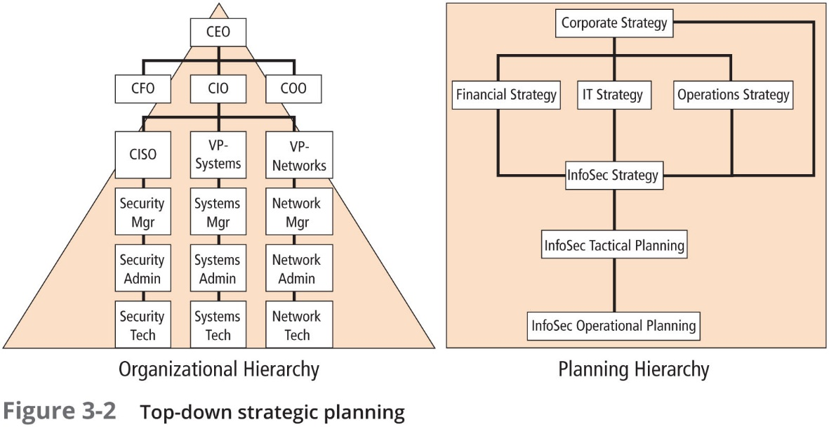

Slide 14
Strategic Planning (Continued)
Information security, like information technology, must support more than its immediate parent in the organizational chart
As all organizational units will be using information, not just IT-based information, the information security group must understand and support the strategic plans (a.k.a strategies) of all business units
This role may at times conflict with that of the IT department as IT’s role is the efficient and effective delivery of information and information resources, while InfoSec’s role is the protection of all information assets

Slide 15
Creating a Strategic Plan
After an organization develops a general strategy, it must create an overall strategic plan by extending that general strategy into specific strategic plans for major divisions
Each level of each division translates those objectives into more specific objectives for the level below
The conversion of goals from the strategic level to the next lower level relies on the executive’s ability to know and understand the strategic goals of the entire organization, to know and appreciate the strategic and tactical abilities of each unit within the organization, and to negotiate with peers, superiors, and subordinates

Slide 16
Planning Levels
Once the organization’s overall strategic plan is translated into strategic goals for each major division or operation, the next step is to translate these strategies into objectives that are specific, measurable, achievable, and time-bound
Strategic plans are used to create tactical plans, which are in turn used to develop operational plans

Slide 17
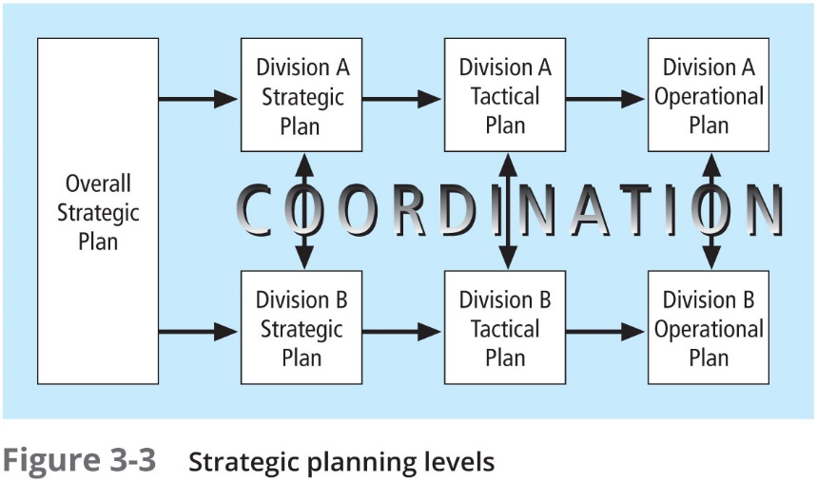

Slide 18
Planning Levels (Continued)
Tactical planning
has a more short-term focus than strategic planning
usually one to three years
breaks applicable strategic goals into a series of incremental objectives
Operational planning
used by managers and employees to organize the ongoing, day-to-day performance of tasks
includes clearly identified coordination activities across department boundaries such as communications requirements, weekly meetings, summaries, and progress reports

Slide 19
Planning and the CISO
The first priority of the CISO and the InfoSec management team should be the structure of a strategic plan
While each organization may have its own format for the design and distribution of a strategic plan, the fundamental elements of planning are the same for all types of enterprises

Slide 20
Basic Components of a Typical Strategic Plan
Executive Summary
Mission, Vision, and Values Statements
Organizational Profile and History
Strategic Issues and Challenges
Organizational Goals and Objectives
Major Business Units (or Product/Service) Goals and Objectives
Appendices (as applicable, including market analyses, internal/external surveys, budgets, and R&D projections)

Slide 21
Tips for Planning
Articulate a comprehensive and meaningful vision statement that communicates what the organization strives to accomplish and attracts like-minded persons to join in the effort to achieve that goal
Endeavor to bring a sense of logical analysis of the objectives and what has been accomplished
Work from an overarching plan that has been developed with the input from key stakeholders
Strive for transparency in the planning process so that inevitable changes to plans are explained to stakeholders
Make planning a process that engages all involved to work toward the common objectives

Slide 22
Tips for Planning (Continued)
Stick with the process over time because results may not always be achieved as quickly as intended
Develop consistent and repeatable methods of planning that are adopted as part of the organization’s culture
Explain what is being done so that stakeholders perceive the intentions of the process
Use processes that fit the organization’s culture
Make the process as engaging as possible so that participants are not overwhelmed and feel put upon by the required actions

Slide 23
Information Security Governance
Chapter 03: Governance and Strategic Planning for Security

Slide 24
Information Security Governance
Governance is “the set of responsibilities and practices exercised by the board and executive management with the goal of providing strategic direction, ensuring that objectives are achieved, ascertaining that risks are managed appropriately, and verifying that the enterprise’s resources are used responsibly”
Strategic planning and corporate responsibility are best accomplished using an approach industry refers to as governance, risk management, and compliance (GRC)

Slide 25
Information Security Governance (Continued)
The governance of information security is a strategic planning responsibility whose importance has grown in recent years
Information security objectives must be addressed at the highest levels of an organization's management team in order to be effective and offer a sustainable approach
When security programs are designed and managed as a technical specialty within IT, they are less likely to be effective; rather a broader view of InfoSec encompasses all of an organization’s information assets, including IT assets

Slide 26
The ITGI Approach to Information Security Governance
According to ISACA’s Information Technology Governance Institute (ITGI), InfoSec governance includes the accountabilities and methods undertaken by the board of directors and executive management to provide:
strategic direction,
establishment of objectives,
measurement of progress toward those objectives,
verification that risk management practices are appropriate, and
validation that the organization’s assets are used properly

Slide 27
The ITGI Approach to Information Security Governance (Continued)
ITGI recommends that boards of directors supervise strategic InfoSec objectives by:
Creating and promoting a culture that recognizes the criticality of information and InfoSec to the organization
Verifying that management’s investment in InfoSec is properly aligned with organizational strategies and the organization’s risk environment
Mandating and assuring that a comprehensive InfoSec program is developed and implemented
Requiring reports from the various layers of management on the InfoSec program’s effectiveness and adequacy

Slide 28
ITGI Information Security Governance Desired Outcomes
Strategic alignment of InfoSec with business strategy to support organizational objectives
Risk management by executing appropriate measures to manage and mitigate threats to information resources
Resource management by utilizing InfoSec knowledge and infrastructure efficiently and effectively
Performance measurement by measuring, monitoring, and reporting InfoSec governance metrics to ensure that organizational objectives are achieved
Value delivery by optimizing InfoSec investments in support of organizational objectives

Slide 29
NACD InfoSec Governance Board of Directors Essential Practices
Place InfoSec on the board’s agenda
Identify InfoSec leaders, hold them accountable, and ensure support for them
Ensure the effectiveness of the corporation’s InfoSec policy through review and approval
Assign InfoSec to a key committee and ensure adequate support for that committee

Slide 30
Benefits of Information Security Governance
An increase in share value for organizations
Increased predictability and reduced uncertainty of business operations by lowering information-security-related risks to definable and acceptable levels
Protection from the increasing potential for civil or legal liability as a result of information inaccuracy or the absence of due care
Optimization of the allocation of limited security resources
Assurance of effective InfoSec policy and policy compliance
A firm foundation for efficient and effective risk management, process improvement, and rapid incident response
A level of assurance that critical decisions are not based on faulty information
Accountability for safeguarding information during critical business activities, such as mergers and acquisitions, business process recovery, and regulatory response

Slide 31
Benefits of Information Security Governance (Continued)
When developing an InfoSec governance program, the designers should ensure that the program includes:
An InfoSec risk management methodology
A comprehensive security strategy explicitly linked with business and IT objectives
An effective security organizational structure
A security strategy that talks about the value of information being protected and delivered
Security policies that address each aspect of strategy, control, and regulation
A complete set of security standards for each policy to ensure that procedures and guidelines comply with policy
Institutionalized monitoring processes to ensure compliance and provide feedback on effectiveness and mitigation of risk
A process to ensure continued evaluation and updating of security policies, standards, procedures, and risks

Slide 32
NCSP Framework for Information Security Governance
According to the Corporate Governance Task Force (CGTF), an advisory group from the National Cyber Security Partnership (NCSP), the organization should engage in a core set of activities suited to its needs to guide the development and implementation of the InfoSec governance program:
Conduct an annual InfoSec evaluation, the results of which the CEO should review with staff and then report to the board of directors
Conduct periodic risk assessments of information assets as part of a risk management program
Implement policies and procedures based on risk assessments to secure information assets
Establish a security management structure to assign explicit individual roles, responsibilities, authority, and accountability

Slide 33
NCSP Framework for Information Security Governance (Continued)
Develop plans and initiate actions to provide adequate InfoSec for networks, facilities, systems, and information
Treat InfoSec as an integral part of the system life cycle
Provide InfoSec awareness, training, and education to personnel
Conduct periodic testing and evaluation of the effectiveness of InfoSec policies and procedures
Create and execute a plan for remedial action to address any InfoSec deficiencies
Develop and implement incident response procedures
Establish plans, procedures, and tests to provide continuity of operations
Use security best practices guidance, such as the ISO 27000 series, to measure InfoSec performance

Slide 34
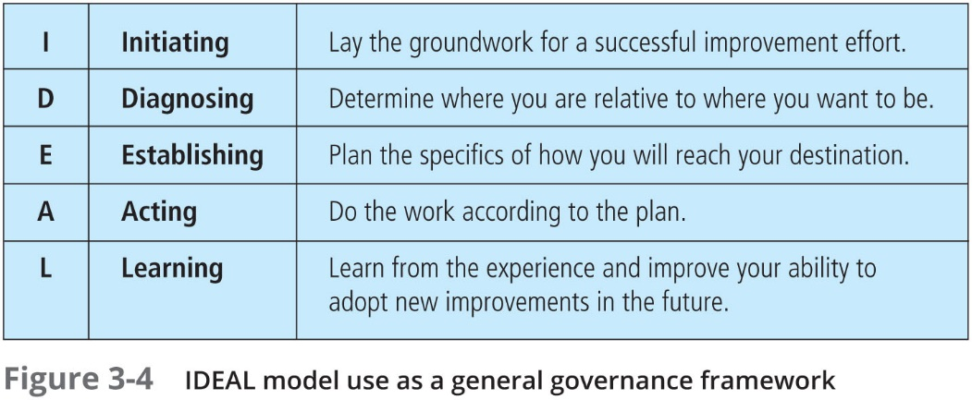

Slide 35
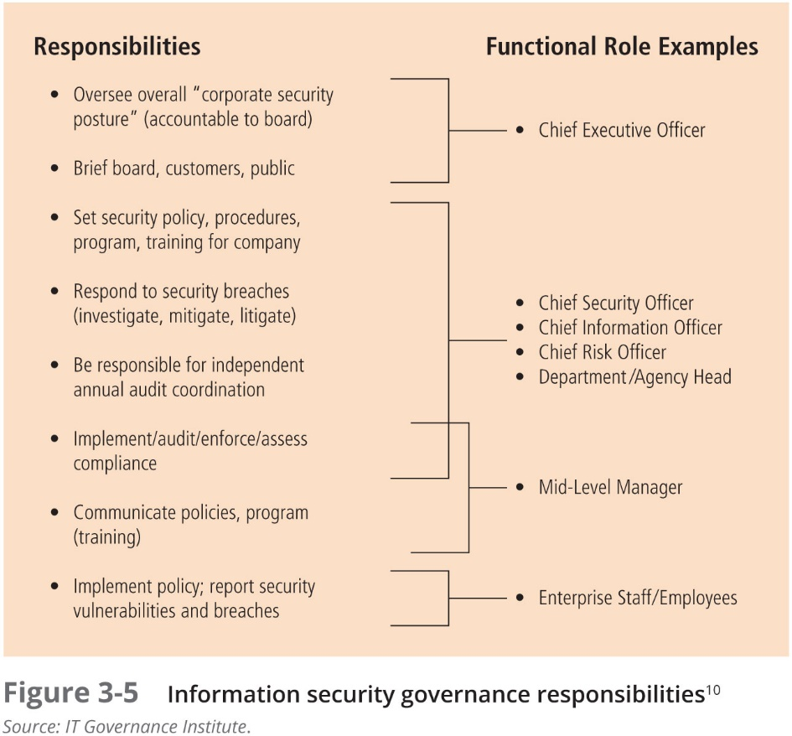

Slide 36
CERT Governing for Enterprise Security Implementation
In 2007, the CERT Division of Carnegie Mellon University’s Software Engineering Institute (CMU/SEI) published and promoted an implementation guide for its trademarked Governing for Enterprise Security (GES) program, no longer formally supported but still useful
The GES includes three supporting Articles:
Article 1: Characteristics of Effective Security Governance
Article 2: Defining an Effective Enterprise Security Program
Article 3: Enterprise Security Governance Activities

Slide 37
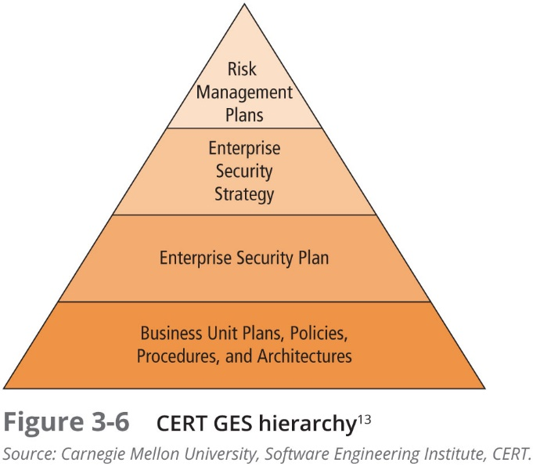

Slide 38
ISO/IEC 27014: Governance of Information Security
ISO 27014:2013 is the ISO 27000 series standard for Governance of Information Security
The standard specifies six high-level “action-oriented” information security governance principles:
Establish organization-wide information security
Adopt a risk-based approach
Set the direction of investment decisions
Ensure conformance with internal and external requirements
Foster a security-positive environment
Review performance in relation to business outcomes

Slide 39
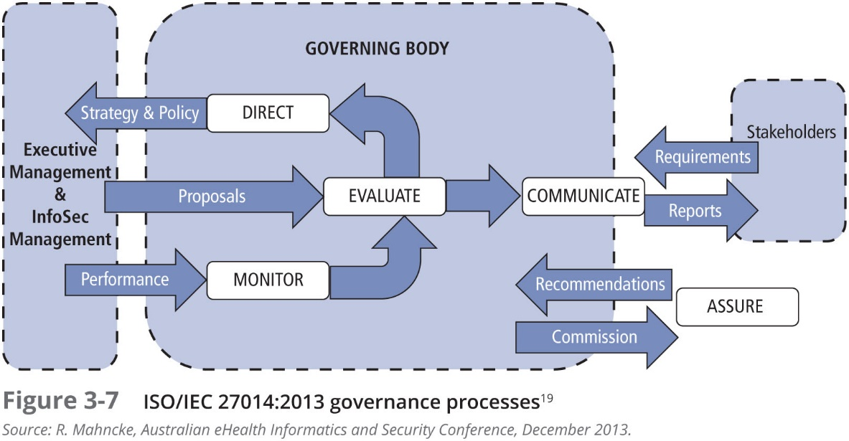

Slide 40
Security Convergence
The convergence of security-related governance in organizations has been observed since the broad deployment of information systems began in the 1970s and 1980s
Industry media have discussed the issues surrounding this merging of management accountability in the areas of corporate (physical) security, corporate risk management, computer security, network security, and InfoSec as such trends waxed and waned over the years

Slide 41
Security Convergence (Continued)
A Deloitte report on convergence commissioned by the Alliance for Enterprise Security Risk Management identified the key approaches organizations are using to achieve unified enterprise risk management (ERM):
Combining physical security and InfoSec under one leader as one business function
Using separate business functions (each with a separate budget and autonomy) that report to a common senior executive
Using a risk council approach to provide a collaborative method for risk management, to set policy about assuming risk to the organization

Slide 42
Benefits of Security Convergence
Significantly lower costs
Use existing servers to make the decisions
Use existing IT infrastructure to keep the system running
Use existing IT redundancy and backup to protect in case of failures
Let the IT department protect valuable data and keep out cyber-intruders
Merge physical access and logical access into a single system
Let security worry about the “who, when, and where”; let IT handle moving the data
Take away remote databases not managed by IT, and reduce the ability of hackers to penetrate the access system and use it as a gateway to the rest of the IT system
Save significant hardware money to spend on other security measures

Slide 43
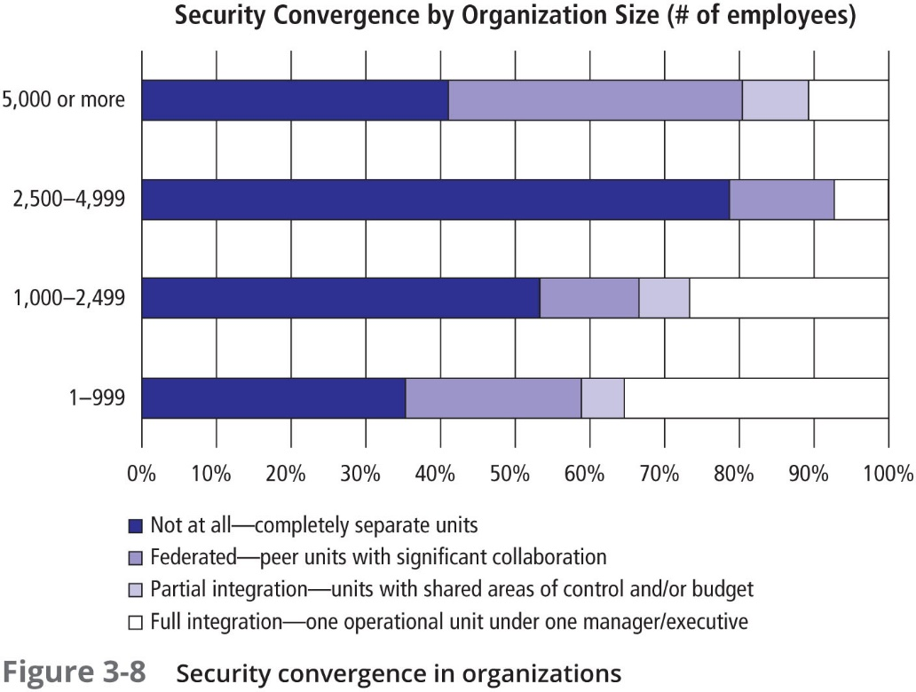

Slide 44
Planning for Information Security Implementation
Chapter 03: Governance and Strategic Planning for Security

Slide 45
Planning for Information Security Implementation
The CIO and CISO play important roles in translating overall strategic planning into tactical and operational information security plans
When the CISO reports directly to the CIO, the CIO charges the CISO and other IT department heads with creating and adopting plans that are consistent with and supportive of the IT strategy as it supports the organizational strategy
It falls upon the CISO to go beyond the plans and efforts of the IT group to ensure that the InfoSec plan directly supports the entire organization and the strategies of other business units, beyond the scope of the IT plan

Slide 46
CISO Job Description
Creates a strategic information security plan with a vision for the future of information security at Company X
Understands the fundamental business activities performed by Company X, and based on this understanding, suggests appropriate information security solutions that uniquely protect these activities
Develops action plans, schedules, budgets, status reports, and other top management communications intended to improve the status of information security at Company X

Slide 47
Planning for InfoSec
Once plan has been translated into IT and information security objectives and tactical and operational plans information security implementation can begin, and it is typically accomplished in one of two ways:
bottom-up—a grassroots effort in which systems and network administrators attempt to improve the security of their systems
top-down—a formal program, proposed and coordinated by high-level managers with executive management support to provide resources; give direction; issue policies, procedures, and processes; dictate the goals and expected outcomes of the project; and determine who is accountable for each of the required actions

Slide 48
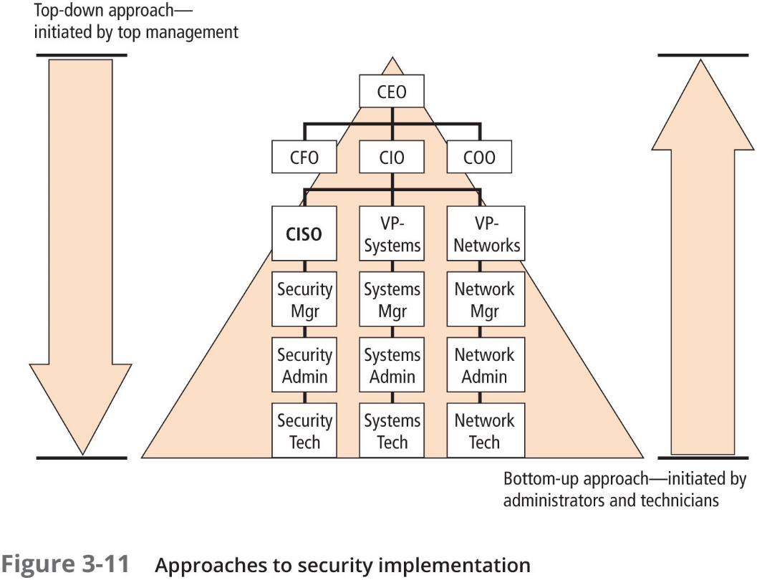

Slide 49
Implementing the Security Program Using the SDLC
An SDLC is a methodology for the design and implementation of an information system and is combined with sound project management practices to develop key project milestones, allocate resources, select personnel, and perform the tasks needed to accomplish a project’s objectives
The SDLC approach can be scaled up to support the design, implementation, and maintenance of an entire security program, which is then called the security systems development life cycle (SecSDLC)
Once a security program is implemented, it should be supported with a continuous improvement program (CIP)

Slide 50
Introduction to the Security Systems Development Life Cycle (SecSDLC)
While a number of SDLC models exist, the waterfall model is best suited to describe the SecSDLC
While the two may differ in several specifics, the overall methodologies are similar
The SecSDLC process involves the identification of specific threats and the risks that they represent as well as the subsequent design and implementation of specific controls to counter those threats and manage the risk

Slide 51
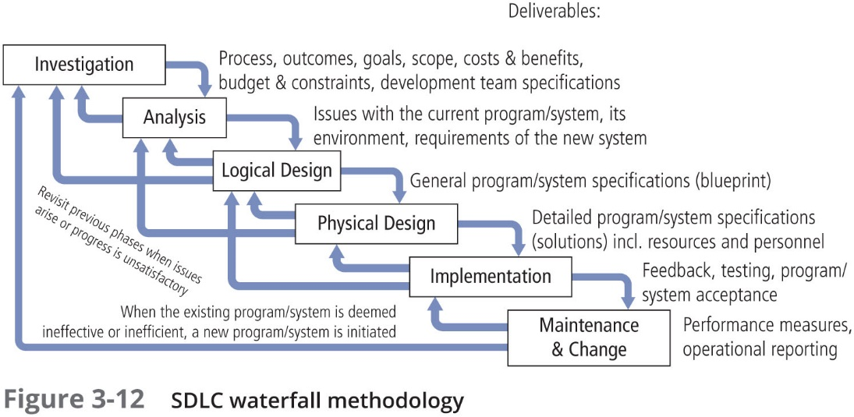

Slide 52
Investigation in the SecSDLC
Often begins as directive from management specifying the process, outcomes, and goals of the project and its budget
Frequently begins with the affirmation or creation of security policies
Teams assembled to analyze problems, define scope, specify goals, and identify constraints
A feasibility analysis determines whether the organization has the resources and commitment to conduct a successful security analysis and design

Slide 53
Analysis in the SecSDLC
A preliminary analysis of existing security policies or programs is prepared along with known threats and associated controls
Includes an analysis of relevant legal issues that could affect the design of the security solution
Risk management, the process of identifying, assessing, and evaluating the levels of risk an organization faces—specifically, the threats to the organization’s security and to the information stored and processed by the organization, also begins in this stage

Slide 54
Design in the SecSDLC
The design phase actually consists of two distinct phases:
In the logical design phase, team members create and develop a blueprint for security, and examine and implement key policies
In the physical design phase, team members evaluate the technology needed to support the security blueprint, generate alternative solutions, and agree upon a final design

Slide 55
Design in the SecSDLC (Continued)
The design phase continues with:
The formulation of the controls and safeguards used to protect information from attacks by threats
The creation of essential preparedness documents
Physical security, which requires the design, implementation, and maintenance of countermeasures to protect the physical resources of an organization

Slide 56
Implementation in the SecSDLC
The security solutions are acquired, tested, implemented, and retested
Personnel issues are evaluated and specific training and education programs conducted
Perhaps the most important element of the implementation phase is the management of the project plan:
Planning the project
Supervising the tasks and action steps within the project
Wrapping up the project

Slide 57
InfoSec Project Team
Should consist of individuals experienced in one or multiple technical and nontechnical areas including:
Champion
Team leader
Security policy developers
Risk assessment specialists
Security professionals
Systems administrators
End users

Slide 58
Staffing the InfoSec Function
Each organization should examine the options for staffing of the information security function:
The organization must decide how to position and name the security function
The InfoSec community of interest plan for the proper staffing of the information security function
The IT community of interest must understand the impact of information security across every role in IT
Finally, the general management community of interest must work with the InfoSec professionals to integrate solid information security concepts into the personnel management practices of the organization

Slide 59
InfoSec Professionals
It takes a wide range of professionals to support a diverse information security program:
Chief Information Officer (CIO)
Chief Security Officer (CSO)
Chief Information Security Officer (CISO)
Security Managers
Security Technicians
Data Owners
Data Custodians
Data Users

Slide 60
Maintenance in the SecSDLC
Today’s InfoSec systems need constant monitoring, testing, modifying, updating, and repairing
As new threats emerge and old threats evolve, the InfoSec profile of an organization requires constant adaptation to prevent threats from successfully penetrating sensitive data
Once the information security program is implemented, it must be operated, properly managed, and kept up to date by means of established procedures
Whereas a systems management model is designed to manage and operate systems, a maintenance model is intended to complement a systems management model and focus those ongoing maintenance efforts that are needed to keep systems useable and secure

Slide 61
Summary
Planning is central to the management of any organization and is based on the preparation, application, and control of a sequence of action steps to achieve specific goals
To develop and implement effective planning, documents representing the philosophical, ethical, and entrepreneurial perspectives of the company are first created—namely, the values, vision, mission, and strategy of the organization. Strategic planning lays out the long-term direction to be taken by the organization and guides organizational efforts
Information security, like information technology, must support more than its immediate parent in the organizational chart
As all organizational units will be using information, and not just IT-based information, the information security group must understand and support the strategic plans (a.k.a strategies) of all business units

Slide 62
Summary (Continued)
This role may at times conflict with that of the IT department, as IT’s role is the efficient and effective delivery of information and information resources, while InfoSec’s role is the protection of all information assets
Security can begin either as a grassroots effort (a bottom-up approach) or with plans formulated by senior management (a top-down approach). InfoSec governance is the process of creating and maintaining the organizational structures that manage the InfoSec function within an enterprise. It has five key objectives: strategic alignment of InfoSec and business objectives; use of risk management practices to guide InfoSec decision making; implementation of rational resource management practices for InfoSec programs; measurement of performance of InfoSec functions; and delivering value to the organization

Slide 63
Summary (Continued)
The systems development life cycle (SDLC) is a methodology for the design and implementation of an information system in an organization. The process of phased system development described by the traditional SDLC can be adapted to support the specialized implementation of a security project by using the security systems development life cycle (SecSDLC)
The investigation phase of the SecSDLC begins with a directive from upper management dictating the process, outcomes, and goals of the project, as well as its budget and other constraints. In the analysis phase, the team examines existing security policies or programs, along with documented current threats and associated controls

Slide 64
Summary (Continued)
The design phase of the SecSDLC includes two distinct phases, the logical design phase, where blueprints for security are created, and key policies that influence later decisions are examined and implemented, and the physical design phase, where the security technology needed to support these blueprints is evaluated, alternative solutions are generated, and a final design is determined
The maintenance and change phase of the SecSDLC, though last, is perhaps most important, given the flexibility and persistence of many of the threats facing the modern organization

