Slide 1
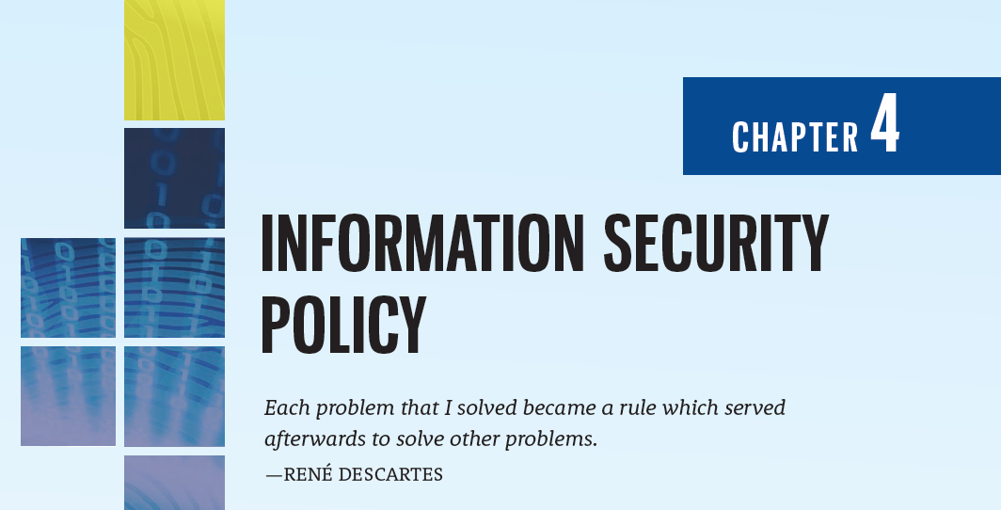

Slide 2
Learning Objectives
Upon completion of this material, you should be able to:
Define information security policy and discuss its central role in a successful information security program
List and describe the three major types of information security policy and discuss the major components of each
Explain what is necessary to implement effective policy and what consequences the organization may face if it does not
Discuss the process of developing, implementing, and maintaining various types of information security policies

Slide 3
Why Policy?
Chapter 04: Information Security Policy

Slide 4
Introduction
Policy is the essential foundation of an effective information security program:
The success of an information resources protection program depends on the policy generated, and on the attitude of management toward securing information on automated systems
You, the policy maker, set the tone and the emphasis on how important a role information security will have within your agency
Your primary responsibility is to set the information resource security policy for the organization with the objectives of reduced risk, compliance with laws and regulations and assurance of operational continuity, information integrity, and confidentiality
(NIST, 1989)

Slide 5
Why Policy?
A quality information security program begins and ends with policy
In general, a policy is simply a manager’s or other governing body’s statement of intent; as such, a policy (document) actually contains multiple policies (statements)
Some basic rules must be followed when shaping a policy:
Policy should never conflict with law
Policy must be able to stand up in court if challenged
Policy must be properly supported and administered

Slide 6
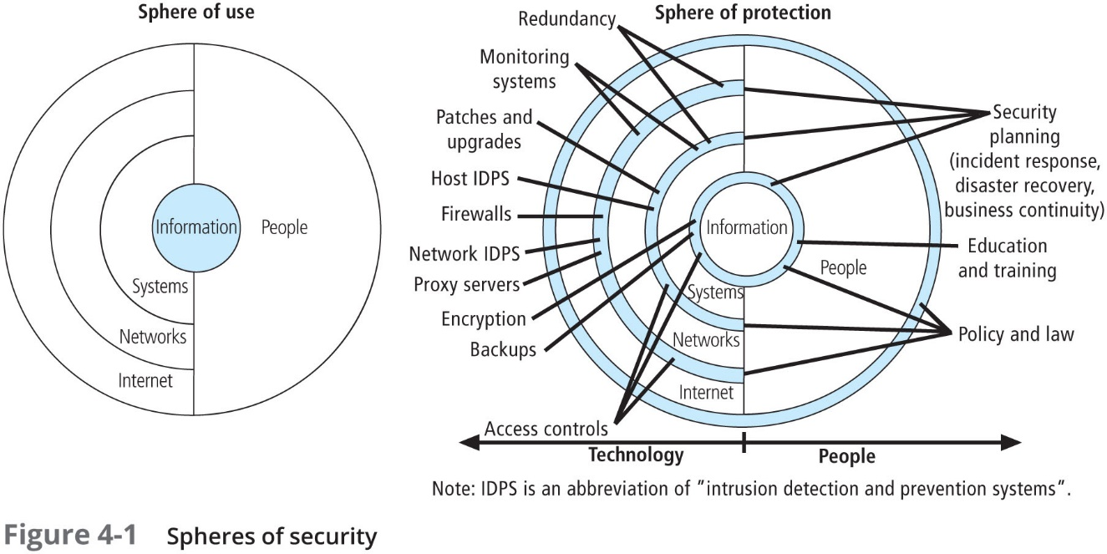

Slide 7
Why Policy? (Continued)
According to Bergeron and Bérubé, the following guidelines can help in the formulation of IT policy as well as InfoSec policy:
All policies must contribute to the success of the organization
Management must ensure the adequate sharing of responsibility for proper use of information systems
End users of information systems should be involved in the steps of policy formulation

Slide 8
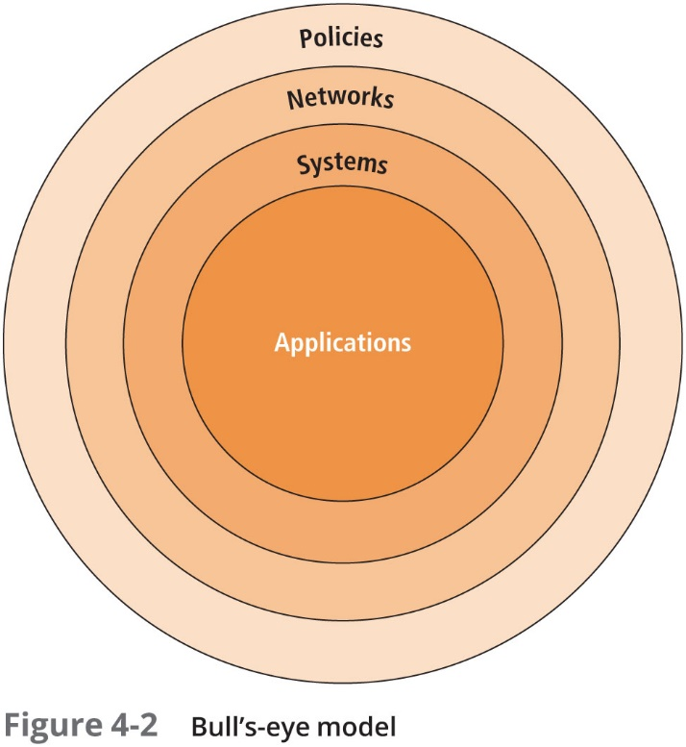

Slide 9
Policy-Centric Decision Making
Bull’s-eye model layers:
Policies—first layer of defense
Networks—threats first meet the organization’s network
Systems—computers and manufacturing systems
Applications—all applications systems
Policies are important reference documents for internal audits and for the resolution of legal disputes about management's due diligence [and] policy documents can act as a clear statement of management's intent (Wood, 2012)

Slide 10
Policy, Standards, and Practices
Policy is a set of “organizational guidelines that dictate certain behavior within the organization”
A standard is “a detailed statement of what must be done to comply with policy, sometimes viewed as the rules governing policy compliance”
Guidelines are “nonmandatory recommendations the employee may use as a reference in complying with a policy”
Procedures are “step-by-step instructions designed to assist employees in following policies, standards, and guidelines”
Practices are “examples of actions that illustrate compliance with policies”
Policies define what you can do and not do, whereas the other documents focus on the how

Slide 11
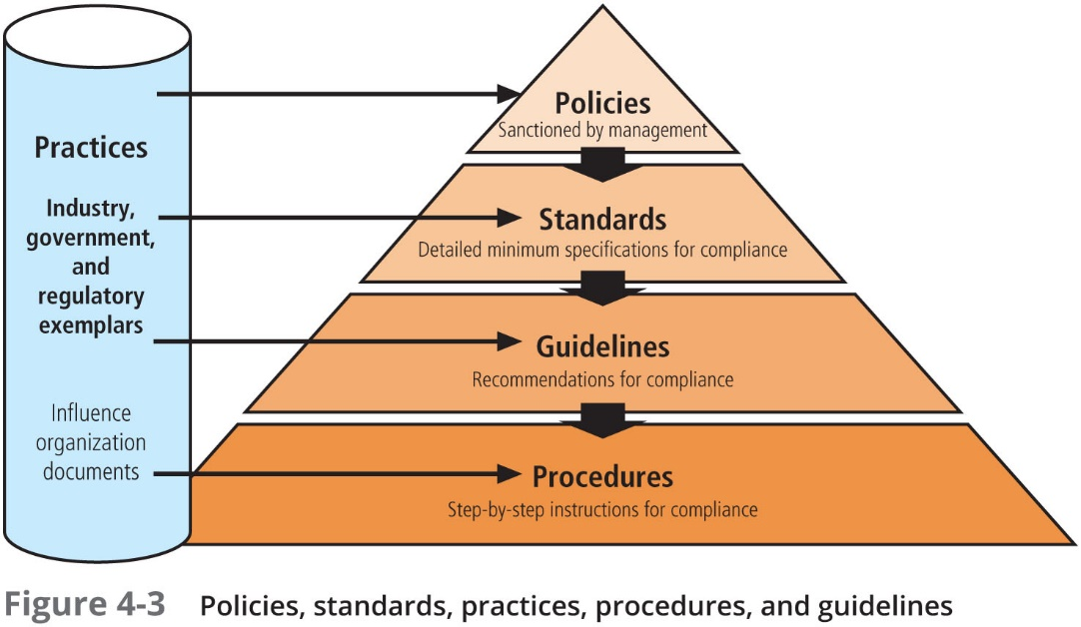

Slide 12
Policy, Standards, and Practices (Continued)
Policies require constant modification and maintenance
In order to produce a complete information security policy, management must define three types of information security policy:
Enterprise information security program policy
Issue-specific information security policies
Systems-specific policies

Slide 13
Enterprise Information Security Policy
Chapter 04: Information Security Policy

Slide 14
Enterprise Information Security Policy (EISP)
Enterprise information security policy (EISP) is high-level information security policy that sets the strategic direction, scope, and tone for all of an organization’s security efforts
An EISP is also known as a security program policy, general security policy, IT security policy, high-level InfoSec policy, or simply an InfoSec policy

Slide 15
EISP Elements
An EISP assigns responsibilities for the various areas of InfoSec, including maintenance of InfoSec policies and the practices and responsibilities of end users
In particular, the EISP guides the development, implementation, and management requirements of the InfoSec program, which must be met by InfoSec management and other specific security functions

Slide 16
Integrating an Organization’s Mission and Objectives into the EISP
The EISP plays a number of vital roles, not the least of which is to state the importance of InfoSec to the organization’s mission and objectives
The EISP should not contradict the organizational mission statement
However, it would be prudent for an institution to have policies that govern such access and ensure that such access does not interfere or create a hostile work environment for other employees

Slide 17
EISP Elements
An overview of the corporate philosophy on security
Information on the structure of the InfoSec organization and individuals who fulfill the InfoSec role
Fully articulated responsibilities for security that are shared by all members of the organization (employees, contractors, consultants, partners, and visitors)
Fully articulated responsibilities for security that are unique to each role within the organization

Slide 18
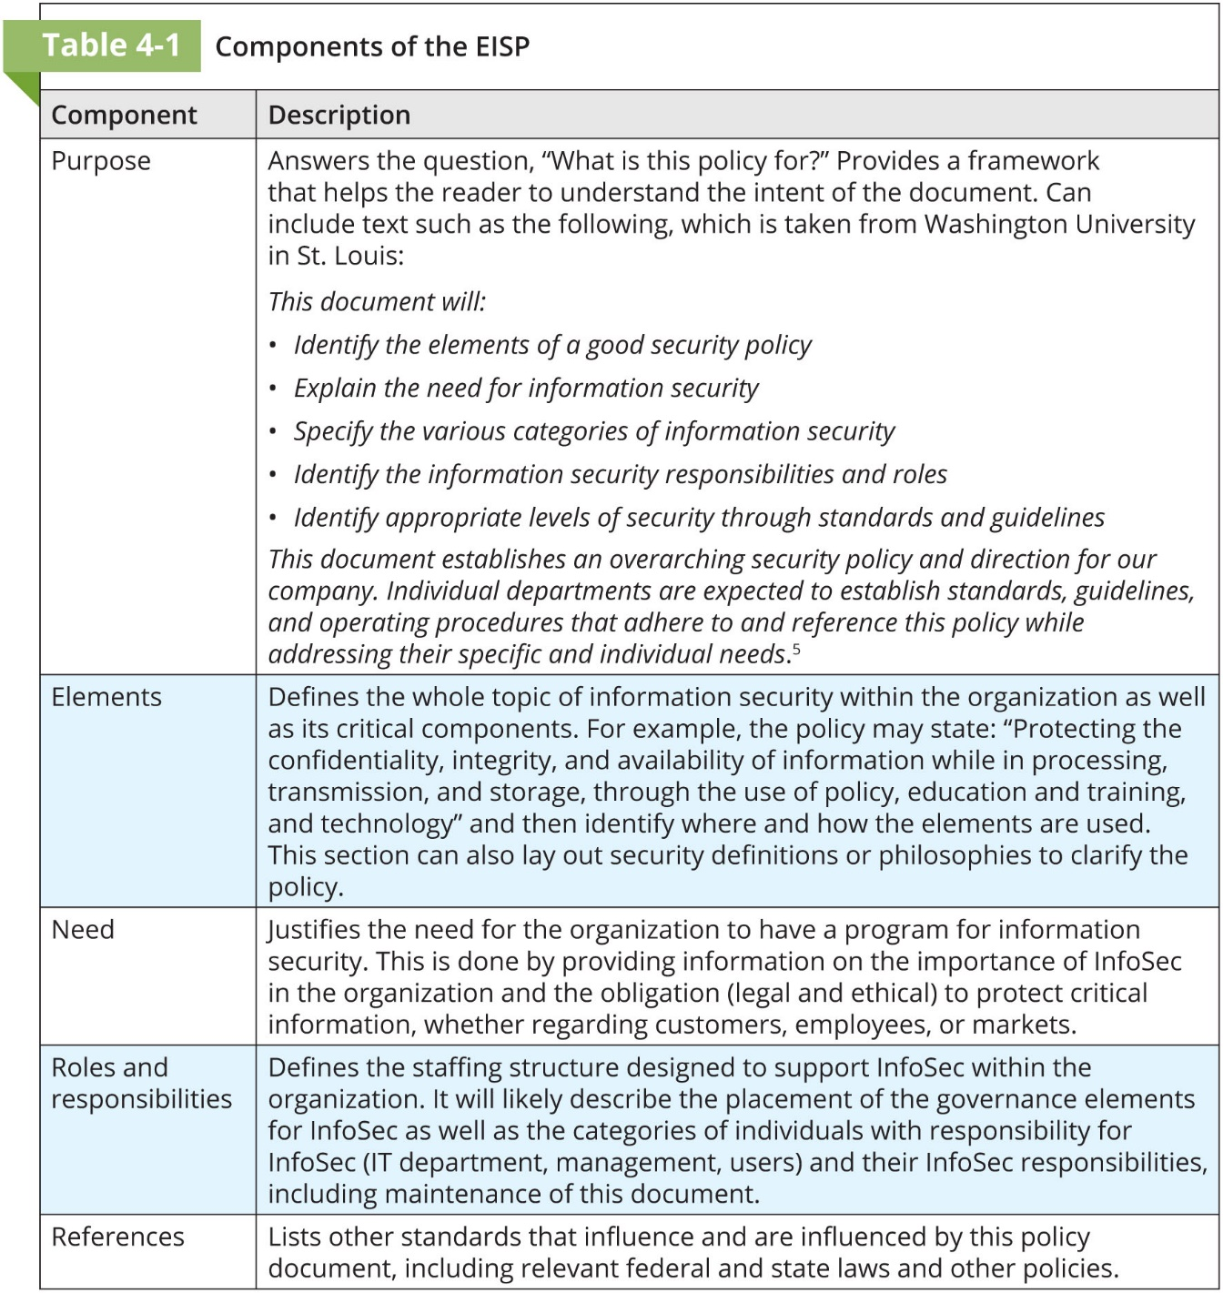

Slide 19
Issue-Specific Security Policy
Chapter 04: Information Security Policy

Slide 20
Issue-Specific Security Policy (ISSP)
An issue-specific security policy (ISSP) is “an organizational policy that provides detailed, targeted guidance to instruct all members of the organization in the use of a resource, such as one of its processes or technologies”
In some organizations, ISSPs are referred to as fair and responsible use policies, describing the intent of the policy to regulate appropriate use
The ISSP should assure members of the organization that its purpose is not to establish a foundation for administrative enforcement or legal prosecution but rather to provide a common understanding of the purposes for which an employee can and cannot use the resource

Slide 21
Issue-Specific Security Policy (ISSP) (Continued)
An effective ISSP accomplishes the following:
It articulates the organization’s expectations about how its technology-based system should be used
It documents how the technology-based system is controlled and identifies the processes and authorities that provide this control
It indemnifies the organization against liability for an employee’s inappropriate or illegal use of the system
Every organization’s ISSPs should:
Address specific technology-based systems
Require frequent updates
Contain a statement on the organization’s position on an issue

Slide 22
Issue-Specific Security Policy (ISSP) (Continued)
ISSP topics:
Use of electronic mail, IM, and other communications apps
Use of the Internet, the Web, and company networks by company equipment
Malware protection requirements
Use of nonorganizationally issued software or hardware on organization assets
Use of organizational information on nonorganizationally owned computers
Prohibitions against hacking or testing security controls or attempting to modify or escalate privileges
Personal and/or home use of company equipment
Removal of organizational equipment from organizational property
Use of personal equipment on company networks (BYOD)
Use of personal technology during work hours
Use of photocopying and scanning equipment
Requirements for storage and access to company information while outside company facilities
Specifications for the methods, scheduling, conduct, and testing of data backups
Requirements for the collection, use, and destruction of information assets
Storage of access control credentials by users

Slide 23
Elements of the ISSP
Statement of Purpose
Scope and Applicability
Definition of Technology Addressed
Responsibilities
Authorized Access and Usage of Equipment
User Access
Fair and Responsible Use
Protection of Privacy
Prohibited Usage of Equipment
Disruptive Use or Misuse
Criminal Use
Offensive or Harassing Materials
Copyrighted, Licensed, or Other Intellectual Property
Other Restrictions

Slide 24
Elements of the ISSP (Continued)
Systems Management
Management of Stored Materials
Employer Monitoring
Virus Protection
Physical Security
Encryption
Violations of Policy
Procedures for Reporting Violations
Penalties for Violations
Policy Review and Modification
Scheduled Review of Policy and Procedures for Modification
Limitations of Liability
Statements of Liability or Disclaimers

Slide 25
Implementing the ISSP
Common approaches:
A number of independent ISSP documents, each tailored to a specific issue
A single comprehensive ISSP document that covers all issues
A modular ISSP document that unifies policy creation and administration while maintaining each specific issue’s requirements
The recommended approach is the modular policy, which provides a balance between issue orientation and policy management

Slide 26
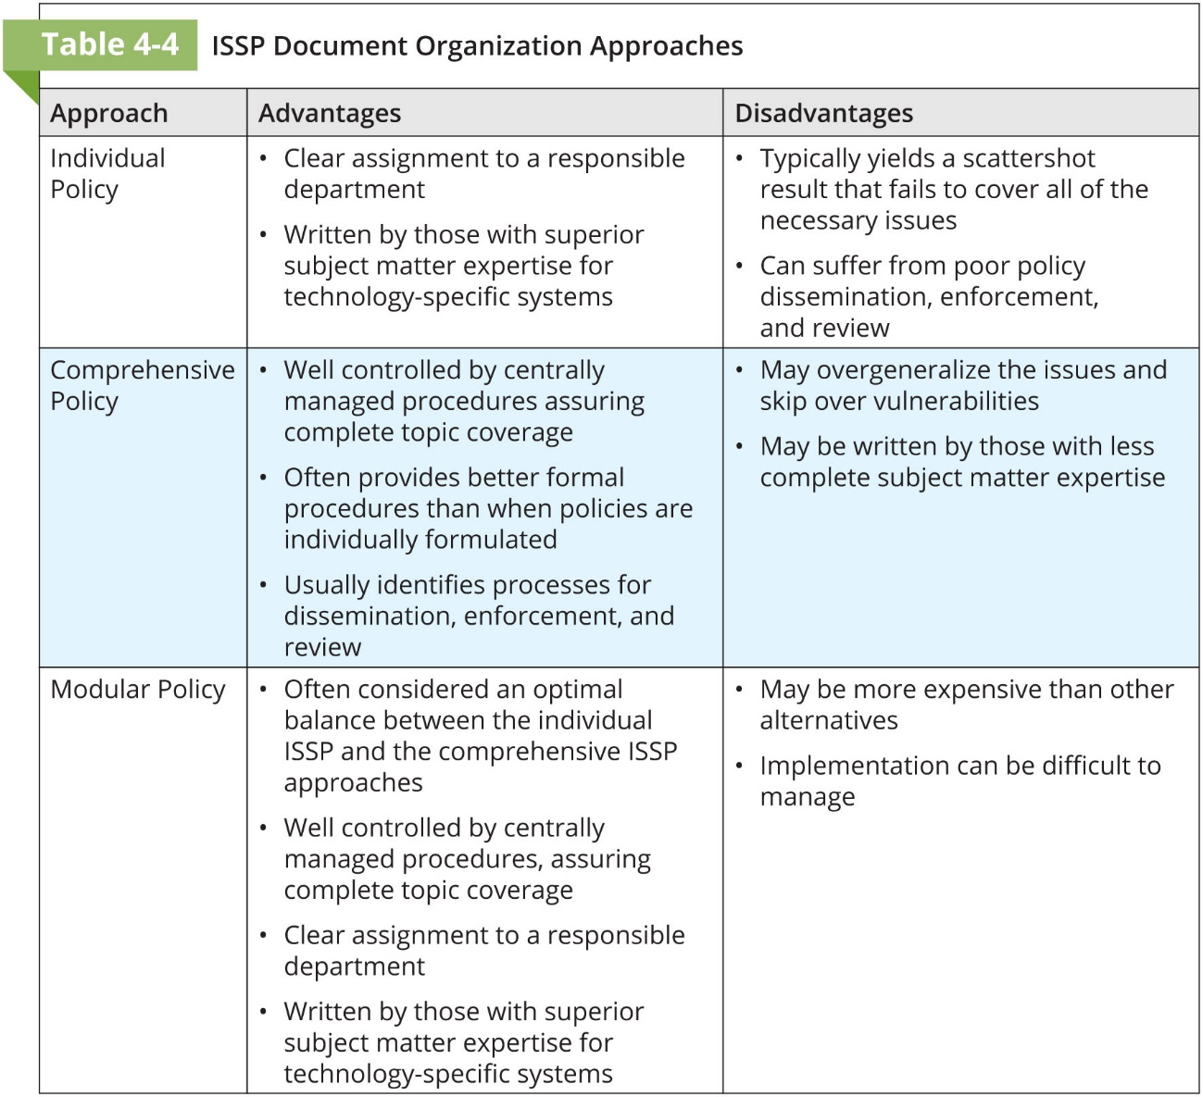

Slide 27
System-Specific Security Policy
Chapter 04: Information Security Policy

Slide 28
System-Specific Security Policy
System-Specific Security Policies (SysSPs) are “organizational policies that often function as standards or procedures to be used when configuring or maintaining systems”
SysSPs can be:
separated into managerial guidance and technical specifications; or
combined in a single unified SysSP document

Slide 29
Managerial Guidance SysSPs
Created by the management to guide the implementation and configuration of technology, as well as to address the behavior of people in the organization in ways that support the security of information
Applies to any technology that affects the confidentiality, integrity, or availability of information
Informs technologists of management intent

Slide 30
Technical Specifications SysSPs
System administrators’ directions and actions on implementing managerial policy
While the manager is primarily responsible for the creation of the managerial specifications, the sysadmins may be the primary authors or architects of the technical specifications version
There are two general methods of implementing such technical controls:
Access control lists
Configuration rules

Slide 31
Access Control Lists
Include the user access lists, matrices, and capability tables that govern the rights and privileges
A capability table specifies which subjects and objects that users or groups can access
These specifications are frequently complex matrices, rather than simple lists or tables
In general, ACLs enable administrations to restrict access according to user, computer, time, duration, or even a particular file

Slide 32
Access Control Lists (Continued)
In general ACLs regulate:
Who can use the system
What authorized users can access
When authorized users can access the system
Where authorized users can access the system from
How authorized users can access the system
Common user privileges (also known as permissions) include:
Read
Write
Execute
Delete

Slide 33
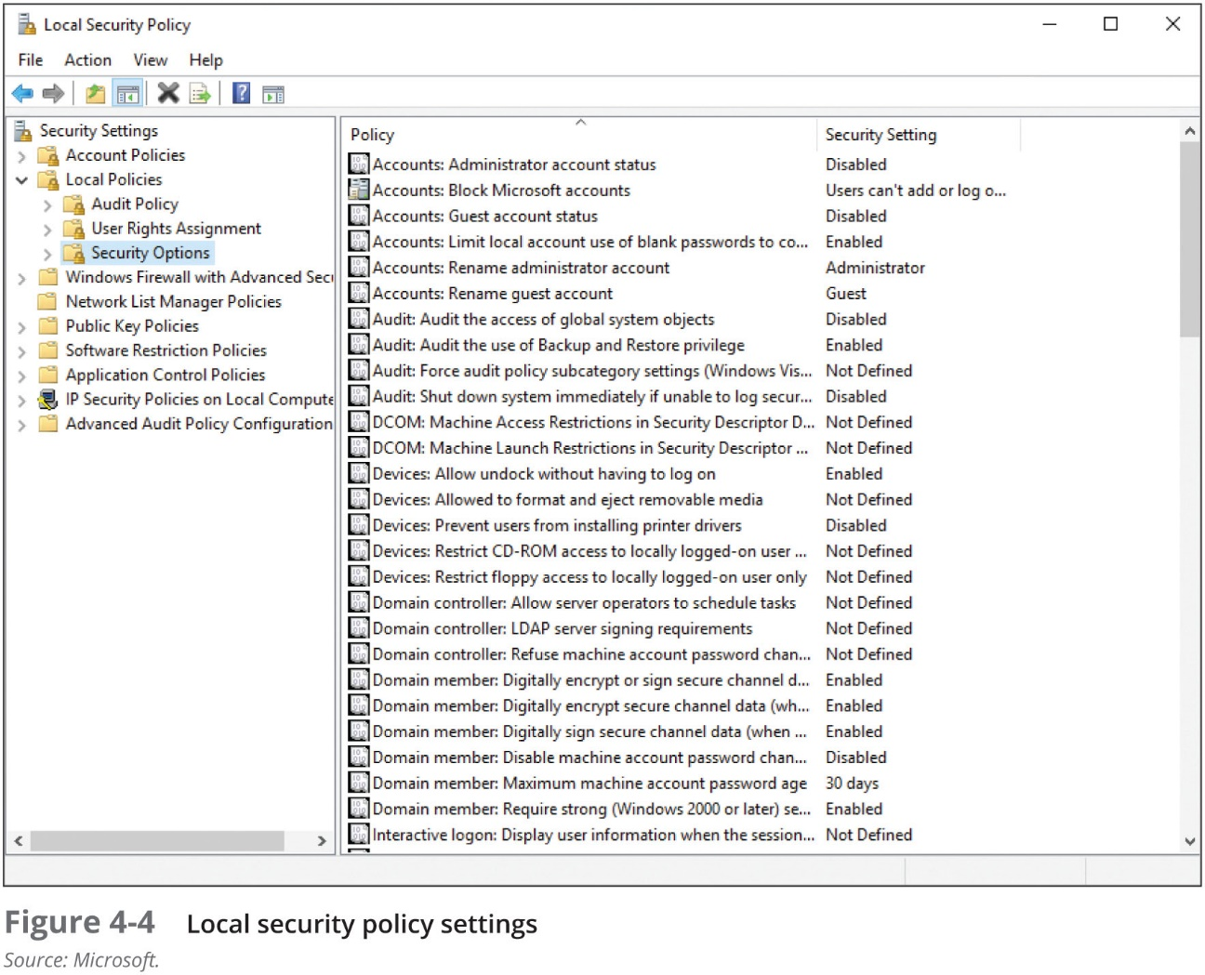

Slide 34
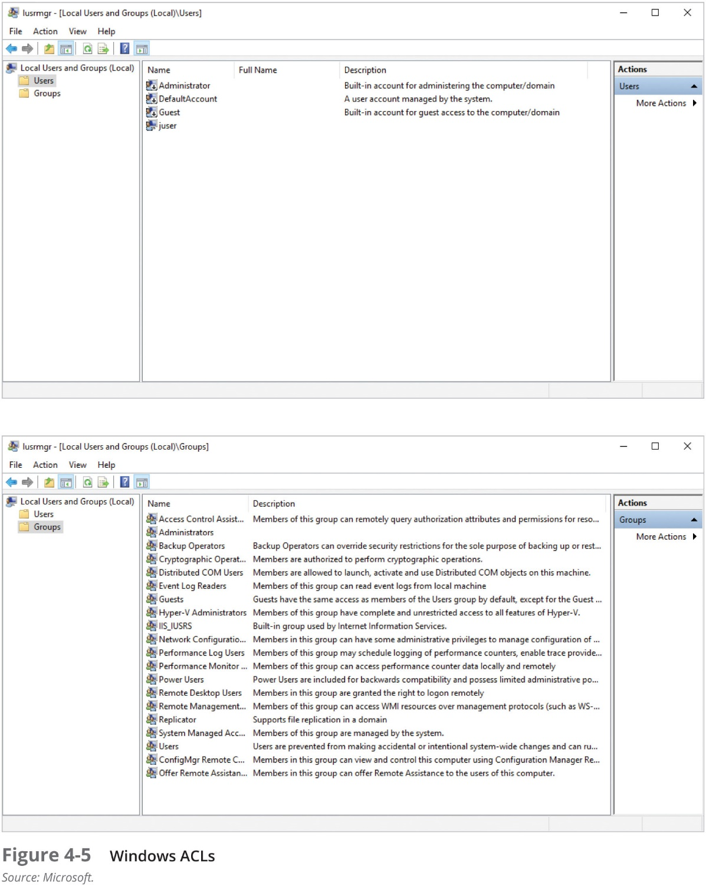

Slide 35
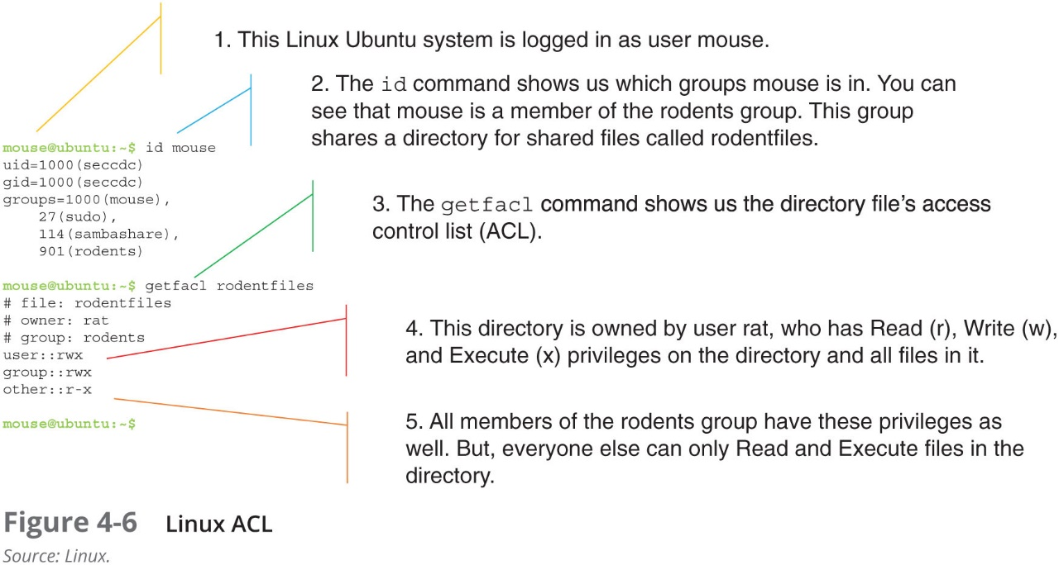

Slide 36
Configuration Rules
Configuration rules are instructional codes that guide the execution of the system when information is passing through it
Rule policies are more specific to the operation of a system than ACLs, and may or may not deal with users directly
Many security systems require specific configuration scripts telling the systems what actions to perform on each set of information they process

Slide 37
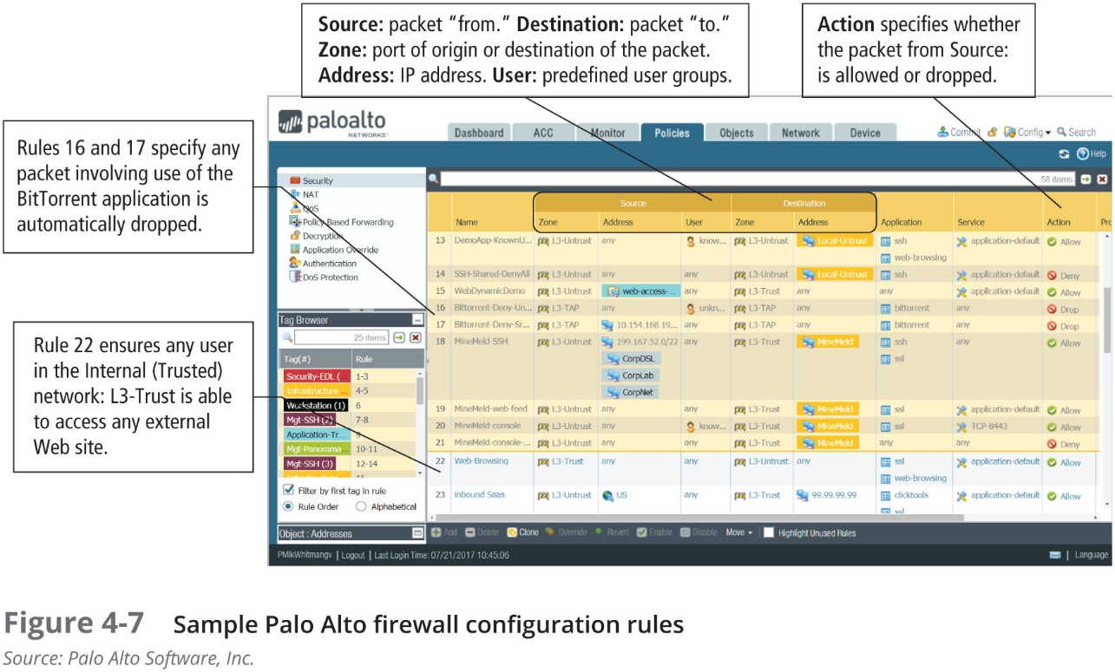

Slide 38
Combination SysSPs
Many organizations create a single document combining elements of both management guidance and technical specifications SysSPs
While this document can be somewhat confusing to the users of the policies, it is very practical to have the guidance from both perspectives in a single place
Such a document should carefully articulate the required actions for each procedure described

Slide 39
Guidelines for Effective Policy Development and Implementation
Chapter 04: Information Security Policy

Slide 40
Guidelines for Effective Policy
For policies to be effective, and legally defensible, they must be properly:
Developed using industry-accepted practices, and formally approved by management
Distributed using all appropriate methods
Read by all employees
Understood by all employees
Formally agreed to by act or affirmation
Uniformly applied and enforced

Slide 41
Developing Information Security Policy
It is often useful to view policy development as a three-part project
The policy is designed and written (or redesigned and rewritten)
A senior manager or executive at the appropriate level and the organization’s legal counsel review and formally approves the document
Management processes are established to perpetuate the policy within the organization
The first part is an exercise in project management, while the latter two require adherence to good business practices

Slide 42
Policy Distribution
Can be accomplished by hard copy distribution and/or electronic distribution
Unless the organization can prove that the policy actually reached the end users, it cannot be enforced
Distribution of classified policies requires additional levels of controls, in the labeling of the document, in the dissemination of new policy, and in the collection and destruction of older versions to assure the confidentiality of the information contained within the policy documents themselves

Slide 43
Policy Reading
Barriers to employees’ reading policies can arise from literacy or language issues
Literacy-challenged and visually impaired employees require additional assistance, either through audio or large-type versions of the document
Multinational organizations also must deal with the challenges of gauging reading levels and language translations for foreign citizens

Slide 44
Policy Comprehension
To be certain that employees understand the policy, the document must be written at a reasonable reading level, with minimal technical jargon and management terminology
The next step is to use some form of assessment to gauge how well employees understand the policy’s underlying issues
Quizzes and other forms of examination can be employed to assess quantitatively which employees understand the policy by earning a minimum score, and which employees require additional training and awareness efforts before the policy can be enforced

Slide 45
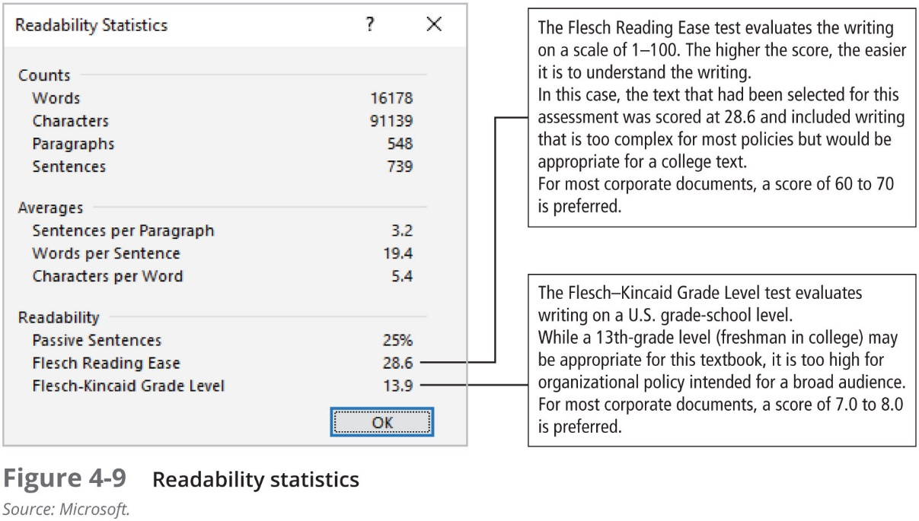

Slide 46
Policy Compliance
Policies must be agreed to by act or affirmation
Agreement by act occurs when the employee performs an action, which requires them to acknowledge understanding of the policy, prior to use of a technology or organizational resource (Whitman, 2008)
What if an employee refuses explicitly to agree to comply with policy?
It seems clear that failure to agree to a policy is tantamount to refusing to work and thus may be grounds for termination

Slide 47
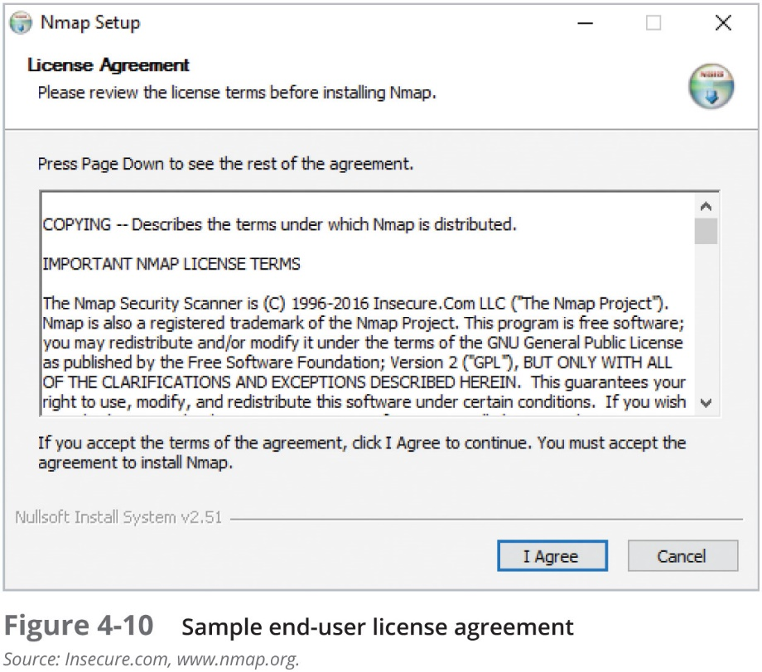

Slide 48
Policy Enforcement
The final component of the design and implementation of effective policies is uniform and impartial enforcement
As in law enforcement, policy enforcement must be able to withstand external scrutiny
If an employee is punished, censured, or dismissed as a result of a refusal to follow policy and is subsequently able to demonstrate that the policies are not uniformly applied or enforced, the organization may find itself facing punitive as well as compensatory damages

Slide 49
Policy Development and Implementation Using the SDLC
Like any major project, a policy development or redevelopment project should be well planned, properly funded, and aggressively managed to ensure that it is completed on time and within budget
One way to accomplish this goal is to use a systems development life cycle (SDLC)

Slide 50
Investigation Phase
The policy development team should attain:
Support from senior management
Support and active involvement of IT management, specifically the CIO
Clear articulation of goals
Participation of the correct individuals from the communities of interest affected by the policies
Be composed from legal, human resources and end-user representatives
Assign a project champion with sufficient stature and prestige
Acquire a capable project manager
A detailed outline of the scope of the policy development project and sound estimates for the cost and scheduling of the project

Slide 51
Analysis Phase
The analysis phase should include the following activities:
A new or recent risk assessment or IT audit documenting the current InfoSec needs of the organization
The gathering of key reference materials—including any existing policies

Slide 52
Design Phase
The first task in the design phase is the drafting of the actual policy document—while this can be done by a committee, it is most commonly done by a single author
There are a number of references and resources available on the Web, through professional literature and from peers and consultants
Next, the development team or committee reviews the work of the primary author and makes recommendations about its revision
Once the committee approves the document, it goes to the approving manager or executive for sign-off

Slide 53
Implementation Phase
In the implementation phase, the team must create a plan to distribute and verify the distribution of the policies
Members of the organization must explicitly acknowledge that they have received and read the policy (compliance)
The simplest way to document acknowledgment of a written policy is to attach a cover sheet that states “I have received, read, understood, and agreed to this policy”
The employee’s signature and date provide a paper trail of his or her receipt of the policy

Slide 54
Maintenance Phase
During the maintenance phase, the policy development team monitors, maintains, and modifies the policy as needed to ensure that it remains effective as a tool to meet changing threats
The policy should have a built-in mechanism via which users can report problems with the policy, preferably anonymously
Periodic review should be built in to the process

Slide 55
Software Support for Policy Administration
The need for effective policy management has led to the emergence of a class of software tools that supports policy development, implementation, and maintenance
Once developed, the policies can be approved by management and then published for users to review
All material is electronic, meaning there is no need for hard-copy documents, because the site is hosted on the Web and not a company’s intranet
In the event of an incident or disaster that disables internal computing infrastructure, critical policies can still be accessed as the organization works to recover

Slide 56
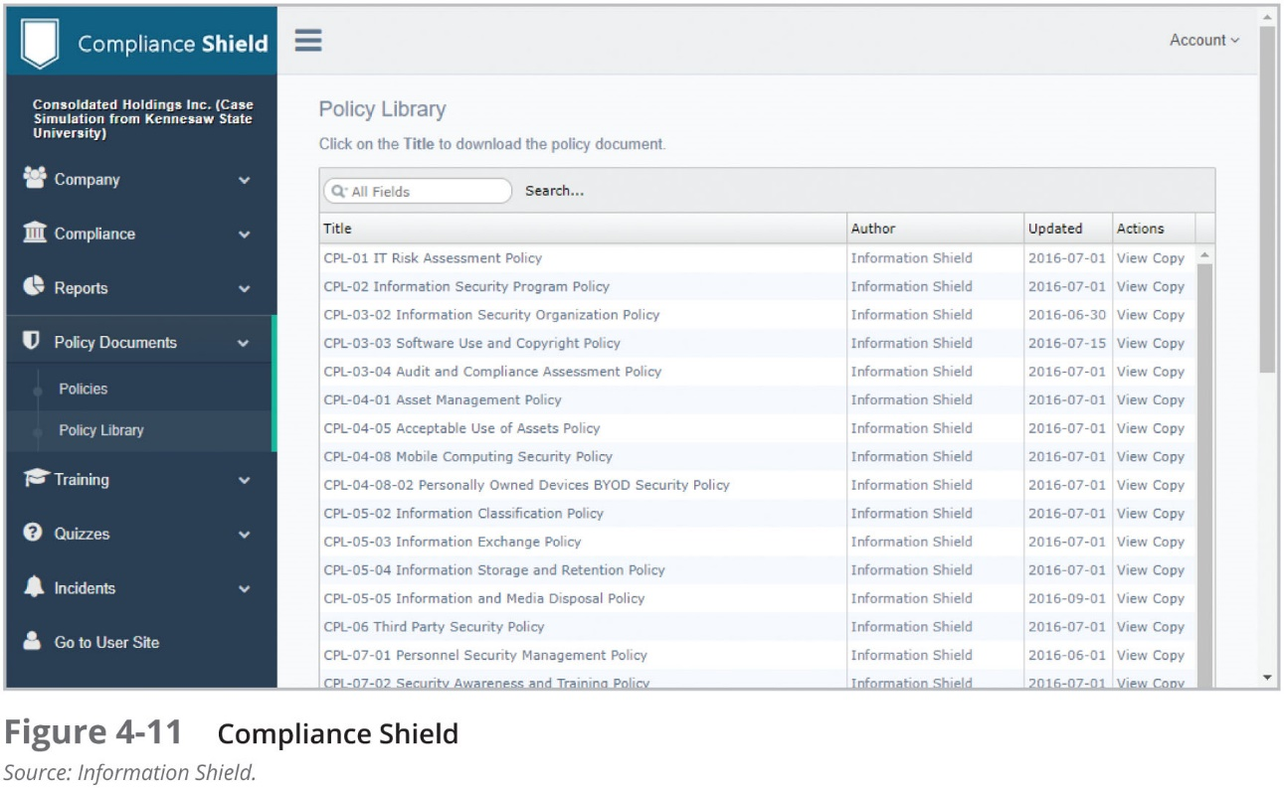

Slide 57
Other Approaches to InfoSec Policy Development
There are a number of other approaches to developing information security policy
Information Security Policies Made Easy approach
SP 800-18, Rev.1: Guide for Developing Security Plans for Federal Information Systems

Slide 58
Policy Administrator
Just as information systems and InfoSec projects must have a champion and a manager, so must policies
The policy champion position combined with the manager position is called the policy administrator
Typically, this person is a mid-level staff member who is responsible for the creation, revision, distribution, and storage of the policy

Slide 59
Review Schedule
In a changing environment, policies can retain their effectiveness only if they are periodically reviewed for currency and accuracy, and modified to keep them updated
Any policy document should contain a properly organized schedule of reviews
Generally, a policy should be reviewed at least annually

Slide 60
Review Procedures and Practices
To facilitate policy reviews, the policy administrator should implement a mechanism by which individuals can easily make recommendations for revisions to the policies and other related documentation
Recommendation methods could include e-mail, office mail, or an anonymous drop box
Once the policy has come up for review, all comments should be examined and management-approved changes should be implemented

Slide 61
Policy and Revision Date
In some organizations, policies are drafted and published without a date, leaving users of the policy unaware of its age or status
This practice can create problems, including legal ones, if employees are complying with an out-of-date policy
Ideally, the policy document should include its date of origin, along with the dates, if any, of revisions
Some policies may need a “sunset clause,” particularly if they govern information use for a short-term association with second-party businesses or agencies

Slide 62
A Final Note on Policy
Chapter 04: Information Security Policy

Slide 63
A Final Note on Policy
As mentioned earlier, while policies can help organizations avoid litigation, their first and foremost function is to inform employees of what is and is not acceptable behavior in the organization
Policy development is meant to improve employee productivity and prevent potentially embarrassing situations
In reality, most employees inherently want to do what is right. If properly educated on what is acceptable and what is not, they will choose to follow the rules for acceptable behavior

Slide 64
A Final Note on Policy (Continued)
There are three general causes of unethical and illegal behavior, such as an employee failing to follow policy:
Ignorance
Accident
Intent
Whatever the cause of illegal, immoral, or unethical behavior, one thing is certain: information security personnel must do everything in their power to deter these acts and to use policy, education and training, and technology to protect information and systems

Slide 65
A Final Note on Policy (Continued)
Laws, policies, and their associated penalties only provide deterrence if three conditions are present:
Fear of penalty
Probability of being apprehended
Probability of penalty being applied
In reality, most employees inherently want to do what is right
Knowing what is prohibited, what the penalties are, and how penalties will be enforced is a preventive measure that should free employees to focus on the business at hand

Slide 66
Summary
A quality InfoSec program begins and ends with policy
Policy drives the performance of personnel in ways that enhance the InfoSec of an organization’s information assets
Developing proper guidelines for an InfoSec program is a management problem, not a technical one. The technical aspect of an InfoSec program is merely one part of the entire program and should be dealt with only after management has created relevant policies
Although InfoSec policies are the least expensive means of control, they are often the most difficult to implement. Policy controls cost only the time and effort that the management team spends to create, approve, and communicate them, and that employees spend to integrate the policies into their daily activities

Slide 67
Summary (Continued)
The InfoSec policy must satisfy several criteria:
Policy should never conflict with law
Policy must stand up in court, when it is challenged
Policy must be properly supported and administered
Guidelines for the formulation of InfoSec policy are as follows:
Policy generators must recognize that all policies contribute to the success of the organization
Management must ensure the adequate sharing of responsibility
End users should be involved in the policy development process

Slide 68
Summary (Continued)
A policy is a statement of the organization’s position that is intended to influence and determine decisions and actions and that is used to control the actions of people and the development of procedures
A policy may be viewed as a set of rules that dictates acceptable and unacceptable behavior within an organization
Policies must contain information on what is required and what is prohibited, on the penalties for violating policy, and on the appeals process

Slide 69
Summary (Continued)
Management must define three types of InfoSec policies:
Enterprise information security program policy, which sets the strategic direction, scope, and tone for all security efforts; the EISP and must be based on and support the organization’s vision and mission statements
Issue-specific information security policies, which provide guidance to all members of an organization regarding the use of IT
System-specific information security policies, which guide the management and technical specifications of particular technologies and systems
For a policy to be effective, it must be properly written, distributed, read, understood, agreed to, and uniformly applied to those for whom it is intended

