Slide 1
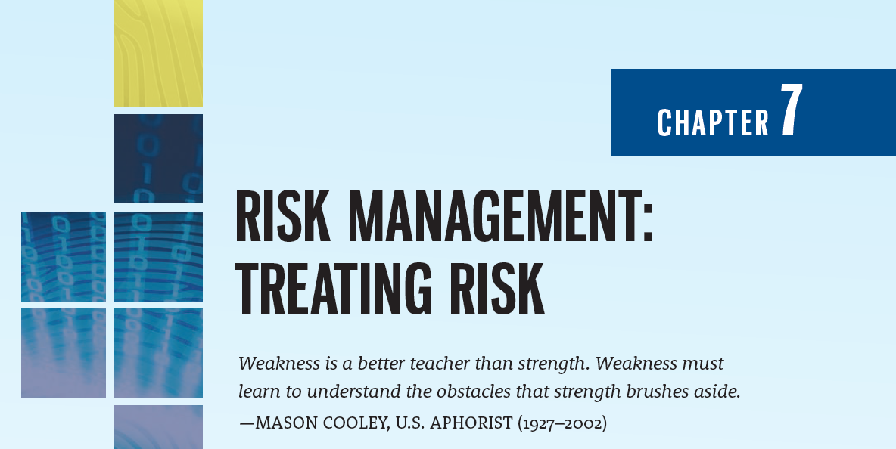

Slide 2
Learning Objectives
Upon completion of this chapter, you should be able to:
Discuss the strategy options used to treat risk and be prepared to select from them when given background information
Evaluate control alternatives under the defense risk treatment strategy and formulate a cost–benefit analysis (CBA) using existing conceptual frameworks
Explain how to maintain and perpetuate controls
Describe popular methodologies used in the industry to manage risk

Slide 3
Introduction to Risk Treatment
Chapter 07: Risk Management: Treating Risk

Slide 4
Introduction to Risk Treatment
To remain competitive, organizations must design and create a secure environment in which business processes and procedures can function and evolve effectively
This environment must maintain confidentiality and privacy and assure the integrity and availability of organizational data
These objectives are met via the application of the principles of risk management

Slide 5
Introduction to Risk Treatment (Continued)
After the risk management (RM) process team has identified, analyzed, and evaluated the level of risk currently inherent in its information assets (risk assessment), it then must treat the risk that is deemed unacceptable when it exceeds its risk appetite
Treating risk begins with an understanding of what risk treatment strategies are and how to formulate them

Slide 6
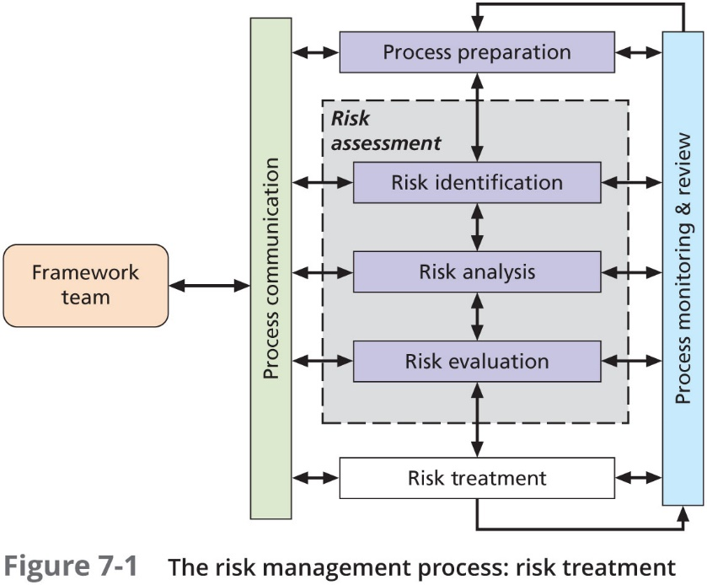

Slide 7
Risk Treatment Strategies
Once the project team for InfoSec development has identified the information assets with unacceptable levels of risk, the team must choose one of five basic strategies to treat the risks for those assets:
Defense
Transference
Mitigation
Acceptance
Termination

Slide 8
Defense
The defense risk treatment strategy attempts to prevent the exploitation of the vulnerability
This is the preferred approach and is accomplished by means of countering threats, removing vulnerabilities in assets, limiting access to assets, and adding protective safeguards
This approach is sometimes referred to as “avoidance”
Three common methods of risk defense:
Application of policy
Application of SETA programs
Implementation of technology

Slide 9
Transference
The transference risk treatment strategy attempts to shift risk to another entity
This goal may be accomplished by rethinking how services are offered, revising deployment models, outsourcing to other organizations, purchasing insurance, or implementing service contracts with providers
When an organization does not have adequate security management and administration experience, it should consider hiring individuals or firms that provide expertise in those areas (outsourcing)

Slide 10
Service Level Agreement
The key to an effective transference risk control strategy is the implementation of an effective service level agreement (SLA)
In some circumstances, an SLA is the only guarantee that an external organization will implement the level of security the client organization wants
The FDIC suggests that, to create a successful SLA, organizations use the following four steps:
Determining objectives
Defining requirements
Setting measurements
Establishing accountability

Slide 11
Mitigation
The mitigation risk treatment strategy is the treatment approach that focuses on planning and preparation to reduce the impact or potential consequences of an incident or disaster
This approach includes four types of plans:
Disaster recovery (DR) plan
Incident response (IR) plan
Business continuity (BC) plan
Crisis Management (CM) plan
Mitigation derives its value from its ability to detect and respond to an attack as quickly as possible

Slide 12
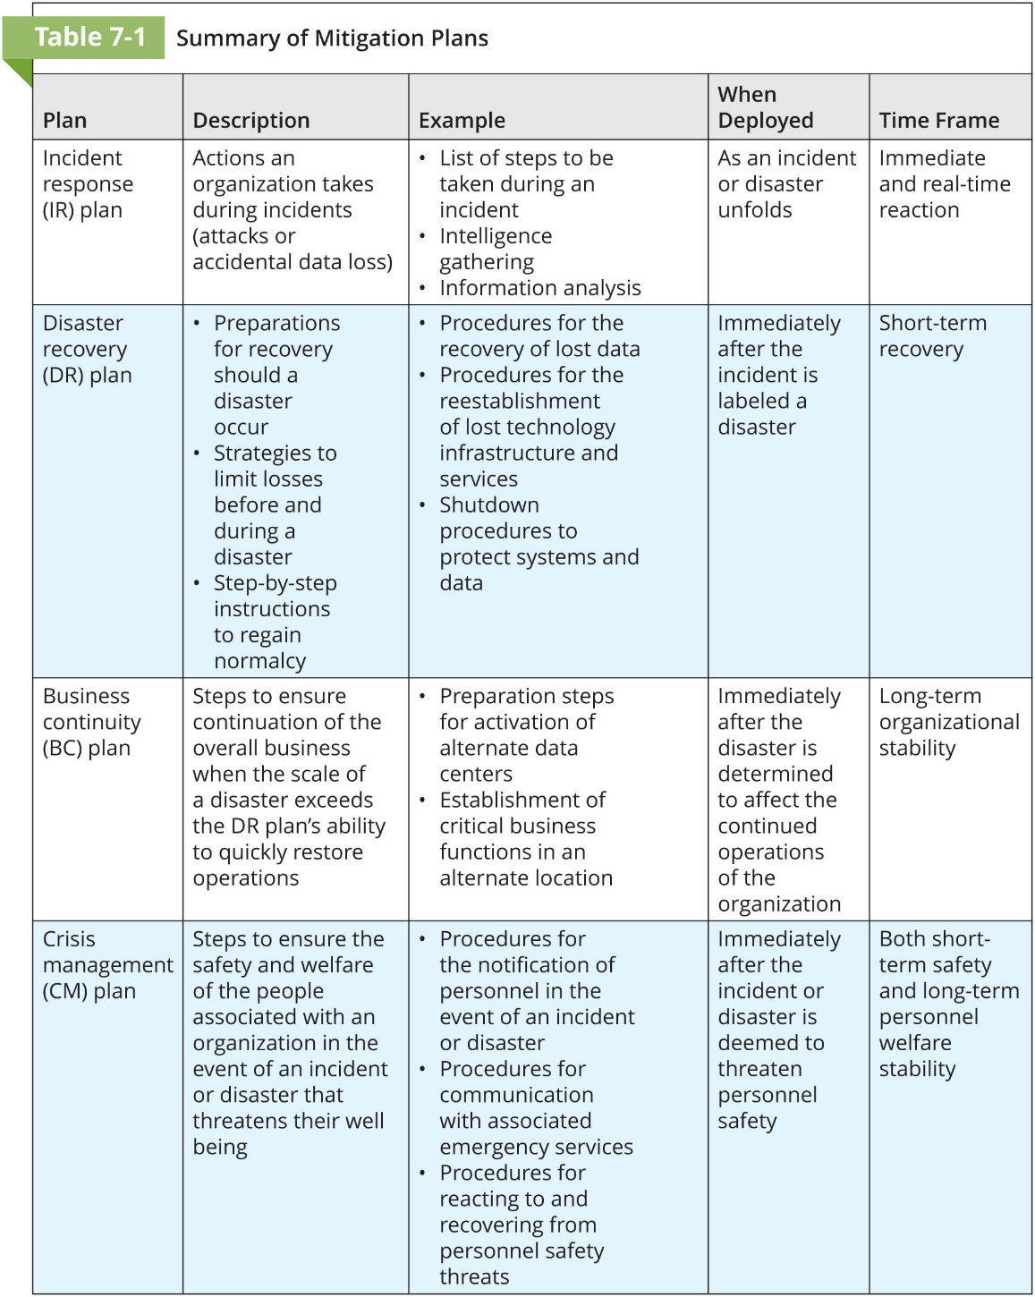

Slide 13
Acceptance
The acceptance risk treatment strategy is the decision to do nothing beyond the current level of protection to protect an information asset from risk, and to accept the outcome from any resulting exploitation
While the selection of this treatment strategy may not be a conscious business decision in some organizations, the unconscious acceptance of risk is not a productive approach to risk treatment
This strategy assumes that it can be a prudent business decision to examine the alternatives and conclude that the cost of protecting an asset does not justify the security expenditure

Slide 14
Acceptance (Continued)
Acceptance is recognized as a valid strategy only when the organization has:
Determined the level of risk posed to the information asset
Assessed the probability of attack and the likelihood of a successful exploitation of a vulnerability
Estimated the potential impact (damage or loss) that could result from a successful attack
Evaluated potential controls using each appropriate type of feasibility
Performed a thorough risk assessment, including a financial analysis such as a CBA
Determined that the costs to treat the risk to a particular function, service, collection of data, or information asset do not justify the cost of implementing and maintaining the controls

Slide 15
Termination
Like acceptance, the termination risk treatment strategy is based on the organization’s intentional choice not to protect an asset
Here, however, the organization does not wish the information asset to remain at risk and so removes it from the environment that represents risk
Sometimes, the cost of protecting an asset may outweigh its value, or it may be too difficult or expensive to protect an asset, compared to the value or advantage that asset offers the company

Slide 16
Managing Risk
Chapter 07: Risk Management: Treating Risk

Slide 17
Managing Risk
Risk appetite is the quantity and nature of risk that organizations are willing to accept as they evaluate the trade-offs between perfect security and unlimited accessibility
The reasoned approach to risk is one that balances the expense (in terms of finance and the usability of information assets) against the possible losses, if exploited

Slide 18
Managing Risk (Continued)
When vulnerabilities have been controlled to the degree possible, there is often remaining risk that has not been completely removed, shifted, or planned for—in other words, residual risk
Residual risk persists even after safeguards are implemented to reduce the levels of risk associated with threats, vulnerabilities, and information assets

Slide 19
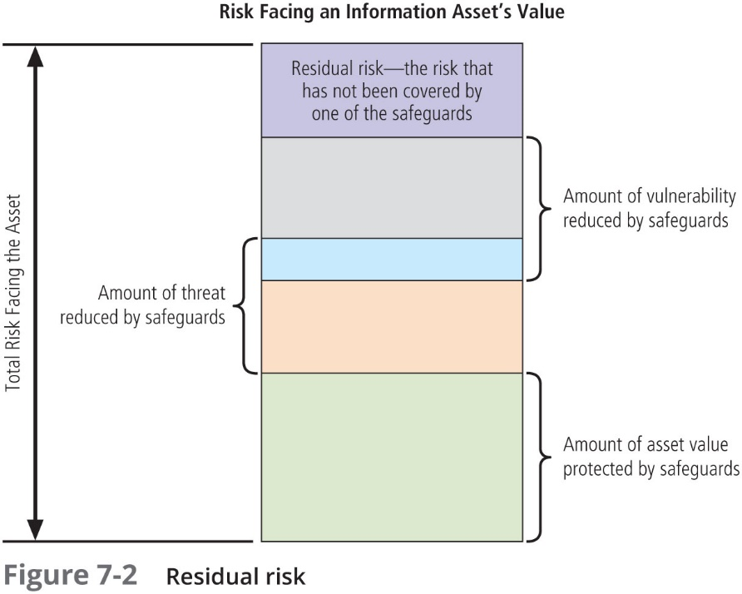

Slide 20
Managing Risk (Continued)
The goal of InfoSec is not to bring residual risk to zero; rather it is to bring it in line with an organization’s risk appetite
If decision makers have been informed of uncontrolled risks and the proper authority groups within the communities of interest decide to leave residual risk in place, then the information security program has accomplished its primary goal

Slide 21
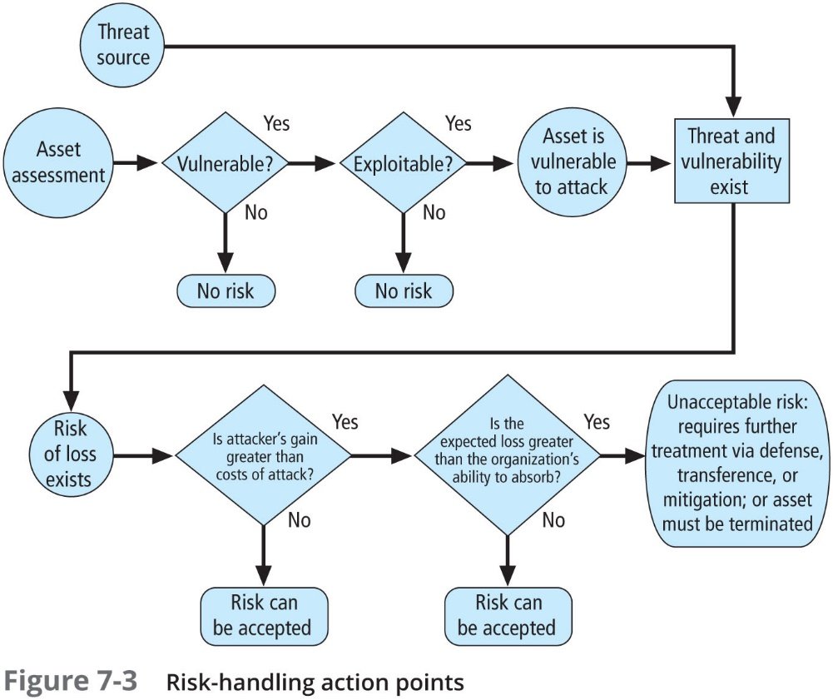

Slide 22
Managing Risk (Continued)
Rules of thumb for selecting a strategy:
When a vulnerability exists in an important asset—Implement security controls to reduce the likelihood of a vulnerability being exploited
When a vulnerability can be exploited—Apply layered protections, architectural designs, and administrative controls to minimize the risk or prevent the occurrence of an attack
When the attacker’s potential gain is greater than the costs of attack—Apply protections to increase the attacker’s cost or reduce the attacker’s gain by using technical or managerial controls
When the potential loss is substantial—Apply design principles, architectural designs, and technical and nontechnical protections to limit the extent of the attack, thereby reducing the potential for loss

Slide 23
Risk Management
Once a treatment strategy has been selected and implemented, controls should be monitored and measured on an ongoing basis to determine their effectiveness and to maintain an ongoing estimate of the remaining risk
At a minimum, each information threat/vulnerability/asset (TVA) triplet that was developed in the risk assessment created previously should have a documented treatment strategy that clearly identifies any residual risk that remains after the proposed strategy has been executed

Slide 24
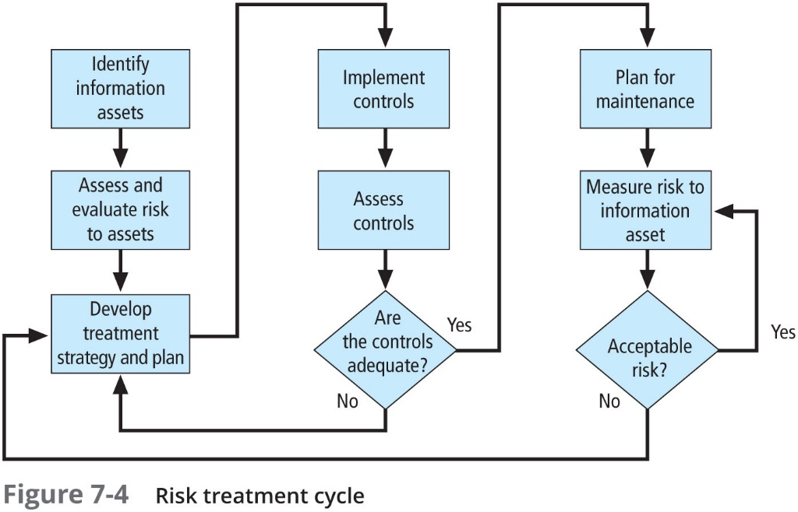

Slide 25
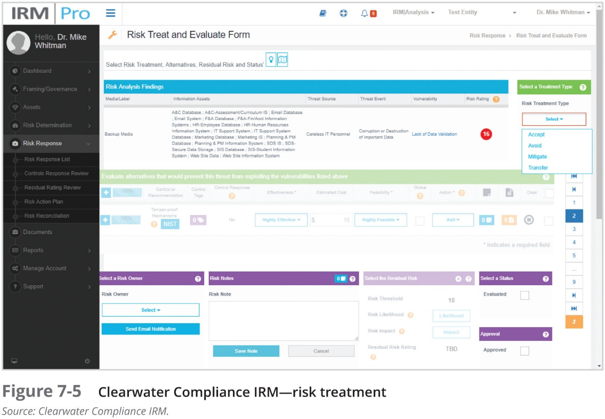

Slide 26
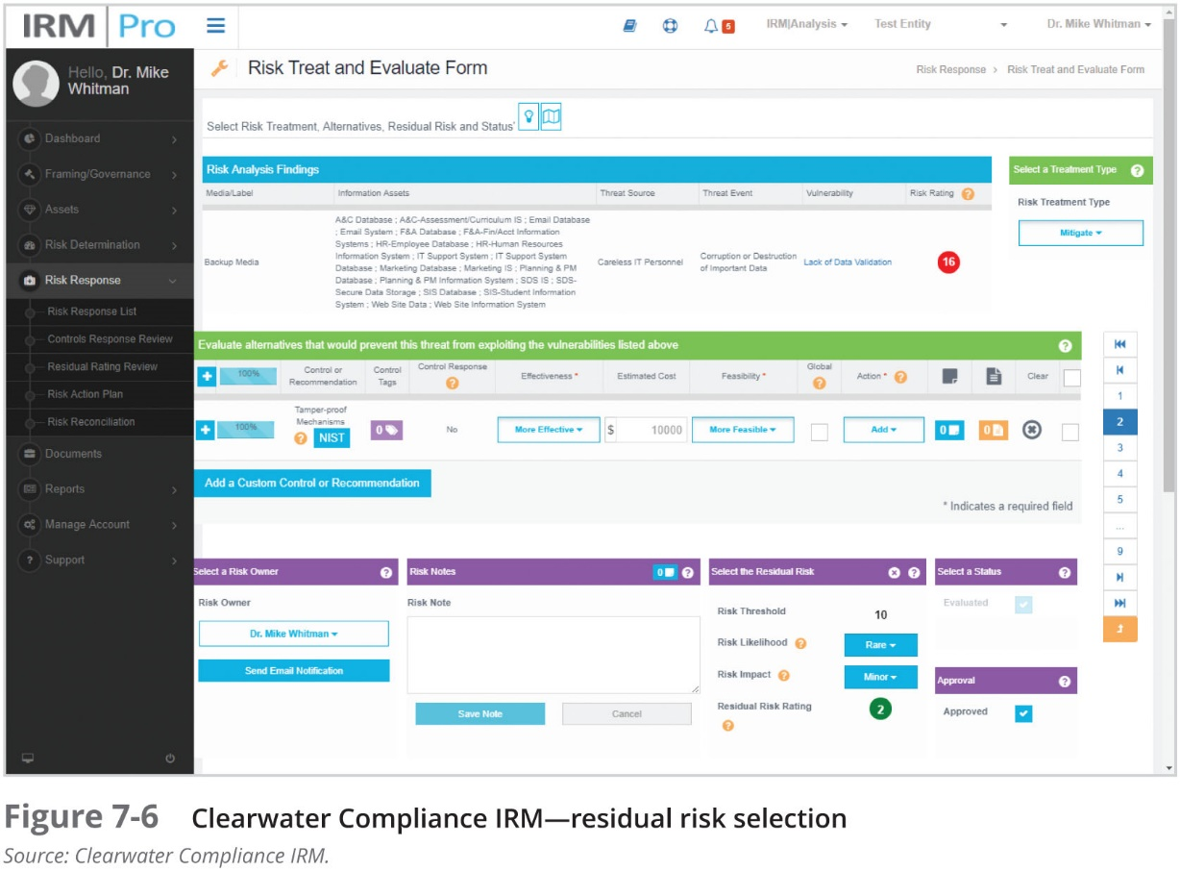

Slide 27
Feasibility and Cost–Benefit Analysis
Before deciding on the strategy for a specific TVA triplet, an organization should explore all readily accessible information about the economic and noneconomic consequences of an exploitation of the vulnerability, when the threat causes a loss to the asset
“What are the actual and perceived advantages of implementing a control as opposed to the actual and perceived disadvantages?”

Slide 28
Feasibility and Cost–Benefit Analysis (Continued)
While the advantages of a specific strategy can be identified in a number of ways, the primary way is to determine the value of the information assets it is designed to protect
Cost avoidance is the money saved by using the defense strategy via the implementation of a control, thus eliminating the financial ramifications of an incident
The criterion most commonly used when evaluating a strategy to implement InfoSec controls and safeguards is economic feasibility

Slide 29
Cost
Just as it is difficult to determine the value of information, it is difficult to determine the cost of safeguarding it
Some of the items that affect the cost of a control or safeguard include:
Cost of development or acquisition
Training fees
Cost of implementation
Service costs
Cost of maintenance
Potential cost from the loss of the asset

Slide 30
Benefit
Benefit is the value to the organization of using controls to prevent losses associated with a specific vulnerability
The benefit is usually determined by valuing the information asset or assets exposed by the vulnerability and then determining how much of that value is at risk and how much risk there is for the asset
This is expressed as the annualized loss expectancy (ALE)

Slide 31
Asset Valuation
Asset valuation is the process of assigning financial value or worth to each information asset
The value of information differs within and between organizations
Asset valuation involves the estimation of real and perceived costs, which can be selected from those associated with the design, development, installation, maintenance, protection, recovery, and defense against loss or litigation

Slide 32
Asset Valuation (Continued)
Some of the components of asset valuation include:
Value retained from the cost of creating the information asset
Value retained from past maintenance of the information asset
Value implied by the cost of replacing the information
Value from providing the information
Value acquired from the cost of protecting the information
Value to owners
Value of intellectual property
Value to adversaries
Loss of productivity while the information assets are unavailable
Loss of revenue while information assets are unavailable
Total cost of ownership

Slide 33
Asset Valuation (Continued)
A traditional model of calculating quantitative cost–benefit analyses involves estimating the likelihood of an attack based on an annualized rate of occurrence and the impact of an attack based on loss expectancy
The questions that must be asked include:
What damage could occur, and what financial impact would it have?
What would it cost to recover from the attack, in addition to the financial impact of damage?
What is the single loss expectancy for each risk?

Slide 34
Asset Valuation (Continued)
A single loss expectancy (SLE) is the calculated value associated with the most likely loss from a single occurrence of a specific attack
It takes into account both the value of the asset and the expected percentage of loss that would occur from a particular attack
SLE = asset value (AV) × exposure factor (EF)
Where EF = the percentage loss that would occur from a given vulnerability being exploited
This information is usually estimated

Slide 35
Asset Valuation (Continued)
Usually, the probability of a threat occurring is depicted as a table that indicates how frequently an attack from each threat type is likely to occur within a given time frame
This value is commonly referred to as the annualized rate of occurrence (ARO)
ARO simply indicates how often you expect a specific type of attack to occur

Slide 36
Asset Valuation (Continued)
Once you determine the loss from a single attack and the likely frequency of successful attacks, you can calculate the overall loss potential per risk expressed as an annualized loss expectancy (ALE) using the previous values for the ARO and SLE
ALE = SLE × ARO

Slide 37
Asset Valuation (Continued)
The CBA determines whether the benefit from a control alternative is worth the associated cost of implementing and maintaining the control
A CBA may be performed before implementing a control, or they can be performed after controls have been in place for a while
CBA = ALE (precontrol) − ALE (postcontrol) − ACS
Where:
ALE (precontrol) = ALE of the risk before the implementation of the control
ALE (postcontrol) = ALE examined after the control has been in place for a period of time
ACS = annualized cost of the safeguard

Slide 38
Other Methods of Establishing Feasibility
Organizational feasibility analysis examines how well the proposed information security alternatives will contribute to efficiency, effectiveness, and overall operation of an organization
Operational feasibility refers to user acceptance and support, management acceptance and support, and the system’s compatibility with the requirements of the organization’s stakeholders
User engagement and support can be achieved by means of three simple actions: communicate, educate, and involve

Slide 39
Other Methods of Establishing Feasibility (Continued)
Technical feasibility determines whether or not the organization has or can acquire the technology and expertise to implement, support, and manage the new safeguards
Political feasibility defines what can and cannot occur based on the consensus and relationships between the communities of interest, especially given that the budget allocation decisions can be politically charged

Slide 40
Alternatives to Feasibility Analysis
Benchmarking
Due care and due diligence
Best business practices
Gold standard
Government recommendations and best practices

Slide 41
Recommended Alternative Risk Treatment Practices
Chapter 07: Risk Management: Treating Risk

Slide 42
Recommended Alternative Risk Treatment Practices
Between the difficult task of valuing information assets and the dynamic nature of the ALE calculations, it is no wonder that organizations typically look for a more straightforward method of implementing controls
This preference has prompted an ongoing search for ways to design security architectures that go beyond the direct application of specific controls for specific information asset vulnerability

Slide 43
Qualitative and Hybrid Asset Valuation Measures
Many of the approaches to asset valuation described previously attempt to use actual values or estimates to create a quantitative assessment; in some cases, an organization might be unable to determine these values
Fortunately, risk assessment steps can be executed using estimates based on a qualitative assessment
A more granular approach, the semi-qualitative or hybrid assessment, tries to reduce some of the ambiguity of qualitative measures without resorting to the unsubstantiated estimations used for quantitative measures

Slide 44
Delphi Technique
The Delphi technique, named for the oracle at Delphi, is a process whereby a group rates or ranks a set of information
The individual responses are compiled and then returned to the group for another iteration
This process continues until the entire group is satisfied with the result
This technique can be applied to the development of scales, asset valuation, asset or threat ranking, or any scenario that can benefit from the input of more than one decision maker

Slide 45
Alternative Risk Management Methodologies
Chapter 07: Risk Management: Treating Risk

Slide 46
The OCTAVE Methods
The Operationally Critical Threat, Asset, and Vulnerability Evaluation (OCTAVE) Method defines the essential components of a comprehensive, systematic, context-driven, self-directed information security risk evaluation
By following the OCTAVE Method, an organization can make information-protection decisions based on risks to the confidentiality, integrity, and availability of critical information technology assets
The operational or business units and the IT department work together to address the information security needs of the organization

Slide 47
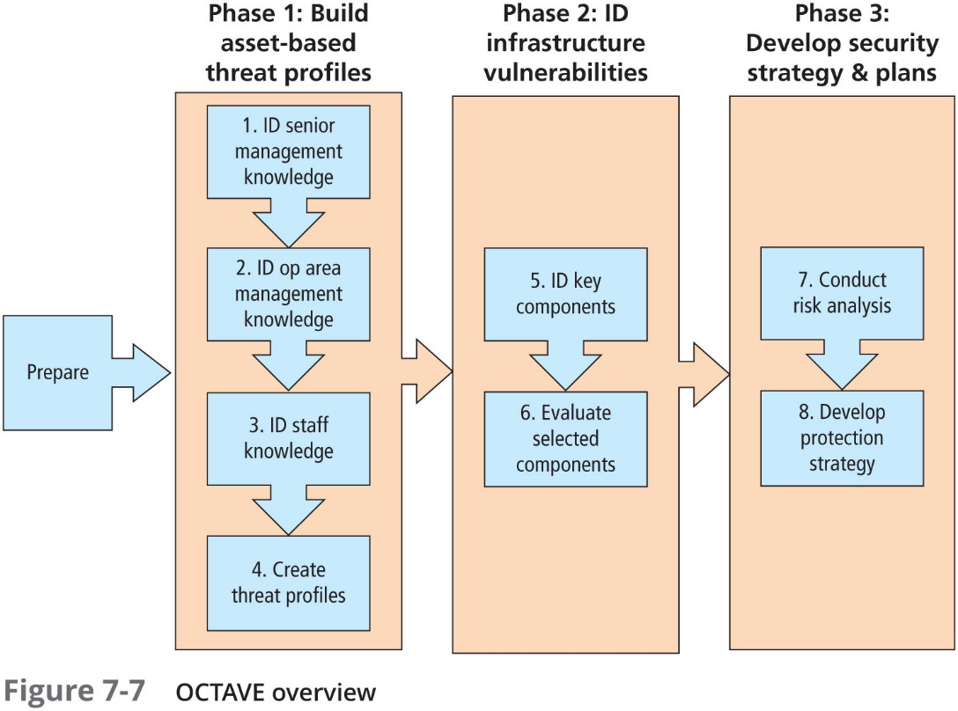

Slide 48
The OCTAVE Methods (Continued)
There are three variations of the OCTAVE Method:
The original OCTAVE method, which forms the basis for the OCTAVE body of knowledge, and which was designed for larger organizations (300 or more users)
OCTAVE-S, for smaller organizations of about 100 users
OCTAVE-Allegro, a streamlined approach for information security assessment and assurance

Slide 49
Microsoft Risk Management Approach
Microsoft also promotes a risk management approach
Four phases in the MS InfoSec risk management process:
Assessing risk
Conducting decision support
Implementing controls
Measuring program effectiveness

Slide 50
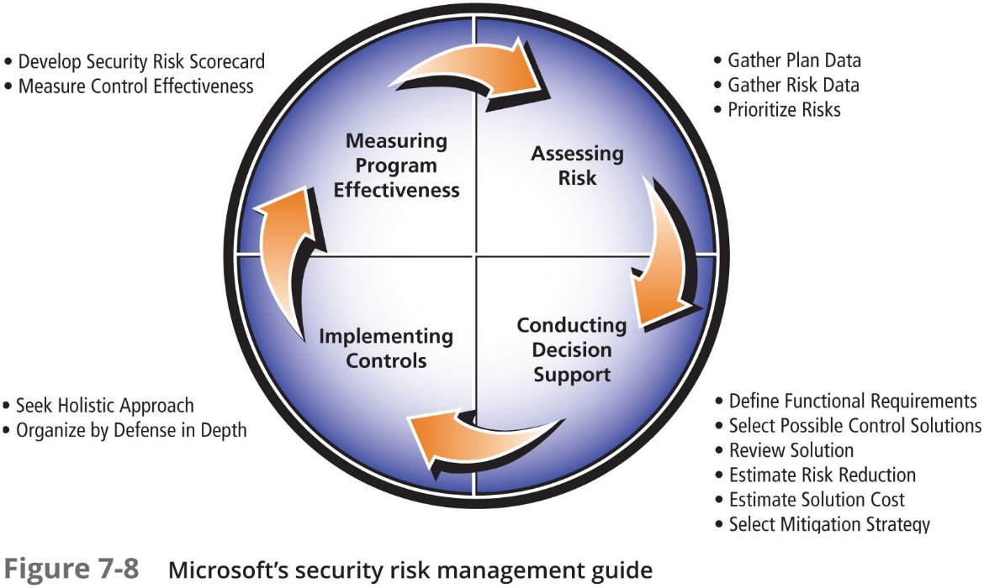

Slide 51
FAIR
The Factor Analysis of Information Risk (FAIR) framework includes:
A taxonomy for information risk
Standard nomenclature for information risk terms
A framework for establishing data collection criteria
Measurement scales for risk factors
A computational engine for calculating risk
A modeling construct for analyzing complex risk scenarios

Slide 52
FAIR (Continued)
Basic FAIR analysis is composed of ten steps in four stages:
Stage 1—Identify scenario components:
1. Identify the asset at risk
2. Identify the threat community under consideration
Stage 2—Evaluate Loss Event Frequency (LEF):
3. Estimate the probable Threat Event Frequency (TEF)
4. Estimate the Threat Capability (TCap)
5. Estimate Control strength (CS)
6. Derive Vulnerability (Vuln)
7. Derive Loss Event Frequency (LEF)

Slide 53
FAIR (Continued)
Stage 3—Evaluate Probable Loss Magnitude (PLM)
8. Estimate worst-case loss
9. Estimate probable loss
Stage 4—Derive and articulate Risk
10. Derive and articulate Risk
Unlike other risk management frameworks, FAIR relies on the qualitative assessment of many risk components using scales with value ranges, for example very high to very low

Slide 54
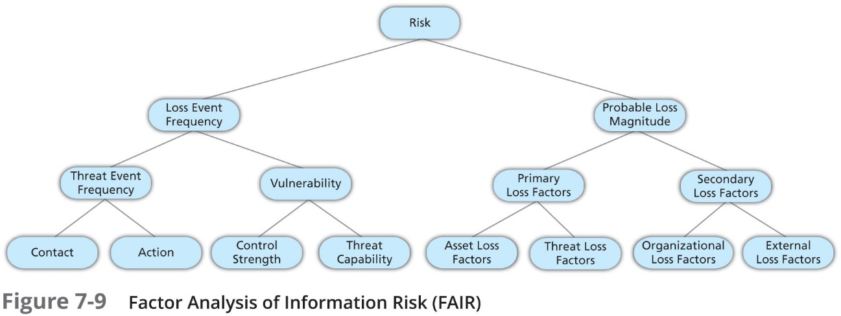

Slide 55
ISO Standards for InfoSec Risk Management
The ISO 27000 series includes a standard for the performance of Risk Management, ISO 27005 (http://www.27000.org/iso-27005.htm)
The 27005 document includes a five-stage risk management methodology:
Risk Assessment
Risk Treatment
Risk Acceptance
Risk Communication
Risk Monitoring and Review

Slide 56
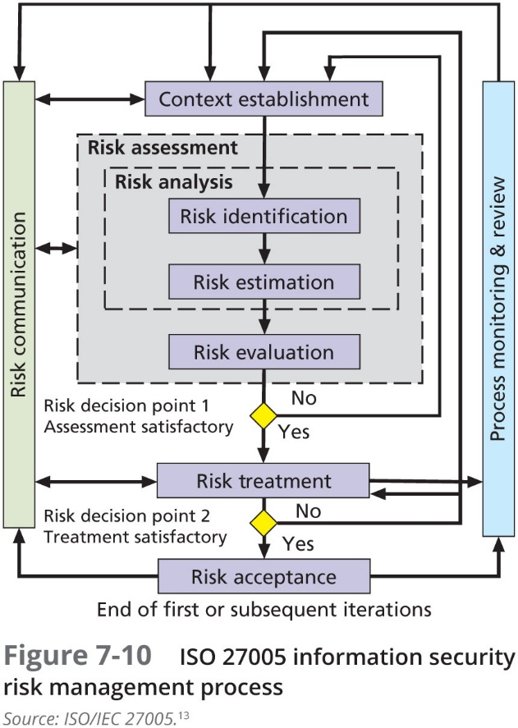

Slide 57
ISO 31000
The ISO has another standard that addresses risk management: ISO 31000, which was used in the formalization of the risk management methodology presented elsewhere in this text
While more generic than the standard for information security risk management, ISO 31000 nonetheless provides a structured methodology for evaluating threats to economic performance in an organization
There is a good deal of overlap between the two standards, as the heart of any good risk management program involves the same basic steps, much like the heart of any good systems development life cycle involves the same basic steps

Slide 58
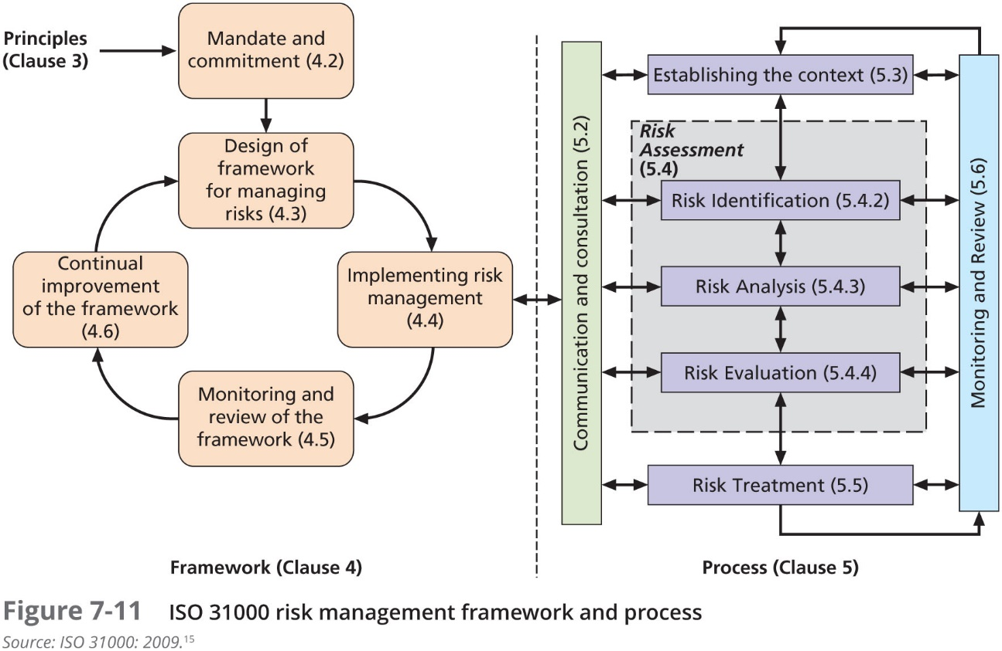

Slide 59
NIST Risk Management Framework
National Institute for Standards and Technology (NIST) has modified its fundamental approach to systems management and certification/accreditation to one that follows the industry standard of effective risk management
As discussed in “Special Publication 800-39: Managing Information Security Risk: Organization, Mission, and Information System View”

Slide 60
NIST Risk Management Framework (Continued)
The first component of risk management addresses how organizations frame risk or establish a risk context—that is, describing the environment in which risk-based decisions are made
The second component of risk management addresses how organizations assess risk within the context of the organizational risk frame
The third component of risk management addresses how organizations respond to risk once that risk is determined based on the results of risk assessments
The fourth component of risk management addresses how organizations monitor risk over time

Slide 61
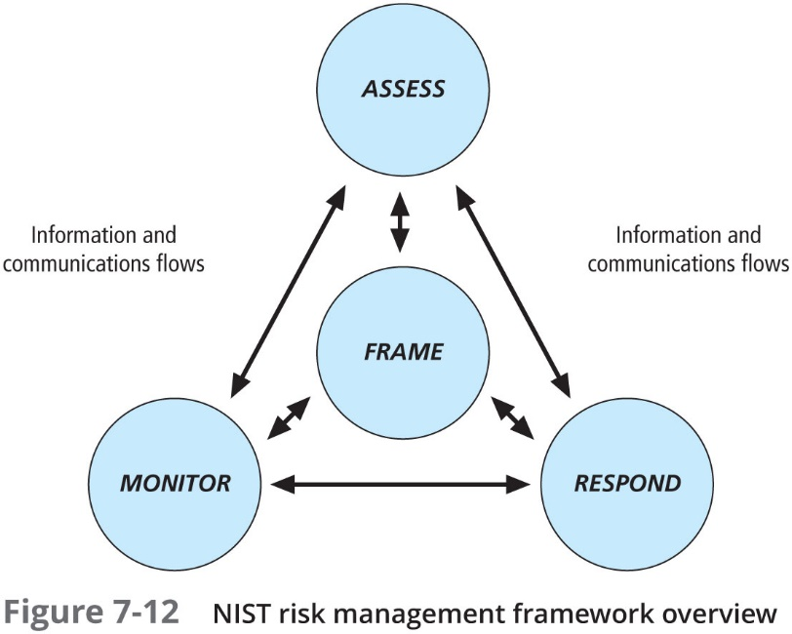

Slide 62
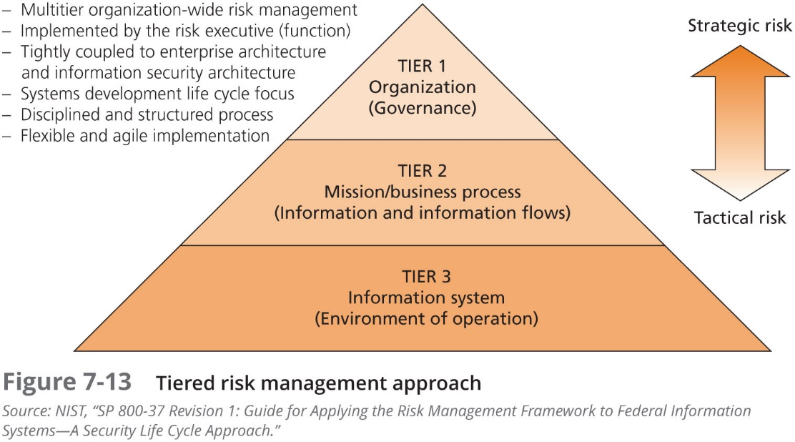

Slide 63
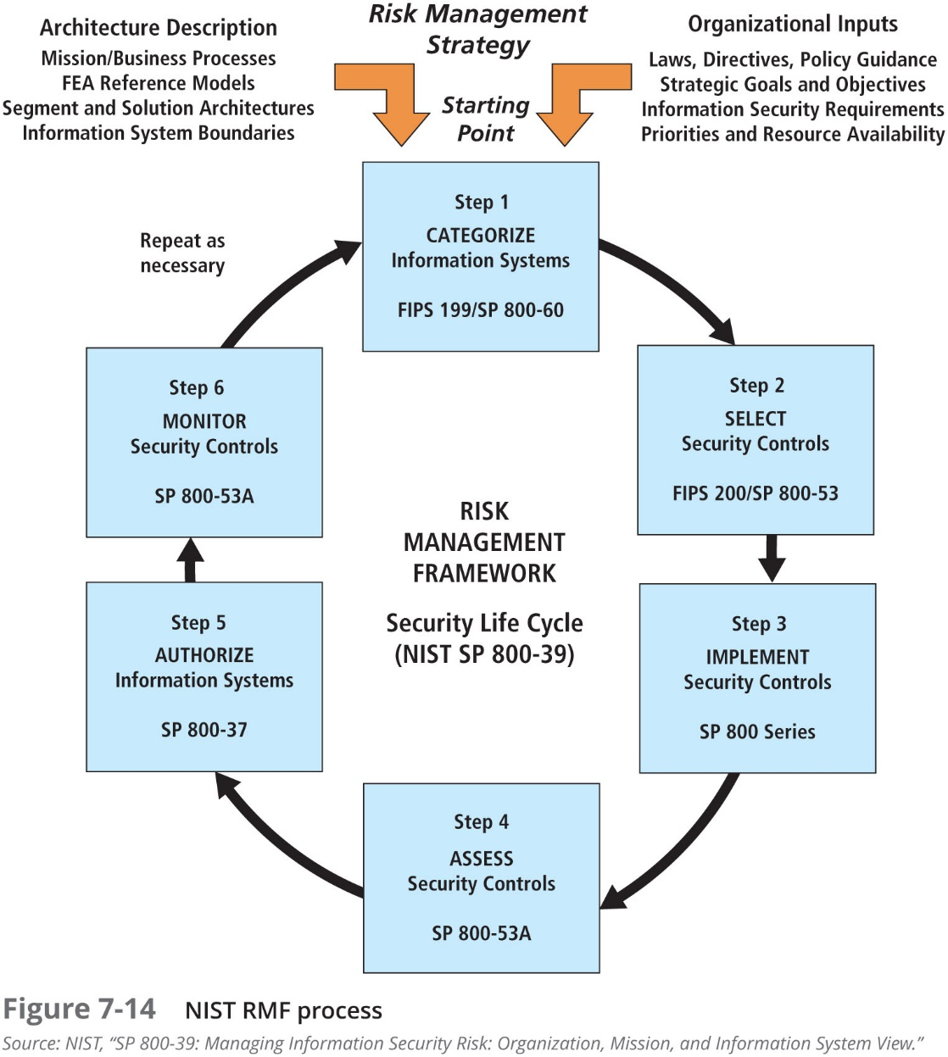

Slide 64
Other Methods
Mitre
European Network and Information Security Agency
New Zealand’s IsecT

Slide 65
Selecting the Best Risk Management Model
Most organizations already have a set of RM practices in place
If not, a recommended approach is to begin by studying the models presented here and by identifying what each offers to the envisioned process
Other organizations may hire a consulting firm to provide or even develop a proprietary model
When faced with the daunting task of building a risk management program from scratch, it may be best to talk with other security professionals, perhaps through professional security organization meetings like ISSA, to find out how others in the field have approached this problem

Slide 66
Summary
Once vulnerabilities are identified and ranked, a strategy to treat uncontrolled risks must be chosen. Five treatment strategies are defense, transference, mitigation, acceptance, and termination
Economic feasibility studies determine and compare costs and benefits from potential treatments (often called a cost–benefit analysis). Other forms of feasibility analysis include analyses based on organizational, operational, technical, and political factors
An organization must be able to place a dollar value on each collection of information and the information assets it owns. There are several methods an organization can use to calculate these values

Slide 67
Summary (Continued)
Single loss expectancy (SLE) is calculated from the value of the asset and the expected percentage of loss that would occur from a single successful attack. Annualized loss expectancy (ALE) represents the potential loss per year
Cost–benefit analysis (CBA) determines whether a control alternative is worth its associated cost. CBA calculations are based on costs before and after controls are implemented and the cost of the controls. Other feasibility analysis approaches can also be used
Organizations may choose alternatives to feasibility studies to justify applying InfoSec controls, including benchmarking with either metrics-based measures or process-based measures; due care and/or due diligence; best security practices up to and including the near mythic gold standard; and/or baselining

Slide 68
Summary (Continued)
Risk appetite defines the quantity and nature of risk that organizations are willing to accept as they evaluate the trade-offs between perfect security and unlimited accessibility. Residual risk is the amount of risk unaccounted for after the application of controls
It is possible to repeat risk analysis using estimates based on a qualitative assessment. The Delphi technique can be used to obtain group consensus on risk assessment values
Once a control strategy has been implemented, the effectiveness of controls should be monitored and measured

