Slide 1
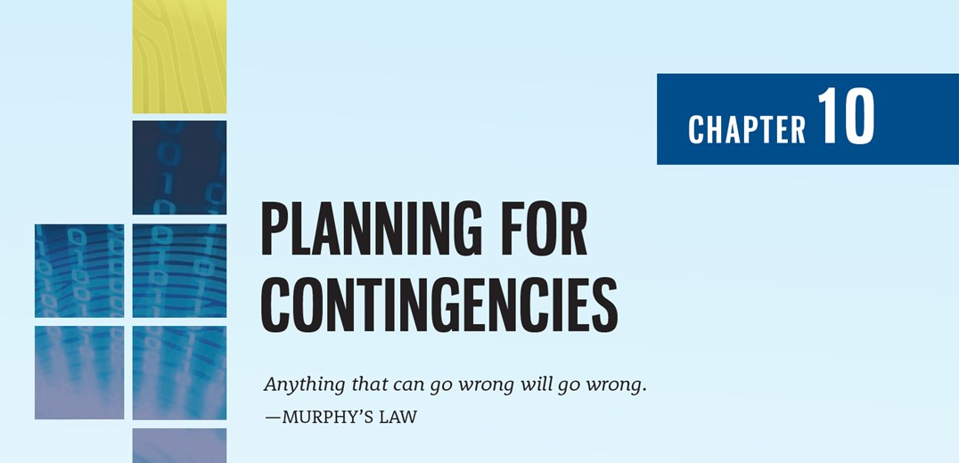

Slide 2
Learning Objectives
Upon completion of this material, you should be able to:
Discuss the need for contingency planning
Describe the major components of incident response, disaster recovery, and business continuity
Define the components of crisis management and business resumption
Discuss how the organization would prepare and execute a test of contingency plans

Slide 3
Introduction to Contingency Planning
Chapter 10: Planning for Contingencies

Slide 4
Introduction
This chapter focuses on planning for unexpected adverse events, when the use of technology is disrupted and business operations can come to a standstill
An organization’s ability to weather losses caused by an adverse event depends on proper planning and execution of such a plan, without which an adverse event can cause severe damage to an organization’s information resources and assets from which it may never recover
According to the Hartford insurance company, over 40% of businesses that don't have a disaster plan go out of business after a major loss

Slide 5
Fundamentals of Contingency Planning
The overall planning for unexpected adverse events is called contingency planning (CP)
It is how communities of interest position their organizational units to prepare for, detect, react to, and recover from events that threaten the security of information resources and assets
The main goal of CP is to restore normal modes of operation with minimum cost and disruption to normal business activities after an unexpected adverse event

Slide 6
Fundamentals of Contingency Planning (Continued)
CP consists of four major components:
Business impact analysis (BIA)
Incident response plan (IR plan)
Disaster recovery plan (DR plan)
Business continuity plan (BC plan)
Depending on the organization’s size and business philosophy, IT and InfoSec managers can either
create and develop these four CP components as one unified plan or
create the four separately in conjunction with a set of interlocking procedures that enable continuity

Slide 7
NIST CP Methodology
Once formed, the contingency planning management team (CPMT) begins developing a CP document, for which NIST recommends using the following steps:
Develop the CP policy statement
Conduct the BIA
Identify preventive controls
Create contingency strategies
Develop a contingency plan
Ensure plan testing, training, and exercises
Ensure plan maintenance

Slide 8
Contingency Planning Policy Components
An introductory statement by senior management
The scope and purpose of the CP operations
A call for periodic risk assessment and BIA by the CPMT
A description of the major components of the CP
A call for, and guidance in, the selection of recovery options and business continuity strategies
A requirement to test the various plans on a regular basis
Identification of key regulations and standards that impact CP planning and a brief overview of their relevancy
Identification of key individuals responsible for CP operations
An appeal for support to the individual members of the organizations
Additional administrative information

Slide 9
Individuals and Teams involved in CP
The CPMT including:
Champion
Project Manager
Team Members
Business managers
Information technology managers
Information security managers
Representatives of the supplemental teams (IR, DR, BC)
IR Team
DR Team
BC Team

Slide 10
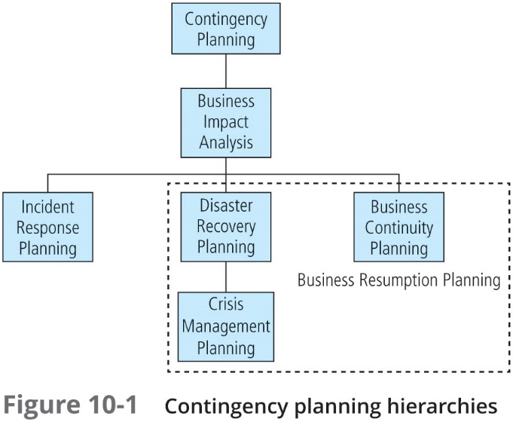

Slide 11
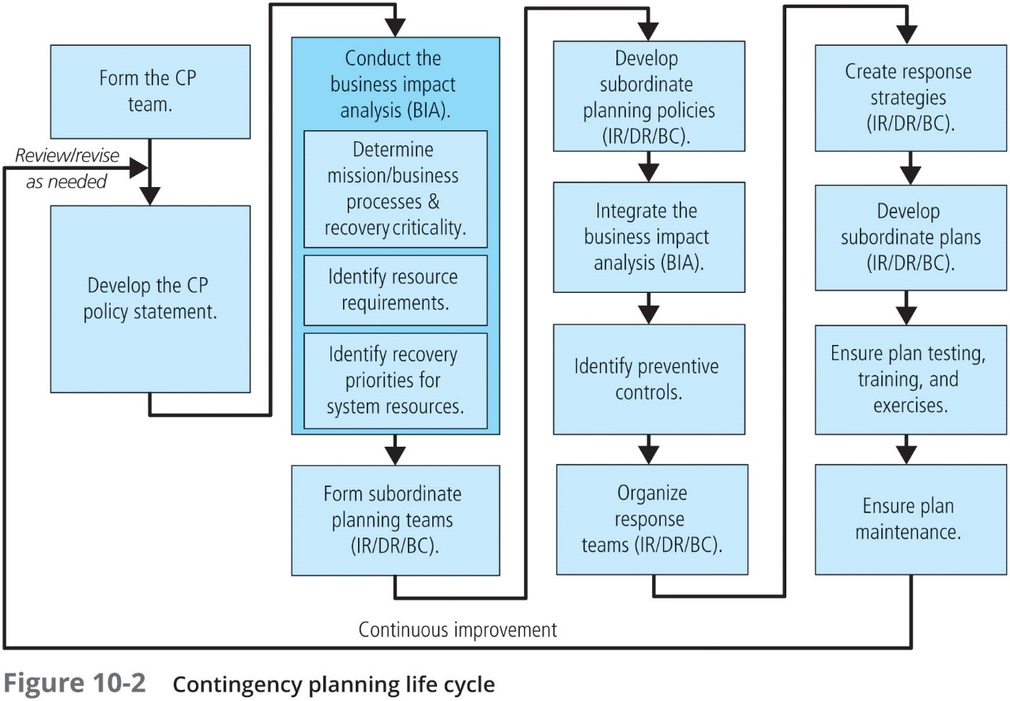

Slide 12
Components of CP
The business impact analysis (BIA) is the first phase of the CP process and serves as an investigation and assessment of the impact that various adverse events can have on the organization
One of the fundamental differences between a BIA and risk management is that risk management focuses on identifying the threats, vulnerabilities, and attacks to determine which controls can protect the information
The BIA assumes that these controls have been bypassed, have failed, or have otherwise proved ineffective, that the attack succeeded, and that the adversity that was being defended against has been successful

Slide 13
Business Impact Analysis (BIA)
The BIA begins with the prioritized list of threats and vulnerabilities identified in the risk management process and enhances the list by adding the information needed to respond to the adversity
When undertaking the BIA, the organization should consider:
Scope
Plan
Balance
Objective
Follow-up

Slide 14
Business Impact Analysis (BIA) (Continued)
According to NIST SP 800-34, Rev. 1, the CPMT conducts the BIA in three stages:
Determine mission/business processes and recovery criticality
Identify resource requirements
Identify recovery priorities for system resources

Slide 15
Business Process and Recovery Criticality
The first major BIA task is the analysis and prioritization of business processes within the organization, based on their relationship to the organization’s mission
Each business department, unit, or division must be independently evaluated to determine how important its functions are to the organization as a whole
A weighted analysis table (weighted factor analysis) can be useful in evaluating business functions
The BIA questionnaire is useful in identifying and collecting information about business functions for analysis

Slide 16
Business Process and Recovery Criticality (Continued)
When organizations consider recovery criticality, key recovery measures are usually described in terms of how much of the asset they must recover within a specified time frame
The terms most commonly used to describe this are:
Recovery time objective (RTO)
Recovery point objective (RPO)
Maximum tolerable downtime (MTD)
Work recovery time (WRT)
Plotting cost balance points will show an optimal point between disruption and recovery costs

Slide 17
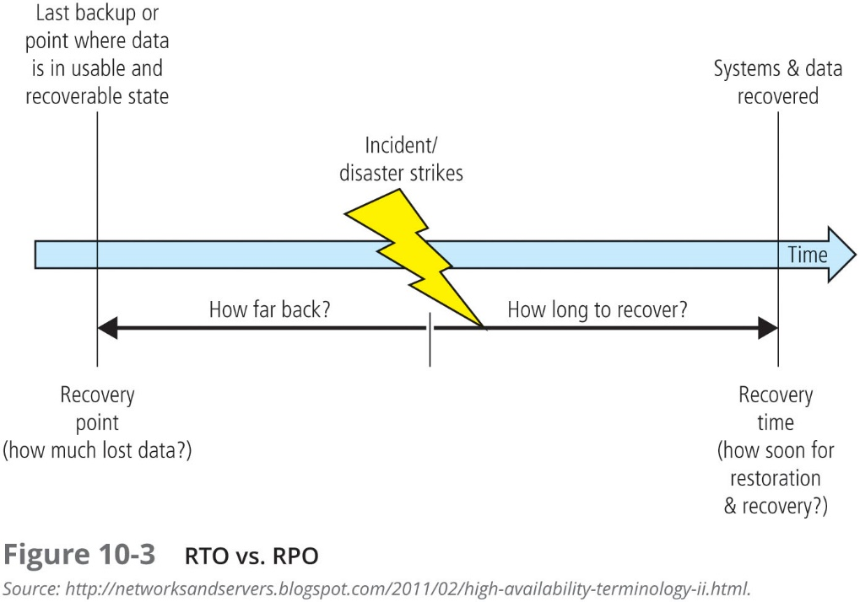

Slide 18
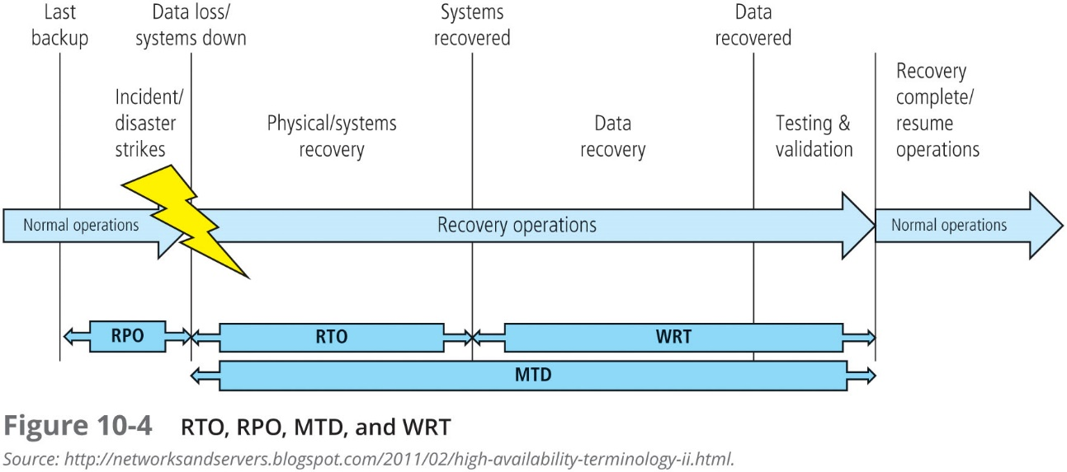

Slide 19
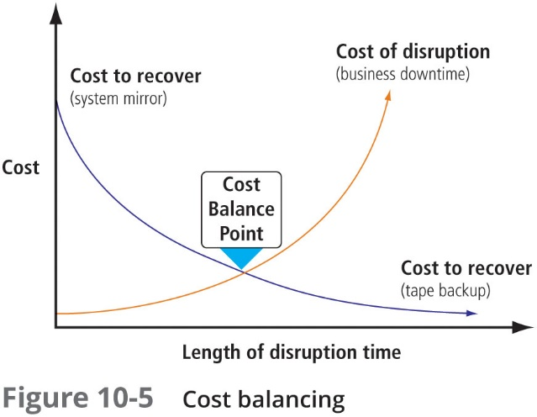

Slide 20
Information Asset Prioritization
As the CPMT conducts the BIA, it will be assessing priorities and relative values on mission/business processes
To do so, it needs to understand the information assets used by those processes as the presence of high-value information assets may influence the valuation of a particular business process
Normally, this task would be performed as part of the risk-assessment function within the risk management process

Slide 21
Recovery Requirements
Once the organization has created a prioritized list of its mission/business processes, it needs to determine what resources would be required in order to recover those processes and the assets associated with them
For each process (and information asset) identified in the previous BIA stage, the organization should identify and describe the relevant resources needed to provide or support that process
A simplified method for organizing this information is to put it into a resource/component table

Slide 22
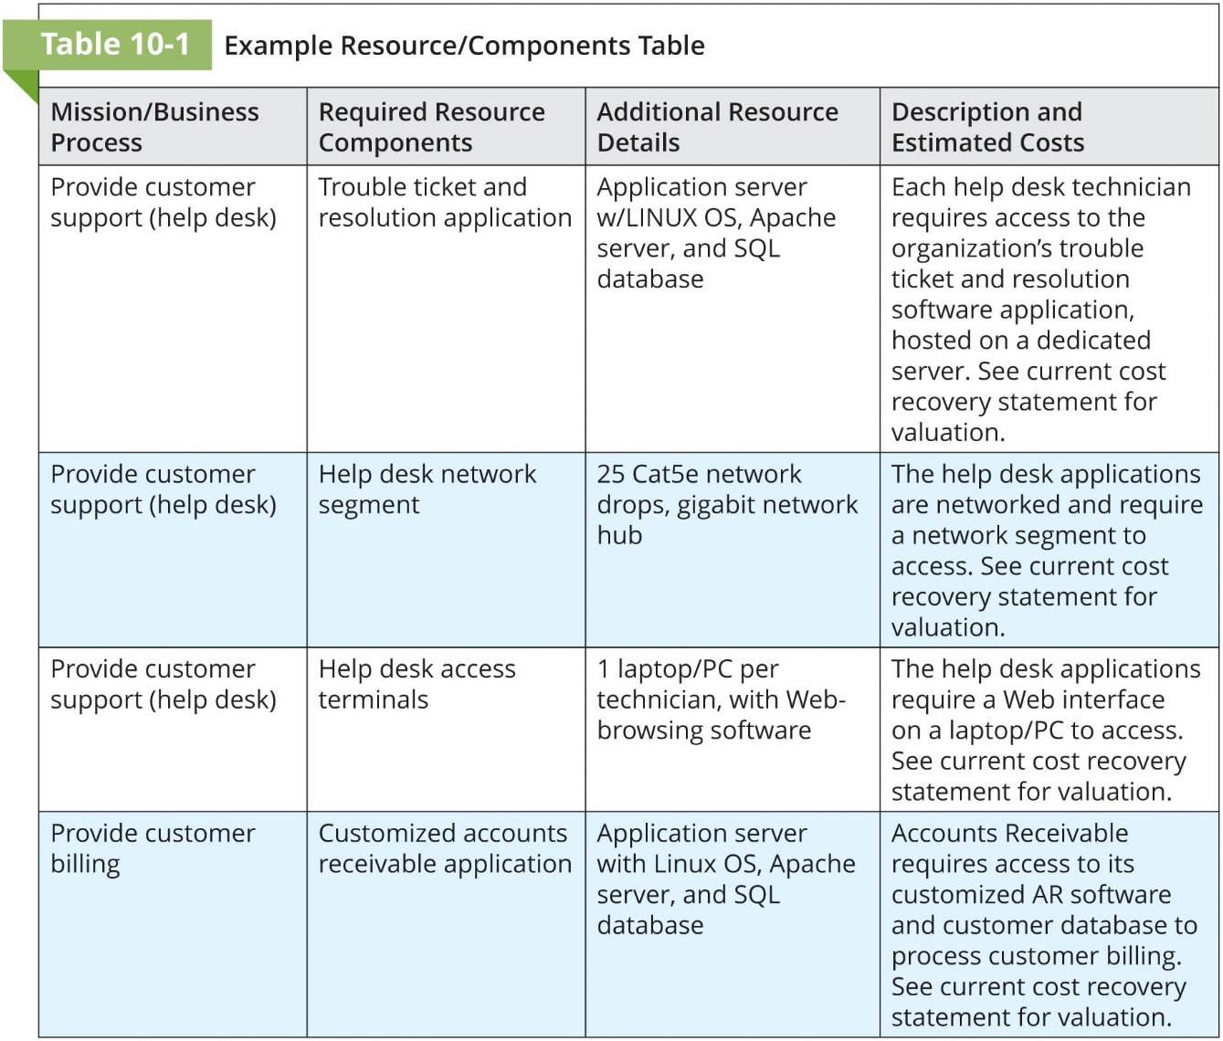

Slide 23
System Resource Recovery Priorities
The last stage of the BIA is prioritizing the resources associated with the mission/business processes, which provides a better understanding of what must be recovered first, even within the most critical processes
With the information from previous steps in hand, the organization can create additional weighted tables of the resources needed to support the individual processes
In addition to the weighted tables described earlier, a simple valuation and classification scale, such as Primary/Secondary/Tertiary, or Critical/Very Important/Important/Routine can be used to provide a quicker method of valuating the supporting resources

Slide 24
Contingency Planning Policies
Prior to the development of each of the types of CP documents outlined in this chapter, the CP team should work to develop the policy environment that will enable the BIA process and should provide specific policy guidance toward authorizing the creation of each of the planning components (IR, DR, and BC)
These policies provide guidance on the structure of the subordinate teams and the philosophy of the organization, and they assist in the structuring of the plan
Just as the enterprise InfoSec policy defines the InfoSec roles and responsibilities for the entire enterprise, each of the CP documents is based on a specific policy that defines the related roles and responsibilities for that element of the overall CP environment within the organization

Slide 25
Incident Response
Chapter 10 Planning for Contingencies

Slide 26
Incident Response Plan
Most organizations have experience detecting, reacting to, and recovering from attacks, employee errors, service outages, and small-scale natural disasters, and are thus performing incident response (IR)
IR must be carefully planned and coordinated because organizations heavily depend on the quick and efficient containment and resolution of incidents
Incident response planning (IRP), therefore, is the preparation for such an effort and is performed by the IRP team (IRPT)

Slide 27
Incident Response
When those events represent the potential for loss, they are referred to as adverse events or incident candidates
When an adverse event begins to manifest as a real threat to information, it becomes an incident
The incident response plan (IR plan) is usually activated when the organization detects an incident that affects it, regardless of how minor the effect is

Slide 28
Getting Started
An early task for the CPMT is to form the IRPT, which will begin work by developing policy to define the team’s operations, articulate the organization’s response to various types of incidents, and advise users how to contribute to the organization’s effective response, rather than contributing to the problem at hand
The IRPT then forms the computer security incident response team (CSIRT)
As part of an increased focus on cybersecurity infrastructure protection, NIST has developed a Framework for Improving Critical Infrastructure Cybersecurity, also referred to as the NIST Cybersecurity Framework (CSF)

Slide 29
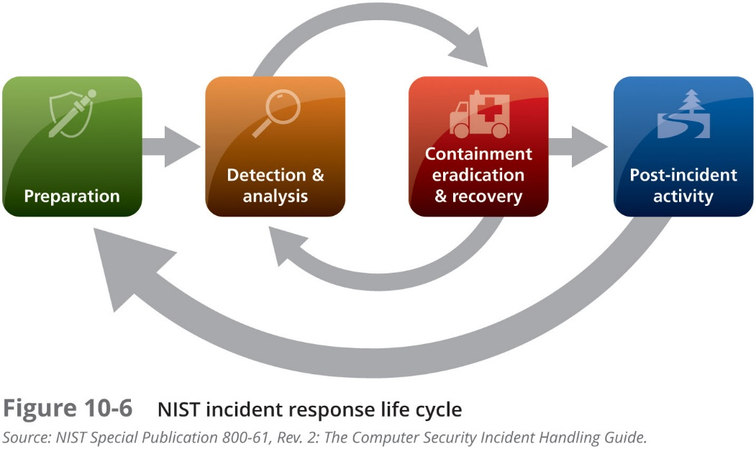

Slide 30
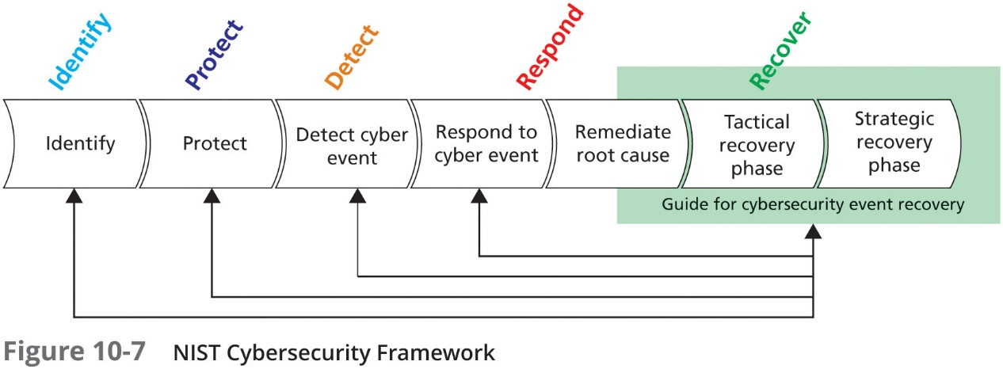

Slide 31
Incident Response Policy
NIST SP 800-61, Rev. 2: The Computer Security Incident Handling Guide identifies the following key components of a typical IR policy:
Statement of management commitment
Purpose and objectives of the policy
Scope of the policy (to whom and what it applies and under what circumstances)
Definition of InfoSec incidents and related terms
Organizational structure and definition of roles, responsibilities, and levels of authority
Prioritization or severity ratings of incidents
Performance measures
Reporting and contact forms

Slide 32
Incident Response Planning
When a threat becomes a valid adverse event, it is classified as an InfoSec incident if:
It is directed against information assets
It has a realistic chance of success
It threatens the confidentiality, integrity, or availability of information resources and assets
It is important to understand that IR is a reactive measure, not a preventative one, although most IR plans include preventative recommendations

Slide 33
IR Planning
The responsibility for creating an organization’s IR plan usually falls to the CISO, or an IT manager with security responsibilities
According to NIST SP 800-61, Rev. 2, the IR plan includes:
Mission
Strategies and goals
Senior management approval
Organizational approach to incident response
How the incident response team will communicate
Metrics for measuring incident response capability and effectiveness
Roadmap for maturing incident response capability
How the program fits into the overall organization

Slide 34
IR Planning (Continued)
For every incident scenario, the CP team creates three sets of incident-handling procedures:
During the incident
After the incident
Before the incident
Once these sets of procedures are clearly documented, the IR portion of the IR plan is assembled and the critical information outlined in these planning sections is recorded

Slide 35
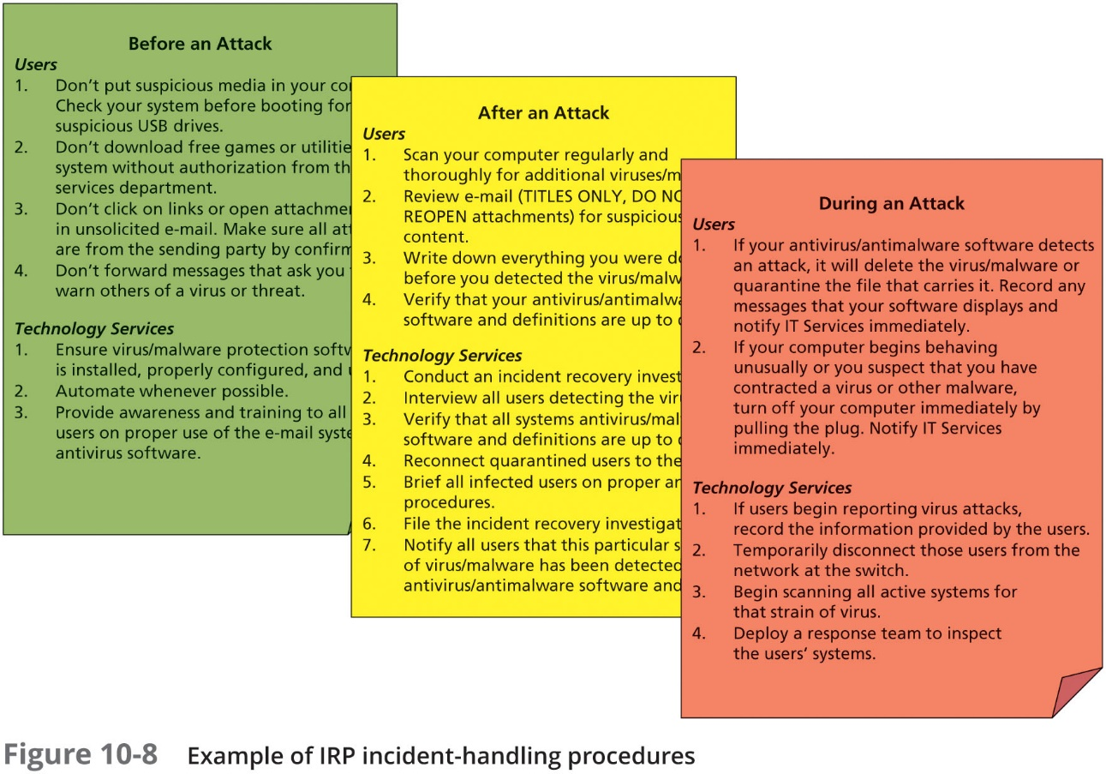

Slide 36
IR Planning (Continued)
Planning requires a detailed understanding of the information systems and the threats they face
The IRPT seeks to develop predefined responses that will guide the CSIRT and users through the IR steps
Predefining incident responses enables rapid reaction without confusion or wasted time and effort

Slide 37
IR Planning (Continued)
The execution of the IR plan typically falls to the Computer Security Incident Response Team (CSIRT)
The CSIRT is a separate group from the IRPT, although some overlap may occur and is composed of technical and managerial IT and InfoSec professionals prepared to diagnose and respond to an incident
In some organizations, the CSIRT may simply be a loose or informal association of IT and InfoSec staffers who would be called up if an attack was detected on the organization’s information assets
In other, more formal implementations, the CSIRT is a set of policies, procedures, technologies, people, and data put in place to prevent, detect, react to, and recover from an incident that could potentially damage the organization’s information

Slide 38
IR Actions
Incident response actions can be organized into three basic phases:
Detection
Reaction
Recovery

Slide 39
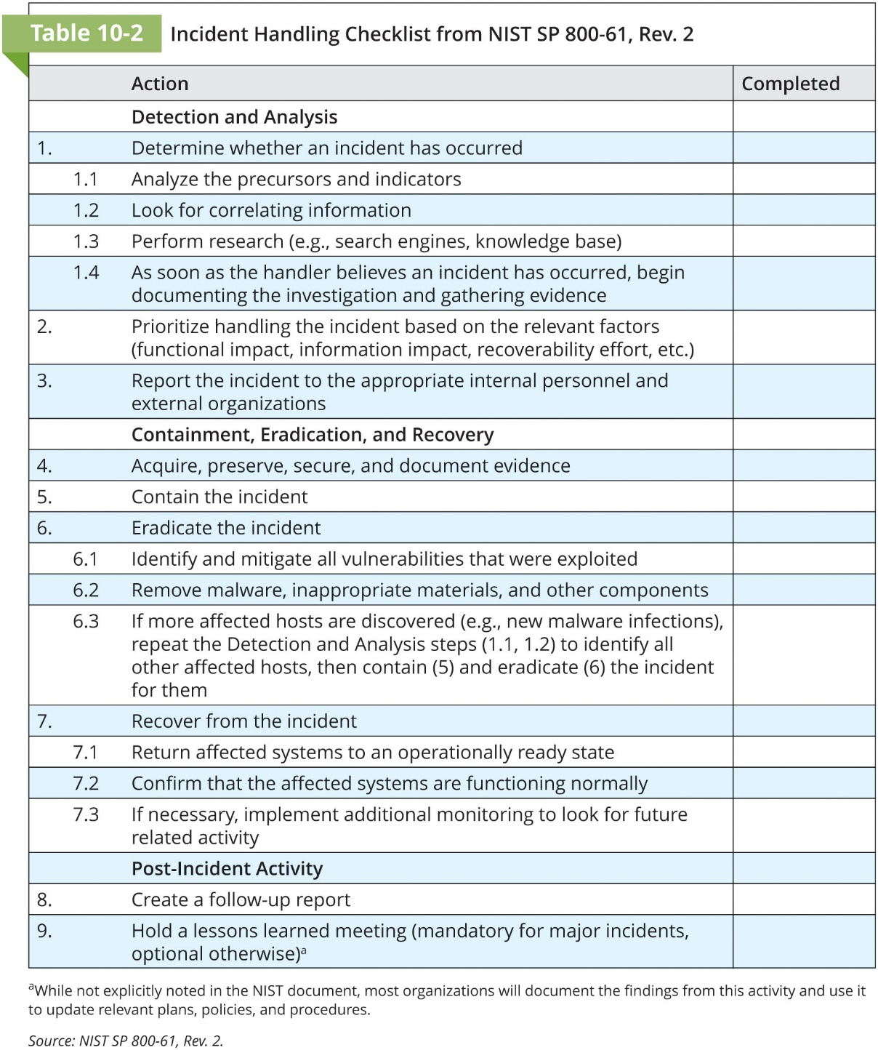

Slide 40
Data Protection in Preparation for Incidents
An organization has several options for protecting its information and getting operations up and running quickly after an incident:
Traditional data backups
Electronic vaulting
Remote journaling
Database shadowing
Industry recommendations for data backups include:
“3-2-1 rule”—three copies of important data on at least two different media, with at least one copy stored off-site, and daily on-site backups
Weekly off-site backups

Slide 41
Detecting Incidents
The challenge is determining whether an event is the product of routine systems use or an actual incident
Incident classification is the process of examining an adverse event or incident candidate and determining whether it constitutes an actual incident
Initial reports from end users, intrusion detection systems, host- and network-based virus detection software, and systems administrators are all ways to track and detect incident candidates
Once an actual incident is properly identified and classified, members of the IR team can effectively execute the corresponding procedures from the IR plan

Slide 42
Incident Indicators
Possible Indicators
Presence of unfamiliar files
Presence or execution of unknown programs or processes
Unusual consumption of computing resources
Unusual system crashes
Probably Indicators
Activities at unexpected times
Presence of new accounts
Reported attacks
Notification from IDS

Slide 43
Incident Indicators (Continued)
Definite Indicators
Use of dormant accounts
Changes to logs
Presence of hacker tools
Notifications by partner or peer
Notification by hacker
Potential Incident Results
Loss of availability
Loss of integrity
Loss of confidentiality
Violation of policy
Violation of law

Slide 44
Reacting to Incidents
Once an actual incident has been confirmed and properly classified, the IR plan moves from the detection phase to the reaction phase
The steps in IR are designed to stop the incident, mitigate its effects, and provide information for the recovery from the incident
In the incident response phase, a number of action steps taken by the CSIRT and others must occur quickly and may occur concurrently

Slide 45
Notification of Key Personnel
As soon as an incident is declared, the right people must be immediately notified in the right order
An alert roster is a document containing contact information on the individuals to be notified in the event of an actual incident either sequentially or hierarchically
The alert message is a scripted description of the incident
Other key personnel must also be notified of the incident only after the incident has been confirmed, but before media or other external sources learn of it

Slide 46
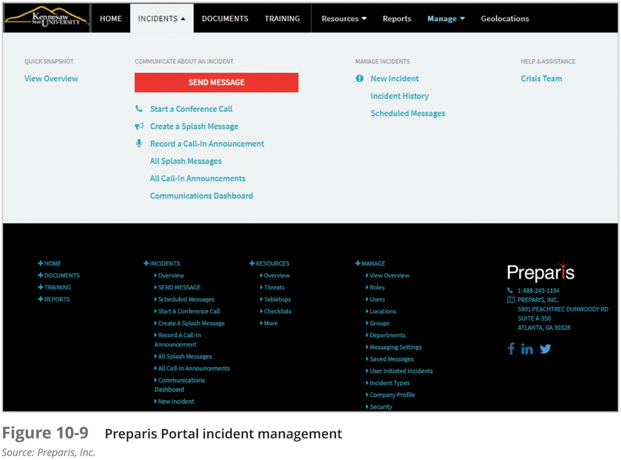

Slide 47
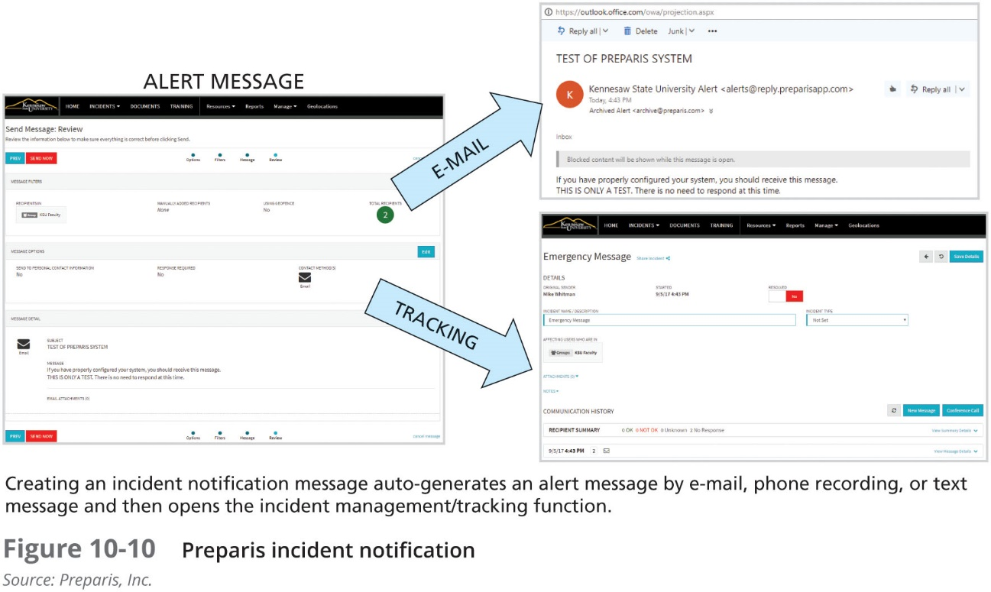

Slide 48
Documenting an Incident
As soon as an incident has been confirmed and the notification process is underway, the team should begin to document it
The documentation should record the who, what, when, where, why, and how of each action taken while the incident is occurring
It serves as a case study after the fact to determine if the right actions were taken and if they were effective
It can also prove the organization did everything possible to deter the spread of the incident

Slide 49
Incident Containment Strategies
The essential task of IR is to stop the incident and contain its scope or impact
Incident containment strategies focus on two tasks:
Stopping the incident
Recovering control of the affected systems
Typical containment strategies include:
Disabling compromised user accounts
Reconfiguring a firewall to block the problem traffic
Temporarily disabling the compromised process or service
Taking down the conduit application or server
Disconnecting the affected network or network segment
Stopping all computers and network devices

Slide 50
Incident Escalation
An incident may increase in scope or severity to the point that the IRP cannot adequately contain the incident
Each organization will have to determine, during the business impact analysis, the point at which the incident becomes a disaster
The organization must also document when to involve outside responders

Slide 51
Recovering from Incidents
Once the incident has been contained, and system control regained, incident recovery can begin
As in the incident reaction phase, the first task is to inform the appropriate human resources
Almost simultaneously, the CSIRT must assess the full extent of the damage so as to determine what must be done to restore the systems
The immediate determination of the scope of the breach of confidentiality, integrity, and availability of information and information assets is called incident damage assessment
Those who document the damage must be trained to collect and preserve evidence, in case the incident is part of a crime or results in a civil action

Slide 52
Recovering from Incidents (Continued)
The incident recovery process:
Identify the vulnerabilities that allowed the incident to occur and spread and resolve them
Address the safeguards that failed to stop or limit the incident, or were missing from the system in the first place and install, replace, or upgrade them
Evaluate monitoring capabilities (if present)
Restore the data from backups as needed
Restore the services and processes in use
Continuously monitor the system
Restore the confidence of the communities of interest

Slide 53
Common Mistakes CSIRTs make
According to McAfee, CSIRTS commonly fail to:
Appoint a clear chain of command with a specified individual in charge
Establish a central operations center
“Know their enemy”
Develop a comprehensive IR plan with containment strategies
Record IR activities at all phases
Document the events as they occur in a timeline
Distinguish incident containment from incident remediation (as part of reaction)
Secure and monitor networks and network devices
Establish and manage system and network logging
Establish and support effective anti-virus and antimalware solutions

Slide 54
NIST Recommendations for Incident Handling
Acquire tools and resources that may be of value during incident handling
Prevent incidents from occurring by ensuring that networks, systems, and applications are sufficiently secure
Identify precursors and indicators through alerts generated by several types of security software
Establish mechanisms for outside parties to report incidents
Require a baseline level of logging and auditing on all systems, and a higher baseline level on all critical systems
Profile networks and systems
Understand the normal behaviors of networks, systems, and applications
Create a log retention policy
Perform event correlation
Keep all host clocks synchronized

Slide 55
NIST Recommendations for Incident Handling (Continued)
Maintain and use a knowledge base of information
Start recording all information as soon as the team suspects that an incident has occurred
Safeguard incident data
Prioritize handling of the incidents based on the relevant factors
Include provisions for incident reporting in the organization’s incident response policy
Establish strategies and procedures for containing incidents
Follow established procedures for evidence gathering and handling
Capture volatile data from systems as evidence
Obtain system snapshots through full forensic disk images, not file system backups
Hold lessons-learned meetings after major incidents

Slide 56
Organizational Philosophy on Incident and Disaster Handling
Eventually the organization will encounter incidents and disasters that stem from an intentional attack on its information assets by an individual or a group, as opposed to one from an unintentional source
At that point, the organization must choose one of two philosophies that will affect its approach to IR and DR as well as subsequent involvement of digital forensics and law enforcement
Protect and forget, also known as “patch and proceed”
Apprehend and prosecute, also known as “pursue and prosecute”

Slide 57
Disaster Recovery
Chapter 10: Planning for Contingencies

Slide 58
Disaster Recovery
Disaster recovery planning (DRP) entails preparation for and recovery from a disaster, whether natural or man-made
In general, an incident is a disaster when:
the organization is unable to contain or control the impact of an incident, or
the level of damage or destruction from an incident is so severe the organization is unable to quickly recover
The key role of a DR plan is defining how to reestablish operations at the location where the organization is usually located (primary site)

Slide 59
Disaster Recovery (Continued)
As you learned earlier, the CP team creates the DR planning team (DRPT)
The DRPT in turn organizes and prepares the DR response teams (DRRTs) to actually implement the DR plan in the event of a disaster
These teams may have multiple responsibilities in the recovery of the primary site and the reestablishment of operations:
Recover information assets that are salvageable from the primary facility after the disaster
Purchase or otherwise acquire replacement information assets from appropriate sources
Reestablish functional information assets at the primary site if possible or at a new primary site, if necessary

Slide 60
Disaster Recovery Response Teams
Some common DRRTs include:
DR Management
Communications
Computer Recovery (Hardware) Team
Systems Recovery (OS)
Network Recovery Team
Storage Recovery
Applications Recovery
Data Management
Vendor Contact
Damage Assessment and Salvage
Business Interface
Logistics
Others (as needed)

Slide 61
Disaster Recovery Process
The NIST methodology can be adapted for DRP:
Organize the DR team
Develop the DR planning policy statement
Review the BIA
Identify preventive controls
Create DR strategies
Develop the DR plan document
Ensure DR plan testing, training, and exercises
Ensure DR plan maintenance

Slide 62
Disaster Recovery Policy (Continued)
The DR team, led by the manager designated as the DR team leader, begins with the development of the DR policy soon after the team is formed
The DR policy contains the following key elements:
Purpose
Scope
Roles and responsibilities
Resource requirements
Training requirements
Exercise and testing schedules
Plan maintenance schedule
Special considerations

Slide 63
Disaster Classifications
A DR Plan can classify disasters in a number of ways:
Natural disasters
Man-made disasters
By speed of development
Rapid onset disasters
Slow onset disasters

Slide 64
Natural Disasters
Fire
Flood
Earthquake
Lightning
Landslide or mudslide
Tornado or severe windstorm
Hurricane or typhoon
Tsunami
Electrostatic discharge (ESD)
Dust contamination

Slide 65
Planning to Recover
Scenario development and impact analysis are used to categorize the level of threat of each potential disaster
When generating a DR scenario, start with the most important asset: people
Key points in the DR plan:
Clear delegation of roles and responsibilities
Execution of the alert roster and notification of key personnel
Clear establishment of priorities
Documentation of the disaster
Action steps to mitigate the impact
Alternative implementations for the various systems components

Slide 66
Simple DR Plan Elements
Name of agency
Date of completion or update of the plan and the date of the most recent test
Agency staff to be called in the event of a disaster
Emergency services to be called (if needed) in event of a disaster
Locations of in-house emergency equipment and supplies
Sources of off-site equipment and supplies
Salvage priority list
Agency disaster recovery procedures
Follow-up assessment

Slide 67
Business Continuity
Chapter 10: Planning for Contingencies

Slide 68
Business Continuity Planning (BCP)
Sometimes, disasters have such a profound effect on the organization that it cannot continue operations at its primary site until it fully completes all DR efforts, which requires business continuity (BC) strategies
BC planning (BCP) ensures critical business functions can continue in a disaster, and is most likely managed by the CEO or COO of the organization
BCP is activated and executed concurrently with the DRP when needed
While BCP reestablishes critical functions at an alternate site, DRP focuses on reestablishment at the primary site

Slide 69
Business Continuity
The NIST methodology can also be adapted to BC:
Form the BC team
Develop the BC planning policy statement
Review the BIA
Identify preventive controls
Create relocation strategies
Develop the BC plan
Ensure BC plan testing, training, and exercises
Ensure BC plan maintenance

Slide 70
Business Continuity Policy
Purpose
Scope
Roles and responsibilities
Resource requirements
Training requirements
Exercise and testing schedules
Plan maintenance schedule
Special considerations

Slide 71
Continuity Strategies
There are several continuity strategies for business continuity; determining factor is usually cost
Three exclusive-use options:
Hot sites
Warm sites
Cold sites
Three shared-use options:
Timeshare
Service bureaus
Mutual agreements
Specialized options:
Rolling mobile site
Externally stored (prepositioned) resources

Slide 72
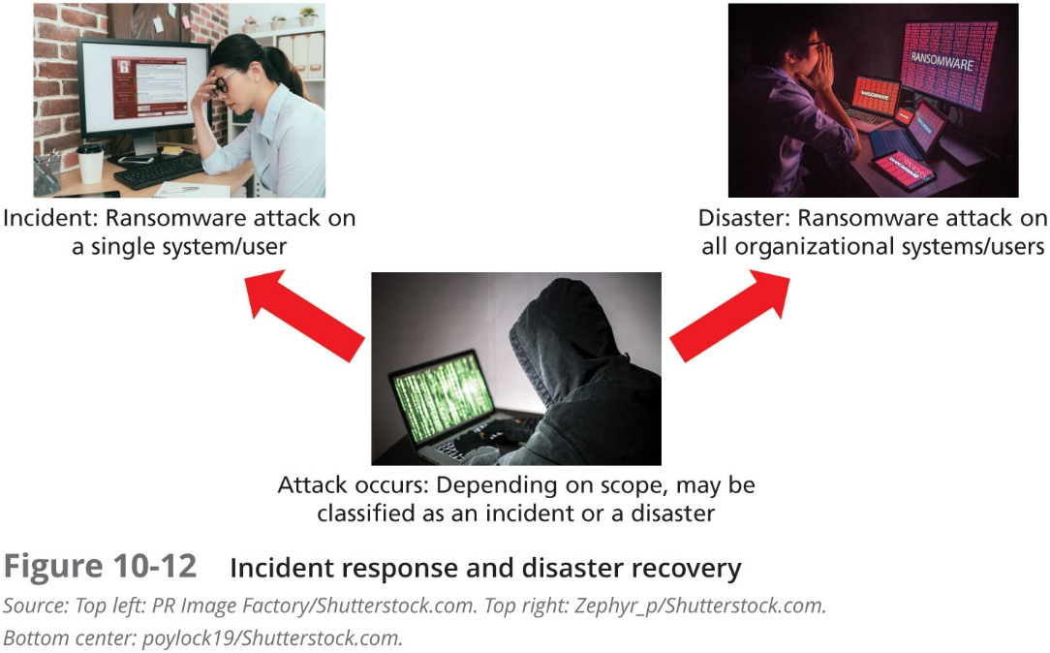

Slide 73
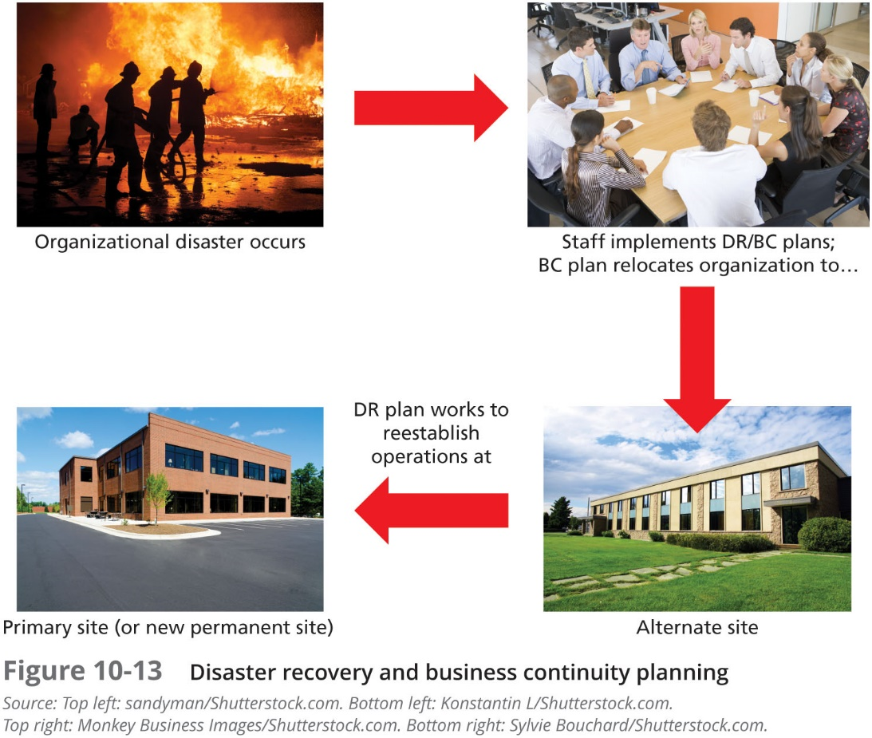

Slide 74
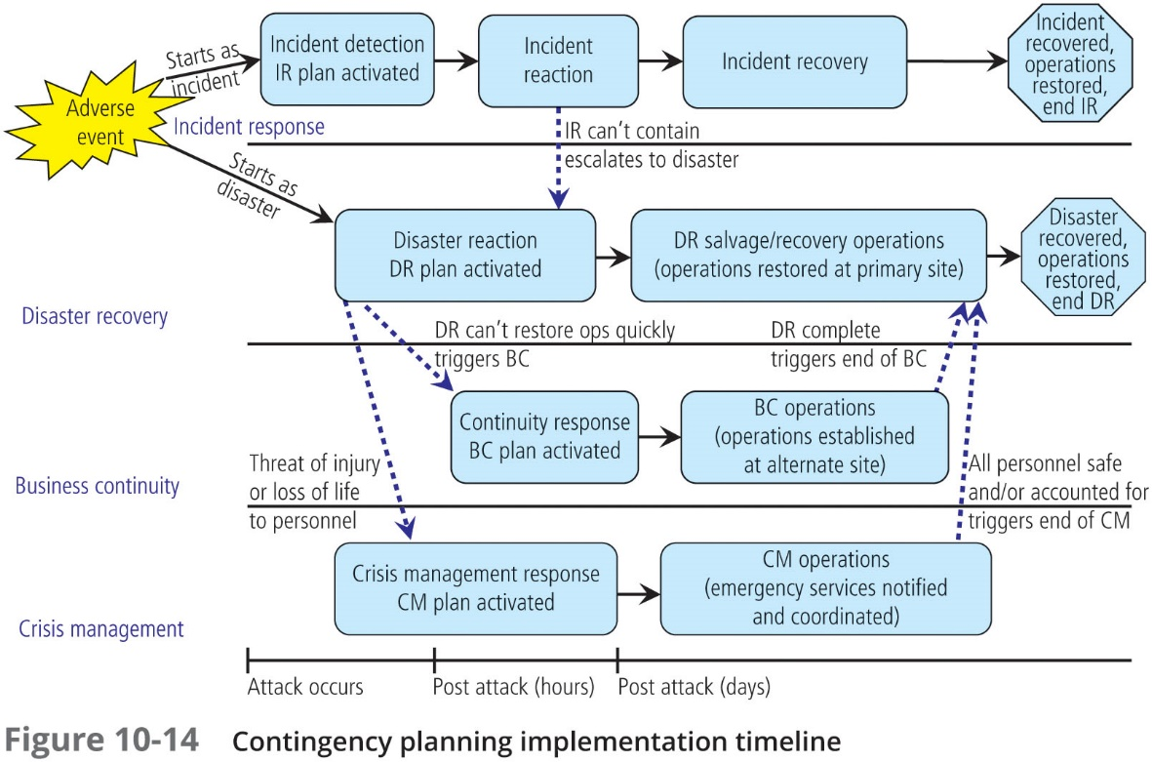

Slide 75
Crisis Management
Chapter 10: Planning for Contingencies

Slide 76
Crisis Management
Another process that many organizations plan for separately is crisis management (CM), which focuses more on the effects that a disaster has on people than its effects on information assets
While some organizations include crisis management as a subset of the DR plan, the protection of human life and the organization’s image is such a high priority that it may deserve its own committee, policy, and plan

Slide 77
Crisis Management (Continued)
According to Gartner Research, the crisis management team is responsible for managing the event from an enterprise perspective and performs the following roles:
Supporting personnel and their loved ones during the crisis
Keeping the public informed about the event and the actions being taken to ensure the recovery of personnel and the enterprise
Communicating with major customers, suppliers, partners, regulatory agencies, industry organizations, the media, and other interested parties

Slide 78
Crisis Management (Continued)
The crisis management planning team (CMPT) should establish a base of operations or command center near the site of the disaster as soon as possible
The CMPT should include individuals from all functional areas of the organization in order to facilitate communications and cooperation
The CMPT is charged with three primary responsibilities:
Verifying personnel status
Activating the alert roster
Coordinating with emergency services

Slide 79
Business Resumption
Chapter 10: Planning for Contingencies

Slide 80
Business Resumption Planning
Because the DR and BC plans are closely related, most organizations merge the two functions into a single function called business resumption planning (BRP)
Such a comprehensive plan must be able to support the reestablishment of operations at two different locations—one immediately at an alternate site and one eventually back at the primary site

Slide 81
Testing Contingency Plans
Chapter 10: Planning for Contingencies

Slide 82
Testing Contingency Plans
Very few plans are executable as initially written; instead, they must be tested to identify vulnerabilities, faults, and inefficient processes
There are four testing strategies that can be used to test contingency plans:
Desk check
Structured walkthrough
Simulation
Full interruption

Slide 83
Final Thoughts on CP
Iteration results in improvement
A formal implementation of this methodology is a process known as continuous process improvement (CPI)
Each time the plan is rehearsed it should be improved
Constant evaluation and improvement leads to an improved outcome

Slide 84
Summary
Planning for unexpected events is usually the responsibility of managers from both the information technology and the information security communities of interest
For a plan to be seen as valid by all members of the organization, it must be sanctioned and actively supported by the general business community of interest
Some organizations are required by law or other mandate to have contingency planning procedures in place at all times, but all business organizations should prepare for the unexpected
Contingency planning (CP) is the process by which the information technology and information security communities of interest position their organizations to prepare for, detect, react to, and recover from events that threaten the security of information resources and assets, both human and artificial

Slide 85
Summary (Continued)
CP is made up of four major components: the data collection and documentation process known as the business impact analysis (BIA), the incident response (IR) plan, the disaster recovery (DR) plan, and the business continuity (BC) plan
Organizations can either create and develop the three planning elements of the CP process (the IR, DR, and BC plans) as one unified plan, or they can create the three elements separately in conjunction with a set of interlocking procedures that enable continuity

Slide 86
Summary (Continued)
To ensure continuity during the creation of the CP components, a seven-step CP process is used:
1. Develop the contingency planning policy statement
2. Conduct the BIA
3. Identify preventive controls
4. Create contingency strategies
5. Develop a contingency plan
6. Ensure plan testing, training, and exercises
7. Ensure plan maintenance
Four teams of individuals are involved in contingency planning and contingency operations: the CP team, the IR team, the DR team, and the BC team. The IR team ensures the CSIRT is formed
The IR plan is a detailed set of processes and procedures that plan for, detect, and resolve the effects of an unexpected event on information resources and assets

Slide 87
Summary (Continued)
For every scenario identified, the CP team creates three sets of procedures—for before, during, and after the incident—to detect, contain, and resolve the incident
Incident classification is the process by which the IR team examines an incident candidate and determines whether it constitutes an actual incident
Three categories of incident indicators are used: possible, probable, and definite
When any one of the following happens, an actual incident is in progress: loss of availability of information, loss of integrity of information, loss of confidentiality of information, violation of policy, or violation of law
DR planning encompasses preparation for handling and recovering from a disaster, whether natural or man-made

Slide 88
Summary (Continued)
The DR plan must include crisis management, the action steps taken during and after a disaster
BC planning ensures that critical business functions continue if a catastrophic incident or disaster occurs. BC plans can include provisions for hot sites, warm sites, cold sites, timeshares, service bureaus, and mutual agreements
Because the DR and BC plans are closely related, most organizations prepare the two at the same time and may combine them into a single planning document called the business resumption (BR) plan
All plans must be tested to identify vulnerabilities, faults, and inefficient processes. Several testing strategies can be used to test contingency plans: desk check, structured walk-through, simulation, and full-interruption

