Slide 1
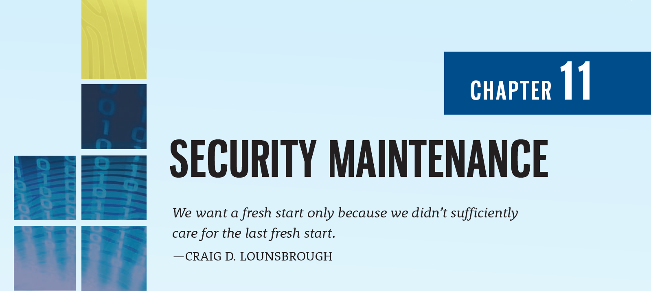

Slide 2
Learning Objectives
Upon completion of this material, you should be able to:
Discuss the need for ongoing maintenance of the information security program
Define a model for a full maintenance program
Identify the key factors involved in monitoring the external and internal environment
Describe how planning, risk assessment, vulnerability assessment, and remediation tie into information security maintenance
Explain how to build readiness and review procedures into information security maintenance
Notes:
Learning Objectives
Upon completion of this material you should be able to:
Discuss the need for the ongoing maintenance of the information security program
List the recommended security management models
Define a model for a full maintenance program
Identify the key factors involved in monitoring the external and internal environment
Describe how planning, risk assessment, vulnerability assessment, and remediation tie into information security maintenance
Explain how to build readiness and review procedures into information security maintenance
Define digital forensics, and describe the management of the digital forensics function
Describe the process of acquiring, analyzing, and maintaining potential evidentiary material

Slide 3
Introduction
Organizations should avoid overconfidence after improving their information security profile
The following changes may affect an organization’s information security environment:
The acquisition of new assets and the divestiture of old assets
The emergence of vulnerabilities associated with new or existing assets
Shifting business priorities
The formation of new partnerships
The dissolution of old partnerships
The departure of personnel who are trained, educated, and aware of policies, procedures, and technologies
The hiring of personnel
Notes:
Introduction
Organizations should avoid overconfidence after improving their information security profile
Organizational changes that may occur include:
Acquisition of new assets; emergence of new vulnerabilities; shifting business priorities; partnerships form or dissolve; employee hire and turnover
If program is not adequately adjusting, may be necessary to begin cycle again
If organization creates adjustable procedures and systems, existing security improvement program can continue to work well

Slide 4
Security Management Maintenance Models
Management model must be adopted to manage and operate ongoing security program
Models are frameworks that structure the tasks of managing particular set of activities or business functions
Notes:
Security Management Models
To assist the information security community to manage and operate the ongoing security program, a management model must be adopted.
In general, management models are frameworks that structure the tasks of managing a particular set of activities or business functions.

Slide 5
NIST SP 800-100 Information Security Handbook: A Guide for Managers
Provides managerial guidance for establishing and implementing an information security program
There are 13 areas of information security management presented
Provides for specific monitoring activities for each task
Tasks should be done on an ongoing basis
Not all issues are negative
Notes:
NIST SP 800-100 Information Security Handbook
Provides managerial guidance for establishing and implementing an information security program
There are thirteen areas of information security management presented
Provides for specific monitoring activities for each task
Tasks should be done on an ongoing basis
Not all issues are negative

Slide 6
NIST SP 800-100 Information Security Handbook: A Guide for Managers (Continued)
Information security governance
Agencies should monitor the status of their programs to ensure:
Ongoing information security activities providing appropriate support
Policies and procedures are current
Controls are accomplishing their intended purpose
System Development Life Cycle
Including configuration and change management (CCM)
Awareness and training
An automated tracking system should be designed to capture key information about program activity
Tracking compliance involves assessing the status of the program as indicated by the database information and mapping it to standards established by the agency
Security policies must evolve and awareness/training updated
Notes:
Information security governance
Agencies should monitor the status of their programs to ensure:
Ongoing information security activities providing appropriate support
Policies and procedures are current
Controls are accomplishing their intended purpose
System Development Life Cycle: the overall process of developing, implementing, and retiring information systems through a multistep process

Slide 7
NIST SP 800-100 Information Security Handbook: A Guide for Managers (Continued)
Capital planning and investment control
Departments required to allocate funding toward highest-priority investments
Designed to facilitate the expenditure of agency funds
Interconnecting systems
The direct connection of two or more systems for sharing data
Can expose the participating organizations to risk
If one of the connected systems is compromised, interconnection could be used as conduit
Performance measures
Should be used for monitoring the performance of information security controls and initiating performance improvements
Notes:
Interconnecting systems
The direct connection of two or more information systems for sharing data and other information resources
Can expose the participating organizations to risk
If one of connected systems compromised, interconnection could be used as conduit
Performance measures
Metrics should be used for monitoring performance of information security controls
Six phase iterative process

Slide 8
NIST SP 800-100 Information Security Handbook: A Guide for Managers (Continued)
Security planning
One of the most crucial ongoing responsibilities in security management
Information technology contingency planning
Consists of a process for recovery and documentation of procedures
Risk management
Ongoing effort
Tasks include performing risk identification, analysis, and management
Notes:
Security planning
One of the most crucial ongoing responsibilities in security management
Information technology contingency planning
Consists of a process for recovery and documentation of procedures
Risk management
Ongoing effort
Tasks include performing risk identification, analysis, and management

Slide 9
NIST SP 800-100 Information Security Handbook: A Guide for Managers (Continued)
Certification, accreditation, and security assessments
The status of security controls is checked regularly
Includes auditing—the review of a system’s use to determine if misuse/malfeasance has occurred
Security services and products acquisition
Security products and services should be selected and used to support the organization’s overall program
Incident response: incident response life cycle
A well-defined incident response capability helps the organization detect incidents rapidly, minimize loss and destruction, identify weaknesses, and restore operations rapidly
Notes:
Certification, accreditation, and security assessments
An essential component of any security program
The status of security controls is checked regularly
Auditing: the review of a system’s use to determine if misuse/malfeasance has occurred
Security services and products acquisition
Incident response: incident response life cycle
Configuration (or change) management: manages the effects of changes in configurations, 5 step process

Slide 10
NIST SP 800-100 Information Security Handbook: A Guide for Managers (Continued)
Configuration (or change) management:
Manages the effects of changes in configurations
Step 1: Identify Change
Step 2: Evaluate Change Request
Step 3: Implementation Decision
Step 4: Implement Approved Change Request
Step 5: Continuous Monitoring

Slide 11
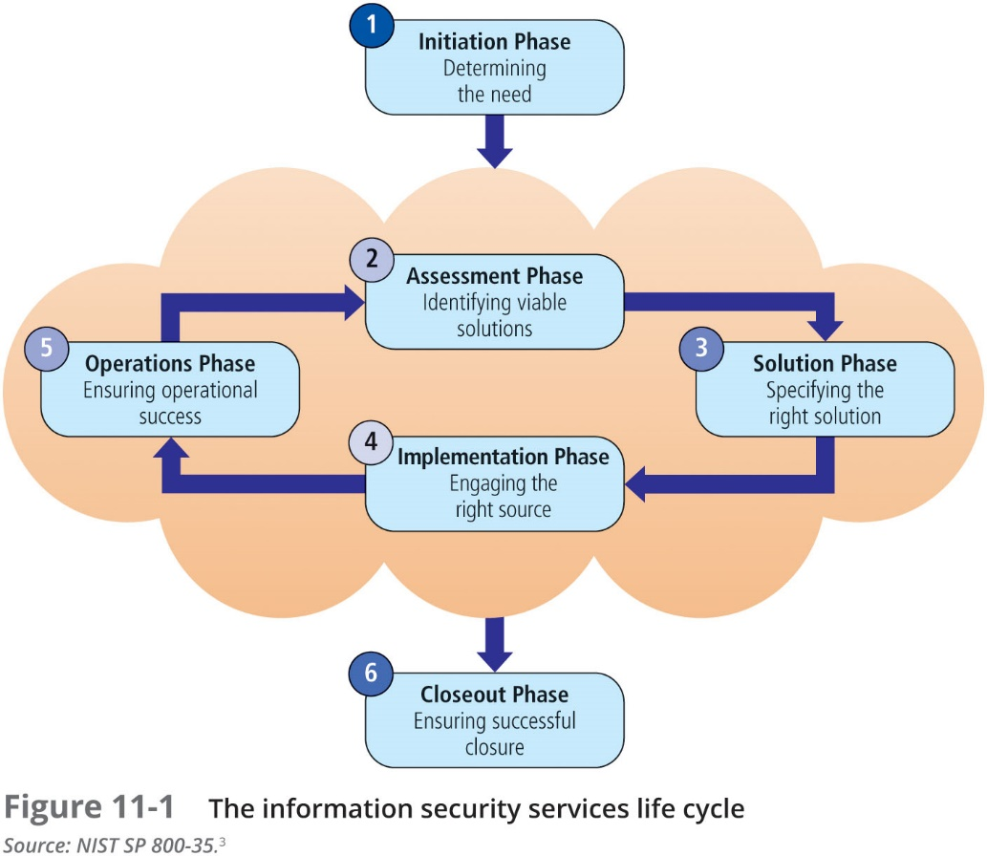

Slide 12
The Security Maintenance Model
Designed to focus organizational effort on maintaining systems
Recommended maintenance model based on five subject areas:
External monitoring
Internal monitoring
Planning and risk assessment
Vulnerability assessment and remediation
Readiness and review
Notes:
The Security Maintenance Model
Designed to focus organizational effort on maintaining systems
Recommended maintenance model based on five subject areas:
External monitoring
Internal monitoring
Planning and risk assessment
Vulnerability assessment and remediation
Readiness and review

Slide 13
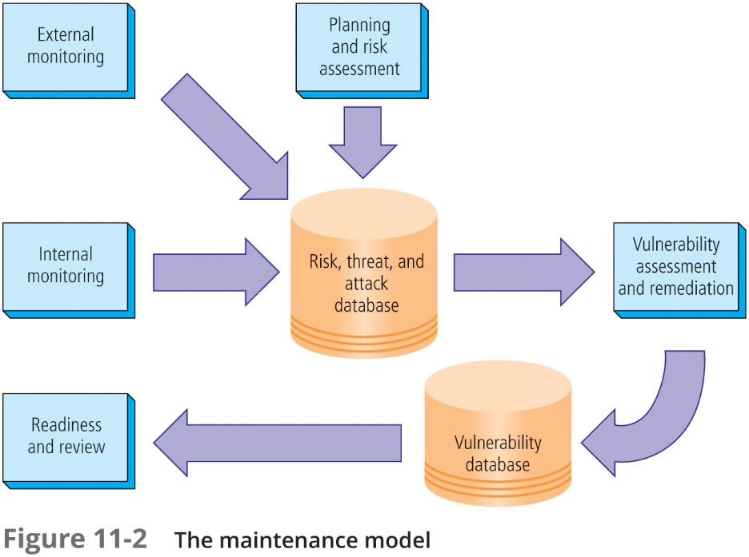

Slide 14
Monitoring the External Environment
Objective to provide early awareness of new and emerging threats, threat agents, vulnerabilities, and attacks so organization can mount an effective defense
Entails collecting intelligence from data sources and giving that intelligence context and meaning for use by organizational decision makers
Notes:
Monitoring the External Environment
Objective to provide early awareness of new and emerging threats, threat agents, vulnerabilities, and attacks so organization can mount an effective defense
Entails collecting intelligence from data sources and giving that intelligence context and meaning for use by organizational decision makers

Slide 15
Monitoring the External Environment (Continued)
Data sources
Acquiring threat and vulnerability data is not difficult
Turning data into information decision makers can use is the challenge
External intelligence comes from vendors, computer emergency response teams (CERTs), public network sources, or membership sites
Regardless of where or how external monitoring data are collected, they must be analyzed in the context of the organization’s security environment to be useful
Notes:
Monitoring the External Environment
Objective to provide early awareness of new and emerging threats, threat agents, vulnerabilities, and attacks so organization can mount an effective defense
Entails collecting intelligence from data sources and giving that intelligence context and meaning for use by organizational decision makers

Slide 16
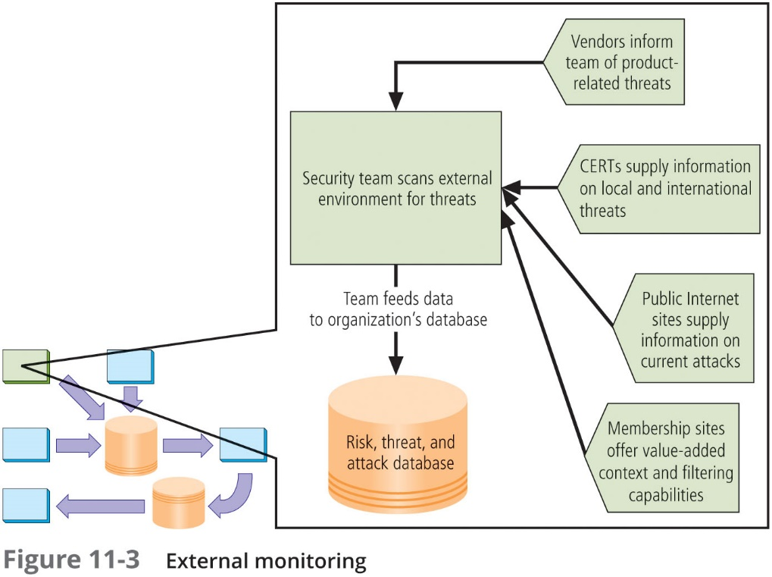

Slide 17
Monitoring the External Environment (Continued)
Monitoring, escalation, and incident response
Function of external monitoring process is to monitor activity, report results, and escalate warnings
Monitoring process has three primary deliverables:
Specific warning bulletins issued when developing threats and specific attacks pose measurable risk to the organization
Periodic summaries of external information
Detailed intelligence on highest risk warnings
Data collection and management
Over time, external monitoring processes should capture information about external environment in appropriate formats
External monitoring collects raw intelligence, filters for relevance, assigns a relative risk impact, and communicates to decision makers in time to make a difference
Notes:
Monitoring, Escalation, and Incident Response
Function of external monitoring process is to monitor activity, report results, and escalate warnings
Monitoring process has three primary deliverables:
Specific warning bulletins issued when developing threats and specific attacks pose measurable risk to organization
Periodic summaries of external information
Detailed intelligence on highest risk warnings

Slide 18
Monitoring the Internal Environment
Primary goal is informed awareness of state of organization’s networks, systems, and security defenses
Internal monitoring accomplished by:
Inventorying network devices and channels, IT infrastructure and applications, and information security infrastructure elements
Leading the IT governance process
Real-time monitoring of IT activity
Monitoring the internal state of the organization’s networks and systems
Notes:
Monitoring the Internal Environment
Primary goal is informed awareness of state of organization’s networks, systems, and security defenses
Internal monitoring accomplished by:
Inventorying network devices and channels, IT infrastructure and applications, and information security infrastructure elements
Leading the IT governance process
Real-time monitoring of IT activity
Monitoring the internal state of the organization’s networks and systems

Slide 19
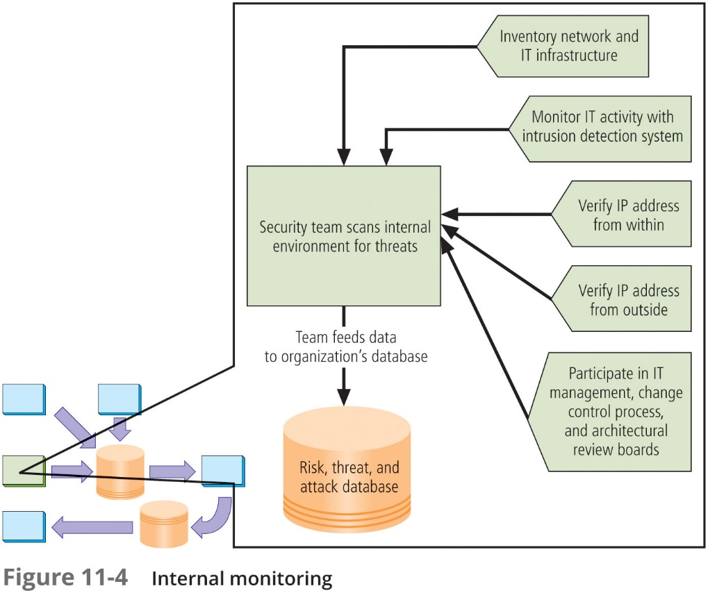

Slide 20
Monitoring the Internal Environment (Continued)
Network characterization and inventory
Organizations should have/maintain carefully planned and fully populated inventory of network devices, communication channels, and computing devices
Once characteristics are identified, they must be carefully organized and stored using a mechanism (manual or automated) that allows timely retrieval and rapid integration of disparate facts
Notes:
Network Characterization and Inventory
Organizations should have/maintain carefully planned and fully populated inventory of network devices, communication channels, and computing devices
Once characteristics identified, they must be carefully organized and stored using a mechanism (manual or automated) that allows timely retrieval and rapid integration of disparate facts

Slide 21
Monitoring the Internal Environment (Continued)
Making intrusion detection and prevention systems work
The most important value of raw intelligence provided by the IDS is providing indicators of current or imminent vulnerabilities
Log files from IDS engines can be mined for information
Another IDS monitoring element is traffic analysis
Analyzing attack signatures from unsuccessful system attacks can identify weaknesses in various security efforts
Detecting differences
Difference analysis: procedure that compares current state of network segment against known previous state of same segment
Unexpected differences between the current state and the baseline state could indicate trouble
Notes:
Detecting Differences
Difference analysis: procedure that compares current state of network segment against known previous state of same segment
Unexpected differences between the current state and the baseline state could indicate trouble

Slide 22
Planning and Risk Assessment
Primary objective is to keep a lookout over the entire information security program
Accomplished by identifying and planning ongoing information security activities that further reduce risk
Primary objectives
Establishing a formal information security program review process
Instituting formal project identification, selection, planning, and management processes
Coordinating with project teams to introduce risk assessment and review for all projects
Integrating a mindset of risk assessment throughout organization
Notes:
Planning and Risk Assessment
Primary objective is to keep lookout over entire information security program
Accomplished by identifying and planning ongoing information security activities that further reduce risk

Slide 23
Planning and Risk Assessment (Continued)
Information security program planning and review
Periodic review of ongoing information security program and planning for enhancements and extensions is recommended
Should examine future IT needs of organization and its impact on information security
A recommended approach takes advantage of the fact that most organizations have annual capital budget planning cycles and manage security projects as part of that process
Notes:
Information Security Program Planning and Review
Periodic review of ongoing information security program and planning for enhancements and extensions is recommended
Should examine future IT needs of organization and impact on information security
A recommended approach takes advantage of the fact most organizations have annual capital budget planning cycles and manage security projects as part of that process

Slide 24
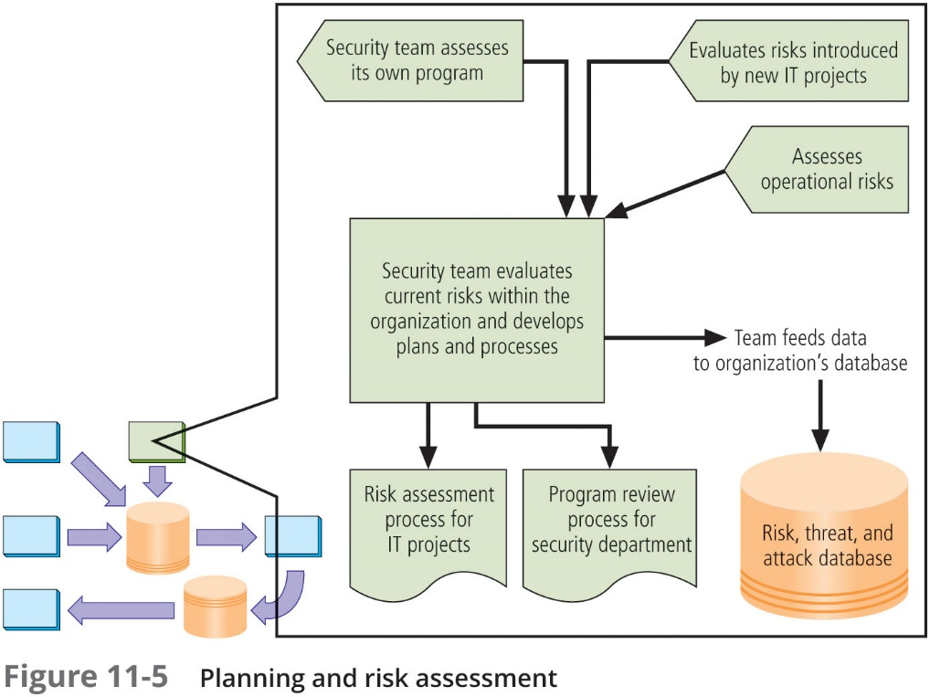

Slide 25
Planning and Risk Assessment (Continued)
Large projects should be broken into smaller projects for several reasons:
Smaller projects tend to have more manageable impacts on networks and users
Larger projects tend to complicate the change control process in the implementation phase
Shorter planning, development, and implementation schedules reduce uncertainty
Most large projects can easily be broken down into smaller projects, giving more opportunities to change direction and gain flexibility
Notes:
Planning and Risk Assessment
Large projects should be broken into smaller projects for several reasons
Smaller projects tend to have more manageable impacts on networks and users
Larger projects tend to complicate change control process in implementation phase
Shorter planning, development, and implementation schedules reduce uncertainty
Most large projects can easily be broken down into smaller projects, giving more opportunities to change direction and gain flexibility

Slide 26
Planning and Risk Assessment (Continued)
Security risk assessments
A key component for driving security program change is risk assessment (RA)
RA identifies and documents the risk that a project, process, or action introduces to the organization and offers suggestions for controls
Information security group coordinates the preparation of many types of RA documents
Notes:
Planning and Risk Assessment
Large projects should be broken into smaller projects for several reasons
Smaller projects tend to have more manageable impacts on networks and users
Larger projects tend to complicate change control process in implementation phase
Shorter planning, development, and implementation schedules reduce uncertainty
Most large projects can easily be broken down into smaller projects, giving more opportunities to change direction and gain flexibility

Slide 27
Vulnerability Assessment and Remediation
Primary goal: identification of specific, documented vulnerabilities and their timely remediation
Accomplished by:
Using vulnerability assessment procedures
Documenting background information and providing tested remediation procedures for vulnerabilities
Tracking vulnerabilities from the time they are identified
Communicating vulnerability information to owners of vulnerable systems
Reporting on the status of vulnerabilities
Ensuring the proper level of management is involved
Notes:
Vulnerability Assessment and Remediation
Primary goal: identification of specific, documented vulnerabilities and their timely remediation
Accomplished by:
Using vulnerability assessment procedures
Documenting background information and providing tested remediation procedures for vulnerabilities
Tracking vulnerabilities from the time they are identified
Communicating vulnerability information to owners of vulnerable systems
Reporting on the status of vulnerabilities
Ensuring the proper level of management is involved

Slide 28
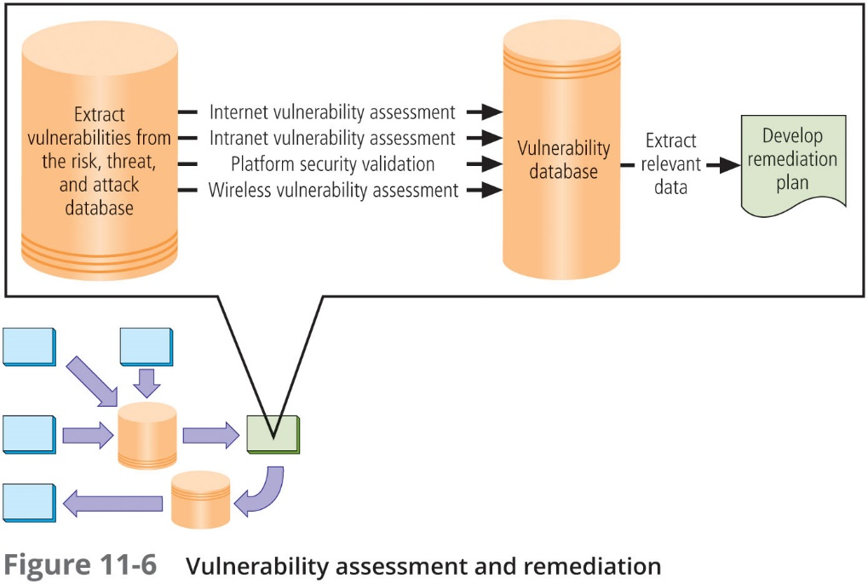

Slide 29
Vulnerability Assessment and Remediation (Continued)
Process of identifying and documenting specific and provable flaws in the organization’s information asset environment
Five following vulnerability assessment processes can help many organizations balance intrusiveness of vulnerability assessment with the need for stable and effective production environment
Notes:
Vulnerability Assessment and Remediation
Process of identifying and documenting specific and provable flaws in organization’s information asset environment
Five following vulnerability assessment processes can help many organizations balance intrusiveness of vulnerability assessment with need for stable and effective production environment

Slide 30
Vulnerability Assessment and Remediation (Continued)
Penetration testing
A level beyond vulnerability testing
Is a set of security tests and evaluations that simulate attacks by a malicious external source (hacker)
Penetration test (pen test): usually performed periodically as part of a full security audit
Can be conducted one of two ways: black box or white box
Notes:
Vulnerability Assessment and Remediation
Process of identifying and documenting specific and provable flaws in organization’s information asset environment
Five following vulnerability assessment processes can help many organizations balance intrusiveness of vulnerability assessment with need for stable and effective production environment

Slide 31
Vulnerability Assessment and Remediation (Continued)
Internet vulnerability assessment
Designed to find and document vulnerabilities present in an organization’s public network
Steps in the process include:
Planning, scheduling, and notification
Target selection
Test selection
Scanning
Analysis
Record keeping
Notes:
Internet Vulnerability Assessment
Designed to find and document vulnerabilities present in organization’s public network
Steps in the process include:
Planning, scheduling, and notification
Target selection
Test selection
Scanning
Analysis
Record keeping

Slide 32
Vulnerability Assessment and Remediation (Continued)
Intranet vulnerability assessment
Designed to find and document the selected vulnerabilities likely present on the internal network
Attackers are often internal members of the organization, affiliates of business partners, or automated attack vectors (such as viruses and worms)
This assessment is usually performed against critical internal devices with a known, high value by using selective penetration testing
Steps in the process are almost identical to the steps in the Internet vulnerability assessment
Notes:
Intranet Vulnerability Assessment
Designed to find and document selected vulnerabilities likely present on the internal network
Attackers are often internal members of organization, affiliates of business partners, or automated attack vectors (such as viruses and worms)
This assessment is usually performed against critical internal devices with a known, high value by using selective penetration testing
Steps in process almost identical to steps in Internet vulnerability assessment

Slide 33
Vulnerability Assessment and Remediation (Continued)
Platform security validation
Designed to find and document vulnerabilities that may be present because misconfigured systems are in use within the organization
These misconfigured systems fail to comply with company policy or standards
Fortunately, automated measurement systems are available to help with the intensive process of validating the compliance of platform configuration with policy
Notes:
Intranet Vulnerability Assessment
Designed to find and document selected vulnerabilities likely present on the internal network
Attackers are often internal members of organization, affiliates of business partners, or automated attack vectors (such as viruses and worms)
This assessment is usually performed against critical internal devices with a known, high value by using selective penetration testing
Steps in process almost identical to steps in Internet vulnerability assessment

Slide 34
Vulnerability Assessment and Remediation (Continued)
Wireless vulnerability assessment
Designed to find and document vulnerabilities that may be present in wireless local area networks of the organization
Since attackers from this direction are likely to take advantage of any flaw, assessment is usually performed against all publicly accessible areas using every possible wireless penetration testing approach
Documenting vulnerabilities
Vulnerability database should provide details about reported vulnerability as well as a link to the information assets
Low cost/ease of use makes relational databases a realistic choice
Vulnerability database is an essential part of effective remediation
Notes:
Wireless Vulnerability Assessment
Designed to find and document vulnerabilities that may be present in wireless local area networks of organization
Since attackers from this direction are likely to take advantage of any flaw, assessment is usually performed against all publicly accessible areas using every possible wireless penetration testing approach

Slide 35
Vulnerability Assessment and Remediation (Continued)
Remediating vulnerabilities
Objective is to repair flaw causing a vulnerability instance or remove risk associated with vulnerability
As last resort, informed decision makers with proper authority can accept risk
Important to recognize that building relationships with those who control information assets is key to success
Success depends on the organization adopting team approach to remediation, in place of cross-organizational push and pull
Notes:
Remediating Vulnerabilities
Objective is to repair flaw causing a vulnerability instance or remove risk associated with vulnerability
As last resort, informed decision makers with proper authority can accept risk
Important to recognize that building relationships with those who control information assets is key to success
Success depends on organization adopting team approach to remediation, in place of cross-organizational push and pull

Slide 36
Vulnerability Assessment and Remediation (Continued)
Acceptance or transference of risk
In some instances, risk must be either simply acknowledged as part of the organization’s business process or transferred to another organization via insurance
Management must be assured that decisions made to accept risk or buy insurance were made by properly informed decision makers
Information security must make sure the right people make risk assumption decisions with complete knowledge of the impact of the decision
Notes:
Acceptance or Transference of Risk
In some instances, risk must either simply be acknowledged as part of organization’s business process or transferred to another organization via insurance
Management must be assured that decisions made to accept risk or buy insurance were made by properly informed decision makers
Information security must make sure the right people make risk assumption decisions with complete knowledge of the impact of the decision

Slide 37
Vulnerability Assessment and Remediation (Continued)
Threat removal
In some circumstances, threats can be removed without repairing vulnerability
Other vulnerabilities may be mitigated by inexpensive controls
Vulnerability repair
Best solution in most cases is to repair vulnerability
Applying patch software or implementing a workaround often accomplishes this
Most common repair is the application of a software patch
Notes:
Threat removal
In some circumstances, threats can be removed without repairing vulnerability
Other vulnerabilities may be mitigated by inexpensive controls
Vulnerability repair
Best solution in most cases is to repair vulnerability
Applying patch software or implementing a workaround often accomplishes this
Most common repair is application of a software patch

Slide 38
Readiness and Review
Primary goal is to keep information security program functioning as designed and continuously improving
Accomplished by:
Policy review
Program review
Rehearsals
Notes:
Readiness and Review
Primary goal is to keep information security program functioning as designed and continuously improving
Accomplished by:
Policy review
Program review
Rehearsals

Slide 39
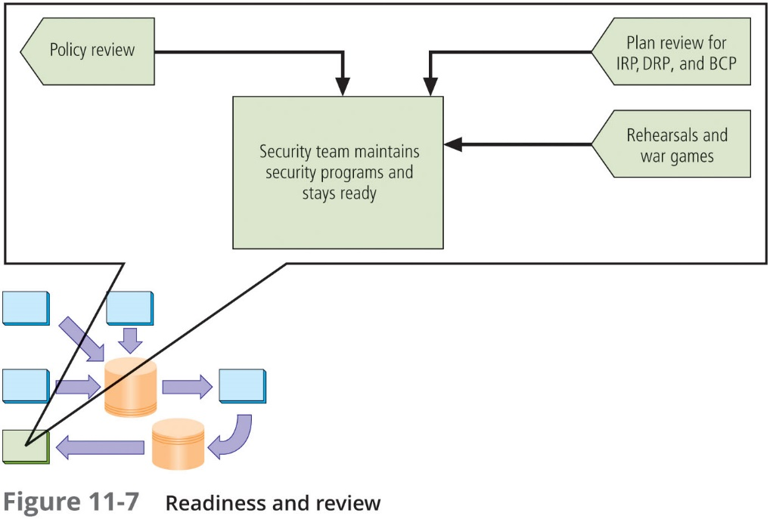

Slide 40
Summary
Change is inevitable, so organizations should have procedures to deal with changes in the operation and maintenance of the information security program
The CISO decides whether the information security program can adapt to change as it is implemented or whether the macroscopic process of the risk management program must be started anew
The maintenance model recommended in this chapter is made up of five subject areas or domains: external monitoring, internal monitoring, planning and risk assessment, vulnerability assessment and remediation, and readiness and review
To stay current, the information security community of interest and the CISO must constantly monitor the three components of the security triple—threats, assets, and vulnerabilities

Slide 41
Summary (Continued)
To assist the information security community in managing and operating the ongoing security program, the organization should adopt a security management maintenance model
These models are frameworks that are structured by the tasks of managing a particular set of activities or business functions
NIST SP 800-100, Information Security Handbook: A Guide for Managers, outlines managerial tasks performed after the program is operational

Slide 42
Summary (Continued)
For each of the 13 areas of information security management presented in SP 800-100, there are specific monitoring activities:
1. Information security governance
2. Systems development life cycle
3. Awareness and training
4. Capital planning and investment control
5. Interconnecting systems
6. Performance measures
7. Security planning
8. Information technology contingency planning
9. Risk management
10. Certification, accreditation, and security assessments
11. Security services and products acquisition
12. Incident response
13. Configuration and change management

Slide 43
Summary (Continued)
The objective of the external monitoring domain in the maintenance model is to provide early awareness of new and emerging threats, threat agents, vulnerabilities, and attacks so that an effective and timely defense can be mounted
The objective of the internal monitoring domain is an informed awareness of the state of the organization’s networks, information systems, and information security defenses The security team documents and communicates this awareness, particularly when it concerns system components that face the external network
The primary objective of the planning and risk assessment domain is to keep an eye on the entire information security program

Slide 44
Summary (Continued)
The primary objectives of the vulnerability assessment and remediation domain are to identify specific, documented vulnerabilities and remediate them in a timely fashion
The primary objectives of the readiness and review domain are to keep the information security program functioning as designed and keep improving it over time

